Slide 1

The Miraculous:
3. Science & the Rise of Liberalism
Robert C. Newman

Slide 2
The Renaissance
The Greek classical authors were rediscovered by western Europe with the fall of Constantin-ople to the Turks, as refugees fled to the West.
Europeans thus became aware of what these ancient authors really thought and taught, correcting the distorted information which had come down through the middle Ages and the less distorted material transmitted from Spain thru Arabic translations.

Slide 3
The Renaissance
This material included philosophy, science, ethics, history, government, medicine, rhetoric, drama & poetry, but also pagan religion & magic.
The upshot was a great stimulus to the European universities, and a growing interest in the ancient languages Greek and Hebrew.
It helped the Europeans to see their own culture in a wider context than medieval Christianity, Islam, and Judaism, but also re-introduced a number of ancient heresies.
Scholars became aware of the nature of miracle accounts from ancient paganism.

Slide 4
The Reformation
A rediscovery of the Gospel of God's grace, which had been confused and diluted by centuries of ignorance of God's Word, due to:
  low levels of literacy,
  syncretism with local paganisms and worldly society,
  institutional momentum of the Catholic Church and monasticism.

Slide 5
The Reformation
This led to a renewed interest in what the Bible actually taught, as opposed to how it had come to be understood through the filter of centuries of medieval Catholicism.
One result of this study was a realization that medieval and modern Catholic miracles had a different flavor than those of the Bible. Since Catholicism taught that miracles continued in connection with the lives of especially holy people, there was a tendency to reject the continuation of miracle.

Slide 6
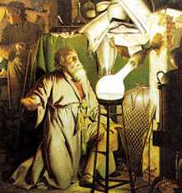
The Rise of
Modern Science

Slide 7
Medieval Science
Some of the medieval universities had done rather impressive work in physics, showing that Aristotle was mistaken about the motion of objects on earth, but it was the work of Copernicus, Galileo and Kepler which showed that Aristotle's earth-centered cosmology was wrong and paved the way for the rise of modern science.

Slide 8
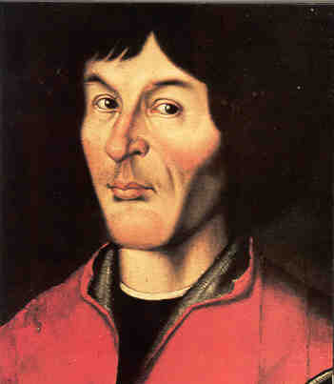
Copernicus
Nicolas Copernicus (1473-1543), aware of the astronomical speculation of the ancient world, noted that a great simplification of the technique for calculating the positions of the planets could be obtained if it was assumed they rotated about the sun rather than the earth.

Slide 9
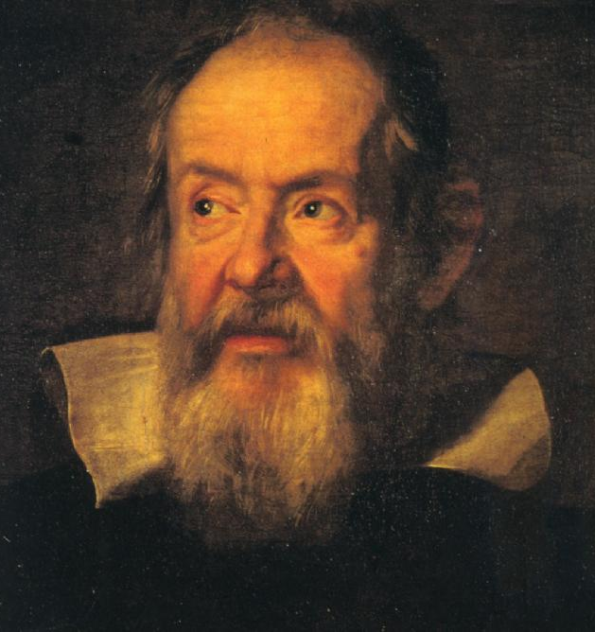
Galileo
Galileo (1564-1642), the first to apply the newly-invented telescope to looking at the heavens, showed that neither the sun nor moon were perfect, as Aristotle had claimed, and that a "planetary system" of moons revolved about the planet Jupiter, so that everything did not revolve around the earth.

Slide 10
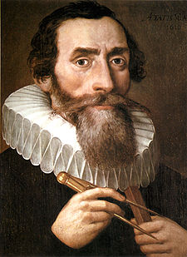
Kepler
Johannes Kepler (1571-1630) used the vast observational data compiled by his mentor Tycho Brahe to show that the planets did indeed revolve around the sun, and that their motions could be described by several laws.

Slide 11
Isaac Newton (1642-1727)
Newton, one of the most brilliant minds in history, designed a new type of telescope, discovered that a glass prism will separate white light into its various colored components, invented a new type of mathematics (calculus), and showed that Kepler's laws of planetary motions could be explained by (1) a very general set of laws of motion which applied to all objects on earth as well, plus (2) a force called gravity which attracts all massive objects to one another.

Slide 12
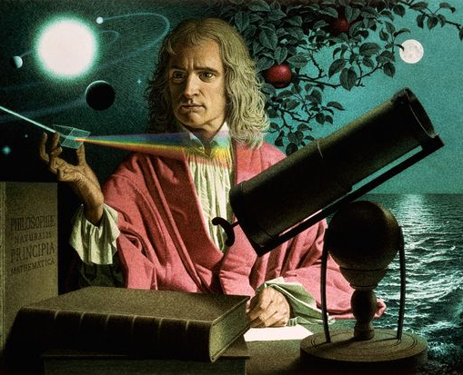
Newton
The contemporary poet, Alexander Pope, wrote of him:
Nature, and nature's laws, lay hid in night;
God said, 'Let Newton be!' and all was light.

Slide 13
Newton’s Influence
Newton himself was a professing Christian (albeit of an Arian sort)
He believed in God the Creator who could miraculously intervene in nature, and he spent a good deal of his time researching biblical prophecy.
But many who came after him felt that he had explained so much of reality in terms of law that God was not needed.
This led to the deist movement in England and later the philosophé movement in France, which was popularized by the authors of the great French Encyclopedia.

Slide 14
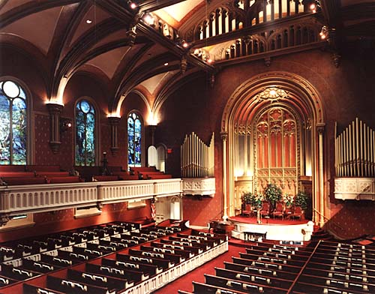
The Rise of Theological Liberalism

Slide 15
Spinoza, Hume, and Kant
Three men also paved the way for theological liberalism by providing philosophical justification for the rejection of the miraculous:
  Benedict Spinoza
  David Hume
  Immanuel Kant
We will look at their arguments in greater detail later.

Slide 16
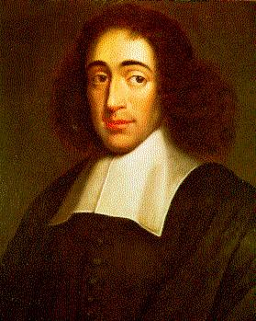
Benedict Spinoza (1632-77)
Spinoza, adopting a pantheistic outlook, argued that nature and God were two different words for the same thing; that natural law and God's decree were likewise the same; that God's decrees are unchangeable, and therefore miracles are impossible by definition.

Slide 17
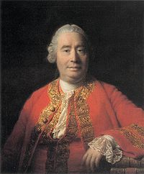
David Hume (1711-76)
Hume attacked miracles from an empirical point of view. He argued that our natural laws are based on "firm and unalterable experience," and that miracles by definition violate natural law. Therefore we ought never to accept a miraculous explanation for an event unless a non-miraculous explanation would be even more unlikely.

Slide 18
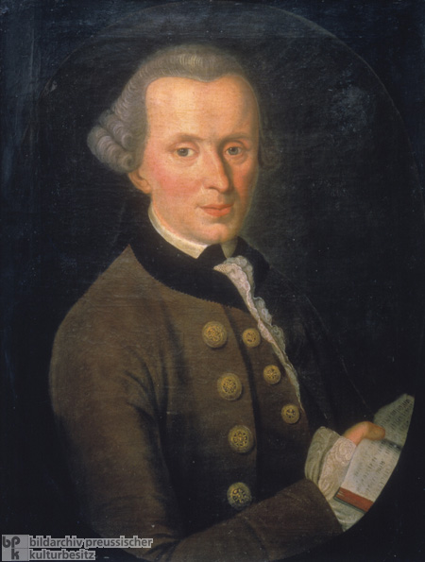
Immanuel Kant (1724-1804)
Kant argued that man has access only to appearances and not to things as they really are, so that all theology and metaphysics was unwarranted speculation.
Only practical reason had a right to postulate the existence of God, freedom, and immortality, leading to a moral religion of duty only.
Such a religion (a form of Deism) needs no attestation by miracles, which are thus irrelevant to everyday life, except perhaps to encourage the common people to practice morality when they cannot be brought to do so from better motives.

Slide 19
Theological Liberalism
Theological liberalism, as we call it today, is an outgrowth within Protestant circles of the forces sketched above:
  (1) a Protestant revulsion against Catholic miracle accounts;
  (2) a scientific disdain for reports of irregular and superstitious events;
  (3) a philosophical feeling that miracles are either deductively impossible, inductively unwarranted, or practically irrelevant; and
  (4) a Deistic belief that real religion was moral rather than revelational.

Slide 20
Origin in Germany
Theological liberalism arose in 19th century Germany as a "more Christian" alternative to British Deism and French Atheism, seeking to preserve the moral character of Christianity and the "better teachings" of the Bible, especially the New Testament and the life of Jesus.
It is seen in the attempts to rewrite the life of Christ along liberal lines;
Also to avoid the miraculous in sacred history by
  redating biblical books,
  postulating diverse sources and editors,
  having prophecy written after the event, and
  admitting fictitious narratives and false authorship into Scripture.

Slide 21
The Spread of Liberalism
Liberalism spread from Germany into Britain and the United States in the latter part of the 19th century, with considerable help from Darwinism.
It came to dominate first the universities, then the theological seminaries, and finally the mainline denominations.
  It is the "orthodoxy" of most intellectual and cultural leaders in the US and Europe today.
  It is also influential in similar circles in most of the older mission fields.

Slide 22
Influence of Liberalism
Liberalism has never been as popular among the common people in the US as among the leadership.
Still, it has considerable influence by way of mixture even among more conservative Christian groups.
Various cults and New Age groups have accepted many of its teachings.
Orthodox Christians have sometimes over-reacted in responding to liberalism.

Slide 23
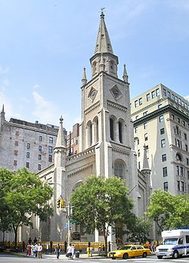
The End

