Slide 1
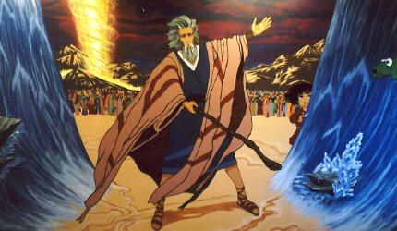
The Miraculous: 1. OT & NT Miracles
Robert C. Newman

Slide 2
What is a Miracle?
Dictionary definition: Webster’s New World Dictionary (1966):
An event or action that apparently contradicts known scientific laws.
Not too bad, but this eliminates striking providences, like the quail blown into camp in Numbers 11:31.
Let’s have a look at biblical terminology for miracles.

Slide 3
Biblical Terminology
Terms expressing the wondrous or marvelous aspect:
Hebrew mofet, niflaot, pele’, temach
Greek teras, thauma
Terms expressing its power:
Greek dunamis
Terms expressing its significance:
Hebrew ’ot
Greek semeion

Slide 4
What is a Miracle?
So we suggest a biblical definition of miracle:
A Biblical miracle is a striking or wonderful event, displaying supernatural power and intended to carry a certain significance.
We will operate with this definition, which does not rule out striking providential events.

Slide 5
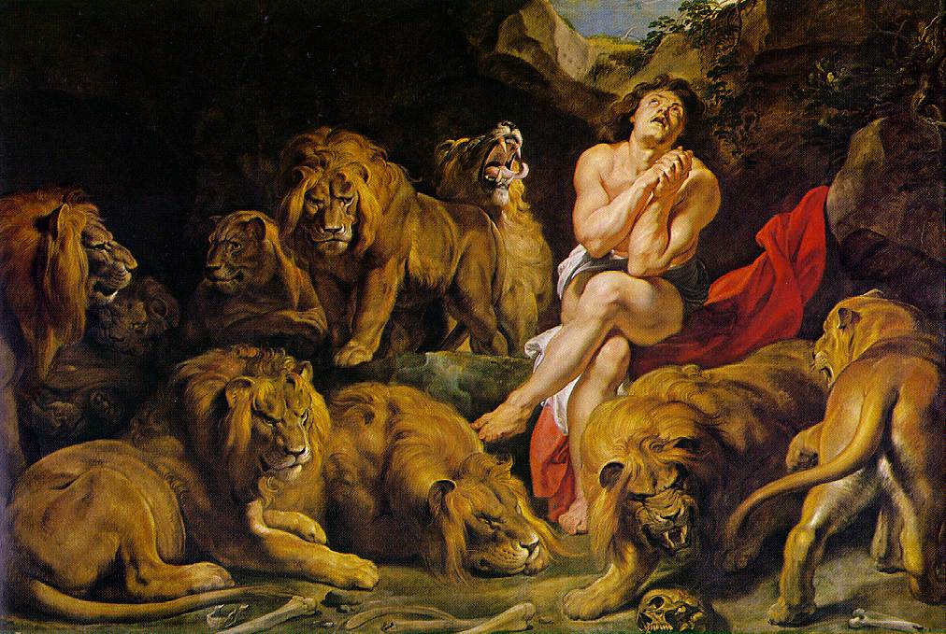
Old Testament Miracles
A quick tour of their nature & purpose

Slide 6
Creation
Narrated in Genesis 1-3
Numerous events here seem to involve the miraculous, even though humans were not present.
So the miraculous may not occur only for the benefit of humans.
Or they may occur for the benefit of later generations of humans, e.g., us!

Slide 7
The Flood
Narrated in Genesis 6-9
There seems to be both intervention and providence involved here.
The purposes of the flood are clearly:
Judgment, for those not on the ark
Deliverance, for those who are

Slide 8
The Patriarchal Period
Babel (Gen 11) – judgment
Abraham
Flaming torch (Gen 15:17)
covenant, revelation
Sodom & Gomorrah (Gen 18-19)
judgment with deliverance
Isaac's birth (Gen 18, 21) – promise
Joseph's dreams (Gen 37, 40-41)
revelation, deliverance, attestation

Slide 9
The Mosaic Period
Burning bush (Ex 3)
revelation, promise, deliverance
Moses' signs (Ex 4) - staff, hand
attestation of message, messenger
The Plagues (Ex 7-12)
attestation, judgment, deliverance
Crossing Red Sea (Ex 14)
deliverance, judgment

Slide 10
The Mosaic Period
Provision in Wilderness
Cloud - guidance, protection, attestation
Manna, water, quail – provision
Clothing, sandals (Deut 29:5) – provision
Sinai events - revelation, attestation, covenant
Amalek defeated (Ex 17) – judgment, attestation, deliverance
Korah, Dathan, Abiram destroyed (Num 16) – judgment, attestation
Aaron's rod (Num 17) - attestation

Slide 11
Conquest of Canaan
Crossing Jordan (Josh 3)
attestation (3:10-13, 4:6-7, 22-24)
provision (3:15)
Jericho (Josh 2, 6)
judgment, deliverance
Sun at Gibeon (Josh 10)
judgment, attestation

Slide 12
Period of Judges
Angel of Lord (Judg 2)
revelation
Gideon's fleece (Judg 6)
attestation
Samson (Judg 13-16)
judgment, deliverance

Slide 13
Kingdom Period
Birth of Samuel? (1 Sam 1) - attestation?
Samuel's vision (1 Sam 3) - revelation, attestation?
Ark among Philistines (1 Sam 5-6)
revelation, attestation to pagans
phenomena surrounding return especially interesting (cart, cows, etc.)
Call of Saul (1 Sam 10) - attestation (10:7)

Slide 14
Kingdom Period
Jonathan's exploits (1 Sam 14)
attestation (14:8-10)
David & Goliath (1 Sam 17)
judgment, deliverance, attestation
Disaster moving ark (2 Sam 6) – judgment
Cloud in temple (1 Kings 8) – attestation
Sign to Jeroboam (1 Kings 13)
attestation, judgment

Slide 15
Kingdom Period
Sign to Abijah (1 Kings 14)
judgment (14:6-11)
attestation (14:12,17)
Ministry of Elijah (1 Kings 17 - 2 Kings 2)
See separate slides
Ministry of Elisha (2 Kings 2-13)
See separate slides

Slide 16
Ministry of Elijah
Drought (1 Kings 17-18)
judgement, attestation
Ravens (17) – provision
Replenished food (17)
provision, attestation
Resurrection of widow's son (17)
deliverance, attestation
Fire on Mt Carmel (18) – attestation

Slide 17
Ministry of Elijah
Run to Jezreel (1 Kings 18)
provision? attestation?
Manifestation at Sinai (19)
revelation, provision
Deliverance of Ahab from Syrians (20)
Fire falls on soldiers (2 Kings 1)
judgment, attestation
Elijah's ascent, Jordan parted (2 Kings 2)
attestation

Slide 18
Ministry of Elisha
Opening Jordan (2 Kings 2) – attestation
Healing water (2) - provision, attestation
Two bears (2) - judgment, attestation
Water-filled valley (3)
judgment, deliverance, attestation
Multiplication of oil (4) - provision
Raising Shunemite's son (4) – deliverance
Canceling poison (4) - provision

Slide 19
Ministry of Elisha
Multiplication of loaves (2 K 4) - provision
Healing of Naaman (2 Kings 5)
deliverance, attestation to pagan
Floating axe-head (6) – deliverance
Heavenly army (6) – attestation
Blinding Syrians (6) – deliverance, attestation
Prediction of plenty (7) – attestation
Resurrection touching bones (13)
deliverance, attestation

Slide 20
Kingdom Period
Uzziah's leprosy (2 Chr 26)
judgment, attestation
Assyrian army devastated (2 K 19)
judgment, deliverance, attestation
Hezekiah healed (2 Kings 20)
deliverance
Sun's shadow reverses (20)
attestation

Slide 21
Babylonian Captivity
Daniel interprets dream (Dan 2)
revelation, attestation
Fiery furnace (3)
deliverance, attestation
Nebuchadnezzar's madness (4)
judgment, revelation, attestation
Handwriting on wall (5)
judgment, revelation, attestation
Daniel in lions' den (6)
deliverance, attestation

Slide 22
Summary: OT Miracle Themes
Attestation of messenger
Attestation of God
Judgment (on false belief, sinful practice)
Protection & Deliverance
Picturing God's nature
Wilderness provisions, Holiness of ark
Carrying out God's program
Abraham, Exodus, Elijah

Slide 23
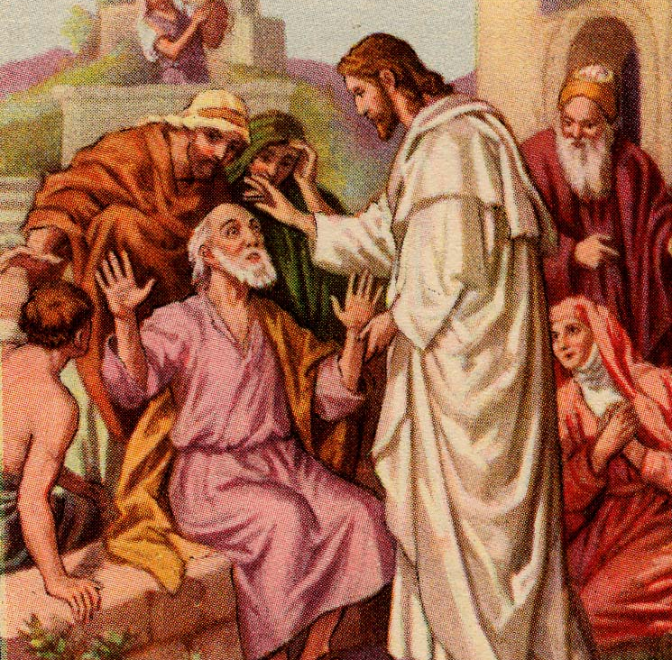
New Testament Miracles
A quick tour of their nature & purpose

Slide 24
Miracles of Jesus
His birth
His ministry
Will return to these for the bulk of the course
His resurrection & ascension

Slide 25
Apostolic Miracles
Pentecost (Acts 2) (Jesus)
fulfillment, attestation
Healing lame beggar (Acts 3) (Peter)
deliverance
Death of Ananias & Sapphira (5) (Peter)
judgment
Apostles rescued from prison (5) (angel)
deliverance

Slide 26
Apostolic Miracles
Holy Sp to Samaritans (8) (Peter & John)
fulfillment, attestation
Guidance & Transport of Philip (8) (HS)
revelation, ministry
Conversion of Paul (9) (Jesus)
deliverance
Healing paralytic Aeneas (9) (Peter)
deliverance, attestation

Slide 27
Apostolic Miracles
Resurrection of Dorcas (9) (Peter)
deliverance, attestation
Conversion of Cornelius (10) (angel)
deliverance, attestation
Famine prophecy (11) (Agabus)
revelation
Peter rescued from prison (12) (angel)
deliverance

Slide 28
Apostolic Miracles
Death of Herod Agrippa I (12) (angel)
judgment
Elymas struck blind (13) (Paul)
judgment, attestation
Lame man healed at Lystra (14) (Paul)
deliverance, attestation
Macedonian vision (16) (?)
revelation

Slide 29
Apostolic Miracles
Demonized girl at Philippi (16) (Paul)
deliverance
Earthquake at Philippian prison (16) (?)
deliverance, attestation
Vision at Corinth (18) (Lord) – revelation
HS on followers of Jn Bapt (19) (HS)
fulfillment, attestation
Demonic attack on sons of Sceva (19) (Satan) - judgment

Slide 30
Apostolic Miracles
Resurrection of Eutychus (20) (Paul)
deliverance
Arrest prophecy (21) (Agabus)
revelation
Vision at Jerusalem (23) (Lord)
revelation
Vision re/ shipwreck (27) (angel)
revelation

Slide 31
Apostolic Miracles
Paul not hurt by snake (27) (Paul)
deliverance, attestation
Healings on Malta (28) (Paul)
deliverance, attestation
Visions to John on Patmos (Jesus, angel)
revelation

Slide 32
Summary on NT Miracles
Much the same as OT re/ themes
More Christocentric
Probably all of the miracles of judgment and deliverance have some function as attestation for the miracle worker or for the Gospel and the Christian church.
No clear evidence in Acts of decrease in miraculous toward end of book.

Slide 33
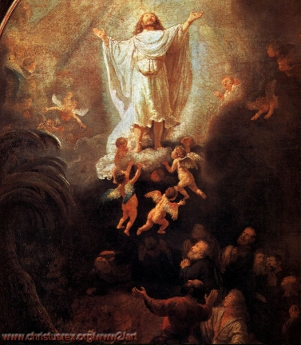
The End

