Slide 1
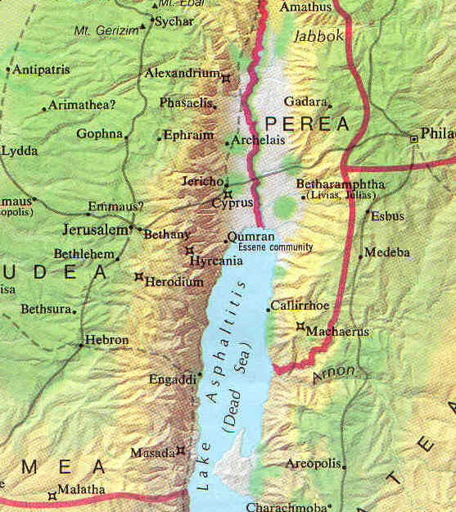

The Geography of Palestine
A Photographic Tour
Robert C. Newman

Slide 2
Physical Features of Palestine
Major Regions
  Going from West to East
Some Smaller Geographic Features
  Going from North to South
The Major Bodies of Water
  Seas, lakes, rivers

Slide 3
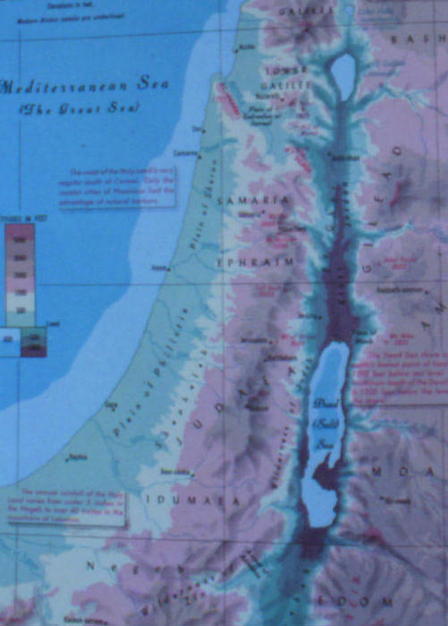
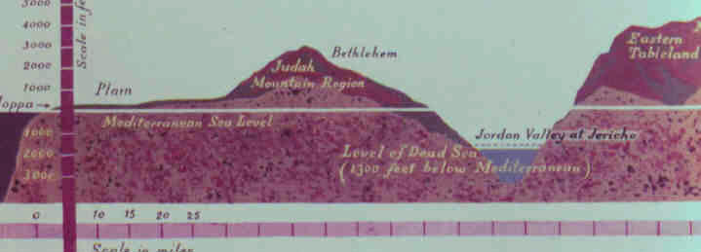
Major Regions West to East
Coastal Plain - 1
Shephelah - 2
Hill Country - 3
Rift Valley - 4
Trans-Jordan Plateau - 5
5
3
4
2
1
3
5
1
2
4

Slide 4
Coastal Plain
Low, flat
Fertile where not too salty or sandy
Easily invaded
  Terrain pretty smooth
  Open to South
  Reached from North thru passes
Coastal
Plain

Slide 5
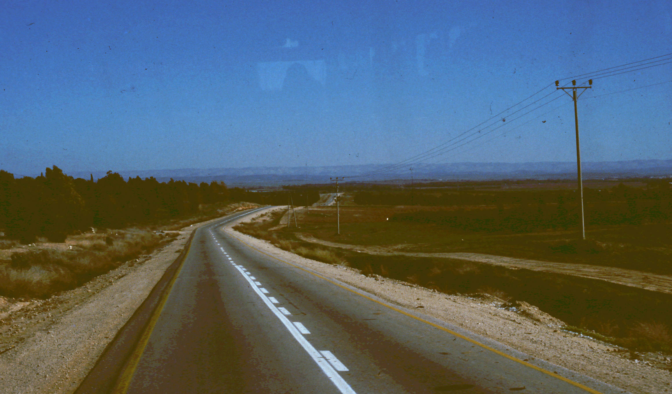
Coastal Plain

Slide 6
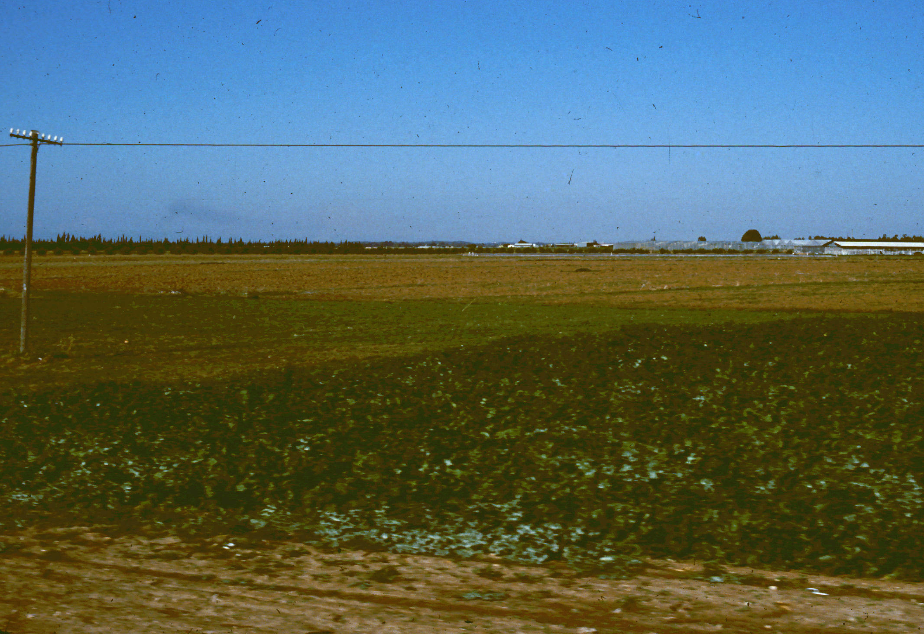
Coastal Plain

Slide 7
Shephelah "Lowlands"
Somewhat higher than coastal plain
Lower than Hill Country
Rolling terrain
Travel typically along valleys
Relatively easy to invade
Shephelah

Slide 8
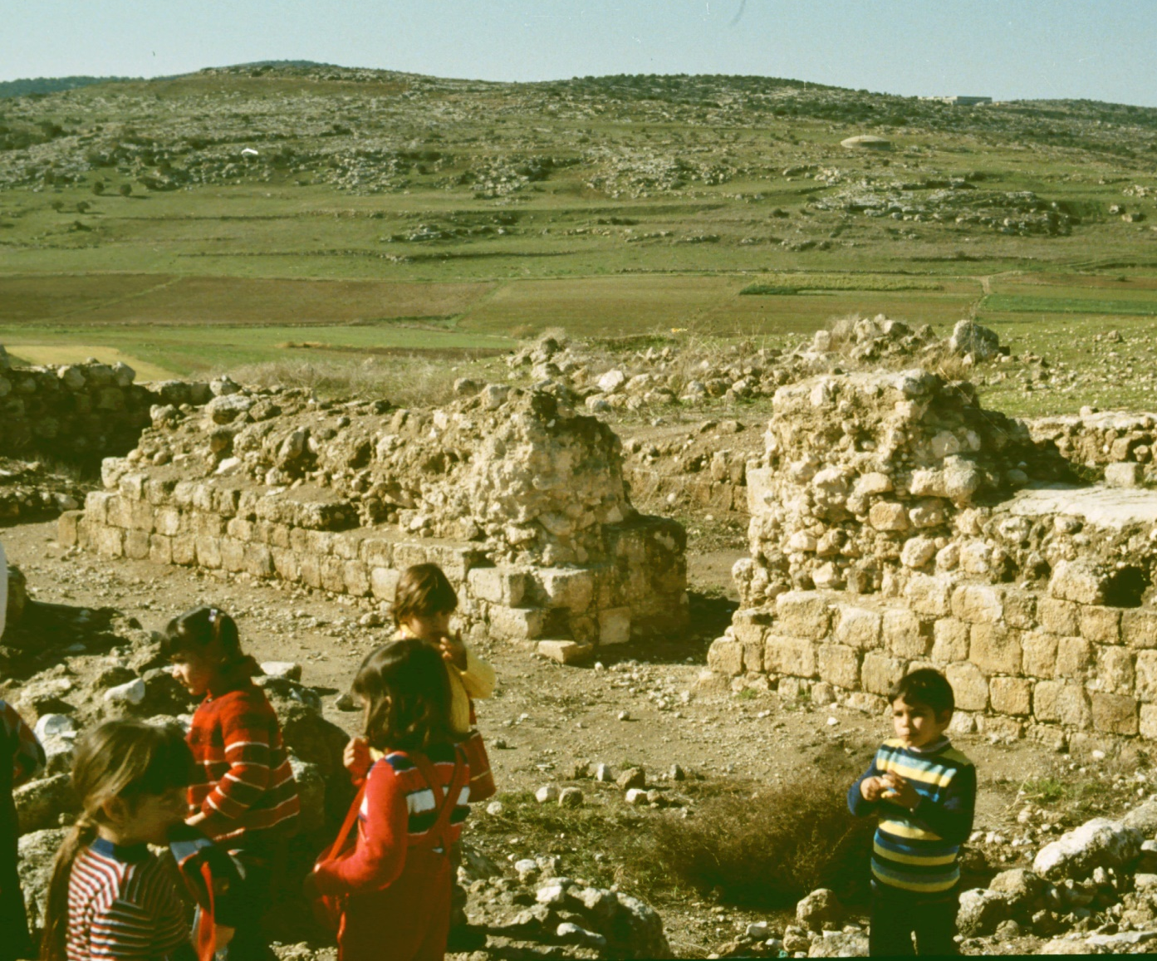
Shephelah "Lowlands"
Beth
Shemesh

Slide 9
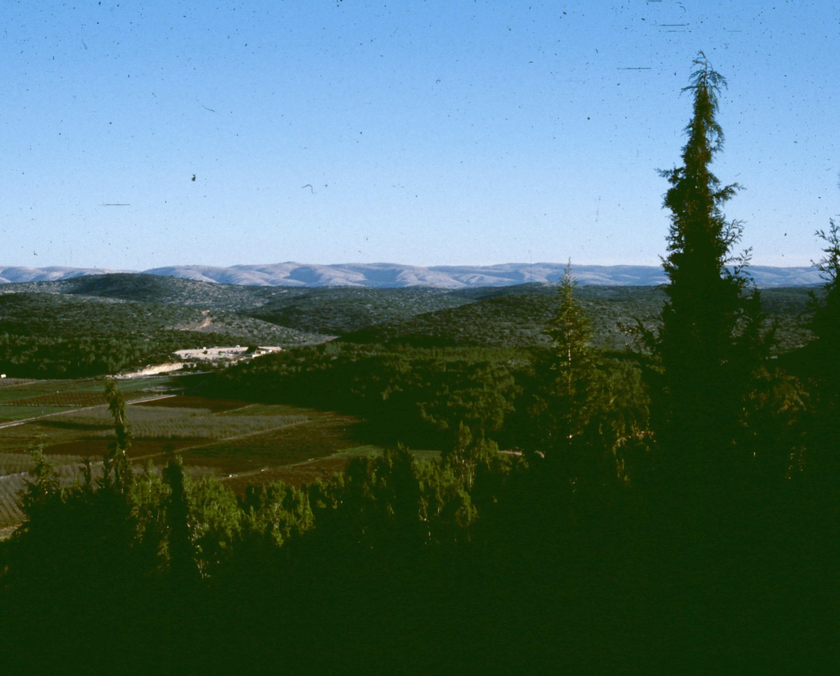
Shephelah "Lowlands"
Shephelah
from Azekah

Slide 10
Hill Country
Sharp hills, V-shaped valleys
Resembles West Virginia
Travel along ridges
Difficult to invade
Agriculture uses terraces
Rainfall good W of ridge, poor to E of ridge
Hill
Country

Slide 11
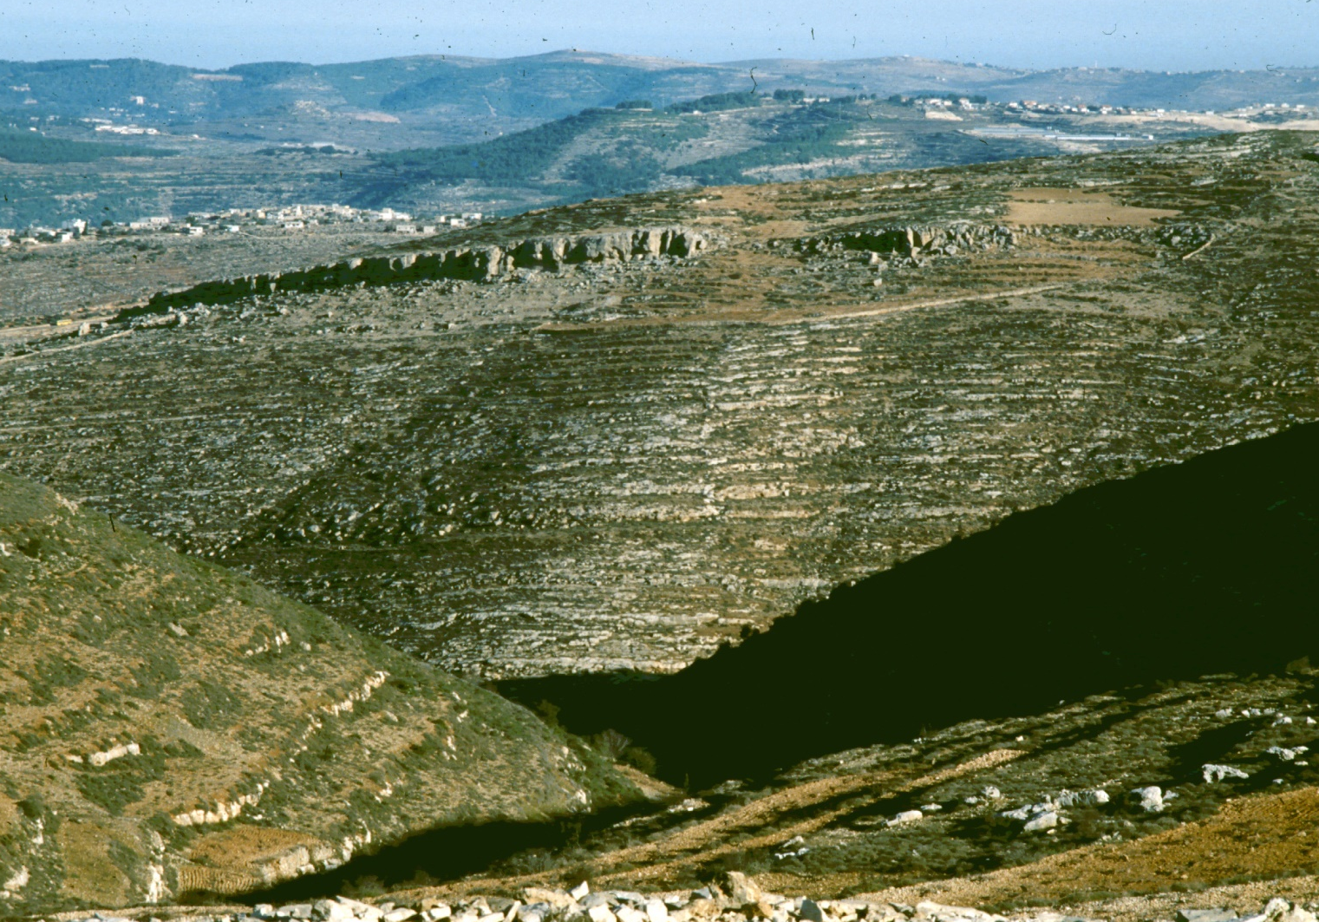
Hill Country
Kefar
Ezyon

Slide 12
Rift Valley
A geologic fault (Graben)
Extends S into Africa, N into Syria
Wide U-shaped valley
Jordan R has its own valley in middle
Climate hot & dry
To grow crops, must use irrigation
Rift
Valley

Slide 13
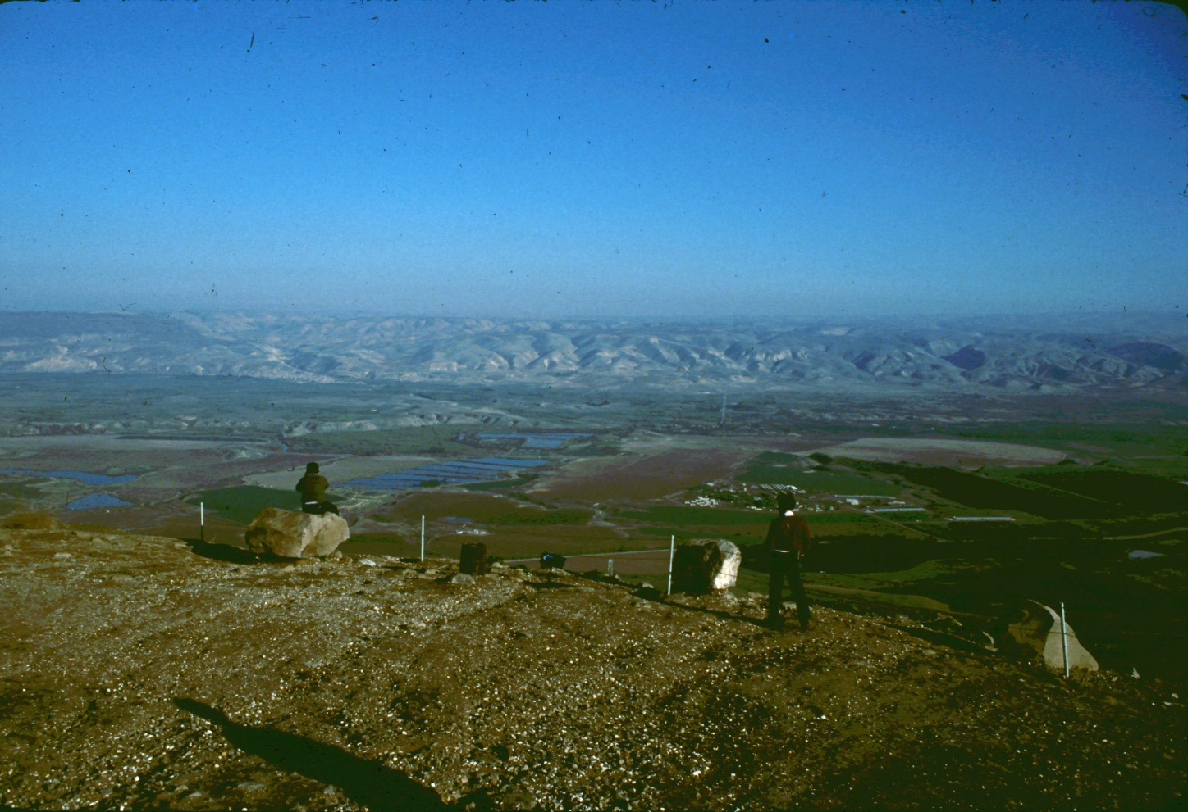
Rift Valley
Rift Valley
from Belvoir

Slide 14
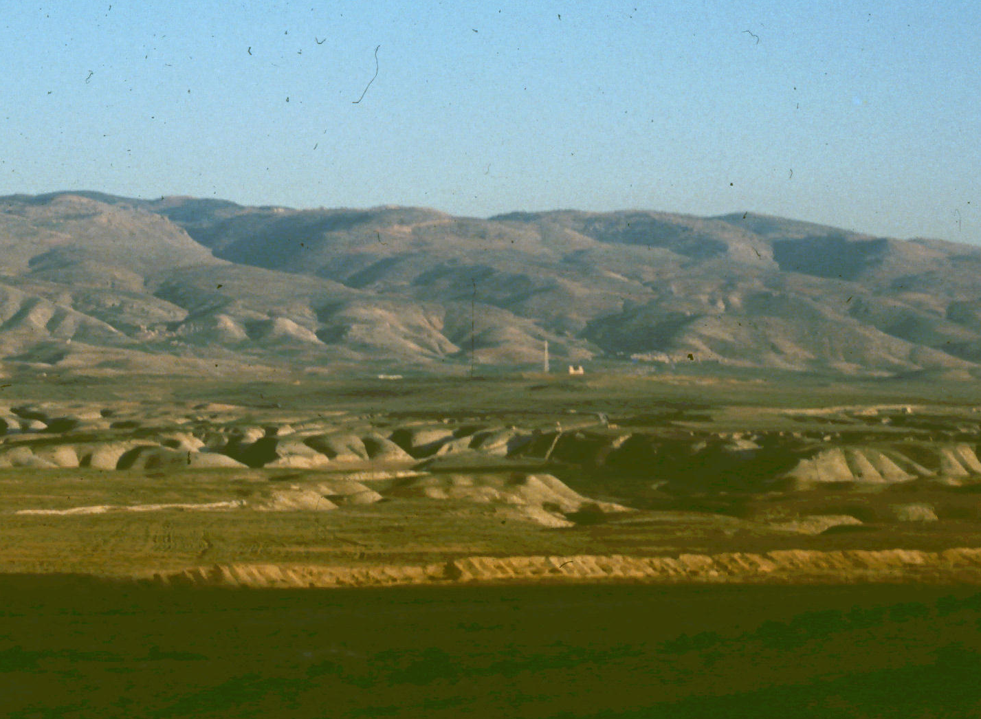
Rift Valley
In Rift Valley
North of Jericho

Slide 15
Trans-Jordan Plateau
A flat tableland
Higher than Hill Country
Relatively well-watered at Western edge
Quickly becomes desert as one moves Eastward
T-J
Plateau

Slide 16
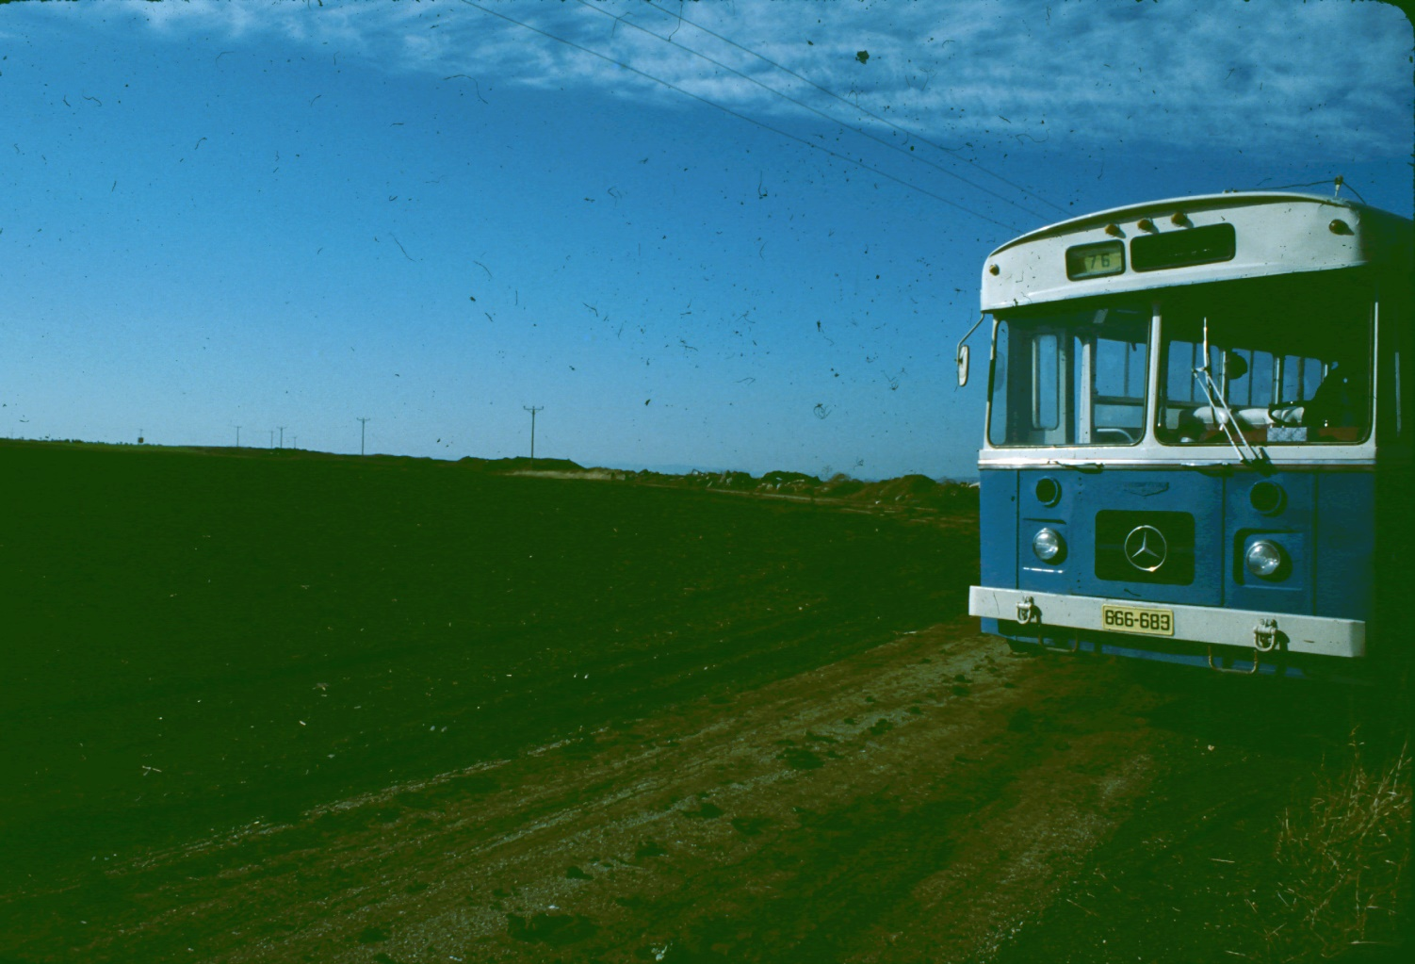
Trans-Jordan Plateau
Fertile soil on
T-J Plateau

Slide 17
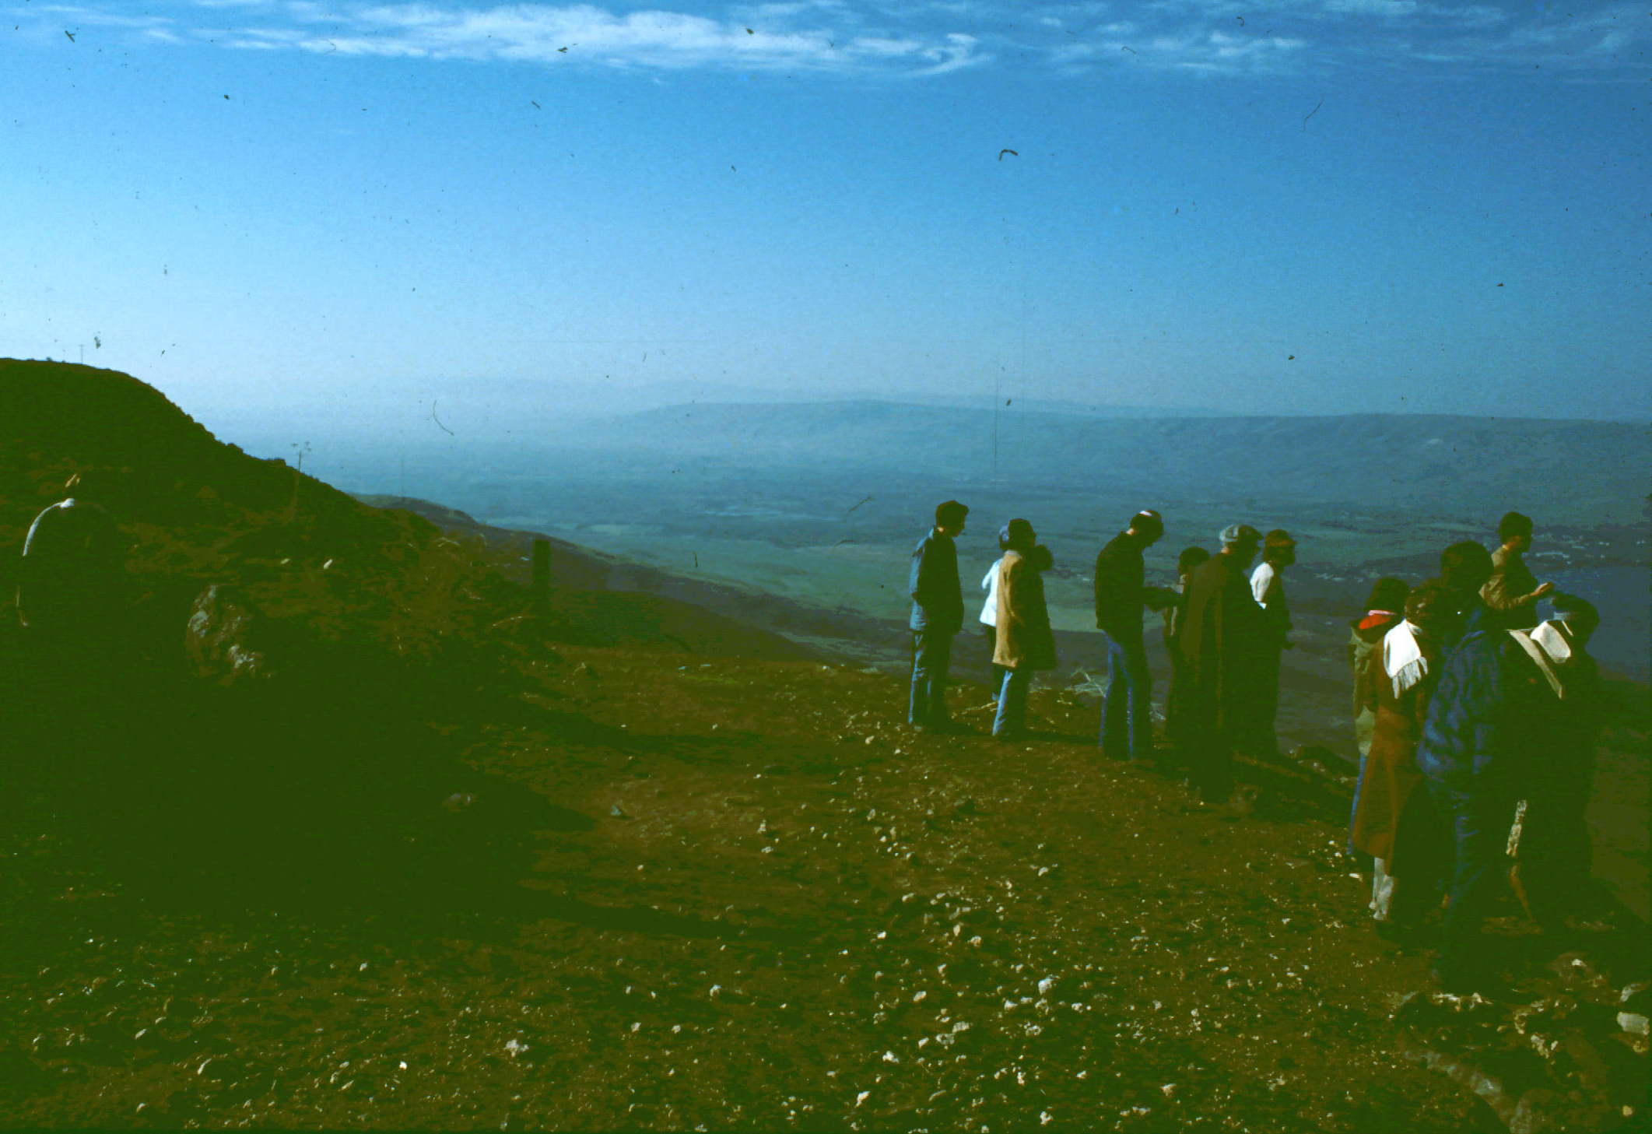
Trans-Jordan Plateau
On T-J Plateau
Looking SW
Into Rift Valley

Slide 18
Smaller Geographical Features
A
Mount Hermon - A
Galillee & Mt. Tabor - B
Jezreel Valley - C
Mount Carmel - D
Wilderness of Judea - E
The Negev - F
B
D
C
E
F

Slide 19
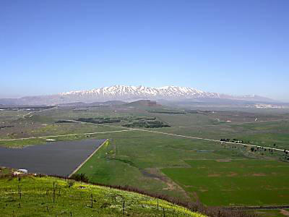
Mount Hermon
Highest peak in Palestine area
Elevation over 9,000 ft
Southernmost peak of the Anti-Lebanon range
Peak is generally snow-covered all year

Slide 20
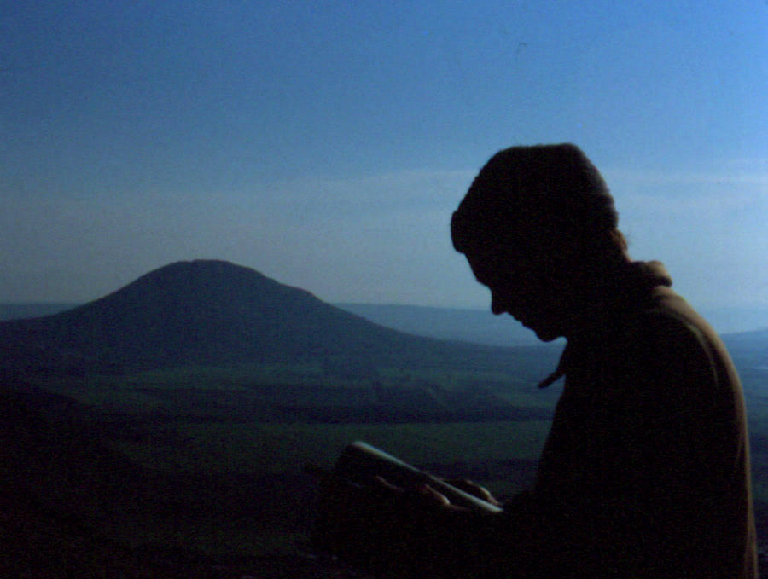
Galilee & Mount Tabor
Hilly region, N extension of Hill Country
Best-watered area in Palestine, similar to Eastern United States
N is higher, S lower
Reasonably cool except around Sea of Galilee
Mt Tabor (1900 ft) is an isolated peak

Slide 21
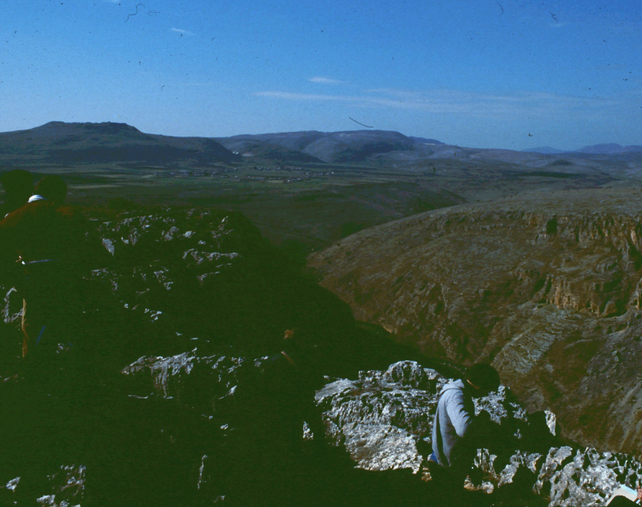
Galilee
Galilee & Horns
of Hattin from
Mt Arbel

Slide 22
Jezreel Valley
An E-W valley connecting coast with Jordan valley
Separates Samaria from Galilee
Easiest passage from Rift Valley to coast
An important trade route
Jezreel
Valley

Slide 23
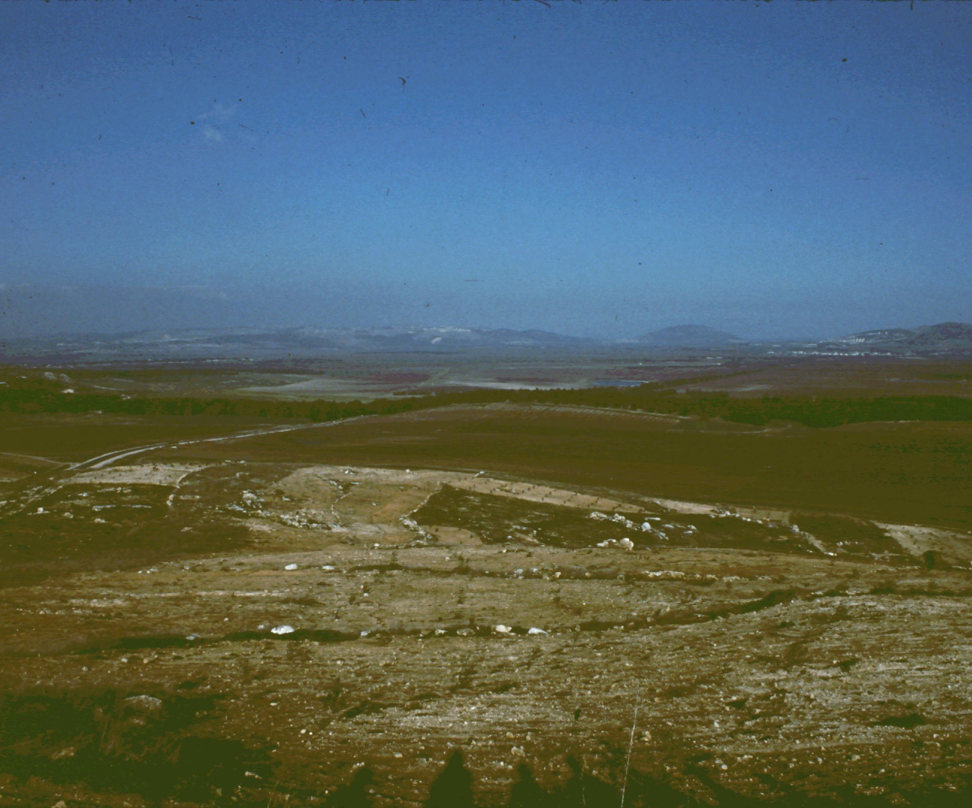
Jezreel Valley
Jezreel Valley
from Megiddo Pass

Slide 24
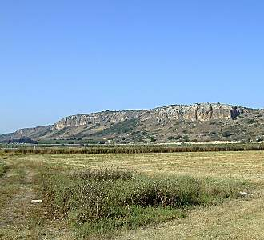
Mount Carmel
Long ridge on S side of Jezreel Valley
Maximum height about 1800 feet
Barrier to N-S travel
Trade routes go thru passes
City of Megiddo controls one pass

Slide 25
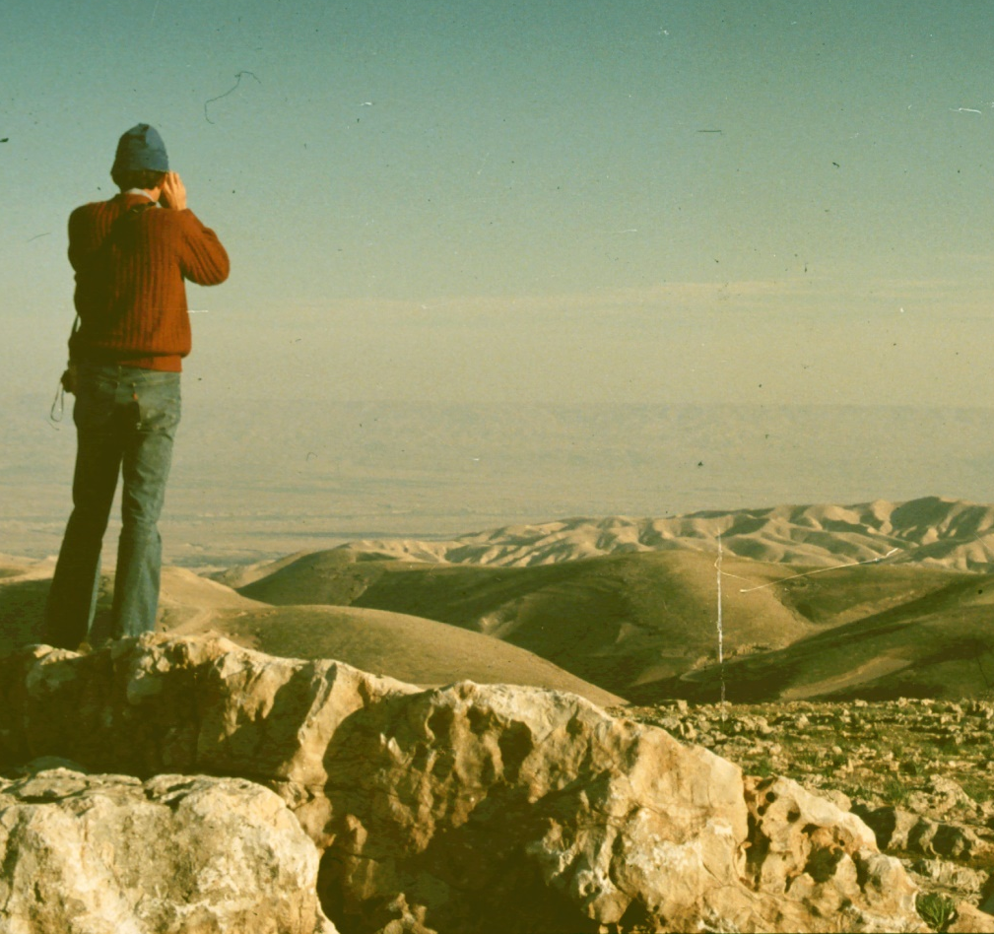
Wilderness of Judea
A badlands region E of Jerusalem
Virtually uninhabited, due to poor rainfall & soil
Used for grazing sheep in winter (wetter) season
Site of Jesus' temptations

Slide 26
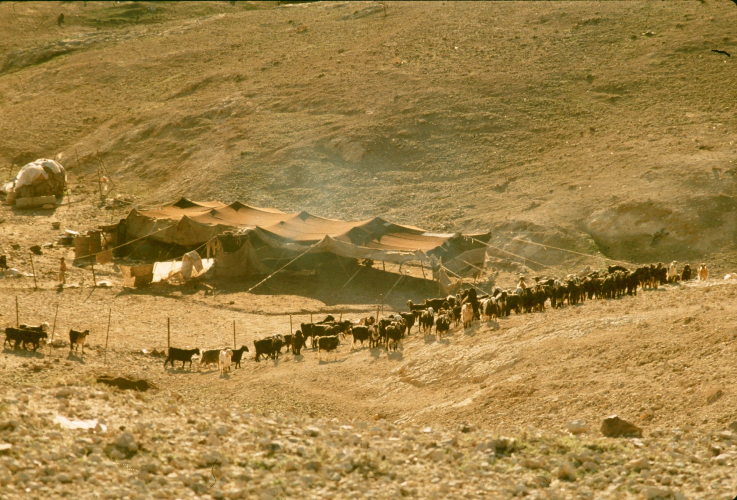
Wilderness of Judea
Bedouin tent
& sheep

Slide 27
The Negev
Arid region South of Hebron
Flat or rolling terrain
Soil is good for agriculture
Very little rainfall due to latitude effect
Agriculture possible using tricks to concentrate water
Negev

Slide 28
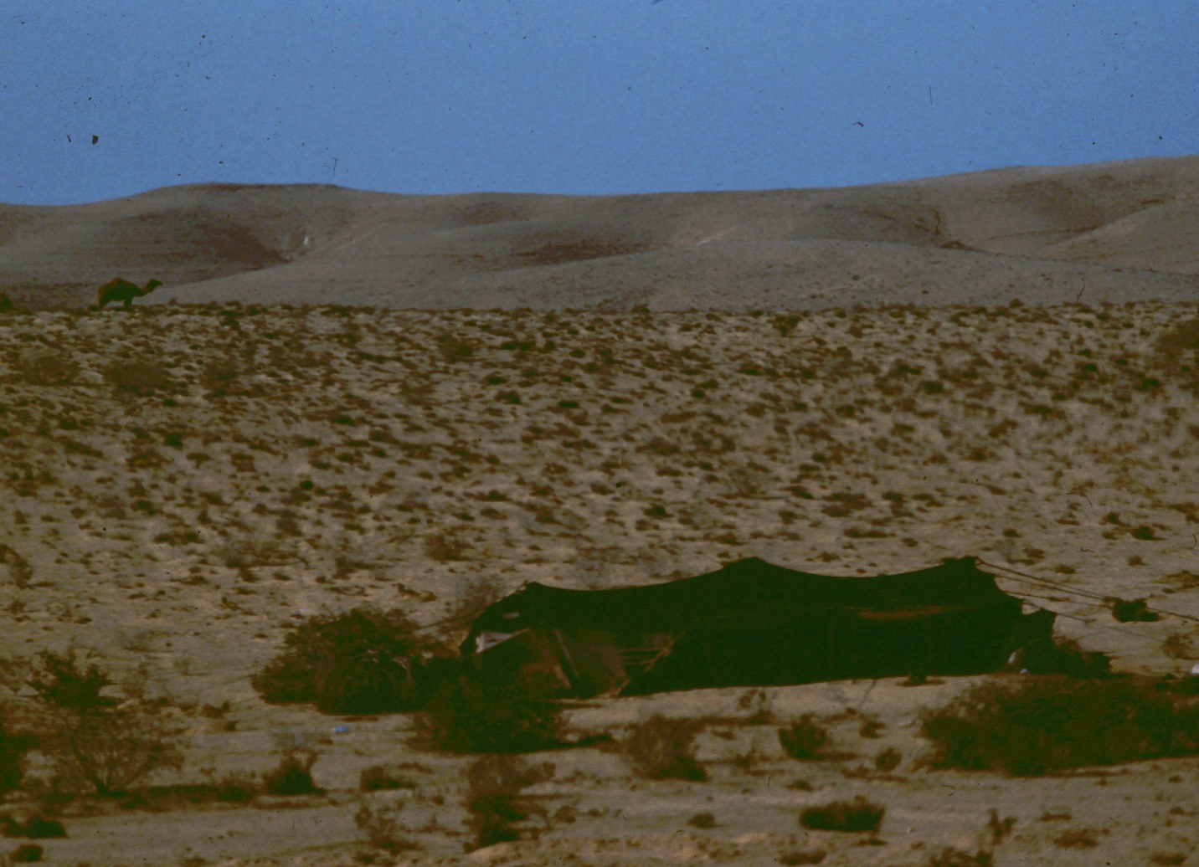
The Negev
Camel &
Tent

Slide 29
Major Bodies of Water
Mediterranean Sea – 1
Sea of Galilee – 2
Jordan River – 3
Dead Sea – 4
2
1
3
4

Slide 30
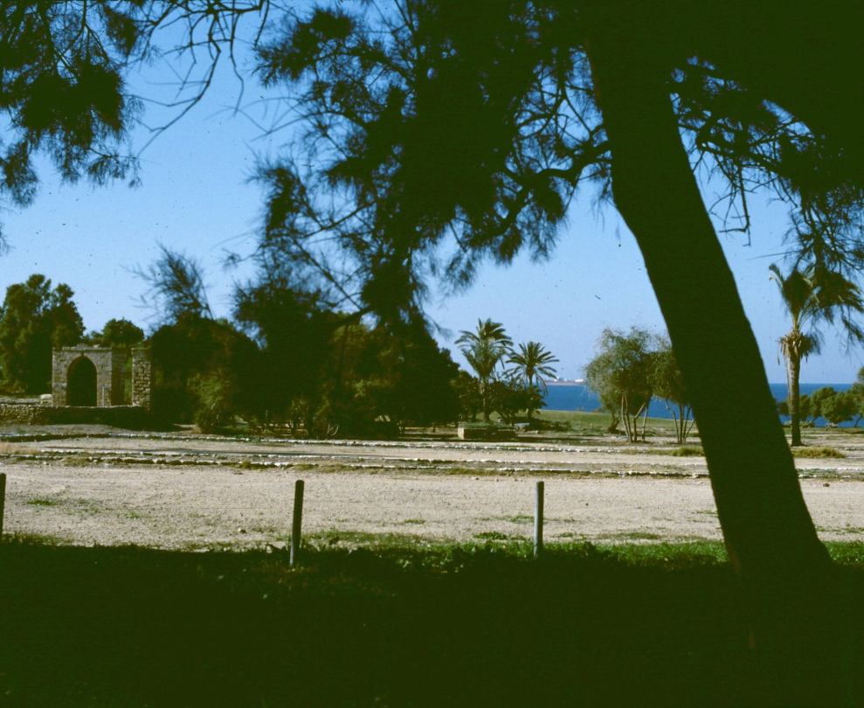
Mediterranean Sea
Large body of salt water (1700 x 500 mi)
Connects to Atlantic at Gibraltar
Major transportation route
Palestine has few ports, so Jews typically middle-men rather than sailors

Slide 31
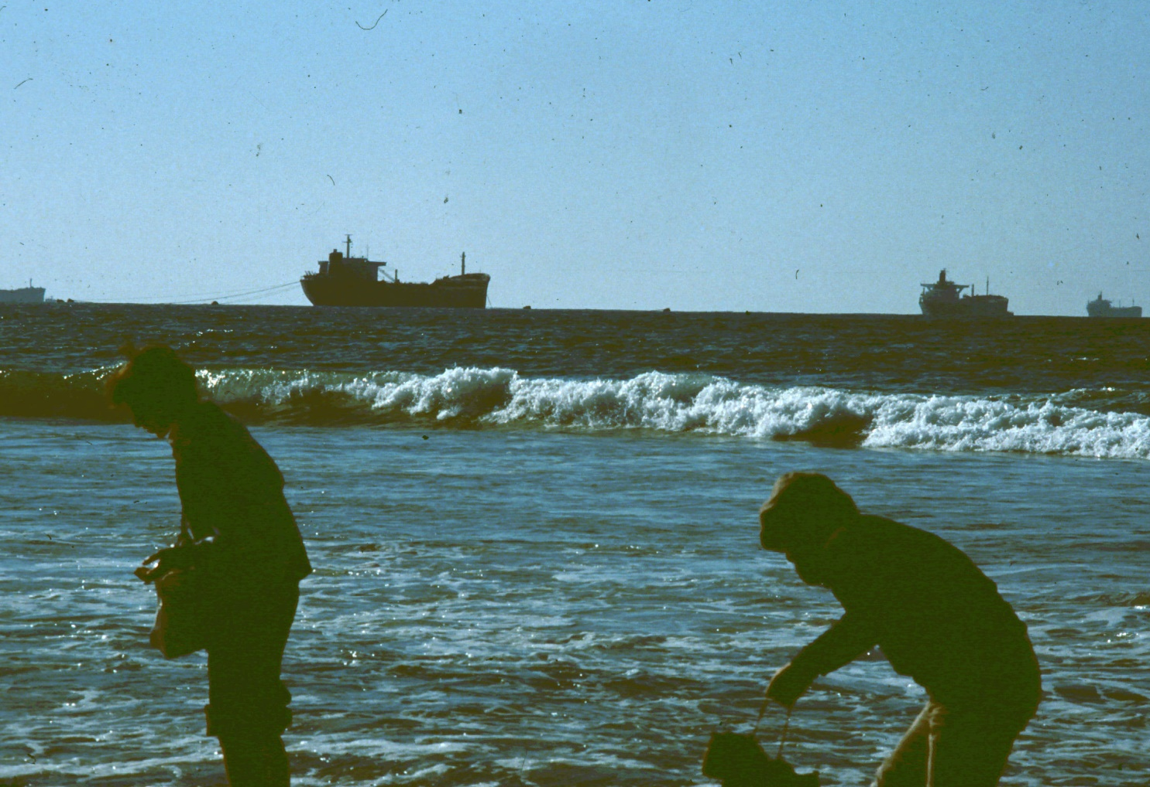
Mediterranean Sea
Near
Ashkelon

Slide 32
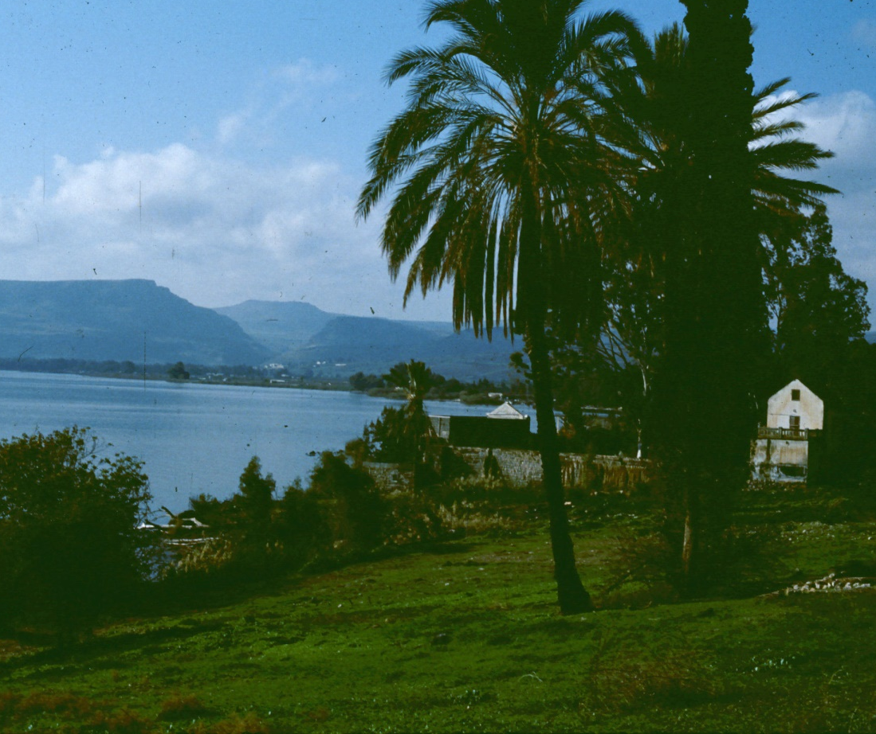
Sea of Galilee
A fresh-water lake (about 7 x 13 miles)
Surface is 600 ft below sea level!
Source & outlet both called Jordan River
Important for fishing
Peculiar topography allows violent storms

Slide 33
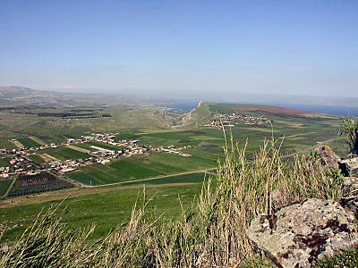
Sea of Galilee
Sea of Galilee from
Horns of Hattin

Slide 34
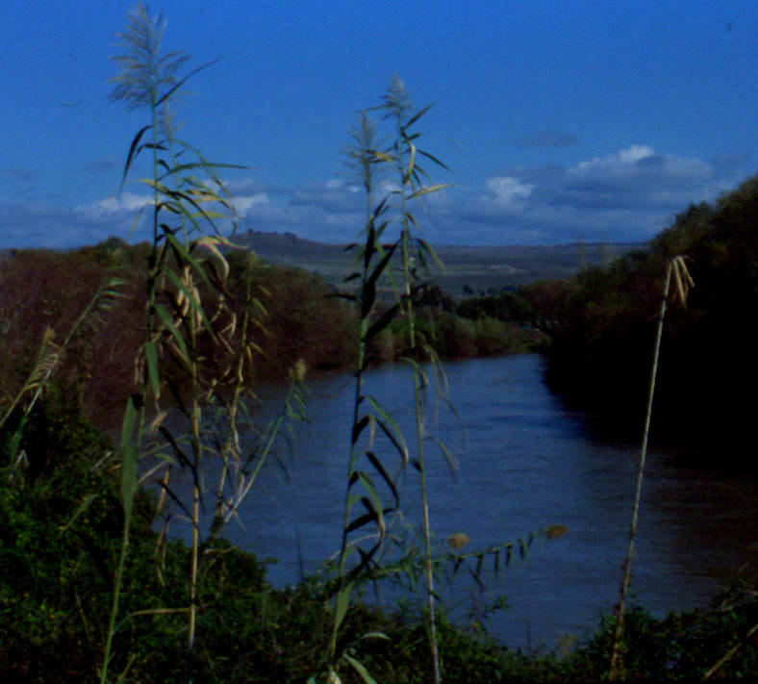
Jordan River
Begins in N on lower slopes of Mt Hermon
Descends thru Sea of Galilee to end in Dead Sea
Drops about 2300 ft in 100 mi (with river winding perhaps 250 mi)

Slide 35
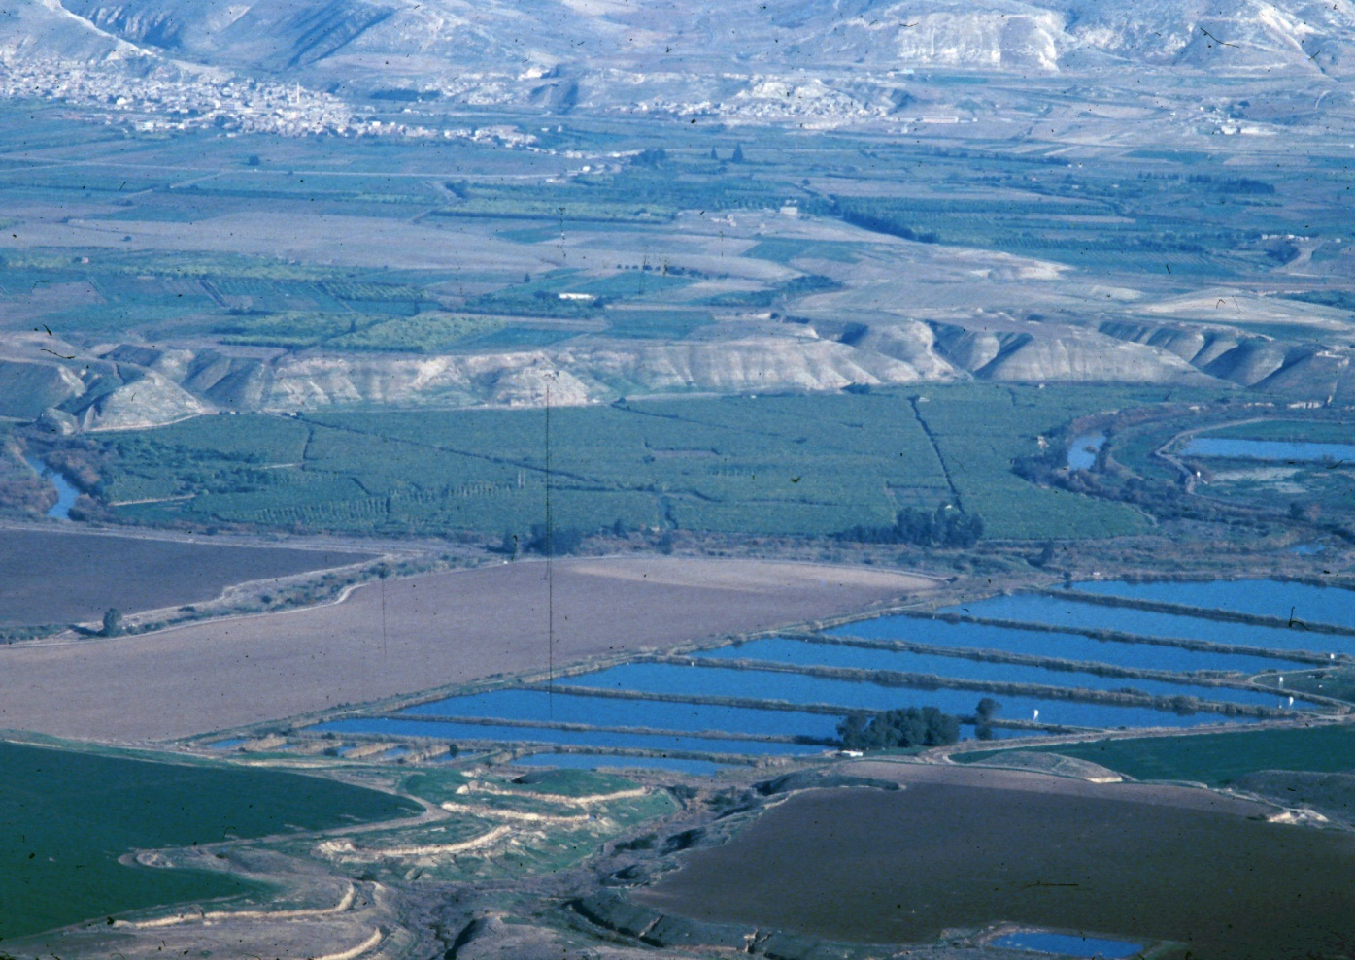
Jordan River
Jordan from
Belvoir

Slide 36
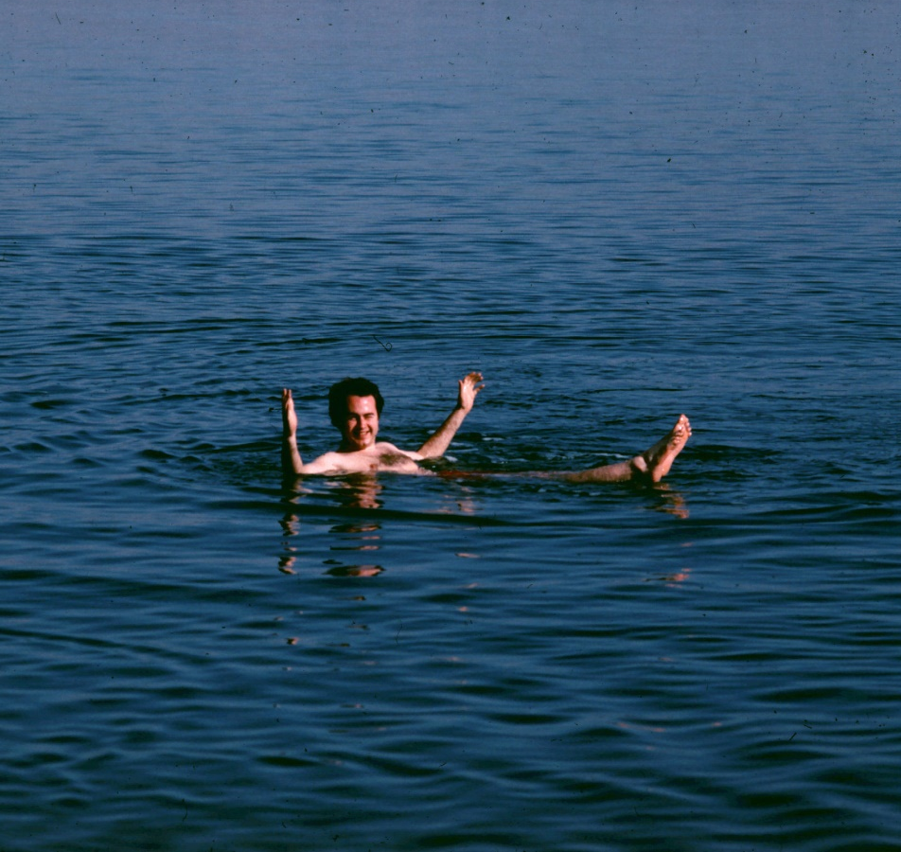
Dead Sea
Surface is lowest point on earth, 1296 ft below sea level
Water is extremely salty, so fish cannot live in it
Objects float unusually well
Mined in antiquity and today for minerals

Slide 37
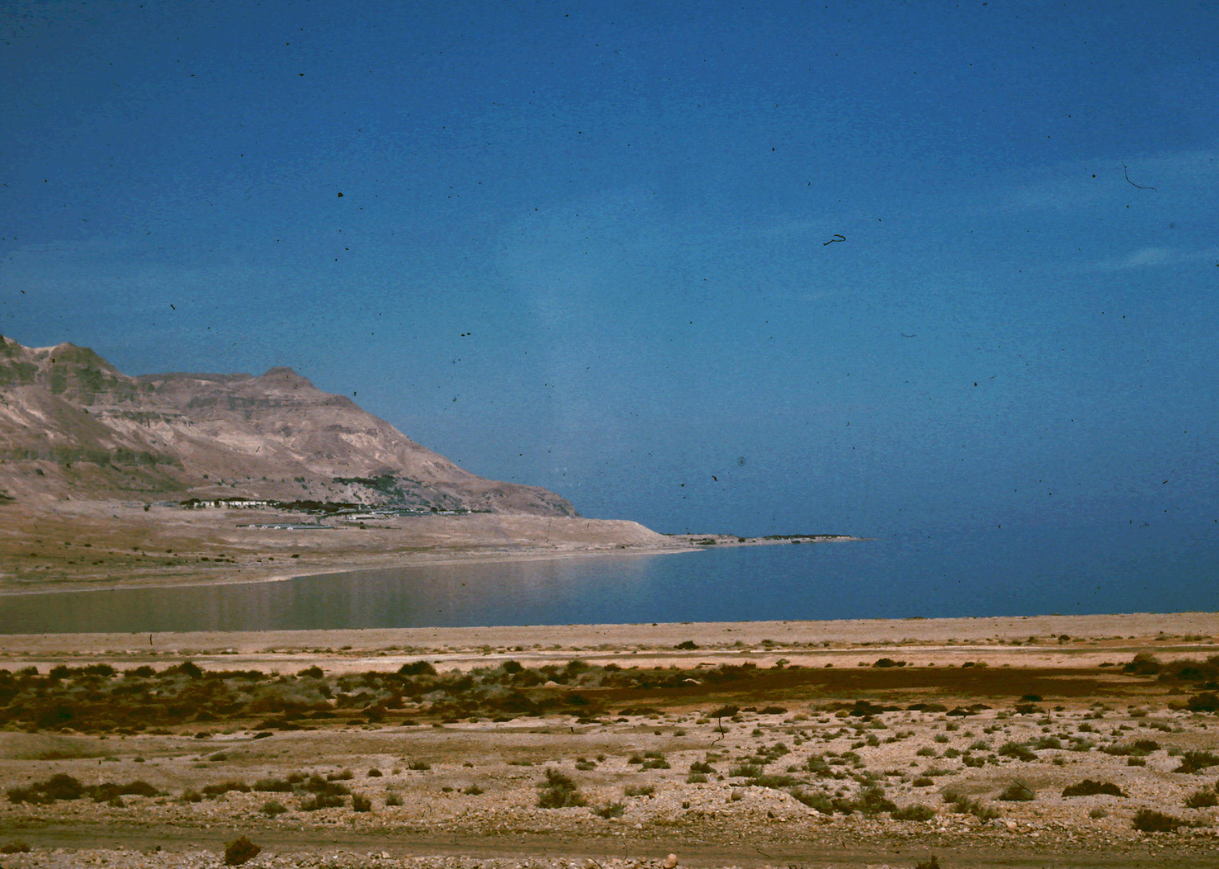
Dead Sea
Dead Sea near
En-Gedi

Slide 38
Political Features of Palestine
Political divisions at time of Jesus' ministry
Cities of Palestine at same time
Major roads
The Herodian fortifications

Slide 39
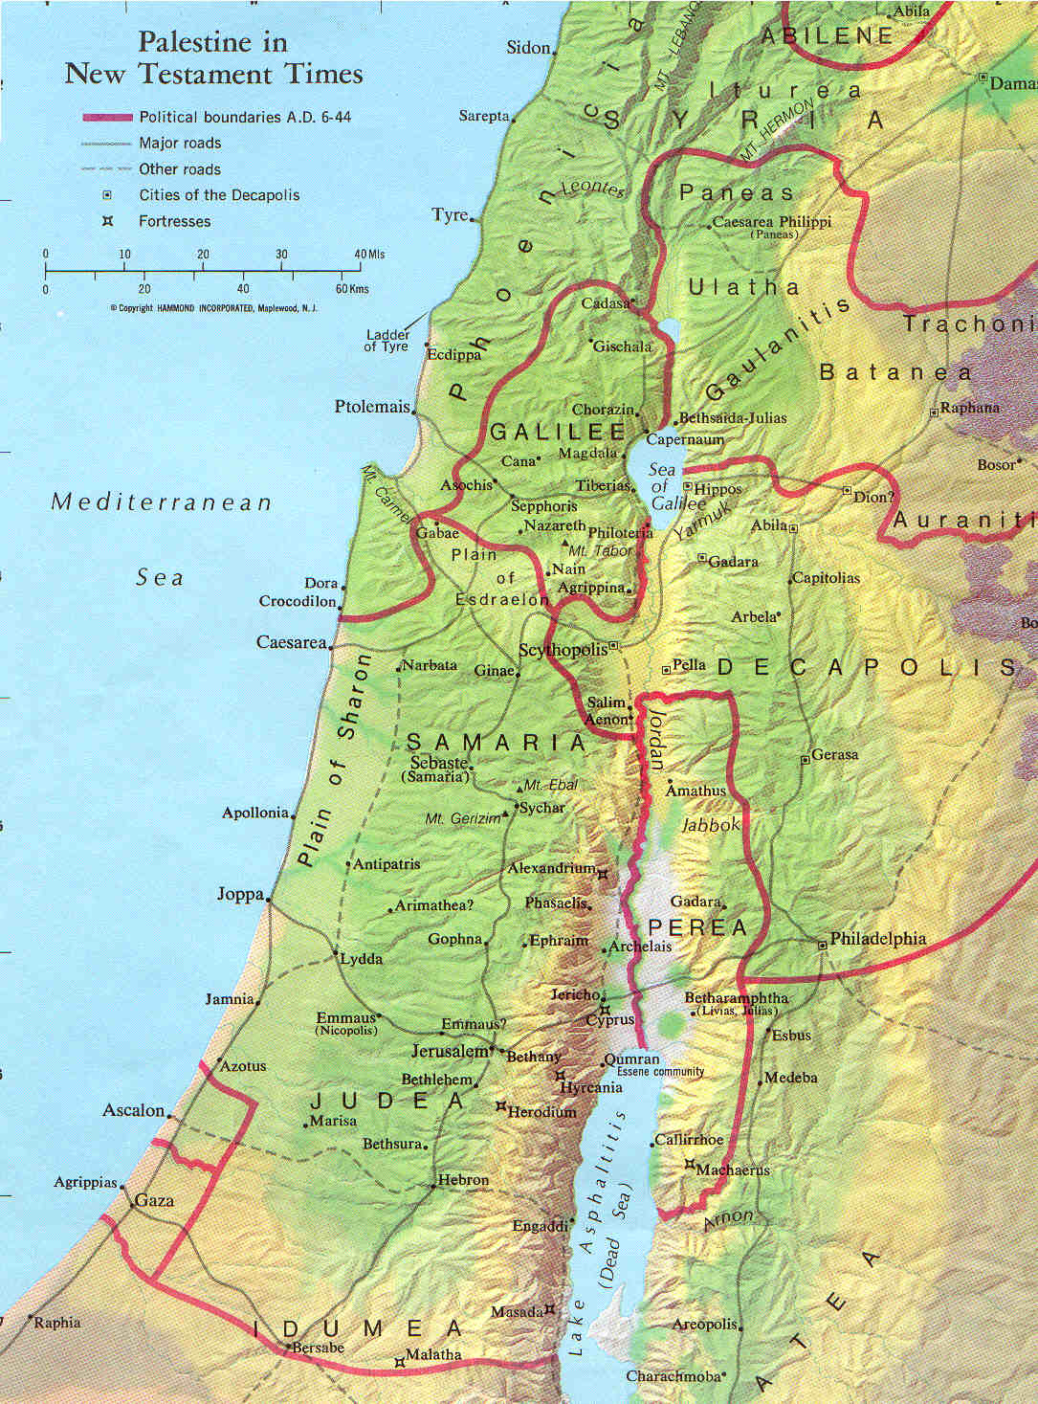
Political Divisions
Boundaries are red lines
Judea – A
Galilee – B
Perea – C
Tetrarchy of Philip – D
The Decapolis – E
D
B
E
A
C

Slide 40
Judea
Also included Samaria & Idumea
Population mostly Jews
  Gentiles in Samaria & Idumea
Rulers:
  Herod the Great
  Archelaus
  Roman governors
  Herod Agrippa 1
  Roman governors
Judea

Slide 41
Galilee
Area W of Sea of Galilee
Territory of N tribes till captivity
Territory of Gentiles till Maccabees took it back
Rulers:
  Herod the Great
  Herod Antipas
  Roman governors
  Herod Agrippa 1
  Roman governors
Galilee

Slide 42
Perea
Narrow strip E of the Jordan
Inhabited mainly by Jews after Maccabean conquests
Same rulers as Galilee
Perea

Slide 43
Tetrarchy of Philip
Region NE of Sea of Galilee
Multi-ethnic, mostly Gentile
Part of Herod the Great's territory, went to Philip
Rulers:
  Herod the Great
  Philip the Tetrarch
  Roman governors
  Herod Agrippa 1
  Roman governors
Philip

Slide 44
The Decapolis
League of Hellenistic cities (w/ territories)
Mostly Gentile
Under Maccabees during their power
After Romans came, made independent of Jewish control
Decapolis

Slide 45
Cities of Palestine
Jerusalem – 1
Caesarea – 2
Sebaste – 3
Tiberias – 4
Caesarea Philippi – 5
5
4
2
3
1

Slide 46
Major Roads
Via Maris
  Latin for "Way of the Sea"
  Coastal road from Egypt to Antioch & Damascus
King’s Highway
  On T-J Plateau
  Gulf of Aqabah to Damascus
Ridge Route
  Thru Hill Country
  Connects Jerusalem with Galilee

Slide 47
Herodian Fortifications
Macherus – A
  E of Dead Sea
  John the Baptist killed here, acc to Josephus
Masada – B
  W of Dead Sea
  Last stand of Zealots
Herodium – C
  Near Bethlehem
  Herod buried here?
C
B
A

Slide 48
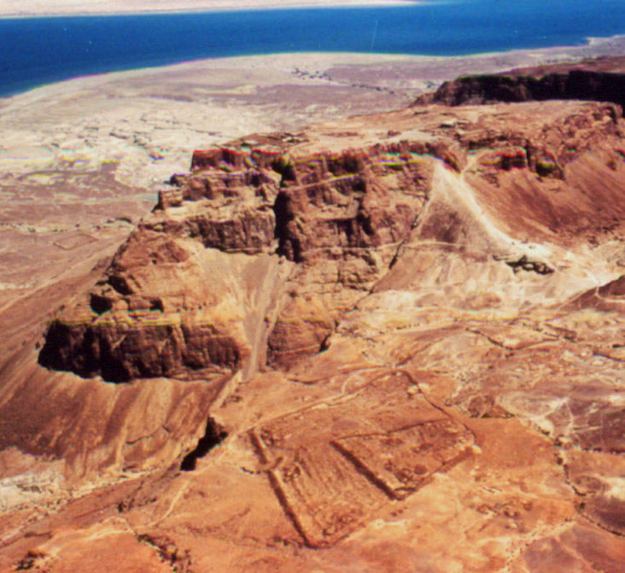
Masada

Slide 49
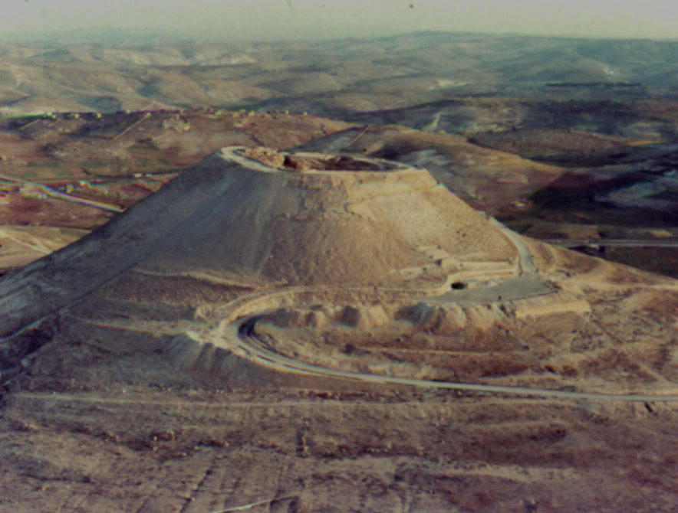
Herodium

Slide 50
The End
Knowing geography helps in understanding the narratives of the OT, the Gospels & Acts.

