Slide 1
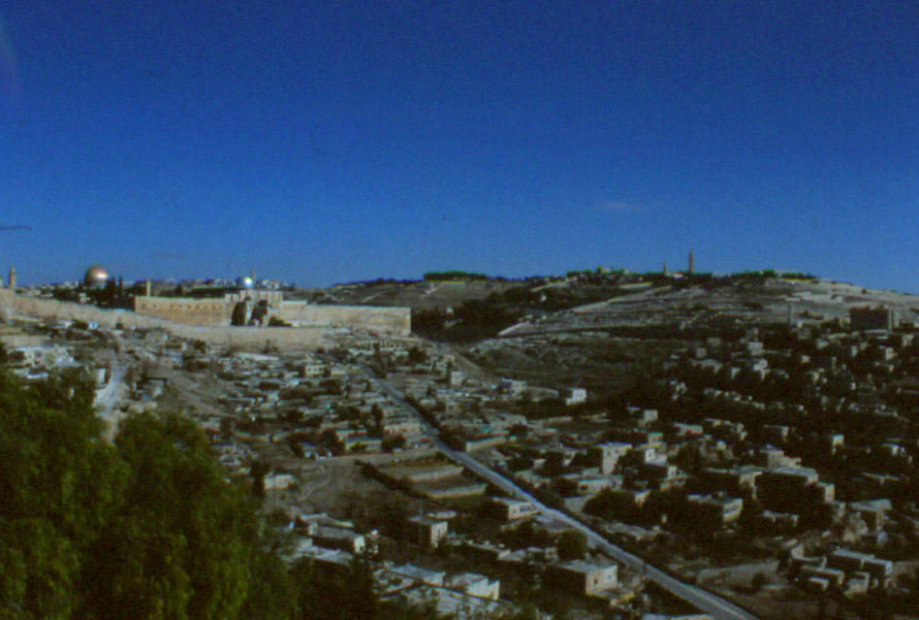

The Geography of Jerusalem
A Photographic Tour
Robert C. Newman

Slide 2
The Geography of Jerusalem
The Valleys around Jerusalem
The Hills
The City Walls in the NT Period
Sections of the City
Major Buildings & Structures
Other Sites related to Jesus' Ministry

Slide 3
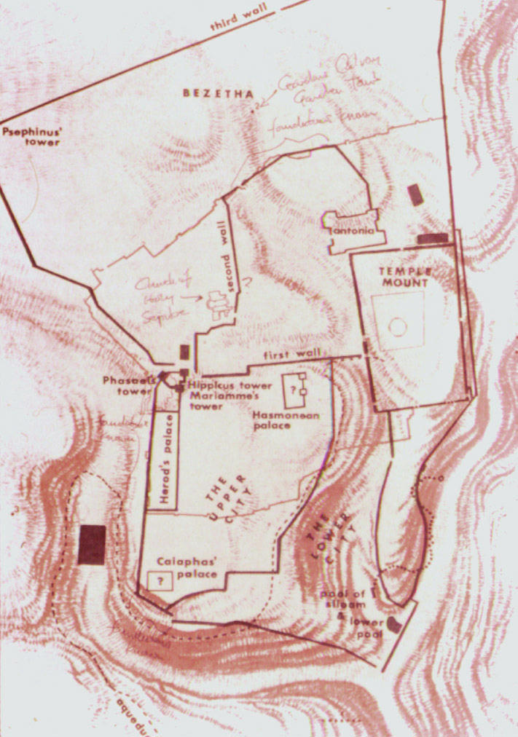
The Valleys around Jerusalem
Hinnom Valley – H
  W and S of city
  Place garbage burned
Kidron Valley – K
  E of city
  Location of Gethsemane
Tyropoean Valley – T
  Midst of city
  Greek for 'cheesemakers'
  Now largely filled in
T
K
H
H
K
T
H
K

Slide 4
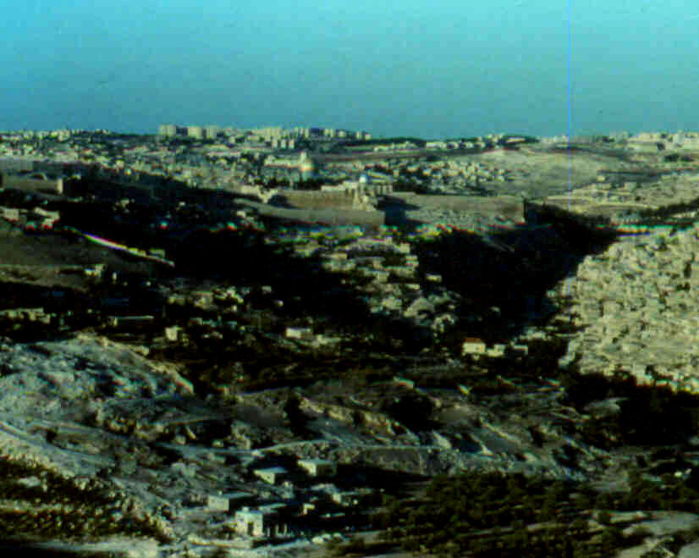
The Valleys around Jerusalem
Viewed from S
Near sunset
Hinnom
Kidron

Slide 5
The Hills around Jerusalem
Ophel – O
  Site of Jebusite city
Moriah – M
  Site of temple & Abraham's sacrifice
Mt of Olives – L
  Outside city ½ mi to E
Hill of Upper City – U
  To W & higher than Ophel or Moriah
L
M
U
O
L

Slide 6
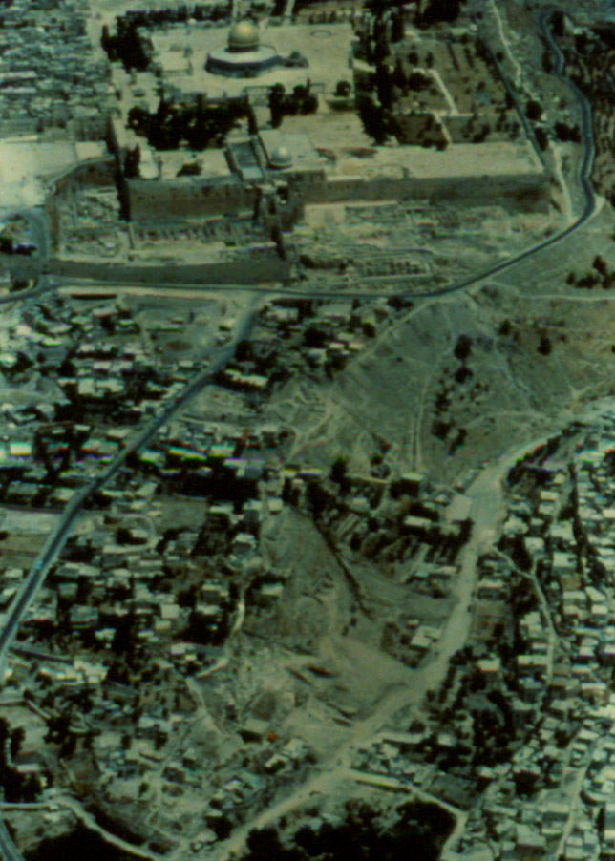
The Hills around Jerusalem
Moriah
Aerial view of
Ophel (bottom)
& Moriah (top)
Ophel

Slide 7
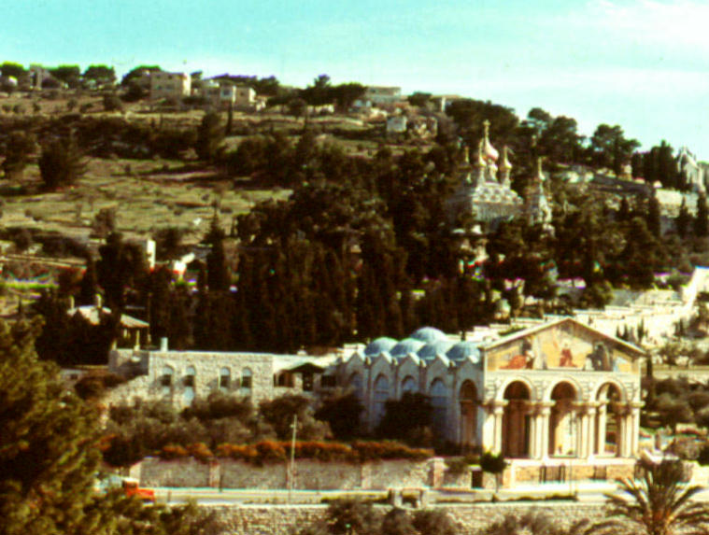
The Hills around Jerusalem
Mount of
Olives

Slide 8
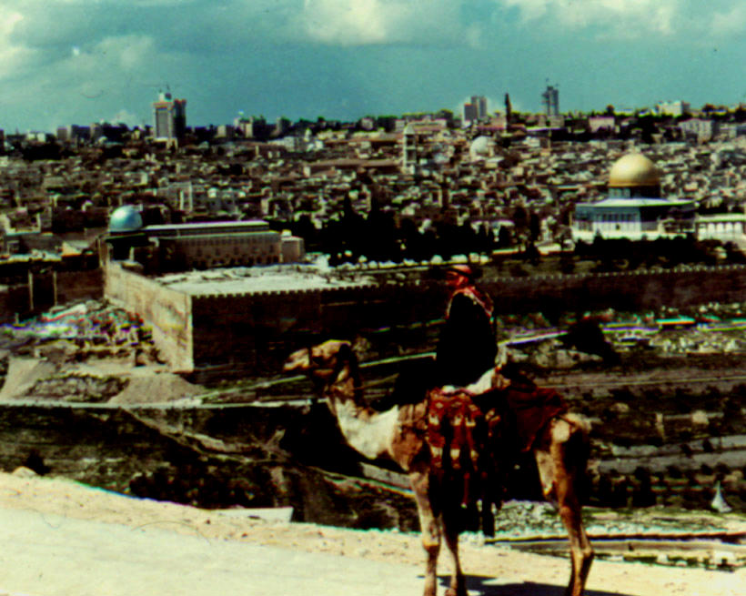
The Hills around Jerusalem
Upper City
Moriah &
Hill of Upper
City from Mt
Olives
Moriah

Slide 9
The City Walls in 1st Cen AD
South Wall
East Wall
West Wall
North Walls
  1st
  2nd
  3rd

Slide 10
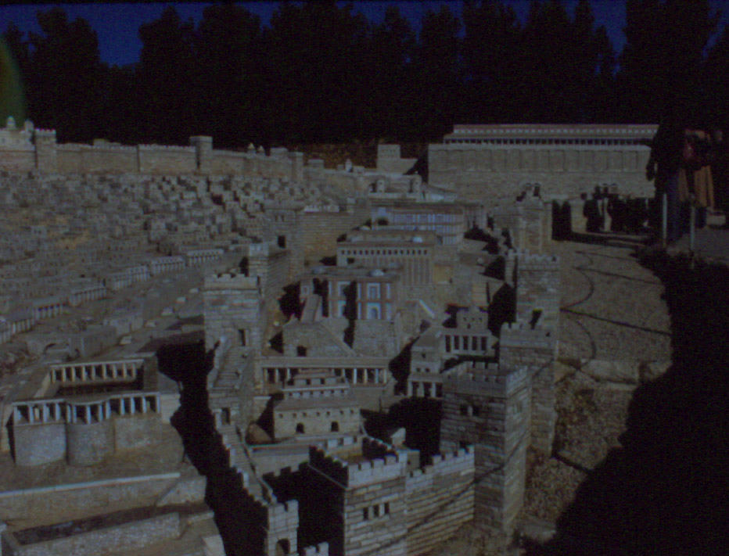
The City Walls
E Wall on
Jerusalem
Model
← East
Wall

Slide 11
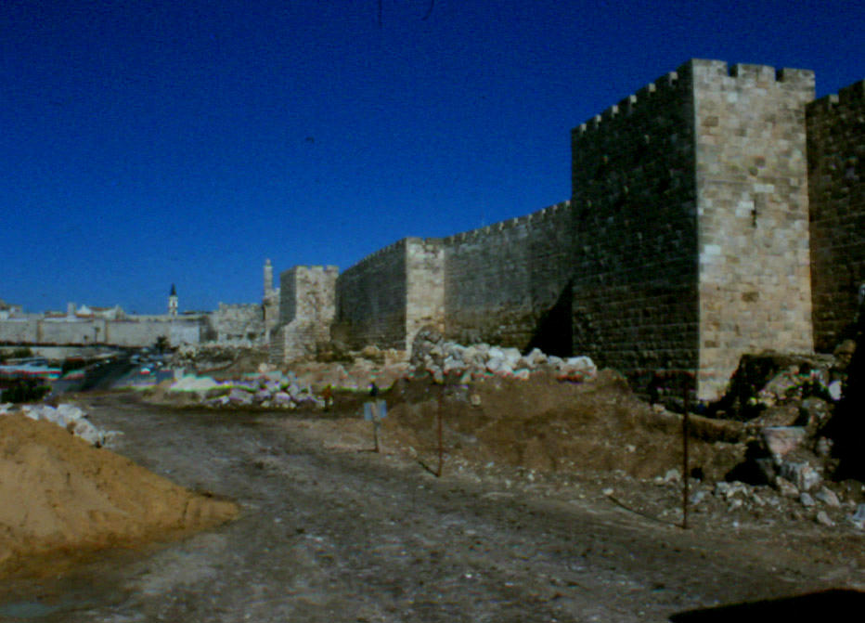
The City Walls
W Wall
Today

Slide 12
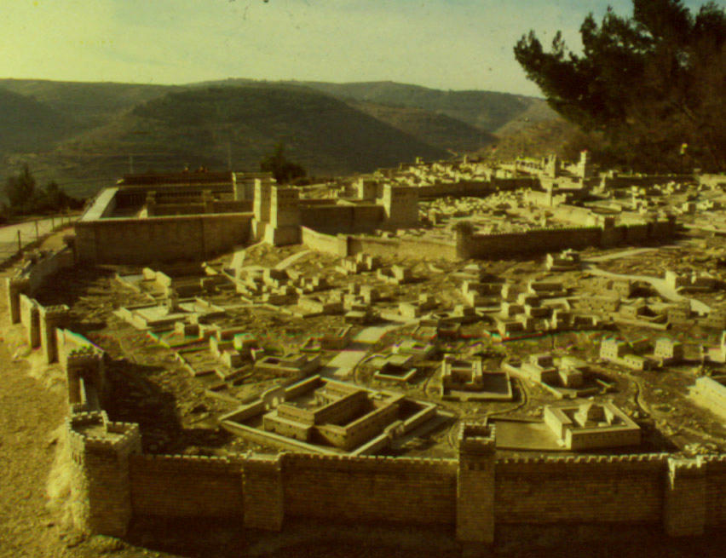
The City Walls
N Walls on
Jerusalem
Model
First
Second
Third

Slide 13
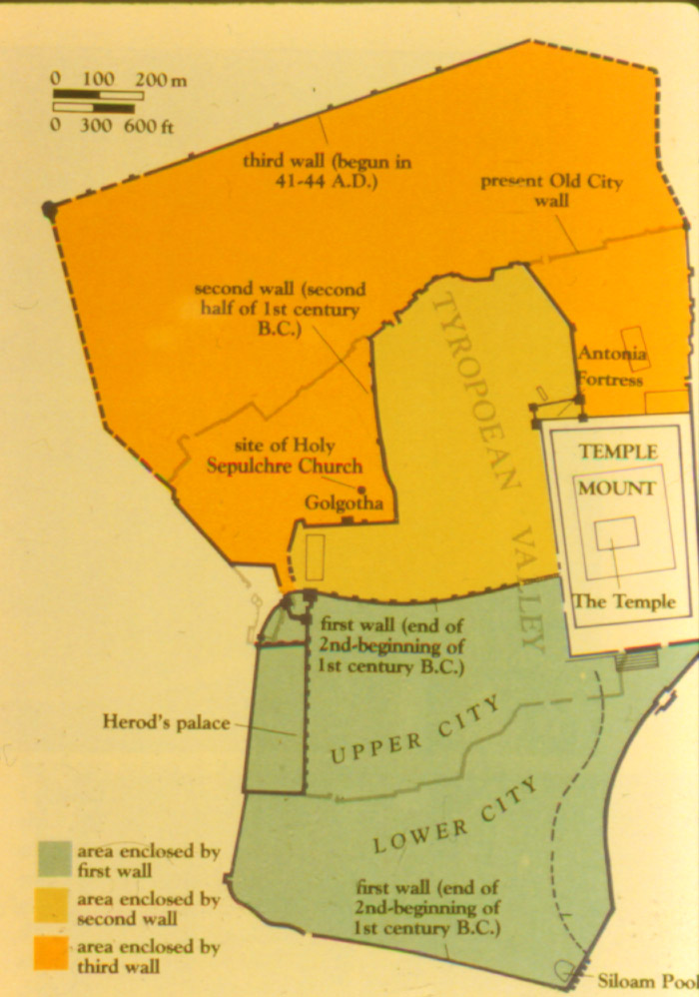
Sections of the City
City of David – D
Temple Mount – T
Lower City – L
Upper City – U
Second Quarter
New City/Bezetha
New City
2nd
Q
T
L
U
D

Slide 14
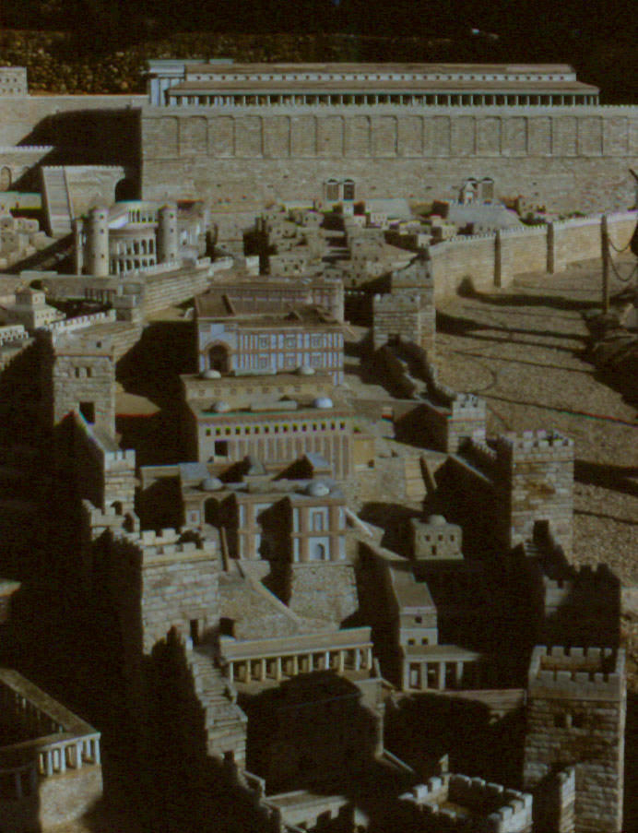
Sections of the City
City of David according to the
Jerusalem Model, as it is thought
to have looked in NT times

Slide 15
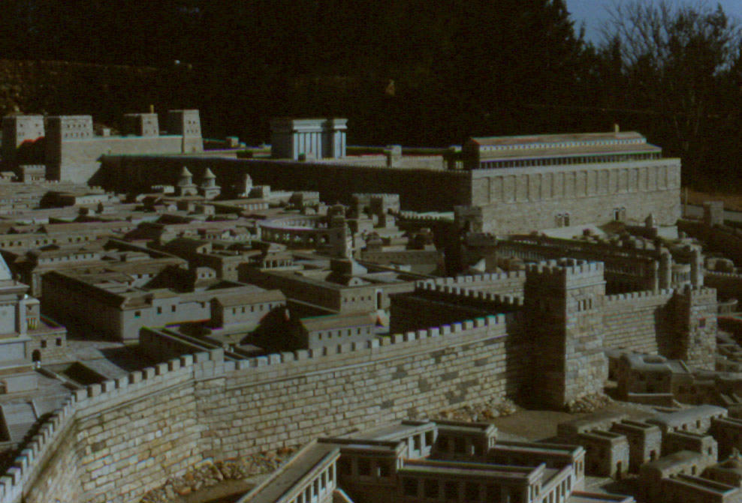
Sections of the City
Upper City in
Jerusalem
Model

Slide 16
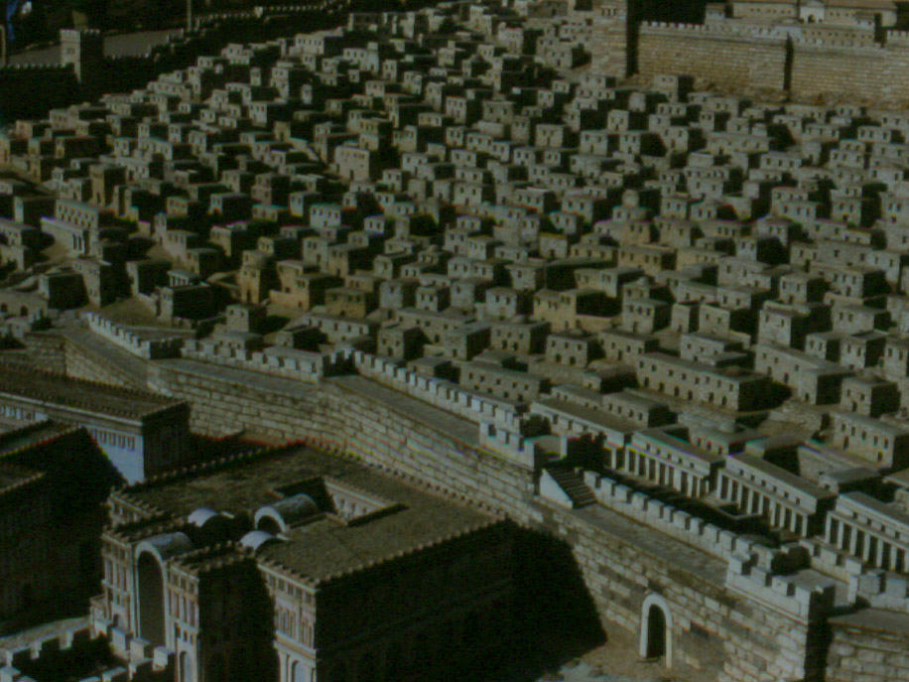
Sections of the City
Lower City in
Jerusalem
Model

Slide 17
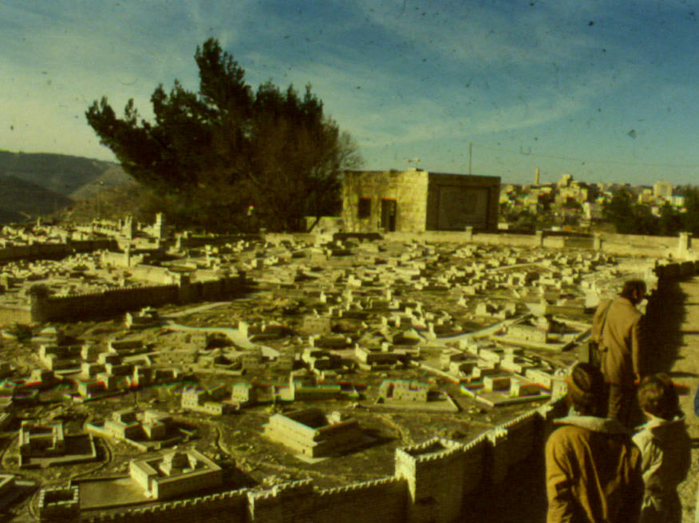
Sections of the City
New City or
Bezetha in
Jerusalem
Model

Slide 18
Major Buildings & Structures
Temple complex – T
Fortress Antonia – A
Jaffa Gate towers – J
Herod's palace – H
Sanhedrin building? – S
Hippodrome? – C
Theater?
A
T
J
S
H
C

Slide 19
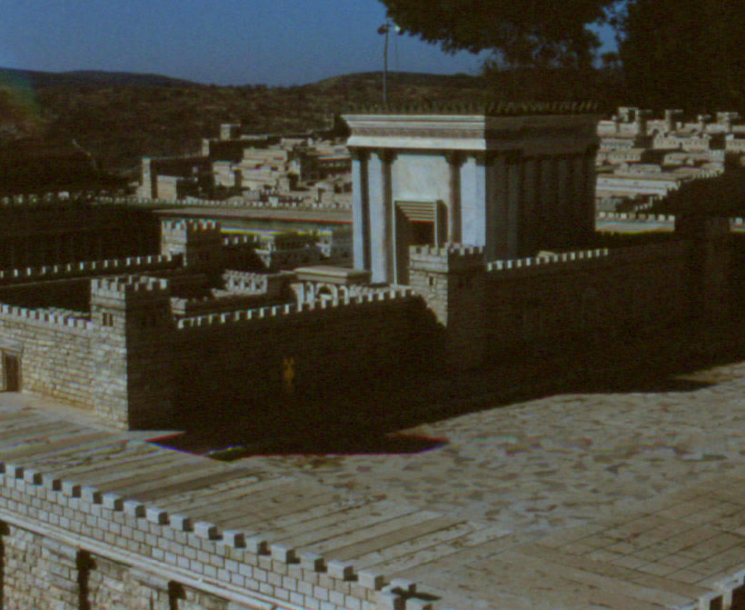
Major Buildings & Structures
Temple & courts in
Jerusalem Model

Slide 20
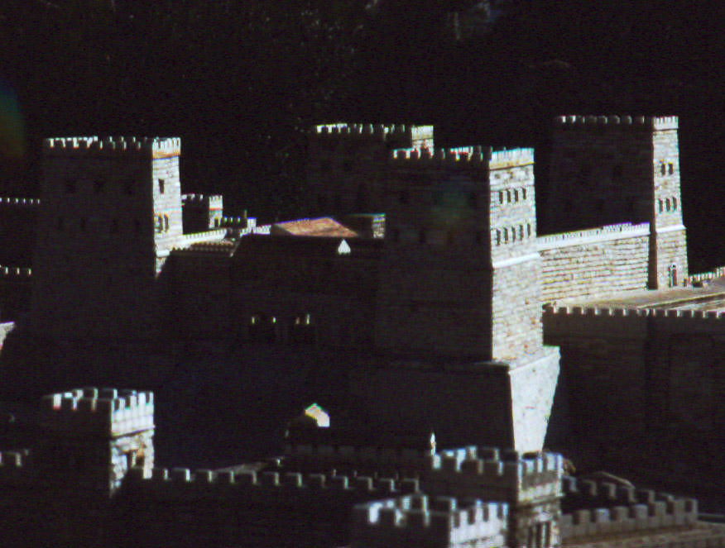
Major Buildings & Structures
Antonia
Fortress in
Model

Slide 21
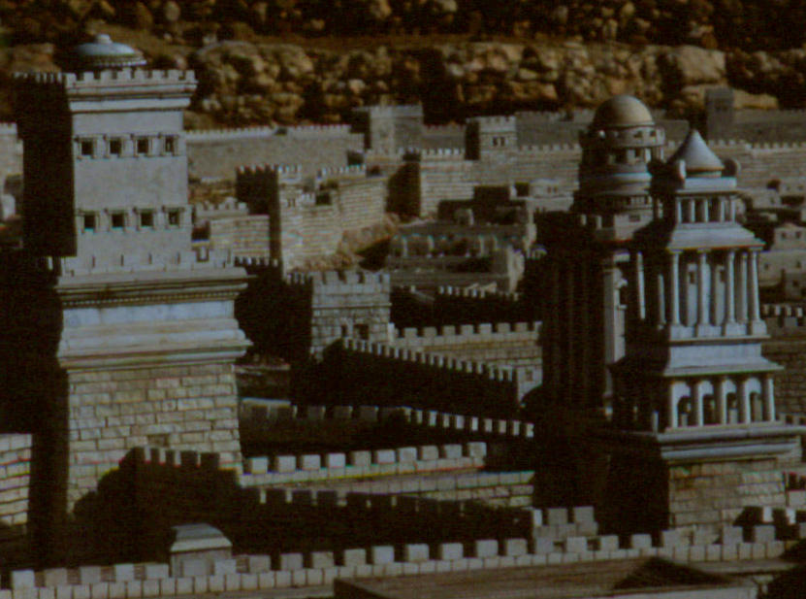
Major Buildings & Structures
Jaffa Gate Towers
in Model

Slide 22
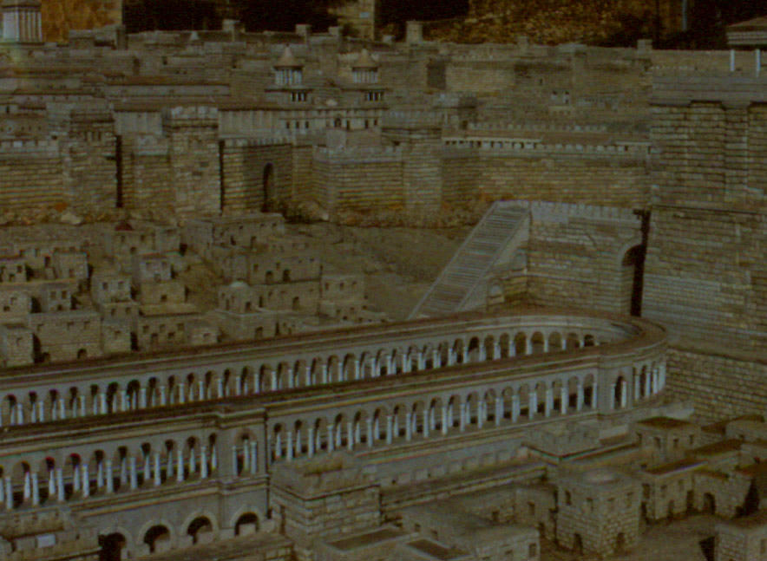
Major Buildings & Structures
Hippodrome in
Model

Slide 23
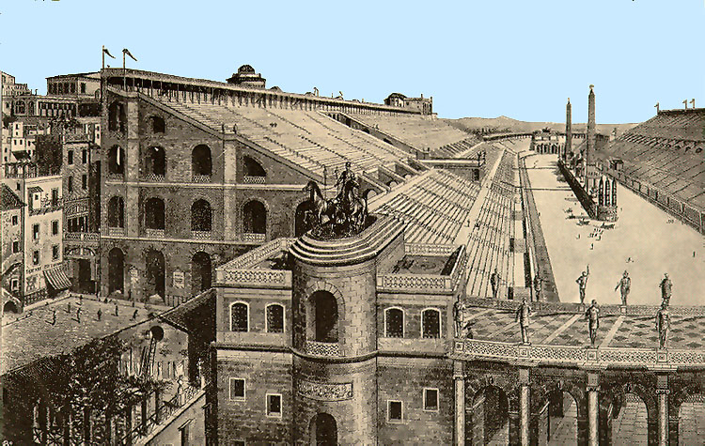
Reconstruction of a Hippodrome

Slide 24
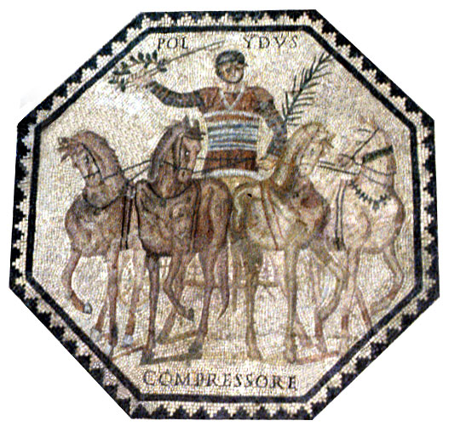
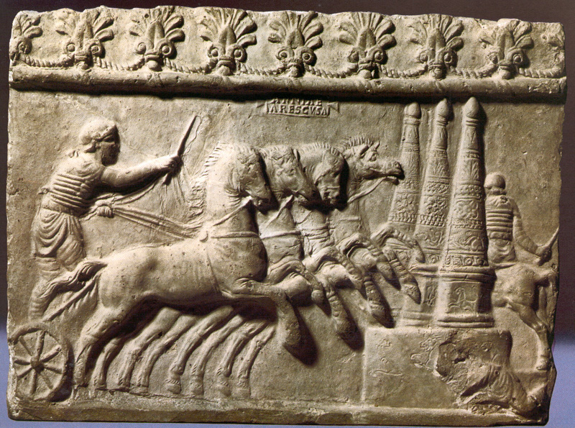
Chariot Racers

Slide 25
Other Sites re/ Jesus’ Ministry
Pool of Bethesda – B
Pool of Siloam – S
Upper Room – U
Caiaphas' House – C
Gethsemane – G
Calvary
  Traditional – CT
  Gordon's – CG
  Martin's – CM
CG
B
G
CT
CM
C
U
S

Slide 26
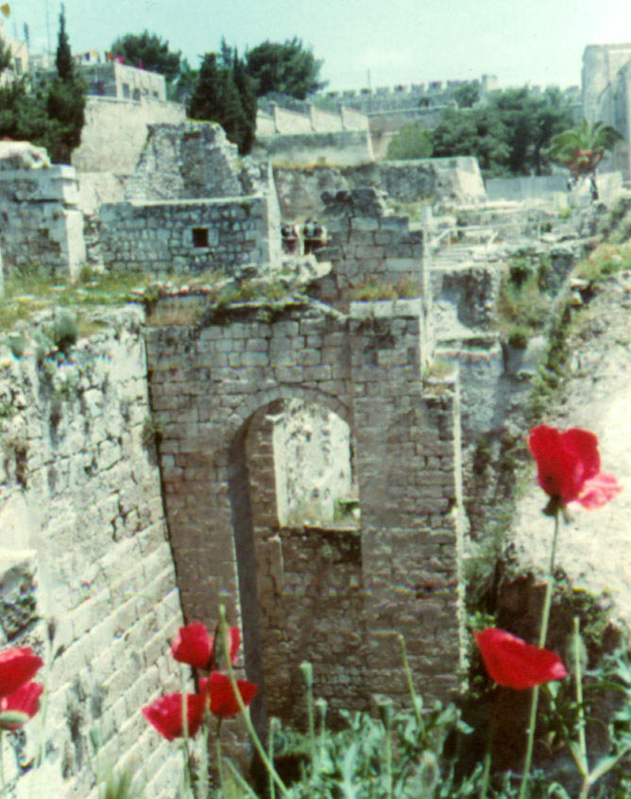
Other Sites
Pool of Bethesda

Slide 27
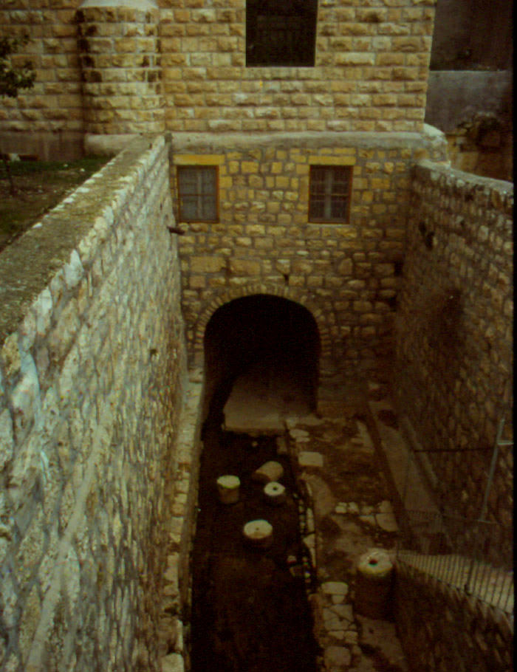
Other Sites
Pool of Siloam

Slide 28
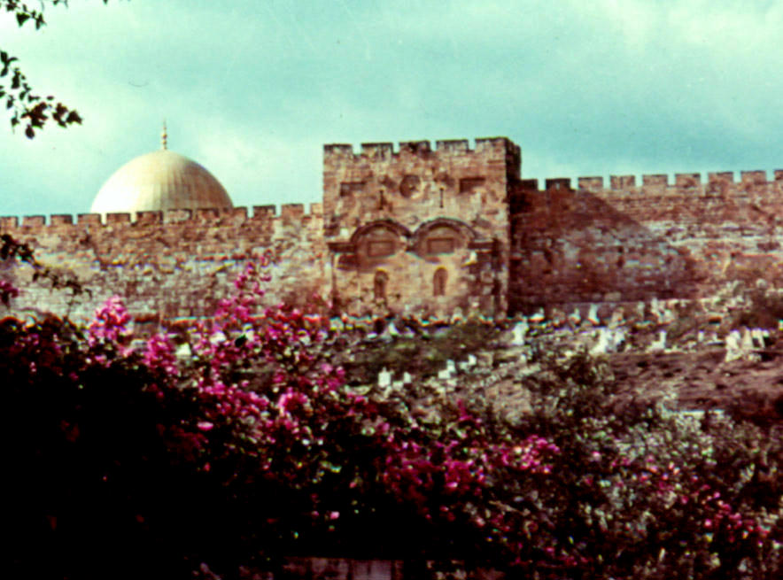
Other Sites
Golden
Gate

Slide 29
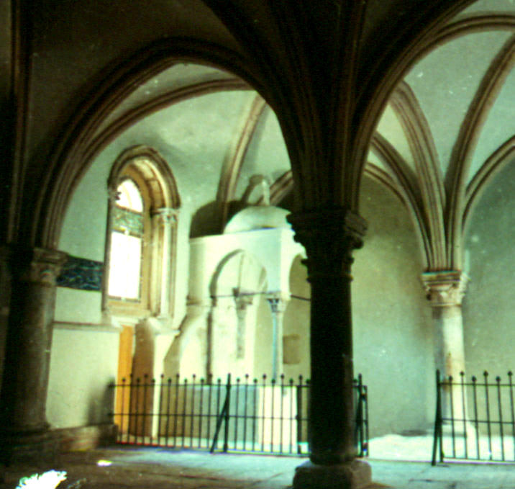
Other Sites
Traditional Site of
Upper Room

Slide 30
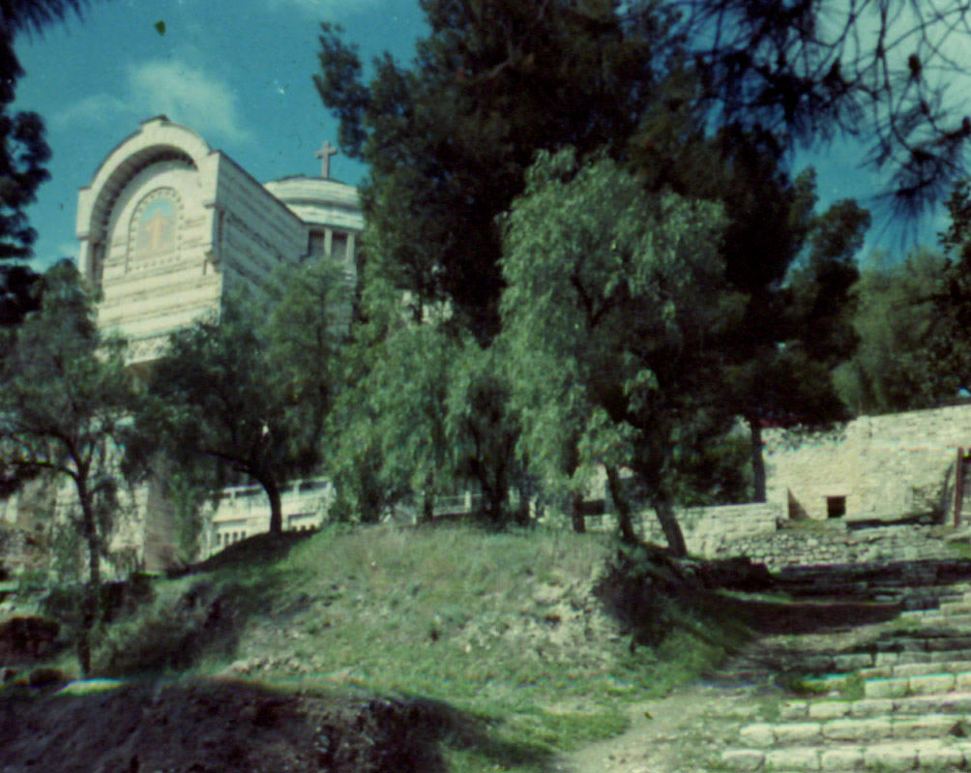
Other Sites
Church over
Caiaphas'
House

Slide 31
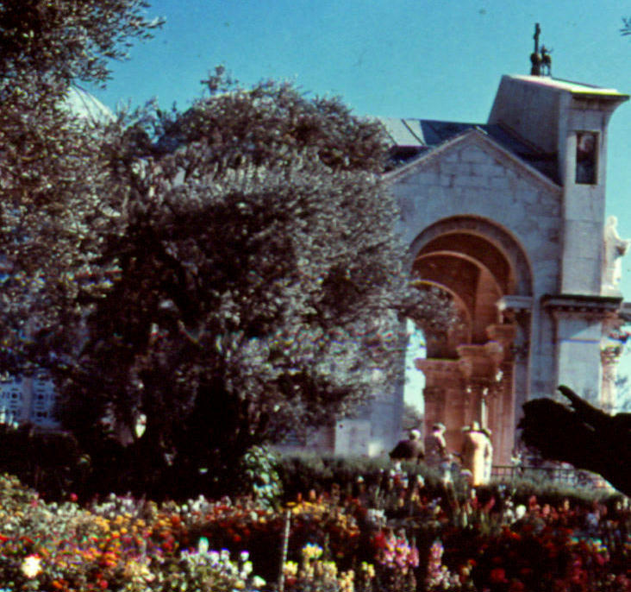
Other Sites
Church and Garden
at Gethsemane

Slide 32
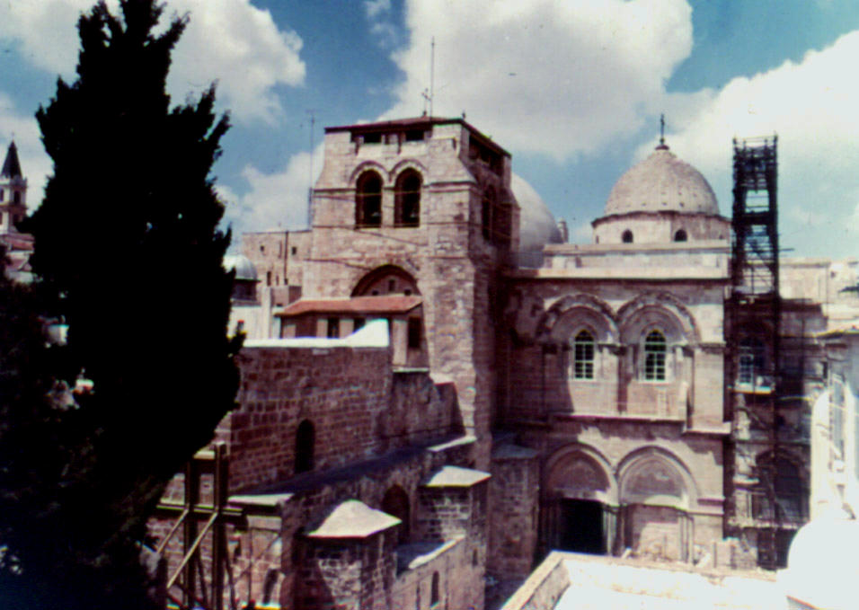
Other Sites
Church of the
Holy Sepulcher

Slide 33
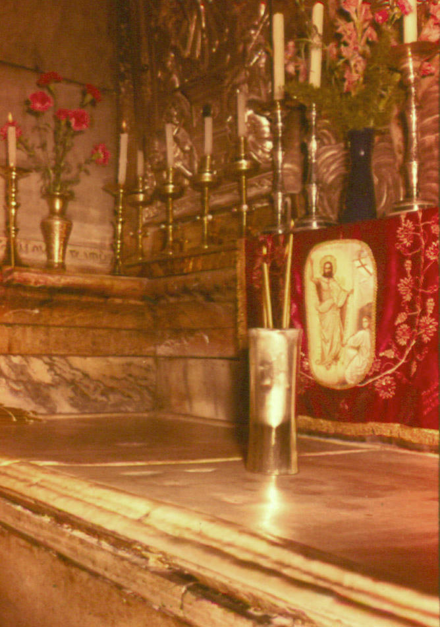
Other Sites
Tomb in the Church of
the Holy Sepulcher

Slide 34
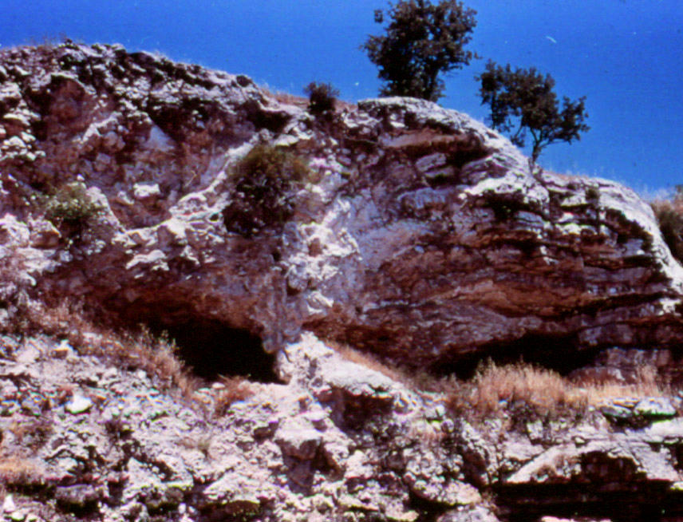
Other Sites
Gordon's
Calvary

Slide 35
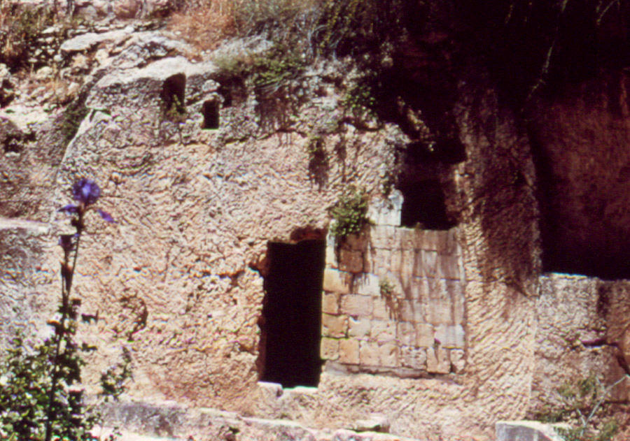
Other Sites
The Garden
Tomb

Slide 36
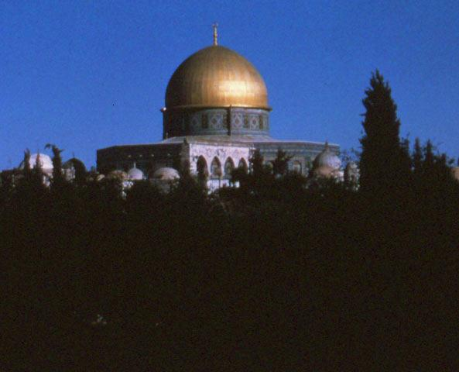
The End

