Slide 1
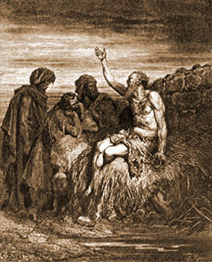

The Book of Job
Understanding Suffering
Robert C. Newman

Slide 2
Facing Inexplicable Suffering
Most of us have experienced examples of this:
  Loved one has long painful illness before dying
  Young person cut off in the prime of life
  We ourselves experience suffering that seems purposeless
The book of Job is helpful in understanding some of the most difficult such cases.

Slide 3
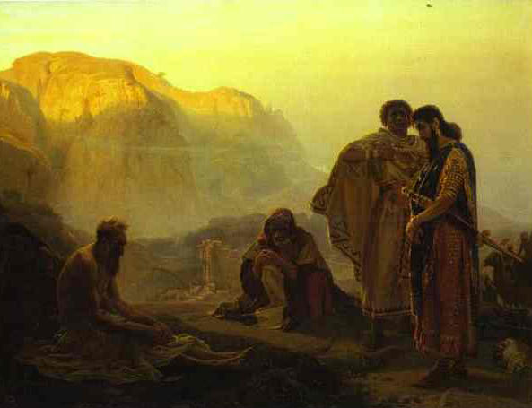
The Plot of Job

Slide 4
How the Book Begins
Job's circumstances:
  Most righteous person on earth in his day
    No reason to think our day much better
  Very wealthy
  Happy family
God's evaluation
  No one on earth like him
Satan's response
  Job is well-paid to be good !
  Take his wealth away, he will curse you to your face !

Slide 5
The Tests
God permits a test to see whether Satan’s challenge is warranted.
First test (chapter 1)
  Satan takes away Job's:
    Wealth
    Children
  Satan times arrival of messengers to build impact.
  But Job doesn't curse God.

Slide 6
The Tests
Second test (chapter 2)
  Satan is not about to admit he is wrong.
  He raises the stakes.
  Job will curse God if his health is taken away.
  Satan takes away:
    Job's health
    The support of his wife
  Still Job doesn't curse God.

Slide 7
The Rest of the Book
Why chapters 3-42?
  Wouldn't the message be clearer with just a chapter or so on Job's friends, plus another for interview with God?
  Looks like God continues the test to take away things Satan didn't (not sure what part Satan plays in this):
    Support of friends (Eliphaz, Bildad, Zophar)
    Support of being right (Elihu)
    Support of God (who comes with accusations)

Slide 8
The Rest of the Book
When God finally does appear (ch 38), Job doesn’t curse him.
  Job comes to see his own sins, and repents.
  If we find it hard to imagine ourselves doing this, it just shows we aren’t in Job’s league !
Then God praises Job …
  … though he said things he shouldn’t have
God rebukes Job’s friends …
  … who were trying hard to defend God

Slide 9
The Rest of the Book
Job remained (relatively) faithful under far more difficult circumstances than his friends faced.
Finally – ruining the story for many liberals – God gives Job double what he had lost.
  By the way, if you were Job, this wouldn’t ruin the story !
Let us look at the book to see what lessons we can learn from it.

Slide 10
Some Lessons from Job

Slide 11
The Two Worlds
As readers, we have a great advantage over Job & his friends.
  We see what is happening in the unseen world.
Job’s friends don't see this other world.
  To defend God (which they know is right) …
  … they attack Job (inventing a 'secret sin' theory).
  Their theology (& Satan's) is like today's health & wealth gospel.

Slide 12
The Two Worlds
Job doesn't see the unseen world either.
  He knows God allowed these things to happen.
  He is right about this, whether he knows about Satan or not.
  He knows that his friends' accusations are false, so their preaching/counseling tends to drive him away from God rather than toward repentance.

Slide 13
The Two Worlds
Outside the book of Job, we don’t see this unseen world either.
  Will we respond like Job's friends?
  Will we respond like Job in his worse moments?
  Will we cling to God & trust Him for vindication in His time?
Apparently much (all?) inexplicable suffering is really persecution from Satan.

Slide 14
Job’s Response
Though Satan claimed that Job served God for what he got out of it …
… Job (& friends) came to see that Job served God because of who God is.
God is worthy of our worship whether we get anything for it or not.
Do we serve God for who He is or for what we can get out of it?

Slide 15
Satan's Response
He clears out before the end.
He is defeated, but not about to admit it !
He won't admit it until the very end …
  … when every knee will bow & every tongue confess.
So don't expect vindication in this life.
  We may get vindication here and now.
  We may not.

Slide 16
God's Response
Important that Job not know what is happening.
  Otherwise this won't be the right kind of test
  God cannot intervene to bail Job out, or the test will be invalidated.
  So God goes beyond Satan's charges to take away everything.
  Once Job has seen God, admitted God's charges, worshiped Him, the test is over.

Slide 17
God's Response
God then praises Job, humbles his friends.
Job's other 'friends' come back.
God gives Job double what he lost.
  Two times the wealth
  Same number more children
God is no cheapskate.
  Though we serve Him for nothing …
  … He will not send us away empty-handed.
  But the full reward cannot come till the test is over.

Slide 18
Our Response?
Pay attention to the book of Job.
We are experiencing similar things.
  The unseen world
  Satan's attacks
  The same God
  Our friends are watching too.

Slide 19
The End?
Not yet!
Therefore, be steadfast, unmovable, always abounding… for your labor is not in vain in the Lord.

