Slide 1

Some Problems for
Theistic Evolution
Robert C. Newman

Slide 2
Some Problems for
Theistic Evolution
What is Theistic Evolution?
Some Scientific Problems
Some Theological Problems

Slide 3
What is Theistic Evolution?
Keith Stewart Thomson's Definitions of Evolution
Theistic Evolution in the ASA Creation Statement
Two Alternative Proposals for a Definition

Slide 4
Pattern: Change over Time
"A general sense of change over time"
  Change admitted by all but a few Greek philosophers
Coupled with "a parallel set of data for changes in the earth itself"
  Parts company with young-earth creation
  But not with old-earth creation
Thomson sees this as:
  “The most solidly based fact of evolution"
  But no "statement/inference about process"

Slide 5
Process: Descent through Common Ancestry
"Organisms are related by descent thru common ancestry."
  All agree this is true for some organisms.
  Not even all atheistic evolutionists think this true for all organisms.
So no need for this to be required for theistic evolution.
Most OECs hold to multiple origins, but need not do so.

Slide 6
Mechanism: Natural Selection
A model involving "random variation & differential survival"
Here TE and OEC part company.
But not so simple:
  Nearly all theistic models have some natural selection.
  Real divide is whether this is sole mechanism to explain diversity.
  And what do we mean by "random"?

Slide 7
ASA Creation Statement
General statement on which all agree.
Special statements characterizing various views.
  Young-earth creation (YEC)
  Old-earth creation (OEC)
  Theistic evolution (TE)
Here we look at the statement on TE.

Slide 8
ASA Statement on TE
Theological Statements
  Areas of agreement
  Areas of diversity
Scientific Statements

Slide 9
Theological Areas of Agreement
God is free to act in creation in any way consistent with His character. The nature of the physical universe and of God's interaction is a consequence of God's free choice.
Evolutionary processes are not antithetical to God's creative action. Furthermore, nothing in scripture provides a theological basis for rejecting the descent of all living beings from a common ancestor, including humans.

Slide 10
Theological Areas of Agreement
An evolutionary view of the history of life provides a positive, productive context for understanding God's relationship to creation, and our role as His image bearers. It also provides a fruitful context for considering the meaning and implications of Christology and the cross.
Christians should rejoice and praise God for each new revelation of the history and character of the creation, for each new discovery that fills previous gaps in our scientific understanding.

Slide 11
Theological Areas of Diversity
How does God direct the creation to His desired ends? Various models for God's action have been proposed, of which some follow. These are not mutually exclusive, so individuals may hold more than one.
  God is actively directing ALL natural processes ALL the time so that all physical events are specifically willed by Him.
  God gave, and continues to give, being to a creation gifted with all the capabilities to bring forth all the forms, processes, and events willed by Him.
  Creation responds to God's will as our bodies respond to ours. However, God's being is not embodied in creation but is transcendent over it.
  God acts to determine the inherent indeterminacies of physical events, at the micro level of quantum phenomena and at the macro level of chaotic systems…

Slide 12
Theological Areas of Diversity
To what extent has God granted freedom to His creatures? Various suggestions have been proposed:
  God has chosen to limit His direct control over some aspects of creation to give His creatures genuine freedom.
  God allows for a certain level of genuine indeterminacy in creation such that specific outcomes are not predetermined. At the same time, He remains sovereign and the fulfillment of His will is assured.
  All physical events are predetermined and preknown by God.

Slide 13
Scientific Statements
An ancient and dynamically changing Earth and universe is supported by overwhelming evidence from geology, physics, astronomy, and cosmology.
The common descent of all living things is well-supported by diverse lines of evidence in geology, paleontology, biology, and genetics.
Biological evolution has great explanatory power and has proven effective in generating new and testable hypotheses in a wide range of scientific disciplines including historical geology, paleontology, ecology, biogeography, developmental biology, biochemistry, and genetics.
New discoveries and new models are progressively closing many previous gaps in our knowledge and understanding of evolutionary history and mechanisms…

Slide 14
Comments on
Theological Statements
Special creationists agree on the first and fourth of these.
Some agree on the first half of the second also.
Where TE’s diverge among themselves:
  Only the fully-gifted model is likely to be testable.
  On freedom, these are basically the Arminian, Openness, and Calvinistic views.

Slide 15
Comments on
Scientific Statements
1st is acceptable to OEC’s.
2nd opts for common descent.
3rd is neither necessary nor sufficient to make the TE view true.
4th deals with filling gaps (on which more later).

Slide 16
Two Alternative Definitions of Theistic Evolution

Slide 17
Proposal 1
Theistic evolution is a view of origins in which God used providential means such as mutation & natural selection as the prime or only means for producing the diversity of living things on earth.
Special creation is a view of origins in which God used miraculous intervention as the prime or only means for producing the diversity of living things on earth.

Slide 18
Proposal 1

Slide 19
Proposal 2
Theistic evolution is a view of origins in which God used providential means such as mutation & natural selection as a means for producing the diversity of living things on earth.
Special creation is a view of origins in which God used miraculous intervention as a means for producing the diversity of living things on earth.

Slide 20
Proposal 2

Slide 21
Scientific Problems for
Theistic Evolution
Transitional Fossils
Irreducible Complexity
Shape of the Fossil Record
Natural Law & Mediation

Slide 22
Transitional Fossils
The number of fossils that can reasonably be considered transitional is small.
This is quite surprising if the steps taken in evolving from one form to another (rather different) form are small steps.

Slide 23
Biological
Classification System
Kingdom: Animals
Phylum: Chordates
Subphylum: Vertebrates
Class: Mammals
Order: Carnivores
Family: Canidae
Genus: Canus
Species: familiaris

Slide 24
Transitional Fossils
Darwin was aware of the problem.
He suggested that the fossil record is very fragmentary.
There is some sense in which this is true, but there are some ¼ billion fossils in museum collections.
How detailed a picture could one make with ¼ billion pixels?

Slide 25

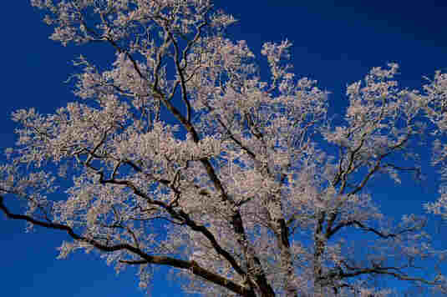
Pictures & Pixels
190,460 pixels
6700 pixels

Slide 26
Fossil Record &
Small Populations
The rarity of transitions in the fossil record was apparently one of the reasons driving a move to the Neo-Darwinian view.
  Instead of all living things evolving significantly,
  Have major changes take place in small, isolated groups.
  These will leave few transitional fossils.

Slide 27
Small Populations
The argument is that fluke changes can come to dominate a small group more easily than a large one.
This is true. Consider the relative chances of throwing 60% heads in 10 tosses of a coin versus 100.

Slide 28
Small Populations
This works fine for single mutations, but fails when multiple mutations are needed.
For multiple mutations, the chance of finding them in a large population is much greater than in a small one.
Alternatively, the small population must grow large before the next mutation is likely.
In either case, there will be a large population to leave transitional fossils.

Slide 29
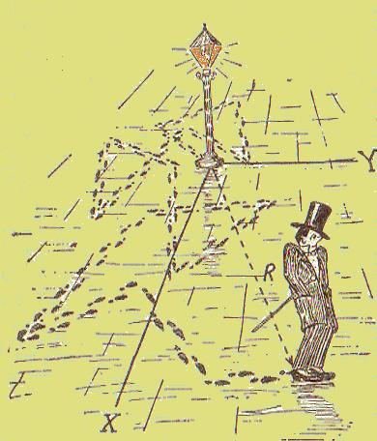
Random Walk
If transitions not guided, many more steps are needed to cross a given gap.
The distance traveled is equal to the average step times the square root of the number of steps taken.

Slide 30
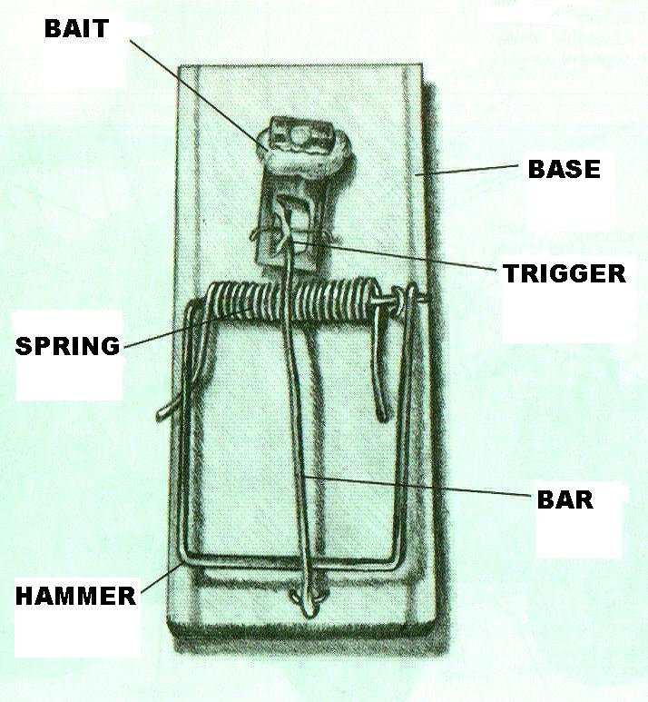
Irreducible Complexity
Complexity – lots of parts
Irreducible complexity – each part is needed for mechanism to have any function.
Example: mouse trap
  Bait is optional
  Other parts necessary

Slide 31
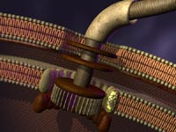
Irreducible Complexity
Rotary motor of flagellum of bacteria
Complex chemical processes:
  Vision
  Blood clotting
Transport inside cell

Slide 32
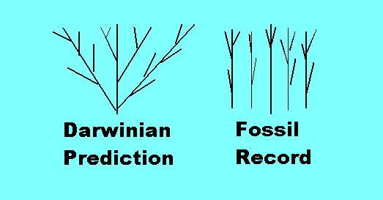
Shape of the Fossil Record
Darwinian evolution builds diversity progressively, so that species should form early and phyla form late.
This is not what we see in the fossil record.

Slide 33
Natural Law & Mediation
What is Natural Law?
Providence & Miracle
Distinguishing Providence & Miracle

Slide 34
What is Natural Law?
For an atheistic worldview:
  Some sort of structure that allows an organized universe.
  Its origin is finally inexplicable.
For a theistic worldview, 2 alternatives:
  The way God normally works, no real separate existence.
  A created structure to which God has given certain capabilities.

Slide 35
Providence & Miracle
Providence – God's normal action in the universe, whether mediated by natural law or not.
Miracle – God's unusual action in the universe, usually considered divine intervention.
How does one distinguish providence from miracle from inside the universe?

Slide 36
Distinguishing
Providence and Miracle
One rather distinct feature is discontinuity:
  Not all miracles are discontinuous, but a rather good number are.
  E.g., turning water into wine.
Science seeks to discover natural laws
  These are continuous on some scale.
  So scientists tend to fill gaps with smooth interpolation.
Actual observations are discontinuous
  How do we tell when we correctly fill a gap?

Slide 37
Distinguishing
Providence and Miracle
Every person is constantly filling gaps.
  With natural explanations
  With miracles
What is the right methodology?
  Miracles are rarer.
  Should we just opt for natural?
  Spin a pointer?
  Treat natural as default in absence of markers for the miraculous?

Slide 38
Markers for the Miraculous
Events are miracles if they are sufficiently:
  Powerful
  Amazing
  Significant
  Wondrous
What is "sufficiently"?
  See Dembski, Behe
  If miracle looks like better explanation
  Inference to the best explanation

Slide 39
Theological Problems for Theistic Evolution
Exegesis of Genesis 1-3
Theology of Genesis 2-3
Hermeneutics of Genesis 2-3
Fully-Gifted Creation
Mind-Body Problem

Slide 40
Genesis One
No problem for TE if Genesis 1 is understood as allowing for an old earth.
"After their kind" does not really rule out development.
  Often taken as fixity of species.
  Term not used for propagation.
  "After" is Old English for Hebrew le (ל) – according to
God made the various kinds of animals; doesn't say how.

Slide 41
Genesis Two
A different situation here.
Adam apparently formed by a miraculous process.
  Body molded from dust of earth.
  God breathes into him, and he becomes a living creature.
  Passage does not suggest God put a soul in an ape-man.
Eve also formed by a miraculous process.
  After Adam, from Adam

Slide 42
Genesis Three
The fall of mankind is problematic for at least some kinds of TE.
Narrated as a real historical event.
  Two individuals (plus serpent)
  Specific choice
  Real consequences

Slide 43
Theology of Genesis 2-3
No problem for versions of TE in which Adam & Eve are special creations (not descended from previous life).
If Adam from apes, but still a special creation, only problem is Gen 2:7, where Adam becomes a living being.
These views may be called "Adam-type" Theistic Evolution.

Slide 44
Theology of Genesis 2-3
But serious problem for "No-Adam" TE
  Never a single pair of 1st humans
  Whole population of apes gradually become human
Thus Genesis 2-3 cannot be historical.
  Rather mythological/parabolic
  Simple way of telling story which must be recast in light of modern science
  Considerable reshaping of fall, perhaps of redemption and atonement

Slide 45
Hermeneutics of Genesis 2-3
What is the genre of Gen 2-3?
Special Creation (YEC or OEC)
  Fairly straightforward historical narrative
Adam-Type TE
  Similar
No-Adam TE
  Myth, parable or allegory?

Slide 46
A Parallel to Ezekiel 16?
Ezekiel 16 is a parable/allegory for the relation of God and Jerusalem
  Jerusalem – a girl abandoned at birth
  God – a man who adopts & later marries her
  Some parts of the allegorical narrative correspond to those of actual relationship, some don’t.

Slide 47
The Ezekiel 16 Narrative
Parents mentioned.
Baby abandoned.
God rescues her.
She is adopted, cleaned, married.
God gives her gifts.
Her fame spreads far & wide
She turns away, becomes unfaithful, kills her children.
God is going to bring disaster.
She is like her mother & sisters.
One day, God will restore her.

Slide 48
Comparing Gen 2-3 & Ezek 16
From No-Adam TE perspective
Each narrative resembles & differs from the reality it is intended to picture.
Individuals are used to represent groups.
Rather striking figures in the story represent something different in reality.

Slide 49
Problems
Ezek 16 gives indicators that it is allegorical, but Gen 2-3 does not.
What about allegorical names in Genesis?
  Adam = man?
  Eve = life?
  Possible, but would not expect distinctive names for the 1st man and woman.
Ezek 16 shifts back and forth between literal and figurative, which reader can handle, knowing real story. How does reader of Gen 2-3 know real story?

Slide 50
Conclusions on
Gen 2-3 & Ezek 16
Ezek 16 does provide a possible parallel to what no-Adam TE's claim for Gen 2-3.
The warrant for reading Gen 2-3 this way would have to come entirely from general revelation in nature.
Evidence for gapless evolution is not strong enough to warrant this paradigm shift.

Slide 51
Fully-Gifted Creation
A variety of "pure TE"
Name emphasizes that God built into the original creation everything needed to produce life, diversity, humanity.
None of this is imposed by supernatural intervention along the way.

Slide 52
Response to F-G Creation
Should be testable.
Is there any evidence that nature contains the information necessary to make complex life:
  In the DNA?
  In the invisible law structures?
  In the supposed ability of chaos → order?
  In the power of mutation & natural selection?

Slide 53
Response to F-G Creation
My studies suggest these won't do the job.
Is it gauche to have a universe in which God intervenes?
  Watchmaker vs. guitarist/violinist?
If God intervenes in salvation history, when did salvation history begin?
Maybe miracles in creation are for the benefit of angels then or scientists now.

Slide 54
The Mind-Body Problem
TE of No-Adam sort tends to favor a monist view of human nature
  The mind is inseparable from the body.
  The mind is a development, as the brain grows more complex.
This view faces some serious problems from the biblical teaching on the intermediate state.

Slide 55
The Mind-Body Problem
The mind-body interaction is a paradigm for intelligent design.
  ID is not reducible to natural law nor to chance phenomena.
The mind-body interaction is a model for the interaction of God with nature.
  Unseen producing visible results.
  Unseen transcendent over the seen.

Slide 56
Summary
Scientific Problems:
  Transitional fossils
  Irreducible complexity
  Filling gaps with natural law
Theological Problems:
  Human origins in Gen 2
  Human sin in Gen 3
  Warrant for reading Gen 2-3 as allegory
  Monistic view of human nature

Slide 57
For Further Reading
Michael Behe, Darwin's Black Box
William Dembski, Intelligent Design
John Eccles, How the Self Controls Its Brain
John Cooper, Body, Soul, and Life Everlasting

Slide 58
The End
May God guide us as we study His word and world!

