Slide 1

Teaching Science Amidst Controversy
Robert C. Newman

Slide 2
The Controversy
There are a number of areas of controversy in science teaching today.
Our concern here is the Creation-Evolution dispute.

Slide 3
The Controversy
Teachers are typically caught in the middle:
  If they teach evolution, they get flack from evangelical parents.
  If they teach creation, they get flack from some other parents.
  If they teach neither or both, they also get complaints.
What is a teacher to do?

Slide 4
What is Science?
Two distinct definitions:
  Explanation without invoking the supernatural
  Explanation of how things really are
Confusion arises when people:
  Switch back and forth between these
  Assume the two definitions are equivalent
Part of the debate over whether creation or evolution is scientific comes in here.

Slide 5
What is Science?
We suggest that the teacher needs to clarify this ambiguity.
Treating the two definitions as equivalent is (in fact) to preach a philosophical or religious view:
  "The cosmos is all that is, or ever was, or ever will be" – Carl Sagan, Cosmos

Slide 6
What is Religion?
Also various definitions. Consider these:
  (1) Beliefs regarding ultimate reality.
  (2) Worship of a supreme being.
According to definition (1), religion is already being taught in those classrooms where the worldview "evolutionism" is promoted.
According to definition (2), this is not what creationists are asking for in science classes.

Slide 7
Can We Teach Science in a Publicly-Funded Setting?
Public funding does not remove one's responsibility to teach truth.
But it does raise questions re/ fairness in a pluralistic society.
  Taxpayers are rightly incensed if they feel they are paying the salaries of people who are attacking their worldviews.
Obviously parents can send their children to private schools (& many are).

Slide 8
Can We Teach Science in a Publicly-Funded Setting?
This still does not alleviate the problem that they are helping finance public education.
This raises the question whether the 1st amendment re/ established religion is consistent with public schooling.
Perhaps we need to adopt a voucher system as most other western democracies have done.

Slide 9
Recognizing the
Limits of Science
Science is empirically based, and operates with a limited data base.
It does best with mathematical and mechanical models.
It has problems handling the operation of the intellect.
So if an intellect was involved in the origin & operation of the universe, we may be missing something.

Slide 10
Recognizing the
Limits of Science
It would be helpful if students could be shown where science has been mistaken in the past.
For balance, Christians need to recognize where the Bible has been misinterpreted in the past, also.

Slide 11
Distinguishing Known from Unknown, Fact from Theory
Science teaching in elementary school, high school, often even college, does not clearly distinguish data from theory.
  Daily life of Piltdown man
Creationists have often been sloppy here as well.
  Speculation re/ tidal waves during Flood

Slide 12
Some Suggestions
These are drawn from the ASA booklet, Teaching Science in a Climate of Controversy.
Discussing Open Questions re/ Origins
Handling the Controversy in the Classroom

Slide 13
Discussing Open Questions
(1) Did the universe have a beginning?
(2) Did life arise by chance?
(3) Where did the first animals come from?
(4) Do we humans share ancestry with the apes?

Slide 14
Handling Controversy
(1) Don't avoid the subject; use it as an opportunity to discuss science on a topic in which most students are naturally interested.
(2) Try to keep the discussion within boundaries.
(3) Show respect for opposing views.

Slide 15
Handling Controversy
(4) Consider the whole spectrum of opinion.
(5) Seek common ground.
(6) Watch your language.
(7) Keep asking questions.

Slide 16
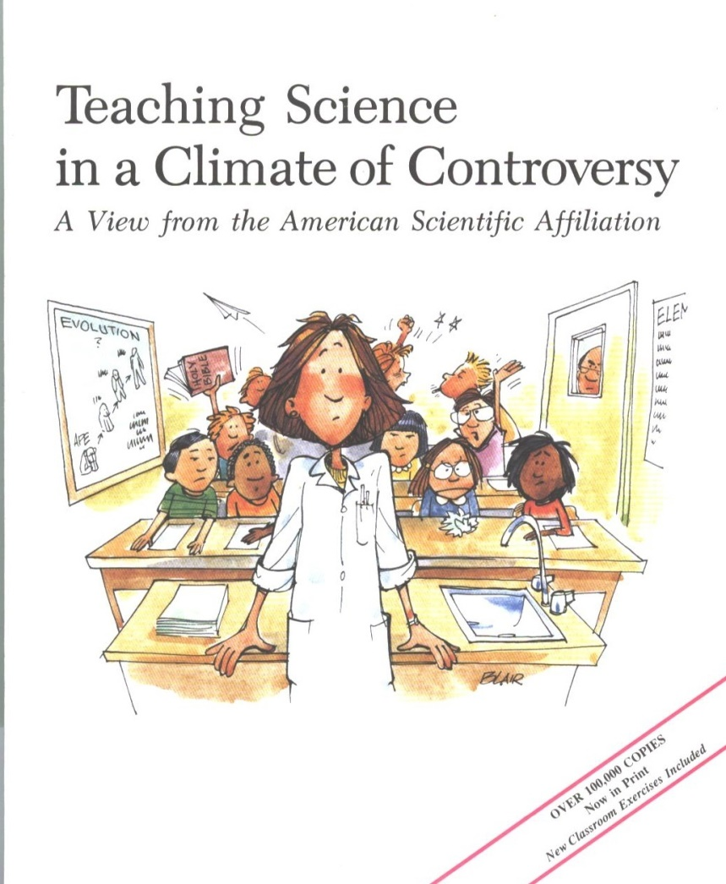
For Further Reading
Available from the American Scientific Affiliation; see their website at www.asa3.org

Slide 17
The End…
… but not of the controversy, not for a long time!

