Slide 1
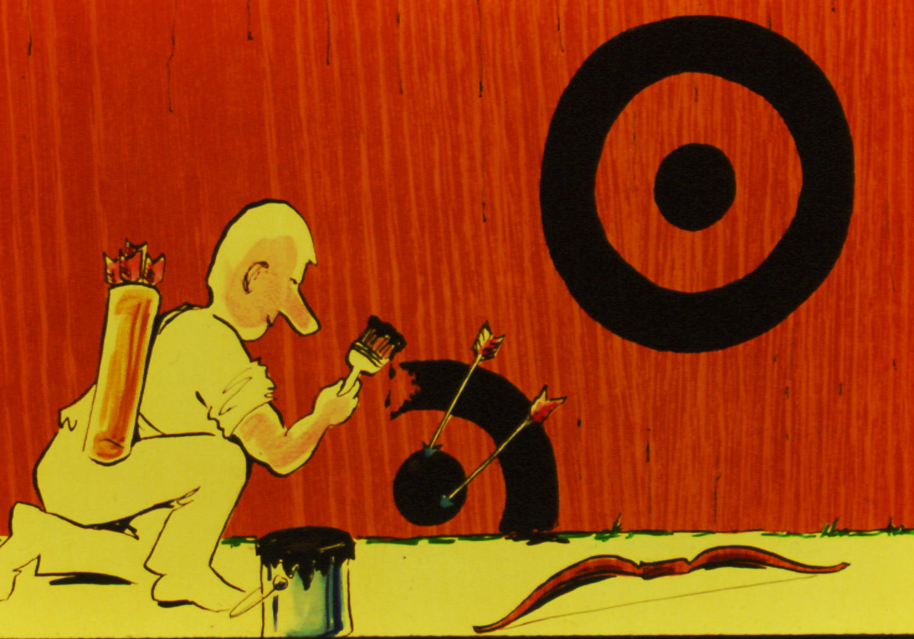
Substitutes for Sanctification
Robert C. Newman
Cartoons by James I. Newman

Slide 2
Warning!
This talk is ironic, even cynical!
But it has some good purposes:
To help people tell the difference between real holiness and cheap substitutes.
To keep us from thinking we’re OK when the Last Judgment will reveal that we aren’t.
To help us make to course corrections while we still can.

Slide 3
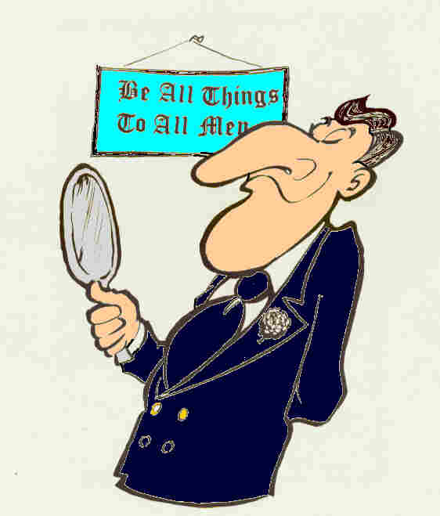
How to Make Yourself Holy Without the Holy Spirit

Slide 4
In General
Rather than actually becoming more conformed to the image of Christ…
Or doing a better job of keeping God’s laws…
Put all the harder laws in another dispensation, for example:
Before the Church Age
During the Millennium

Slide 5
In General
Realize that this is the Age of Grace, not of Law:
So you don’t need to keep all those laws…
And it is Legalism to try…
Define away certain sins…
They are merely mistakes, imperfections…

Slide 6
In General
Concentrate on certain externals…
Or on certain specific areas of behavior.
Notice how bad everyone else is.
(This will vary from group to group.)
They drink (or smoke).
They don’t keep the Sabbath.
They consort with sinners.
They dress the wrong way.
(No doubt you can supply additional items.)

Slide 7
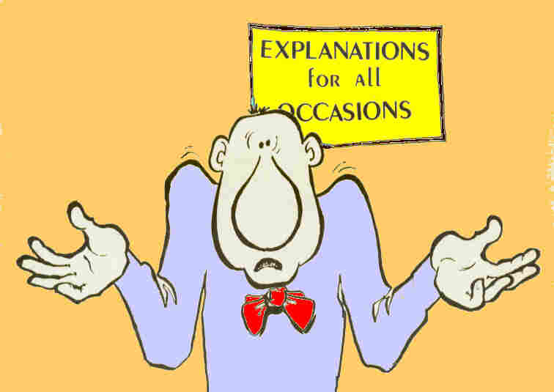
Substitutes for the Fruit of the Spirit

Slide 8
The Fruit of the Spirit
Galatians 5:22 (NIV) But the fruit of the Spirit is love, joy, peace, patience, kindness, goodness, faithfulness, 23 gentleness and self-control. Against such things there is no law.

Slide 9
Love
Instead, just have a pleasant outward appearance & smile a lot…
So long as no one crosses you.
Condescend to those you consider beneath you.
Flatter those you think may be superior to you.

Slide 10
Joy
The suggestions for “Love” (above) will probably do the trick here.
You do need to be careful to try & stick to:
Pleasant surroundings
Pleasant people
Comfortable circumstances
It’s too tough to be joyful in difficult situations.

Slide 11
Peace
Both the suggestions under “Love” and “Joy” should prove helpful here.
Try to avoid controversy…
Or if that doesn’t work, ignore it.
Don’t think of people in the categories “saved” and “unsaved.”
Or if you do, stay away from the latter.
Don’t think about the troubles other Christians are facing.

Slide 12
Patience
This is hard to fake, so stay away from circumstances where this is needed.
You aren’t required to be patient…
When dealing with nasty people
Where matters of principle are involved.
Make sure the offender knows that you are “long-suffering.”

Slide 13
Kindness
Like “Love,” you may use the practice of kindness as an excuse for not rebuking sin…
At least in certain areas.
Remember “judge not,” unless someone really deserves it.

Slide 14
Goodness
This means being more holy according to the general principles sketched in those panels above labelled “In General.”
We shouldn’t tell others how good we are, but we can show them by:
Being an obvious example
Pointing out the faults of others
Giving free advice

Slide 15
Faith, Faithfulness
Sometimes translated “faith”
What others should have in what you say
A device to avoid:
Planning (I did it by faith)
Obedience (The Spirit led me…)
If translated “faithfulness”
Loyalty to leadership whatever they are doing
My group, right or wrong
Not needed if they disagree with you

Slide 16
Gentleness
Traditionally “meekness”
Not to be applied to your understanding of Scripture, since you are illuminated by the Holy Spirit, and thus “spiritual”
Taking a backseat to obvious superiors, unless they are trying to muscle in
Giving in if the other person is too strong

Slide 17
Gentleness
Allows bragging about:
Growing up in poverty
Your earlier life of sin
Lack of education
How you interpret Scripture w/o human aid
Your parents who were…
Christians
Missionaries
Pastors

Slide 18
Self-Control
Traditionally translated “temperance.”
Total abstinence from alcohol is a good substitute in some circles.
Drinking in moderation will do in others.
Also includes not speaking the truth if your audience will consider the truth intemperate.
Self-control is demonstrated by putting up with those who are moderately aggravating…
Not necessary if they are really aggravating.
Doesn’t apply to eating habits

Slide 19
Summary
Moving out of the ironic, cynical mode…
I found a good deal of this rather convicting, as I find myself practicing such techniques all too often.
May God help us to recognize fake spirituality, in ourselves & in others.
May the Lord change us, so that we may indeed grow in true holiness.

Slide 20
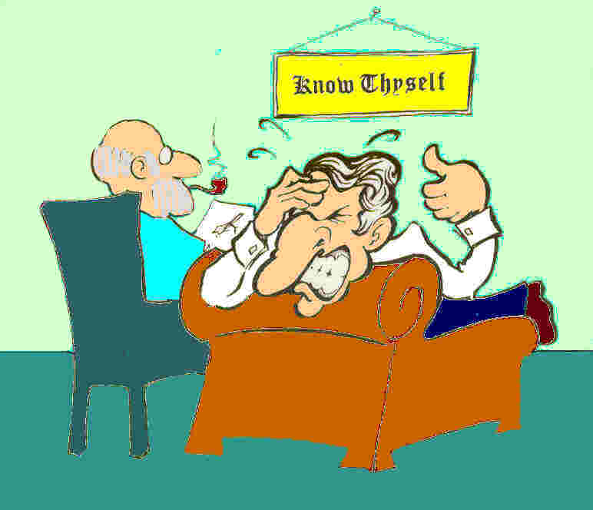
The End

