Slide 1

Spiritual Drama
Acting Out Biblical Truths
Robert C. Newman

Slide 2
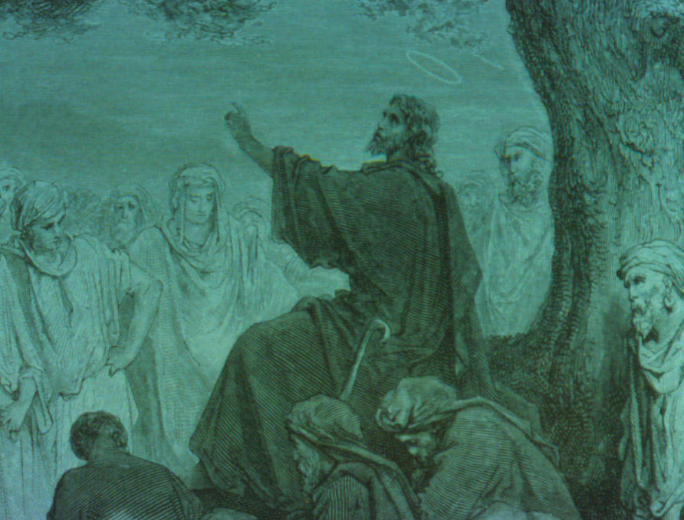
Parables as Spiritual Drama
Most of us are familiar with Jesus' parables.
In most of the parables Jesus told, a spiritual truth is taught by an earthly story.
Some examples of Jesus' parables:
  Prodigal Son (Luke 15)
  The Sower (Matthew 13)
  The Hidden Treasure (Matthew 13)

Slide 3
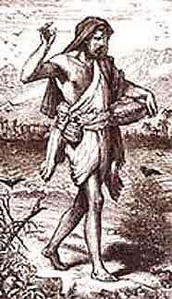
The Sower
(Matt 13, Mark 4, Luke 8)
A sower scatters seed.
  The message of the Kingdom
It falls on various kinds of soil.
  Different responses to the Gospel
  Pathway – doesn't sink in
  Thin soil – doesn't form good roots
  Thorny soil – stifled by competition
  Good soil – produces, but various yields
It does produce an abundant crop.

Slide 4
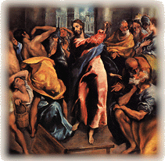
Acted Parables
Not so well known as spoken parables
We have several of these in the OT:
  Jeremiah & the clay pot (Jeremiah 19)
  Hosea & wife Gomer (Hosea 1-3)
Jesus, too, acted out parables:
  Cursing the fig tree (Matthew 21)
  Cleansing the temple (Matthew 21)

Slide 5
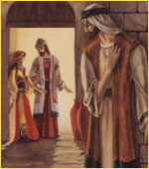
Hosea & Gomer (Hosea 1-3)
Hosea marries an adulterous wife.
  God chooses sinful, unfaithful Israel.
They have children, or Gomer does!
  Israel's offspring don't look like God's.
Gomer runs off.
  Israel departs into idolatry.
Gomer is bought back by Hosea.
  Israel redeemed by God.

Slide 6
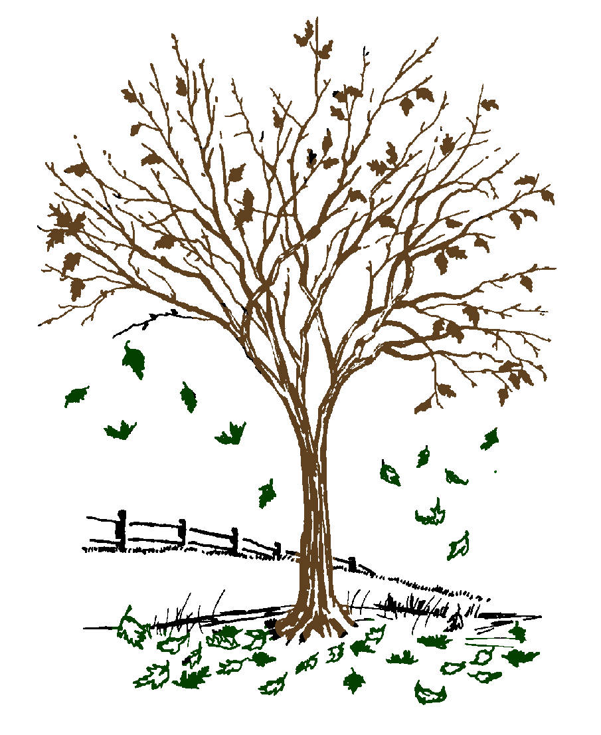
Cursing the Fig Tree (Mt 21)
Jesus sees a fig tree in leaf, implying fruit.
  Israel professes to be God’s people.
When examined more closely, it has no fruit.
  Israel’s behavior contradicts its profession.
Jesus pronounces a curse on the tree.
  God pronounces a curse on the nation.

Slide 7
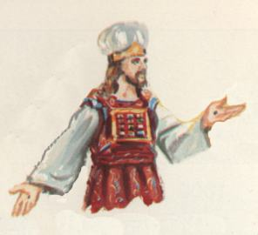
Liturgy as Acted Parable

Slide 8
Liturgy as Acted Parable
It appears that the liturgical practices of both OT and NT are acted parables.
Take sacrifice:
  An innocent animal is killed to pay for the sin of the guilty.
  The animal must be without physical blemish.
  The person offering the sacrifice confesses his/her sins over the animal before its throat is cut.
  The animal is then burned up in the altar fire.

Slide 9
Sacrifice as Parable
An innocent animal dies for the sin of the guilty.
  Jesus dies for sinners.
The animal must be without physical blemish.
  Jesus had no spiritual blemish.
The sacrificer confesses sin over the animal before its throat is cut.
  Those who trust in Jesus lay their sins on Him.
The animal is burned up in the altar fire.
  Jesus takes the punishment of hell we deserve.

Slide 10
The Tabernacle/
Temple Service
The tabernacle/temple is God's house.
Access is restricted for sinful humans.
The closer to the inner part, the more restriction.
Only with sacrifice may one come near.
Only one suitably holy may enter the most holy place.
The glory of God is a consuming fire.

Slide 11
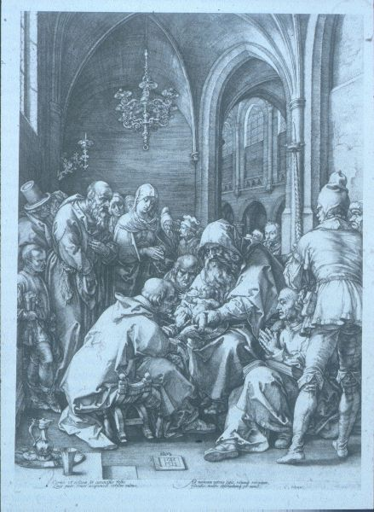
Circumcision: the Action
Removal of flesh from the male sexual organ
Done on the eighth day for newborns
Any male not circumcised is to be cut off from God's people.
Is this an acted parable?

Slide 12
Circumcision: its Meaning?
Removal of flesh from male organ
  Removal of sinful flesh?
  Cutting off of the promised seed?
Done on the eighth day
  Jesus rises on the eighth day, showing that God accepted his atoning death.
Any male not circumcised is cut off.
  No one comes to the Father but by Me.

Slide 13
New Testament Liturgy
The NT is less liturgical than the OT.
Perhaps this is due to the non-localized nature of God's people, after the Gospel goes out to the Gentiles.
Still, there are at least two liturgical actions:
  Baptism
  The Lord's Supper

Slide 14
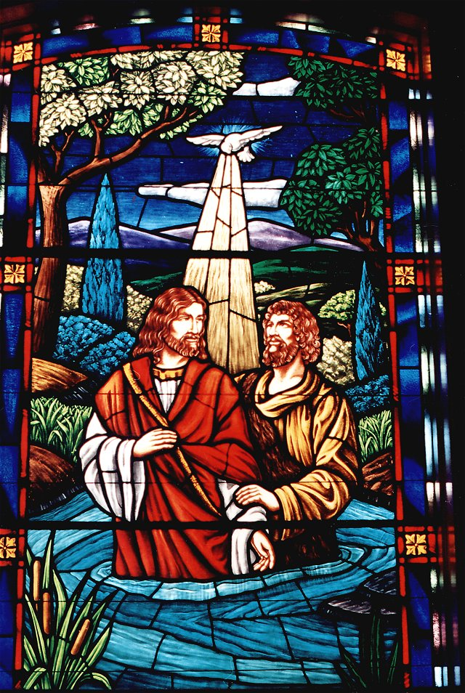
Baptism: the Action
A new convert is cleansed by washing.
This follows his/her confession of Christ.
Among immersionists, the convert is buried in water.
Among affusionists, the convert is covered with poured water.
Among aspersionists, the convert is sprinkled with water.

Slide 15
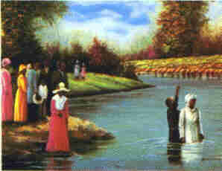
Baptism: its Meaning
The washing signifies cleansing (by the Spirit) due to our identification with Christ.
  Immersion – death, burial & resurrection
  Affusion – Holy Spirit is poured out
  Aspersion – recalls OT sprinkling ceremonies
The ceremony is a picture of the believer's being born again to a new life.

Slide 16
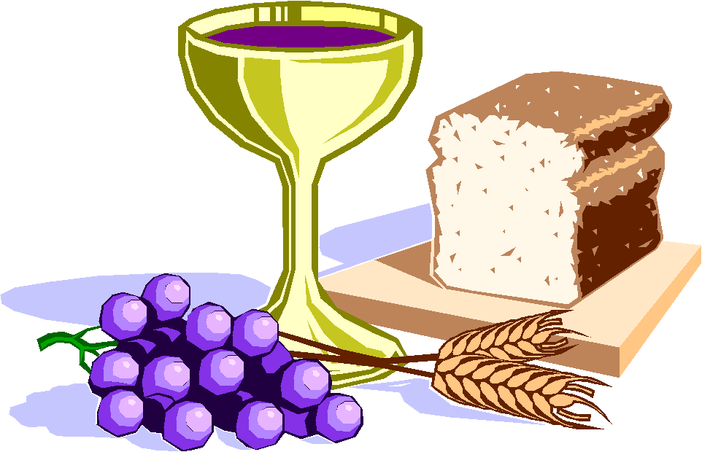
The Lord's Supper: the Action
Believers gather for a symbolic meal.
There are two elements:
  Bread, often unleavened
  Fruit of the vine, sometimes wine, sometimes juice
The elements are eaten/drunk along with words of explanation and thanksgiving.

Slide 17
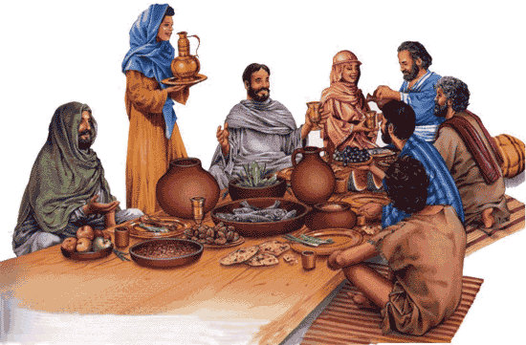
The Lord's Supper: Meaning
The meal:
  Looks back to Last Supper & Crucifixion
  Looks forward to Messianic Banquet
The elements:
  The bread (sustenance) = Jesus' body broken.
  The wine (joy) pictures Jesus' blood poured out.
The quantity:
  Just a taste; this is not the real thing!
  Wait till you see what God has in store for us!

Slide 18
The End (of this talk)
But why don't we begin to think about what God is telling us in these things?

