Slide 1
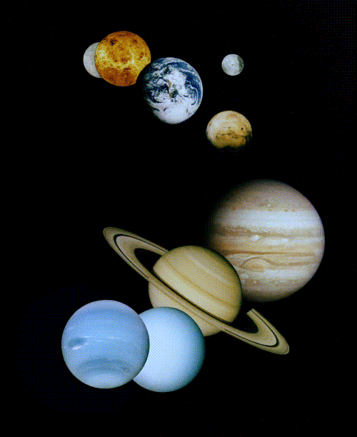
The Solar System
Robert C. Newman

Slide 2
The Solar System
This is the name we give to the sun (Latin, sol) and its planets, plus the other objects that are gravitationally bound to the sun.
In this talk, we will start with our earth & its moon, then work inward toward the sun, then outward to the outermost parts of the solar system.

Slide 3
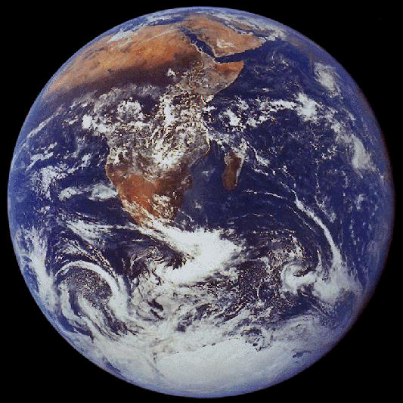
The Earth

Slide 4
The Earth
The earth is our planet, the largest in the inner solar system.
We typically take the radius of its orbit around the sun (93 million miles, about 150 million km) as the unit for measuring the orbits of other planets in our system.
We call this distance 1 AU (astronomical unit).

Slide 5
Earth's Other Measurements
We take Earth's orbital period (about 365 days) to be the unit for orbital times, 1 year. Or for shorter periods, we use days.
We take the Earth's mass (6 x 10²⁴ kg) as the unit for planetary masses.
We take the Earth's radius (about 6400 km, 4000 mi) as the unit for planetary sizes.

Slide 6
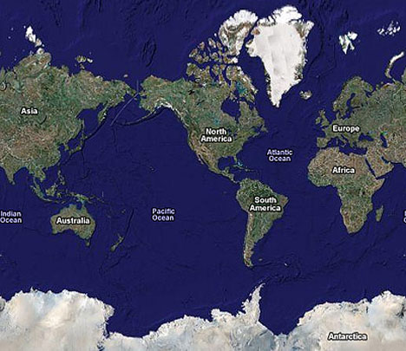
Satellite Map

Slide 7
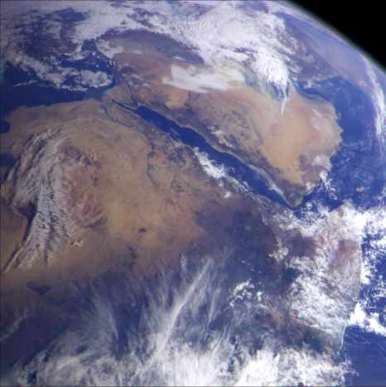
Arabia & Egypt

Slide 8
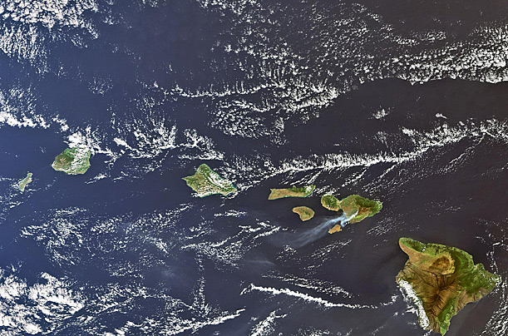
Hawaii

Slide 9
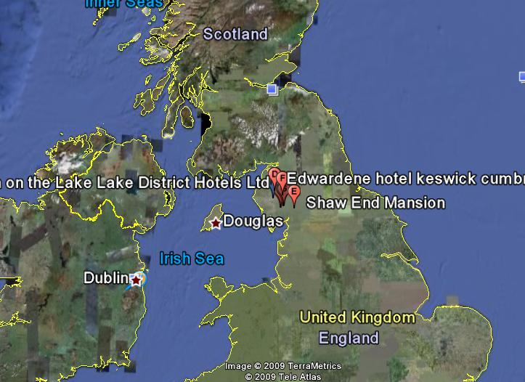
United Kingdom on Google Earth

Slide 10
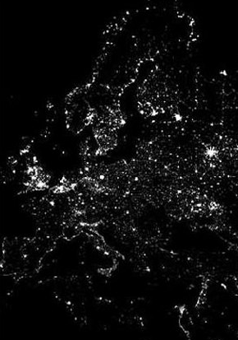
Night Scene

Slide 11
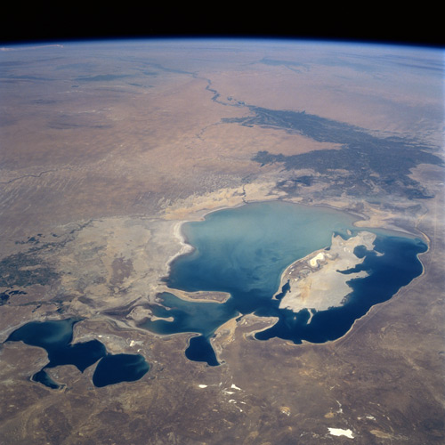
Remains of the Aral Sea

Slide 12
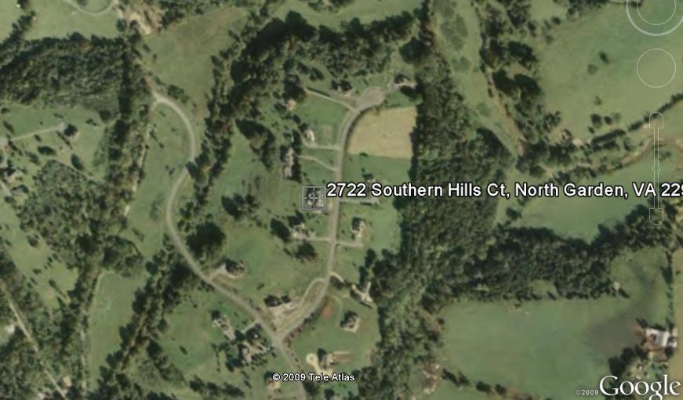
Home

Slide 13
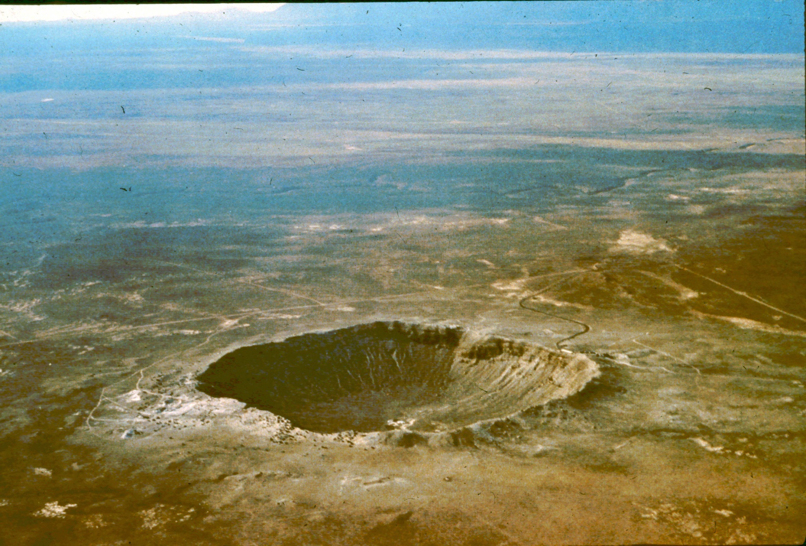
Meteor Crater, Arizona
◄=== ¾ mile ===►

Slide 14
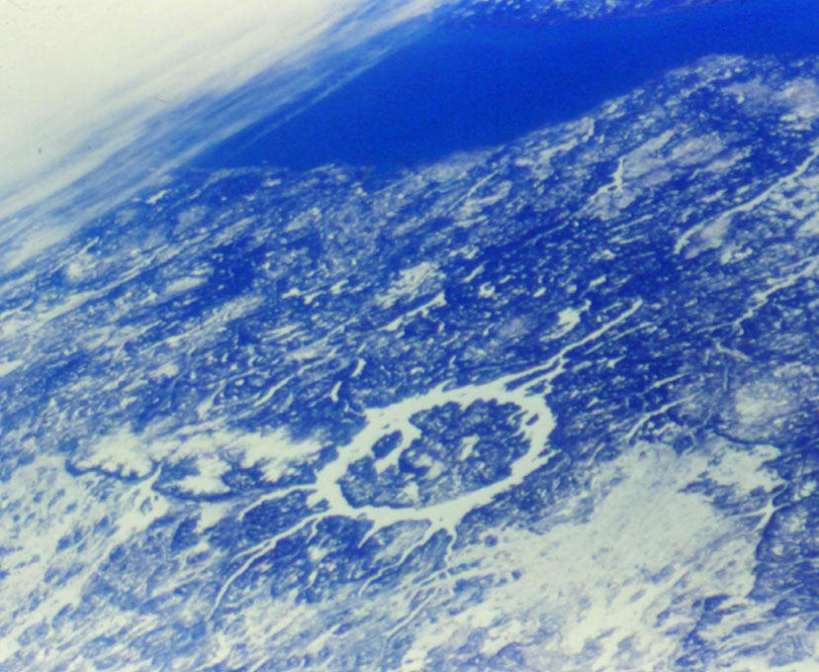
Manicouagan Impact Structure, Quebec
◄=43mi=►

Slide 15
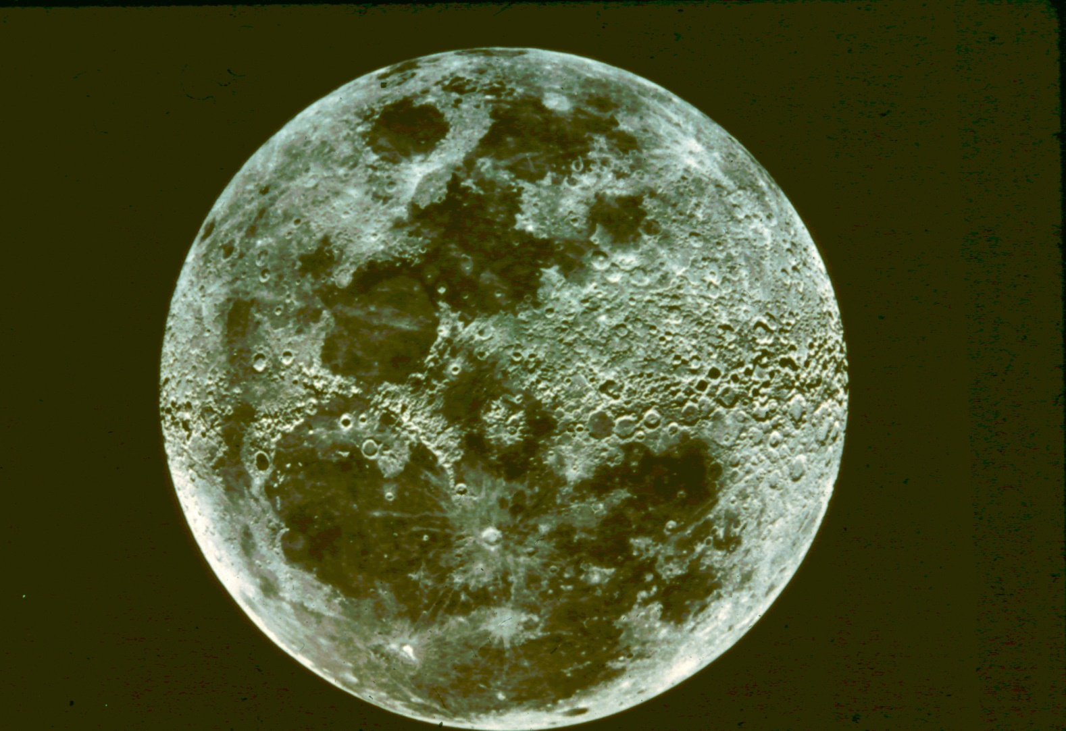
The Earth's Moon

Slide 16
The Moon
Our moon is not the largest moon in the solar system, but it is the largest compared to the size of its planet.
Its radius is about 1740 km, 1100 mi, only a bit over ¼ that of earth.
Its mass is only about 1/100 that of earth.

Slide 17
Moon's Atmosphere
The moon has virtually no atmosphere, which makes a huge difference for conditions on the moon:
No air to breathe
No protection from radiation from space
No greenhouse effect
Erosion is very slow, except for meteors.
There is no air to slow down meteors approaching the moon.

Slide 18
Moon's Temperature
The moon rotates at such a speed as to keep one side facing the earth at all times.
This means the moon has a very long day & night (half a month each).
Thus the moon cools down for two weeks.
Then it warms up for two weeks.
The daytime highs are about 270 F.
The nighttime lows are about -270 F.

Slide 19
Lunar Landforms
The major surface features are craters formed by meteor collisions.
There are also mountain ranges and some cracks here and there.
The areas that Galileo and others called 'seas,' now called mare/maria, are large, rather flat areas where lava has filled in lowland terrain.

Slide 20
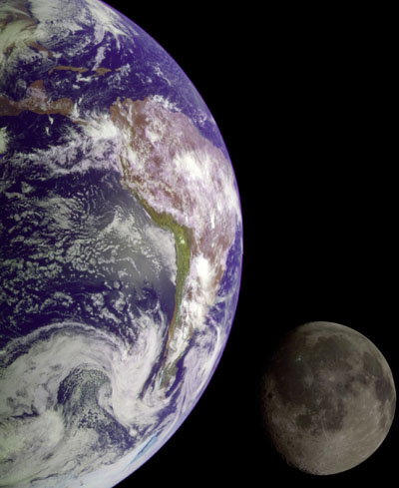
Earth and Moon compared

Slide 21
Near side composite

Slide 22
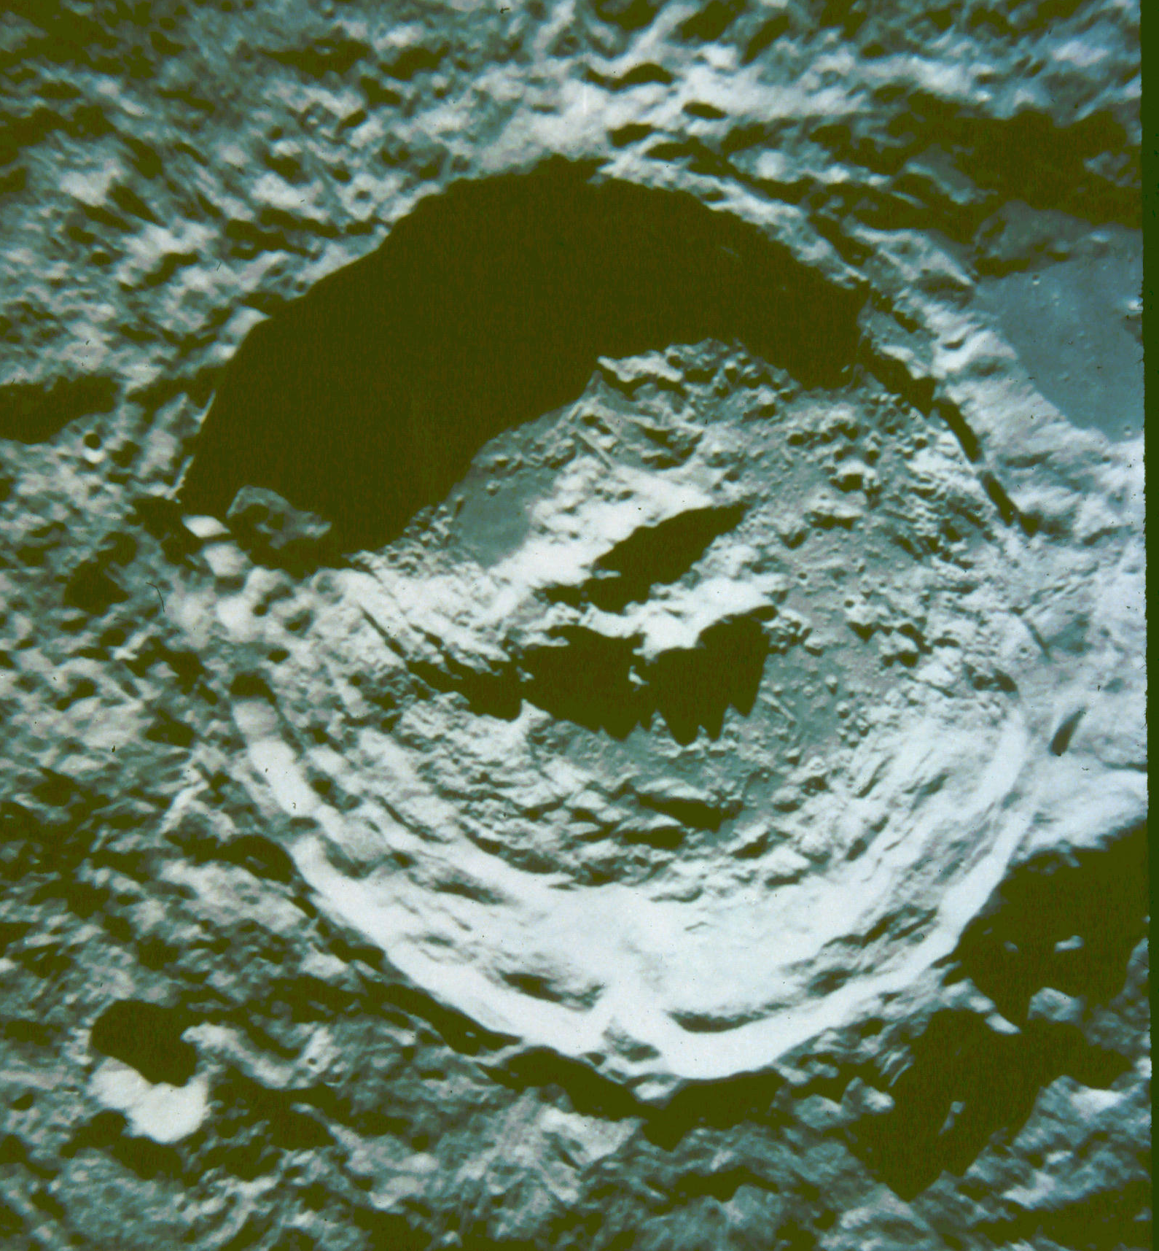
Crater King
~45 mi across

Slide 23
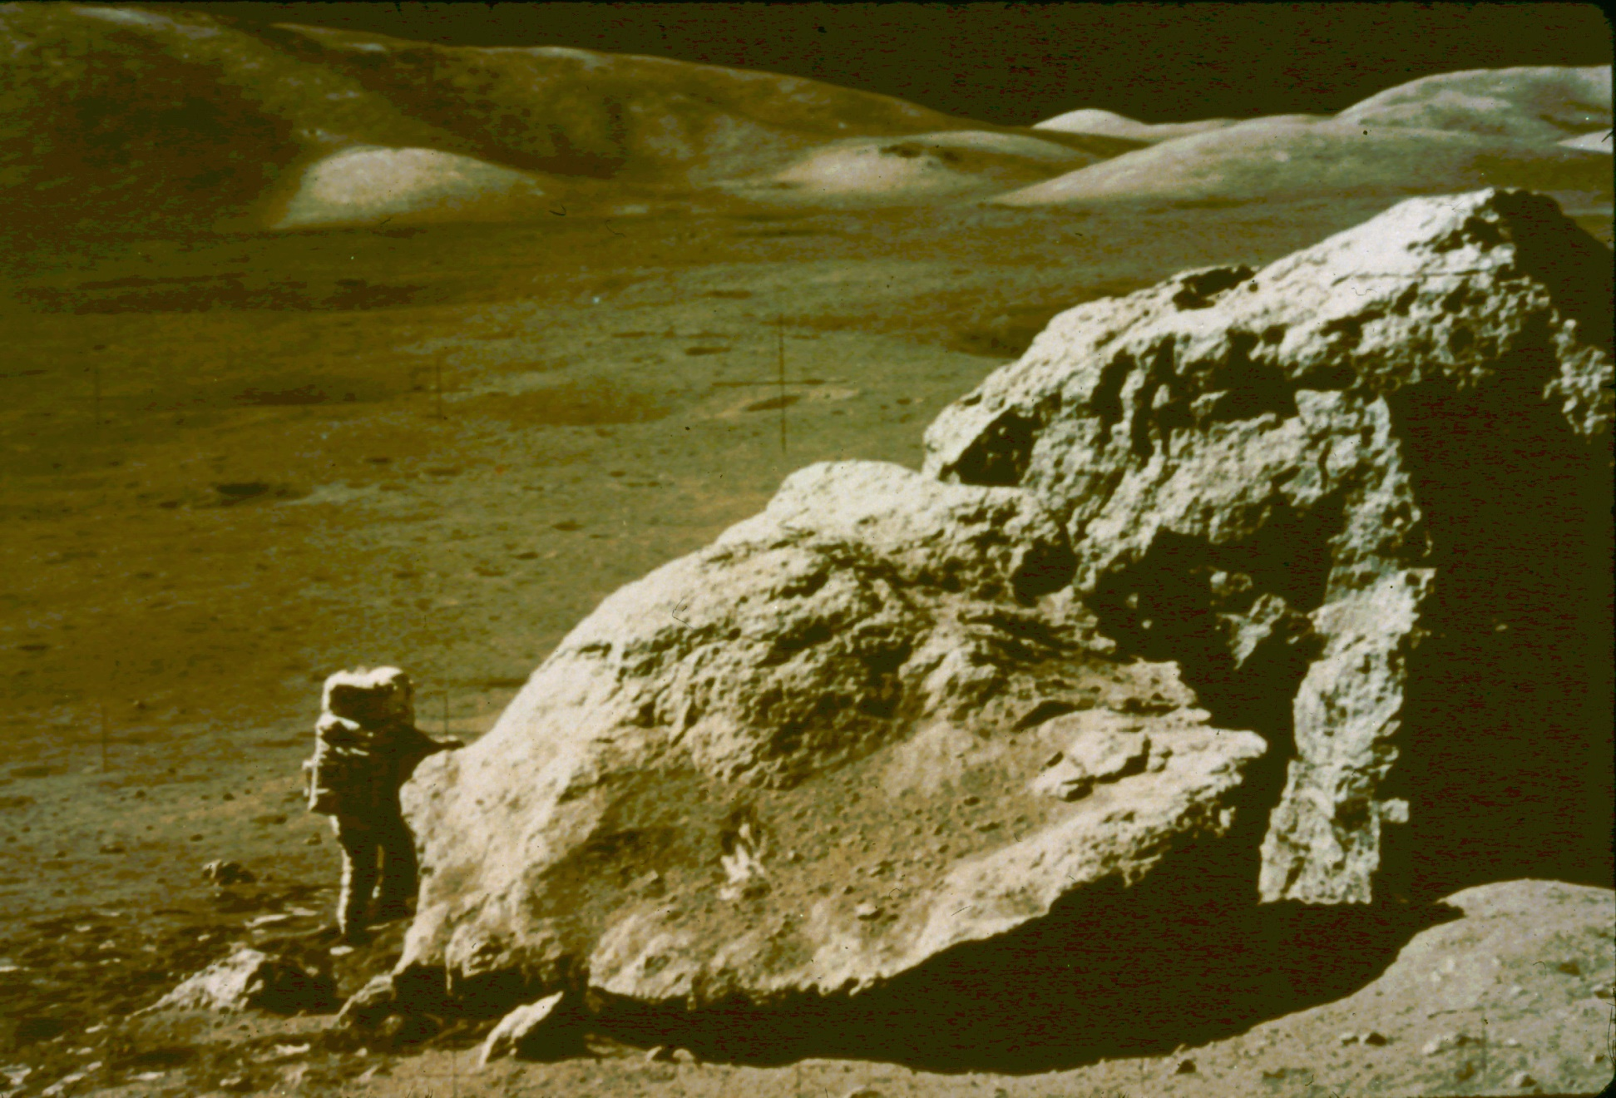
Lunar Surface Apollo 17

Slide 24
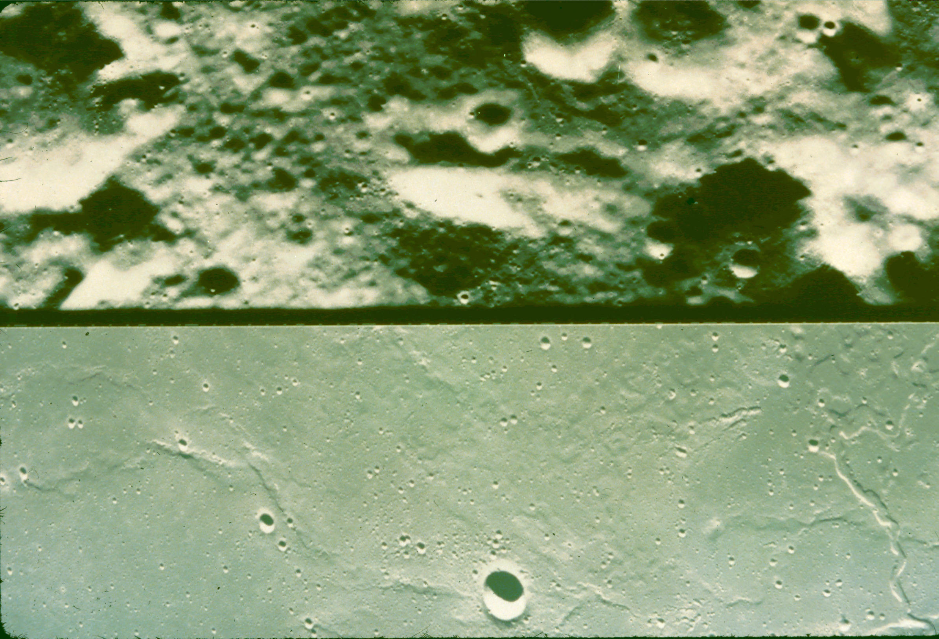
Highland Terrain
Mare Terrain

Slide 25
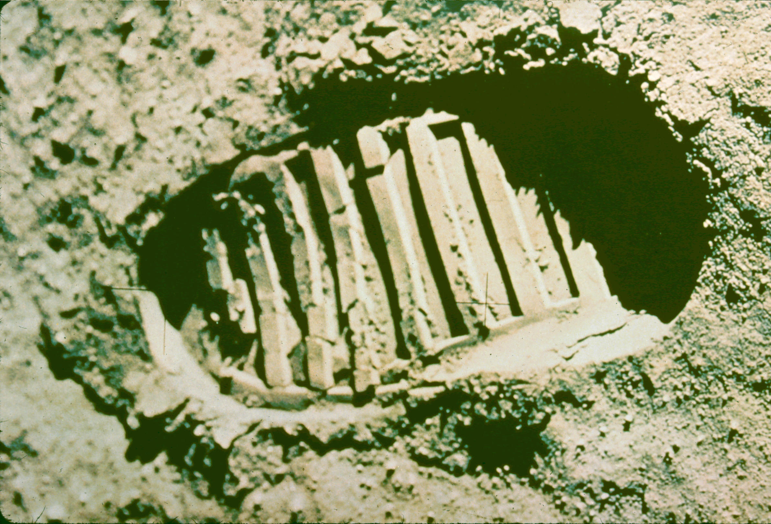

Slide 26
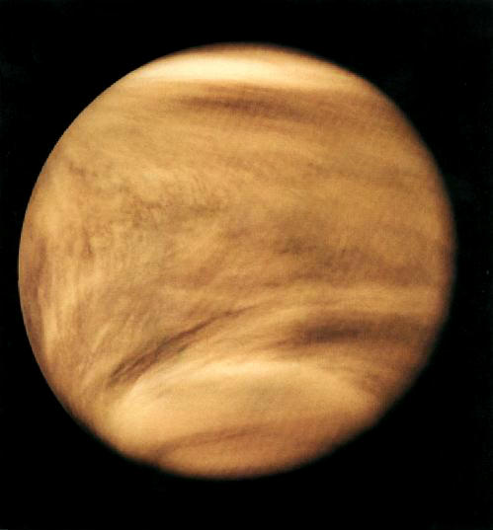
Venus

Slide 27
Venus
Venus is earth’s 'twin planet' in our solar system.
Its radius is about 95% that of earth.
Its mass is about 82%.
But it is a good deal closer to the sun, at 0.723 AU.
Its year is shorter, only 225 days.
It rotates very slowly, backwards, in 243 days, so it has a very long day & night!

Slide 28
Venus' Temperature
Venus is naturally hotter than the earth, being closer to the sun.
On top of this, Venus has a thick atmosphere, with a surface pressure about 90 times that on earth.
About 90% of the Venus atmosphere is CO₂, a good greenhouse gas, resulting in a temperature of about 900 F!
Venus is thickly covered by clouds of sulfuric acid droplets, so that only about 1% of the sunlight reaches its surface.

Slide 29
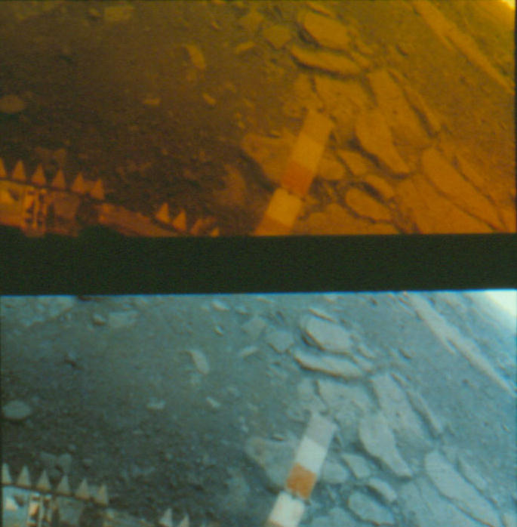
Venus Surface
Natural Light
White Light

Slide 30
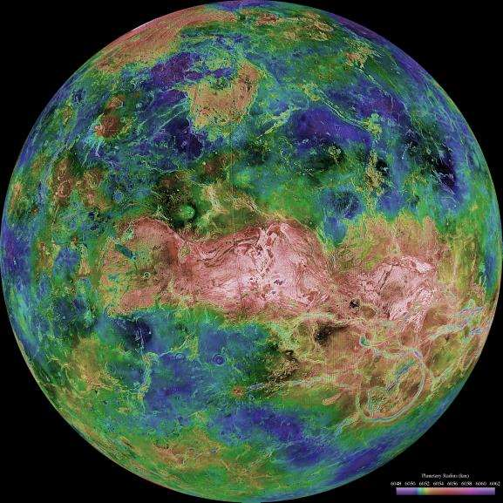
Venus Topography

Slide 31
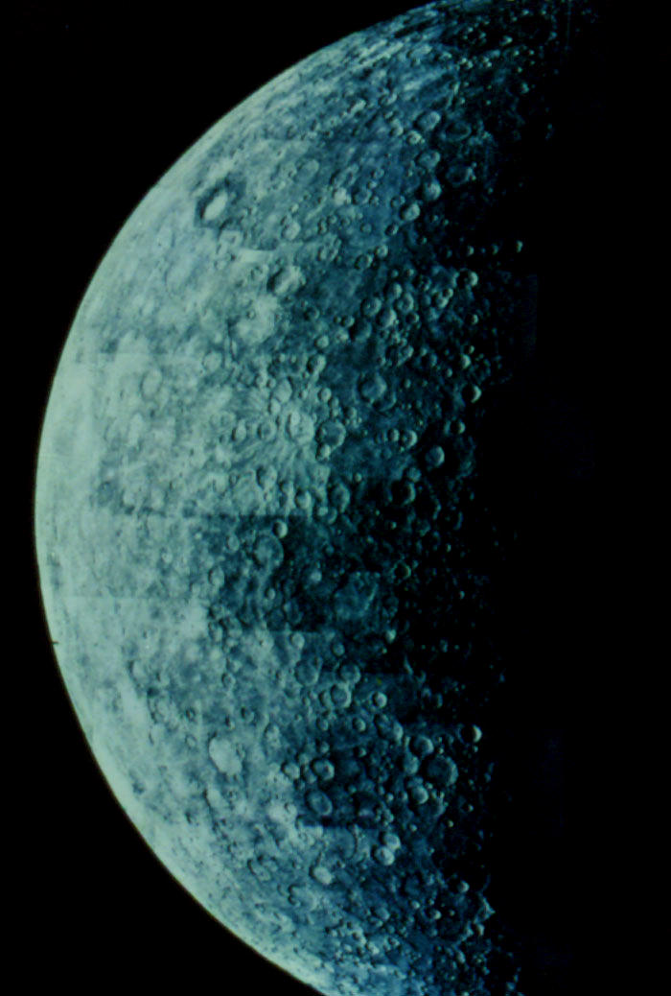
Mercury

Slide 32
Mercury
Mercury is the planet closest to the sun (0.39 AU).
Because it is so close, most people have never seen Mercury in the sky, though it is actually fairly bright.
It is the smallest planet in our system (since Pluto was demoted), with a size only 38% earth’s, and a mass only 6%.

Slide 33
Mercury Features
Mercury moves around the sun in only 88 days, but it has a long day of its own, with a rotation period of 59 days, tidally locked into a 3:2 resonance with the sun.
The temperature at Mercury's equator varies from about 800 F at noon to about -280 F at night.
Mercury apparently has little or no atmosphere of its own, and its surface looks somewhat like that of our moon.

Slide 34
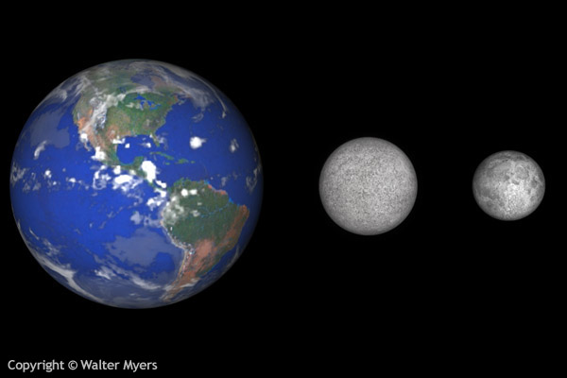
Mercury compared with Earth & Moon
Mercury

Slide 35
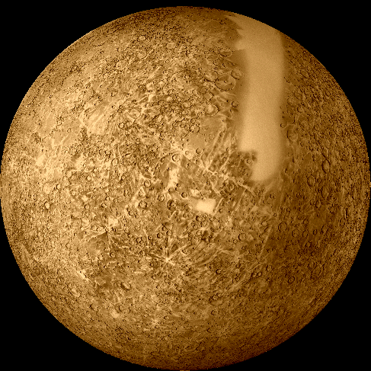
Mercury Mosaic

Slide 36
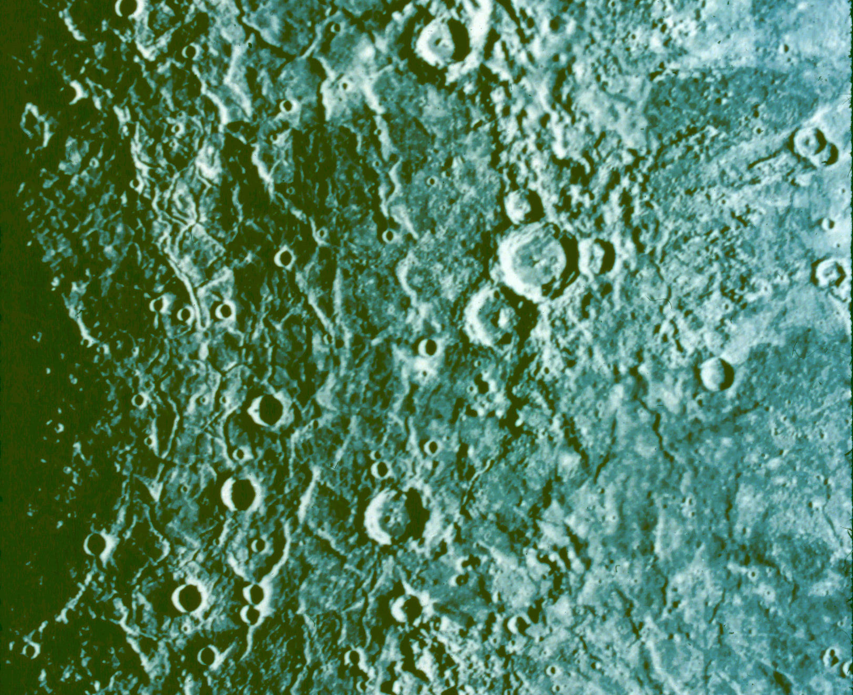
Caloris Basin

Slide 37
Discovery Rupes (Cliff)

Slide 38
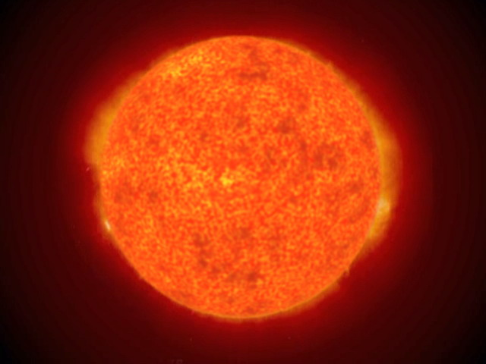
The Sun

Slide 39
The Sun
The sun is the star of our solar system.
It provides nearly all of the energy available to heat the planets, sending out radiant energy at the rate of 2 billion 50-megaton hydrogen bombs per second.
It also sheds its upper atmosphere in a hot, fast-moving wind, called the solar wind.

Slide 40
The Sun's 'Surface'
The sun appears to have a fairly sharp surface, but this is really just the level at which the Sun's gases become opaque.
The temperature at this level is about 7500 degrees F, but much higher down inside and (surprisingly) at upper levels also.
The surface is characterized by sunspots, prominences and flares.

Slide 41
The Sun's Motion
The sun rotates on its axis in the same direction as the planets go around the sun, more rapidly at its equator than near its poles, about 25 days at the equator, about 40 at the poles.
The sun moves around our galaxy at about 150 miles per second, carrying our planets with it.

Slide 42
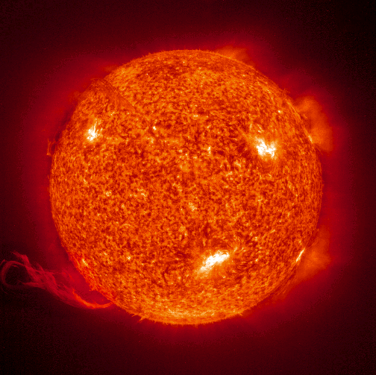
Sun w/ flares & prominences

Slide 43
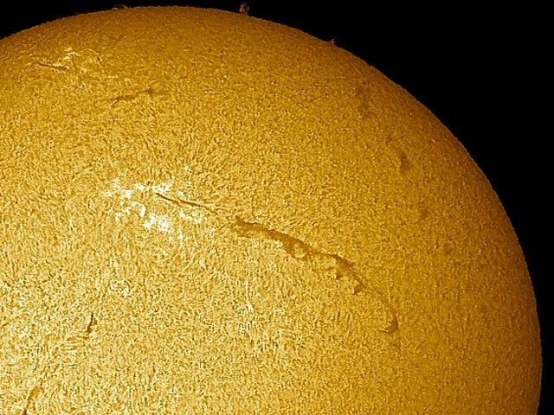
Solar filament

Slide 44
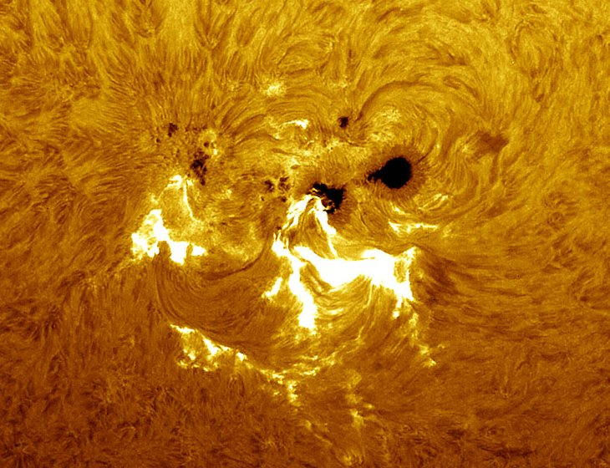
Sunspot group

Slide 45
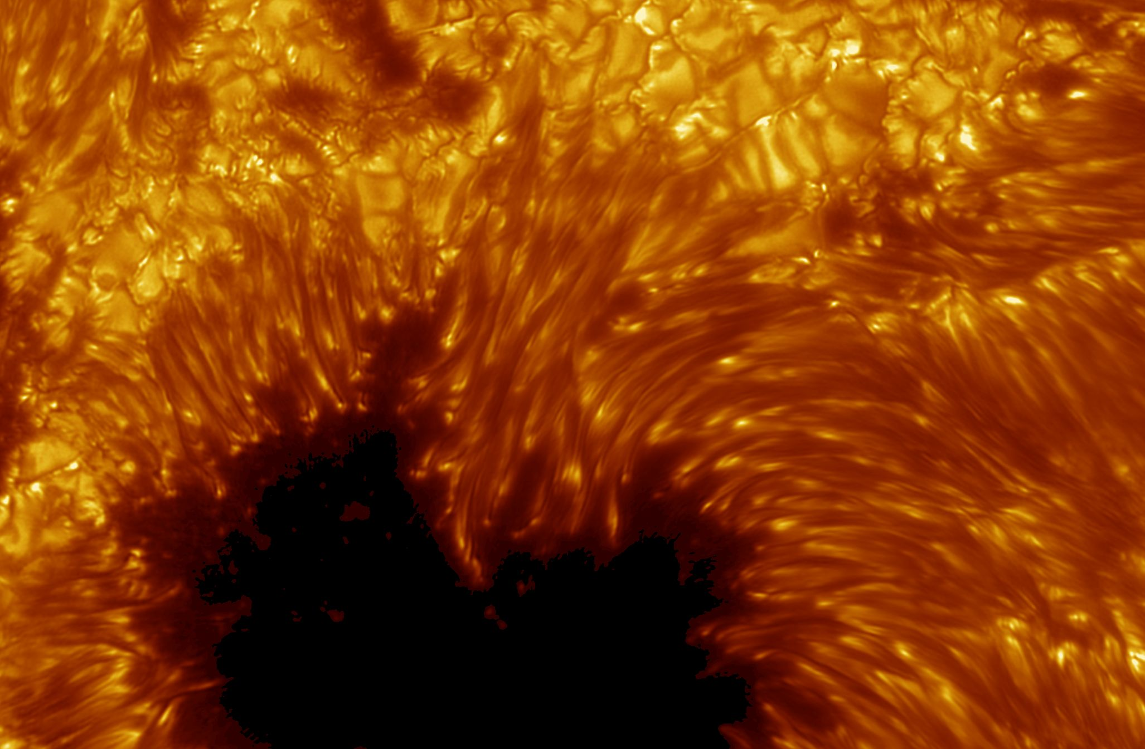
Sunspot closeup

Slide 46
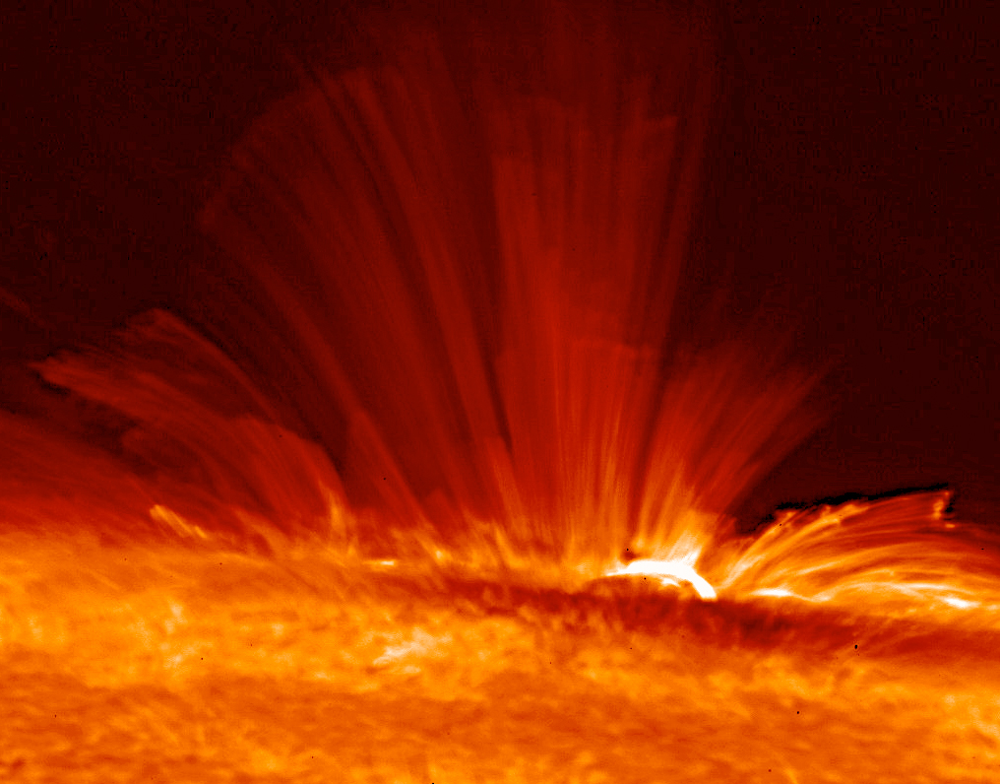
Side view of flare & prominences

Slide 47
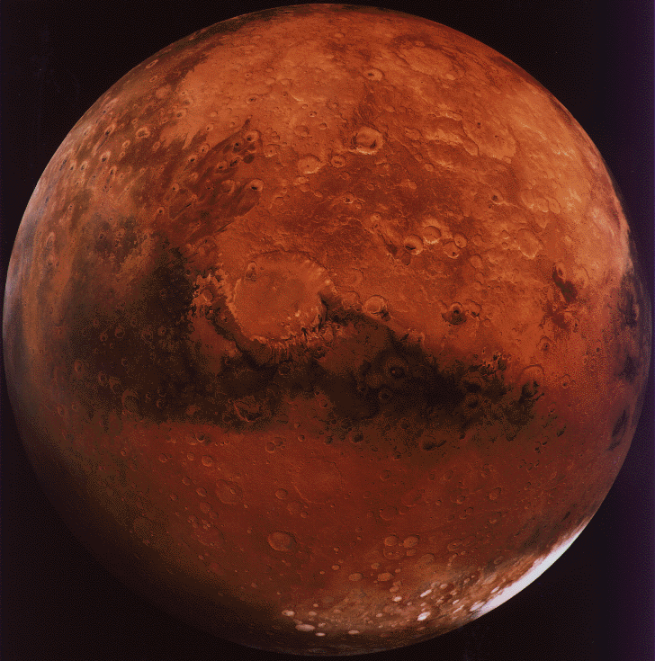
Mars

Slide 48
Mars
Mars is the first planet out beyond earth.
Its orbit averages 1.52 AU from the sun.
Its year is 1.88 of ours.
Mars' radius is only 53% that of earth, and its mass 11%.
Mars rotates once in 24.6 hours.

Slide 49
Mars' Conditions
Mars has a very thin atmosphere (5-7 mb), mostly CO₂ (93%) and a little nitrogen (3%).
Temperatures at the equator rise as high as 57 F during the day but fall to -100 F at night.
At the poles, the temperatures are more like -160 F.

Slide 50
Mars' Moons
Mars has two very small moons.
Phobos, the larger, is about 7.5 miles across, and circles Mars in less than 8 hours.
Deimos, the smaller, is only about 4.6 miles across, and circles Mars in about 30 hours.
Being so small, neither moon is round.

Slide 51
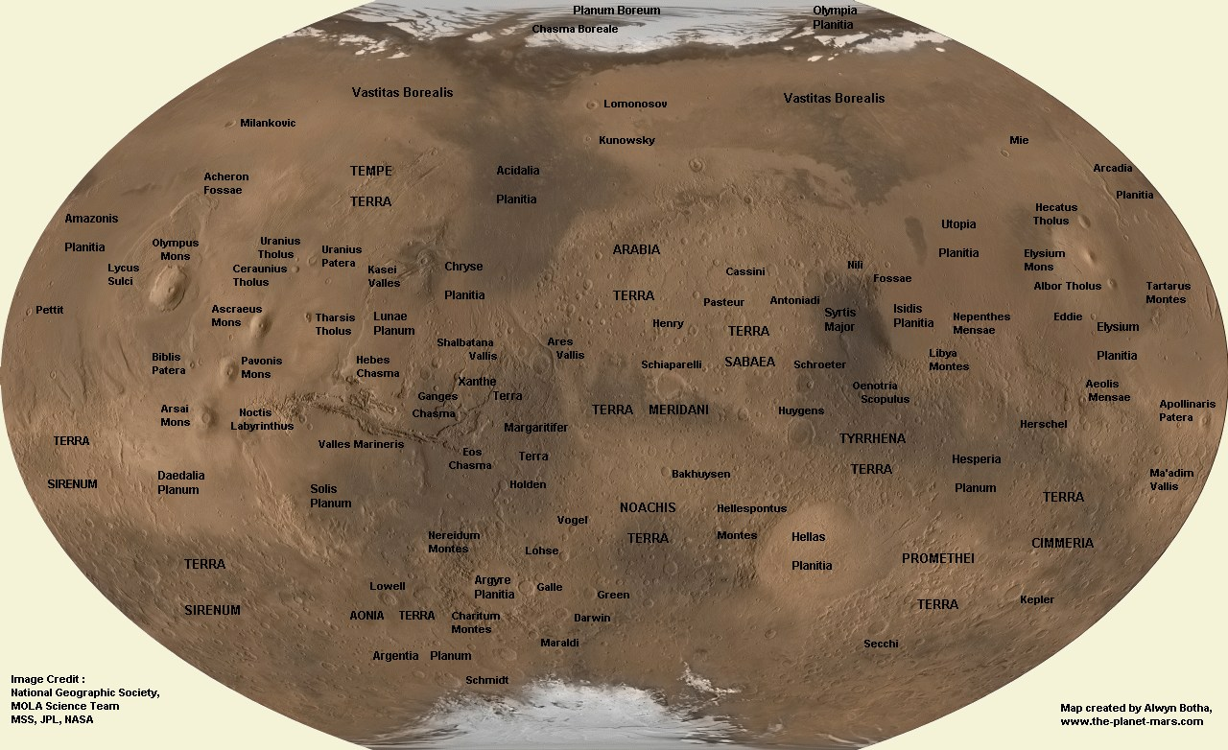
Mars Map

Slide 52
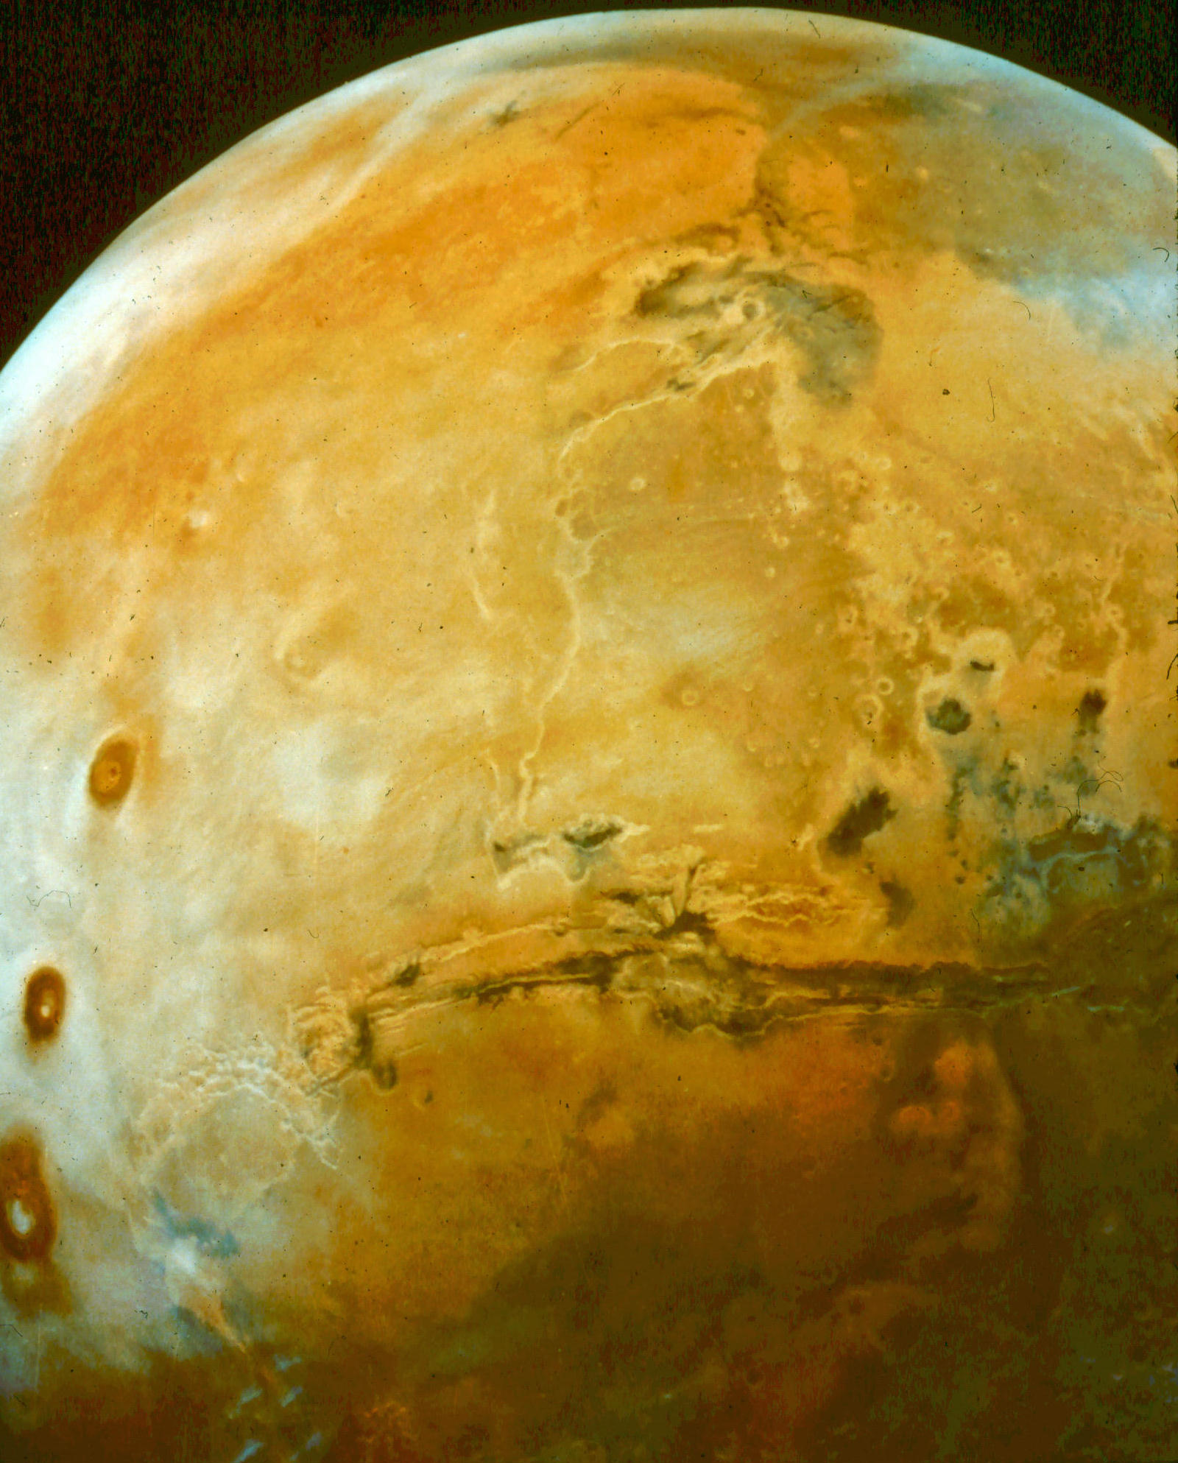
Mars northern Hemisphere

Slide 53
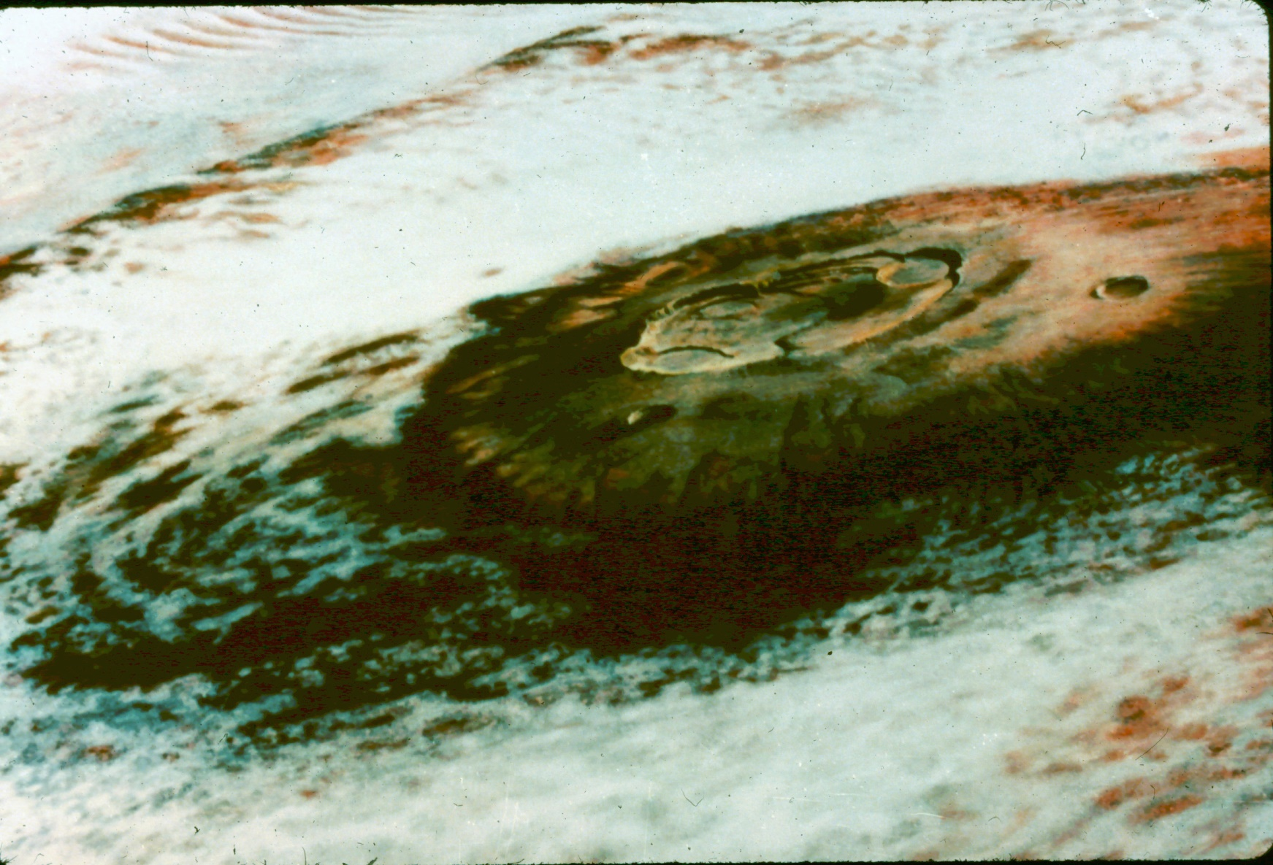
Olympus Mons

Slide 54
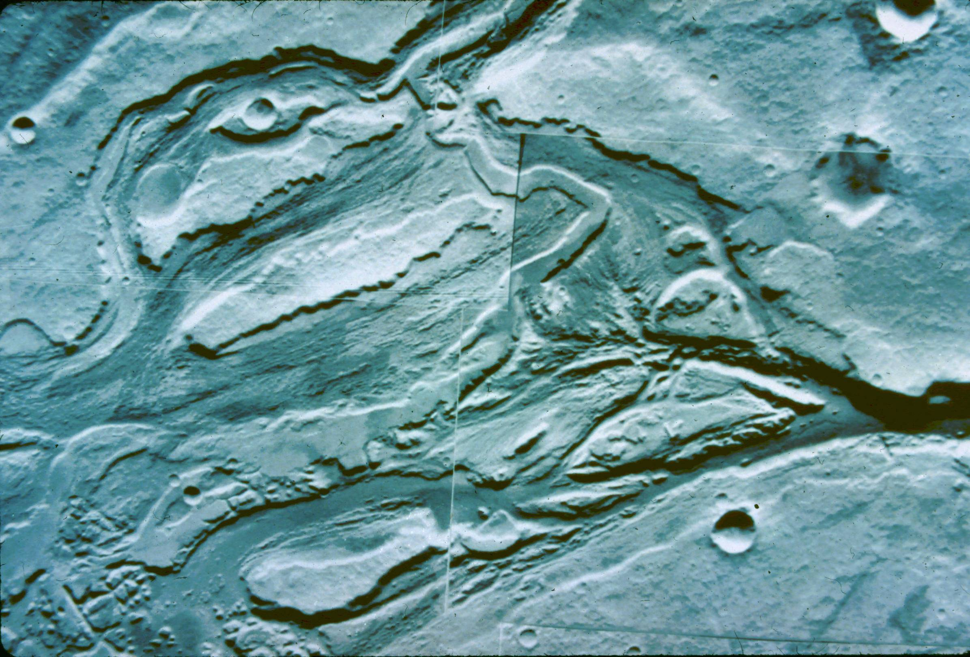
Mangalla Vallis Channels

Slide 55
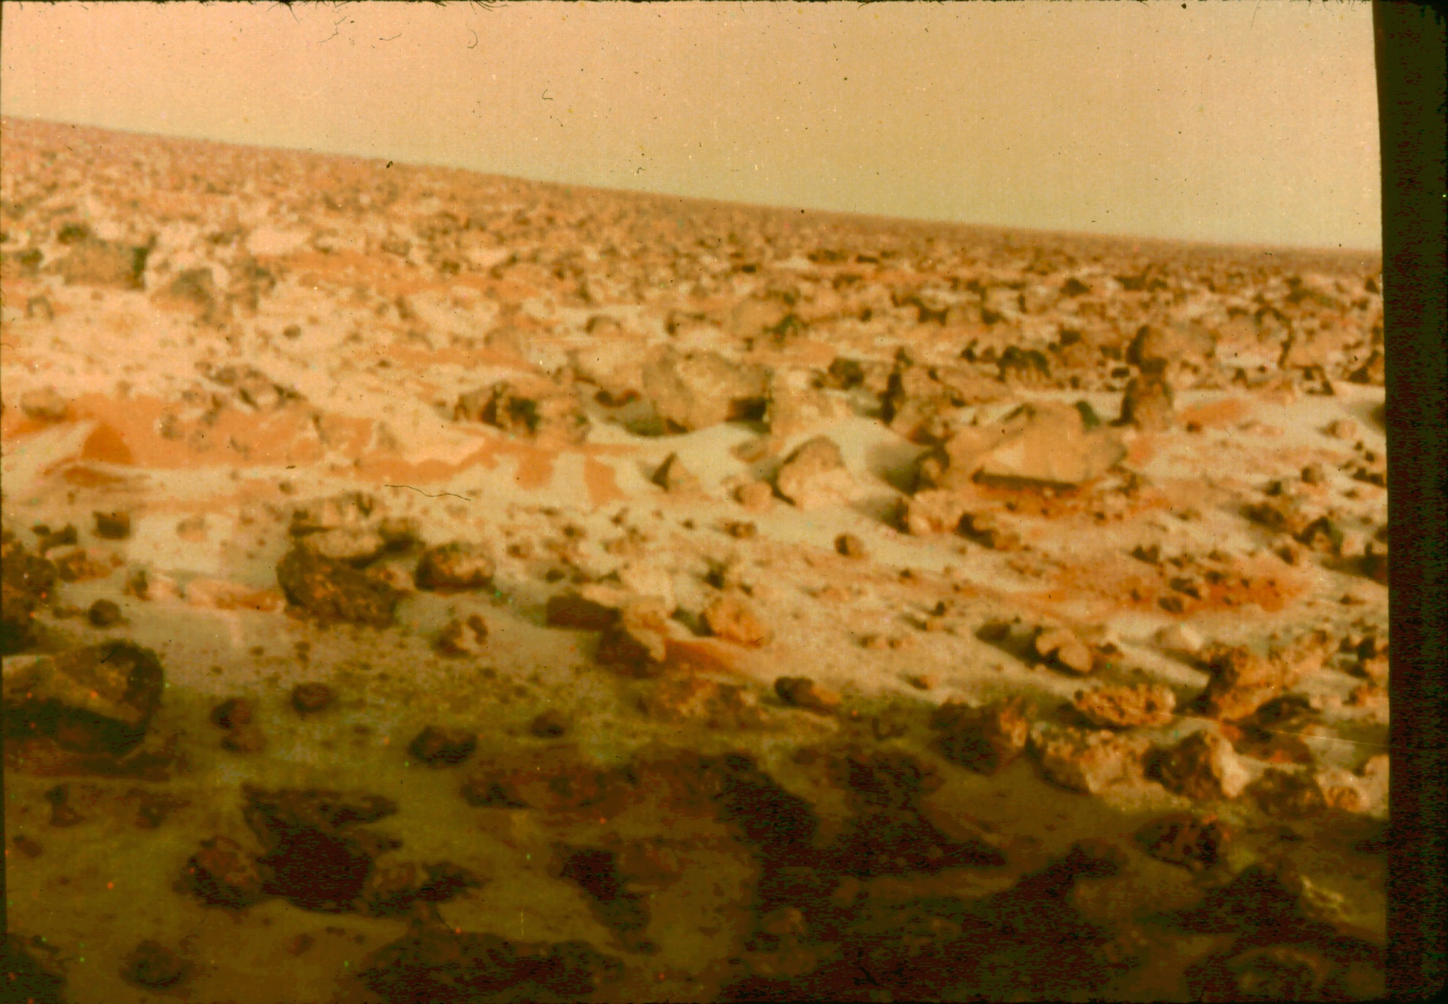
Viking 2 Lander View - frost

Slide 56
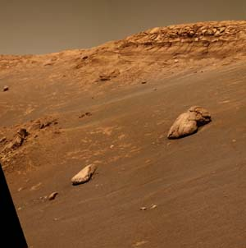
Mars Rover Shot

Slide 57
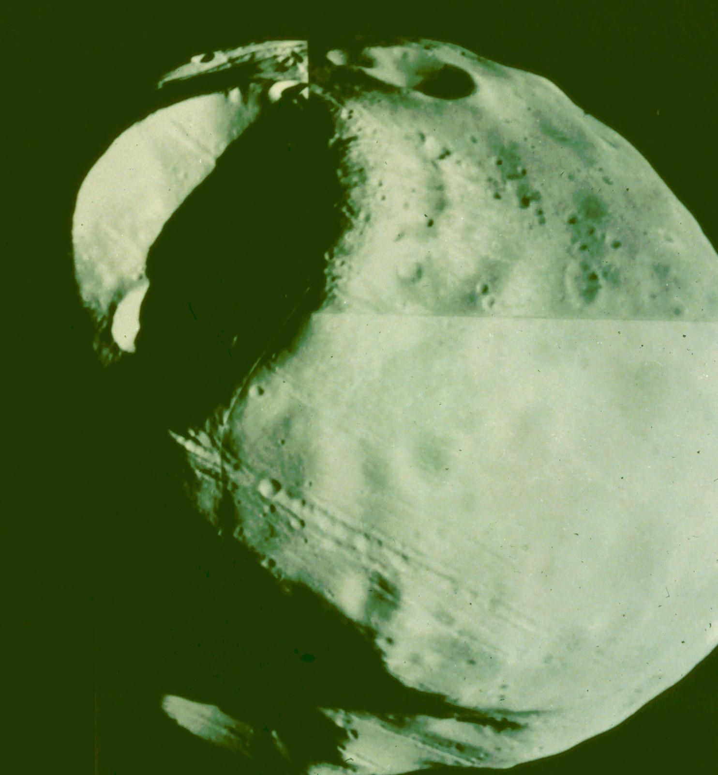
Phobos

Slide 58
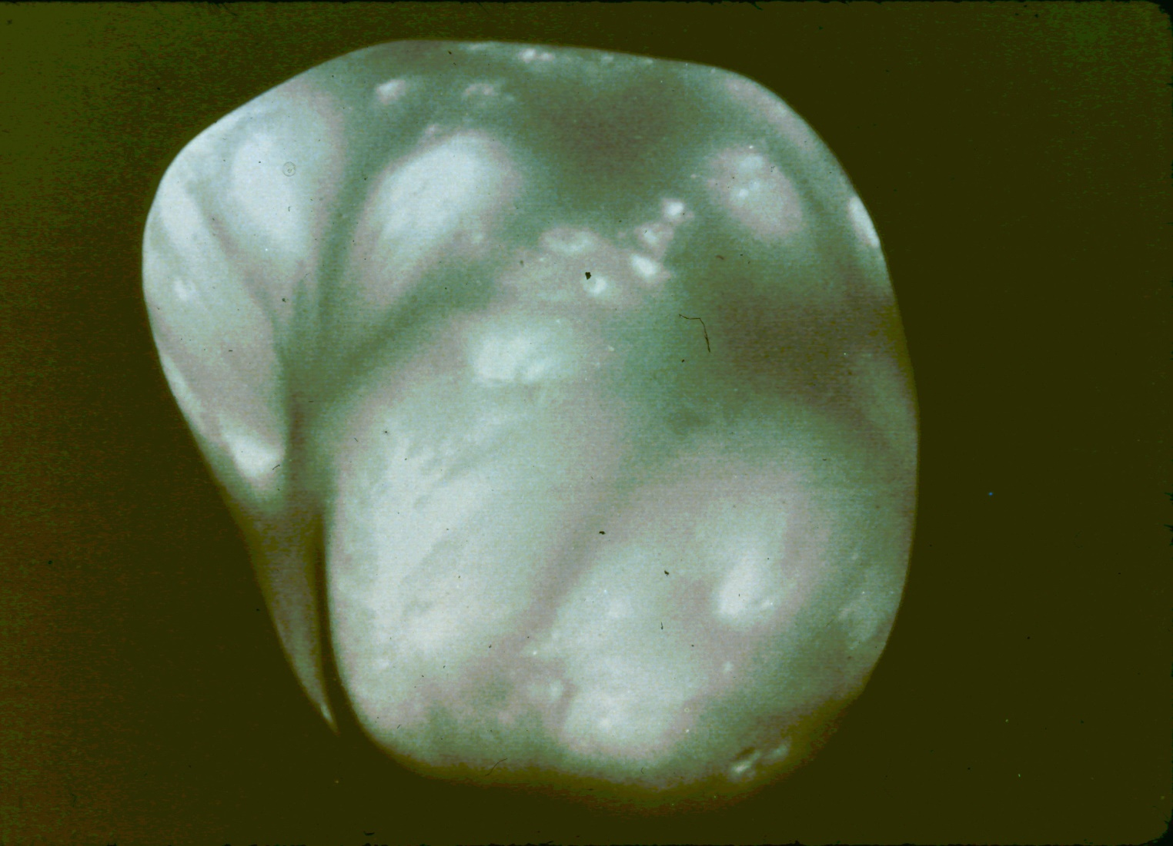
Deimos

Slide 59
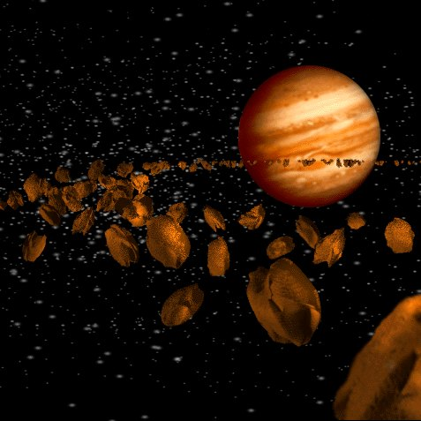
Asteroids

Slide 60
Asteroids
This is the name we give to small objects orbiting around the sun (so not moons), that are too large to count as meteors.
There are thousands of such objects, mostly between the orbits of Mars and Jupiter.
A few of these cross the orbit of earth and spend part of their time in the inner solar system.

Slide 61
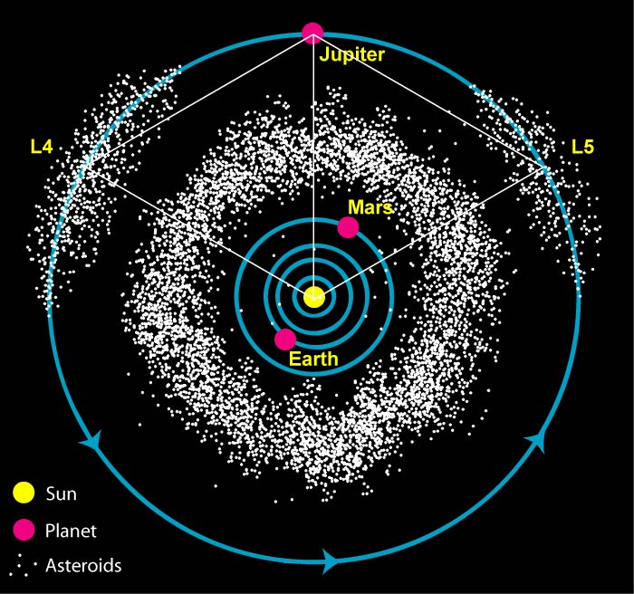

Slide 62
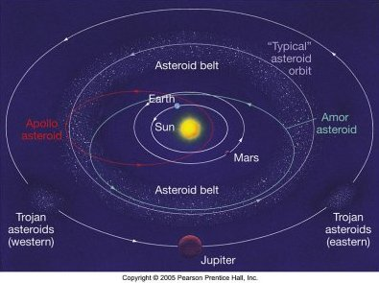

Slide 63
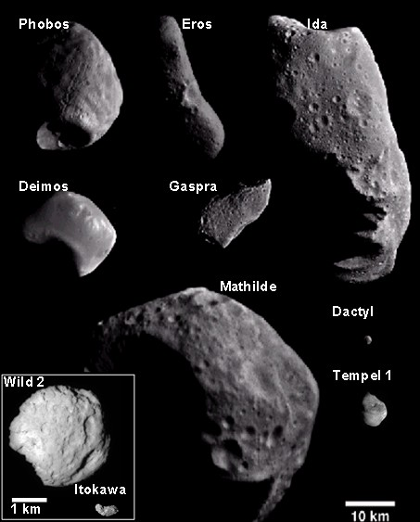

Slide 64
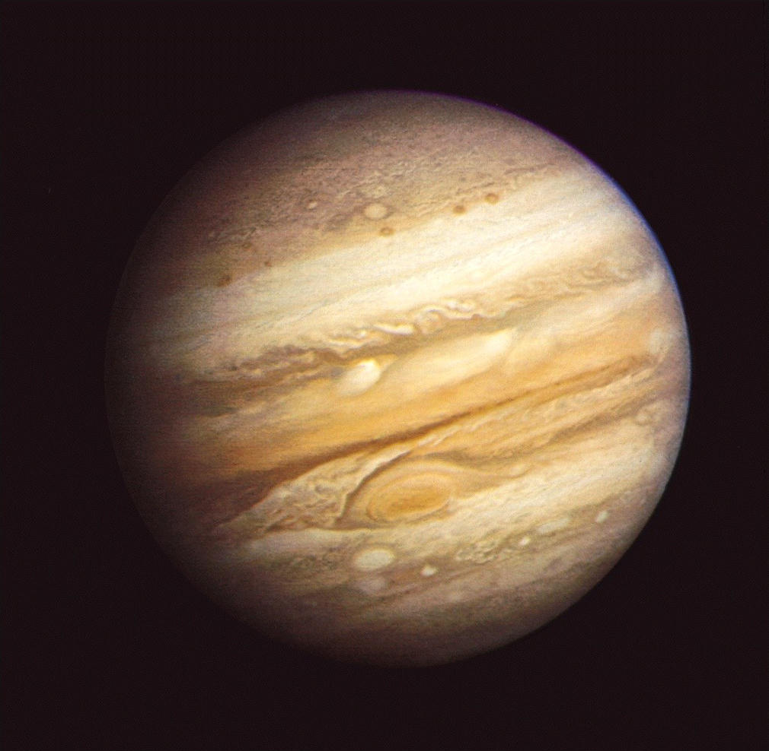
Jupiter

Slide 65
Jupiter
Jupiter is the largest planet in our solar system, with a radius 11 times that of earth, and a mass over 300 times larger.
It orbits in a nice circle some 5.2 AU in radius, with a period of 11.9 years.
This is the first of the four 'gas-giant' planets, made mostly of gas & liquid, with possibly a solid core.

Slide 66
Jupiter's Atmosphere
The atmosphere of Jupiter consists of hydrogen and helium, along with ammonia and various other hydrogen compounds, which form brightly colored clouds.
The clouds form horizontal bands, as well as ovals that are storm systems, some of which are larger than the earth, such as the giant Red Spot.

Slide 67
Jupiter's Moons
Jupiter has four large moons, first seen by Galileo, and many smaller moons, some of which are surely captured asteroids.
Jupiter also has a set of rings, which were only discovered in the space age.
Jupiter likewise has a strong magnetic field.

Slide 68
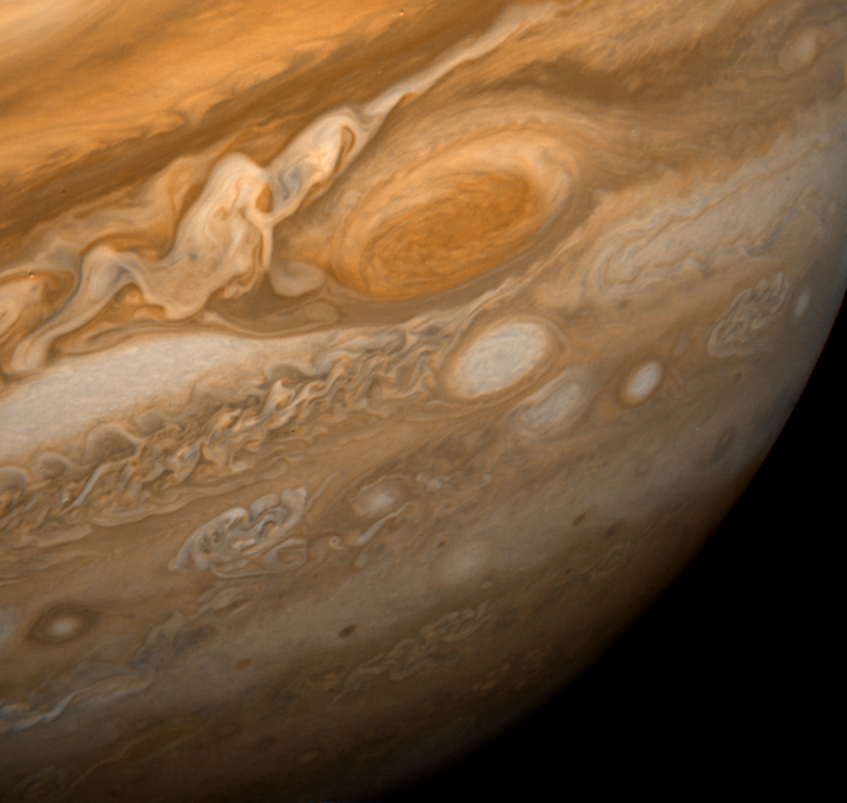
The Red Spot

Slide 69
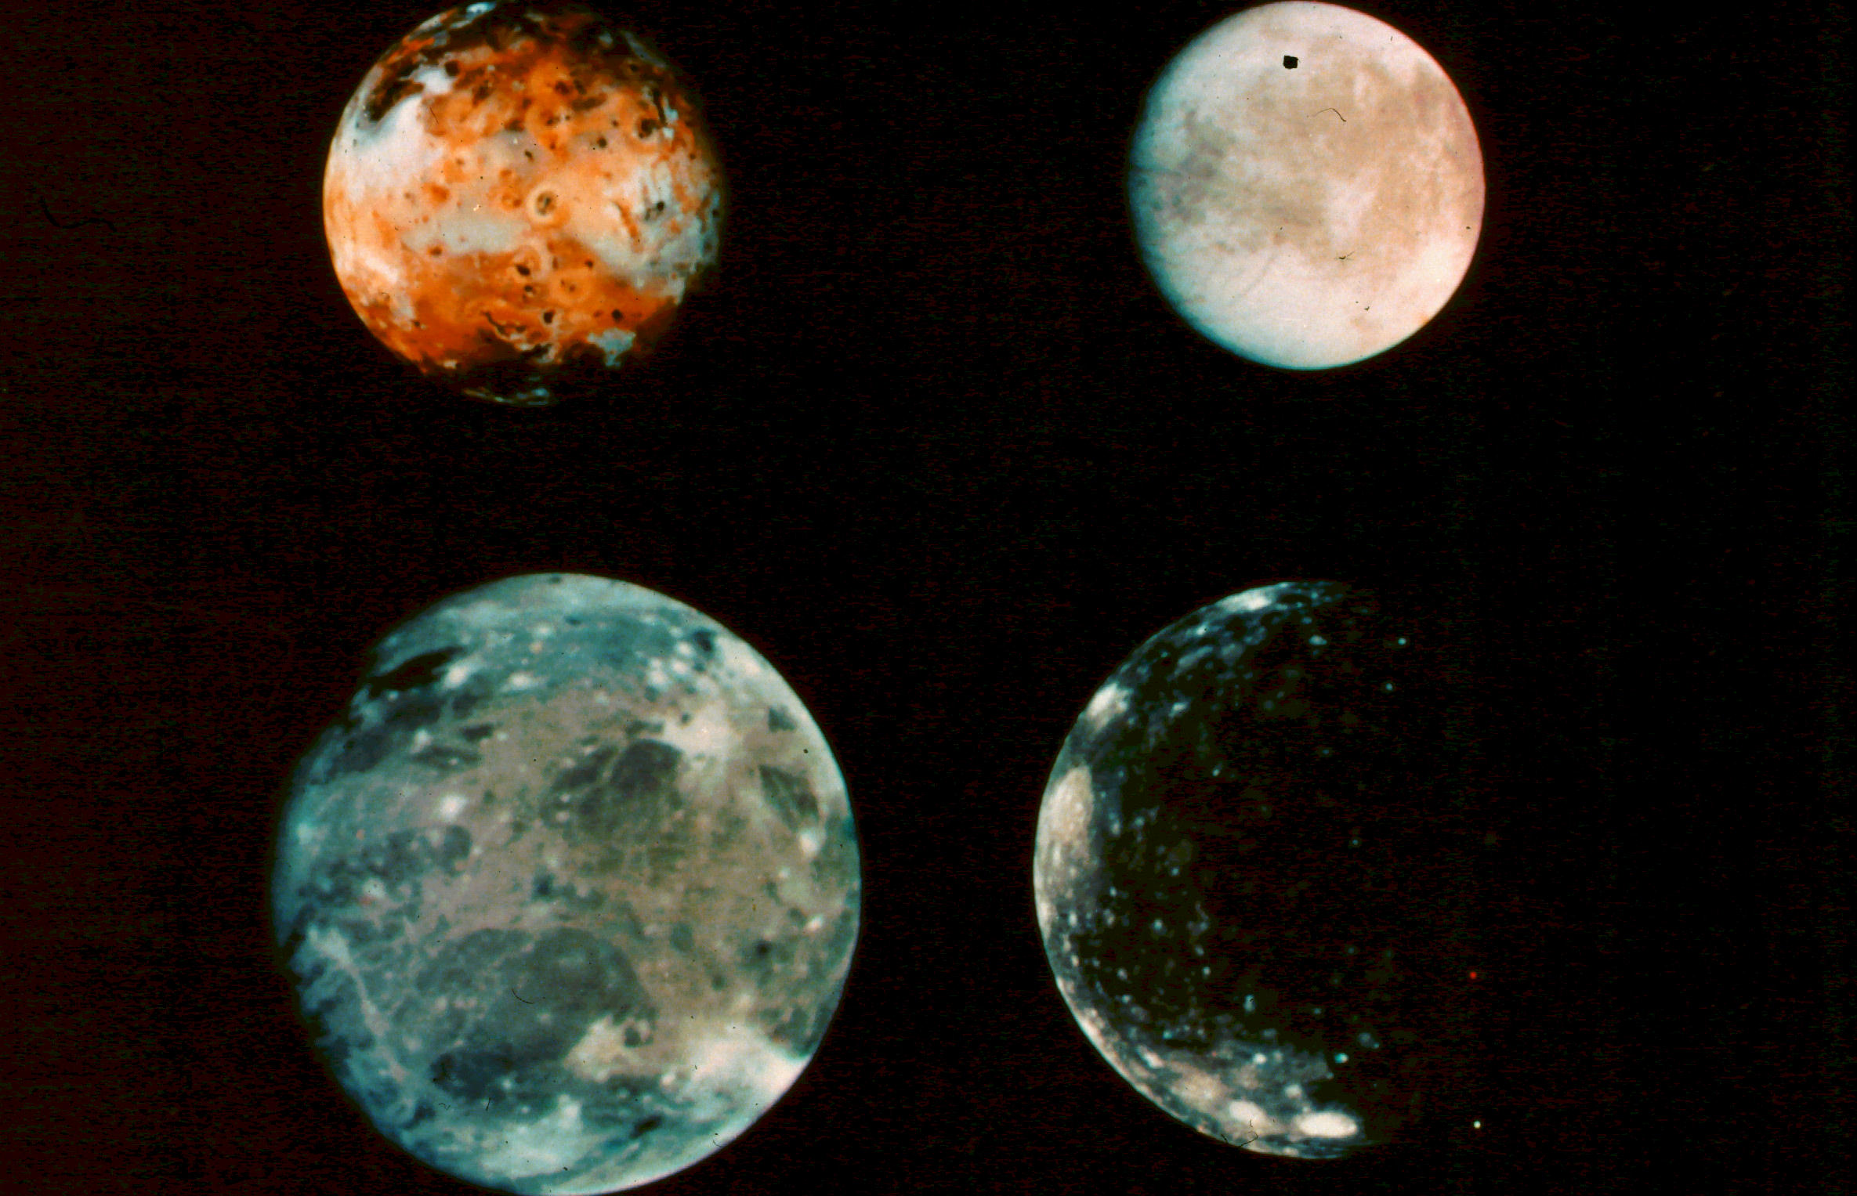
The Galilean Satellites

Slide 70
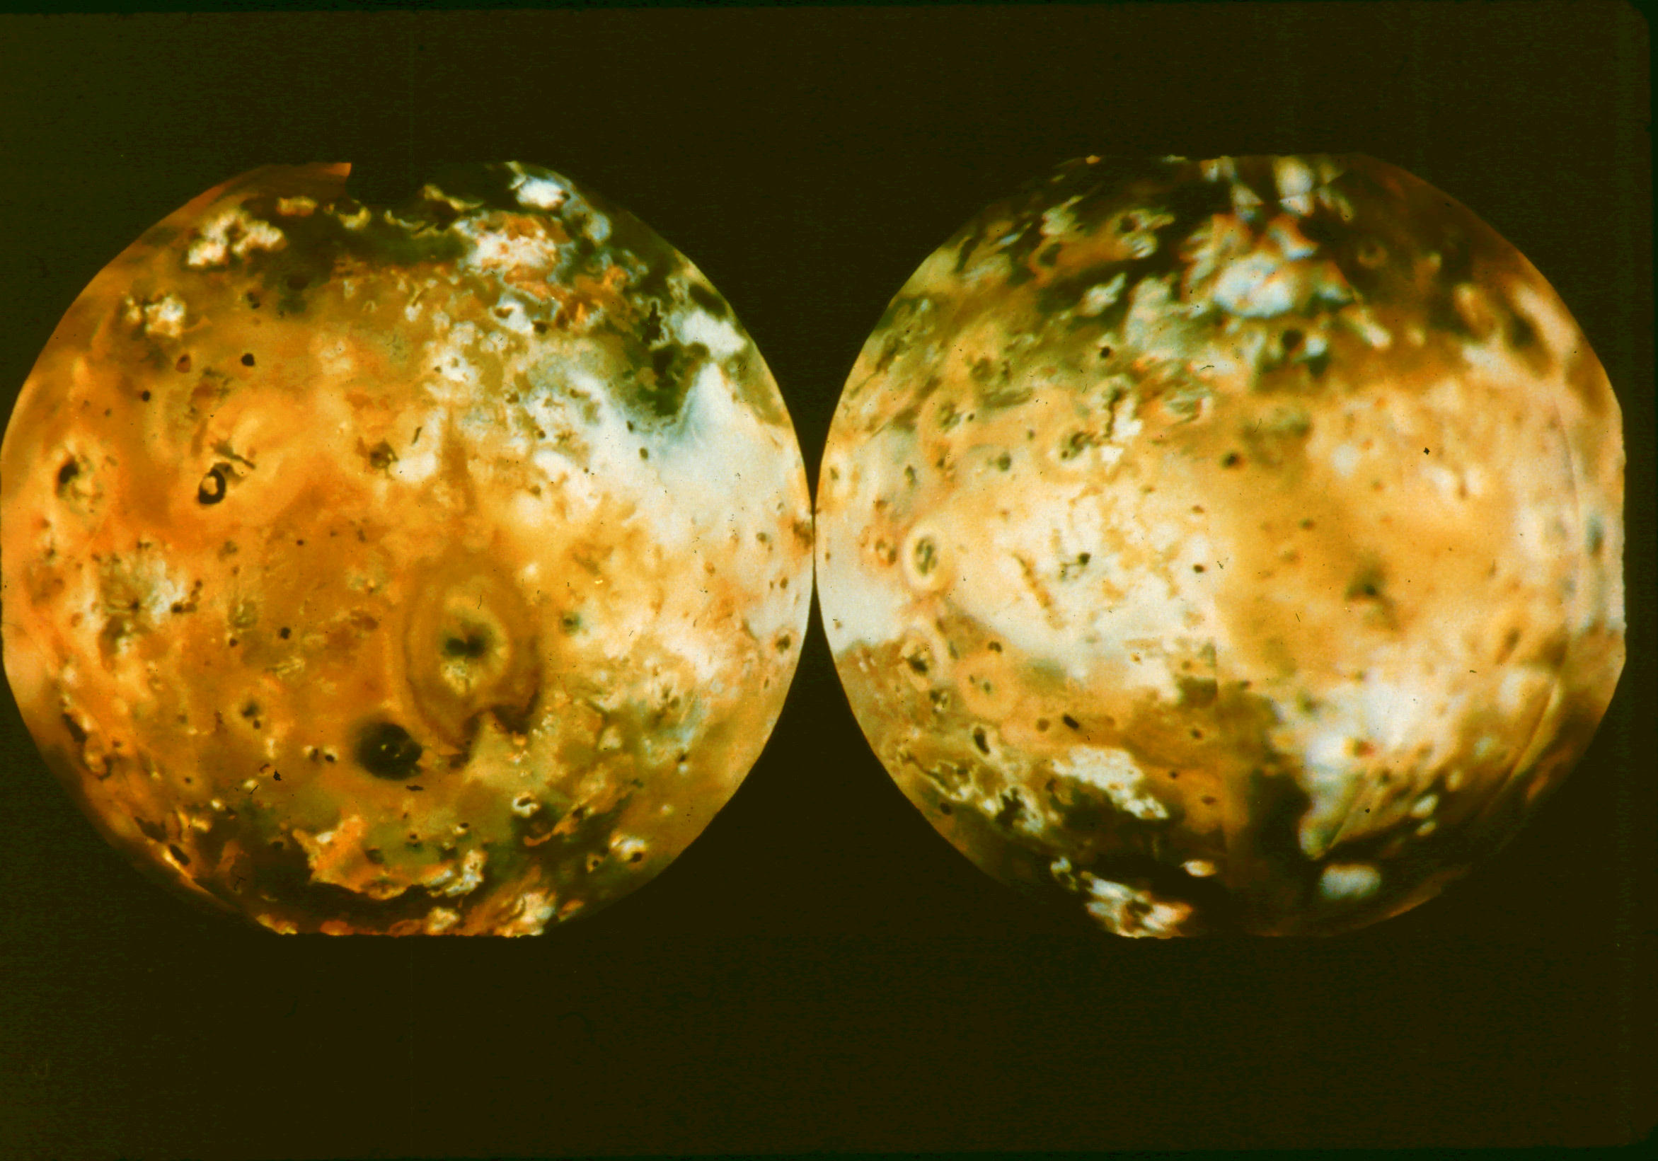
Io

Slide 71
Europa surface

Slide 72
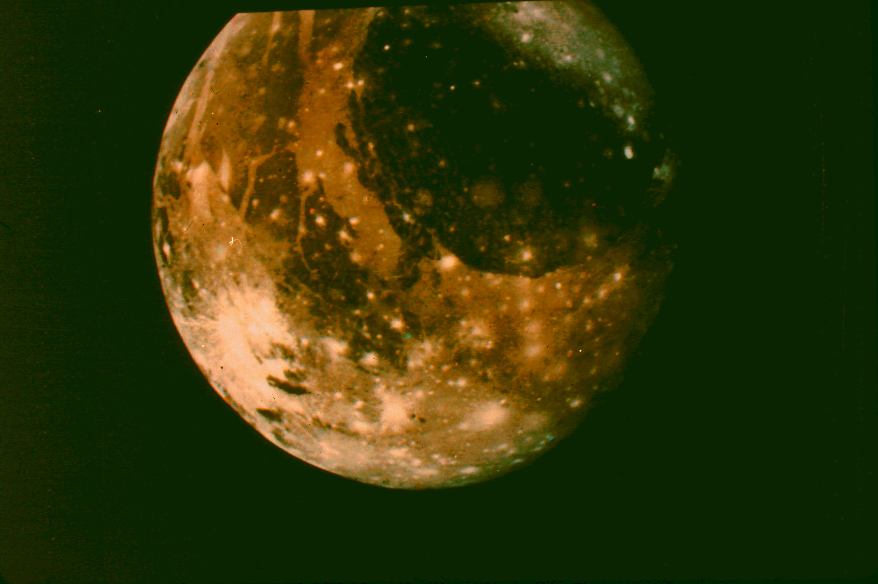
Ganymede

Slide 73
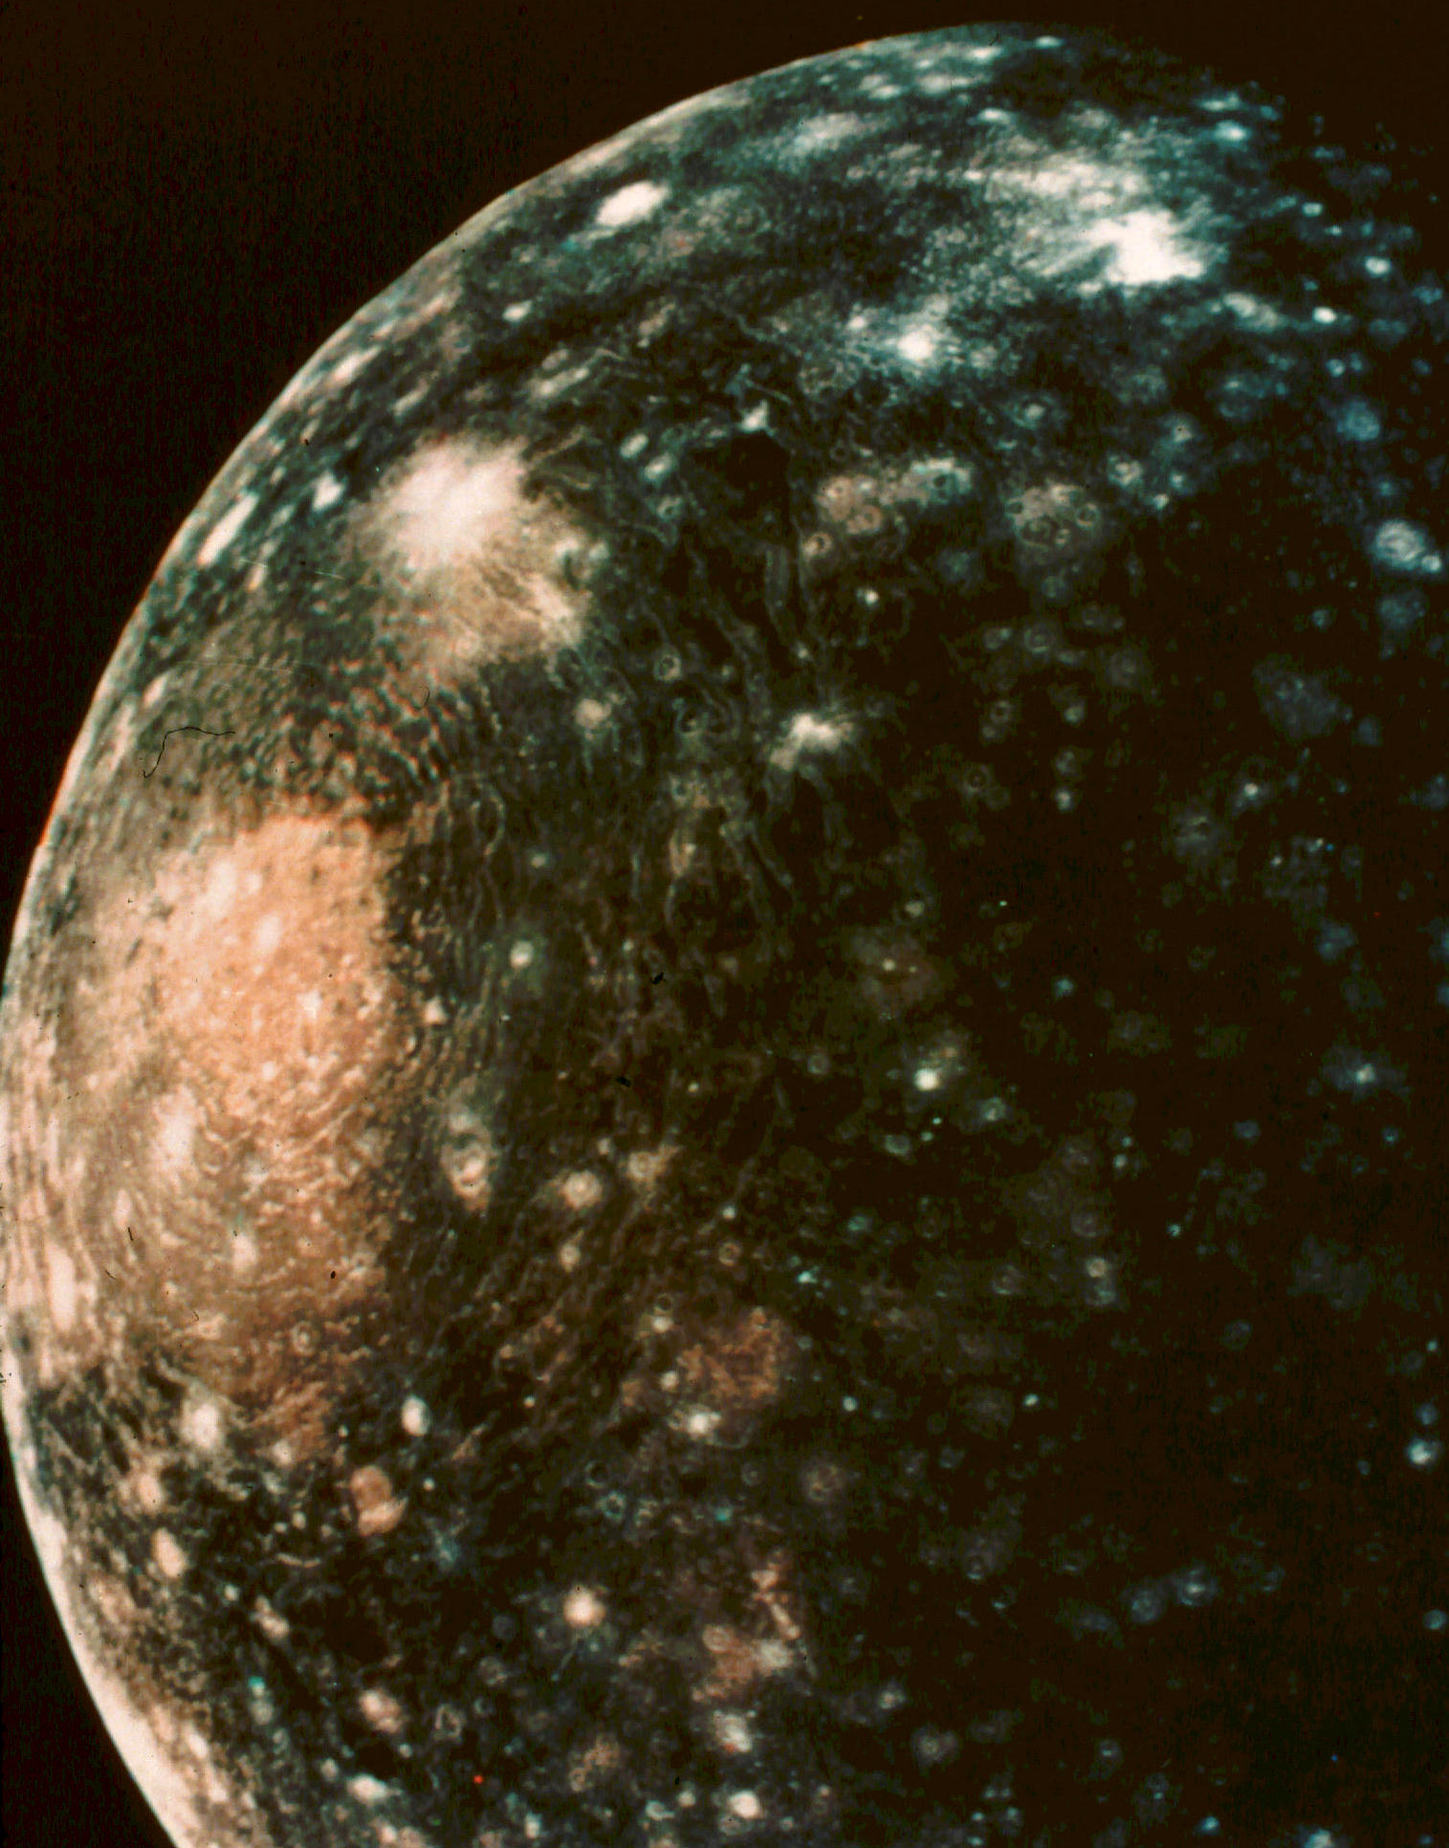
Callisto

Slide 74
Jupiter's Radio Image

Slide 75
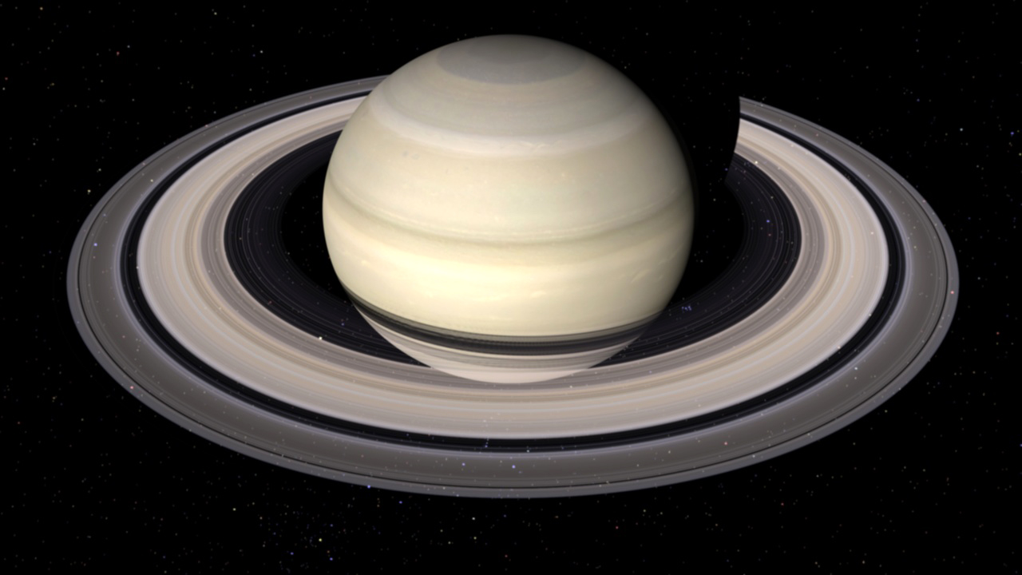
Saturn

Slide 76
Saturn
Saturn is the 2nd largest of the solar system's planets, with a radius 9.5 times that of earth and a mass 95 times larger.
It is the least dense of the planets, with a density less than that of water.
Saturn's orbit has a radius of 9.5 AU and a period of 29.5 years.

Slide 77
Saturn's Rings
Saturn is best known for its spectacular rings, though we now realize that Jupiter, Uranus and Neptune also have rings.
There are five rings visible from earth, but on close approach these resolve into thousands of separate rings.
The ring system is about 170,000 miles across, but only about 10 miles thick.
The rings are apparently made of ice particles a few inches to a foot in diameter.

Slide 78
Saturn's Moons
Saturn, too, has lots of moons, but only one large one, Titan, which is larger than our moon, and (like Ganymede) larger than Mercury also.
Titan has a significant atmosphere, mostly nitrogen, and a thick haze, at about 200 miles. It appears to have methane seas.
Five other moons are over 100 miles in radius.

Slide 79
Crescent Saturn

Slide 80
Ring structure

Slide 81
Titan

Slide 82
Atmospheres Compared

Slide 83
Titan Surface

Slide 84
Uranus

Slide 85
Uranus
Uranus and Neptune are also nearly twin planets. Uranus has an orbit at 19.2 AU, with a period of 84 years.
The planet is 4.1 times larger than earth, with a mass 14.5 times earth’s.
Uranus' axis is titled nearly 90 degrees from its orbital plane, giving the planet a very strange sequence of day & night.

Slide 86
Uranus' Moons
Uranus, too, has lots of moons, but only five of them are over 100 miles in radius. None are half as large as our moon.
Uranus has a number of rings, at least ten of which are known at present.

Slide 89
Uranus' Rings

Slide 90
Neptune

Slide 91
Neptune
Neptune is the outermost of the giant planets in our solar system. Its orbit has a radius of 30 AU, and its period is 165 years.
The planet is 3.9 times larger than earth, with a mass 17 times larger.
The color of the planet is surprising, as it was expected to be blander than Uranus.

Slide 92
Other Features
Neptune has rings, as mentioned before.
The atmosphere has markings, of which the most striking is the Great Dark Spot, thought to be a storm rather like Jupiter's Red Spot.
Neptune has some 8 moons, of which 6 were discovered by the Voyager 2 flyby. The largest moon, Triton, is nearly as big as our moon.

Slide 93
Great Dark Spot

Slide 94
Neptune's Rings

Slide 95
Triton

Slide 96
Pluto & Beyond

Slide 97
Pluto
Discovered in 1930, Pluto was long considered the 9th and outermost planet of the solar system. It was demoted to a new category of ‘dwarf planet’ in 2006 by the IAU, after a still larger object (since named Eris) was discovered beyond Pluto.
Pluto is about 18% the size of earth, its mass only about .3% of earth’s.
Pluto has an elliptical orbit of radius ~39 AU, and takes 248 years to go around the sun.

Slide 98
More on Pluto
Pluto has a large moon Charon, that is about ½ the size of Pluto.
It is now thought that Pluto, Charon, Eris, and several other objects about ¾ Pluto’s size (Quaor, Orcus, and Sedna) are all Kuiper Belt objects, and there may be hundreds of these orbiting our sun.
Contrasted with Pluto's 39 AU orbit, Eris ranges from 38 to 97 AU, Sedna from 76 to 975 AU.

Slide 100
Eris

Slide 101
HAUMEA
MAKEMAKE

Slide 102
The End

