Slide 1

The Significance of Christmas
Robert C. Newman

Slide 2
The Significance of Christmas
"But when the time had fully come, God sent his Son, born of a woman, born under law, to redeem those under law, that we might receive the full rights of sons." – Galatians 4:4-5

Slide 3
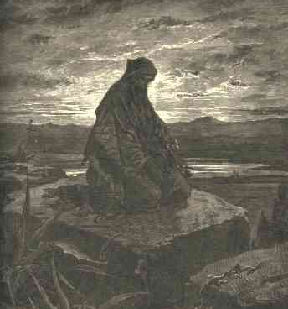
When the Time had fully come…
Preparation & Prophecy

Slide 4
Preparation: the Right Time
The coming of Alexander the Great (c330 BC)
The spread of Greek language & culture
Result: a single language known throughout the Mediterranean for some 900 years.
The Bible comes to be translated into Greek and so understandable throughout the whole Greco-Roman world.

Slide 5
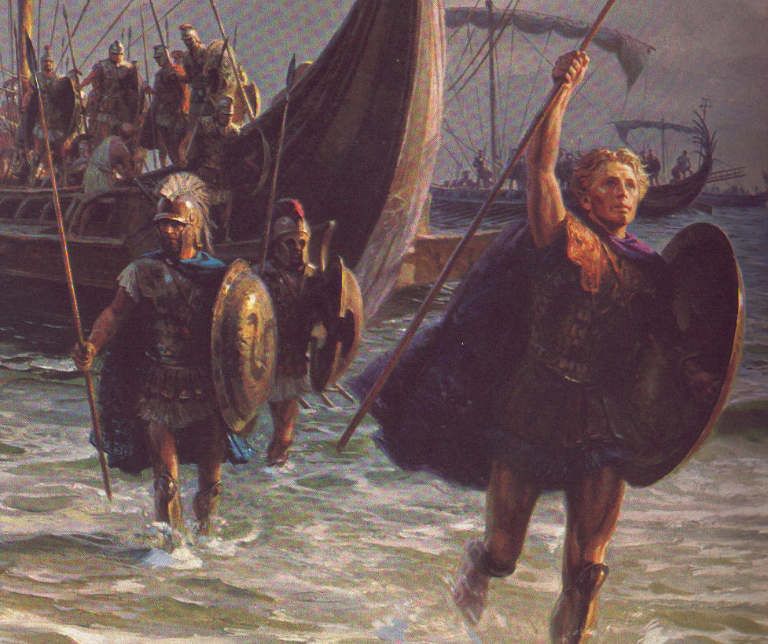
Alexander

Slide 6
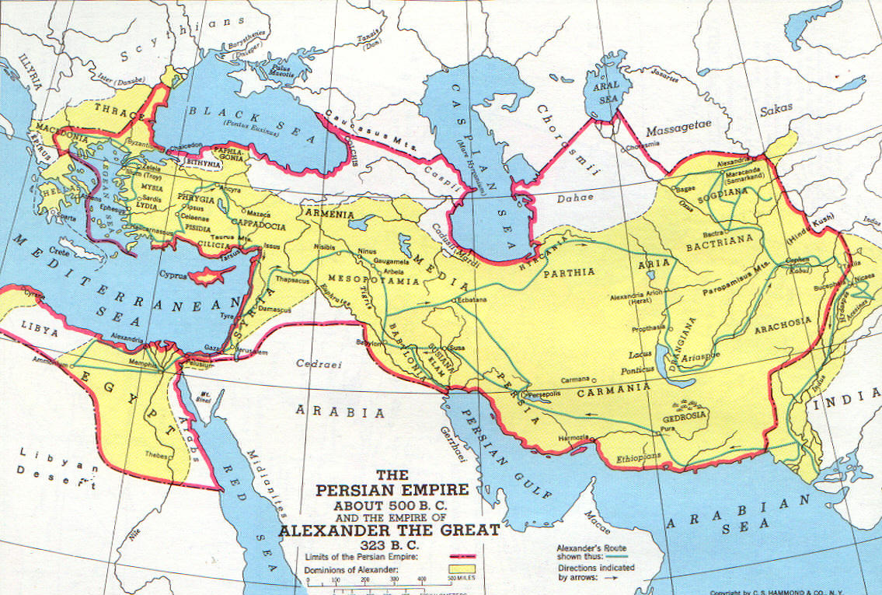
His Empire

Slide 7
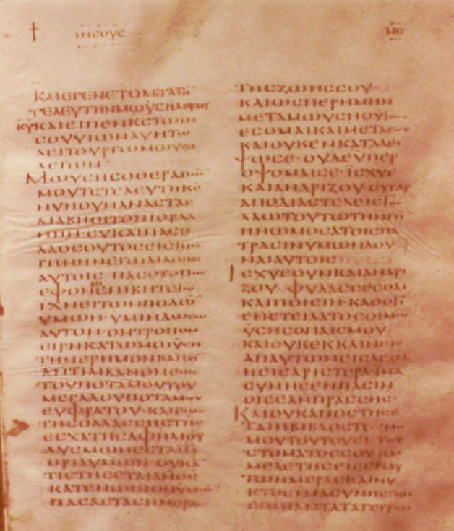
The Bible in Greek
The first page of Joshua in Greek

Slide 8
Preparation: the Right Time
The Spread of the Roman Empire (c30 BC)
Continues to about AD 475
Roman peace for the first 200 years
Lack of barriers, easy travel
Jews in virtually every city:
  Synagogues where God is worshiped
  The Bible available in Greek

Slide 9
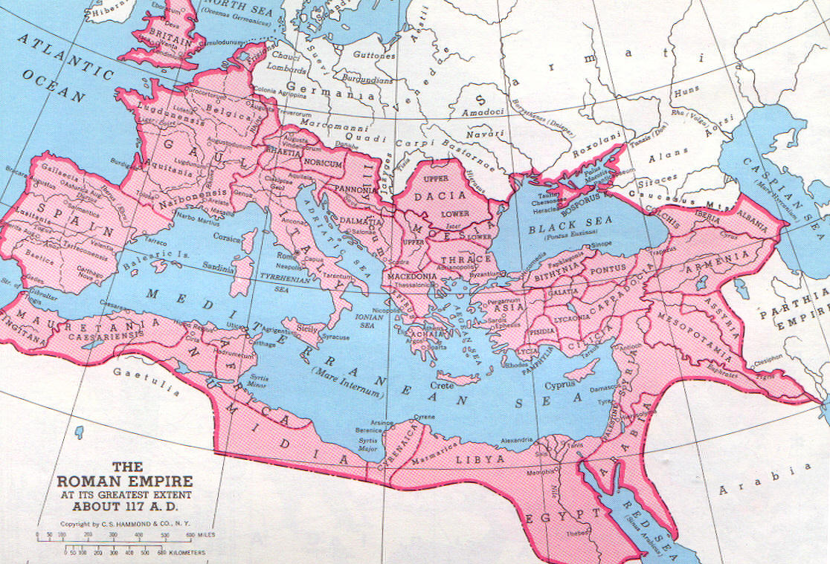
The Roman Empire

Slide 10
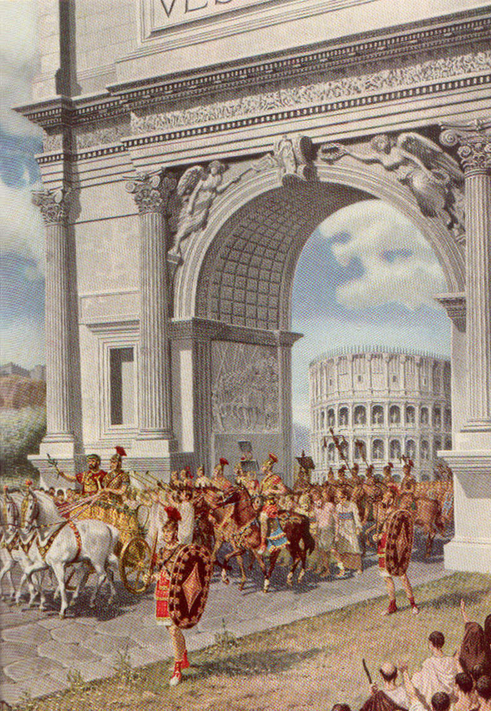
The Roman Peace
Peace enforced by a small but effective army.

Slide 11
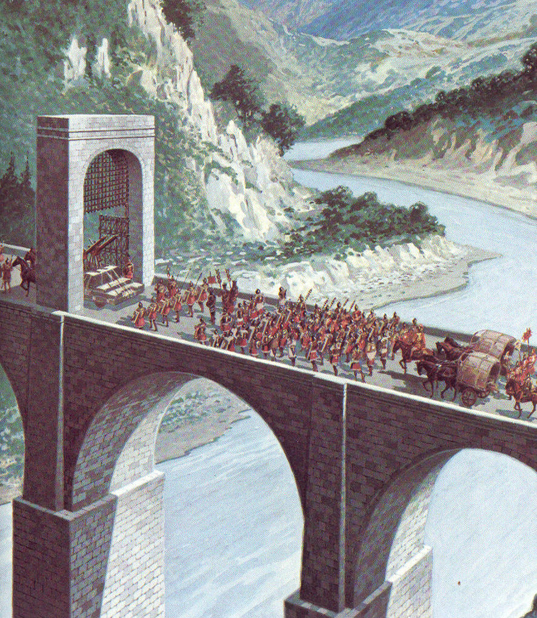
Easy Travel
A bridge, part of the Roman road system

Slide 12
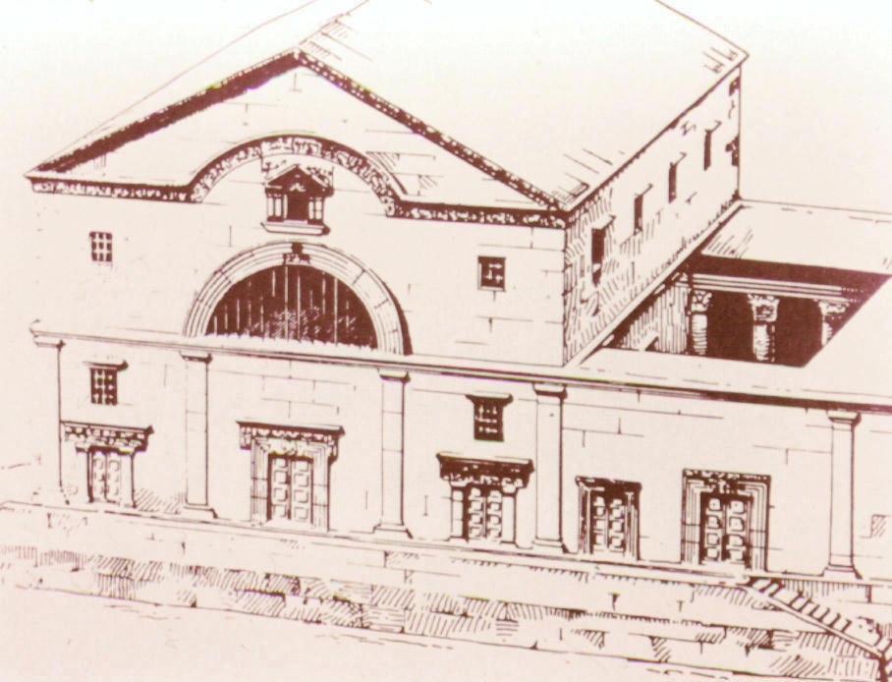
Jewish Synagogue
Reconstruction of synagogue in Capernaum

Slide 13
Prophecy: the Announced Time
"Know and understand this: From the issuing of the decree to restore and rebuild Jerusalem until the Anointed One, the ruler, comes, there will be seven 'sevens,' and sixty-two 'sevens.' It will be rebuilt with streets and a trench, but in times of trouble. After the sixty-two 'sevens,' the Anointed One will be cut off and will have nothing." – Daniel 9:25-26

Slide 14
Daniel's "Sevens"
449 442 435 428 421 414 407 BC
⬇
1 2 3 4 5 6
… AD 7 14 21 28 35

65 66 67 68 69
⬇ Artaxerxes' decree, 445 BC
 Jesus' crucifixion, 30 AD

Slide 15
God sent His Son…
The coming of Jesus

Slide 16
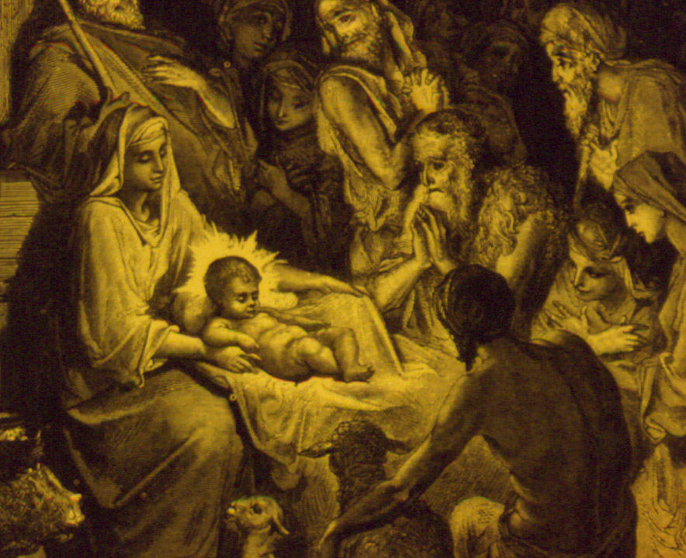
Born of a Virgin
God enters the human race to rescue us.
He takes on our humanity, yet without sin.
Jesus is the only being in the universe who is both created & uncreated.
Having volunteered to become created, he does not owe his obedience to God, and can give it away.

Slide 17
Born at Bethlehem
“But you, Bethlehem Ephrata, though you are small among the clans of Judah, out of you will come for me one who will be ruler, whose origins* are from of old, from ancient times." – Micah 5:2
*activities, campaigns

Slide 18
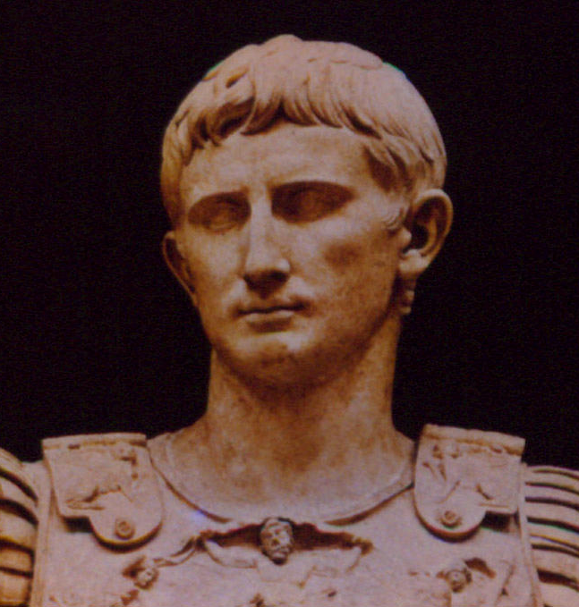
Born at Bethlehem
How in Bethlehem, since Mary & Joseph are both living in Nazareth, some 60 miles away?
God uses a Roman emperor, Augustus, to decree a census, which forces them to go there.

Slide 19
Born at Bethlehem
"In those days Caesar Augustus issued a decree that a census should be taken of the entire Roman world… And everyone went to his own town to register. So Joseph also went up from the town of Nazareth in Galilee to Judea, to Bethlehem, the town of David, because he belonged to the house and line of David. He went there with Mary, who was pledged to be married to him and was expecting a child. While they were there, the time came for the baby to be born." – Luke 2:1-6

Slide 20
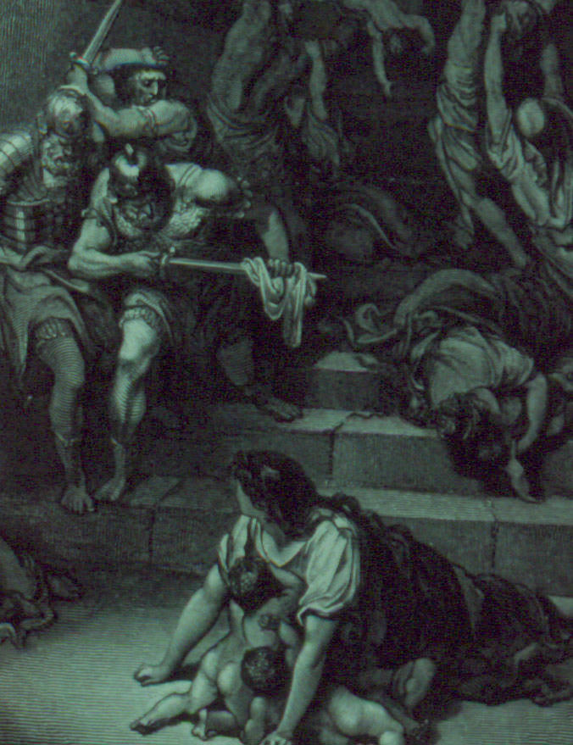
To Egypt and Back
Jesus is opposed by Satan, who tries (through Herod) to have him killed.
God uses the Magi so Jesus and his family escape.
Jesus succeeds where Israel failed, resisting temptation in the wilderness.

Slide 21
To redeem us…
Jesus Pays for Our Sin

Slide 22
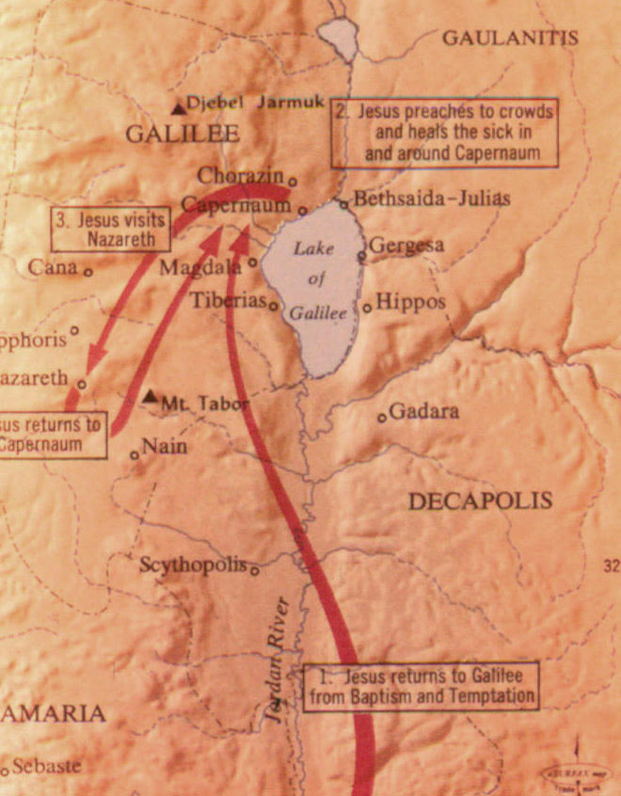
Beginning in Galilee
The Messiah (Christ) comes as a child.
The light first dawns in Galilee

Slide 23
Messiah Comes as a Child
"For to us a child is born, to us a son is given, and the government will be on his shoulders. And he will be called Wonderful Counselor, Mighty God, Everlasting Father, Prince of Peace. Of the increase of his government and peace there will be no end. He will reign on David's throne and over his kingdom, establishing and upholding it with justice and righteousness from that time on and forever." – Isaiah 9:6-7

Slide 24
The Light First Shines in Galilee
"Nevertheless, there will be no more gloom for those who were in distress. In the past he humbled the land of Zebulun and the land of Naphtali, but in the future he will honor Galilee of the Gentiles, by the way of the sea, along the Jordan — The people walking in darkness have seen a great light; on those living in the land of the shadow of death a light has dawned…" – Isaiah 9:1-2

Slide 25
He Suddenly Comes to His Temple
"See, I will send my messenger, who will prepare the way before me. Then suddenly, the Lord you are seeking will come to his temple, the messenger of the covenant, whom you desire, will come," says the LORD Almighty. But who can endure the day of his coming? Who can stand when he appears? For he will be like a refiner's fire or a launderer’s soap. – Malachi 3:1-2

Slide 26
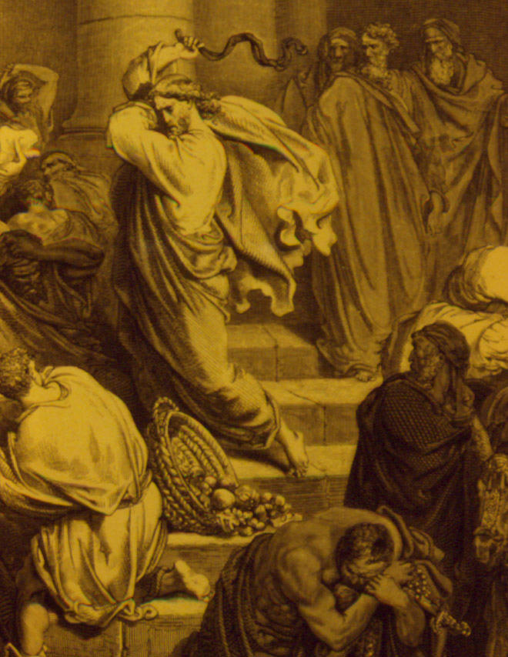
He Suddenly Comes to His Temple
The Lord, whom you seek will come.
But who can stand when he appears?
He will bring cleansing.
Jesus clears out the money changers who are trading in the temple.

Slide 27
His Death
"My strength is dried up like a potsherd, and my tongue sticks to the roof of my mouth; you lay me in the dust of death. Dogs have surrounded me; a band of evil men has encircled me, they have pierced my hands and feet. I can count all my bones; people stare and gloat over me. They divide my garments among them and cast lots for my clothing." – Psalm 22:15-18

Slide 28
His Death
"Surely he took up our infirmities and carried our sorrows, yet we considered him stricken by God, smitten by him, and afflicted. But he was pierced for our transgressions, he was crushed for our iniquities; the punishment that brought us peace was upon him, and by his wounds we are healed. We all, like sheep, have gone astray, each of us has turned to his own way, and the LORD has laid on him the iniquity of us all." – Isaiah 53:4-6

Slide 29
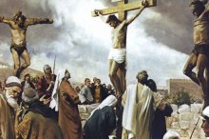
His Death
Described centuries in advance:
  Humiliated
  Thirsty
  Surrounded by enemies
  Pierced hands & feet
  Gambling for clothing
Paid for our sins
  We thought he was being punished for his sins.
  But he was suffering for ours.

Slide 30
His Resurrection
"He was assigned a grave with wicked men, but he was with a rich man in his death, because he had done no violence, nor was any deceit in his mouth. Yet it was the LORD's will to crush him and cause him to suffer, and though the LORD makes his life a guilt offering, he will see his offspring and prolong his days, and the will of the LORD will prosper in his hand. After the suffering of his soul, he will see the light of life and be satisfied; by knowledge of him my righteous servant will justify many, and he will bear their iniquities." – Isaiah 53:9-11

Slide 31
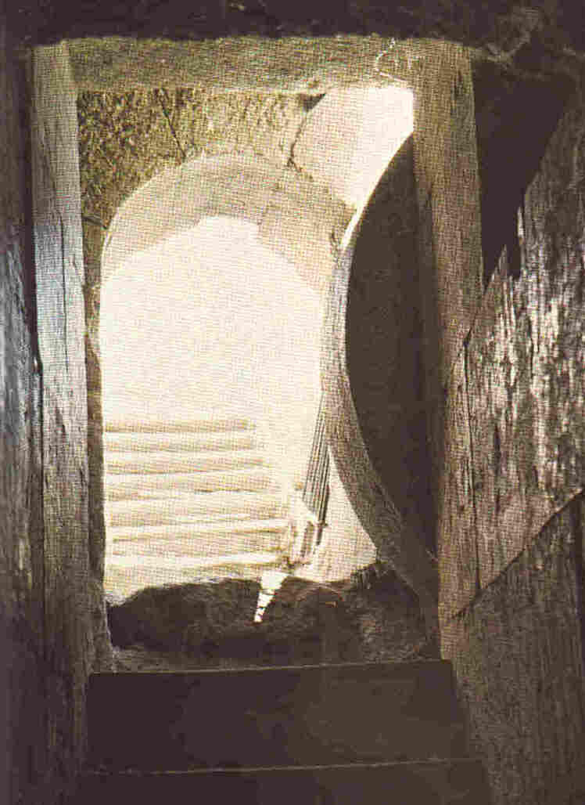
His Resurrection
Also described centuries in advance.
Buried, but not with the wicked.
Made a guilt offering.
Afterward, he prolongs his days, he sees the light of life.

Slide 32
The Significance of Christmas
"But when the time had fully come, God sent his Son, born of a woman, born under law, to redeem those under law, that we might receive the full rights of sons." – Galatians 4:4-5

Slide 33
The Significance of Christmas
Christmas is especially a time for gifts.
God gave his only Son to pay for our sins.
We can have this gift if we will turn back to Him.

Slide 34
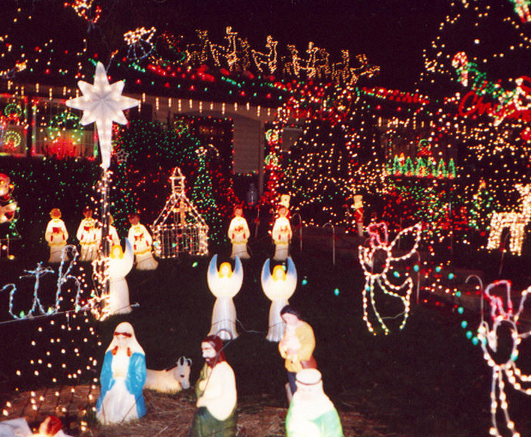
The Significance of Christmas
Christmas is especially a time of lights.
God sent his Son to be the Light of the World.
We do not need to walk in darkness.
We can have the light of eternal life!

Slide 35
This can be the beginning…
May you find Jesus this Christmas season!

