Slide 1

Search for the Historical Jesus
Robert C. Newman
Biblical Theological Seminary

Slide 2




Will the real Jesus please stand up?
?
?
?
?

Slide 3
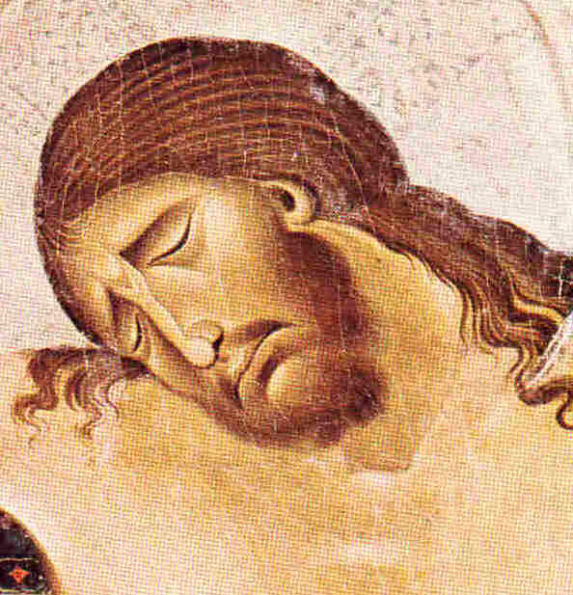
Some Recent Examples
The Last Temptation of Christ
Jesus Christ Superstar
The Passover Plot
The Sacred Mushroom & the Cross
Jesus the Magician
The DaVinci Code

Slide 4
The Last Temptation of Christ
Novel (1955) - Nikos Kazantzakas
Film (1988) - Martin Scorsese
Plot: Jesus…
  Makes crosses for Romans
  Gathers followers as prophet
  Loves or hates Romans?
  Gets Judas to betray him
  Fantasizes on cross re/ sex & marriage
  Rejects temptation, dies

Slide 5

Jesus Christ Superstar
Rock opera (1971) & film (73) by Andrew Lloyd-Weber & Tim Rice
Plot:
  Jesus a superstar religious guru, his fame goes to his head
  Begins believing what others say about him, leading to cross
  Blames God, but dies anyway
  Judas speaks from grave, also blames God
  No resurrection

Slide 6

The Passover Plot
Book (1966) – Schonfield
Here Jesus has (almost) everything under control:
  Learns to interpret prophecy
  Decides he is Messiah
  Sets out to fulfill prophecy
  Stages triumphal entry
  Blows Judas' mind
  Times events so only on cross briefly
  (But speared by soldier)
  Revived in tomb, sends message, dies

Slide 7

Sacred Mushroom & the Cross
Book (1970) by John M. Allegro
A super plot theory!
  Jesus never existed…
  … neither did Christianity!
  … nor Judaism!
All are code-words & covers for a super-secret sex-drug cult.
When all in on the secret die off, the movements continue as Christianity & Judaism.

Slide 8

Jesus the Magician
Book (1978) by Morton Smith
Jesus a gnostic magician
  Possessed by a spirit
  Claimed to be deity
Develops self-hypnosis
  Claimed to fly & taught flying
  Visited heaven, saw God
  Freed by God from Law

Slide 9

The DaVinci Code
A murder mystery (2003), set in the present
Yet the plot turns on the idea that Jesus was merely human, that he had children, and that the Holy Grail is Jesus' royal blood-line.

Slide 10
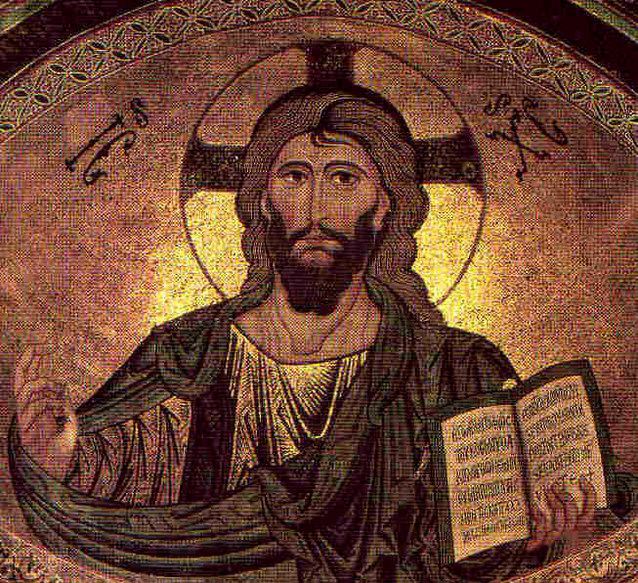
Why all this variety?
Are the Gospels really this unclear?
No…
…but if you haven't read them, you're a sucker for every charlatan that comes along.
But why all this variety?

Slide 11
Why all this variety?
Many don't like the biblical Jesus.
  He interferes with their preferred lifestyle.
Many won't admit the occurrence of miracles.
  Hume – would you believe a miracle report?
  Harnack – ancient people ignorant of nature
  Bultmann – universe a closed system
So they reconstruct Jesus from hypothetical sources.

Slide 12
Historical Evidence on Jesus
There is significant historical information about Jesus:
Early pagan sources
Early Jewish sources
Early Christian sources
Let's see.

Slide 13
Early Pagan Sources
Cornelius Tacitus (55-120), Annals
  Historian, formerly secretary to emperor
Pliny the Younger (61-113), Letters
  Governor of Bithynia, writing to emperor Trajan
Mara bar Serapion (73-160), Letter to Son
  Syrian Stoic philosopher

Slide 14
Tacitus, Annals 15.44
But neither human help, nor imperial munificence, nor all the modes of placating Heaven, could stifle scandal or dispel the belief that the fire had taken place by order. Therefore to scotch the rumor, Nero substituted as culprits, and punished with the utmost refinements of cruelty, a class of men loathed for their vices, whom the crowd styled Christians. Christus, the founder of the name, had undergone the death penalty in the reign of Tiberius, by sentence of the procurator Pontius Pilatus, and the pernicious superstition was checked for a moment, only to break our once more…

Slide 15
Pliny the Younger, Letters 10.96
Pliny to the Emperor Trajan:
It is my custom to refer all my difficulties to you, Sir, for no one is better able to resolve my doubts and inform my ignorance. I have never been present at an examination of Christians… For the moment this is the line I have taken with all persons brought before me on the charge of being Christians. I have asked them in person if they are Christians, and if they admit it, I repeat the question a second and third time, with a warning of the punishment awaiting them. If they persist, I order them to be led away for execution…

Slide 16
Pliny the Younger, Letters 10.96
An anonymous pamphlet has been circulated which contains the names of a number of accused persons. Among these I considered that I should dismiss any who denied that they were or ever had been Christians, when they had repeated after me a formula of invocation to the gods and had made offerings of wine and incense to your statue, none of which things, I understand, any genuine Christian can be induced to do. Others, whose names were given me by an informer, first admitted the charge and then denied it; they said they had ceased to be Christians two or more years previously…

Slide 17
Pliny the Younger, Letters 10.96
They also declared that the sum total of their guilt or error amounted to no more than this: they had met regularly before dawn on a fixed day to chant verses alternately among themselves in honor of Christ as if to a god… This made me decide it was all the more necessary to extract the truth by torture from two slave-women, whom they call deaconesses. I found nothing but a degenerate sort of cult carried to extravagant lengths. I have therefore postponed any further examination and hastened to consult you.

Slide 18
Mara bar Serapion, Letter
For what else have we to say, when wise men are forcibly dragged by the hands of tyrants, and their wisdom is taken captive by calumny, and they are oppressed in their intelligence without defense? For what advantage did the Athenians gain by their murder of Socrates…. Or the people of Samos by the burning of Pythagoras… Or the Jews by the death of their wise king, because from that time their kingdom was taken away?

Slide 19
Mara bar Serapion, Letter
For with justice did God make recompense to the wisdom of these three: for the Athenians died of famine; and the Samians were overwhelmed by the sea without remedy; and the Jews, desolate and driven from their own kingdom, are scattered through every country. Socrates is not dead, because of Plato; neither Pythagoras, because of the statue of Juno; nor the wise King, because of the laws which he promulgated.

Slide 20
Summary on Pagan Sources
Jesus lived in Judea in the reign of Tiberius.
A Messianic claim was ascribed to him.
He apparently was a teacher.
He was put to death by Pontius Pilate and/or the Jews.
His followers continued after his death.
They worshiped Jesus as God, though they would not worship the gods.
They were willing to endure torture and death rather than curse Jesus.

Slide 21
Early Jewish Sources
Josephus, Antiquities of the Jews
  Participant on both sides of the Jewish War (66-73)
Agapius, Universal History
  Condensation of Josephus in Arabic, 10th century
Babylonian Talmud, Sanhedrin
  References to "Ben Pantera"
  A tradition from the period 70-200

Slide 22
Josephus, Antiquities 18.63-64
About this time there lived Jesus, a wise man, if indeed one ought to call him a man. For he was one who wrought surprising feats and was a teacher of such people as accept the truth gladly. He won over many Jews and many of the Greeks. He was the Messiah. When Pilate, on hearing him accused by men of highest standing among us, had condemned him to be crucified, those who had in the first place come to love him did not give up their affection for him. On the third day he appeared to them restored to life, for the prophets had prophesied these and countless other marvelous things about him.

Slide 23
Agapius, Universal History
Similarly Josephus the Hebrew…. At this time there was a wise man who was called Jesus. His conduct was good and he was known to be virtuous. And many people from among the Jews and the other nations became his disciples. Pilate condemned him to be crucified and to die. But those who had become his disciples did not abandon his discipleship. They reported that he had appeared to them three days after his crucifixion, and that he was alive; accordingly he was perhaps the Messiah, concerning whom the prophets have recounted wonders.

Slide 24
Babylonian Talmud and Celsus
The Babylonian Talmud and other early Jewish literature occasionally refer to an opponent named "Ben Pantera."
The pagan author Celsus (c150), in his anti-Christian work The True Account, says that Jewish sources claim Jesus is the illegitimate son of a Roman soldier Pantera and the Jewish girl Mary.

Slide 25
Talmud, Sanhedrin 43a
On the eve of Passover Yeshua was hanged. For forty days before the execution a herald went forth and cried, "He is going to be stoned because he has practiced sorcery and enticed Israel to apostasy. Anyone who can say anything in his favor, let him come forward and plead on his behalf." But since nothing was brought forward in his favor he was hanged on the eve of Passover.

Slide 26
Summary on Jewish Sources
Jesus lived in Judea during the rule of Pontius Pilate.
His birth was alleged to be unusual, illegitimate.
His character was controversial.
He worked miracles, also controversial.
He gathered followers, who considered him the Messiah.
He was condemned by Pilate, accused by Jews.
He was hanged/crucified on Passover eve.
His resurrection was reported on the third day.

Slide 27
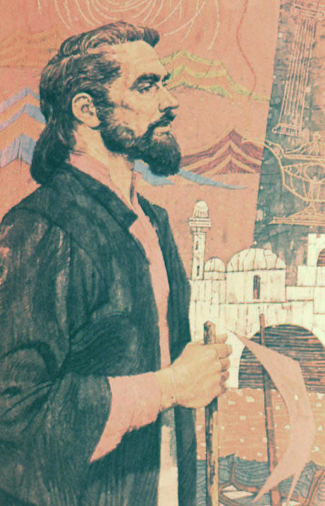
Early Christian Sources
The Gospels
  Matthew
  Mark
  Luke
  John
The Letters of Paul
  An early opponent of Xy
  Became a Xn when Jesus appeared to him

Slide 28
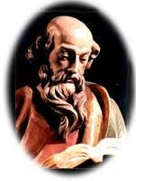
Paul, Letters
Jesus is God.
He is also human, a descendant of David.
He had brothers, including James.
Jesus taught, and appointed apostles.
He instituted the Lord's Supper.
He was killed by rulers.
He rose from the dead on the third day.
He has ascended to heaven.

Slide 29
Conclusions
The earliest sources, though they disagree in their estimation of Jesus, agree on several items which moderns often wish to reject:
  Jesus made a Messianic claim.
  Jesus worked miracles.
  Jesus was put to death by Roman-Jewish collaboration.
One can reject miracles only by discarding the very evidence from antiquity that points most strongly in this direction.

Slide 30
Conclusions
If miracles are not rejected in advance, the Gospels look good by the methods used by
  Secular historians
  Liberal New Testament scholars
Satan's strategy?
  Keep people off balance by bringing out a new Jesus every few years.
  Keep their attention away from the historical records.

Slide 31
C.S. Lewis' Trilemma
I am trying to prevent anyone saying the really foolish thing that people often say about [Jesus]: "I'm ready to accept Jesus as a great moral teacher, but I don’t accept his claim to be God." This is the one thing we must not say. A man who was merely a man and said the sort of things Jesus said would not be a great moral teacher. He would either be a lunatic – on a level with the man who says he is a poached egg – or else he would be the Devil of Hell. You must make your choice. Either this man was, and is, the Son of God, or else a madman or something worse.

Slide 32
What will you do with Jesus?
Is he:
  Liar?
  Lunatic?
  Lord of all?
There is no place for postmodernism here:
  He either is, or isn't, what he claimed to be.
  If he is, you must face him one day.

Slide 33
What will you do with Jesus?
The choice is yours.

