Slide 1
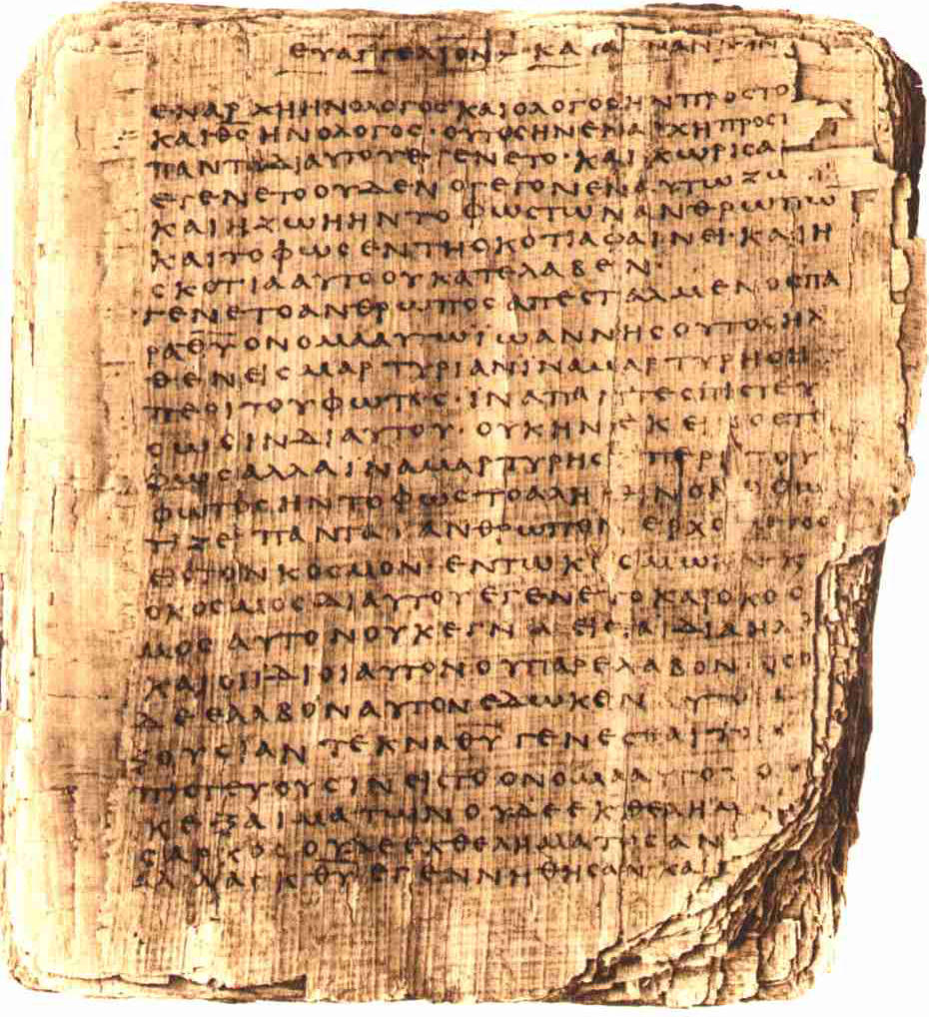

Scripture in the Early Church
Robert C. Newman

Slide 2
The Term "Scripture"
This is the traditional term used in English.
  It is borrowed from a Latin term Scriptura, meaning "what is written."
It is used in English Bibles to translate:
  The Greek graphai, grafai
  The Hebrew katuvim, {mybwtk
  Both of which mean "what is written."
  These terms are used to refer to the sacred writings given by God:
  To the Jewish people thru the prophets before the time of Christ;
  To the early church thru Jesus' chosen apostles.

Slide 3
How Was Scripture Used?
The Old Testament was used to bring the message of Jesus to Jews and to 'God-fearers' (non-Jews who worshiped with the Jews).
The Old Testament was used as a record of God’s activity in previous centuries, as a revelation of God's character and of human nature, and a guide for how believers ought to live.
The New Testament was prepared to record the testimony of the apostles, who would not be living much longer, to the person & work of Jesus.

Slide 4
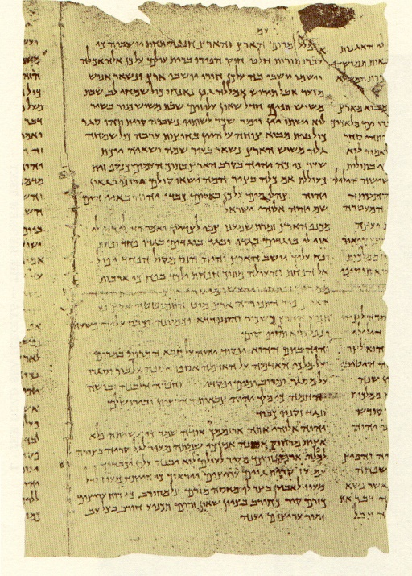
The OT is used to bring the message of Jesus to Jews & 'Godfearers.'

Slide 5
OT as Message of Jesus
Peter's speech to the crowds at the Jewish feast of Weeks (Pentecost) – Acts 2:14-39
Peter argues that the phenomenon they have witnessed, and the miracles of Jesus, are testimonies that Jesus is Messiah.
As fulfillments of OT Messianic prophecy, Peter cites
  Joel 2:28-32
  Psalm 16:8-11
  Psalm 110:1

Slide 6
OT as Message of Jesus
Stephen's speech to the Jewish supreme court (Sanhedrin) – Acts 7:2-53
They are trying Stephen for allegedly speaking against the Temple and the Law.
In response, Stephen recites Israel's history from OT, quoting:
  Genesis 12:1; 15:13-14
  Exodus 2:14; 3:6; 3:5-10
  Deuteronomy 18:15
  Exodus 32:1
  Amos 5:25-27
  Isaiah 66:1-2

Slide 7
OT as Message of Jesus
Philip's conversation with the Ethiopean official – Acts 8:26-40
The official is reading Isaiah 53, and asks for Philip's help in understanding it.
Philip explains that Isaiah 53 is describing the sacrificial death of Jesus centuries in advance.

Slide 8
OT as Message of Jesus
Paul's speech in the synagogue at Antioch of Pisidia – Acts 13:16-41
Speaking at the request of the synagogue officials, Paul recites Israel's history, showing how the various promises & prophecies point to Jesus. He cites:
  Psalm 2:7
  Isaiah 55:3
  Psalm 16:10
  Habakkuk 1:5

Slide 9
OT as Message of Jesus
Paul's speech to the leaders of the Jewish community at Rome – Acts 28:17-28
Paul explains why he has been sent in chains to Rome, that he is a messenger about Jesus and the kingdom of God.
  He seeks to convince them about Jesus from the Law & the Prophets
  He cites Isaiah 6:9-10 as a prophecy about Jewish resistance to this message.

Slide 10
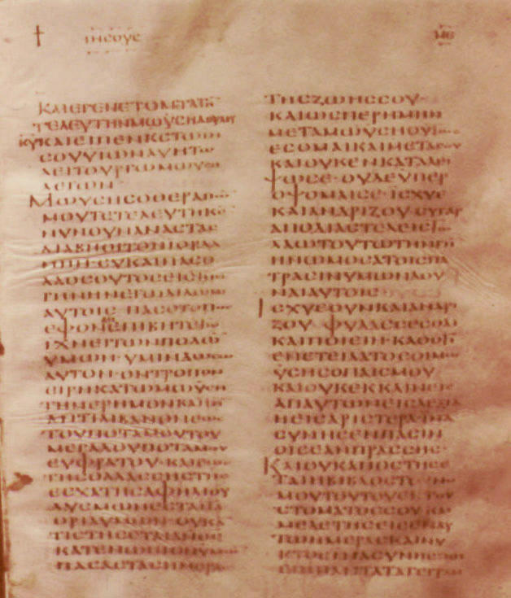
The OT is used as a record of God's activity in the past, as a revelation of God’s character & of human nature, and as a guide for how believers ought to live.

Slide 11
OT as Record and Guide
Peter's argument for choosing a successor to Judas – Acts 1:15-22
Peter cites OT prophecy regarding the fate of Judas, implying that his place should be filled by a successor:
  Psalm 69:25
  Psalm 109:8

Slide 12
OT as Record and Guide
The believers' prayer in the face of persecution – Acts 4:23-30
The Christians recognize that the rulers' persecution of believers is a fulfillment of prophecy and ask for strength & boldness to carry out God's commission.
  Cites Psalm 2:1-2

Slide 13
OT as Record and Guide
James' argument at the council of Jerusalem for accepting Gentiles – Acts 15:13-21
James notes that the OT predicts that there will be Gentiles who bear God's name, so that they need not become Jews in order to be saved.
  Cites Amos 9:11-12

Slide 14
OT as Record and Guide
Paul's argument that no one is good enough to be acceptable to God – Romans 3:9-20.
Paul cites a series of OT passages:
  Psalm 14:1-3 (= 53:1-3)
  Psalm 5:9
  Psalm 140:3
  Psalm 10:7
  Isaiah 59:7-8
  Psalm 36:1

Slide 15
OT as Record and Guide
Paul's argument that sinners are given forgiveness rather than earning it – Romans 4:1-8
Paul notes that neither Abraham nor David was accepted because of good works:
  Example of Abraham, Genesis 15:6,22
  Example of David, Psalm 32:1-2

Slide 16
OT as Record and Guide
Paul's response to concern that Jews rejected their Messiah – Romans 9-11
Paul, too, is concerned, but this does not argue against Christianity as it was predicted. He cites about 30 passages from OT:
  Mostly from Genesis, Exodus, Deuteronomy, 1 Kings, Psalms, Isaiah, Hosea

Slide 17

The NT was prepared to record the testimony of the apostles, who would not be living much longer, to the person & work of Jesus.

Slide 18
NT as Testimony of Apostles
Luke 1:1-4
John 20:30-31
John 21:22-24
1 Timothy 1:3-7
1 Timothy 3:14-15
1 Peter 1:12-15
2 John 7-11

Slide 19
Luke 1:1-4
Luke 1:1 (NIV) Many have undertaken to draw up an account of the things that have been fulfilled among us, 2 just as they were handed down to us by those who from the first were eyewitnesses and servants of the word. 3 Therefore, since I myself have carefully investigated everything from the beginning, it seemed good also to me to write an orderly account for you, most excellent Theophilus, 4 so that you may know the certainty of the things you have been taught.

Slide 20
John 20:30-31
John 20:30 (NIV) Jesus did many other miraculous signs in the presence of his disciples, which are not recorded in this book. 31 But these are written that you may believe that Jesus is the Christ, the Son of God, and that by believing you may have life in his name.

Slide 21
John 21:22-24
John 21:22 (NIV) Jesus answered, "If I want him to remain alive until I return, what is that to you? You must follow me." 23 Because of this, the rumor spread among the brothers that this disciple would not die. But Jesus did not say that he would not die; he only said, "If I want him to remain alive until I return, what is that to you?" 24 This is the disciple who testifies to these things and who wrote them down. We know that his testimony is true.

Slide 22
1 Timothy 1:3-7
1Tim 1:3 (NIV) As I urged you when I went into Macedonia, stay there in Ephesus so that you may command certain men not to teach false doctrines any longer 4 nor to devote themselves to myths and endless genealogies. These promote controversies rather than God's work–which is by faith. 5 The goal of this command is love, which comes from a pure heart and a good conscience and a sincere faith. 6 Some have wandered away from these and turned to meaningless talk. 7 They want to be teachers of the law, but they do not know what they are talking about or what they so confidently affirm.

Slide 23
1 Timothy 3:14-15
1Tim 3:14 (NIV) Although I hope to come to you soon, I am writing you these instructions so that, 15 if I am delayed, you will know how people ought to conduct themselves in God's household, which is the church of the living God, the pillar and foundation of the truth.

Slide 24
1 Peter 1:12-15
1Pet 1:12 (NIV) It was revealed to them that they were not serving themselves but you, when they spoke of the things that have now been told you by those who have preached the gospel to you by the Holy Spirit sent from heaven. Even angels long to look into these things. 13 Therefore, prepare your minds for action; be self-controlled; set your hope fully on the grace to be given you when Jesus Christ is revealed. 14 As obedient children, do not conform to the evil desires you had when you lived in ignorance. 15 But just as he who called you is holy, so be holy in all you do.

Slide 25
2 John 7-11
2Joh 1:7 (NIV) Many deceivers, who do not acknowledge Jesus Christ as coming in the flesh, have gone out into the world. Any such person is the deceiver and the antichrist. 8 Watch out that you do not lose what you have worked for, but that you may be rewarded fully. 9 Anyone who runs ahead and does not continue in the teaching of Christ does not have God; whoever continues in the teaching has both the Father and the Son. 10 If anyone comes to you and does not bring this teaching, do not take him into your house or welcome him. 11 Anyone who welcomes him shares in his wicked work.

Slide 26
The End
May we, too, use the Bible as the early Christians did, to testify to the reality and truth of Jesus' claims!

