Slide 1
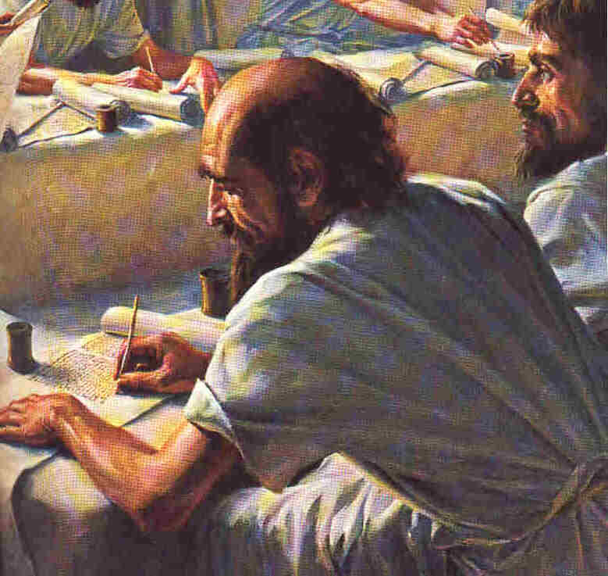
Scribes of the Kingdom
Matthew 13:51-52
Robert C. Newman

Slide 2
Matthew 13:51-52
51 (NIV) "Have you understood all these things?" Jesus asked.
"Yes," they replied.
52 He said to them, "Therefore every teacher of the law who has been instructed about the kingdom of heaven is like the owner of a house who brings out of his storeroom new treasures as well as old."

Slide 3
Context
This passage comes at the end of the kingdom parables in Matthew 13.
Jesus has unpacked some of these parables for his disciples, others have been left unexplained.
Of these latter parables, some are still argued over nearly 2,000 years later.
It is thus something of a surprise that the disciples claim to understand them all!

Slide 4
Scribes
The word which the NIV translates “teacher of the law” is translated “scribe” by the KJV, NKJV, RSV, NRSV, NASB and NASU.
Originally the scribe was one who wrote or copied documents in the ages before printing, typewriters or word processors.
But before the end of the OT period, the term had broadened to cover one who specialized in the study of the Bible.

Slide 5
Ezra the Scribe
Ezra 7:1 (NASU) Now after these things, in the reign of Artaxerxes king of Persia, [there went up] Ezra son of Seraiah, son of Azariah, son of Hilkiah … 5 son of Abishua, son of Phinehas, son of Eleazar, son of Aaron the chief priest. 6 This Ezra went up from Babylon, and he was a scribe skilled in the law of Moses, which the Lord God of Israel had given; and the king granted him all he requested because the hand of the Lord his God [was] upon him.
Ezra 7:11 (NASU) Now this is the copy of the decree which King Artaxerxes gave to Ezra the priest, the scribe, learned in the words of the commandments of the Lord and His statutes to Israel:

Slide 6
Scribes in the New Testament
Most of the occurrences of “scribe” in the NT appear in the combination “scribes and Pharisees.”
These were among the most adamant opponents of Jesus, so the term usually does not have a good connotation.
In spite of this, Jesus gives a place for “scribes of the Kingdom” among his followers, both in our passage here, and in Matthew 23:34.

Slide 7
Matthew 23
34 (NASU) "Therefore, behold, I [Jesus] am sending you prophets and wise men and scribes; some of them you will kill and crucify, and some of them you will scourge in your synagogues, and persecute from city to city, 35 so that upon you may fall [the guilt of] all the righteous blood shed on earth, from the blood of righteous Abel to the blood of Zechariah, the son of Berechiah, whom you murdered between the temple and the altar.

Slide 8
What Our Passage Teaches
He [Jesus] said to them, "Therefore every teacher of the law who has been instructed about the kingdom of heaven is like the owner of a house who brings out of his storeroom new treasures as well as old."
In our passage (Matthew 13:52), Jesus tells us something about:
The Responsibility of the Kingdom Scribe
The Method of the Kingdom Scribe
Let’s see.

Slide 9
Responsibility
Christian ‘scribes’ have the responsibility of teaching others:
Even while still learning themselves
This passage occurs in the latter part of Jesus’ Galilean ministry, so much of the education of the apostles still lies ahead of them.
But their responsibility is for what they already know & understand
Note the immediate context: they had just understood Jesus’ parables on the kingdom.

Slide 10
Method
Christian scribes should teach like a householder showing off his prized possessions.
Be enthusiastic, anxious that others see the treasure of God’s Word.
Teach both old and new things:
Don’t neglect the basic truths that now seem so simple to you; repetition is very important.
Keep studying, so that you can always be showing others new truths from God’s Word.

Slide 11
Conclusions
This was originally given in the chapel at Biblical School of Theology in January 1973, where the audience was primarily faculty and students preparing to be pastors, i.e., Christian scribes.
But in a sense, all Christians are called to be scribes.
We should all be practicing what we preach, and continually learning so that we may practice and preach the Way of Life more accurately.

Slide 12
The End
May God help us to be faithful scribes of His kingdom!

