Slide 1
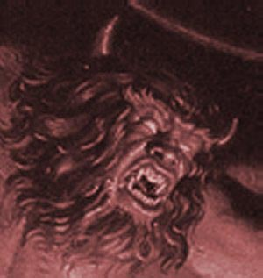

Satan’s Schemes
Robert C. Newman

Slide 2
Satan’s Schemes
In 2 Corinthians 2:11, Paul says:
  (NIV) … in order that Satan might not outwit us. For we are not unaware of his schemes.
Even if Paul & his first readers were aware of these schemes, are we?
What are Satan’s schemes?
We want to look at some of them here.

Slide 3
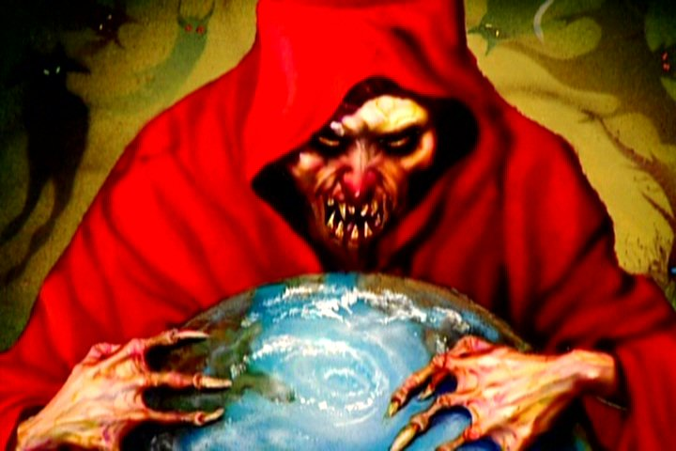
Satan’s Schemes against Unbelievers

Slide 4
Satan Traps
2 Timothy 2:25 (NIV) Those who oppose him he must gently instruct, in the hope that God will grant them repentance leading them to a knowledge of the truth,
26 and that they will come to their senses and escape from the trap of the devil, who has taken them captive to do his will.

Slide 5
Satan Controls
1 John 3:7 (NIV) Dear children, do not let anyone lead you astray. He who does what is right is righteous, just as he is righteous. 8 He who does what is sinful is of the devil, because the devil has been sinning from the beginning. The reason the Son of God appeared was to destroy the devil's work. 9 No one who is born of God will continue to sin, because God's seed remains in him; he cannot go on sinning, because he has been born of God.
10 This is how we know who the children of God are and who the children of the devil are: Anyone who does not do what is right is not a child of God; nor is anyone who does not love his brother.

Slide 6
Satan Controls
John 8:42 (NIV) Jesus said to them, “If God were your Father, you would love me, for I came from God and now am here. I have not come on my own; but he sent me. 43 Why is my language not clear to you? Because you are unable to hear what I say.
44 You belong to your father, the devil, and you want to carry out your father's desire. He was a murderer from the beginning, not holding to the truth, for there is no truth in him. When he lies, he speaks his native language, for he is a liar and the father of lies.”

Slide 7
Satan Blinds
2 Corinthians 4:3 (NIV) And even if our gospel is veiled, it is veiled to those who are perishing. 4 The god of this age has blinded the minds of unbelievers, so that they cannot see the light of the gospel of the glory of Christ, who is the image of God.

Slide 8
Satan Takes Away Truth
Matthew 13:3 (NIV) Then he told them many things in parables, saying: “A farmer went out to sow his seed. 4 As he was scattering the seed, some fell along the path, and the birds came and ate it up…”
19 “When anyone hears the message about the kingdom and does not understand it, the evil one comes and snatches away what was sown in his heart. This is the seed sown along the path.”

Slide 9
Satan vs Unbelievers
He traps them.
He controls them.
He blinds them.
He snatches truth away from them.

Slide 10
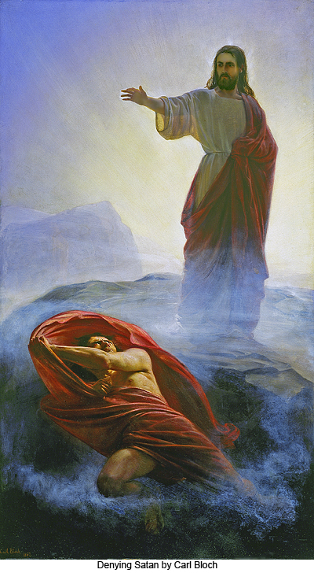
Satan’s Schemes against Believers

Slide 11
Satan Accuses
Job 1:8 (NIV) Then the LORD said to Satan, "Have you considered my servant Job? There is no one on earth like him; he is blameless and upright, a man who fears God and shuns evil."
9 "Does Job fear God for nothing?" Satan replied.
10 "Have you not put a hedge around him and his household and everything he has? You have blessed the work of his hands, so that his flocks and herds are spread throughout the land.
11 But stretch out your hand and strike everything he has, and he will surely curse you to your face."

Slide 12
Satan Accuses
Revelation 12:10 (NIV) Then I heard a loud voice in heaven say:
"Now have come the salvation and the power and the kingdom of our God,
and the authority of his Christ.
For the accuser of our brothers, who accuses them before our God day and night, has been hurled down.

Slide 13
Satan Tempts
Matthew 4:1 (NIV) Then Jesus was led by the Spirit into the desert to be tempted by the devil. 2 After fasting forty days and forty nights, he was hungry.
3 The tempter came to him and said, “If you are the Son of God, tell these stones to become bread.”
4 Jesus answered, “It is written: ‘Man does not live on bread alone, but on every word that comes from the mouth of God.’”

Slide 14
Satan Tempts
Matthew 16:22 (NIV) Peter took him aside and began to rebuke him. “Never, Lord!” he said. “This shall never happen to you!”
23 Jesus turned and said to Peter, “Get behind me, Satan! You are a stumbling block to me; you do not have in mind the things of God, but the things of men.”

Slide 15
Satan Disguises as Good
2 Corinthians 11:13 (NIV) For such men are false apostles, deceitful workmen, masquerading as apostles of Christ.
14 And no wonder, for Satan himself masquerades as an angel of light.

Slide 16
Satan Founds False Religions
Matthew 13:37 (NIV) He answered, “The one who sowed the good seed is the Son of Man. 38 The field is the world, and the good seed stands for the sons of the kingdom. The weeds are the sons of the evil one, 39 and the enemy who sows them is the devil. The harvest is the end of the age, and the harvesters are angels.”

Slide 17
Satan vs Believers
He accuses them.
He tempts them to sin.
He masquerades as righteous.
He founds false religions.

Slide 18
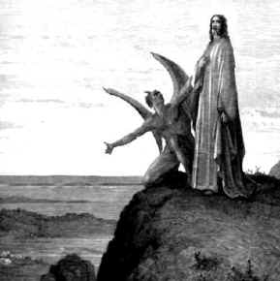
How Can We Escape?

Slide 19
Get Saved
2 Timothy 2:25 (NIV) Those who oppose him he must gently instruct, in the hope that God will grant them repentance leading them to a knowledge of the truth,
26 and that they will come to their senses and escape from the trap of the devil, who has taken them captive to do his will.

Slide 20
Get Saved
1 John 5:18 (NIV) We know that anyone born of God does not continue to sin; the one who was born of God keeps him safe, and the evil one cannot harm him. 19 We know that we are children of God, and that the whole world is under the control of the evil one. 20 We know also that the Son of God has come and has given us understanding, so that we may know him who is true. And we are in him who is true n even in his Son Jesus Christ. He is the true God and eternal life.

Slide 21
Be Aware of His Schemes
2 Corinthians 2:10 (NIV) If you forgive anyone, I also forgive him. And what I have forgiven n if there was anything to forgive n I have forgiven in the sight of Christ for your sake,
11 in order that Satan might not outwit us. For we are not unaware of his schemes.

Slide 22
Be on Guard
1 Peter 5:8 (NIV) Be self-controlled and alert. Your enemy the devil prowls around like a roaring lion looking for someone to devour.
9 Resist him, standing firm in the faith, because you know that your brothers throughout the world are undergoing the same kind of sufferings.

Slide 23
Draw Near to God
James 4:6 (NIV) But he gives us more grace. That is why Scripture says: “God opposes the proud but gives grace to the humble.” {Prov. 3:34}
7 Submit yourselves, then, to God. Resist the devil, and he will flee from you.

Slide 24
Resist Satan
James 4:6 (NIV) But he gives us more grace. That is why Scripture says: “God opposes the proud but gives grace to the humble.” {Prov. 3:34}
7 Submit yourselves, then, to God. Resist the devil, and he will flee from you.

Slide 25
Use God’s Armament
Ephesians 6:11 (NIV) Put on the full armor of God so that you can take your stand against the devil's schemes. 12 For our struggle is not against flesh and blood, but against the rulers, against the authorities, against the powers of this dark world and against the spiritual forces of evil in the heavenly realms…14 Stand firm then, with the belt of truth buckled around your waist, with the breastplate of righteousness in place, 15 and with your feet fitted with the readiness that comes from the gospel of peace. 16 In addition to all this, take up the shield of faith, with which you can extinguish all the flaming arrows of the evil one. 17 Take the helmet of salvation and the sword of the Spirit, which is the word of God. 18 And pray in the Spirit on all occasions with all kinds of prayers and requests. With this in mind, be alert and always keep on praying for all the saints.

Slide 26
Expect Christ’s Help
Luke 22:31 (NIV) “Simon, Simon, Satan has asked to sift you as wheat.
32 But I have prayed for you, Simon, that your faith may not fail. And when you have turned back, strengthen your brothers.”

Slide 27
Expect Christ’s Help
Romans 8:33 (NIV) Who will bring any charge against those whom God has chosen? It is God who justifies.
34 Who is he that condemns? Christ Jesus, who died n more than that, who was raised to life n is at the right hand of God and is also interceding for us.

Slide 28
How Can We Escape?
Get saved.
Be aware of Satan’s schemes.
Be on your guard.
Draw near to God.
Resist Satan.
Use the armaments God provides.
Expect help from Christ.

Slide 29
The End
Be aware of Satan’s schemes!

