Slide 1
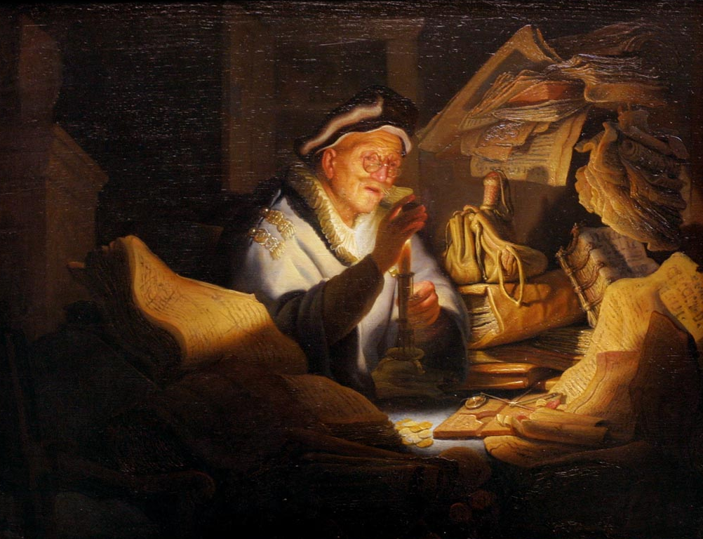
The Rich Fool
Luke 12:13-21
Robert C. Newman

Slide 2
The Rich Fool
This is an old story that is very relevant for today.
It is also a special type of parable, apparently found only in the Gospel of Luke.
We call these sorts of stories “sample” or “paradigm” parables, because they give a sample of the lesson they are teaching, rather than giving an earthly story with a heavenly meaning as the usual parable does.

Slide 3
Luke 12:13-21
13 (NIV) Someone in the crowd said to him, “Teacher, tell my brother to divide the inheritance with me.”
14 Jesus replied, “Man, who appointed me a judge or an arbiter between you?”
15 Then he said to them, “Watch out! Be on your guard against all kinds of greed; a man's life does not consist in the abundance of his possessions.”
16 And he told them this parable: “The ground of a certain rich man produced a good crop.
17 He thought to himself, ‘What shall I do? I have no place to store my crops.’

Slide 4
Luke 12:13-21
18 “Then he said, ‘This is what I'll do. I will tear down my barns and build bigger ones, and there I will store all my grain and my goods.
19 And I'll say to myself, “You have plenty of good things laid up for many years. Take life easy; eat, drink and be merry.”’
20 But God said to him, ‘You fool! This very night your life will be demanded from you. Then who will get what you have prepared for yourself?’
21 This is how it will be with anyone who stores up things for himself but is not rich toward God.”

Slide 5
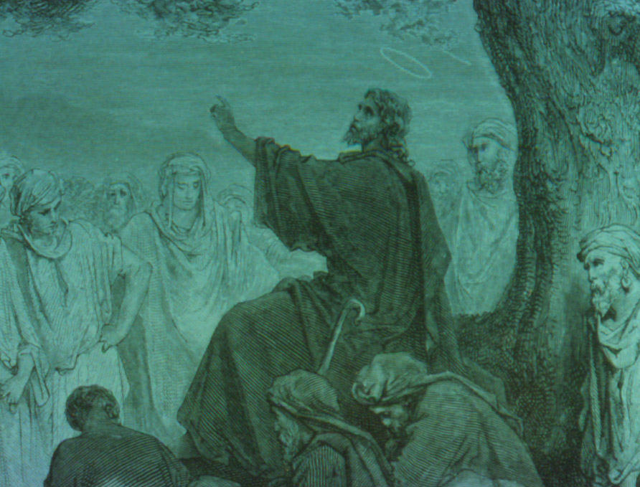
The Occasion
Verses 13-15

Slide 6
The Occasion
Jesus, while speaking to a crowd, is interrupted by a request that he intervene in a family inheritance dispute. (13)
He refuses to get involved (14-15)
Who made me a judge or arbitrator?
Beware of greed.
Life is not about possessions.
He then tells the audience this parable:

Slide 7
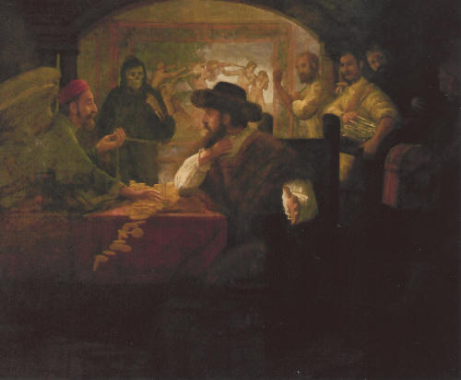
The Parable
Verses 16-20

Slide 8
The Rich Man’s Dilemma
A rich landowner
He has a great harvest.
He doesn’t have enough space in his storerooms.
His scheme:
Tear down the old barns (don’t waste valuable space)
Build bigger barns (solve the storage problem)

Slide 9
The Rich Man’s Misplaced Confidence
His confidence (19)
I have much wealth for many years.
Now I have real security.
Take it easy.
Eat, drink, be merry!
God’s response (20)
You are a fool.
You don’t have many years; you die tonight!
Now who will enjoy your wealth?

Slide 10
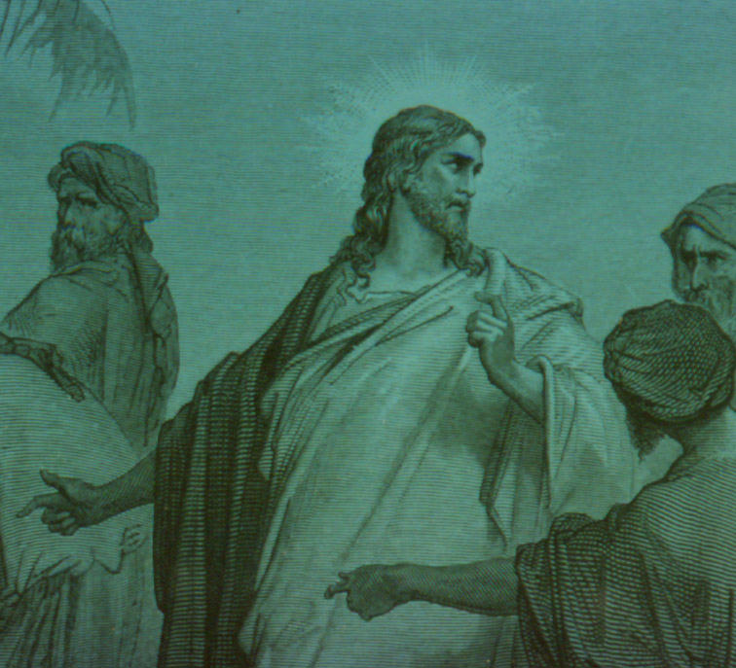
Jesus’ Teaching
Verse 21

Slide 11
Jesus’ Teaching Here
This is what happens to someone who stores up for himself but is not generous toward God. (21)
From before the parable (15)
Watch out for greed.
Life is not about possessions.

Slide 12
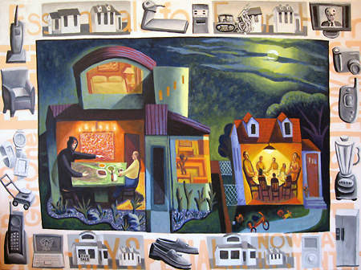
What Was Foolish?

Slide 13
What was foolish about this fellow?
He spent all his life building up security (making preparations for retirement), but he never lived to enjoy it.
Wealth was apparently not nearly the security he thought it was.
He didn’t expect to die any time soon, so he hadn’t made any plans for this.
There is no indication he thought much about God or about others.
He apparently didn’t know what life was all about.

Slide 14
What is life all about?
Do I think much about God?
What do you suppose He wants me to do with my life?
What does Jesus say is the greatest commandment?
Do I think much about others?
What is the 2nd greatest commandment?
What is the “Golden Rule”?

Slide 15
What is life all about?
The Westminster Shorter Catechism asks as its first question:
What is the chief end of man?
Its answer (which is thoroughly biblical):
To glorify God and to enjoy Him forever.
Am I a fool? A rich fool? A poor fool?
The fear of the Lord is the beginning of wisdom (Psalm 111:10).

Slide 16
Are we fools?
We must continually ask ourselves:
What am I living for?
Our society strongly encourages living for:
Pleasure
Wealth
Fame
Security

Slide 17
Am I planning to die any time soon?
Getting to really know God is the best thing I can do with my life and the best preparation I can make for my death.
Jesus said: “I have come that they may have life, and have it to the full.” (Jn 10:10)
He also said: “This is eternal life, that they may know you, the only true God, and Jesus Christ, whom you have sent.” (Jn 17:3)

Slide 18
Planning for death
Jesus said: “I am the true and living way. No one comes to the Father except through me.” (Jn 14:6)
Jesus said: “Whoever hears my word and believes him who sent me has eternal life, and will not be condemned; he has crossed over from death to life.” (Jn 5:24)

Slide 19
The End
Don’t be a fool and die too soon.

