Slide 1
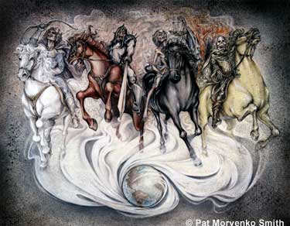
Revelation
An overview
Robert C. Newman

Slide 2
Outline of Revelation
On the broadest level, there is considerable disagreement on how to outline the book. We will follow George Ladd's suggestion.
There is general agreement on how the book is structured at the next level down, e.g., letters to churches, the seven seals, etc.

Slide 3
Ladd's Structure
Prologue (1:1-8)
1st Vision (1:9-3:22): The Present
2nd Vision (4:1-16:21): The Future
3rd Vision (17:1-21:8): The End
4th Vision (21:9-22:5): The Beginning
Epilogue (22:6-21)

Slide 4
First Vision: The Present
Vision of the glorified Christ (1:9-20)
His letters to the seven churches (2:1-3:22)

Slide 5
Second Vision: The Future
The heavenly throne room (4:1-11)
The seven seals (5:1-8:1)
The seven trumpets (8:2-11:19)
2nd vision interlude (12:1-14:20)
The seven bowls (15:1-16:21)

Slide 6
The Third Vision: The End
Babylon destroyed (17:1-19:5)
Final victory (19:6-21:8)

Slide 7
The Fourth Vision: The Beginning
The New Jerusalem (21:9-27)
The River of Life (22:1-5)

Slide 8
More Detail: Next Level Down

Slide 9
The seven seals (5:1-8:1)
The scroll & the Lamb (5:1-14)
Six seals are opened (6:1-17)
Seal interlude: 2 multitudes (7:1-17)
The 144,000 (7:1-8)
The innumerable multitude (7:9-17)
The seventh seal (8:1)

Slide 10
The seven trumpets (8:2-14:20)
Trumpets prepare to sound (8:2-6)
Six trumpets sounded (8:7-9:21)
The trumpet interlude: angel w/ scroll & 2 witnesses (10:1-11:13)
The seventh trumpet sounds (11:14-20)

Slide 11
2nd vision interlude (12:1-14:20)
The dragon, the woman & her seed (12:1-17)
The two beasts (13:1-18)
The 144,000, the 3 angels, the 2 harvests (14:1-20)

Slide 12
The seven bowls (15:1-16:21)
The bowls prepared (15:1-8)
The bowls poured out (16:1-21)

Slide 13
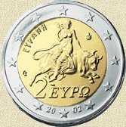
Babylon destroyed (17:1-19:5)
The woman on the beast (17:1-18)
The judgment on the city (18:1-19:5)

Slide 14
Final victory (19:6-21:8)
The marriage of the Lamb (19:6-10)
Christ's second coming (19:11-21)
The millennial rule (20:1-10)
The last judgment (20:11-15)
New heavens & new earth (21:1-8)

Slide 15
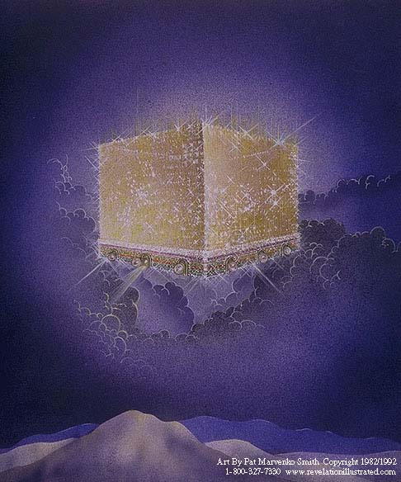
The End
What practical applications do we find in the book of Revelation?

Slide 16
Practical Applications
Worship! – more in this book than in any book of the New Testament.
Persecution – believers can expect to face persecution in this world, especially at the end.
Future hope – here is the clearest picture of the hope which believers have, which should motivate them to serve God.

