Slide 1
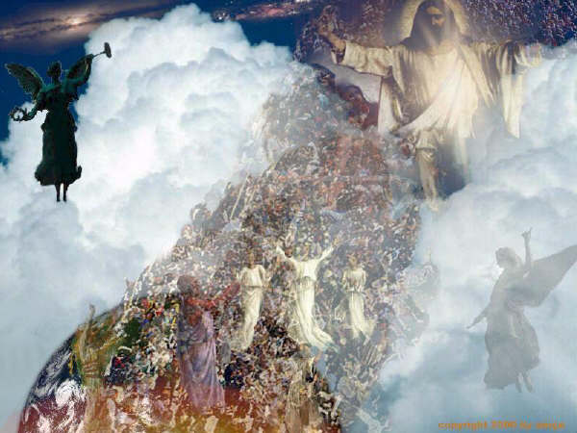
The Rapture
Robert C. Newman

Slide 2
The term "rapture"
A very special use in theology
Not the usual "state of being carried away, by joy, love, etc."
Nor the common "expression of great joy"

Slide 3
The term "rapture"
But an older (now archaic) literal meaning, "being carried away physically" (from Latin rapere)
In theology, this term is specialized to the snatching away of believers at the Lord’s coming, to be with him.

Slide 4
The Rapture Debate
Christians disagree on when the rapture will take place relative to the tribulation:
Will it occur before, during or after the great tribulation?
Will it involve all or only part of the saints then living on earth?

Slide 5
The term "tribulation"
A general word, defined in the dictionary as "great misery or distress, as from oppression; deep sorrow; something that causes suffering or distress."
In theology, the word is often used this way, but it also has a narrower, specialized meaning.

Slide 6
The term "tribulation"
This narrower, specialized meaning is applied to the worst time of disaster that will occur on earth…
usually called "the great tribulation,"
sometimes (from Jeremiah 30:7) the "time of Jacob's trouble."

Slide 7
The Great Tribulation
Matthew 24:20 (NASU) But pray that your flight will not be in the winter, or on a Sabbath. 21 For then there will be a great tribulation, such as has not occurred since the beginning of the world until now, nor ever will. 22 Unless those days had been cut short, no life would have been saved; but for the sake of the elect those days will be cut short.

Slide 8
The Time of Jacob's Trouble
Jeremiah 30:7 (NIV)
How awful that day will be!
None will be like it.
It will be a time of trouble for Jacob,
but he will be saved out of it.

Slide 9
The Various Views
Pre-Trib Rapture – the rapture occurs (shortly) before the great tribulation
Mid-Trib Rapture – occurs during the great tribulation
Post-Trib Rapture – occurs (just) after the great tribulation
Partial Rapture – only certain of the saints will be raptured before the great tribulation; the others will go through it.

Slide 10
Case for Pre-Trib Rapture
Usually based on a sharp division between the Church and Israel
Emphasis on the "any moment" return of Christ
The Church is to escape from God's wrath: 1 Thess 1:10; 5:9
The Church is to be kept from the hour of temptation: Rev 3:10

Slide 11
1 Thessalonians
1:10 (NASU) and to wait for His Son from heaven, whom He raised from the dead, [that is] Jesus, who rescues us from the wrath to come.
5:9 (NASU) For God has not destined us for wrath, but for obtaining salvation through our Lord Jesus Christ…

Slide 12
Revelation 3:10
(NASU) Because you have kept the word of My perseverance, I also will keep you from the hour of testing, that [hour] which is about to come upon the whole world, to test those who dwell on the earth.

Slide 13
Case for Mid-Trib Rapture
Agrees with Pre-Trib re/ Christians avoiding God's wrath.
Points out that all the rapture passages have a trumpet, which Paul (1 Cor 15:52) calls the "last trumpet."
The last trumpet we know about is the seventh in Revelation, which is in the midst of the tribulation period.

Slide 14
Case for Post-Trib Rapture
The only rapture that is explicitly located in Scripture is the one that comes "immediately after the tribulation of those days" (Matt 24:29).
It looks like Paul's teaching on the rapture is drawn from this passage, in Jesus' Olivet Discourse.

Slide 15
The Classic Passages
Rapture:
1 Thessalonians 4:13-18
1 Corinthians 15:50-54
Tribulation:
Matthew 24:9-28

Slide 16
1 Thessalonians 4:13-18
13 (NASU) But we do not want you to be uninformed, brethren, about those who are asleep, so that you will not grieve as do the rest who have no hope. 14 For if we believe that Jesus died and rose again, even so God will bring with Him those who have fallen asleep in Jesus. 15 For this we say to you by the word of the Lord, that we who are alive and remain until the coming of the Lord, will not precede those who have fallen asleep. 16 For the Lord Himself will descend from heaven with a shout, with the voice of [the] archangel and with the trumpet of God, and the dead in Christ will rise first. 17 Then we who are alive and remain will be caught up together with them in the clouds to meet the Lord in the air, and so we shall always be with the Lord. 18 Therefore comfort one another with these words.

Slide 17
1 Corinthians 15:50-54
50 (NASU) Now I say this, brethren, that flesh and blood cannot inherit the kingdom of God; nor does the perishable inherit the imperishable. 51 Behold, I tell you a mystery; we will not all sleep, but we will all be changed, 52 in a moment, in the twinkling of an eye, at the last trumpet; for the trumpet will sound, and the dead will be raised imperishable, and we will be changed. 53 For this perishable must put on the imperishable, and this mortal must put on immortality. 54 But when this perishable will have put on the imperishable, and this mortal will have put on immortality, then will come about the saying that is written, "Death is swallowed up in victory."

Slide 18
Matthew 24:9-28
Persecution of believers (9-14)
Believers hated, killed
False prophets, increased wickedness
Gospel to all the nations
Abomination of desolation (15-25)
Get out of Jerusalem area!
Coming of Christ (26-28)
Don't be misled!
Unmistakable, like lightning, vultures

Slide 19
The Rapture?
Matthew 24:9-28 is immediately followed by what looks like a description of the rapture.
See Matthew 24:29-31 on following panel:

Slide 20
Matthew 24:29-31
29 (NASU) But immediately after the tribulation of those days the sun will be darkened, and the moon will not give its light, and the stars will fall from the sky, and the powers of the heavens will be shaken. 30 And then the sign of the Son of Man will appear in the sky, and then all the tribes of the earth will mourn, and they will see the Son of Man coming on the clouds of the sky with power and great glory. 31 And He will send forth His angels with a great trumpet and they will gather together His elect from the four winds, from one end of the sky to the other.

Slide 21
Note the parallels
1 Thess 4:13-18 – Lord comes from heaven, with loud command, with voice of archangel, with trumpet call of God, dead in Christ & those still alive caught up to be with him.
Matt 24:29-31 – Son of Man coming on clouds, sends his angels with loud trumpet call, gathers his elect.

Slide 22
Compare 1 Thess 4-5 & Matt 24
Lord returns – 4:15, 30
Noticeably – 4:16, 27, 30
With angels – 4:16, 31
Trumpet – 4:16, 31
Believers gathered – 4:15-17, 31
Time unknown - 5:1, 36
Compared to thief - 5:2, 43-48
Compared to birth pains - 5:3, 8

Slide 23
Conclusions
These and other parallels suggest that Paul is repeating Jesus' teaching here in 1 Thessalonians.
See Paul's remark in 1 Thess 4:15.
See the JETS article by Henry G. Waterman, vol. 18 (1975), pages 105-113.
If so, then Matthew 24 expressly teaches a post-trib rapture.

Slide 24
1 Thessalonians 4:15
1The 4:15 (NASU) For this we say to you by the word of the Lord, that we who are alive and remain until the coming of the Lord, will not precede those who have fallen asleep. 16 For the Lord Himself will descend from heaven with a shout, with the voice of [the] archangel and with the trumpet of God, and the dead in Christ will rise first.

Slide 25
Case for a Partial Rapture
Mainly directed against Pre-Trib rapture, by citing passages emphasizing the need to be ready.
If the rapture is after the tribulation, it probably doesn't make much difference whether it is partial or not.

Slide 26
For Further Reading
Three Views on the Rapture
Feinberg: Pre-Trib
Archer: Mid-Trib
Moo: Post-Trib
Reiter: History of the Positions

Slide 27
For Further Reading
A Post-Trib Alternative to the Pre-Trib Rapture
Douglas & Virginia Chinn

Slide 28
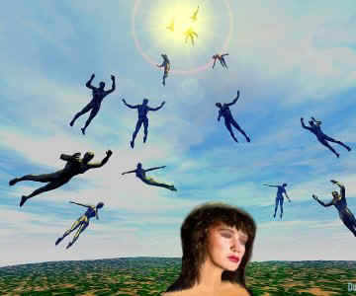
The End
We will find out one day who is right; in the meantime, we need to be ready to face God.

Slide 29
What are the practical values of the rapture?
If pre-trib, those Christians who are alive will escape the great tribulation.
If mid-trib (& some post-trib), they will escape the bowls of wrath.
God will intervene, and will not let all of his saints die at the hands of Antichrist.
The story has a good ending!

