Slide 1
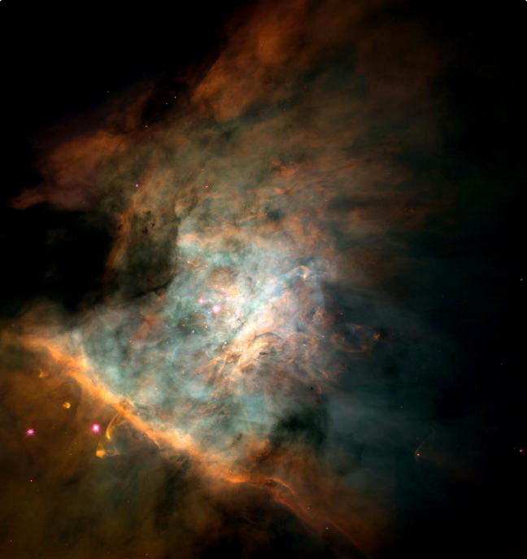

Proclaiming God’s Glory in Nature
Robert C. Newman

Slide 2
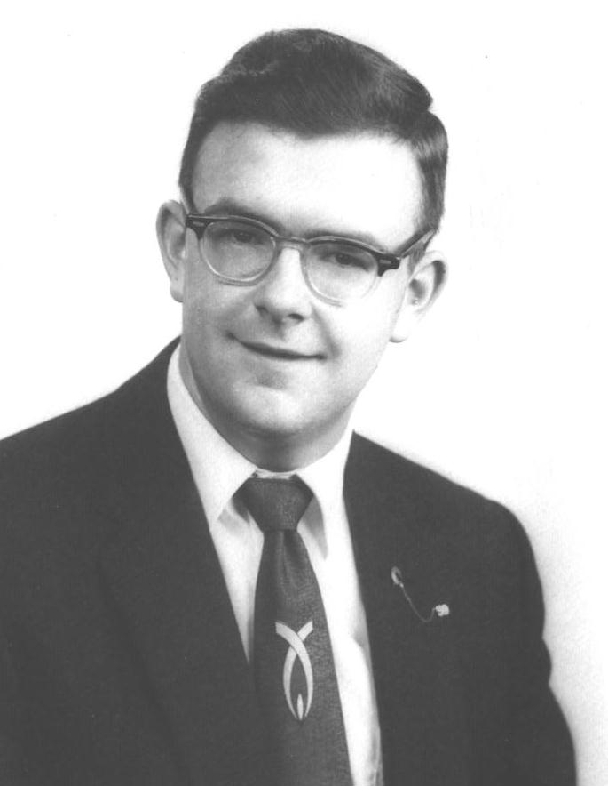
My Personal Experience

Slide 3
Growing Up
I became very interested in science from elementary school onward.
The scientists & science teachers I knew seemed to know or care little about God or the Bible.
  Exception: Thomas Christie at Washington-Lee HS
The pastors & Sunday school teachers seemed to know or care little about science.
  Exception: Herman Eckelmann at Cornell

Slide 4
As an Adult
I find this is still a serious problem.
  Scientists are often skeptical about the Bible or even God.
  Christians are often skeptical about science or even nature.
This should not be, since God is the creator of both the Bible & nature.
We at IBRI are trying to do something about this.
  See our website: www.ibri.org.

Slide 5
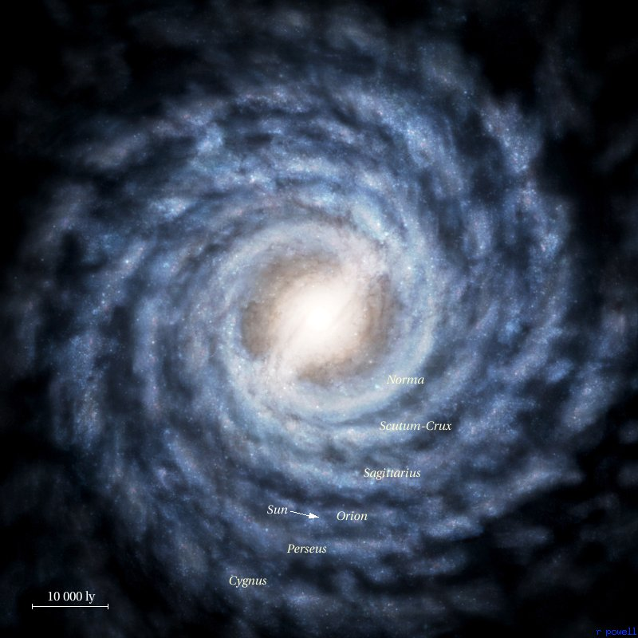
God Revealed in Nature
Psalm 19:1-4a

Slide 6
Psalm 19:1-4a
1 (NIV) The heavens declare the glory of God;
the skies proclaim the work of his hands.
2 Day after day they pour forth speech;
night after night they display knowledge.
3 There is no speech or language
where their voice is not heard.
4 Their voice [Septuagint, Jerome and Syriac; Hebrew line] goes out into all the earth,
their words to the ends of the world.

Slide 7
The Heavens are Telling
The heavens (or skies) are telling us something.
Elsewhere we see this is true of:
  The land (Acts 14:17) and
  Everything God made (Rom 1:18-20).
So, all of creation is telling us something.

Slide 8
Acts 14
14 (NIV) But when the apostles Barnabas and Paul heard of this, they tore their clothes and rushed out into the crowd, shouting: 15 "Men, why are you doing this? We too are only men, human like you. We are bringing you good news, telling you to turn from these worthless things to the living God, who made heaven and earth and sea and everything in them. 16 In the past, he let all nations go their own way. 17 Yet he has not left himself without testimony: He has shown kindness by giving you rain from heaven and crops in their seasons; he provides you with plenty of food and fills your hearts with joy."

Slide 9
Romans 1
18 (NIV) The wrath of God is being revealed from heaven against all the godlessness and wickedness of men who suppress the truth by their wickedness, 19 since what may be known about God is plain to them, because God has made it plain to them. 20 For since the creation of the world God's invisible qualities n his eternal power and divine nature n have been clearly seen, being understood from what has been made, so that men are without excuse.

Slide 10
What Are They Telling?
About God’s glory:
  Hebrew kavod
  Greek doxa
  Include ideas of abundance, riches, honor, splendor, glory, dignity, reputation n depending on context.
In this context, probably glory, splendor, reputation.

Slide 11
How Are They Telling?
By means of God’s craftsmanship:
  This calls up the image of a skilled craftsman, known to others by the quality of his work.
Physicists today speak of the “fine-tuning” of the basic forces and elements in the universe.
  See our talk “Discovering God’s Fingerprints.”
Biologists speak of elegant design in living things, though typically ascribing this to purely natural causes.
  See our talk “Intelligent Design.”

Slide 12
Where Are They Telling?
Time?
  Day and night
  i.e., all the time
Location?
  Everywhere
Audience?
  Everyone

Slide 13
Psalm 19:1-4a
1 (NIV) The heavens declare the glory of God;
the skies proclaim the work of his hands.
2 Day after day they pour forth speech;
night after night they display knowledge.
3 There is no speech or language
where their voice is not heard.
4 Their voice [Septuagint, Jerome and Syriac; Hebrew line] goes out into all the earth,
their words to the ends of the world.

Slide 14
What Should
We Do?

Slide 15
What Should We Do?
We should study God’s creation with:
  Expectancy
  Appreciation
  Thanksgiving
We should help others:
  To appreciate what God has made
  To honor Him for it

Slide 16
Deuteronomy 6
6 (NIV) These commandments that I give you today are to be upon your hearts. 7 Impress them on your children. Talk about them when you sit at home and when you walk along the road, when you lie down and when you get up. 8 Tie them as symbols on your hands and bind them on your foreheads. 9 Write them on the doorframes of your houses and on your gates.
As Psalm 19 notes, just as God is revealed in Scripture, so He reveals Himself in nature.
So we should talk to our friends & children about God as He reveals Himself in nature just as we should talk to them about God’s Word.

Slide 17
Psalm 148
1 (NIV) Praise the LORD. Praise the LORD from the heavens, praise him in the heights above. 2 Praise him, all his angels, praise him, all his heavenly hosts. 3 Praise him, sun and moon, praise him, all you shining stars. 4 Praise him, you highest heavens and you waters above the skies. 5 Let them praise the name of the LORD, for he commanded and they were created.
All of God’s creation should praise Him, including us humans.

Slide 18
Psalm 139
13 (NIV) For you created my inmost being; you knit me together in my mother's womb. 14 I praise you because I am fearfully and wonderfully made; your works are wonderful, I know that full well. 15 My frame was not hidden from you when I was made in the secret place. When I was woven together in the depths of the earth, 16 your eyes saw my unformed body. All the days ordained for me were written in your book before one of them came to be.
We should marvel at God’s creativity in the human body, which is “fearfully and wonderfully made.”

Slide 19
Psalm 145
3 (NIV) Great is the LORD and most worthy of praise; his greatness no one can fathom. 4 One generation will commend your works to another; they will tell of your mighty acts. 5 They will speak of the glorious splendor of your majesty, and I will meditate on your wonderful works.
Praise God for His works, both in creation & redemption.
Note the refrain: 17 The LORD is righteous in all his ways and loving toward all he has made.

Slide 20
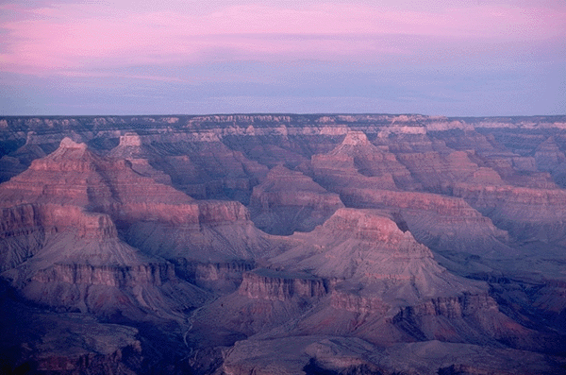
The End
May God help us to appreciate & praise His glory in nature!

