Slide 1
The Priory of Sion
Prieuré de Sion
Robert C. Newman

Slide 2
Claim in The Da Vinci Code
FACT: The Priory of Sion – a European secret society founded in 1099 – is a real organization. In 1975 Paris's Bibliothèque Nationale discovered parchments known as Les Dossiers Secrets, identifying numerous members of the Priory of Sion, including Sir Isaac Newton, Botticelli, Victor Hugo, and Leonardo da Vinci.

Slide 3
Problems with the Claim
If the Priory really is a secret organization, then there would be little evidence for its existence.
If it is a fraud, there would be no evidence for its existence before the fraud was perpetrated.
The parchments known as Les Dossiers Secrets were apparently discovered inside the Bibliothèque Nationale in 1975. How did they get there? Were they forged and planted?
In fact, we do have some evidence about the Priory and its alleged history. Let's see.

Slide 4
Pierre Plantard (1920-2000)
Pierre Plantard "was the principal figure associated with the known history of the Priory of Sion, and is widely believed to have been the main creator of many of the claims about the Priory's supposed past history that later inspired the books Holy Blood, Holy Grail and The Da Vinci Code among others."
"Pierre Plantard" in Wikipedia

Slide 5
Plantard
Pierre Plantard is mentioned in Holy Blood, Holy Grail as the current Grand Master of the Priory of Sion.
The Plantard family is mentioned in The Da Vinci Code as descendants of the French Merovingian royal family (442).

Slide 6
Priory Founded 1956
The Priory was founded in 1956 by Pierre Plantard and Andre Bonhomme, who signed the statutes and registration documents required by the 1901 French Law of Associations. The Priory's purpose was to promote the "Defense and Liberty of Low-Cost Housing." The original Priory of Sion had nothing to do with the Templars, the Grail, or related matters, according to co-founder Bonhomme.
"Pierre Plantard" in Wikipedia
"Priory of Sion Debunked" at http://priory-of-sion.com

Slide 7
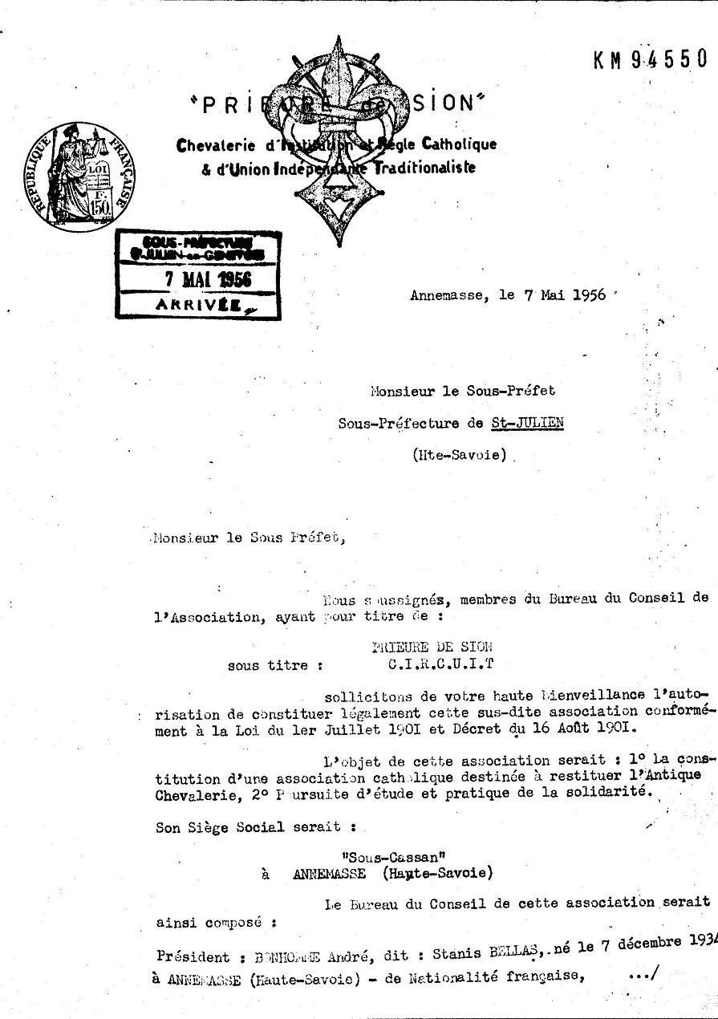
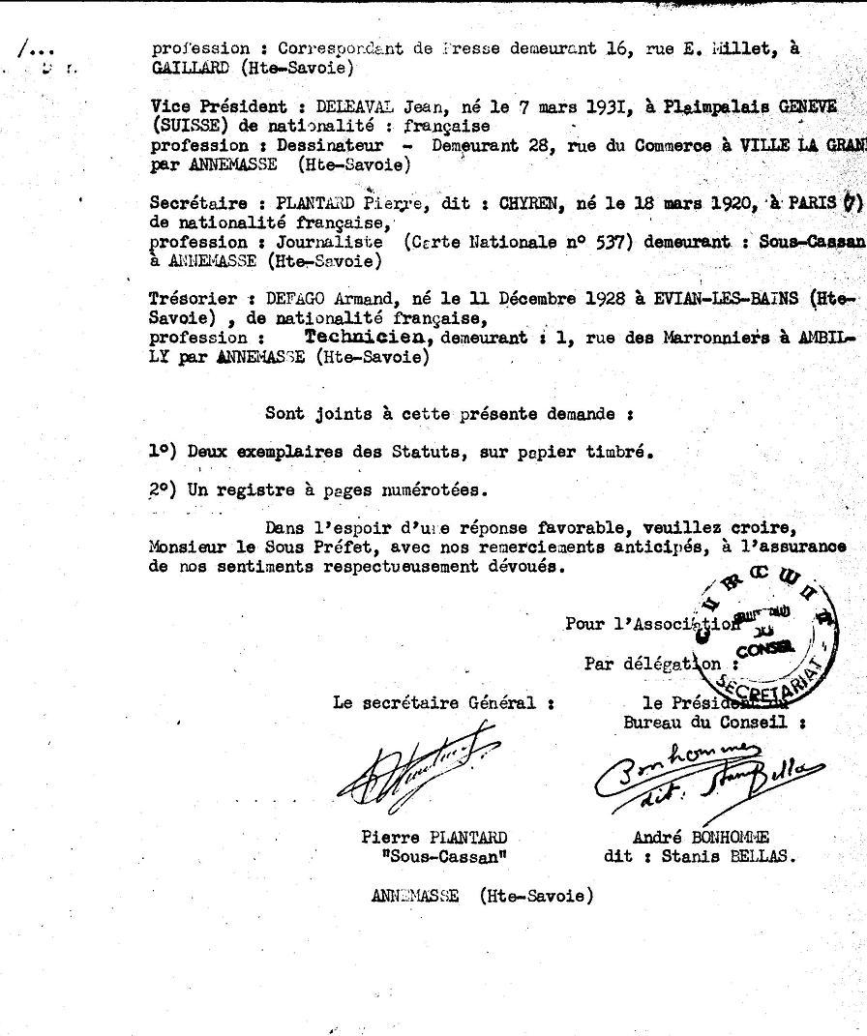
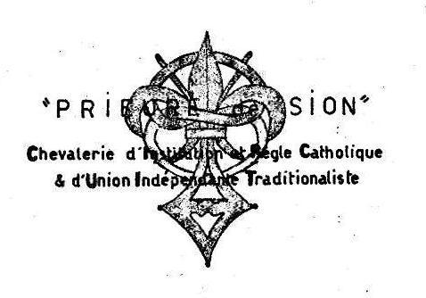
Piory of Sion Registration

Slide 8
Plantard's Organizations
Already from 1937 onward, Plantard had been involved in the creation of several bogus organizations: the French Union (1937), the French National Renewal (1941), and the Alpha Galates (1942), an order of knighthood for which he was briefly imprisoned by the Vichy government for not registering his group. Plantard later served six months in prison for fraud and embezzlement (1953-54).
"Pierre Plantard" in Wikipedia and "Priory of Sion Debunked"

Slide 9
Priory of Sion Mythologized
Plantard revived the Priory from 1962 onward, "creating a mystique involving the legends of Gisors, Berenger Sauniere and Rennes-la-Chateau, secret societies, his claim to be from a French Line of Kings, the keeper of secrets and possessor of secret parchments – he also claimed that the Priory of Sion was founded during the Crusades by Godfrey de Bouillon, was linked with the Knights Templar, and produced a list of Grand Masters spanning centuries."
"Priory of Sion Debunked"

Slide 10
Plantard's Downfall
In 1993, "Plantard claimed that Roger-Patrice Pelat had once been grandmaster of the Priory of Sion. Pelat was a friend of then-President of France Françoise Mitterand and center of a scandal involving French Prime Minister Pierre Beregovoy. A French court ordered a search of Plantard's home, turning up many documents, including some proclaiming Plantard the true king of France. Under oath, Plantard admitted that he had fabricated everything, including Pelat's involvement with the Priory of Sion."
"Pierre Plantard" in Wikipedia

Slide 11
Claim in The Da Vinci Code
FACT: The Priory of Sion – a European secret society founded in 1099 – is a real organization. In 1975 Paris's Bibliothèque Nationale discovered parchments known as Les Dossiers Secrets, identifying numerous members of the Priory of Sion, including Sir Isaac Newton, Botticelli, Victor Hugo, and Leonardo da Vinci.

Slide 12
Response to the Claim
As best we can tell, the Priory of Sion is an invention of Pierre Plantard and Andre Bonhomme, initially to promote lost-cost housing in the area where they lived.
It appears to have been "upgraded" by Plantard into a mystical secret society with a striking history and an impressive list of grand masters.

Slide 13
The Priory of Sion
Appears to be a hoax!

