Slide 1

Practicing Restraint
Mark 9:38-50
Robert C. Newman

Slide 2
Practicing Restraint
As fallen humans, we often get in trouble by not restraining ourselves.
Proverbs emphasizes the importance of controlling our tongues:
  Prov 10:19 (NIV) When words are many, sin is not absent, but he who holds his tongue is wise.
  Prov 12:18 (NIV) Reckless words pierce like a sword, but the tongue of the wise brings healing.

Slide 3
David’s Restraint
David restrained his temptation to vent his anger on Shimei:
  2Sam 16:5 (NIV) As King David approached Bahurim, a man from the same clan as Saul's family came out… 6 He pelted David and all the king's officials with stones… 7 As he cursed, Shimei said, "Get out, get out, you man of blood, you scoundrel! 8 The LORD has repaid you for all the blood you shed in the household of Saul, in whose place you have reigned. The LORD has handed the kingdom over to your son Absalom. You have come to ruin because you are a man of blood!" 9 Then Abishai son of Zeruiah said to the king, "Why should this dead dog curse my lord the king? Let me go over and cut off his head." 10 But the king said, "What do you and I have in common, you sons of Zeruiah? If he is cursing because the LORD said to him, `Curse David,' who can ask, `Why do you do this?'" 11 David then said to Abishai and all his officials, "My son, who is of my own flesh, is trying to take my life. How much more, then, this Benjamite! Leave him alone; let him curse, for the LORD has told him to. 12 It may be that the LORD will see my distress and repay me with good for the cursing I am receiving today."
God blessed him for it.

Slide 4
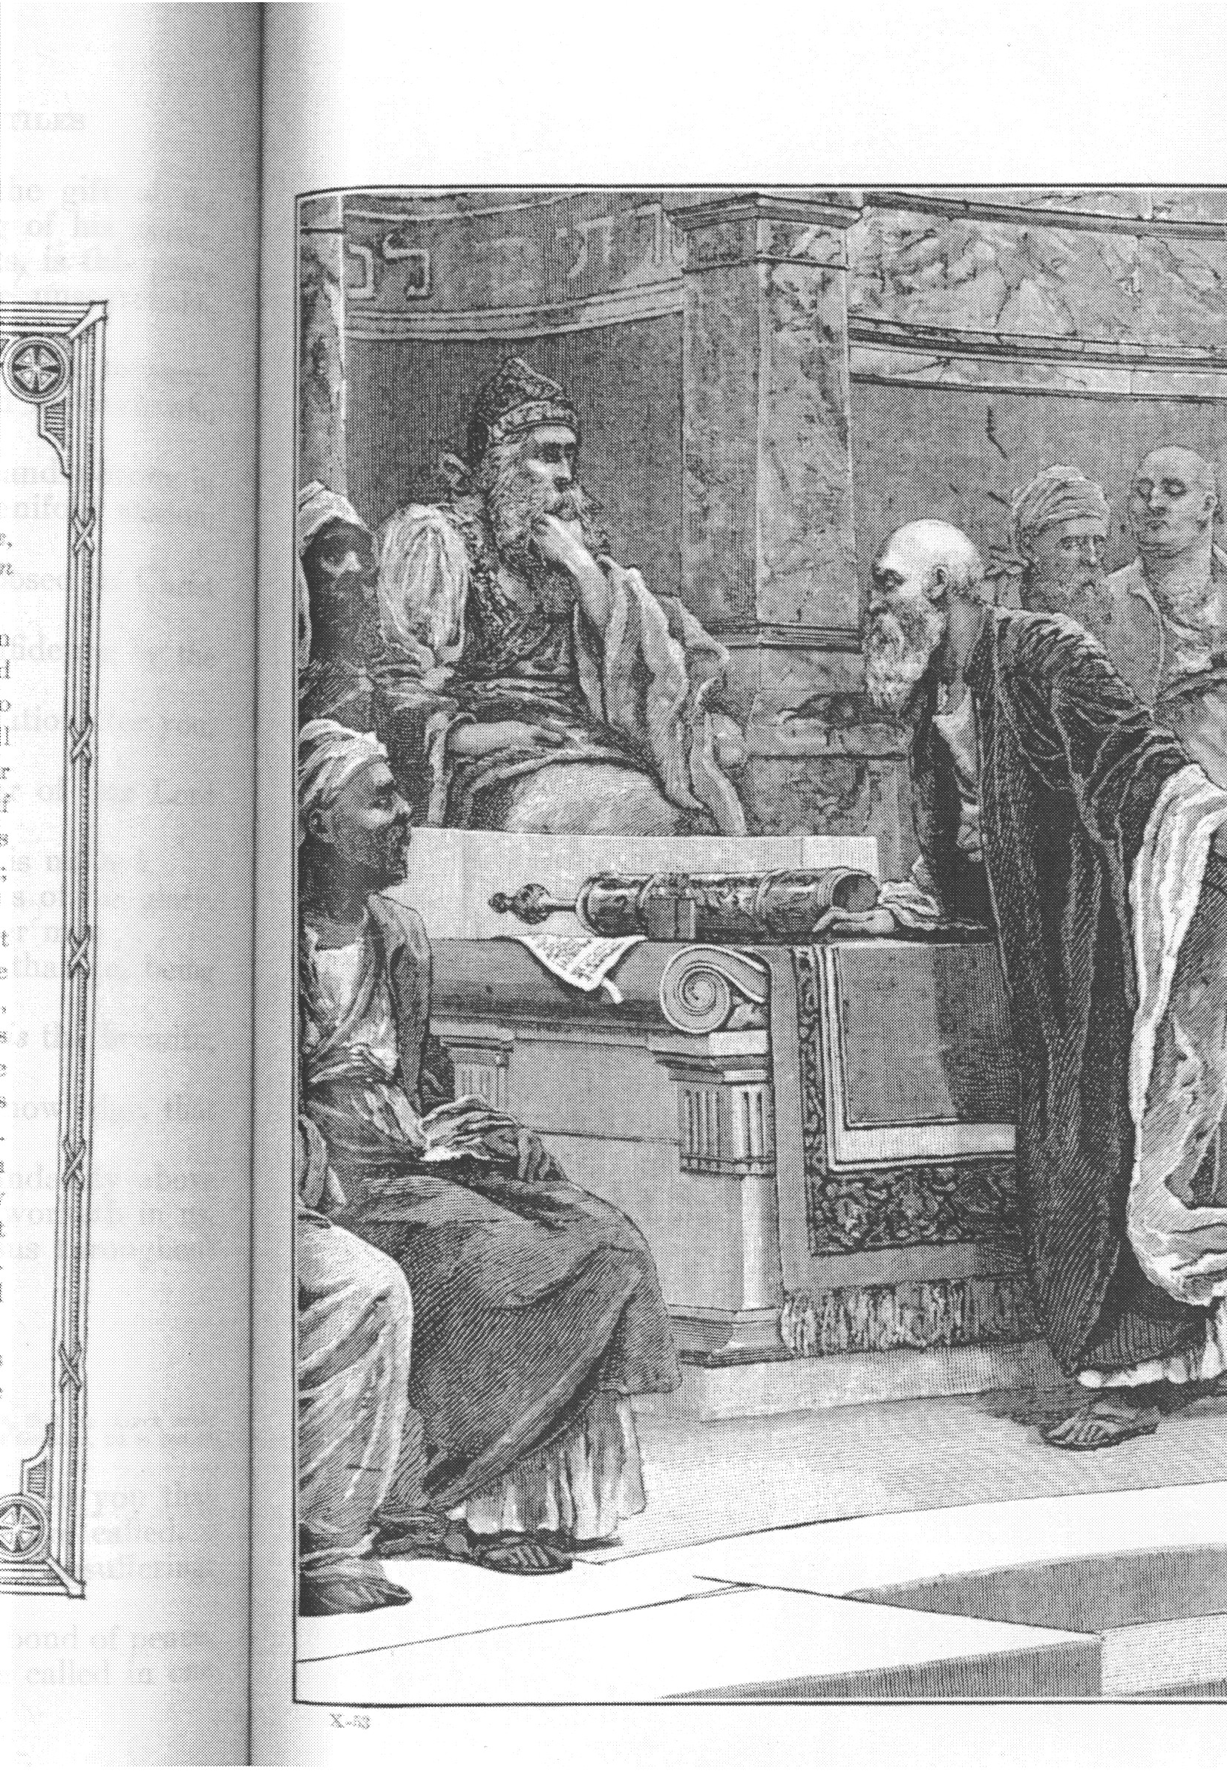
Gamaliel Recommends Restraint
Gamaliel recommended that the Sanhedrin not kill the apostles (Acts 5).
God used this to protect them.
Let us consider Jesus’ teaching on restraint in Mark 9:38-50:

Slide 5
Mark 9:38-50
38 (NIV) "Teacher," said John, "we saw a man driving out demons in your name and we told him to stop, because he was not one of us." 39 "Do not stop him," Jesus said. "No one who does a miracle in my name can in the next moment say anything bad about me, 40 for whoever is not against us is for us. 41 I tell you the truth, anyone who gives you a cup of water in my name because you belong to Christ will certainly not lose his reward. 42 And if anyone causes one of these little ones who believe in me to sin, it would be better for him to be thrown into the sea with a large millstone tied around his neck. 43 If your hand causes you to sin, cut it off. It is better for you to enter life maimed than with two hands to go into hell, where the fire never goes out…

Slide 6
Mark 9:38-50
45 “And if your foot causes you to sin, cut it off. It is better for you to enter life crippled than to have two feet and be thrown into hell. 47 And if your eye causes you to sin, pluck it out. It is better for you to enter the kingdom of God with one eye than to have two eyes and be thrown into hell, 48 where `their worm does not die, and the fire is not quenched.' {Isaiah 66:24} 49 Everyone will be salted with fire.
50 Salt is good, but if it loses its saltiness, how can you make it salty again? Have salt in yourselves, and be at peace with each other."

Slide 7

Restraint from
Hindering Good
Mark 9:38-41

Slide 8
Mark 9:38-41
:38 (NIV) "Teacher," said John, "we saw a man driving out demons in your name and we told him to stop, because he was not one of us." 39 "Do not stop him," Jesus said. "No one who does a miracle in my name can in the next moment say anything bad about me,
40 for whoever is not against us is for us.
41 I tell you the truth, anyone who gives you a cup of water in my name because you belong to Christ will certainly not lose his reward.”

Slide 9
Hindering Good
John’s Misdirected Zeal (38)
  “We saw a man driving out demons in your name and we told him to stop, because he was not one of us.“
  John tries to stop unauthorized use of Jesus’ name.
Jesus rebukes John (39-41)

Slide 10
Jesus’ Rebuke (39-41)
Don’t stop someone doing good in Jesus’ name.
They cannot easily curse Jesus’ later.
  They will discredit themselves.
They are “for Jesus” in some sense.
They will be properly rewarded.
Lesson: We should be very careful that our commission to rebuke sin does not expand to rebuking good deeds done by sinners.

Slide 11
Restraint from
Encouraging Evil
Mark 9:42-48

Slide 12
Mark 9:42-48
42 (NIV) "And if anyone causes one of these little ones who believe in me to sin, it would be better for him to be thrown into the sea with a large millstone tied around his neck. 43 If your hand causes you to sin, cut it off. It is better for you to enter life maimed than with two hands to go into hell, where the fire never goes out…45 And if your foot causes you to sin, cut it off. It is better for you to enter life crippled than to have two feet and be thrown into hell. 47 And if your eye causes you to sin, pluck it out. It is better for you to enter the kingdom of God with one eye than to have two eyes and be thrown into hell, 48 where `their worm does not die, and the fire is not quenched.' {Isaiah 66:24}”

Slide 13
Causing Another to Sin
Jesus’ warning:
“little ones” – younger then we, or younger in the faith
“better to be thrown into the sea with a large millstone tied around his neck” – better to suffer death than to cause another to sin

Slide 14
Causing Self to Sin
Jesus’ warnings:
Hand, foot, eye:
  Doing, going to, seeing, what encourages sin
Entering life crippled, lame, one-eyed
  Entering (eternal) life
  Spending rest of life so maimed until our resurrection

Slide 15
Going to Hell
We must not use the doctrine of “eternal security” or “perseverance of the saints” to evaporate this warning.
  God links obedience with assurance
The “worm does not die / fire not quenched”
  Hell is real and eternal, even though the idea is not a pleasant one.

Slide 16
The Importance of
Being Salty
Mark 9:49-50

Slide 17
Mark 9:49-50
49 (NIV) “Everyone will be salted with fire. 50 Salt is good, but if it loses its saltiness, how can you make it salty again? Have salt in yourselves, and be at peace with each other."

Slide 18
Everyone Salted w/ Fire
Verse 49 is difficult to understand.
Some Biblical references to salt:
  Leviticus 2:13 – the grain offering is salted; God’s covenant
  Colossians 4:6 – speech seasoned with salt
  Matthew 5:13 – you are the salt of the earth
  Luke 14:34 – salt becoming saltless

Slide 19
What Does Salt Do?
Seasoning – improves taste
Preservative – keeps meat from spoiling
Produces thirst
Stings in a wound
We as Christians are called to be “the salt of the earth,” presumably to function in the world as some or all of these things.

Slide 20
Conclusions
We (as salt) need to be different from the unsaved in restraint also.
If we treat our provoking others to sin as itself a grave sin:
  We will act accordingly.
  We may influence others to do so as well.
If we treat our own sinning as worse than whatever we might suffer for doing right:
  Others may begin to take sin seriously also.

Slide 21
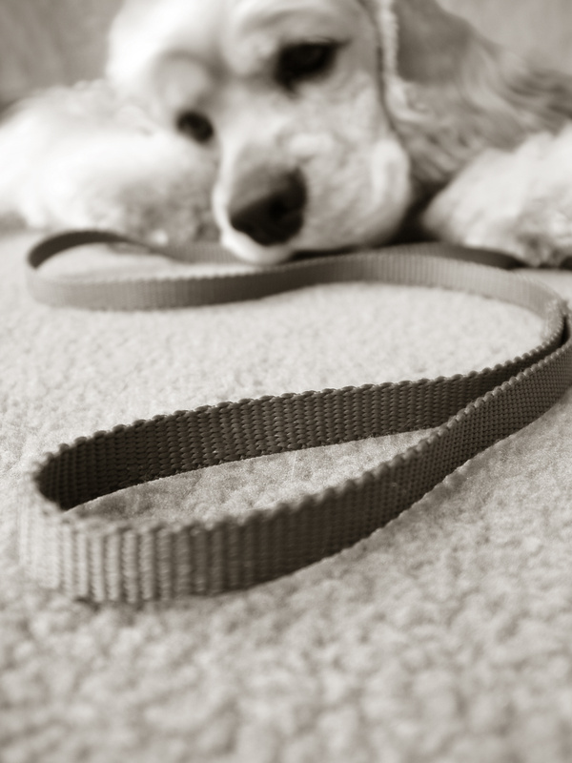
The End
May we seek to practice Biblical restraint

