Slide 1
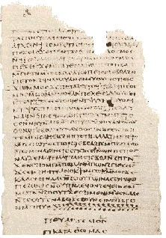

The Other Gospels
Nick Perrin
Robert C. Newman

Slide 2

Brown's Claims
"More than eighty gospels were considered for the New Testament and yet only a relatively few were chosen for inclusion – Matthew, Mark, Luke and John among them." – Da Vinci Code, 231.

Slide 3
A Question to Consider
Were there really eighty gospels considered for the New Testament?
There is good early evidence for the four Gospels:
  Irenaeus (~180)
  Justin (~150)
  Allusions in longer ending of Mark
  Papias (~125)
No suggestion that other Gospels were ever considered seriously for inclusion in canon.

Slide 4
Some "Other Gospels"
There have been some other gospels over the centuries:
Q ?
Gospel of Thomas
Gospel of Peter
Gospel of Philip
Gospel of Ebionites
Gospel according to the Hebrews
Gospel of Mary
Some others …
Nothing close to eighty! Perhaps 20-30 in all.

Slide 5
Brown's Claims
"These are … the Nag Hammadi and Dead Sea Scrolls … The earliest Christian records. Troublingly, they do not match up with the gospels in the Bible." – Da Vinci Code, 245-46

Slide 6
Another Question to Consider
Are the Nag Hammadi and Dead Sea texts really the earliest Christian records?

Slide 7
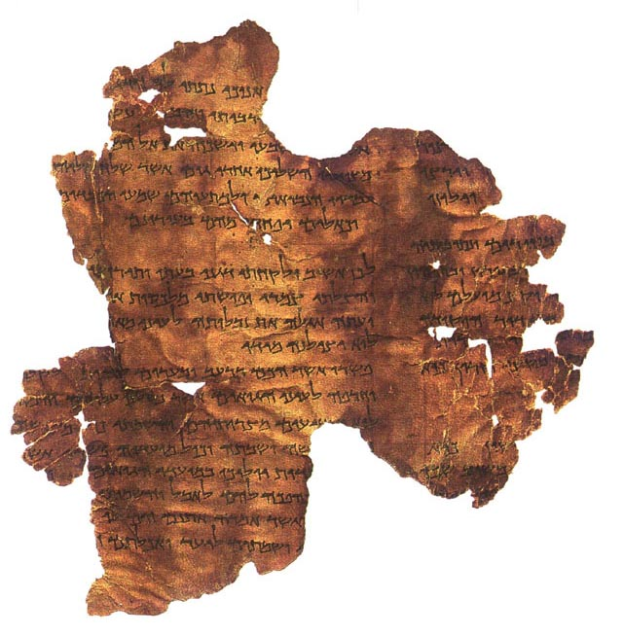
The Dead Sea Scrolls
A number of scrolls and thousands of fragments, discovered ~1948 in Palestine.
Oldest from ~250 BC, most from 1st cen BC.
Nearly all of these pre-date Christianity.
They are not Christian, but Jewish.

Slide 8
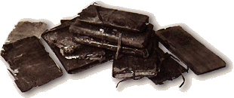
The Nag Hammadi Papyri
52 texts written on papyrus and bound in 12 booklets, found in the Egyptian desert ~1945.
These are all written in Coptic and date to the fourth century AD.
They contain four works titled "Gospel."

Slide 9
The Nag Hammadi Papyri
These four Nag Hammadi Gospels are:
The Gospel of Thomas
The Gospel of Philip
The Gospel of the Egyptians
The Gospel of Truth

Slide 10
How do we date…
The Gospel of Philip?
The Gospel of Thomas?
Q?

Slide 11
How do we date… Philip?
Philip cites Paul and the Gospel of John.
  So after 100 AD
Its theology is Valentinian.
  So after 140-160 AD
Though our copy is in Coptic, the text shows a Syrian background.
  So later 2nd century AD at earliest
Bart Ehrman dates it ~250 AD

Slide 12
How do we date… Thomas?
This is the foundational building block of the Jesus Seminar.
It contains 114 sayings, ~1/2 are from our four Gospels.
It appears to quote Paul and Revelation, suggesting it is after AD 100.
Elaine Pagels dates it earlier, 1st cen AD.
The most widely accepted date is ~140.
Nick Perrin dates it as late 2nd cen AD.

Slide 13
How do we date… Q?
Used by Matthew and Luke
  So mid-1st cen AD.
But wait a minute!
  What is meant by Q?
  Did Q ever really exist?

Slide 14
What is meant by Q?
Q is a hypothetical document:
Proposed to explain similarities between Matthew & Luke…
… On the assumption that they used Mark and another written source to compose their Gospels.

Slide 15
Did Q ever really exist?
This is currently disputed.
No document corresponding to Q has ever been found, tho proponents claim it would look something like Thomas.
No reference to Q from antiquity has ever been found, tho some claim that Papias' reference to Matthew's logia is really about Q rather than the Gospel of Matthew.

Slide 16
Dating these other Gospels
Q
Thomas
Peter
Philip
Ebionites
Hebrews
Mary
50 (if it existed!)
50? 140? 175?
150?
175-250?
150?
150?
175?

Slide 17
Questions to Consider
"These are … the Nag Hammadi and Dead Sea Scrolls … The earliest Christian records. Troublingly, they do not match up with the gospels in the Bible." – Da Vinci Code, 245-46
Is it true that these records do not match up with the Gospels in the Bible?

Slide 18
Brown's Claims
"Fortunately for historians … some of the gospels that Constantine attempted to eradicate managed to survive. The Dead Sea Scrolls were found in the 1950s hidden in a cave near Qumran in the Judean desert. And, of course, the Coptic Scrolls in 1945 at Nag Hammadi. In addition to telling the true Grail story, these documents speak of Christ's ministry in very human terms." – Da Vinci Code, 234.

Slide 19
Brown's Claims
"The scrolls highlight glaring historical discrepancies and fabrications, clearly confirming that the modern Bible was compiled and edited by men who possessed a political agenda – to promote the divinity of the man Jesus and use His influence to solidify their own power base." – Da Vinci Code, 234

Slide 20
Brown's Claims
"… the early Church needed to convince the world that a mortal prophet Jesus was a divine being. Therefore, any gospels that described earthly aspects of Jesus' life had to be omitted from the Bible." – Da Vinci Code, 244

Slide 21
Questions to Consider
Do the Nag Hammadi and/or other non-canonical accounts of Jesus really emphasize the humanity of Jesus?

Slide 22
Jesus in the Gospels
The canonical Gospels (Matthew, Mark, Luke, John) actually emphasize Jesus' humanity and usually only hint at his deity.
The alleged Q document provides no evidence of a different Jesus than the one seen in these Gospels.
What do the Gnostic Gospels tell us about Jesus?

Slide 23
Jesus in Gospel of Philip
"For he [Jesus] showed himself not to be as he really was, but he appeared in a way that they could see him. To those … he appeared, he appeared to the great as Great. He appeared to the small as small. He appeared to the angels as an angel and to humans as a human" – Gosp Phil 26
In Philip, Jesus only appeared to be human.

Slide 24
Jesus in Gospel of Peter
"Others standing there were spitting in his [Jesus'] face; some slapped his cheeks; others were beating him with a reed; and some began to flog him, saying, 'This is how we should honor the Son of God!' They brought forward two evildoers and crucified the Lord between them. But he was silent, as if he had no pain." – Gosp Pet 9 -10
Jesus is pictured as suffering no pain.

Slide 25
Docetism
Brown has got it backwards!
The Biblical Gospels emphasize
Jesus' human traits more than
the Gnostic Gospels do!
Docetism is a term used to refer to a theological perspective among some in the early church who regarded the sufferings and the human aspects of Christ as imaginary or apparent instead of being part of a real incarnation. The basic thesis of such docetics was that if Christ suffered he was not divine, and if he was God he could not suffer … While the framers of the Apostles' and Nicene Creeds were opposed to docetic teaching and clearly assumed the two natures of Jesus, the drafters of the Definition of Chalcedon (451 AD) made explicit the Christian teaching concerning Jesus Christ as "truly God and truly man." – GL Borchert, "Docetism," Evangelical Dictionary of Theology

Slide 26
Brown's Claims
"Unfortunately for the early editors, one particularly troubling earthly theme kept recurring in the gospels. Mary Magdalene … More specifically, her marriage to Jesus Christ" – Da Vinci Code, 244

Slide 27
Brown's Claims
Teabing pointed to a passage, "The Gospel of Philip is always a good place to start."
Sophie read the passage:
And the companion of the Saviour is Mary Magdalene. Christ loved her more than all the disciples and used to kiss her often on her mouth. The rest of the disciples were offended by it and expressed disapproval. They said to him, "Why do you love her more than all of us?"
The words surprised Sophie, and yet they hardly seemed conclusive. "It says nothing of marriage."

Slide 28
Brown's Claims
"Au contraire." Teabing smiled, pointed to the first line. "As any Aramaic scholar will tell you, the word companion, in those days, literally meant spouse."
Langdon concurred with a nod.
Sophie read the first line again. And the companion of the Savior is Mary Magdalene. – Da Vinci Code, 246

Slide 29
Jesus & Mary in Philip
"There were three Marys who walked with the Lord all the time: his mother, his sister, and Magdalene – the one who is called his partner (koinônos). For his sister and his mother and his associate (chôtre) are Marys." – Gosp Phil 32
The Coptic terms (partner, associate) are primarily business and religious terms, respectively. While it is possible for either term to mean "spouse," these usages are rare.

Slide 30
The Meaning of the Coptic Terms
Koinônos
  Business partner
  Spiritual partaker
  Co-participant
Chôtre
  Joining, yoke
  Twin, double
From Lambdin, Coptic Grammar

Slide 31
Is Jesus Really Married in the Gospel of Philip?
The Coptic terms (partner, associate) are primarily business and religious terms, respectively. While it is possible for either term to mean "spouse," these usages are rare.
If the Gospel of Philip was originally written in Syriac (no one thinks it was written in Aramaic), the only Syriac term that allows for the meaning of both 'partner' and 'spouse' is shawtopho. This word is very rarely applied to the marriage context, but like the Coptic chôtre normally means "co-religionist" or "fellow communicant."

Slide 32
Is Jesus Really Married in the Gospel of Philip?
Given the theological context, it is most likely that Jesus and Mary are partners in the sense that together they are seen to constitute the mythic primeval androgyny.
This would be a development from an early rabbinic view:
  Genesis 1 – Adam is originally a male/female combination (androgyne, hermaphrodite).
  Genesis 2 – Adam is then separated into the male Adam & female Eve.

Slide 33
The Primeval Androgyny
"When Eve was still in Adam, death did not exist. When she was separated from him death came into being. If he enters again and attains his former self, death will be no more" – Gosp Phil 68
"If the woman had not separated from the man, she should not die with the man. His separation became the beginning of death. Because of this Christ came to repair the separation which was from the beginning and again united the two" – Gosp Phil 70

Slide 34
The Kiss on the Mouth
The 'kiss on the mouth' in Philip is shared among all the enlightened; it is the means of transfusing grace.
"The Logos comes forth from the mouth. And he who is nourished from the mouth shall become perfect. The perfect are conceived through a kiss, and they are born. Therefore we also kiss one another – to receive conception in our mutual grace." – Gosp Phil 35

Slide 35
The Bridal Chamber in Philip
The term 'bridal chamber' in Philip appears to be a metaphor for union with God.
"A bridal chamber is not for animals, nor is it for the slaves, nor for defiled women; but it is for free men and virgins" – Gosp Phil 69

Slide 36
The Bridal Chamber in Philip
"No one can know when the husband and the wife have intercourse with one another except the two of them. Indeed marriage in the world is a mystery for those who have taken a wife. If there is a hidden quality in the marriage of defilement, how much more is the undefiled marriage a true mystery! It is not fleshly but pure. It belongs not to desire but to the will. It belongs not to the darkness … but to the day and the light" – Gosp Phil 81-82

Slide 37
The Bridal Chamber
May not be so metaphorical as some have suggested or as Philip seems to say.
Irenaeus (~180), on basis of reports from women who had followed Valentinian Gnostic teaching but then repented and returned to the church, notes that they had been led astray into sexual intercourse by these teachers.

Slide 38
Conclusions
Were there really "eighty gospels considered for the New Testament"?
  NO
Are the Nag Hammadi and Dead Sea texts really the earliest Christian records?
  NO
Do the Nag Hammadi and other non-canonical accounts of Jesus really emphasize his humanity?
  NO

Slide 39
Conclusions
Is Jesus really married in the Gospel of Philip?
  UNLIKELY
Is it true that the non-canonical gospels and similar records do not match up with the gospels in the Bible?
  YES, BUT SO MUCH THE WORSE FOR THE NON-CANONICAL GOSPELS!

Slide 40
The Other Gospels
Proclaim another Gospel!

