Slide 1
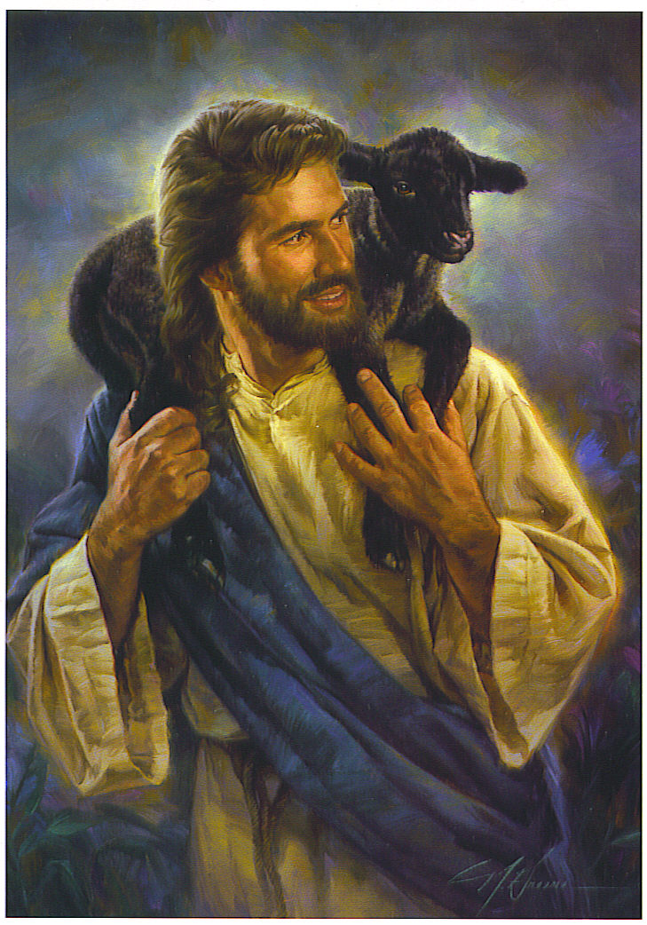

Parables of Lost & Found
Luke 15:1-32
Robert C. Newman

Slide 2
The Occasion
Tax collectors & other sinners are attracted to Jesus.
The Pharisees complain that he receives them & even eats with them.
Jesus gives his answer to the Pharisees (& to us) in these three parables.

Slide 3
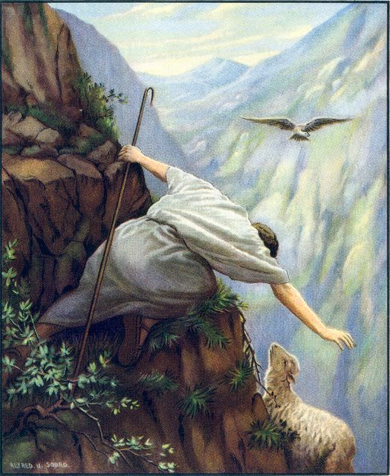
The Lost Sheep
Luke 15:3-7

Slide 4
Luke 15:3 (NIV) Then Jesus told them this parable: 4 “Suppose one of you has a hundred sheep and loses one of them. Does he not leave the ninety-nine in the open country and go after the lost sheep until he finds it? 5 And when he finds it, he joyfully puts it on his shoulders 6 and goes home. Then he calls his friends and neighbors together and says, ‘Rejoice with me; I have found my lost sheep.’ 7 I tell you that in the same way there will be more rejoicing in heaven over one sinner who repents than over ninety-nine righteous persons who do not need to repent.”

Slide 5
The Story
A man has 100 sheep.
One of them wanders off.
The man searches until he finds it.
He carries it back home.
He calls in his friends to rejoice with him.

Slide 6
Interpretation
Shepherd = God, or Jesus?
  Yes (and no)
  Note verse 4: “what man of you?”
  So the audience is called to imagine themselves in the shepherd’s place.
Significance of “until he finds”?
  Story: shepherd does not give up easily
  Interpretation: not universalism; election?

Slide 7
Interpretation
Who are the 99 righteous?
  Angels?
  Humans who are already saved?
  Ironic for Pharisees?
    Probably this last alternative, in view of the parable of the Lost Son.
This is probably a parable in which not all details are to be transferred.

Slide 8
Main Points
It is natural:
  for people to look for their lost property.
  to rejoice when it is found.
  to want others to rejoice with us.
Compare God’s attitude in Jonah 4:10-11:
  10 (NIV) But the LORD said, "You have been concerned about this vine, though you did not tend it or make it grow. It sprang up overnight and died overnight. 11 But Nineveh has more than a hundred and twenty thousand people who cannot tell their right hand from their left, and many cattle as well. Should I not be concerned about that great city?"

Slide 9
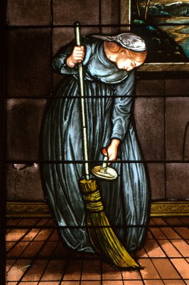
The Lost Coin
Luke 15:8-10

Slide 10
Luke 15:8 (NIV) “Or suppose a woman has ten silver coins {[8] Greek ten drachmas, each worth about a day's wages} and loses one. Does she not light a lamp, sweep the house and search carefully until she finds it?
9 And when she finds it, she calls her friends and neighbors together and says, ‘Rejoice with me; I have found my lost coin.’
10 In the same way, I tell you, there is rejoicing in the presence of the angels of God over one sinner who repents.”

Slide 11
The Story
A woman loses 1 of 10 coins.
She lights a lamp & sweeps the floor.
She searches the house until she finds it.
She calls in her neighbors to rejoice with her.

Slide 12
Interpretation
Greek drachma = Roman denarius
  One day’s wage for a common laborer
  Not trivial, but not earth-shaking either.
Is the money part of the woman’s dowry or jewelry?
  Speculative in absence of evidence
  Probably argument of parable is from lesser to greater

Slide 13
Interpretation
Thorough search of house
  Probably a small house with dirt floor
  Little light inside
“Rejoice” doesn’t need to be a formal celebration, just sharing w/ neighbors
  Both this & previous parable reflect a middle eastern culture that is much more gregarious than ours is.

Slide 14
Interpretation
Significance of woman?
  Holy Spirit?
  Church?
  Wisdom?
  To help women in audience to identify?
This parable clearly has the same general significance as the previous one, though some different nuances.

Slide 15
Interpretation
The fraction lost is larger than in the first parable: 1/10 vs 1/100.
The coin is inanimate, so not responsible for getting lost to the same extent as the sheep.
Are we to make anything of the fact that it is a coin, with image embedded in it?

Slide 16
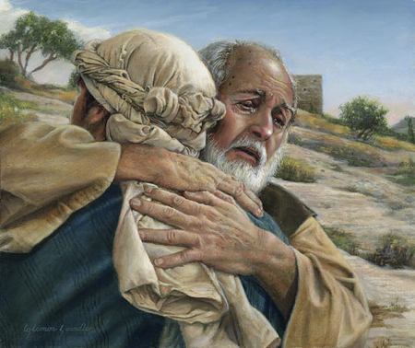
The Lost Son
Luke 15:11-32

Slide 17
Luke 15:11 (NIV) Jesus continued: “There was a man who had two sons. 12 The younger one said to his father, ‘Father, give me my share of the estate.’ So he divided his property between them. 13 Not long after that, the younger son got together all he had, set off for a distant country and there squandered his wealth in wild living. 14 After he had spent everything, there was a severe famine in that whole country, and he began to be in need. 15 So he went and hired himself out to a citizen of that country, who sent him to his fields to feed pigs. 16 He longed to fill his stomach with the pods that the pigs were eating, but no one gave him anything. 17 When he came to his senses, he said, ‘How many of my father's hired men have food to spare, and here I am starving to death!’

Slide 18
Luke 15:18 (NIV) ‘I will set out and go back to my father and say to him: “Father, I have sinned against heaven and against you. 19 I am no longer worthy to be called your son; make me like one of your hired men.”’ 20 So he got up and went to his father. But while he was still a long way off, his father saw him and was filled with compassion for him; he ran to his son, threw his arms around him and kissed him. 21 The son said to him, ‘Father, I have sinned against heaven and against you. I am no longer worthy to be called your son.’ 22 But the father said to his servants, ‘Quick! Bring the best robe and put it on him. Put a ring on his finger and sandals on his feet. 23 Bring the fattened calf and kill it. Let's have a feast and celebrate. 24 For this son of mine was dead and is alive again; he was lost and is found.’ So they began to celebrate.

Slide 19
Luke 15:25 (NIV) Meanwhile, the older son was in the field. When he came near the house, he heard music and dancing. 26 So he called one of the servants and asked him what was going on. 27 ‘Your brother has come,’ he replied, ‘and your father has killed the fattened calf because he has him back safe and sound.’ 28 The older brother became angry and refused to go in. So his father went out and pleaded with him. 29 But he answered his father, ‘Look! All these years I've been slaving for you and never disobeyed your orders. Yet you never gave me even a young goat so I could celebrate with my friends. 30 But when this son of yours who has squandered your property with prostitutes comes home, you kill the fattened calf for him!’ 31 ‘My son,’ the father said, ‘you are always with me, and everything I have is yours. 32 But we had to celebrate and be glad, because this brother of yours was dead and is alive again; he was lost and is found.’”

Slide 20
The Story
Split inheritance before death?
  Ben-Sirach (33:19-23) seeks to discourage practice, so not unheard-of.
  Presumably property split 2:1 (Deut 21:17).
“Pods” from carob tree, not a great staple
  Health-food substitute for chocolate
“See afar off” (20)?
  Recognize his walk?
  Some advance notice?

Slide 21
The Story
Father runs to meet him.
  Virtually unheard-of in modern Arab culture
Kiss = reconciliation
Ring = recognition as son
  Note references to son
  “This son of mine” (24)
  “This son of yours” (30)
  “This brother of yours” (32)

Slide 22
The Story
Older brother’s complaints:
  Slaved, never broke command; vs devoured wealth with prostitutes
  Never given (even) goat vs fattened calf
Father’s answers:
  You are always with me.
  All I have is yours (true in story, but…).
  Have to celebrate

Slide 23
Interpretation
Main theme same as two previous:
  Joy at finding lost; invitation to share joy
Note progression:
  99:1, 9:1, 1:1 (or 0:2?)
This parable pictures repentance.
Father’s love,forgiveness vividly portrayed
Brother’s (Pharisees’) unforgiving spirit shown in true colors.
Parable’s ending is left open.

Slide 24
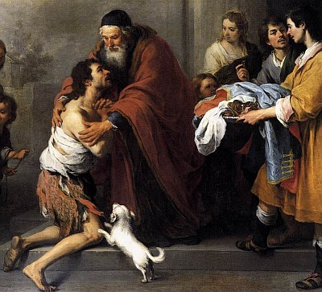
Some Lessons
From all Three Parables

Slide 25
Lessons
We should expect God to care for lost.
  We care for our lost possessions.
If we rejoice when we recover a lost possession, we should all the more rejoice when a sinner turns to Christ.
If we search diligently for something we have lost, how much more for those who have gotten away from God?

Slide 26
Lessons
If it is OK for us to concentrate on finding what is lost to the relative neglect of what isn’t, shall we blame God (or his servants) for also doing so?
If we care this much for lost things, how much more for lost people?
As the father here reflects God’s love, so should we.
Beware the attitude of the elder brother!

Slide 27
The End

