Slide 1
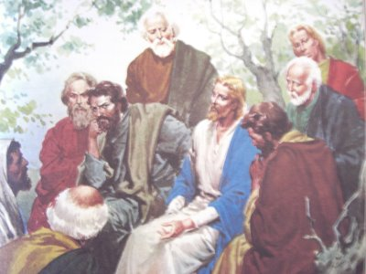

Parable of the Talents
Matthew 25:13-30
Robert C. Newman

Slide 2
Parable of the Talents
This parable told by Jesus has been very influential among Christians.
In fact, the English word “talent” is derived from the interpretation of this parable:
  Talent – the natural endowments of a person; a special often creative or artistic aptitude; general intelligence or mental power; ability

Slide 3
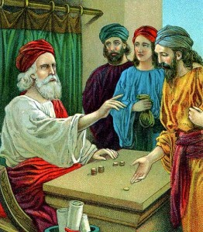
The Parable

Slide 4
Matthew 25:13-30
13 (NIV) "Therefore keep watch, because you do not know the day or the hour. 14 Again, it will be like a man going on a journey, who called his servants and entrusted his property to them. 15 To one he gave five talents of money, to another two talents, and to another one talent, each according to his ability. Then he went on his journey. 16 The man who had received the five talents went at once and put his money to work and gained five more. 17 So also, the one with the two talents gained two more. 18 But the man who had received the one talent went off, dug a hole in the ground and hid his master's money.

Slide 5
Matthew 25:13-30
19 (NIV) "After a long time the master of those servants returned and settled accounts with them. 20 The man who had received the five talents brought the other five. `Master,' he said, `you entrusted me with five talents. See, I have gained five more.' 21 His master replied, `Well done, good and faithful servant! You have been faithful with a few things; I will put you in charge of many things. Come and share your master's happiness!' 22 The man with the two talents also came. `Master,' he said, `you entrusted me with two talents; see, I have gained two more.' 23 His master replied, `Well done, good and faithful servant! You have been faithful with a few things; I will put you in charge of many things. Come and share your master's happiness!'

Slide 6
Matthew 25:13-30
24 (NIV) "Then the man who had received the one talent came. `Master,' he said, `I knew that you are a hard man, harvesting where you have not sown and gathering where you have not scattered seed. 25 So I was afraid and went out and hid your talent in the ground. See, here is what belongs to you.' 26 His master replied, `You wicked, lazy servant! So you knew that I harvest where I have not sown and gather where I have not scattered seed? 27 Well then, you should have put my money on deposit with the bankers, so that when I returned I would have received it back with interest. 28 `Take the talent from him and give it to the one who has the ten talents. 29 For everyone who has will be given more, and he will have an abundance. Whoever does not have, even what he has will be taken from him. 30 And throw that worthless servant outside, into the darkness, where there will be weeping and gnashing of teeth.' “

Slide 7
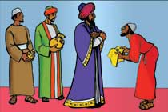
The Story

Slide 8
The Master’s Orders
A slaveowner going on a journey entrusts his property to his slaves:
  Varied amounts according to their abilities
  5 talents, 2 talents, 1 talent
A talent is a substantial unit of weight used in the Greco-Roman world:
  About 60 pounds
  When referring to money, it normally means 60 pounds of silver, quite a substantial sum.

Slide 9
Value of a Talent
This is tricky, due to the huge changes introduced into society by industrialization.
  60 lb of silver = 720 troy oz of silver
    As of 3 May 2011, silver sells at $41.61 /oz.
    So bullion value of a talent of silver is 720 x $41.61 = $29,959.20, about $30K.
  A talent in ancient coinage was worth 6000 drachmas (or denarii), so 6000 days wages for a day-laborer.
    As of 3 May 2011, the US Federal Minimum Wage is $7.25 per hour, so $58.00 per 8-hour day.
    So the wage value of a talent is 6000 x $58. = $348K.

Slide 10
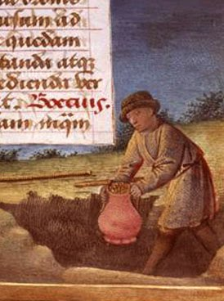
The Slaves’ Activity
Immediately after the owner departs, the first two begin to trade with the money entrusted to them.
The third buries his money.

Slide 11
The Reckoning
After a long time, the master returns.
He calls his slaves in to settle accounts.
The first two have both doubled their money, though they had quite different amounts.
They are praised equally and rewarded about equally (except for verse 28).
Both are also given much greater responsibilities.

Slide 12
The Reckoning
The third slave, who had buried the money entrusted to him, seeks to excuse himself by condemning his master.
He is shown to be self-condemned by his own actions.
He loses his talent and is thrown into “outer darkness.”

Slide 13
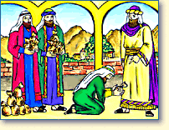
Interpreting the Parable

Slide 14
The Context
The surrounding passages in Matthew are about Jesus coming again:
  24:29-31: the return of the Lord
  24:32-44: the parable of the fig tree
  24:45-51: faithful & unfaithful slaves
  25:1-12: wise & foolish bridesmaids
  25:13-30 [our parable]
  25:31-46: sheep & goat judgment

Slide 15
The Context
The parables from 24:45 on are about faithfulness of some sort:
  24:45-51: faithful & unfaithful slaves
  25:1-12: wise & foolish bridesmaids
  25:13-30 [our parable]
  25:31-46: sheep & goat judgment
Our parable & the two before it seem to involve those who claim to be believers.

Slide 16
Earthly Story & Heavenly Meaning
Slaveowner = Christ
Slaves = those who claim to serve Him
Money = abilities he gives to serve with
Bankers (more difficult); probably = some indirect, low-risk service
Lazy slave seems to be unsaved, judging from the terminology of his punishment.

Slide 17
Some Lessons

Slide 18
Some Lessons
The Lord has given each person who professes to be His follower substantial abilities, wealth, time & opportunities.
Those who use these for Him will be rewarded in proportion to how they use what they have.
Those who don’t use them show that they don’t really love or fear Him. They apparently are not really saved.

Slide 19
Some Lessons
Those who use God’s gifts faithfully will receive more.
Those who don’t will lose even what they now have.
Those who are faithful will enter into the joy of their Master:
  They will share in what He cares about, share the joy of seeing others come to Christ and grow in holiness.

Slide 20
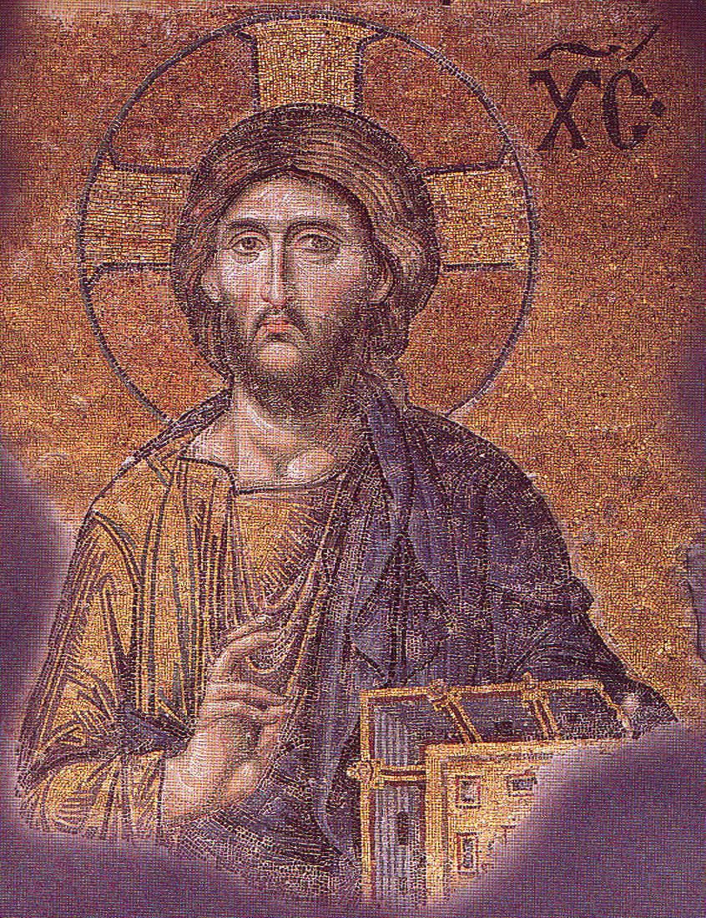
The End
May we so conduct ourselves that we may one day hear Jesus say to us, “Well done!”

