Slide 1
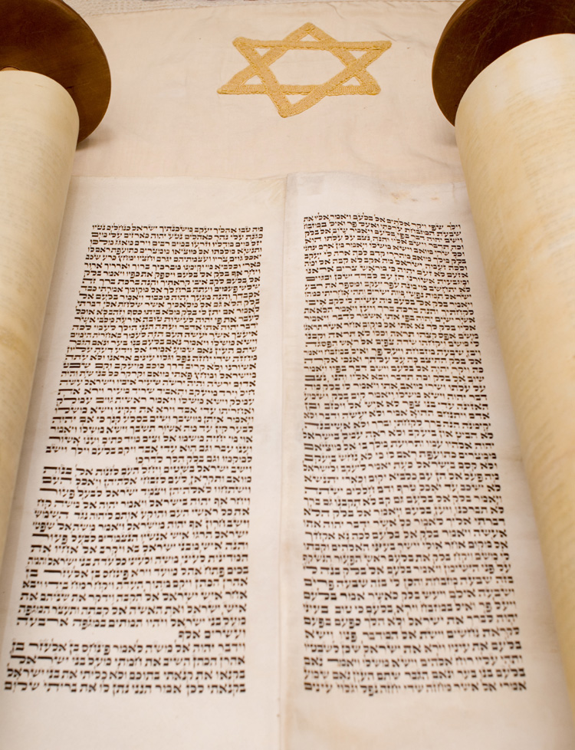
A Quick Overview of Genesis One
What does the text say?
Robert C. Newman

Slide 2
Reading Genesis One
The text is very simple.
The various views read in a lot “between the lines,” so to speak.
This includes both the traditional view as well as the modern ones, both conservative and liberalizing.
We will point up some of these as we go along.

Slide 3
Genesis 1:1-2 (ESV)
(1) In the beginning, God created the heavens and the earth.
A beginning, but some translate differently.
(2) The earth was without form and void, and darkness was over the face of the deep. And the Spirit of God was hovering over the face of the waters.
What does “without form and void” mean?
What is “the deep”?

Slide 4
Genesis 1:3-4
(3) And God said, “Let there be light,” and there was light.
Is this the first light in the universe?
Where is the reader to imagine he/she is located?
(4) And God saw that the light was good. And God separated the light from the darkness.
What does it mean to separate light from darkness?

Slide 5
Genesis 1:5-6
(5) God called the light Day, and the darkness he called Night. And there was evening and there was morning, the first day.
Is this the first day the universe has existed?
The Hebrew reads “one day” (or “day one”), not “the first day”
(6) And God said, “Let there be an expanse in the midst of the waters, and let it separate the waters from the waters.”
What is this “expanse”?

Slide 6
Genesis 1:7-8
(7) And God made the expanse and separated the waters that were under the expanse from the waters that were above the expanse. And it was so.
What are the upper waters?
(8) And God called the expanse Heaven. And there was evening and there was morning, the second day.
What is meant by “heaven” here?

Slide 7
Genesis 1:9-10
(9) And God said, “Let the waters under the heavens be gathered together into one place, and let the dry land appear.” And it was so.
How should we understand “one place”?
(10) God called the dry land Earth, and the waters that were gathered together he called Seas. And God saw that it was good.
Note, “seas,” plural.

Slide 8
Genesis 1:11-12
(11) And God said, “Let the earth sprout vegetation, plants yielding seed, and fruit trees bearing fruit in which is their seed, each according to its kind, on the earth.” And it was so.
Note this (11-12) is the only reference to plants.
(12) The earth brought forth vegetation, plants yielding seed according to their own kinds, and trees bearing fruit in which is their seed, each according to its kind. And God saw that it was good.
How do we understand “according to its kind”?

Slide 9
Genesis 1:13-14
(13) And there was evening and there was morning, the third day.
The Hebrew lacks “the” for days 1-5.
(14) And God said, “Let there be lights in the expanse of the heavens to separate the day from the night. And let them be for signs and for seasons, and for days and years,
The purposes of the lights are given (14-15).

Slide 10
Genesis 1:15-16
(15) and let them be lights in the expanse of the heavens to give light upon the earth.” And it was so.
What does it mean that the lights are “in” the expanse?
(16) And God made the two great lights—the greater light to rule the day and the lesser light to rule the night—and the stars.
Obviously the sun and moon; why not named?
Why mentioned here in the account?

Slide 11
Genesis 1:17-18
(17) And God set them in the expanse of the heavens to give light on the earth,
A repetition.
(18) to rule over the day and over the night, and to separate the light from the darkness. And God saw that it was good.
They give light, rule, separate.

Slide 12
Genesis 1:19-20
(19) And there was evening and there was morning, the fourth day.
Does each day include all the activities back to the previous day?
(20) And God said, “Let the waters swarm with swarms of living creatures, and let birds fly above the earth across the expanse of the heavens.”
How is this fulfilled? How quickly?

Slide 13
Genesis 1:21-22
(21) So God created the great sea creatures and every living creature that moves, with which the waters swarm, according to their kinds, and every winged bird according to its kind. And God saw that it was good.
“Bird” can be more general, “flying thing.”
(22) And God blessed them, saying, “Be fruitful and multiply and fill the waters in the seas, and let birds multiply on the earth.”
First command to fill.

Slide 14
Genesis 1:23-24
(23) And there was evening and there was morning, the fifth day.
Literally “day fifth” or “a fifth day”
(24) And God said, “Let the earth bring forth living creatures according to their kinds—livestock and creeping things and beasts of the earth according to their kinds.” And it was so.
Land animals.
What does “let the earth bring forth” mean?

Slide 15
Genesis 1:25-26
(25) And God made the beasts of the earth according to their kinds and the livestock according to their kinds, and everything that creeps on the ground according to its kind. And God saw that it was good.
Again, a repetition.
(26) Then God said, “Let us make man in our image, after our likeness. And let them have dominion over the fish of the sea and over the birds of the heavens and over the livestock and over all the earth and over every creeping thing that creeps on the earth.”
Humans made to have dominion over all the animals.
What does “in our image” mean?

Slide 16
Genesis 1:27-28
(27) So God created man in his own image, in the image of God he created him; male and female he created them.
First occurrence of poetry. Again a repetition.
(28) And God blessed them. And God said to them, “Be fruitful and multiply and fill the earth and subdue it, and have dominion over the fish of the sea and over the birds of the heavens and over every living thing that moves on the earth.”

Slide 17
Genesis 1:29-30
(29) And God said, “Behold, I have given you every plant yielding seed that is on the face of all the earth, and every tree with seed in its fruit. You shall have them for food.
Humans given plants for food.
(30) And to every beast of the earth and to every bird of the heavens and to everything that creeps on the earth, everything that has the breath of life, I have given every green plant for food.” And it was so.
So are animals. No meat-eating yet?

Slide 18
Genesis 1:31
(31) And God saw everything that he had made, and behold, it was very good. And there was evening and there was morning, the sixth day.
Here, we finally get “the” with “day”

Slide 19
Comment
This ends Genesis chapter 1, but the creation account goes on for a few verses into chapter 2, followed (for the rest of chap 2) by a more detailed account of the creation of humans.
Some see another creation account beginning in Genesis 2:4.
We will postpone this discussion till we consider the origin of humans.

Slide 20
Genesis 2:1-2
(1) Thus the heavens and the earth were finished, and all the host of them.
This completes the creation account.
(2) And on the seventh day God finished his work that he had done, and he rested on the seventh day from all his work that he had done.
No “and it was evening…” for this day (2-3)

Slide 21
Genesis 2:3
(3) So God blessed the seventh day and made it holy, because on it God rested from all his work that he had done in creation.
God blesses & consecrates the 7th day.
What does it mean that “God rested”?

Slide 22
Some Features of Genesis One

Slide 23
An Ordered Account
The structure looks chronological.
Days, numbers
The days are described using ordering numbers (except for the first one, which can be ordinal).
Most models of interpretation see the events of the chapter as included within the days.
A few models see the days as intermittent, with the events coming between the days.
Some models see the days as a literary structure instead of a chronology.

Slide 24
Refrains
Let there be…
And it was so…
And it was evening, and it was morning…
One day, a second day, a third day…
According to their kinds…
Be fruitful and increase…
Let __ bring forth, teem, etc.

Slide 25
Parallelism of Days
Day one and day four:
(1) light, separate light & darkness
(4) lights to separate day & night
Day two and day five:
(2) expanse separates waters below & above
(5) sea life, air life
Day three and day six:
(3) sea gathered, dry land appears
(6) land life, including humans

Slide 26
God Creates by His Word
He speaks, it happens.
How quickly?
Is there mediation?
His word (see John 1:1)
What is ex nihilo?
What is miraculous, but using existing material?
What is providential?

Slide 27
Where are the Angels?
Clearly created, see Nehemiah 9:6:
“You are the Lord, you alone. You have made heaven, the heaven of heavens, with all their host, the earth and all that is on it, the seas and all that is in them; and you preserve all of them; and the host of heaven worships you.
Do we fit them into Genesis 1 (as does the Book of Jubilees), or are they part of an earlier creation? (see Hebrews 9:11, Job 38:7)

Slide 28
Where are the Angels?
Hebrews 9:11:
But when Christ appeared as a high priest of the good things that have come, then through the greater and more perfect tent (not made with hands, that is, not of this creation)
Job 38:6-7:
(6) On what were its bases sunk, or who laid its cornerstone,
(7) When the morning stars sang together and all the sons of God shouted for joy?

Slide 29
The Account is Brief!
31 verses of chapter one, 3 of chapter two, total 34 verses.
Compare other accounts in Genesis:
Cain and Abel (16 verses)
The Flood (3 chapters, 68 vv)
Abram rescues Lot (24 vv)
The three visitors (33 vv)
Sodom & Gomorrah (38 vv)

Slide 30
Summary
The creation account leaves much for our imaginations to fill in.
It leaves out some things we would have expected.
There are numerous alternatives that are consistent with the Bible’s inerrancy.
But only one of these is what actually happened.
Which was it?

Slide 31
The End
Actually, just the Beginning!

