Slide 1
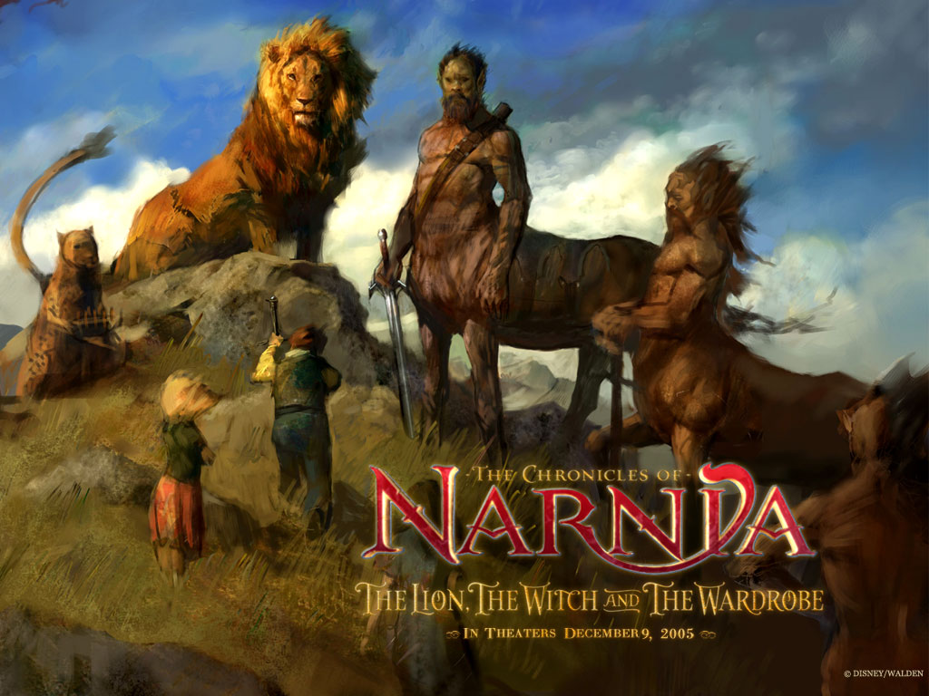

Narnia & the
Watchful Dragons
Robert C. Newman

Slide 2
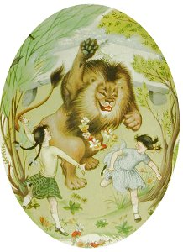
The Narnia Chronicles
Ever since they first appeared over 50 years ago, the Narnia books by CS Lewis have been enormously popular.
Though written for kids, millions of adults have read them – and not just aloud to children!
Obviously these books have struck a chord with young and old alike.

Slide 3
Various Productions
The Narnia series has been made into audios, both narrated and dramatized.
The stories have also been produced for video, both live and cartoon formats.
Now Walt Disney Pictures and Walden Media are in the midst of producing an elaborate & expensive film series.
We give here a sketch of the books.

Slide 4
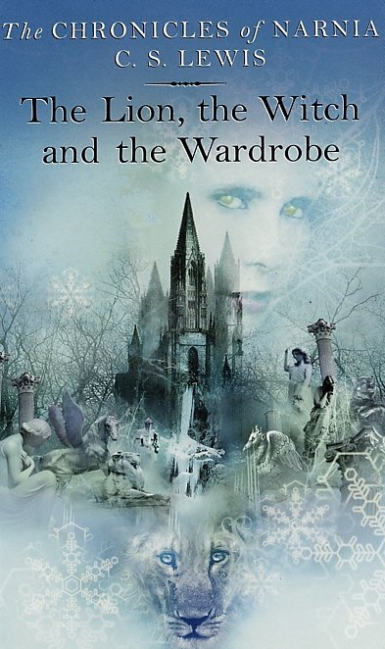
The Narnia Series 1:
The Lion, the Witch & the Wardrobe
Four children (Peter, Susan, Edmund & Lucy) come to live in the rural mansion of an elderly professor to escape the London air raids.
They are accidentally transported to a parallel world, Narnia, by entering an old wardrobe.
Narnia is inhabited by talking animals and various other magical creatures.
It has been enchanted by the wicked witch Jadis so it is always winter but never Christmas.
The Pevensie kids help the lion Aslan rescue Narnia from the witch's power.

Slide 5

Narnia 2: Prince Caspian
After about a year of Earth time, the Pevensies return to Narnia, but find a thousand years have passed there.
Narnia is being oppressed by wicked King Miraz, who is opposed by his nephew Caspian and the talking animals.
When all seems lost, Aslan, Caspian, and the Pevensies defeat Miraz's forces and free the good Narnian creatures.

Slide 6

Narnia 3:
Voyage of the Dawn Treader
Edmund, Lucy and their cousin Eustace are magically transported to Narnia to join Caspian's exploration in the eastern sea.
Caspian is seeking seven of his father's noblemen who left when Miraz was king.
After many exciting adventures, they reach the uttermost East of the Narnian world, where Reepicheep the mouse finds his heart's desire and the children meet Aslan.

Slide 7
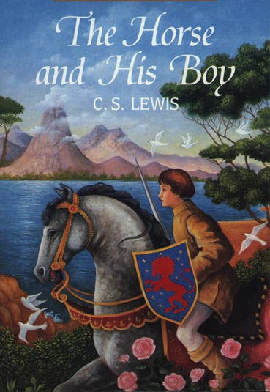
Narnia 4: The Horse & His Boy
Set during the latter part of the Lion, Witch & Wardrobe, this story follows the adventures of a poor boy Shasta, who runs away from home in Calormen when he realizes he is about to be sold into slavery.
He is accompanied by a warhorse Bree and later by the upper-class girl Aravis and her mare Hwin.
They eventually escape to the North, saving a kingdom in the process.

Slide 8
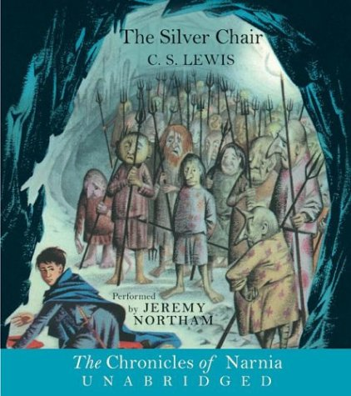
Narnia 5: The Silver Chair
Eustace (from #3, Dawn Treader) and Jill are called into Narnia by Aslan to find and rescue Prince Rilian from a wicked witch, the Queen of Underland.
Accompanied by a marsh wiggle Puddle-glum and guided by four clues, the two travel into the wild north in winter.
In spite of botching nearly all the clues, they do succeed and the story ends more or less happily.

Slide 9
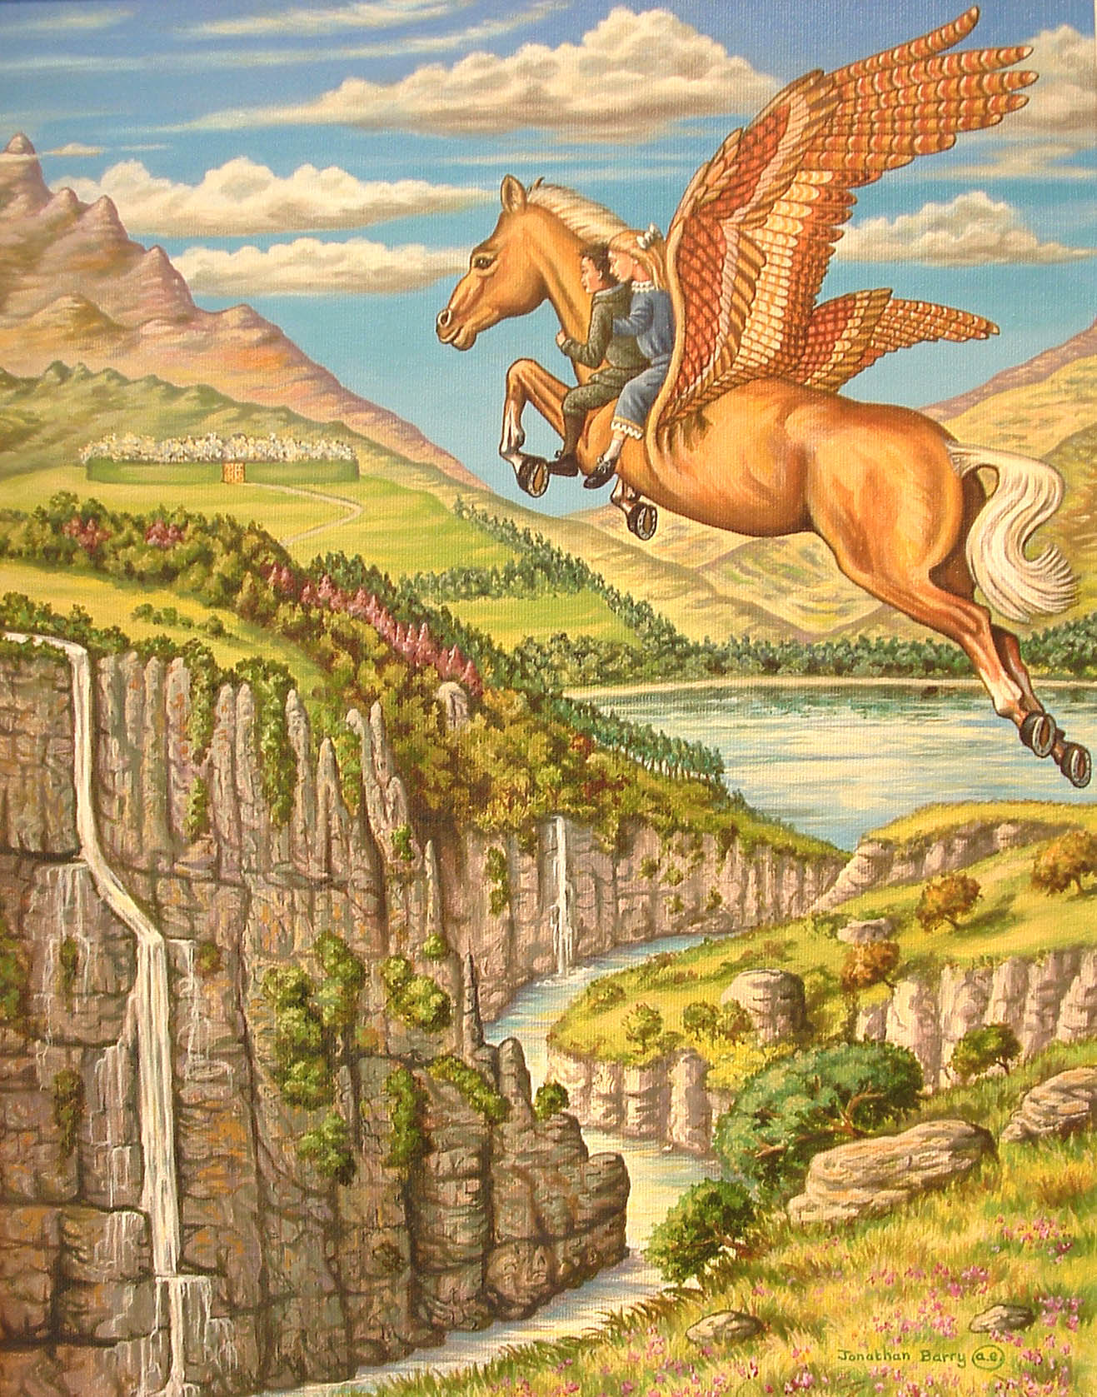
Narnia 6: The Magician's Nephew
This story, set many years before the others, involves the boy Digory (the old professor in LWW), his neighbor Polly, Digory's sick mother, and his magic-dabbling uncle Andrew.
Tricked into using Andrew's magic rings, Digory & Polly travel to other worlds, see the creation of Narnia, and inadvertently bring the wicked witch Jadis into Narnia.

Slide 10
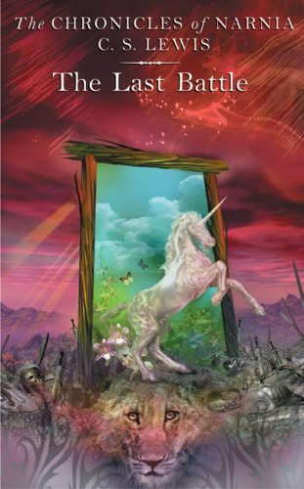
Narnia 7: The Last Battle
The main characters here are again Eustace and Jill (from #5 Silver Chair).
The time in Narnia is centuries later, when the last king Tirian is captured and overthrown by a plot involving a clever ape, a fake Aslan, and the soldiers of Calormen.
The real Aslan intervenes, brings an end to Narnia, and ushers in a new Narnia "further up and further in."

Slide 11
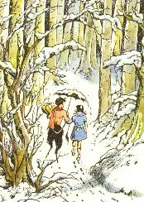
A Rearranged Order
In recent years the Narnia books have been issued in a new order that is chronological:
Magician's Nephew
Lion, Witch, Wardrobe
Horse & His Boy
Prince Caspian
Dawn Treader
Silver Chair
Last Battle

Slide 12
In this talk…
We want to consider several different topics, just briefly…
What is CS Lewis trying to do in the Narnia series?
  Slip past the watchful dragons
What is he teaching?
  Biblical Christianity
How is he going about this?
  He is using mooreeffoc.

Slide 13
What is Lewis Doing?
"I thought I saw how stories of this kind could steal past a certain inhibition which had paralysed much of my own religion in childhood. Why did one find it so hard to feel as one was told one ought to feel about God or about the sufferings of Christ? I thought the chief reason was that one was told one ought to… And reverence itself did harm… But supposing by casting all these things into an imaginary world, stripping them of their stained-glass and Sunday School associations, one could make them for the first time appear in their real potency? Could one not thus steal past those watchful dragons?" Of Other Worlds, p 37.

Slide 14
"These Things" in Narnia
Creation
Sin entering the world
Jesus dying for sin, and rising again
Freedom, supernatural aid
Seeking life's meaning
The last shall be first
Guidance, what is real?
Antichrist, last judgment
Magician's Nephew
Jadis comes to Narnia
Aslan dying for Edmund
Prince Caspian
Dawn Treader
Horse & His Boy
Silver Chair
Last Battle

Slide 15
An Important Technique
One way in which Lewis helps us to see these important truths is by using a technique that some call mooreeffoc.
Mooreeffoc is a literary device by which the author sets up a situation so that the reader will experience a truth from an unusual angle, perhaps coming to see its power for the first time.

Slide 16

What is Mooreeffoc?
"And there is (especially for the humble) Mooreeffoc, or Chestertonian Fantasy. Mooreeffoc is a fantastic word, but it could be seen written up in every town in this land [England]. It is 'Coffee-room,' viewed from the inside through a glass door, as it was seen by Dickens on a dark London day; and it was used by Chesterton to denote the queerness of things that have become trite, when they are seen suddenly from a new angle." The Tolkien Reader, p 58

Slide 17
Mooreeffoc in Narnia
The whole series:
  The basic truths of Christianity are transposed to a fairy-tale world.
Some brief touches:
  Lucy reads the titles of books in Tumnus' library.
A more extended mooreeffoc:
  Puddleglum responds to the Queen of Underland.
Mooreeffoc and angels:
  Surprise!

Slide 18
Tumnus' Library
Lucy sees the title Men, Monks and Game-keepers: A Study in Popular Legend, or Is Man a Myth? (LWW, chapter two)
If man, whom we know exists, is considered mythological by some fauns, may not some of the beings we consider mythological also exist?
A good preparation (for those trained in modern secularism) for a more sympathetic reading of Biblical narratives including angels & demons.

Slide 19

The Queen's Enchantment
The Queen of Underland attempts to enchant Eustace, Jill, Puddleglum, and Rilian to believe there is no other world than hers. (SC, chap 12)
  Their belief in the sun is just an expanded version of the lamp in the ceiling.
  Their belief in Aslan is merely an expanded version of a housecat.
Notice how this mimics the atheists' argument that God is just an expanded version of a human.

Slide 20
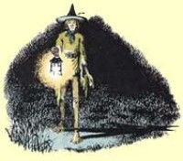
Puddleglum's Answer
"Suppose we have only dreamed, or made up, all these things – trees and grass and sun and moon and stars and Aslan himself. Suppose we have. Then all I can say is that, in that case, the made-up things seem a good deal more important than the real ones. Suppose this black pit of a kingdom of yours is the only world. Well, it strikes me as a pretty poor one. And that's a funny thing, when you come to think of it. We're just babies making up a game, if you're right. But four babies playing a game can make a play-world which licks your real world hollow."

Slide 21
Mooreeffoc and Angels
Another example, about as extensive as the whole Narnia series, is Lewis' back-door approach to angels.
As we identify with the children who travel back and forth from our world to Narnia, we begin to function as angels in Narnian salvation-history!
If this isn't an example of "stealing past the watchful dragons," I don’t know what is!

Slide 22
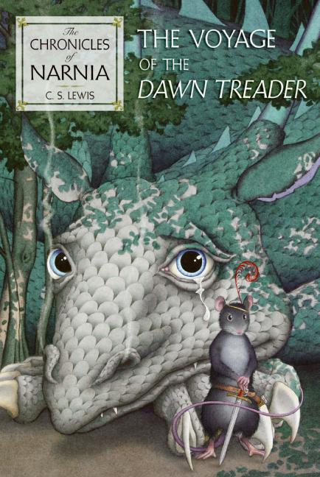
The Chronicles of Narnia
A Way to Visualize, Appreciate, and Feel Biblical Truths!

