Slide 1
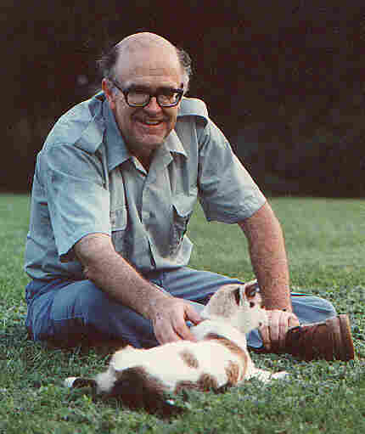

My Life & Ministry
Robert C. Newman

Slide 2
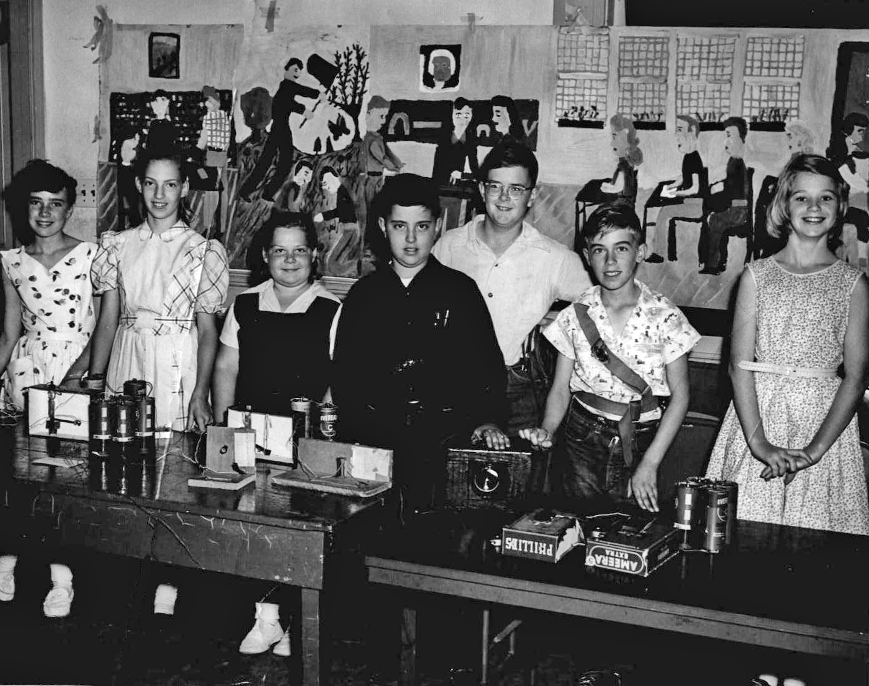
Early Life
I was born in Washington, DC in 1941 to Xn parents.
Raised in the DC suburbs
Made a profession of faith about age 7
Got interested in science in elementary school
Cherrydale School Science Fair 1953

Slide 3
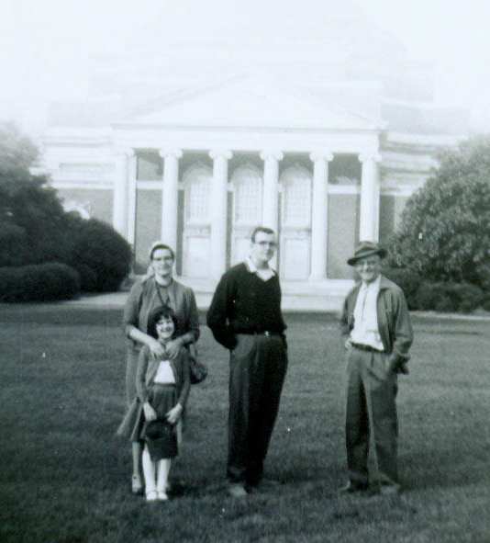
College
Attended college at Duke University.
  BS in physics, 1963
  Asked God to guide my life.
Graduate school at Cornell University
  PhD in theoretical astrophysics, 1967
  Met Herman Eckelmann.
With parents & sister, Duke East Campus

Slide 4

A Change in Direction
Duke University, 1959-63
Required religion courses raised problems.
Helped by writings of CS Lewis.

Slide 5
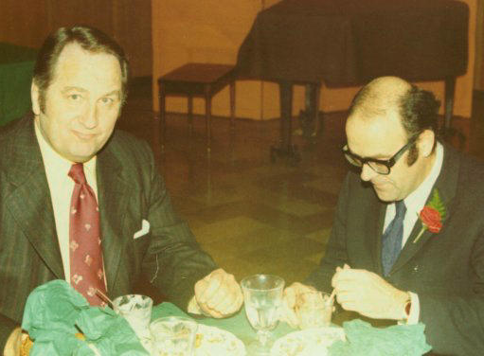
A Change in Direction
Cornell University, 1963-67
Got in better church.
Helped by Herman Eckelmann re/ evidence for Christianity:
  Pastor of Faith Bible Church
  Research Associate in Cornell Space Center
Decided to attend seminary to get Biblical education, planning to use it while teaching astrophysics at university.
Herman Eckelmann (L)

Slide 6
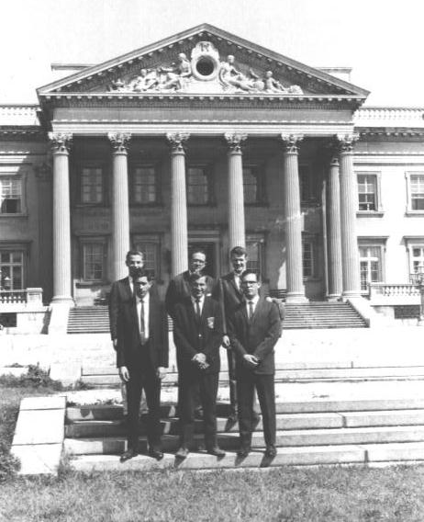
Studying the Bible
Faith Theological Seminary, 1967-71
Finished MDiv, spring 1970.
Began STM program, fall 1970.
But the school split in spring 1971.

Slide 7
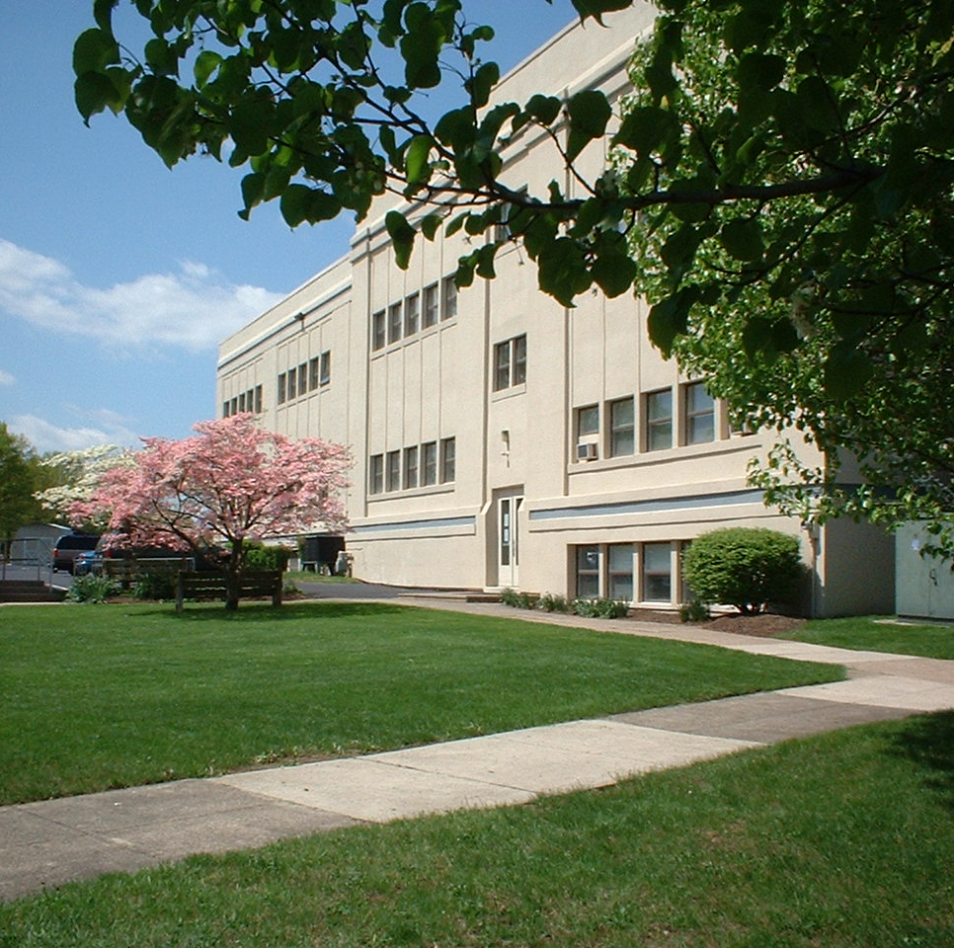
Studying & Teaching the Bible
Biblical Seminary, 1971-72
Asked to teach New Testament, 1971.
Finished STM program, 1972.
Continued teaching there for 35 years! (till retirement, 2006)

Slide 8
Ministry Activities
Teaching at Biblical Seminary 1971-2006
Preaching at various churches 1967-
Speaking at colleges, etc 1967-
Writing ~1965-
IBRI 1979-
Slide talks, eventually converted to PowerPoint presentations 1967-

Slide 9
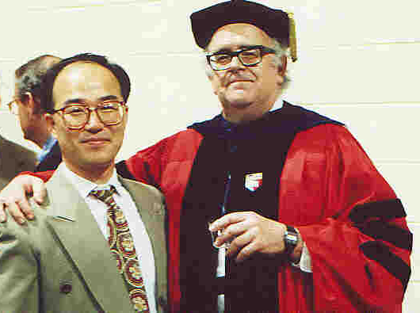
Biblical Seminary
Taught 35 years, 1971-2006
Mostly NT courses, plus Evidence for the Christian Faith
Had some 1000+ students over these years

Slide 10
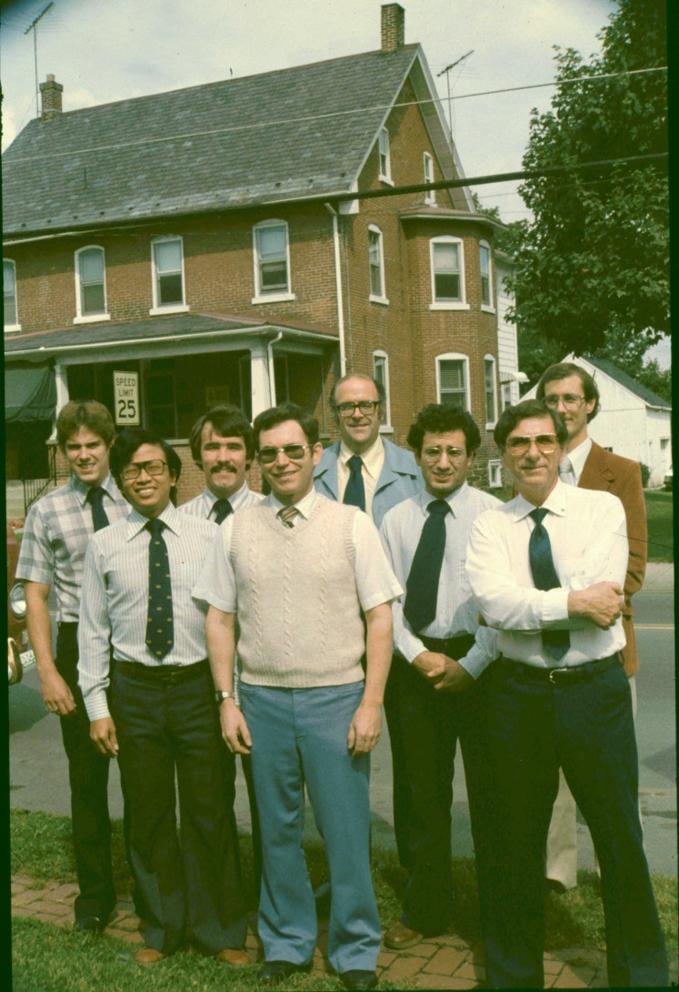
Trinity House
I also started a house for seminary students, which operated from 1982-2006.
These are the Trinity House residents the 1st year.
Had over 100 students during its 24 years.

Slide 11
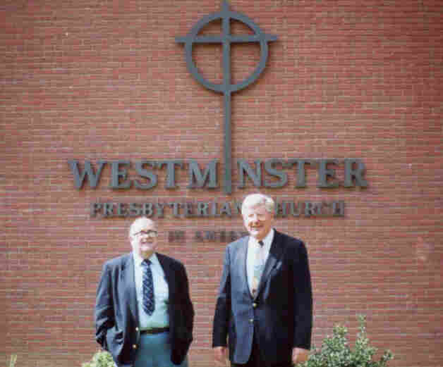
Preaching
I preached mostly in Eastern US, usually within driving distance from Philadelphia, so PA, NJ, NY…
Or, during my summers, operating from DC area, so VA & MD.
Westminster PCA, Butler, PA

Slide 12
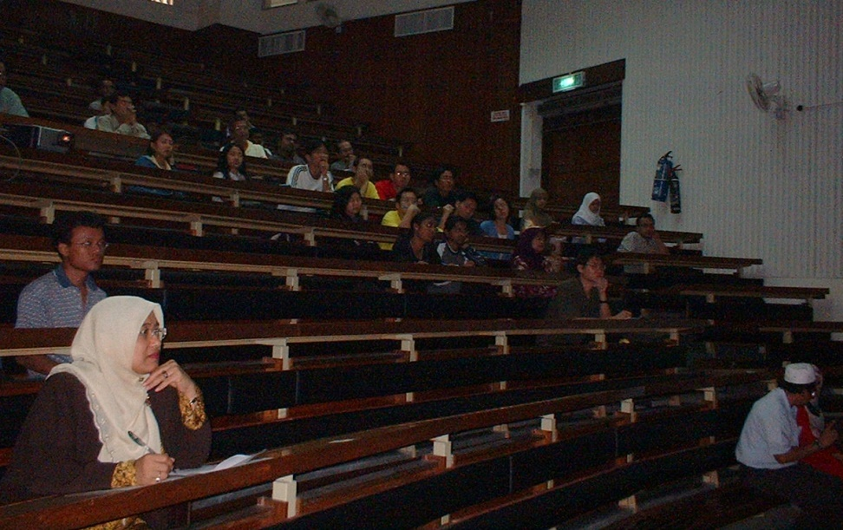
Speaking
Mostly to college & university audiences, mainly in Eastern US, usually sponsored by a Xn organization.
Schools included:
  Cornell
  Princeton
  Penn
  Rutgers
University of Malaya, 2002

Slide 13


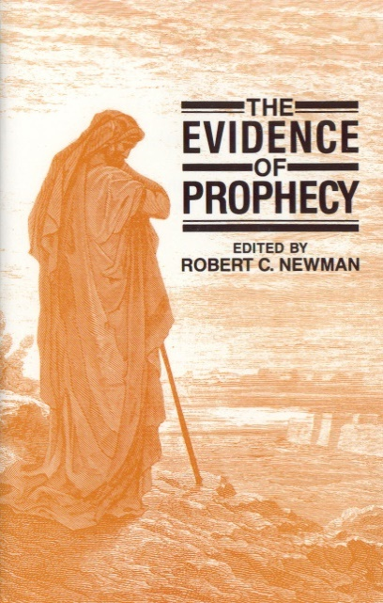
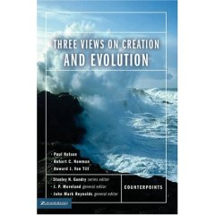
Writing
Wrote over 100 articles in various magazines & journals
Wrote or co-authored six books.
Contributed to several books and encyclopedias.

Slide 14

IBRI
Acronym for “Interdisciplinary Biblical Research Institute”
Founded by a group of faculty & students at Biblical Seminary, 1979-80.

Slide 15
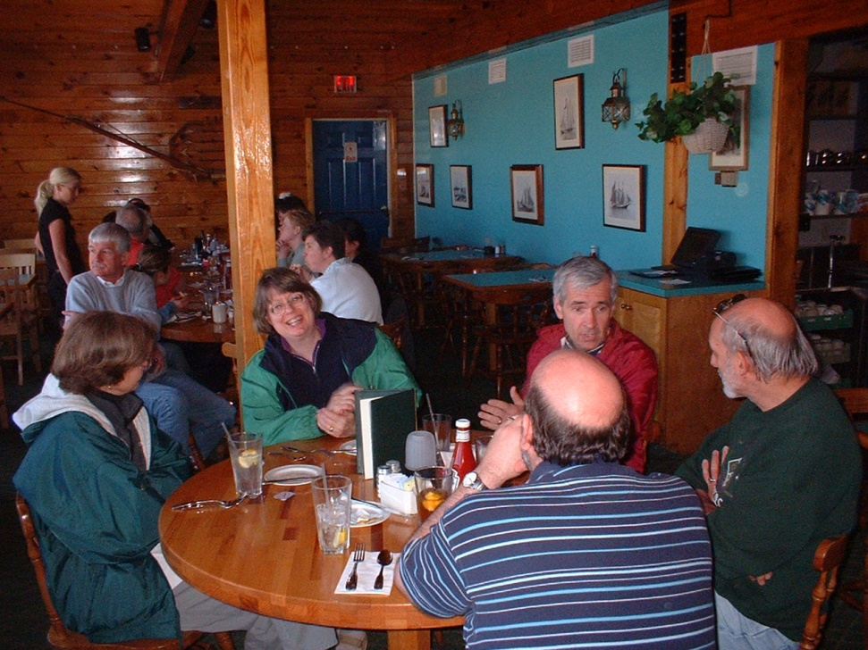
IBRI
Mission: to strengthen churches in their outreach to college-educated seekers
A very low-budget operation!
Part of our Board is pictured here.

Slide 16
IBRI: Early Activities
Colloquium sessions 1979-2003
Research reports 1980-
Books ~1986-
Seminars 1989-2003
  Dice or Deity?
  Evidence for Faith
  Intelligent Design Conference

Slide 17
IBRI: Recent Activities
Website www.ibri.org
Audio lectures/sermons, PowerPoints, papers, course & lecture notes, etc.
Thousands of items by numerous authors
Main topics: Biblical studies, apologetics, interaction of science & Christianity, theology (including practical theology)
In 2010 (224 days) had ~ 3.5 million hits
  Over 15,000 hits per day

Slide 18

IBRI Website
Some Countries Accessing the Site:
  United States (1)
  China (2)
  Australia (3)
  Ukraine (4)
  India (7)
  Netherlands (12)
  Indonesia (20)
  South Africa (22)

Slide 19
PowerPoints
Since retirement in 2006, I have been converting many of my talks into the PowerPoint format, and posting these on our IBRI website, w/ narration in mp3.
We now have about 200 of these available on-line.
See these under “The Robert C. Newman Library” at www.ibri.org.

Slide 20
Ministry Travel Overseas
Began doing this while still teaching at Biblical
  1983: Caribbean (St Vincent)
  1989: Ireland (Limerick, Cork)
  1992: Russia (Novgorod, Vologda)
  1998: London, Cambridge, Cologne
  2001, 2002, 2004: Singapore & Malaysia
  2004: Great Britain (London, L’Abri, Stoke-on-Trent, Leeds)

Slide 21
Ministry Travel Overseas
More since retirement in May 2006:
  2006: Singapore, Malaysia, New Zealand
    Taught two short courses at BC of Malaysia
  2007: Russia (Volgograd)
  2008: Europe (Lyon, L’Abri, Amsterdam, Cologne)
  2008: China (Beijing, Shanghai)
  2009: Taiwan (Taipei, Taichung)
  2009: Ukraine (Kiev)
  2010: Costa Rica (San Jose)

Slide 22
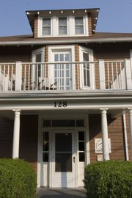
Helping with Center for Christian Study at University of Virginia
Since retirement, I have lived in central Virginia, near UVa.
Lectures @ Center “Doing Science in a Theistic Universe.”
Helping study groups:
  Jesus and Christian Origins
  Faith, Reason and Science.

Slide 23
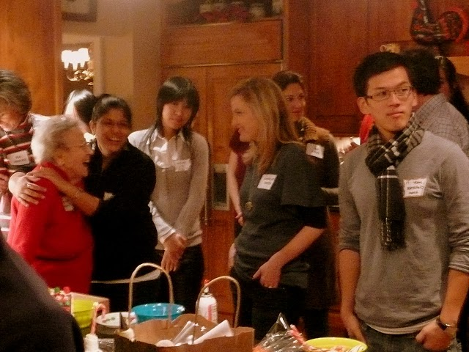
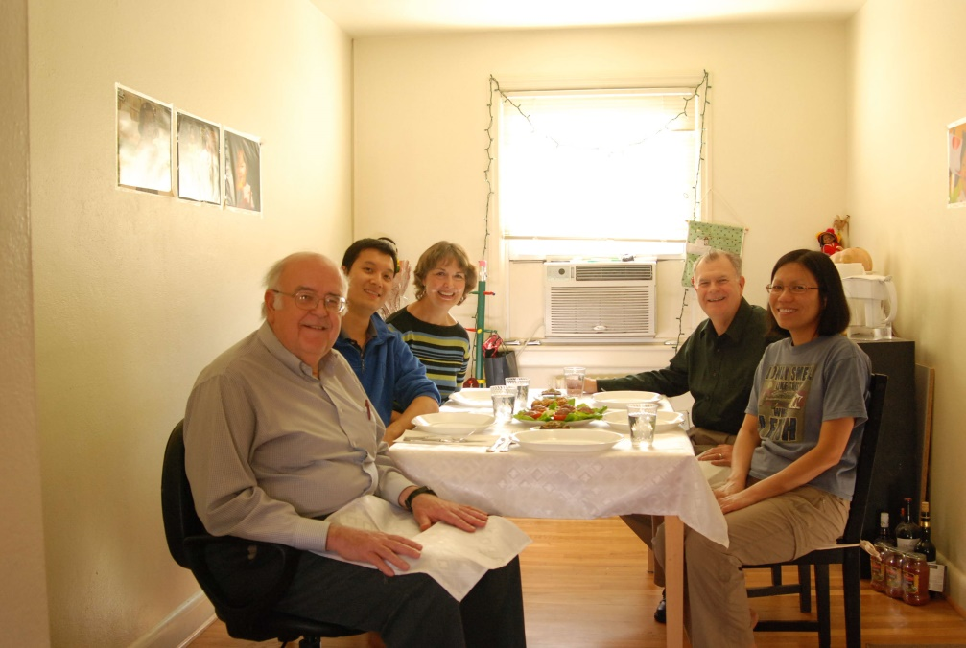
Working with Internationals
I have also helped with outreach to internationals at UVa.
  Volunteering with Intl. Students Inc.
  Serving on our church’s Ethnic Chinese Ministry Team
  Helping internationals with their English

Slide 24
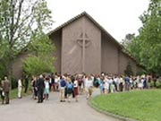
Teaching at Trinity PCA
I have taught in the adult education program at Trinity:
  Various apologetic and biblical topics for two teaching fellowships
  Revelation for the Graduate & Professional Teaching Fellowship
  Most recently, the Parables of Jesus

Slide 25
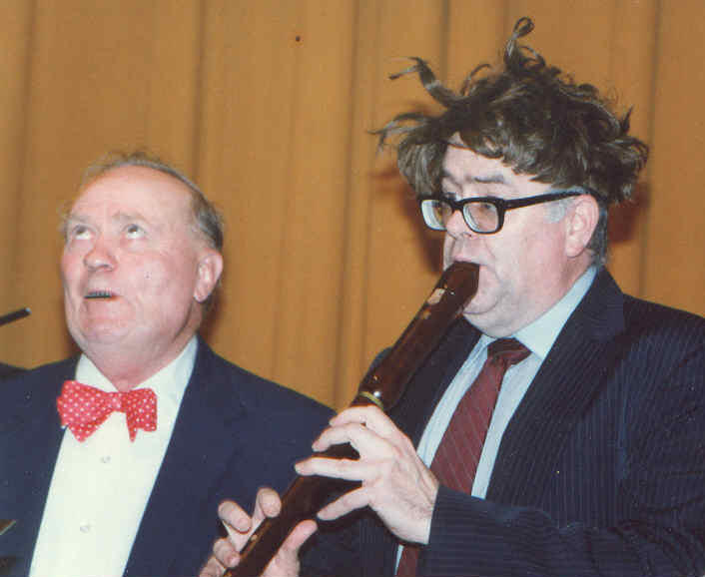
The Future?
I don’t know how long the Lord will leave me here on this earth…
But I hope to continue serving Him in these sorts of ways so long as He gives me health & strength.
Faculty Musical Performance at Biblical Seminary

Slide 26
The End
Therefore, my dear brothers, stand firm. Let nothing move you. Always give yourselves fully to the work of the Lord, because you know that your labor in the Lord is not in vain. 1Cor 15:58 (NIV)

