Slide 1

Motivation to Do God’s Will
Robert C. Newman

Slide 2
Motivation?
Do you sometimes:
  Feel discouraged?
  Want to give up, as things aren’t going right?
  Have a hard time getting motivated to do what you know you ought to do?
The example of Jesus can be a real help to us in these situations.
Let’s see.

Slide 3
Jesus’ Motivation
John 4:27 (NIV) Just then his disciples returned and were surprised to find him talking with a woman. But no one asked, "What do you want?" or "Why are you talking with her?" 28 Then, leaving her water jar, the woman went back to the town and said to the people, 29 "Come, see a man who told me everything I ever did. Could this be the Christ?" 30 They came out of the town and made their way toward him. 31 Meanwhile his disciples urged him, "Rabbi, eat something." 32 But he said to them, "I have food to eat that you know nothing about." 33 Then his disciples said to each other, "Could someone have brought him food?" 34 "My food," said Jesus, "is to do the will of him who sent me and to finish his work."

Slide 4
Jesus’ Motivation
Jesus tells his disciples: "My food is to do the will of him who sent me and to finish his work."
What did this mean in Jesus’ life?
How can it help us?
That’s what we want to think about here.

Slide 5
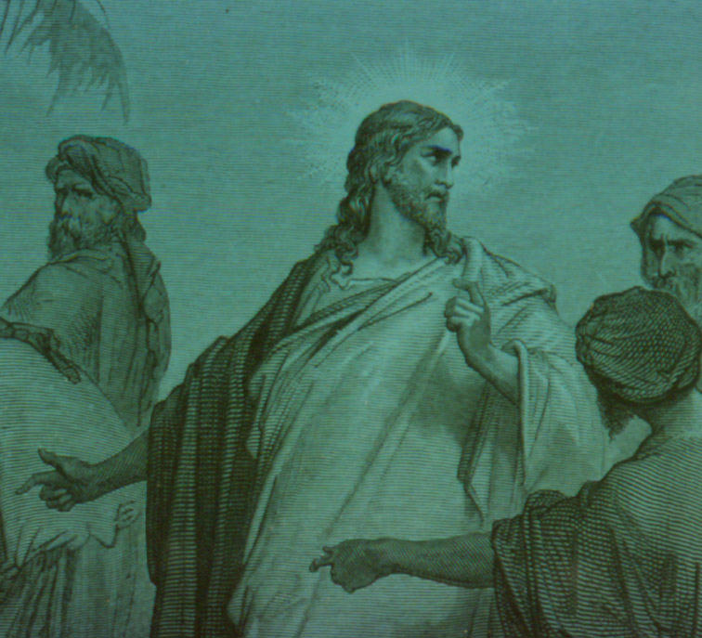
Jesus’ Example

Slide 6
Jesus’ Example
In the Temple at Age 12 (Luke 2:41-52)
Tempted in the Wilderness (Matt 4:1-11)
Rejected at Nazareth (Luke 4:16-30)
Going up to Jerusalem (John 11:7-16)
Cleansing the Temple (Jn 2:12-22; Mk 11:12-18)
Going to the Cross

Slide 7
In Temple at Age 12
Luke 2:41 (NIV) Every year his parents went to Jerusalem for the Feast of the Passover. 42 When he was twelve years old, they went up to the Feast, according to the custom. 43 After the Feast was over, while his parents were returning home, the boy Jesus stayed behind in Jerusalem, but they were unaware of it. 44 Thinking he was in their company, they traveled on for a day. Then they began looking for him among their relatives and friends. 45 When they did not find him, they went back to Jerusalem to look for him. 46 After three days they found him in the temple courts, sitting among the teachers, listening to them and asking them questions. 47 Everyone who heard him was amazed at his understanding and his answers. 48 When his parents saw him, they were astonished. His mother said to him, "Son, why have you treated us like this? Your father and I have been anxiously searching for you." 49 "Why were you searching for me?" he asked. "Didn't you know I had to be in my Father's house?" 50 But they did not understand what he was saying to them.

Slide 8
In Temple at Age 12
We don’t know any of the details of Jesus’ choosing to stay behind at the Temple when his parents set off to return to Nazareth.
But it clearly involved treating God as his father and wanting to be with Him.
It also showed Jesus’ great interest in the things of God.

Slide 9
Temptation in the Wilderness
Matt 4:1 (NIV) Then Jesus was led by the Spirit into the desert to be tempted by the devil. 2 After fasting forty days and forty nights, he was hungry. 3 The tempter came to him and said, "If you are the Son of God, tell these stones to become bread." 4 Jesus answered, "It is written: `Man does not live on bread alone, but on every word that comes from the mouth of God.'" 5 Then the devil took him to the holy city and had him stand on the highest point of the temple. 6 "If you are the Son of God," he said, "throw yourself down. For it is written: "`He will command his angels concerning you, and they will lift you up in their hands, so that you will not strike your foot against a stone.'" 7 Jesus answered him, "It is also written: `Do not put the Lord your God to the test.'" 8 Again, the devil took him to a very high mountain and showed him all the kingdoms of the world and their splendor. 9 "All this I will give you," he said, "if you will bow down and worship me.“
10 Jesus said to him, "Away from me, Satan! For it is written: `Worship the Lord your God, and serve him only.'" 11 Then the devil left him, and angels came and attended him.

Slide 10
Temptation in the Wilderness
Jesus literally went without food for 40 days in order to do God’s will.
Jesus was not grandstanding…
  Can I set a world record for fasting?
… since Jesus refused Satan’s temptation along these lines:
  Throw yourself down!
See also Jesus’ teaching about fasting in his Sermon on the Mount.

Slide 11
Rejected at Nazareth
Luke 4:16 (NIV) He went to Nazareth, where he had been brought up, and on the Sabbath day he went into the synagogue…And he stood up to read…. 18 "The Spirit of the Lord is on me, because he has anointed me to preach good news to the poor. He has sent me to proclaim freedom for the prisoners and recovery of sight for the blind, to release the oppressed, 19 to proclaim the year of the Lord's favor." …21 and he began by saying to them, "Today this scripture is fulfilled in your hearing." …23 Jesus said to them, "Surely you will quote this proverb to me: `Physician, heal yourself! Do here in your hometown what we have heard that you did in Capernaum.' 24 I tell you the truth," he continued, "no prophet is accepted in his hometown. 25 I assure you that there were many widows in Israel in Elijah's time, when the sky was shut for three and a half years and there was a severe famine throughout the land. 26 Yet Elijah was not sent to any of them, but to a widow in Zarephath in the region of Sidon… 28 All the people in the synagogue were furious when they heard this. 29 They got up, drove him out of the town, and took him to the brow of the hill on which the town was built, in order to throw him down the cliff. 30 But he walked right through the crowd and went on his way.

Slide 12
Rejected at Nazareth
Jesus here says to his hometown people what he knew they would not like, yet he did so because he knew that was what God had called him to do.
Similarly, Jesus rebuked the Pharisees in Matthew 23 and parallels.
Jesus put doing God’s will above his own popularity and even his own safety.

Slide 13
Going Up to Jerusalem
John 11:7 (NIV) Then he said to his disciples, "Let us go back to Judea." 8 "But Rabbi," they said, "a short while ago the Jews tried to stone you, and yet you are going back there?" 9 Jesus answered, "Are there not twelve hours of daylight? A man who walks by day will not stumble, for he sees by this world's light. 10 It is when he walks by night that he stumbles, for he has no light." 11 After he had said this, he went on to tell them, "Our friend Lazarus has fallen asleep; but I am going there to wake him up." 12 His disciples replied, "Lord, if he sleeps, he will get better." 13 Jesus had been speaking of his death, but his disciples thought he meant natural sleep. 14 So then he told them plainly, "Lazarus is dead, 15 and for your sake I am glad I was not there, so that you may believe. But let us go to him." 16 Then Thomas (called Didymus) said to the rest of the disciples, "Let us also go, that we may die with him."

Slide 14
Going Up to Jerusalem
Forgetting his own safety, Jesus goes into danger to help Lazarus and his sisters.
In other cases, we see Jesus ministering to the sick and teaching the Word to the point of his own physical exhaustion.
He has given up a comfortable lifestyle to serve others, sharing with the poor in their homelessness and poverty.

Slide 15
Cleansing the Temple
Mark 11:15 (NIV) On reaching Jerusalem, Jesus entered the temple area and began driving out those who were buying and selling there. He overturned the tables of the money changers and the benches of those selling doves, 16 and would not allow anyone to carry merchandise through the temple courts. 17 And as he taught them, he said, "Is it not written: `My house will be called a house of prayer for all nations'{Isaiah 56:7}? But you have made it `a den of robbers.'{Jer. 7:11}" 18 The chief priests and the teachers of the law heard this and began looking for a way to kill him, for they feared him, because the whole crowd was amazed at his teaching.

Slide 16
Cleansing the Temple
Jesus cleanses the Temple twice, both at the beginning and end of his ministry.
Here we especially see his self-forgetting concern for God.
He is angry that God’s Temple is being desecrated, especially by those who claim to be God’s people.
Again, he knows that his actions are dangerous, but he does them anyway.

Slide 17
Going to the Cross
Luke 22:39 (NIV) Jesus went out as usual to the Mount of Olives, and his disciples followed him. 40 On reaching the place, he said to them, "Pray that you will not fall into temptation." 41 He withdrew about a stone's throw beyond them, knelt down and prayed, 42 "Father, if you are willing, take this cup from me; yet not my will, but yours be done."
43 An angel from heaven appeared to him and strengthened him. 44 And being in anguish, he prayed more earnestly, and his sweat was like drops of blood falling to the ground.

Slide 18
Going to the Cross
This is the ultimate example of Jesus’ motivation to do God’s will.
Jesus’ prayer in the Garden of Gethsemane shows that he cared more about doing God’s will than about doing his own will…
  … or even than about life itself.

Slide 19
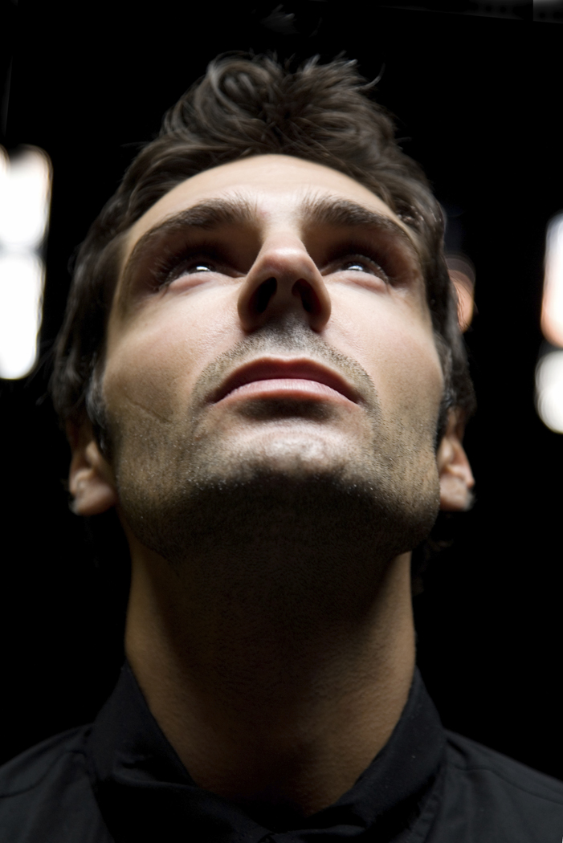
Some Lessons
For Us

Slide 20
Servant Attitude
A servant’s full-time job is to watch out for the concerns of his master.
Jesus came to earth to serve God and to serve fallen humans by bringing us back to God.
Jesus has called us to be his servants with the same commission.

Slide 21
Our Motivation
We are to get our satisfaction from doing God’s will, not from:
  Acclaim
  Success
  Reward
“Man shall not live by bread alone, but by every word that comes from God’s mouth.”
  Matthew 4:4

Slide 22
Our Motivation
God is worth it !
  What else could we do with our lives that is even in the same league?
This is really just part of what it means to love God with all our hearts.
Only in this do we find real accomplishment and real success.
  “The eyes of the Lord range throughout the earth to strengthen those whose hearts are fully committed to him” – 2 Chronicles 16:9

Slide 23
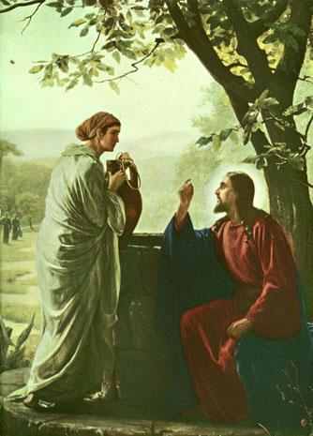
The End
May we too find that our food is to do the will of Him who sent us.

