Slide 1

Modern English Versions of the Bible
Robert C. Newman
Professor of New Testament
Biblical Theological Seminary
Hatfield, PA, USA

Slide 2
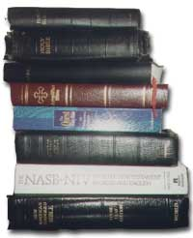
The Problem Stated
We have a very large number of Bible versions in English today, with new ones coming out nearly every year.
How do we tell which ones are reliable for the use of Christians and seekers in trying to understand God’s message to mankind?

Slide 3
Evaluating a Translation
Are the translators in agreement with the teachings of the Bible?
Is the translation faithful to the best available text of the Bible in the original languages?
Is the translation clear for its intended audience?
Does the translation conform to good contemporary English usage?
Does the translation have stylistic beauty?

Slide 4
The Authorized (King James) Version (1611)
A committee translation, with 3 committees appointed by King James 1 and meeting at Westminster, Oxford and Cambridge
Involved the best scholars in England at a time when biblical scholarship was at a peak
All the committee members had a very high opinion of the Bible.
Thus the KJV seems to have satisfied all 5 items when it was translated.
But with the passage of almost 400 years, it no longer satisfies all these criteria.

Slide 5
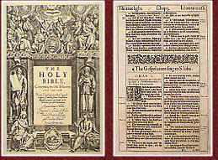
The KJV & the Criteria
The KJV no longer conforms to the best available text in the original languages.
The KJV is no longer in contemporary English.
The original audience of the KJV is long dead.
None of this is the fault of the original translators.

Slide 6

Changes in English since 1611
Verb changes
Pronoun changes
Vocabulary changes

Slide 7
Verb Changes
Disappearance of est forms for 2nd person singular
  thou knowest → you know
Transformation of eth forms for 3rd person singular
  he knoweth → he knows

Slide 8
Pronoun Changes
Disappearance of distinct 2nd person singular forms ‘thou, thee, thy’
  These were not terms of respect when the KJV was made.
Disappearance of 2nd plural ye
  Replaced by 2nd singular/plural you, your
Replacement of relative pronoun which by who when a person is referred to

Slide 9
Verb & Pronoun Changes
None of these changes are likely to produce serious misunderstanding of the text.
They do give the average person the impression either:
  That the Bible was written in some sort of pious or stilted language
  That its writers were illiterate
  Neither of which is true!
Far more important are vocabulary changes, as they hinder understanding.

Slide 10
Vocabulary Changes
Some words in the KJV are archaic or no longer used in modern English:
  Assuage (Job 16:5)
  Ensue (1 Pet 3:11)
  Holpen (Ps 83:8)
  Rereward (Num 10:25)
  Straightway (Mt 4:22)
  Twain (often)
  Wot (Gen 21:26)

Slide 11
Vocabulary Changes
Other words have changed meaning:
  Charity (1 Cor 13)
  Fetch a compass (2 Sam 5:23)
  Girdle (often)
  Leasing (Ps 4:2)
  Meat (often)
  Prevent (Ps 119:147-48)
  Rent (often)
  Tire (Isa 3:18)

Slide 12
Vocabulary Changes
But the Bible was originally written in common, everyday language.
It was intended to be understood by average people.
We need to make a revision or new translation as often as the language changes significantly:
  To preserve God’s intention
  To make His message plain

Slide 13
Textual Discoveries & Developments since 1611
The Textual Basis of the KJV
Manuscript Discoveries since 1611
Developments in Textual Study

Slide 14

The Textual Basis of the KJV
NT ultimately based on the edition of the Greek NT by Erasmus in 1516.
Erasmus’ edition was based on only a few manuscripts; the oldest (10th cen) was least used.
Erasmus had only one (incomplete) manuscript of Revelation; he supplied the last 6 verses from Latin.
Acts 9:6 and 1 John 5:7-8 were also supplied from the Latin.

Slide 15
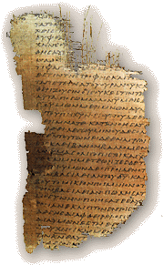
Manuscript Discoveries
In 1611, very few manuscripts known from before AD 1000.
Since then, several hundred earlier mss on parchment have been found, with two nearly complete from before AD 400.
Since 1900, many fragmentary NT mss have been found written on more fragile papyrus and copied before AD 400.
These include substantial parts of several mss from before AD 200 and a small fragment of John from about AD 130.

Slide 16
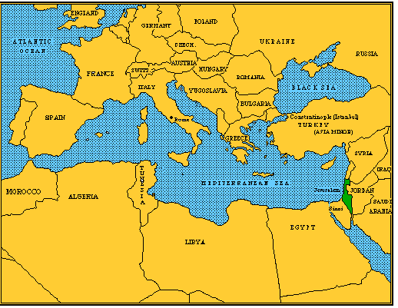
Developments in Text Study
The known manuscripts are now seen to fall into several families, of which the most important are:
  Alexandrian
  Western
  Byzantine
Byzantine
Western
Alexandrian

Slide 17
Text Families
Alexandrian
  Early, known by AD 150
  Short, but seems reliable
  Text used in most recent English versions
Western
  Early, known by AD 150
  Longer, erratic, tendency toward additions
Byzantine
  Later, apparently not before AD 300
  Intermediate length
  Often seems to combine Alex and West readings
  Text used in KJV

Slide 18
Some Differences
Matthew 6:13b – doxology of Lord’s Prayer
  Probably not before 3rd or 4th century
Mark 16:9-20 – ending of Mark
  Most controversial
  Known before AD 150
John 7:53-8:11 – woman caught in adultery
  Not in earlier mss
  Probably a real incident preserved outside NT
1 John 5:7-8 – heavenly witnesses
  Not in Greek before late medieval period
  Not in Latin before 5th century

Slide 19
Theological Trends since 1611
Renaissance (1300-1600)
  Revival of interest in Classical period
  Weakened dominance of the Church
  Reintroduced many pagan ideas
Reformation (1500-1700)
  Return to Scripture as sole authority in faith
  Priesthood of believers → more variety interpreting
  Occultism of Renaissance suppressed

Slide 20
Theological Trends since 1611
Liberalism (1700-present)
  Antisupernatural reaction
  Science replaces authority of Church & Bible
  Rejection of miracles
  Enters German churches in 1800s, US in 1900s
Present situation (c2000)
  Liberalism still strong in academia
  Some resurgence of orthodoxy
  Growing diversity in ethnic groups, with influence of other religions and new age movement

Slide 21
Evaluating Translations
Are the translators in agreement with the teachings of the Bible?
Is the translation faithful to the best available text of the Bible in the original languages?
Is the translation clear for its intended audience?
Does the translation conform to good contemporary English usage?
Does the translation have stylistic beauty?

Slide 22
Evaluating Translations
Are the translators in agreement with the teachings of the Bible?
  Pass: NASU, NIV, NLT, ESV
  Fail: NRSV, REB, NWT
Is the translation faithful to the best available text of the Bible in the original languages?
  Pass: Most modern versions
  Fail: KJV, NKJV, etc.

Slide 23
Evaluating Translations
Is the translation clear for its intended audience?
  Not all have same intended audience.
  NLT easiest reading
  NASU, KJV hardest
Does the translation conform to good contemporary English usage?
  Pass: most modern versions
  Fail: older versions, NASB, Amplified

Slide 24
Evaluating Translations
Does the translation have stylistic beauty?
  Think NIV, ESV best
  NASU, NKJV somewhat weak

Slide 25
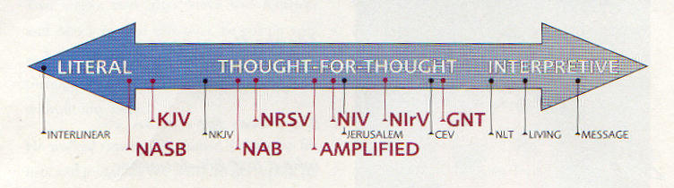
Literal vs Paraphrase

Slide 26
Some Tests for
Theological Soundness
Do the translators think the apostles properly understood the Old Testament?
  Peter – cp Acts 2:27 with Ps 16:10
  Matthew – cp Mt 1:23 with Isa 7:14
  Hebrews – cp Heb 1:8 with Ps 45:6
Do the translators think the apostles believed Jesus was God?
  John – check Jn 1:1 and 8:58
  Paul – check Rom 9:5
  Hebrews – check Heb 1:8

Slide 27
Some Tests for
Theological Soundness
Do the translators downplay Messianic prophecy?
  Ps 2:12 (kiss the Son?)
  Ps 22:16 (pierced hands?)
  Isa 9:6 (names suggest deity?)
  Isa 53:10, 12 (dies and lives again?)
  Dan 9:24-25 (Messiah or just anointed one?)
  Mic 5:2 (eternally pre-existing?)
  Zech 12:10 (look on me?)

Slide 28
Some Tests for
Theological Soundness
Do the translators downplay resurrection in the Old Testament?
  1 Sam 2:6
  Job 19:25-27
  Ps 17:15
  Ps 49:14-15

Slide 29
The End
Lord, help us to judge rightly!

