Slide 1
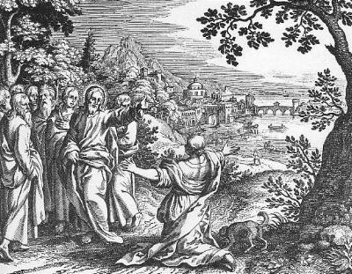
The Miracles of Jesus: 3. Miracles over the Spirit Realm
Robert C. Newman

Slide 2
Introduction
In this last talk in our series on the Miraculous & the Miracles of Jesus, we look at Jesus' mastery over the spirit realm.
As we are using this phrase in distinction from the human realm (previous talk), we here refer to spirit beings other than humans, in this case demonic beings.

Slide 3
Introduction
Among the more secular inhabitants of our modern western world, demons are typically relegated to the realm of fairy tales and superstition.
This is not the view of the Bible,and we should not be tempted to follow the lead of theological liberals of the 19th and 20th centuries in attempting to edit these out of Christianity.

Slide 4
Introduction
We will not have space here to discuss the biblical teaching on spirit beings, but I have done a bit of this in my PowerPoint talk "Angels and Demons."
I have also looked at the possibility of detecting the action of such beings in a more or less scientific way in another talk "Evidence of Angels?"

Slide 5
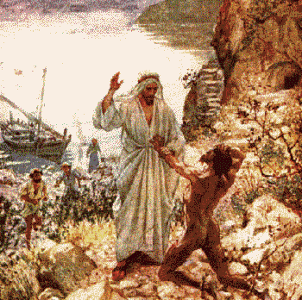
Gadarene Demoniacs
Matthew 8, Mark 5,
Luke 8

Slide 6
Matthew 8:28-34
Matt 8:28 (NIV) When he arrived at the other side in the region of the Gadarenes, two demon-possessed men coming from the tombs met him. They were so violent that no one could pass that way. 29 "What do you want with us, Son of God?" they shouted. "Have you come here to torture us before the appointed time?" 30 Some distance from them a large herd of pigs was feeding. 31 The demons begged Jesus, "If you drive us out, send us into the herd of pigs." 32 He said to them, "Go!" So they came out and went into the pigs, and the whole herd rushed down the steep bank into the lake and died in the water. 33 Those tending the pigs ran off, went into the town and reported all this, including what had happened to the demon-possessed men. 34 Then the whole town went out to meet Jesus. And when they saw him, they pleaded with him to leave their region.

Slide 7
Historicity of Events
Occasion
Closely related to miracle of calming storm, which this immediately follows in all 3 Synoptics.
Still early in Galilean ministry
Jesus met by demoniacs as He & disciples disembark.

Slide 8
Liberal Explanations (Plummer's list)
Whole story myth.
Healing historical, pigs not.
Demoniacs frightened pigs.
Drowning of pigs an accident occurring about same time.
Demoniacs merely insane; Jesus humors them re/ pigs, but story taken as historical.

Slide 9
Evidence of Historicity
Details of location: other side, tombs, steep slope, variant names (Gedara, Gerasa, Gergesa).
Reaction of people in sending Jesus away.

Slide 10
Reaction of Eyewitnesses
Pigs stampede into lake.
Pig herders flee, perhaps to get to town w/ their side of story first.
Demoniacs now normal.
Others come to see what has happened.
Eyewitnesses (disciples, others?) explain.
Former demoniac wants to accompany Jesus.

Slide 11
Old Testament Background
Similar miracles:
Not much; more in pagan, rabbinic & intertestament literature;
Os Guinness' "campfire" effect?
Control of animals by God:
Laban's sheep, plagues, quail, Balaam's donkey, cows pulling ark, ravens, bears, lions in den?
Control of animals by Satan:
snake in Garden, Sabeans, Chaldeans in Job
Demonic influence
Saul (1 Sam 16), false prophets (1 Kings 22:22)

Slide 12
Old Testament Background
Little on Satan in OT:
1 Chron 21:1 – incited David to take census
Job 1-2 – slanders Job
Ps 109:6 – let Satan stand at his right hand
Zec 3:1-2 Satan accusing high priest
poss Gen 6:1-2 – sons of God & daughters of men
Closest here is Zec 3, where God delivers Joshua from Satan (but not possession)

Slide 13
Significance
Immediate effect
Two men freed from Satan's power (main one goes out to proclaim God's work).
Gadarenes are out 2,000 pigs! They ask Jesus to leave.
Probably a deliverance/judgment theme here.

Slide 14
Significance
Place in salvation history
Apparently growing activity of demonic in IT period as far as Jews concerned
perhaps due to mixing w/ Gentiles
possibly due to approaching conflict w/ coming Christ.
Direct confrontation w/ powers of Satan.
Won decisively by Jesus.
Does Jesus use pigs to rid area of demons?
or do demons use pigs to rid area of Jesus?
Jesus’ power extends to spiritual realm, not merely nature and disease.

Slide 15
Symbolic Elements
Foreshadowing defeat of Satan, coming judgment.
Note remark of demons in Mt 8:29:
Matt 8:29 (NIV) "What do you want with us, Son of God?" they shouted. "Have you come here to torture us before the appointed time?"

Slide 16
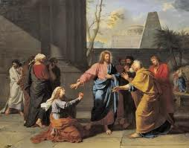
Syrophoenician's Daughter
Matthew 15, Mark 7

Slide 17
Mark 7:24-30
Mark 7:24 (NIV) Jesus left that place and went to the vicinity of Tyre. He entered a house and did not want anyone to know it; yet he could not keep his presence secret. 25 In fact, as soon as she heard about him, a woman whose little daughter was possessed by an evil [unclean] spirit came and fell at his feet. 26 The woman was a Greek, born in Syrian Phoenicia. She begged Jesus to drive the demon out of her daughter. 27 "First let the children eat all they want," he told her, "for it is not right to take the children's bread and toss it to their dogs." 28 "Yes, Lord," she replied, "but even the dogs under the table eat the children's crumbs." 29 Then he told her, "For such a reply, you may go; the demon has left your daughter." 30 She went home and found her child lying on the bed, and the demon gone.

Slide 18
Historicity of the Event
Occasion
During latter part of Jesus' ministry, His special time working w/ disciples
Mt and Mk both put this incident in midst of 2 others:
Pharisaic opposition to disciples not washing hands
Feeding of 4,000
Jesus has withdrawn to NW, presumably to avoid crowds and enemies (Mk 7:24).
Pagan woman recognizes Him, seeks release of demon-possessed daughter.
Liberal explanations
Psychosomatic

Slide 19
Evidence of Historicity
Consistently joined to other incidents.
Reference to woman as
Canaanite (Mt)
Greek, Syro-Phoenician (Mk)
Place: region of Tyre and Sidon
Cryptic remarks of Jesus are characteristic.

Slide 20
Old Testament Background
Similar miracles:
Besides material on demons, noted above.
Done for/to Gentiles:
Naaman
Zarephath widow
Pharaoh
Nebuchadnezzar
Other materials:
Separation between Jew and Gentile
Oriental view of dogs
somewhat modified by use of diminuitive
probably to indicate pet dogs

Slide 21
Significance
Immediate effect
Remote exorcism of demon without even a verbal command.
Child delivered.
Faith of woman in face of obstacles.
Grace to Gentiles.
Place in salvation history
Hint of Gospel to Gentiles, but relation to Jews specified.
Most striking recorded exorcism as noted above.

Slide 22
Symbolic Elements
Woman's parable re/ dogs.
Prediction of Gospel to Gentiles
by synecdoche?

Slide 23
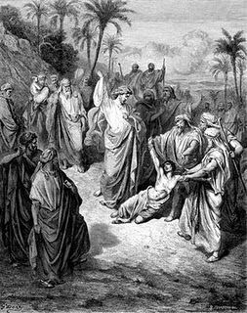
Possessed Boy
Matthew 17
Mark 9
Luke 9

Slide 24
Mark 9:14-18
Mark 9:14 (NIV) When they came to the other disciples, they saw a large crowd around them and the teachers of the law arguing with them. 15 As soon as all the people saw Jesus, they were overwhelmed with wonder and ran to greet him. 16 "What are you arguing with them about?" he asked. 17 A man in the crowd answered, "Teacher, I brought you my son, who is possessed by a spirit that has robbed him of speech. 18 Whenever it seizes him, it throws him to the ground. He foams at the mouth, gnashes his teeth and becomes rigid. I asked your disciples to drive out the spirit, but they could not."

Slide 25
Mark 9:19-23
Mark 9:19 (NIV) "O unbelieving generation," Jesus replied, "how long shall I stay with you? How long shall I put up with you? Bring the boy to me." 20 So they brought him. When the spirit saw Jesus, it immediately threw the boy into a convulsion. He fell to the ground and rolled around, foaming at the mouth. 21 Jesus asked the boy's father, "How long has he been like this?" "From childhood," he answered. 22 "It has often thrown him into fire or water to kill him. But if you can do anything, take pity on us and help us." 23 "'If you can'?" said Jesus. "Everything is possible for him who believes."

Slide 26
Mark 9:24-29
Mark 9:24 (NIV) Immediately the boy's father exclaimed, "I do believe; help me overcome my unbelief!" 25 When Jesus saw that a crowd was running to the scene, he rebuked the evil spirit. "You deaf and mute spirit," he said, "I command you, come out of him and never enter him again." 26 The spirit shrieked, convulsed him violently and came out. The boy looked so much like a corpse that many said, "He's dead." 27 But Jesus took him by the hand and lifted him to his feet, and he stood up. 28 After Jesus had gone indoors, his disciples asked him privately, "Why couldn't we drive it out?" 29 He replied, "This kind can come out only by prayer.[Some manuscripts add and fasting]"

Slide 27
Historicity of Events
Occasion
Linked w/ transfiguration in all 3 Gospels.
Disciples left behind could not heal boy.
Scribes are apparently hassling them.
Liberal Explanation
Boy merely epileptic

Slide 28
Historicity of Events
Evidence of Historicity
Three accounts, all w/ some different details.
Father's faith is a striking detail (Mk 9:24).
Reaction of Eyewitnesses
Only Luke records their astonishment.

Slide 29
Old Testament Background
Similar miracles:
As noted above, little in OT on demonic possession.
Saul's troubles closest (1 Sam 16).
Spirit interference w/ human action also seen in Spirit of God stopping Saul (1 Sam 19).

Slide 30
Significance
Immediate effect
Demon gets in its last shot (Mk 9:26).
Boy healed, possibly resurrected.
All amazed.
Disciples puzzled about their inability.

Slide 31
Place in Salvation History
Even demonic forces subject to Him.
Tougher for disciples?
Faithless generation
prayer
fasting?

Slide 32
Symbolic Elements
An eschatological reference?

Slide 33
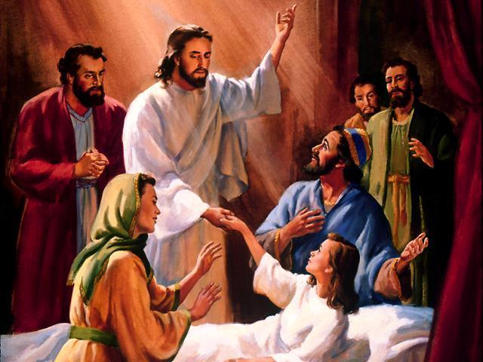
The Significance of Jesus' Miracles

Slide 34
Old Testament Background
Jesus' miracles are as impressive as any of the OT miracles.
Only those of Moses, Elijah & Elisha come close.
Jesus' methods of working miracles generally seem more direct than those of Moses, Elijah & Elisha.

Slide 35
Connection with Creation
Apparent creation:
Turning water into wine
Multiplying loaves & fish
Apparent re-creation:
Healing blind with use of clay
cp Gen 2:7 (NIV) the LORD God formed the man from the dust of the ground and breathed into his nostrils the breath of life, and the man became a living being.
Resurrections

Slide 36
Connection with Redemption/Eschatology
Healing blind, lame, deaf, etc. as sketched in various eschatological passages:
Isa 35:4 (NIV) say to those with fearful hearts, "Be strong, do not fear; your God will come, he will come with vengeance; with divine retribution he will come to save you." 5 Then will the eyes of the blind be opened and the ears of the deaf unstopped. 6 Then will the lame leap like a deer, and the mute tongue shout for joy. Water will gush forth in the wilderness and streams in the desert.

Slide 37
Connection with Redemption/Eschatology
Resurrection is a main feature of the end-times:
Dan 12:1 (NIV) "At that time Michael, the great prince who protects your people, will arise. There will be a time of distress such as has not happened from the beginning of nations until then. But at that time your peopleneveryone whose name is found written in the booknwill be delivered. 2 Multitudes who sleep in the dust of the earth will awake: some to everlasting life, others to shame and everlasting contempt. 3 Those who are wise will shine like the brightness of the heavens, and those who lead many to righteousness, like the stars for ever and ever.

Slide 38
Connection w/ Creation & Redemption
It has been noted that Jesus' miracles are real & striking, yet they are provisional:
He only heals some people, not everyone.
He only raises some of the dead, not all.
This is not an indication of Jesus‘ limitations, but of God's schedule
Jesus‘ miracles are a foretaste of what is to come when he returns
Just as the Lord’s Supper is only a foretaste of the Messianic Banquet.

Slide 39
Jesus' Claims
He claims to be able to forgive sins, and supports this by a visible miracle.
He shows himself to be master over wind & weather, disease & death, fish & animals, and even over the supernatural spirit beings.
Though not a feature of these talks, he shows himself to know what is going to happen.

Slide 40
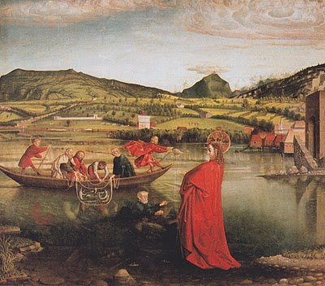
The End
Acts 2:22 (NIV) Men of Israel, listen to this: Jesus of Nazareth was a man accredited by God to you by miracles, wonders and signs, which God did among you through him, as you yourselves know.

