Slide 1
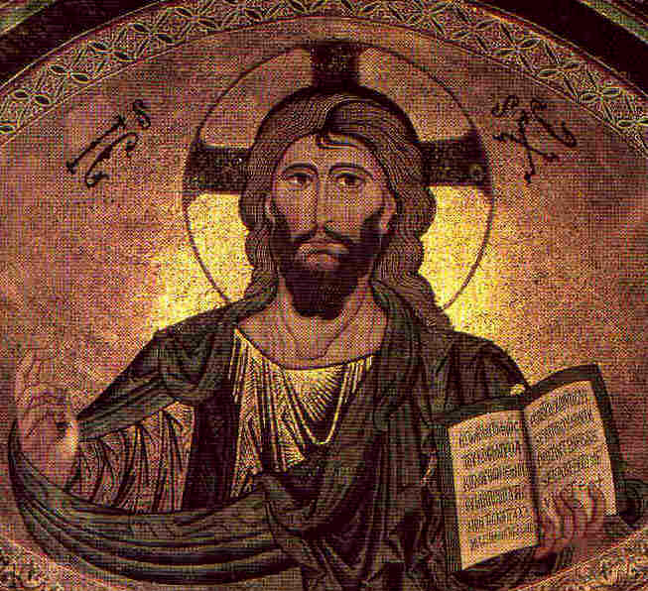
The Miracles of Jesus: 1. Introduction & Nature Miracles
Robert C. Newman

Slide 2
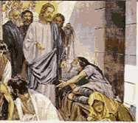
Introduction

Slide 3
Miracles
In an earlier lecture, we proposed this definition of a biblical miracle:
A Biblical miracle is a striking or wonderful event, displaying supernatural power and intended to carry a certain significance.
We will now look at some of Jesus’ miracles, categorized under 3 headings:
Miracles over the Natural Realm
Miracles over the Human Realm
Miracles over the Spirit Realm

Slide 4
Miracles
We will look at the supernatural power that each particular miracle displays, at the reaction it evokes from those who saw it, and the apparent significance of the miracle.
All of these will tell us something about who Jesus is, and what he has come to do, that is, Jesus’ person and work.

Slide 5
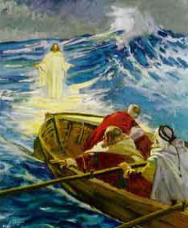
Miracles over the Natural Realm

Slide 6
Nature Miracles
We can categorize the following as in this group:
Changing Water to Wine
Miraculous Catch
Stilling a Storm
Feeding the 5000 (& the 4000)
Walking on Water
Coin in Fish's Mouth
We will look at some of these that are not covered in our other Power-Points.

Slide 7
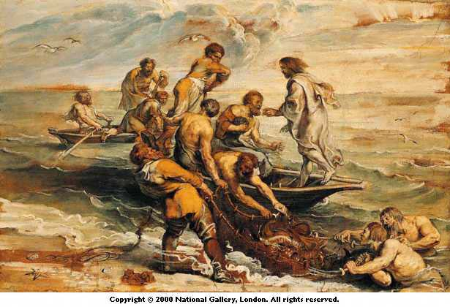
A Miraculous Catch
Luke 5:1-11

Slide 8
Luke 5:1-6
Luke 5:1 (NIV) One day as Jesus was standing by the Lake of Gennesaret, with the people crowding around him and listening to the word of God, 2 he saw at the water's edge two boats, left there by the fishermen, who were washing their nets. 3 He got into one of the boats, the one belonging to Simon, and asked him to put out a little from shore. Then he sat down and taught the people from the boat. 4 When he had finished speaking, he said to Simon, "Put out into deep water, and let down the nets for a catch." 5 Simon answered, "Master, we've worked hard all night and haven't caught anything. But because you say so, I will let down the nets." 6 When they had done so, they caught such a large number of fish that their nets began to break.

Slide 9
Luke 5:7-11
7 So they signaled their partners in the other boat to come and help them, and they came and filled both boats so full that they began to sink. 8 When Simon Peter saw this, he fell at Jesus' knees and said, "Go away from me, Lord; I am a sinful man!" 9 For he and all his companions were astonished at the catch of fish they had taken, 10 and so were James and John, the sons of Zebedee, Simon's partners.
Then Jesus said to Simon, "Don't be afraid; from now on you will catch men." 11 So they pulled their boats up on shore, left everything and followed him.

Slide 10
The Historicity of the Event
After the beginning of Jesus’ public ministry in Galilee, including teaching in synagogues, casting out demons, etc.
Already great multitudes flock to Jesus:
Inconvenience of this leads to using boat as speaking platform.
Disciples had been fishing all previous night without success.
Now, a great catch!

Slide 11
Liberal Explanations
An allegory rather than historical.
First hint of Gentiles receiving Gospel:
Second catch = Gentiles (1st try = Jews)
Great catch = great response (vs Jewish response)
If historical, Jesus saw fish, told disciples.
How far from boat can one see fish in water?
Critical angle at air-water interface: 48½°
So Jesus (eyes ~ 6 ft above surface) can see into water no further than about 7 ft out from boat.
So natural eyesight not a likely explanation!

Slide 12
Evidences of Historicity
We don’t have time-machines, so a skeptical person can deny anything after some time has elapsed.
But particulars of persons, number of boats, details of fishing interesting.
Flavor of miracle rather different than those of apocrypha, etc.

Slide 13
Reaction of Eyewitnesses
Not clear whether crowd still around.
Peter is struck w/ own sin when he realizes what this tells him about Jesus (cp OT theophanies).
Disciples leave all and follow Him.

Slide 14
Old Testament Background
Why look at OT background?
This is the background Jesus’ audience would have, since NT not yet written.
This would be likely source for any symbolic significance the miracles might have.

Slide 15
Old Testament Background
Similar miracles:
Moving a fish - Jonah
Moving a multitude of animals:
Egyptian plagues
Quail in wilderness
Other parallels: Fish in OT
Man made to rule fish (Gen 1:28; Ps 8:8).
But instead fish fear and flee him (Gen 9:2).
Fish are in hand of God (Job 12:7-10).

Slide 16
Old Testament Background
Gen 1:28 (NIV) God blessed them and said to them, "Be fruitful and increase in number; fill the earth and subdue it. Rule over the fish of the sea and the birds of the air and over every living creature that moves on the ground."
Gen 9:2 (NIV) The fear and dread of you will fall upon all the beasts of the earth and all the birds of the air, upon every creature that moves along the ground, and upon all the fish of the sea; they are given into your hands.

Slide 17
Old Testament Background
Job 12:7 (NIV) But ask the animals, and they will teach you, or the birds of the air, and they will tell you; 8 or speak to the earth, and it will teach you, or let the fish of the sea inform you. 9 Which of all these does not know that the hand of the LORD has done this? 10 In his hand is the life of every creature and the breath of all mankind.

Slide 18
Significance of Miracle
Immediate effect:
Fishermen get spectacular haul.
They are shown something about Jesus.
Place in salvation history:
Jesus to restore what Adam lost, here seen in dominion over fish.
Symbolic Elements:
Disciples: men = fishermen: fish
As God controls success in fishing, so in saving people.

Slide 19
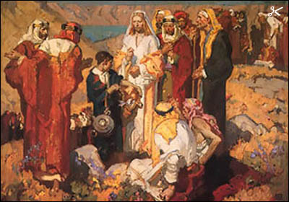
Feeding the 5000
Matthew 14, Mark 6,
Luke 9, John 6

Slide 20
John 6:1-9
John 6:1 (NIV) Some time after this, Jesus crossed to the far shore of the Sea of Galilee (that is, the Sea of Tiberias), 2 and a great crowd of people followed him because they saw the miraculous signs he had performed on the sick. 3 Then Jesus went up on a mountainside and sat down with his disciples. 4 The Jewish Passover Feast was near. 5 When Jesus looked up and saw a great crowd coming toward him, he said to Philip, "Where shall we buy bread for these people to eat?" 6 He asked this only to test him, for he already had in mind what he was going to do. 7 Philip answered him, "Eight months' wages would not buy enough bread for each one to have a bite!" 8 Another of his disciples, Andrew, Simon Peter's bro-ther, spoke up, 9 "Here is a boy with five small barley loaves and two small fish, but how far will they go among so many?"

Slide 21
John 6:10-15
10 Jesus said, "Have the people sit down." There was plenty of grass in that place, and the men sat down, about five thousand of them. 11 Jesus then took the loaves, gave thanks, and distributed to those who were seated as much as they wanted. He did the same with the fish. 12 When they had all had enough to eat, he said to his disciples, "Gather the pieces that are left over. Let nothing be wasted." 13 So they gathered them and filled twelve baskets with the pieces of the five barley loaves left over by those who had eaten. 14 After the people saw the miraculous sign that Jesus did, they began to say, "Surely this is the Prophet who is to come into the world." 15 Jesus, knowing that they intended to come and make him king by force, withdrew again to a mountain by himself.

Slide 22
Historicity of the Event
Occasion
Latter part of Galilean ministry
12 have just returned from their mission (Lk).
Jesus has just heard of John Baptist’s execution (Mt).
Jesus takes disciples off by selves to rest (Mk).
Crowds follow; Jesus teaches all day, feeds them at evening.

Slide 23
Liberal Explanations
A lesson in sharing:
Many have food hidden away, but afraid to share.
Invented story to compare with Elijah & Elisha:
Elijah: 1 Kings 17:13 (NIV) Elijah said to her, "Don't be afraid. Go home and do as you have said. But first make a small cake of bread for me from what you have and bring it to me, and then make something for yourself and your son. 14 For this is what the LORD, the God of Israel, says: 'The jar of flour will not be used up and the jug of oil will not run dry until the day the LORD gives rain on the land.'"
Elisha: 2 Kings 4:42 (NIV) A man came from Baal Shalishah, bringing the man of God twenty loaves of barley bread baked from the first ripe grain, along with some heads of new grain. "Give it to the people to eat," Elisha said. 43 "How can I set this before a hundred men?" his servant asked. But Elisha answered, "Give it to the people to eat. For this is what the LORD says: 'They will eat and have some left over.'" 44 Then he set it before them, and they ate and had some left over, according to the word of the LORD.

Slide 24
Evidences of Historicity
Fourfold record (Matthew, Mark, Luke, John) with considerable variety
Details of place (territory of Bethsaida Julias), green grass, etc.
Reference to kophinoi (standard food baskets of Jews)
Jesus has leftovers gathered up!

Slide 25
Reaction of Eyewitnesses
Only reported by John:
"the prophet" (Deut 18:15)
They were about to force him to become king
So he sends the 12 disciples off in the boat, dismisses the crowd, and goes off into the hills to pray.

Slide 26
Old Testament Background
Similar miracles (besides Cana and Feeding 4000):
Manna (Ex 16, Num 11, Dt 8, Josh 5, Neh 9, Ps 78) in wilderness
Quail (Ex 16, Num 11, Ps 78, 105) in wilderness
Elijah & widow of Zarephath (1 Kings 17)
Oil multiplied (2 Kings 4)
Loaves & grain multiplied (2 Kings 4)

Slide 27
Old Testament Background
Other parallels:
God feeds (Ps 104:27ff; Ps 132:15):
Ps 104:27 (NIV) These all look to you to give them their food at the proper time. 28 When you give it to them, they gather it up; when you open your hand, they are satisfied with good things. 29 When you hide your face, they are terrified; when you take away their breath, they die and return to the dust.
Psa 132:15 (NIV) I will bless her [Zion] with abundant provisions; her poor will I satisfy with food.
Rabbinic views on Leviathan & Behemoth
God will provide them as food for Israel in the end-times.

Slide 28
Significance of Miracle
Immediate effect:
Crowd of 5000+ ate, had all they wanted, with more left over than originally existed.
They want to make Jesus king.
Place in salvation history:
Comparable to Moses w/ Israel in wilderness (so Deut 18:15, prophet like Moses)
But Jesus’ connection w/ miracle much more direct than Moses’

Slide 29
Significance of Miracle
Symbolic elements
Jesus' discourse next day (Jn 6:22-71):
connects this w/ giving own life to sustain man
so significance something like Lord's Supper

Slide 30
Coin in Fish's Mouth
Matthew 17

Slide 31
Matthew 17:24-27
Matt 17:24 (NIV) After Jesus and his disciples arrived in Capernaum, the collectors of the two-drachma tax came to Peter and asked, "Doesn't your teacher pay the temple tax?" 25 "Yes, he does," he replied. When Peter came into the house, Jesus was the first to speak. "What do you think, Simon?" he asked. "From whom do the kings of the earth collect duty and taxesn from their own sons or from others?" 26 "From others," Peter answered. "Then the sons are exempt," Jesus said to him. 27 "But so that we may not offend them, go to the lake and throw out your line. Take the first fish you catch; open its mouth and you will find a four-drachma coin. Take it and give it to them for my tax and yours."

Slide 32
Historicity of the Event
Occasion
Late in Galilean ministry
Just returned to Capernaum, keeping low profile (Mk 9:30)
Peter questioned by those collecting ½ shekel tax, does Jesus pay? Peter answers "yes."
Jesus anticipates Peter’s question, responds with his own question & miracle.

Slide 33
Evidences of Historicity
Details of tax: called double-drachma rather than 1/2 shekel; term used not that of LXX, but fits contemporary usage (different size drachma).
Stater as term for tetradrachm
Jesus' peculiar answer (important for significance)

Slide 34
Reaction of Eyewitnesses
Occurrence not even reported…
Much less reactions

Slide 35
Old Testament Background
Similar miracles:
Movement of animals:
Jonah
Quail
Plagues
Financial provision:
oil for widow
Pre-knowledge:
Samuel re/ Saul (1 Sam 10)

Slide 36
Significance
Immediate effect:
Temple tax paid
Jesus makes point w/ Peter re/ its obligatory nature; seals this point w/ miraculous catch
Place in salvation history:
The One who controls fish has come to earth.
His relation to Father different than that of others (re/ atonement).
He brings others into a similar relation.

Slide 37
Symbolic Elements
Half-shekel tax and atonement
Exod 30:13 (NIV) Each one who crosses over to those already counted is to give a half shekel, according to the sanctuary shekel, which weighs twenty gerahs. This half shekel is an offering to the LORD. 14 All who cross over, those twenty years old or more, are to give an offering to the LORD. 15 The rich are not to give more than a half shekel and the poor are not to give less when you make the offering to the LORD to atone for your lives. 16 Receive the atonement money from the Israelites and use it for the service of the Tent of Meeting. It will be a memorial for the Israelites before the LORD, making atonement for your lives.
Relation of Christian to law
A very controversial area

Slide 38
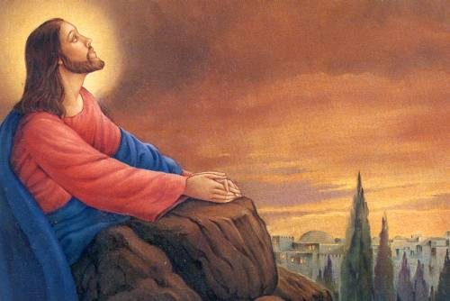
The End

