Slide 1

The Millennial Question
Robert C. Newman

Slide 2
The Millennial Question
What is "the Millennium"?
What are the alternative views?
What do the arguments look like?

Slide 3
What is the Millennium?
The term comes from Revelation 20. Millennium is Latin for "1,000 years."
Several things are to happen in this period of one thousand years:
Satan will be bound in the Abyss (2-3).
Certain believers will come to life & rule with Christ (4-6).
At the end, Satan will be released & lead a rebellion of the nations (7-10).

Slide 4
What are the alternative views?
The alternative views disagree on the timing of the Millennium relative to the return of Christ, and on the nature of the Millennium.
Pre-Millennial View (before Millennium)
Post-Millennial View (after Millennium)
A-Millennial View (no [earthly] Millennium)

Slide 5
Church History
Jesus
Church Age
SecondComing
Nearly all Christians (except extreme Preterists) believe that Jesus will come again in the future, and that the time between his comings is primarily the church age, in which we have a responsibility to take the Gospel to all the nations.

Slide 6
A-Millennial View
MILLENNIUM
Jesus
Church Age
SecondComing
The church age is the millennium. The saints are ruling from heaven, and Satan is bound to such an extent that the Gospel is going out to all the nations.

Slide 7
Post-Millennial View
MILLENNIUM
Jesus
SecondComing
Church Age
The Millennium is not the whole church age, but only the latter part. The Gospel will spread to all the nations, and when this is complete there will be a time of great peace & prosperity.

Slide 8
Pre-Millennial View
MILLENNIUM
Jesus
Church Age
SecondComing
The Millennium follows the church age. It is set up by Christ when he comes and defeats his enemies, and puts Satan into the Abyss. The saints then rule with Jesus on earth for a thousand years.

Slide 9
What do the arguments look like?
Just a sketch here

Slide 10
Pre-Mill Arguments
Natural reading of Revelation 20 in context.
Takes "came to life" and "resurrection" literally here.
Treats promises of land & kingdom to Israel and patriarchs seriously.

Slide 11
A-Mill Arguments
Are sacrifices really going to be re-instituted? What about the argument in Hebrews?
The pre-mill scheme is earthly and Jewish, rather than heavenly and Christian.
The pre-mill scheme re-duplicates the revolt at Christ’s coming so as to have another at the end of the millennium.

Slide 12
Post-Mill Arguments
Will use a-mill arguments against pre-mills.
Is the church age really going to be a defeat rather than a victory? Doesn't Christ promise victory?
Don't the pre-mill and a-mill schemes discourage effort, since God is going to bring in the kingdom without our help?

Slide 13
Conclusions
I personally think the pre-mill arguments are stronger.
The debate does not involve central doctrines of Christianity.
God will do what he wants, whatever our schemes may look like.
There are hermeneutical (interpretive) issues here regarding OT prophecy.

Slide 14
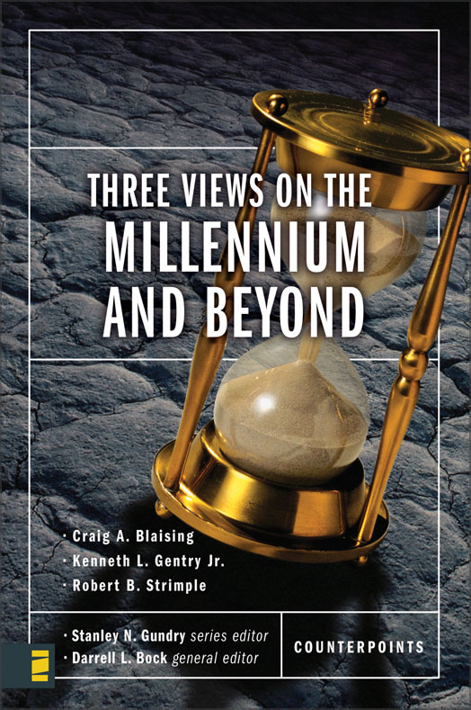
For Further Study
See the book in the Zondervan Counterpoints Series, Three Views on the Millennium & Beyond
Blaising – Pre-Mill
Gentry – Post-Mill
Strimple – A-Mill

Slide 15
The End
Will come when & how God
brings it; may we be faithful!

