Slide 1
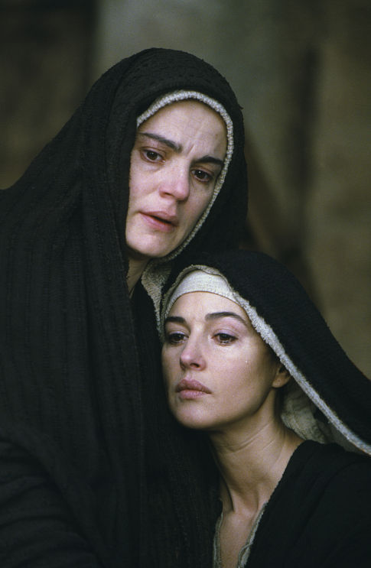
Mary Magdalene
History and Hype
Robert C. Newman

Slide 2
Mary Magdalene
A great deal of interest recently…
… much of this spawned by Dan Brown's Da Vinci Code.
Was Mary really married to Jesus?
Did they have a child which united the two royal families of Israel?
What do we really know about Mary Magdalene?

Slide 3
What do we really know about Mary Magdalene?
A survey and evaluation of our sources

Slide 4
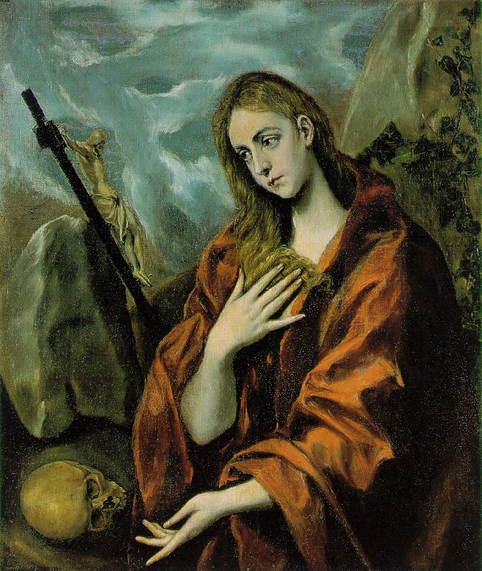
Mary Magdalene in the Four Gospels
What do they tell us?

Slide 5
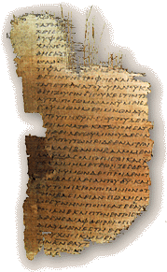
The Four Gospels
All were written in the first century AD, while eyewitnesses still lived.
We have manuscripts of these from before AD 200.
Matthew may be as early as 50-55.
Luke may be from about 58-60.
Mark was probably in mid-60s.
John was written about 90.

Slide 6
Mary Introduced
Luke 8:1-3 (NIV) After this, Jesus traveled about from one town and village to another, proclaiming the good news of the kingdom of God. The Twelve were with him, 2 and also some women who had been cured of evil spirits and diseases: Mary (called Magdalene) from whom seven demons had come out; 3 Joanna the wife of Cuza, the manager of Herod's household; Susanna; and many others. These women were helping to support them out of their own means.

Slide 7
Mary Introduced
Mary is one of the women (3 named, plus others) who traveled w/ Jesus and the apostles, helping financially.
Some of these women had been cured by Jesus.
Mary had been rescued from seven demons.

Slide 8
Mary at the Crucifixion
Mark 15:40-41 (NIV) Some women were watching from a distance. Among them were Mary Magdalene, Mary the mother of James the younger and of Joses, and Salome.
41 In Galilee these women had followed him and cared for his needs. Many other women who had come up with him to Jerusalem were also there.

Slide 9
Mary at the Crucifixion
Mary M was one of the "many women" present at Jesus' crucifixion "watching from a distance."
They had followed Jesus from Galilee "to care for his needs."
John tells us that at some point Mary M was with Jesus' mother and other women "near the cross."

Slide 10
Mary at the Crucifixion
John 19:25 (NIV) Near the cross of Jesus stood his mother, his mother's sister, Mary the wife of Clopas, and Mary Magdalene.

Slide 11
Mary at the Burial
Matt 27:57-61 (NIV) As evening approached, there came a rich man from Arimathea, named Joseph, who had himself become a disciple of Jesus. 58 Going to Pilate, he asked for Jesus' body, and Pilate ordered that it be given to him. 59 Joseph took the body, wrapped it in a clean linen cloth, 60 and placed it in his own new tomb that he had cut out of the rock. He rolled a big stone in front of the entrance to the tomb and went away. 61 Mary Magdalene and the other Mary were sitting there opposite the tomb.

Slide 12
Mary at the Burial
Matthew mentions that Mary M and "the other Mary" sat opposite the tomb as Jesus was being buried.
They saw where Jesus body was buried and where the tomb was located.

Slide 13
Mary at the Empty Tomb
Mary M was among the women who bought spices after the Sabbath ended (Mark 16:1).
They came to anoint Jesus' body the next morning (Matt 28:1; Luke 24:1-10).

Slide 14
Mary at the Empty Tomb
Mark 16:1 (NIV) When the Sabbath was over, Mary Magdalene, Mary the mother of James, and Salome bought spices so that they might go to anoint Jesus' body.
Matt 28:1 (NIV) After the Sabbath, at dawn on the first day of the week, Mary Magdalene and the other Mary went to look at the tomb.

Slide 15
Mary's Report
John adds some additional detail.
Mary ran off to find Peter & John to tell them that Jesus' body had been taken from the tomb.
This was apparently before the angels appeared to tell the women of Jesus' resurrection.

Slide 16
Mary's Report
John 20:1-2 (NIV) Early on the first day of the week, while it was still dark, Mary Magdalene went to the tomb and saw that the stone had been removed from the entrance. 2 So she came running to Simon Peter and the other disciple, the one Jesus loved, and said, "They have taken the Lord out of the tomb, and we don't know where they have put him!"

Slide 17
Jesus appears to Mary
John 20:10-16 (NIV) Then the disciples went back to their homes, 11 but Mary stood outside the tomb crying. As she wept, she bent over to look into the tomb 12 and saw two angels in white, seated where Jesus' body had been, one at the head and the other at the foot… 14 At this, she turned around and saw Jesus standing there, but she did not realize that it was Jesus. 15 "Woman," he said, "why are you crying? Who is it you are looking for?" Thinking he was the gardener, she said, "Sir, if you have carried him away, tell me where you have put him, and I will get him." 16 Jesus said to her, "Mary." She turned toward him and cried out in Aramaic, "Rabboni!" (which means Teacher).

Slide 18
Jesus appears to Mary
Mary M later returned to the tomb.
There Jesus appeared to her.
This was perhaps his first appearance to any of his followers after his resurrection (see Mark 16:9).

Slide 19
Mary Afterwards
Mary was probably present "along with the women and Mary the mother of Jesus" in Jerusalem after Jesus' ascension (Acts 1:12-14).
Otherwise, we hear no more of her in the New Testament.
This is true of a number of people who show up in the Gospels, including Jesus' mother.

Slide 20
Some Speculations from Gospel Information
A number of interpreters have identified Mary M with women mentioned elsewhere in the Gospels.

Slide 21
Is She Mary of Bethany?
Some have identified her with the sister of Martha and Lazarus.
This Mary listened to Jesus while her sister was preparing a meal (Luke 10:38-42).
Her brother was raised from the dead by Jesus (John 11:1-46).
She anointed Jesus (John 12:1-3).

Slide 22
Is She the Sinner of Luke 7?
A woman identified only as a "sinner" also anointed Jesus' feet (probably at Capernaum) earlier in Jesus’ ministry (Luke 7:36-50).
Some have claimed this is Mary Magdalene.
This seems unlikely, given that Mary M is first introduced in Luke 8.

Slide 23
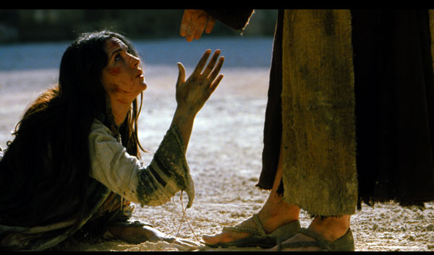
Is She the Woman Caught in Adultery?
Others have identified Mary M with the woman taken in adultery, described in John 7:53-8:11.
Though this incident is not in the earliest manuscripts of John, it is generally thought to have really happened.
This is how Mary M comes to be pictured as a prostitute.

Slide 24
Some Speculations
In the Greek Church, these women were generally seen as separate people.
In the Roman Church, they tended to be lumped together as one person.
It is impossible at this distance to be sure, but it seems unlikely that Mary Magdalene is Mary of Bethany or the "sinner" of Luke 7.

Slide 25
Some Speculations
As James Kiefer points out:
A great many minor characters appear briefly in the gospel narratives… There is a natural tendency for the imagination to try to tidy things up by identifying some of them, so that (for example) the centurion who at the crucifixion said, "Truly this was the Son of God" is suggested to be the same centurion whose servant was healed at Capernaum. But real life is not always tidy…

Slide 26
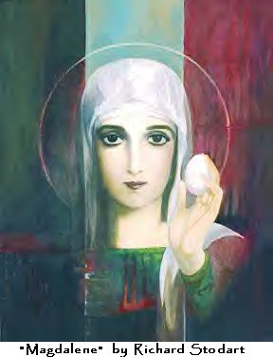
Later Stories about Mary in the Ancient Church
See J. B. Mayor, "Mary," in the Hastings' Dictionary of the Bible

Slide 27
Eastern Church Tradition
Mary followed the apostle John to Ephesus, where she died.
Modestus (~625) says she was a virgin throughout her life, and that she was martyred.
Her relics were later transferred to Constantinople by the emperor Leo 6 (ruled 886-912).

Slide 28
Western Church Tradition
Mary M belonged to a wealthy family with estates at Magdala & Bethany.
She went astray & tempted others, but was saved by Jesus.
In the persecution over Stephen, she and some others were set adrift in a boat on the Mediterranean.
Without oar or sail, they reached Marseilles, France.

Slide 29
Western Church Tradition
In Marseilles, through preaching and miracles, the pagans were saved.
Lazarus became their first bishop.
Mary went off to the wilderness and lived a monastic life for 30 years.
She was carried up to heaven by angels.
Her relics (!) are venerated at Aix.

Slide 30
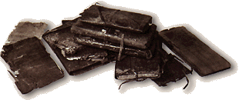
Gnostic Materials about Mary Magdalene
The Gospel of Mary Magdalene
The Gospel of Philip
Other Gnostic Materials

Slide 31
What is Gnosticism?
A religion competing with orthodox Christianity, composed of both pagan and Christian elements.
It is polytheistic, like Greco-Roman paganism.
Yet the gods (called "aeons") have names borrowed from Christianity.

Slide 32
The Gnostic Gods, or Aeons
Proarche
Ennoea
Nous
Aletheia
Logos
Zoe
Anthropos
Ecclesia
Paracletus
Pistis
Elpis
Agape
Ainos
Sophia
Christ
Holy Spirit

Slide 33
What is Gnosticism?
It views creation as a mixture of good and bad from the very beginning, being made by a lesser and rather ignorant god.
Matter tends to be viewed as evil or inferior, spirit as good or superior.
It views humans as of 3 different sorts: matter, soul, or spirit people.

Slide 34
What is Gnosticism?
For Gnosticism, salvation is freedom from this world of matter, rather than freedom from sin.
Salvation is typically by secret knowledge, rather than by faith.
One needs to know how to escape from the prison of this world at death.

Slide 35
What is Gnosticism?
Gnosticism tended to prey on Christians (rather like modern cults) by:
Claiming to go beyond Christianity
Having secret books of their own
Adding secret rituals
Apparently adding sexual rituals
Let's look at two Gnostic Gospels.

Slide 36
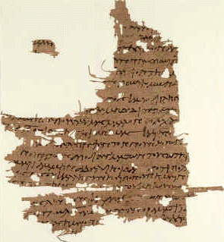
The Gospel of Mary
Name refers to Mary Magdalene rather than Jesus' mother.
Known from a 5th century translation into Coptic, plus 2 fragments in Greek from the 3rd century.
Here Mary is pictured as very close to Jesus, and he loved her "more than the rest of women."

Slide 37
The Gospel of Mary
Slightly under ½ of this gospel survives in Coptic, in the Berlin Codex, 8 of 18 pages.
The last two pages are also preserved in Greek from the early 3rd century.
The gospel thus dates from sometime before AD 200.

Slide 38
Contents of the Gospel of Mary
The first six pages are missing. On page seven we come in just at the end of a conversation of the risen Christ with his disciples. Then he blesses and leaves them.
The disciples are sad and fearful, given their commission and what happened to Jesus.
Mary Magdalene encourages them.

Slide 39
Contents of the Gospel of Mary
Peter asks Mary to tell them the revelations she received from Jesus, who loved her above all other women.
We begin to get a presentation of these when the text breaks off again (pp 11-14 missing).
When the text resumes, she is describing how the soul passes through the planetary spheres, and what the soul is to say to the hostile powers guarding each sphere, a standard Gnostic theme.

Slide 40
Contents of the Gospel of Mary
When she finishes, Andrew & Peter do not believe her.
Mary weeps, saying she is no liar.
Levi rebukes Peter, and the disciples go out to preach to the world.

Slide 41
The Gospel of Philip
Our text comes from the Nag Hammadi Gnostic papyri, from the 5th century.
The work is not a Gospel in the sense of a narrative of Jesus' ministry.
Instead, it is a collection of theological statements on Gnostic sacraments and ethics.
It was probably written in Syria in the late third century.

Slide 42
The Gospel of Philip
This work reflects the type of Gnosticism called Valentinian.
It is very allegorical.
It clearly depends on the canonical Gospels Matthew, Mark, Luke & John.
Two passages mention Mary Magdalene.

Slide 43
Mary M in the Gospel of Philip
There were three who always walked with the Lord: Mary his mother, and her sister, and Magdalene, the one who was called his companion. His sister and his mother and his companion were each a Mary (59:7-11).

Slide 44
Mary M in the Gospel of Philip
As for the Wisdom who is called "the barren," she is the mother of the angels. And the companion of the Savior is Mary Magdalene. But Christ loved her more than all the disciples and used to kiss her often on her mouth. The rest of the disciples were offended by it and expressed disapproval. They said to him, "Why do you love her more than all of us?" The Savior answered and said to them, "Why do I not love you like her? When a blind man and one who sees are both together in the darkness, they are no different from one another. When the light comes, then he who sees will see the light and he who is blind will remain in darkness." (63:30-64:9)

Slide 45
Gnosticism in the Gospel of Philip
The world came about through a mistake. For he who created it wanted to create it imperishable and immortal. He fell short of attaining his desire. For the world never was imperishable, nor, for that matter, was he who made the world. – 75.2-9

Slide 46
Mary M elsewhere in Gnostic Literature
A number of works have Mary along with the apostles asking Jesus arcane questions, usually set in the period between his resurrection and ascension.
One of these is the work called The Sophia of Jesus Christ.

Slide 47
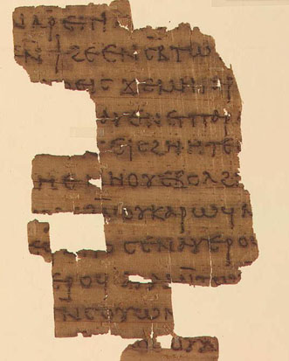
The Sophia of Jesus Christ
This work is found in both the Nag Hammadi books and in the Berlin papyrus that contains the Gospel of Mary.
It appears to be plagiarized from a letter entitled Eugnostos the Blessed.
Eugnostos' words are placed in Jesus' mouth as answers to his disciples' questions.

Slide 48
The Sophia of Jesus Christ
Eugnostos has no Christian flavor.
The Christian flavor of Sophia may have been added (suggests the modern editor) "to attract Christians to Gnostic teachings."
This may provide insight into the character of the Gnostic Gospels in general.

Slide 49
Comments on the Gnostic Gospels
These works clearly teach a different worldview than does the Bible.
They also teach a different worldview than does Dan Brown’s Da Vinci Code.
They have no interest in physical marriage, nor Jewish royalty, nor earthly kingdoms.

Slide 50
What do we really know about Mary Magdalene?
Given the historical circumstances of our various sources, it is unlikely that those coming long after the death of the eyewitnesses of Jesus’ ministry give us reliable information.
We have no good reason to believe that she was Mary of Bethany.

Slide 51
What do we really know about Mary Magdalene?
We are told that she was demon possessed; this might have resulted in prostitution, but we don’t know.
There is no reason to believe she was a Benjamite, much less a descendant of Saul's "royal" family.
The traditions on where Mary M went from Palestine are divergent.

Slide 52
Was Jesus married?
Nothing is said in the New Testament to suggest he was, in contrast with the apostles.
Marriage was more or less expected among Pharisaic Jews, but these did not dominate Judaism until after 70.
At Jesus' time, John the Baptist and Paul were not married, nor were most of the Essenes and Therapeutae.

Slide 53
What about a child?
Again, no evidence.
The report of Jesus' trial before Pilate indicates that Pilate considered Jesus no political threat, as he would if Jesus were starting a dynasty.
The descendants of David had little clout in NT times in spite of OT prophecies. How much less the descendants of Saul!

Slide 54
Conclusions
The scenario of Dan Brown in the Da Vinci Code (borrowed from the earlier book Holy Blood, Holy Grail) has no historical merit.
Some of the uses of Mary Magdalene in radical feminist circles have no merit either.

Slide 55
Mary Magdalene?
A devoted follower of Jesus, hyped and distorted over the centuries.

