Slide 1
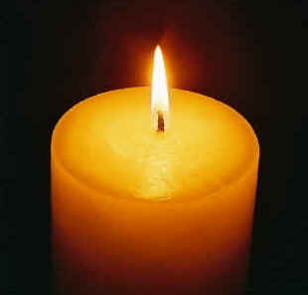
8. Let Your Light Shine
Matthew 5
Robert C. Newman

Slide 2
Introduction
In the last of our series of eight talks on light, we sketch Jesus’ instructions to his followers given in the Gospel of Matthew.
In his Sermon on the Mount, in Matthew 5, our Lord gives us two pictures of how we should conduct ourselves as we carry out his commission.
These are found in Matthew 5:13-16.

Slide 3
The Christian’s Mission in the World
Matthew 5:13-16 (NIV) You are the salt of the earth. But if the salt loses its saltiness, how can it be made salty again? It is no longer good for anything, except to be thrown out and trampled by men. 14 You are the light of the world. A city on a hill cannot be hidden. 15 Neither do people light a lamp and put it under a bowl. Instead they put it on its stand, and it gives light to everyone in the house. 16 In the same way, let your light shine before men, that they may see your good deeds and praise your Father in heaven.

Slide 4
The Christian’s Mission Compared to Salt
Matthew 5:13

Slide 5
Compared to Salt
Matt 5:13 (NIV) You are the salt of the earth. But if the salt loses its saltiness, how can it be made salty again? It is no longer good for anything, except to be thrown out and trampled by men.
What is salt good for?
A number of things, but primarily for:
Seasoning – a little makes food worth eating
Preservative – a large amount keeps food from spoiling

Slide 6
Compared to Salt
“You are the salt of the earth.”
You: earth = salt: food
Christians make life worth living in their society.
Christians keep society from spoiling.
Salt is worthless without saltiness
Taste
Ability to preserve
No better than gravel!
So Christians must maintain their distinct lifestyle, or they are worthless to the world.

Slide 7
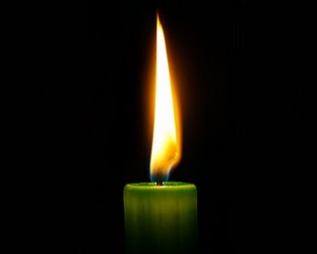
The Christian’s Mission Compared to Light
Matthew 5:14-16

Slide 8
Compared to Light
Matt 5:14-16 (NIV) You are the light of the world. A city on a hill cannot be hidden. 15 Neither do people light a lamp and put it under a bowl. Instead they put it on its stand, and it gives light to everyone in the house. 16 In the same way, let your light shine before men, that they may see your good deeds and praise your Father in heaven.
What does light do?
Seen at a distance – it guides
Seen close up – it illuminates

Slide 9
Compared to Light
“You are the light of the world.”
You: world = light: surroundings
Light is worthless if hidden.
You can’t hide a city that is on a hill.
You can hide a lamp, but don’t (normally) do so.
Let your light shine in such a way → God is glorified.

Slide 10
How Let Our Light Shine?
Note reference to good works in verse 16.
Matt 5:16 (NIV) In the same way, let your light shine before men, that they may see your good deeds and praise your Father in heaven.
Do your good works to be seen by others?
No, see Matt 6:1 (NIV) Be careful not to do your 'acts of righteousness' before men, to be seen by them. If you do, you will have no reward from your Father in heaven.

Slide 11
How Let Our Light Shine?
Rather, we need to have God build into our lives the lifestyle of the Sermon on the Mount.
Then we will stand out without showing off.
Some dangers to avoid:
Being the same as the world around us.
Being hidden from the world in our own ghettos.

Slide 12
Conclusions
Is my life making the world a more pleasant place to live in?
Am I helping to preserve the world from decay?
Does my life attract people’s attention to the Gospel?
Does my life help others to see what life is all about?

Slide 13
The End
Let your light shine before men, that they may see your good deeds and praise your Father in heaven.

