Slide 1
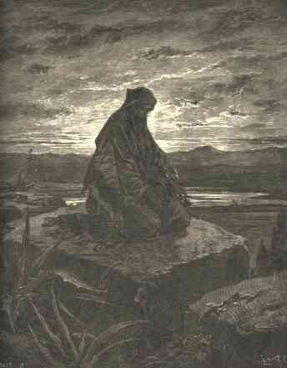
5. God, Our Light in Bad Times
Micah 7
Robert C. Newman

Slide 2
Our Light in Bad Times
So far, we have looked at:
The creation of light (Genesis 1)
How light reveals God (Psalm 19)
How God’s Word is light (Psalm 119)
How the Messiah is light both to Israel and the nations of the world (Isaiah 8-9)
Now we will look at how God is a light to us personally in bad times (Micah 7).

Slide 3
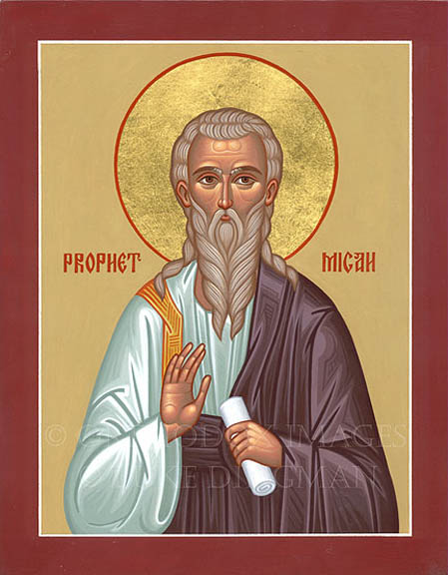
Our Passage
Micah 7:1-13

Slide 4
Micah’s Bad Times
Back when Micah was a prophet in Judah (late 700s BC), the Israelite kingdoms & their people faced bad times.
Both the northern kingdom (Ephraim or Israel) and the southern kingdom (Judah) were characterized by political corruption, religious unfaithfulness & lawlessness.
Both would be destroyed (Ephraim in 722 BC, Judah in 587 BC) by foreign invaders.

Slide 5
Micah 7:1-6
1 (NIV) What misery is mine! I am like one who gathers summer fruit at the gleaning of the vineyard; there is no cluster of grapes to eat, none of the early figs that I crave. 2 The godly have been swept from the land; not one upright man remains. All men lie in wait to shed blood; each hunts his brother with a net. 3 Both hands are skilled in doing evil; the ruler demands gifts, the judge accepts bribes, the powerful dictate what they desire n they all conspire together. 4 The best of them is like a brier, the most upright worse than a thorn hedge. The day of your watchmen has come, the day God visits you. Now is the time of their confusion. 5 Do not trust a neighbor; put no confidence in a friend. Even with her who lies in your embrace be careful of your words. 6 For a son dishonors his father, a daughter rises up against her mother, a daughter-in-law against her mother-in-law n a man's enemies are the members of his own household.

Slide 6
Micah 7:7-13
7 (NIV) But as for me, I watch in hope for the LORD, I wait for God my Savior; my God will hear me. 8 Do not gloat over me, my enemy! Though I have fallen, I will rise. Though I sit in darkness, the LORD will be my light. 9 Because I have sinned against him, I will bear the LORD's wrath, until he pleads my case and establishes my right. He will bring me out into the light; I will see his righteousness. 10 Then my enemy will see it and will be covered with shame, she who said to me, "Where is the LORD your God?" My eyes will see her downfall; even now she will be trampled underfoot like mire in the streets. 11 The day for building your walls will come, the day for extending your boundaries. 12 In that day people will come to you from Assyria and the cities of Egypt, even from Egypt to the Euphrates and from sea to sea and from mountain to mountain. 13 The earth will become desolate because of its inhabitants, as the result of their deeds.

Slide 7
Micah’s Disappointment (1)
What misery is mine! I am like one who gathers summer fruit at the gleaning of the vineyard; there is no cluster of grapes to eat, none of the early figs that I crave.
As Micah looks at the situation in his time, he feels very discouraged, like a farmer who goes to harvest his fruit, but finds that there is nothing left.

Slide 8
A Bad Situation in Israel (2-6)
There are no more righteous (2-4a)
2 (NIV) The godly have been swept from the land; not one upright man remains. All men lie in wait to shed blood; each hunts his brother with a net. 3 Both hands are skilled in doing evil; the ruler demands gifts, the judge accepts bribes, the powerful dictate what they desirenthey all conspire together.4 The best of them is like a brier, the most upright worse than a thorn hedge.

Slide 9
A Bad Situation in Israel (2-6)
There are no righteous left (2-4a).
People kill others like they were wild game (2).
They do evil with both hands (3).
They bribe the judges (3), so the rich oppress the poor.
Even the best people are as bad as briars (4).

Slide 10
A Bad Situation in Israel (2-6)
But there is punishment to come (4b).
The day of your watchmen has come, the day God visits you. Now is the time of their confusion.
You can’t trust anyone (5).
Do not trust a neighbor; put no confidence in a friend. Even with her who lies in your embrace be careful of your words.
Not even your own family! (5-6)

Slide 11
Micah’s Trust (7-8)
But as for me, I watch in hope for the LORD, I wait for God my Savior; my God will hear me. 8 Do not gloat over me, my enemy! Though I have fallen, I will rise. Though I sit in darkness, the LORD will be my light.
Micah will patiently depend on the Lord.
God will raise him up when he is fallen.
God will be his light when he is in darkness.

Slide 12
Sin Will Be Dealt With (9-13)
Micah’s sin will be forgiven (9-10).
Because I have sinned against him, I will bear the LORD's wrath, until he pleads my case and establishes my right. He will bring me out into the light; I will see his righteousness. 10 Then my enemy will see it and will be covered with shame, she who said to me, "Where is the LORD your God?"
God will bring Micah out into the light.

Slide 13
Sin Will Be Dealt With (9-13)
Israel’s sin will be punished (10).
Then my enemy will see it and will be covered with shame, she who said to me, "Where is the LORD your God?" My eyes will see her downfall; even now she will be trampled underfoot like mire in the streets.
But one day restoration will come (11-13).

Slide 14
Sin Will Be Dealt With (9-13)
One day restoration will come (11-12):
The day for building your walls will come, the day for extending your boundaries. 12 In that day people will come to you from Assyria and the cities of Egypt, even from Egypt to the Euphrates and from sea to sea and from mountain to mountain.
But also judgment (13):
The earth will become desolate because of its inhabitants, as the result of their deeds.

Slide 15
Conclusions
As in Micah’s day, our society seems to have turned away from God.
It is hard to find those who are actually righteous.
We too may expect God’s judgment.
Even those who trust Christ may well go through disaster.

Slide 16
Conclusions
But God has purposes for believers going through disaster:
To purge our own sin (9)
To look for fruit (1), especially repentance
To teach us dependence on God in tough situations (7).
God is our light even in bad times.

Slide 17
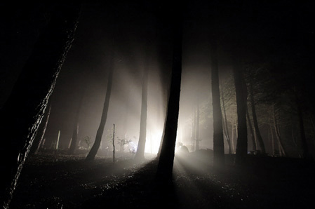
The End
Psalm 27:1 (NIV) The LORD is my light and my salvation. whom shall I fear? The LORD is the stronghold of my life. of whom shall I be afraid?

