Slide 1
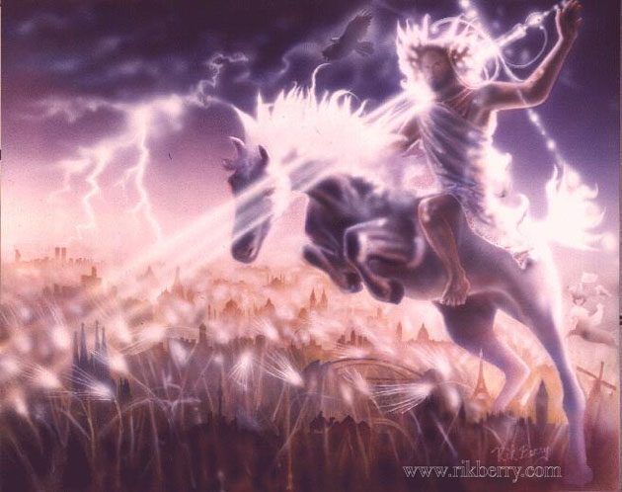

4. Messiah, the Light
Isaiah 8-9
Robert C. Newman

Slide 2
Messiah
For many centuries, the people Israel looked for the coming of a Messiah, one who was appointed by God to rescue them from their enemies and straighten out the world situation.
Here we want to look at how the Bible pictures this Messiah as light, not only to Israel, but also to the nations.

Slide 3
The Context
See the whole of Isaiah chapter 8, especially verses 9-15.
The long-continued unfaithfulness of the nation Israel is about to lead to its being conquered, first by Assyria (722 BC) and then by Babylon (587 BC).

Slide 4
Isaiah 8:16-22
8:16 (NIV) Bind up the testimony and seal up the law among my disciples. 17 I will wait for the LORD, who is hiding his face from the house of Jacob. I will put my trust in him. 18 Here am I, and the children the LORD has given me. We are signs and symbols in Israel from the LORD Almighty, who dwells on Mount Zion. 19 When men tell you to consult mediums and spiritists, who whisper and mutter, should not a people inquire of their God? Why consult the dead on behalf of the living? 20 To the law and to the testimony! If they do not speak according to this word, they have no light of dawn. 21 Distressed and hungry, they will roam through the land; when they are famished, they will become enraged and, looking upward, will curse their king and their God. 22 Then they will look toward the earth and see only distress and darkness and fearful gloom, and they will be thrust into utter darkness.

Slide 5
The Reaction of the Righteous
(8:16-18)
Don’t forget God’s word; it will all happen just as He said (16).
So wait for the Lord with patience & trust (17).
You will see His program being worked out, even in the midst of disaster (18).
Isaiah’s children as signs:
  Maher-shalal-hashbaz (8:3): sudden disaster
  Shaar-jashub (7:3): a remnant will return

Slide 6
The Reaction of the Wicked
(8:19-22)
Looking for any way (but God’s) to escape disaster, they turn to the occult (19-20).
When disaster overtakes them, they curse God (21).
But there is no escape. They are driven away into darkness (22).

Slide 7
Isaiah 9:1-7
9:1 (NIV) Nevertheless, there will be no more gloom for those who were in distress. In the past he humbled the land of Zebulun and the land of Naphtali, but in the future he will honor Galilee of the Gentiles, by the way of the sea, along the Jordann 2 The people walking in darkness have seen a great light; on those living in the land of the shadow of death a light has dawned. 3 You have enlarged the nation and increased their joy; they rejoice before you as people rejoice at the harvest, as men rejoice when dividing the plunder. 4 For as in the day of Midian's defeat, you have shattered the yoke that burdens them, the bar across their shoulders, the rod of their oppressor. 5 Every warrior's boot used in battle and every garment rolled in blood will be destined for burning, will be fuel for the fire. 6 For to us a child is born, to us a son is given, and the government will be on his shoulders. And he will be called Wonderful Counselor, Mighty God, Everlasting Father, Prince of Peace. 7 Of the increase of his government and peace there will be no end. He will reign on David's throne and over his kingdom, establishing and upholding it with justice and righteousness from that time on and forever. The zeal of the LORD Almighty will accomplish this.

Slide 8
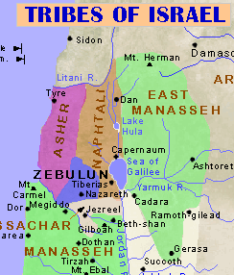
God’s Promised Messiah
(9:1-7)
No more gloom for Israel, especially Zebulun & Naphtali (9:1).
The promise starts to be fulfilled in Galilee, where also the first disasters came (1).
This is just where Jesus ministered!

Slide 9
God’s Promised Messiah
(9:1-7)
He is light for the people (9:2-5).
  They multiply, have joy (2).
  Delivered from oppression, war (4-5).
Messiah as a child (6a)
  “Unto us a child is born”
Messiah as God (6b)
  Divine titles: Mighty God, Everlasting Father
Messiah as eternal king (7)
  “no end,” “forever”

Slide 10
Light to the Nations
Elsewhere in Isaiah, we see that God’s servant will be a light to the other nations, too.
Isaiah 49:5 (NIV) And now the LORD saysnhe who formed me in the womb to be his servant to bring Jacob back to him and gather Israel to himself, for I am honored in the eyes of the LORD and my God has been my strengthn6 he says: "It is too small a thing for you to be my servant to restore the tribes of Jacob and bring back those of Israel I have kept. I will also make you a light for the Gentiles, that you may bring my salvation to the ends of the earth."

Slide 11
Conclusions
We are tempted to follow the world because of its here & now promises.
But it gives us no support in disaster, and tends to wander into the occult.
The one who trusts in God is helped in disaster to develop patience & more trust, learning to see God’s provision, and God’s predictions fulfilled.

Slide 12
Conclusions
A bad world situation will one day be straightened up when Jesus the Messiah returns to rule.
Meanwhile, we have an opportunity to serve as God’s “secret agents” here & now, just as Isaiah and his children did many centuries ago.
Jesus is indeed the light of the world!

Slide 13
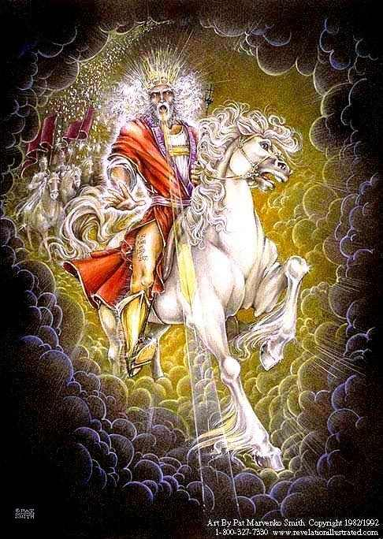
The End

