Slide 1


3. God’s Word is Light
Psalm 119
Robert C. Newman

Slide 2
Introduction
In this series of eight talks, we are now beginning to look at light as a picture which explains something else.
In this third talk, we will see how God’s Word, the Bible, is like light.

Slide 3
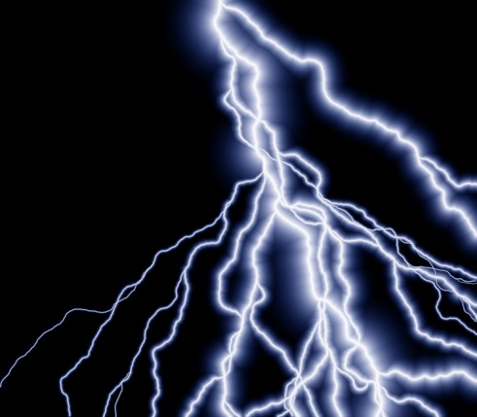
Psalm 119:130
119:130 (NIV) The unfolding of your words gives light; it gives understanding to the simple.
Just as light helps us see physical things by providing illumination…
So God’s Word, the Bible, helps us see spiritual things.
Illustration: lightning at night

Slide 4
Note Psalm 119:98-100
98 (NIV) Your commands make me wiser than my enemies, for they are ever with me.
99 I have more insight than all my teachers, for I meditate on your statutes.
100 I have more understanding than the elders, for I obey your precepts.
Compared to our enemies, our teachers, our elders, we can be wiser than they are by loving, studying & obeying the Bible.

Slide 5
Psalm 119:105
105 (NIV) Your word is a lamp to my feet and a light for my path.
God’s Word is not only our source for knowledge (light illuminating surroundings)…
It is also our source for guidance in life (light to see the pathway).

Slide 6
Look at Psalm 1
“What is Life All About?”
Verses 1-2: Where do we find out?
  Blessed is the man who does not walk in the counsel of the wicked or stand in the way of sinners or sit in the seat of mockers. But his delight is in the law of the LORD, and on his law he meditates day and night.
Verses 3-4: What difference does it make here & Now?
  He is like a tree planted by streams of water, which yields its fruit in season and whose leaf does not wither. Whatever he does prospers. Not so the wicked! They are like chaff that the wind blows away.
Verses 5-6: What difference does it make when we die?
  Therefore the wicked will not stand in the judgment, nor sinners in the assembly of the righteous. For the LORD watches over the way of the righteous, but the way of the wicked will perish.

Slide 7
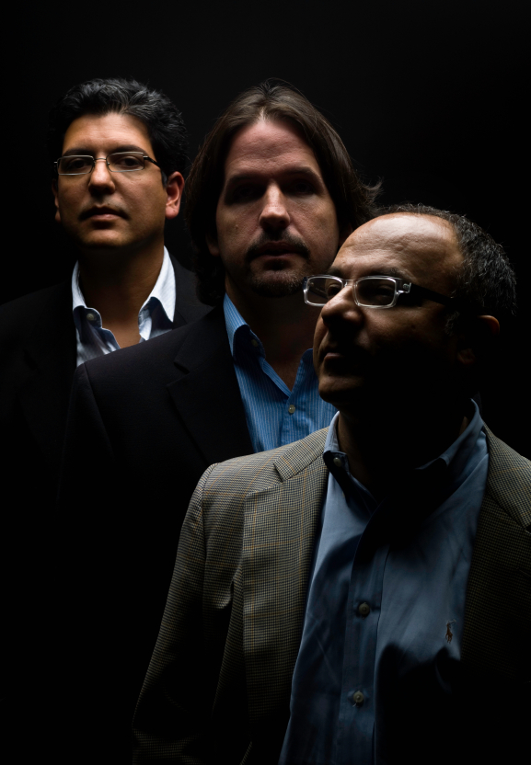
Conclusions
Without God’s Word, we are in the dark!
We won’t know what we need.
We will stumble and fall.
Don’t make a mess of your life by ignoring God’s guidance.

Slide 8
The End

