Slide 1
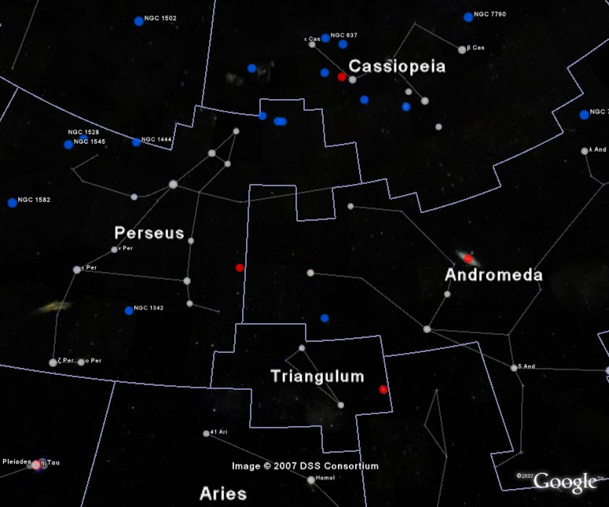

2. Light Revealing God
Psalm 19
Robert C. Newman

Slide 2
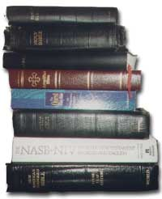
Our Passage
Psalm 19:1-6

Slide 3
Psalm 19:1 (NIV) The heavens declare the glory of God;
the skies proclaim the work of his hands.
2 Day after day they pour forth speech;
night after night they display knowledge.
3 There is no speech or language
where their voice is not heard.
4 Their voice goes out into all the earth,
their words to the ends of the world.
In the heavens he has pitched a tent for the sun,
5 which is like a bridegroom coming forth from his pavilion,
like a champion rejoicing to run his course.
6 It rises at one end of the heavens
and makes its circuit to the other;
nothing is hidden from its heat.

Slide 4

What Is It Saying?

Slide 5
Who Is Acting?
Heavens (declaring)
Skies/Expanse (proclaiming)
Day (pouring forth speech)
Night (displaying knowledge)
Sun
  Coming forth, rising
  Running
  Circling

Slide 6
What Are They Telling?
God’s glory
  His importance
  His nature
His handiwork
  Learn about craftman’s skill via his work
Knowledge
  About God

Slide 7
Who Is Being Told?
Every day, every night
Throughout the earth
To the ends of the world
From one end of heaven to another
Nothing hidden
So, the message is available to everyone.

Slide 8
How Are They Telling?
Are they speaking?
  No.
  One translation has it:
    They have no speech, there are no words;
    no sound is heard from them
Illustration: signaling with light
  Boy Scouts w/ flashlights, mirrors
  Navy (before radio) w/ signal lamps

Slide 9
How do they tell us about God’s existence?
Our passage doesn’t say.
Some suggestions:
  Regularity of movements → order
  Complexity of movements → wisdom
  So a wise Creator (known in ancient times).
  Running down of universe → beginning
  So an Starter (a more recent argument).

Slide 10

Conclusions
God is using the sky to tell us something about:
  His glory
  His handiwork
It is very easy to live as though God doesn’t exist, but it is foolish.
  Illustration: the farmer’s plane ride
  What holds the farmer up?

Slide 11
The End

