Slide 1

The Letter of Jude
Robert C. Newman

Slide 2
Author of Jude

Slide 3
Author of Jude
7 different Jude's or Judas's in the NT:
  Ancestor of Jesus (Luke 3:30)
  Galilean rebel leader (Acts 5:37)
  Judas Iscariot (Mark 3:19)
  Judas of Damascus (Acts 9:11)
  Judas Barsabbas (Acts 15:22)
  Apostle (Luke 6:16, etc.)
  Brother of James & Jesus (Matt 13:55)

Slide 4
The Name "Jude"
English has variously (w/ connotations):
  Jude – (good)
  Judas – (bad)
  Judah – (Jewish)
These all represent the same Hebrew (& Greek) word!
So this distinction is artificial.

Slide 5
The Author of the Letter
Most of 7 listed are pretty obscure.
The name was quite popular.
The author of our letter was probably:
  Jude, of James (Luke 6:16)
  Jude, bro of James and Jesus (Matt 13:55)
The second of these seems best, though Catholics identify the two.
  I don't, as Jesus' brothers did not believe in him during his ministry.

Slide 6
Connection with 2 Peter
Very strong parallels between Jude and 2 Peter 2:1-3:3
Implies some sort of mutual dependence:
  Jude on 2 Peter
  2 Peter on Jude
  Both on some other source

Slide 7
The Parallels
Jude 4 & 2 Pet 2:1
5-7 & 2:4-7
8-10 & 2:10-11
11 & 2:15
12 & 2:13
12-13 & 2:17
17-18 & 3:2-3

Slide 8
Jude 4 & 2 Pet 2:1
2Pet 2:1 (NIV) But there were also false prophets among the people, just as there will be false teachers among you. They will secretly introduce destructive heresies, even denying the sovereign Lord who bought them--bringing swift destruction on themselves.
Jude 1:4 (NIV) For certain men whose condemnation was written about long ago have secretly slipped in among you. They are godless men, who change the grace of our God into a license for immorality and deny Jesus Christ our only Sovereign and Lord.

Slide 9
Jude 5-7 & 2 Pet 2:4-7
Jude 1:5 (NIV) Though you already know all this, I want to remind you that the Lord delivered his people out of Egypt, but later destroyed those who did not believe.
6 And the angels who did not keep their positions of authority but abandoned their own home--these he has kept in darkness, bound with everlasting chains for judgment on the great Day.
7 In a similar way, Sodom and Gomorrah and the surrounding towns gave themselves up to sexual immorality and perversion. They serve as an example of those who suffer the punishment of eternal fire.
2Pet 2:4 (NIV) For if God did not spare angels when they sinned, but sent them to hell, putting them into gloomy dungeons to be held for judgment;
5 if he did not spare the ancient world when he brought the flood on its ungodly people, but protected Noah, a preacher of righteousness, and seven others;
6 if he condemned the cities of Sodom and Gomorrah by burning them to ashes, and made them an example of what is going to happen to the ungodly;
7 and if he rescued Lot, a righteous man, who was distressed by the filthy lives of lawless men

Slide 10
Jude 8-10 & 2 Pet 2:10-11
Jude 1:8 (NIV) In the very same way, these dreamers pollute their own bodies, reject authority and slander celestial beings.
9 But even the archangel Michael, when he was disputing with the devil about the body of Moses, did not dare to bring a slanderous accusation against him, but said, "The Lord rebuke you!"
10 Yet these men speak abusively against whatever they do not understand; and what things they do understand by instinct, like unreasoning animals--these are the very things that destroy them.
2Pet 2:10 (NIV) This is especially true of those who follow the corrupt desire of the sinful nature {[10] Or the flesh} and despise authority.
Bold and arrogant, these men are not afraid to slander celestial beings;
11 yet even angels, although they are stronger and more powerful, do not bring slanderous accusations against such beings in the presence of the Lord.

Slide 11
Jude 11 & 2 Pet 2:15
Jude 1:11 (NIV) Woe to them! They have taken the way of Cain; they have rushed for profit into Balaam's error; they have been destroyed in Korah's rebellion.
2Pet 2:15 (NIV) They have left the straight way and wandered off to follow the way of Balaam son of Beor, who loved the wages of wickedness.

Slide 12
Jude 12 & 2 Pet 2:13
Jude 1:12 (NIV) These men are blemishes at your love feasts, eating with you without the slightest qualm--shepherds who feed only themselves. They are clouds without rain, blown along by the wind; autumn trees, without fruit and uprooted--twice dead.
2Pet 2:13 (NIV) They will be paid back with harm for the harm they have done. Their idea of pleasure is to carouse in broad daylight. They are blots and blemishes, reveling in their pleasures while they feast with you. {[13] Some manuscripts in their love feasts}

Slide 13
Jude 12-13 & 2 Pet 2:17
Jude 1:12 (NIV) These men are blemishes at your love feasts, eating with you without the slightest qualm--shepherds who feed only themselves. They are clouds without rain, blown along by the wind; autumn trees, without fruit and uprooted--twice dead.
13 They are wild waves of the sea, foaming up their shame; wandering stars, for whom blackest darkness has been reserved forever.
2Pet 2:17 (NIV) These men are springs without water and mists driven by a storm. Blackest darkness is reserved for them.

Slide 14
Jude 17-18 & 2 Pet 3:2-3
2Pet 3:2 (NIV) I want you to recall the words spoken in the past by the holy prophets and the command given by our Lord and Savior through your apostles.
3 First of all, you must understand that in the last days scoffers will come, scoffing and following their own evil desires.
Jude 1:17 (NIV) But, dear friends, remember what the apostles of our Lord Jesus Christ foretold.
18 They said to you, "In the last times there will be scoffers who will follow their own ungodly desires."

Slide 15
What sort of dependence?
Liberals say 2 Peter copied Jude, so that they can date 2 Peter late.
Conservatives say Jude copied 2 Peter, which seems to me more natural.
Both 2 Peter and Jude may depend on some unrecorded oral statement by Jesus or one of the apostles.

Slide 16
Jude dependent on 2 Peter
In 2 Pet 2:1, Peter predicts false teachers will come.
  In Jude 4, they are already here.
In 2 Pet 3:2-3, Peter reminds readers of predictions by apostles.
  Jude 17-18 quotes 3:2-3 saying the apostles gave this warning

Slide 17
Jude dependent on 2 Peter
Jude reads most naturally as if Jude were reminding his readers of Peter's letter, which is now beginning to come true.
Liberals try to avoid this by saying that 2 Peter is "cleverly disguised" to look like Jude is quoting it; a fraud theory, coupled with claims that false authorship was OK back then.

Slide 18
Connection with Apocalyptic

Slide 19
Connection with Apocalyptic
2 passages in Jude seem to cite the OT Pseudepigrapha.
  Jude 14-15 & 1 Enoch
    1 En 60:8 – "7th from Adam"
    1 En 1:9 – long quote about Lord’s coming
  Jude 9 & Assumption of Moses
    Dispute over Moses' body

Slide 20
Jude 14-15
Jude 1:14 (NIV) Enoch, the seventh from Adam, prophesied about these men: "See, the Lord is coming with thousands upon thousands of his holy ones
15 to judge everyone, and to convict all the ungodly of all the ungodly acts they have done in the ungodly way, and of all the harsh words ungodly sinners have spoken against him."

Slide 21
1 Enoch 1:9
Behold, he will arrive with ten million of his holy ones to execute judgment upon all. He will destroy the wicked ones and censure all flesh on account of everything that they have done, that which the sinners and wicked ones committed against him.

Slide 22
Connection w/ 1 Enoch?
Direction of dependence?
  Jude on Enoch, vice versa, 3rd source?
Scraps of 1 Enoch at Qumran contain the quotation, so it predates Jude.
Quote does fit naturally into 1 Enoch.
Of course, Jude might be using some common tradition predating 1 Enoch.

Slide 23
Assumption of Moses
Our surviving text (of AsMos) does not contain this incident, but quits before this point in the narrative is reached.
But Clement, Origen, & Didymus say this passage in Jude is a quotation from that work.

Slide 24
The Problem
Liberals use quotations to discredit Jude
  Jude felt these were inspired.
  Early church had no good criteria for Scripture.
Occult types say these quotations validate extra-biblical writings.
Conservatives wonder what to do with these quotations.

Slide 25
Response
Quotation in NT does not prove a work is Scripture.
  Paul cites pagan Greek sources
Secular sources do contain truth.
What Jude cites from 1 Enoch fits biblical teaching about the Lord's coming.
Did Enoch ever say this?

Slide 26
Why cited by Jude?
Does it really go back to Enoch?
  Possible, but seems unlikely.
  Oral traditions shaky over 1000s of years.
Is Jude citing a book accepted by heretics to show that even their own "Scripture" condemns their behavior?
  Think this more likely.

Slide 27
Why would an antinomian group respect 1 Enoch?
Robert Grant thinks 2nd cen Gnostics (antinomian, anti-Jewish) developed from 1st cen Essenes (legalistic, Jewish).
Gnostics were interested in Jewish traditions (Cain, serpent, etc.).
Grant thinks some Gnostics were disillusioned Essenes.

Slide 28
Meaning of Jude's Use?
Jude considered 1 Enoch Scripture?
  Liberals, Occult, New Age
Jude felt this was a valid tradition going back to Enoch?
Jude knew book was respected by heretics and used it against them?

Slide 29
Meaning of Jude's Use?
3rd seems most reasonable.
Similar phenomena today:
  Using Book of Mormon against current Mormon teaching
  Using Qur'an against current Muslim teaching

Slide 30
Occasion of Jude

Slide 31
Occasion of Jude
Planning to write recipients about "our common salvation"
Changed plans due to appearance of heretics
Now appeals to them to "contend earnestly for the faith once delivered to the saints"

Slide 32
The Heretics Described
Crept in unnoticed (4) – deceptive
Licentious (4) – antinomian
Denying Jesus (4) – Lordship? Messiah?
Dreaming (8) – visions?
Defiling the flesh (8) – sexual sin?
Rejecting authority (8-10)
Dangerous (12)

Slide 33
The Heretics Described
Selfish (12)
Unreliable (12-13)
Unstable (12)
Spiritually dead (12)
Grumblers (16)
Lustful (16)
Arrogant (16)

Slide 34
The Heretics Described
Flatterers (16)
Causing divisions (19)
Worldly-minded (19)
  Possibly, Merely natural
Not having the Spirit (19)

Slide 35
Argument of Jude

Slide 36
Outline of Jude
Greeting (1-2)
Arrival of apostates (3-4)
Examples of divine judgment (5-7)
Apostates characterized (8-16)
Predicted by apostles (17-19)
Keep yourselves, rescue others (20-23)
Benediction (24-25)

Slide 37
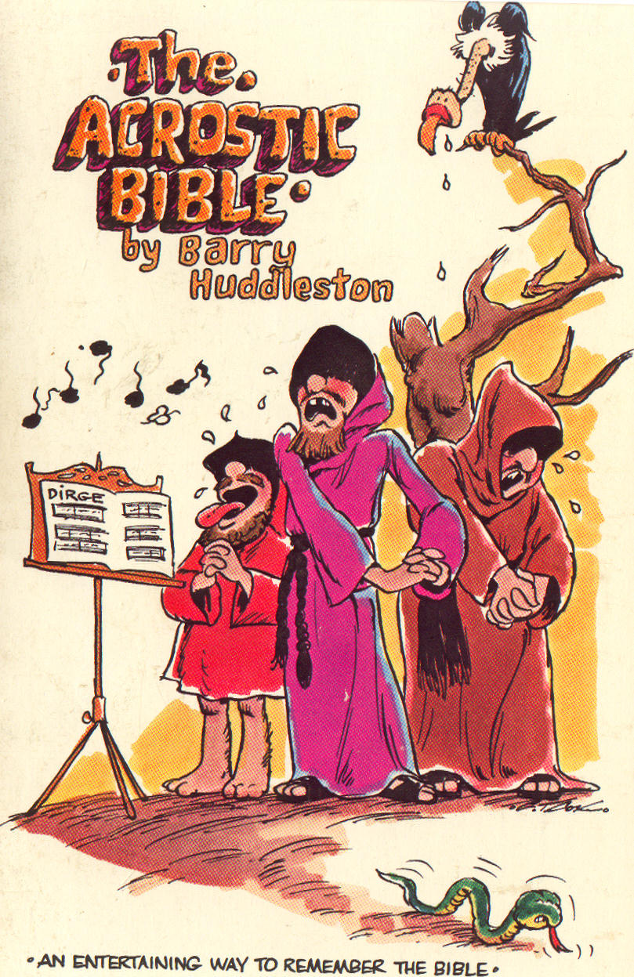
Huddleston's Acrostic
Jude warns against apostasy (1-4)
Unbelief seen throughout history (5-7)
Description of false teachers (8-19)
Exhortation to stay faithful (20-25)

Slide 38
The End

