Slide 1

Jewish Background to the New Testament
Robert C. Newman

Slide 2
The Intertestament Period
Valuable to know something of this period, due to big changes between the OT and NT periods.
OT ends ~400 BC, NT begins ~4 BC.
Government is Persia at end of OT, Roman at beginning of NT.
Languages in OT period are Hebrew, Aramaic; NT period adds Greek, Latin.
OT culture Semitic, NT culture Hellenistic.
Geographic center: OT is Fertile Crescent, NT is Mediterranean

Slide 3
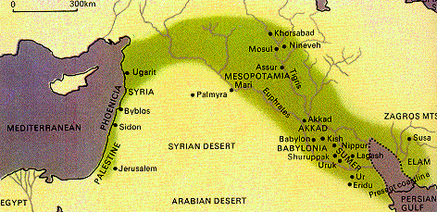
Fertile Crescent

Slide 4
Ancient Sources on the IT Period
OT prediction, esp. Daniel
OT Apocrypha & Pseudepigrapha
Philo of Alexandria (20 BC – AD 40+)
Josephus (AD 37-100+)
Dead Sea Scrolls
Rabbinic literature

Slide 5
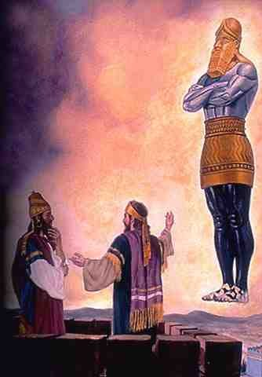
Daniel's Overview of the IT Period
Nebuchadnezzar's Image (Dan 2)
Image described.
  Gold head
  Silver chest
  Bronze thighs
  Iron legs
  Iron & clay feet
Image destroyed by stone.

Slide 6
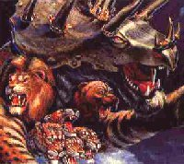
Daniel's Overview
Daniel's Four Wild Animals (Dan 7)
  Successive animals come out of sea.
  The horn from the fourth animal.
  The wild animals judged.
  One like a son of man receives ruling power.

Slide 7
The Kingdoms
Kingdom Image Animal
  Babylon Gold head Lion w/ wings
  Persia Silver chest Bear eating
  Greece Br thighs Leopard 4-heads
  Rome Iron legs Terrible 10-horn
Will use this scheme to structure our survey.

Slide 8
Structure of Survey
Palestine under the Persians
  539-331 BC
Palestine under the Greeks
  331-160 BC
Independence under the Hasmoneans
  160-63 BC
Palestine under the Romans
  63 BC to AD 135 and beyond

Slide 9
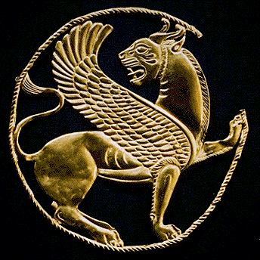
Palestine under Persia
539-331 BC

Slide 10
Palestine under Persia
Rise of Cyrus
Return of the Jews
Rebuilding the Temple
Revival in Judah & Rebuilding Walls
The Aramaic Language
Rise of the Synagogue
The IT Temples

Slide 11
The Rise of Cyrus
559 BC – Cyrus inherits small kingdom of Anshan (Persia)
550 – Cyrus defeats the Medes
  Nabonidus cancels his support!
546 – Cyrus takes Asia Minor
539 – Cyrus takes Babylon

Slide 12
The Return of the Jews
539-530 BC
Cyrus in concerned to stabilize his empire.
One of the problems of Assyria & Babylon rule was religious triumphalism.
  So Cyrus tries to be considerate.
Another problem was their deportation policy.
  Cyrus allow Jews & others to return home.

Slide 13
Rebuilding: the 2nd Temple
Cyrus allowed rebuilding to start, but stopped it when neighbors opposed (Ezra 4 & 6).
When Darius reigns, Jewish loyalty rewarded by allowing rebuilding.
Temple completed 515 by:
  Prophets Haggai & Zechariah
  Governor Zerubbabel & High Priest Jeshua
This 2nd temple lasts till AD 70.

Slide 14
Revival & Rebuilding:
The Walls
Under Artaxerxes 1 (465-423)
458 – Ezra returns from Babylon w/ commission from Persian king; restores people to observing Law.
445 – Nehemiah sent as governor to rebuild city walls of Jerusalem.
With fortifications in place, Jerusalem is now a city again.

Slide 15
The Aramaic Language
Ancient language of Syria/Aram (upper Euphrates valley)
Becomes diplomatic & trade language of ancient Near East
Adopted by the Jews:
  Probably during Babylonian exile, ~550 BC
  Oral translations of OT → Aramaic
  Still in use at time of Jesus
  Used in rabbinic literature beyond AD 550

Slide 16
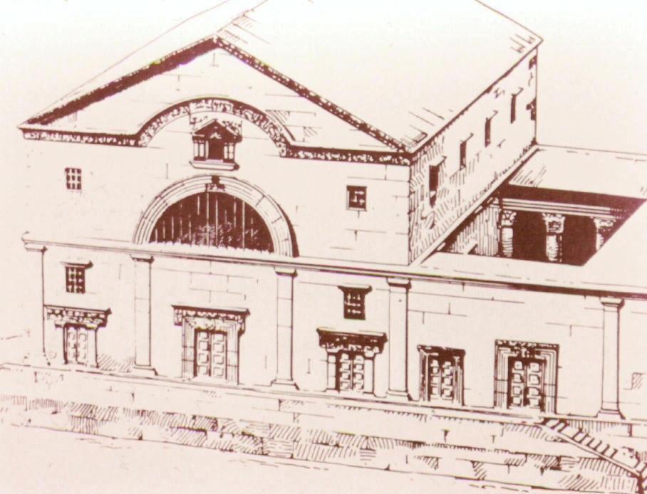
The Rise of the Synagogue
Place of worship for those unable to attend temple
Features prayer & Bible study but no sacrifice
Origin obscure
Continued alongside 2nd temple
Only place of Jewish worship after AD 70

Slide 17
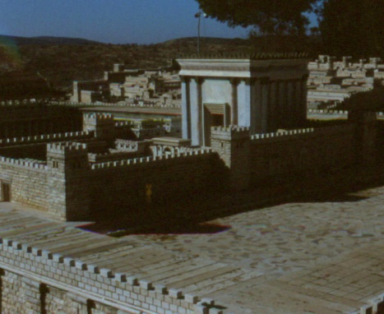
The IT Temples
2nd (Jerusalem) Temple (515-70AD)
  Orthodox, on site of Solomon’s temple
Samaritan Temple (450/330-128BC)
  On Mt Gerizim, near Shechem
  Destroyed by Maccabees
  Still a holy site in NT times & today
Elephantine Temple (525-390BC)
Leontopolis Temple (160-72AD)

Slide 18
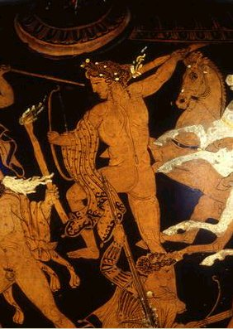
Palestine under the Greeks
331-c160 BC

Slide 19
Palestine under the Greeks
Alexander the Great (336-323 BC)
Struggle for Succession (to 301 BC)
Ptolemaic Dynasty (to 30 BC)
  Controls Palestine 301-198 BC
Seleucid Dynasty (to 63 BC)
  Controls Palestine 198-c160 BC
Hellenism
The Septuagint

Slide 20
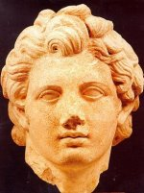
Alexander the Great
336 – succeeds father Philip at age 20
334 – invades Asia Minor
Major victories:
  334 – Granicus River – opens Asia M
  333 – Issus – opens Syria, Pal, Egypt
  331 – Gaugamela – destroys Persian E
Continues to India
323 – dies at Babylon, age 33

Slide 21
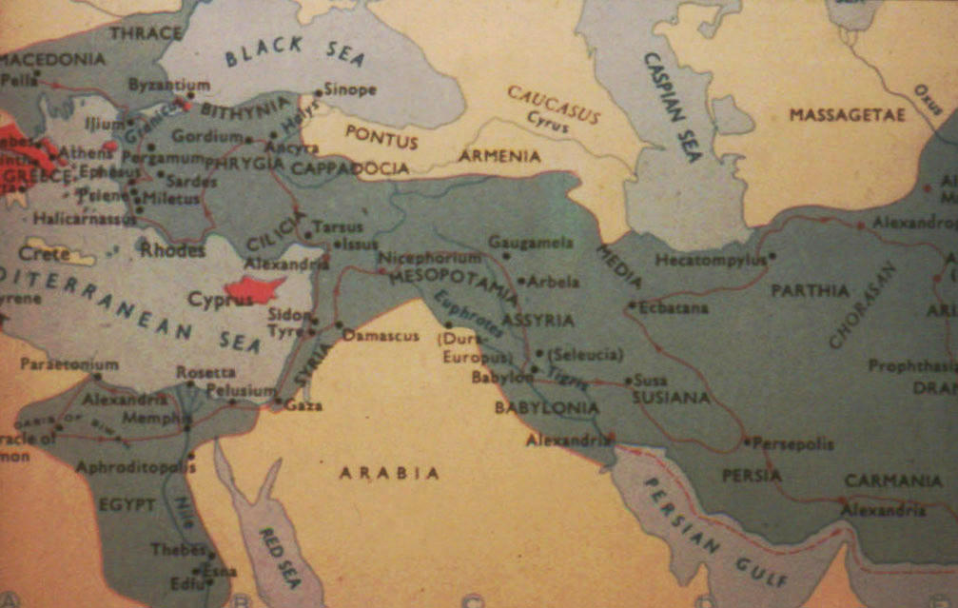
Alexander's Empire

Slide 22
The Struggle for Succession
Alexander did not have an heir.
  Son a baby, dies young
  Brother mentally incompetent
  Generals fall to fighting when son dead
The empire divided
  Thrace ruled by Lysimachus
  Macedonia by Cassander
  Asia Minor, Mesopotamia by Seleucus
  Egypt, Syria by Ptolemy

Slide 23
The Empire Divided
Lysimachus
Cassander
Seleucus
Ptolemy

Slide 24
The Ptolemaic Dynasty
Lasts till 30 BC, controls Palestine 301-198 BC
Ptolemy grabbed off Palestine while other generals fighting Antigonus.
He & successors (almost all named Ptolemy) treat Jews fairly well.
Many Jews settle in Alexandria, capital of Ptolemaic dynasty.

Slide 25
The Seleucid Dynasty
Lasts till 63 BC, controls Palestine 198-160 BC
Gets Palestine after long series of wars with Ptolemies.
Antiochus 4 favors Hellenized Jews & allows them to re-establish Jerusalem as Hellenistic city.
Antiochus later attempts to abolish Judaism (168), leading to Maccabean revolt (167).

Slide 26
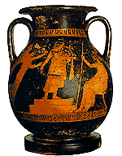
Hellenism
From Greek word for Greece, "Hellas"
Name for Greek culture as it developed in the East after Alexander
Influenced Judaism & somewhat influenced by it
Includes religious mixing
Various Greek philosophies
Political, economic benefits of citizenship

Slide 27
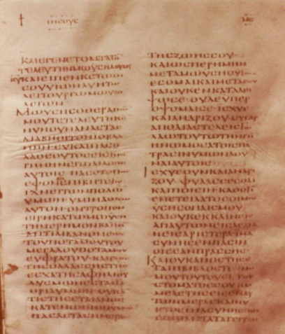
The Septuagint (LXX)
Greek translation of the OT
  Oldest translation into Greek
Origin – Letter of Aristeas
  Ptolemy 2 has Jewish elders translate Law for his library
  Later additions to story
  General opinion of story today

Slide 28
Importance of the LXX
Longest translation of any writing from antiquity
Gives OT text a century before oldest Hebrew manuscripts
Sets pattern for Greek theological terms in NT
Put OT in universal language of Mediterranean
Became the OT for the early church

Slide 29
Independence under the Hasmoneans
160–63 BC

Slide 30
Independence under the Hasmoneans
Antiochus 4 & the Abomination of Desolation
The Maccabean Revolt (167-134)
The Hasmonean Dynasty (164-63)
Jewish Sects of the Period
  Pharisees
  Sadducees
  Essenes

Slide 31
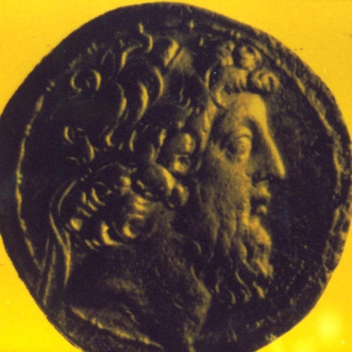
Antiochus Epiphanes
175 – usurps throne from nephew
Tries to unify empire via Hellenism
Favors Hellenistic Jews; Jerusalem refounded
Deposes high priests
  Onias 3 for Jason
  Jason for Menelaus
168 – defeated by Romans in Egypt
  Tries to destroy Judaism; rededicates temple to Zeus

Slide 32
The Maccabean Revolt
Origin
  Aged priest Matthias resists at Modin
  He & sons flee to wilderness to resist
Judah the Maccabee (166-160)
  Succeeds father
  His nickname "Hammerer"
  Successful series of battles
Jonathan (to 142) & Simon (to 134)
  Seleucids weak; Maccs grow by diplomacy
  Both murdered, but start dynasty

Slide 33
The Hasmonean Dynasty
John Hyrcanus (134-104)
  Greatly expands Judean territory
  Rise of Pharisees & Sadducees
Aristobolus (103)
  Kills several brothers, takes title "king"
  Dies from fear, drink, disease
Alexander Jannaeus (102-76)
  Continues expansion to Solomon-sized
  Troubles with Pharisees

Slide 34
The Hasmonean Dynasty
Salome Alexandra (76-67)
  Wife of Aristobolus & Alex Jannaeus
  Succeeds at Alex’s death
  Two sons:
    Hyrcanus 2 – made high priest
    Aristobolus 2 – given military command
End of Hasmonean Independence
  Salome dies, succeeded by Hyrcanus 2
  Aristobolus 2 snatches throne
  Hyrcanus flees, opens war, calls on Rome

Slide 35
Jewish Sects of the Period
Three main groups:
  Pharisees
  Sadducees
  Essenes
Their Theology
Their Influence & Survival

Slide 36
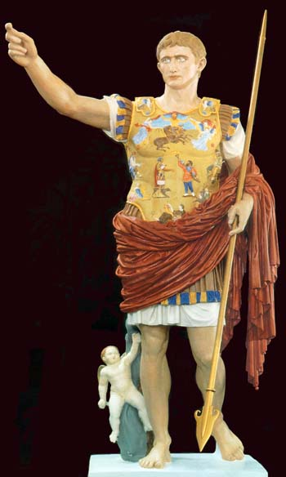
Palestine under the Romans
63 BC to 135 AD +

Slide 37
Palestine under the Romans
End of the Hasmonean Dynasty (63)
The Pax Romana (30 BC – 170 AD)
The Herod Family
  Antipater, Herod's father
  Herod the Great
  Herod's sons
  Herod's descendants
Messianic Expectation & the End of the Jewish State

Slide 38
The End of the
Hasmonean Dynasty
Hyrcanus flees brother Aristobolus.
  Romans intervene in dispute.
  Judea loses most of its conquered territories.
  Hyrcanus 2 made "Ethnarch" of Judea instead of king.
Romans rule Palestine as client state or province from 63 BC to AD 639.

Slide 39
The Roman Peace
Two centuries (30 BC – 170 AD) of peace over empire beginning with Augustus
Great growth in prosperity, reaching peak in 2nd century AD
Important for early spread of Xy:
  Peace
  Roman roads
  Lack of national boundaries

Slide 40
The Herod Family
Antipater, Herod's father
  Idumean, advisor to Hyrcanus 2, power behind the throne
  Made procurator of Judea for helping Julius Caesar
  Made sons Phasael & Herod administrators
  Assassinated 43 BC

Slide 41
Herod the Great
42 – appointed joint Tetrarch with brother Phasael
40 – Phasael killed by invading Parthians, Herod flees to Rome
40 – Roman senate appoints him King of the Jews.
37 – Herod reconquers Jerusalem.
31 – Throne insecure till death of Antony & Cleopatra

Slide 42
Herod the Great
His terrible family troubles
  Combination of conniving & suspicion
  Eventually he kills favorite wife & three sons, among others.
Herod's accomplishments
  Ruled large territory
  Renovated Jerusalem temple (19 BC +)
  Building projects (Caesarea, Sebaste)
  Killing Bethlehem's children

Slide 43
Herod's Sons
& Descendants
Sons: ruled by his will after death
  Archelaus – Judea/Samaria/Idumea till AD 6
  Antipas – Galilee/Peraea to AD 39
  Philip – Iturea/Trachonitis to AD 34
Descendants by Mariamne
  Herod Agrippa 1 – King of Jews 41-44
  Herod Agrippa 2 – a king to c100

Slide 44
Messianic Expectation
Messianic fervor by the end of the IT period
The person of the Messiah
Various views of the Messianic Period
The typical order of events

Slide 45
Messianic Fervor
Very strong in the 1st century AD
  Dissatisfaction with Roman rule
  Zealot leaders calling for revolt
Influential in leading many Jews to participate in revolt against Rome
Probably one of the reasons was that Daniel's prophecy of the 70 weeks looked like it was running out

Slide 46
The Person of the Messiah
Variety of views, changing with time
  Early interpreters see Messiah as more than human, tho no clear view of deity
  Later rabbinic materials tend to minimize importance of Messiah.
OT Paradoxes:
  Re/ office, activity, being, coming
  Solved by NT and Jesus

Slide 47
Various Views of the Messianic Period
Several alternatives:
  Messianic period only
  Eschaton only
  Both will occur – most common
These alternatives somewhat resemble the Christian views:
  Post-Millennial
  A-Millennial
  Pre-Millennial

Slide 48
Order of End-Time Events
Signs will precede the end
  Moral decay, disaster, signs, forerunner
Messianic kingdom established
  Return from exile, nations punished, Messiah rules
Days of Messiah (= Xn millennium)
  Variable features, length uncertain
  Ends with rebellion
The Age to Come (= Xn eternal state)
  Resurrection, judgment, eternal states

Slide 49
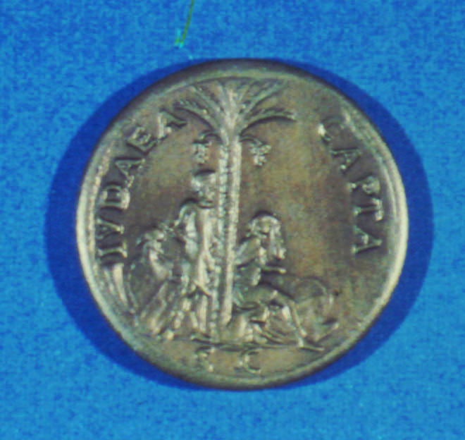
End of the
Jewish State
The Roman Procurators (6-66 AD)
  Replacement for Archelaus (AD 6)
  The activities of the Zealots (6+)
  Caligula's statue (41)
  Herod Agrippa 1's short rule (41-44)
  The insensitivity of the Procurators
The (1st) Jewish Revolt (66-73)
  Started in Caesarea
  Moderate Jews lose control to Zealots
  Jerusalem destroyed (70), Masada (73)

Slide 50
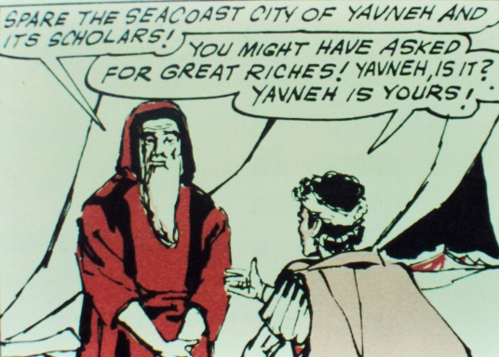
Palestine Afterward
Rabbi Johanan ben Zakkai
  Got Roman permission to continue school & court at Jamnia
  Rebuilt Judaism w/o sacrifice
  Xns excluded from synagogue
The (2nd) Bar-Kochba Revolt (132-35)
  Romans to rebuild Jerusalem as pagan city.
  Simeon b Koseba revolts & is recognized as Messiah.
  Revolt put down w/ much slaughter.
  Jews forbidden to come near Jerusalem

Slide 51
The End
But God is not finished with Israel yet!

