Slide 1


Jesus Discusses the Weather
Robert C. Newman

Slide 2
Matthew 16:1-4
Narrates an unusual incident, the meaning of which may be easily overlooked.
But the lesson it teaches was important back then, and equally so today.
Let’s have a look at the passage.

Slide 3
Matthew 16:1-4
1 (NIV) The Pharisees and Sadducees came to Jesus and tested him by asking him to show them a sign from heaven.
2 He replied, "When evening comes, you say, ‘It will be fair weather, for the sky is red,’
3 and in the morning, ‘Today it will be stormy, for the sky is red and overcast.’ You know how to interpret the appearance of the sky, but you cannot interpret the signs of the times.
4 A wicked and adulterous generation looks for a miraculous sign, but none will be given it except the sign of Jonah." Jesus then left them and went away.

Slide 4
The Demand (verse 1)
“Show us a sign from heaven.”
Not sincere, but “testing” or “tempting.”
Note the background in Matthew:
  Some teachers of the law were present when Jesus healed a paralytic (9:2-8).
  Some Pharisees saw him when he cured a demon-possessed man (9:32-34).
  Other Pharisees saw him heal a man with a shriveled hand (12:10-14).
  Most likely some were present when he fed the 5000 (14:15-21) and the 4000 (15:32-38).

Slide 5
Jesus’ Response (vv 2-3a)
Jesus notes the signficance of red sky in evening vs red sky in morning.
His response is ironic or humorous, but with a real punch.
Jesus gives them two “signs from heaven.”
  These are reliable weather signs in that part of the world (north temperate zone).
  These signs are known to his audience.

Slide 6
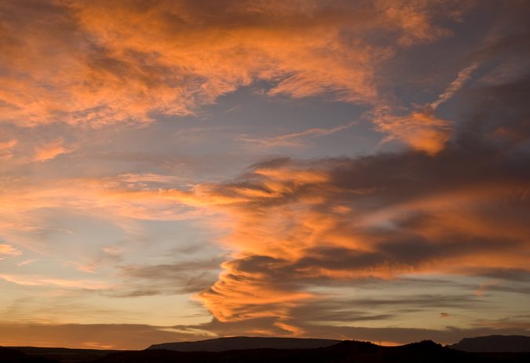
Sunset Red Sky
Red sky at sunset means the sky is clear far to the west.
In temperate zones, where prevailing wind is from the west…
This means (usually) that good weather is coming.

Slide 7
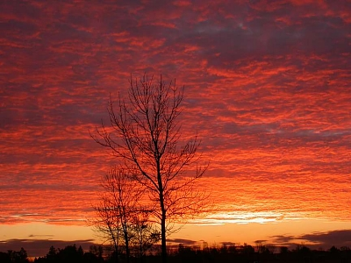
Sunrise Red w/ Clouds
Red sky in the morning means it is clear to the east.
Where the prevailing winds are from the west…
This means (with clouds overhead) that good weather is leaving.

Slide 8
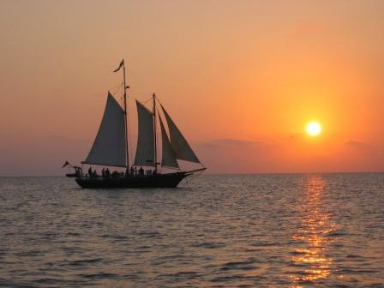
Old Seaman’s Rhyme
Red sky in the morning, sailor take warning…
Red sky at night, sailor’s delight!

Slide 9
The Signs
How had they learned these weather signs?
  Not by making demands from God
  Not by setting arbitrary standards for what will be believed & accepted
Rather by humbly & patiently observing the phenomena around them, and then by trying to figure out what they mean.

Slide 10
Jesus’ Rebuke (3b)
“You know how to interpret the appearance of the sky, but you cannot interpret the signs of the times.”
You are being inconsistent.
Why haven’t you applied the same principles of observation to my works & to the Old Testament prophecies about the Messiah?

Slide 11
Jesus’ Diagnosis (4a)
“A wicked and adulterous generation looks for a miraculous sign…”
“Wicked” points to fallen nature of mankind
“Adulterous” not literal here, but (as often in the Bible) refers to idolatry.
  They want a different God than the one that actually exists.
  They will use the refusal of a sign as an excuse for not following God.

Slide 12
Jesus’ Last Offer (4b)
“[No sign] will be given except the sign of Jonah.”
So one greater sign is still to come n that of Jonah.
Jesus had already explained this back in Matthew 12:39-41.

Slide 13
Matthew 12:39-41
39 (NIV) He answered, “A wicked and adulterous generation asks for a miraculous sign! But none will be given it except the sign of the prophet Jonah.
40 For as Jonah was three days and three nights in the belly of a huge fish, so the Son of Man will be three days and three nights in the heart of the earth.
41 The men of Nineveh will stand up at the judgment with this generation and condemn it; for they repented at the preaching of Jonah, and now one greater than Jonah is here.”

Slide 14
Some Weather Observations

Slide 15
Some Observations
Whether you are a Christian or not, are you making demands of God before you will obey what he commands?
  “I wish God would show me a sign…”
Even today in the West, when it seems there are few miracles occurring, God has provided so much evidence that no one will get off with the excuse “You didn’t make it clear enough!”

Slide 16
More Observations
When the claims that Jesus makes are entered into the competition among religions, the stakes become so high that anyone who does not search out the truth diligently is terribly careless.
We must recognize our own hearts:
  We have a tendency to deceive ourselves.
  We prefer a god of our own making rather than the God who is.

Slide 17
My Prayers
May God bring us to Himself.
May He protect us from ourselves.
May we not make shipwreck of the only life that we know we have.

Slide 18
The End

