Slide 1
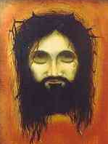


Jesus & the New Age
Robert C. Newman

Slide 2

The New Age Movement
Considerable prominence since 1960s
Much variety in groups, but most involve pantheism & re-incarnation.
Forms designed for the West often use some Christian terminology.
Most have some place for Jesus, but not for the Bible's Jesus.

Slide 3
Jesus as Pictured by New Age Teachers
Lots of variety
Here we give two examples:
Edgar Cayce
Benjamin Creme

Slide 4
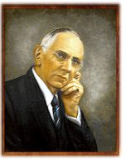
Jesus according to Edgar Cayce
References from
Jeffrey Furst, ed.,
Edgar Cayce's Story
of Jesus (1969)

Slide 5
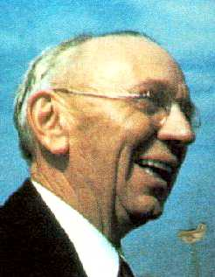

Who is Edgar Cayce?
Called the "sleeping prophet," he began to go into trances in which he would give revelations and answer questions.
Claimed he did not recall what he had said when he awoke.
Moved from orthodox Christianity to a form of New Age occultism.

Slide 6
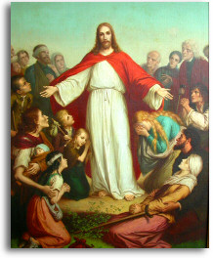
Edgar Cayce's Jesus
Jesus became the Christ (16, 42) …
  …thru acceptance of God's will
Jesus exemplifies the universal Christ-consciousness (16, 42).
Jesus became aware he would be Savior of the world when he fell in Eden (23).

Slide 7
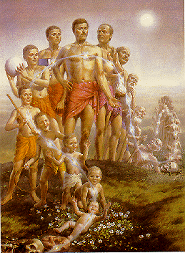
Jesus' Previous Incarnations
Amilius of Atlantus
Adam
Enoch
Melchizedek
Joseph
Joshua
Zend (father of Zoroaster)
And others (23, 28, 37).

Slide 8
Jesus' Previous Incarnations
Jesus sinned in at least some of these incarnations (23).
His mother, Mary, did not sin in her incarnation as his mother (27-28).
She had no human father either!
In a previous incarnation, she was Eve, the twin-soul of Jesus.

Slide 9
Edgar Cayce's Gospel
Pre-Adamic spirits became inmeshed in creation (having projected themselves into rocks, trees, etc.) and then forgot who they were (34).
  A similar scheme in Ron Hubbard's Scientology
Sons of God set about to rescue these spirits by forming bodies of flesh & blood which became channels (thru evolution in successive reincarnations) for eventual release from material being (35).

Slide 10
Edgar Cayce's Gospel
We need to know about this previous history of ourselves (19).
We need to recognize that we are portions of God (32), and live like it (21).
Eventually we will escape from matter and become one with God (44).

Slide 11

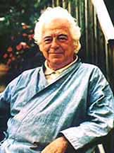
Jesus according to
Benjamin Creme
References from
Benjamin Creme,
The Reappearance of the
Christ & the Masters of
Wisdom (1980)

Slide 12
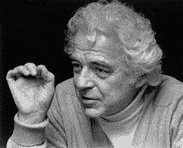
Who is Benjamin Creme?
Described on Canadian website as "a British artist & long-time student of esoteric philosophy … the principal source of information about the emergence of Maitreya, the World Teacher"
Gained considerable attention with ads in major newspapers in April 1982 that Christ had returned in 1977.

Slide 13
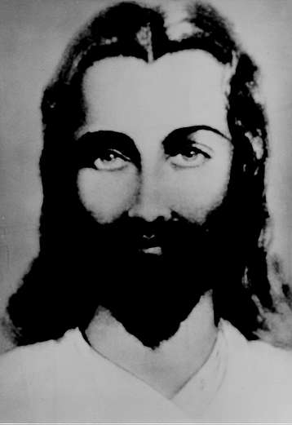
The Christ
The Christ is the Master of all Masters, but not God; He is a Son of God, and so are we (RC 115).
The Christ is not an individual but an office … held (for the past 26,000 years) by Lord Maitreya.
He was manifested in Palestine by overshadowing his disciple Jesus (RC 30).

Slide 14
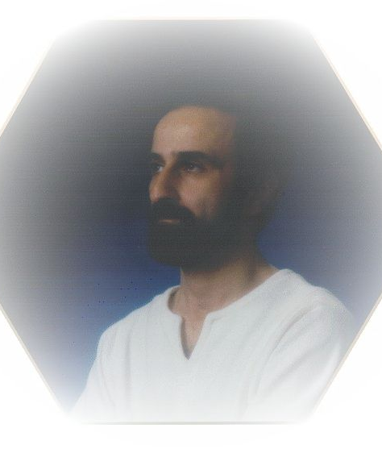
The Christ
Jesus is not the Christ. He was, and still is, a Disciple of the Christ.
He gave up his body for the use of the Christ, who took over … his body from the baptism onwards.
In his next incarnation (as Apollonius of Tyana), Jesus became a Master.
He lives now (in a 600 year-old Syrian body) in Palestine (RC 46).

Slide 15
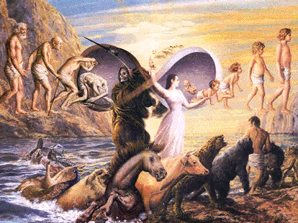
Benjamin Creme's Gospel
Everything is God (RC 110).
All beings are on a 'ladder' which stretches from below man all the way to infinity (RC 72).
We are currently humans, but others ahead of us have become (thru multiple reincarnations) ascended Masters (RC 115).

Slide 16
Benjamin Creme's Gospel
All religions are (more or less) the same, holding out a promise of further revelation to be given by a future Teacher or Avatar:
  Christians look for Christ’s return
  Muslims for the Imam Mahdi
  Hindus for Krishna
  Jews for the Messiah
Those (like Creme) into secret knowledge know these are all one being, the World Teacher, and look for his imminent return as we enter the Age of Aquarius (RC 28)

Slide 17
Benjamin Creme's Gospel
At this point, with the Age of Aquarius dawning, the Masters are about to return to the everyday world for the first time in countless thousands of years.
They will lead us into the Aquarian experience if we will take the first steps in the direction of unity, cooperation, and fusion (RC 30)

Slide 18

A Biblical Response
… to the New Age Versions of Jesus

Slide 19
A Biblical Response
Understand What's Happening:
  Don’t be surprised …
  … by False Prophets
  … by Another Jesus
  … by Another Gospel
Try to Help Others Attracted by the New Age Movement.

Slide 20
False Prophets
Beware of false prophets, who come to you in sheep’s clothing, but inwardly are ravenous wolves. – Matthew 7:15
And many false prophets will arise, and will mislead many. – Matthew 24:11
For false Christs and false prophets will arise and will show great signs and wonders, so as to mislead, if possible, even the elect. – Matthew 24:24

Slide 21
False Prophets
But false prophets also arose among the people, just as there will be false teachers among you, who will secretly introduce destructive heresies, even denying the Master who bought them, bringing swift destruction upon themselves. – 2 Peter 2:1

Slide 22
False Prophets
Beloved, do not believe every spirit, but test the spirits to see whether they are from God; because many false prophets have gone out into the world. – 1 John 4:1

Slide 23

Understand What's Happening
Some of Creme's picture looks like what Bible-believing Christians might expect to be Satan’s program for the end of the age.
We can't tell how much of this really is Satan's program for the world, since he is a great liar, and (in any case) is not in control of history.

Slide 24
Another Jesus
For if one comes and preaches another Jesus whom we have not preached, or you receive a different spirit which you have not received, or a different gospel which you have not accepted, you bear this beautifully! – 2 Corinthians 11:4

Slide 25
Another Gospel
I am amazed that you are so quickly deserting Him who called you by the grace of Christ, for a different gospel; which is not really another; only there are some who are disturbing you, and want to distort the gospel of Christ. But even though we, or an angel from heaven, should preach to you a gospel contrary to that which we have preached to you, let him be accursed. – Galatians 1:6-8

Slide 26
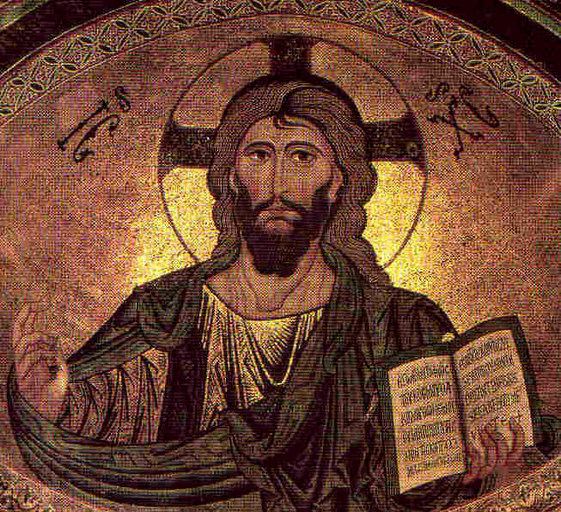
Help Others Attracted by the New Age Movement
We & they need to know what the Bible says about who Jesus is.
We & they need to understand why only the real Jesus can save us.
We need to be able to share the reasons for our hope… the real evidence God has provided that Christianity is true.

Slide 27
Who Jesus Is
John 1
Colossians 1
Hebrews 1

Slide 28
Who Jesus Is
In the beginning was the Word, and the Word was with God, and the Word was God. He was in the beginning with God. All things came into being by Him, and apart from Him nothing came into being that has come into being. In Him was life, and the life was the light of men. – John 1:1-4
And the Word became flesh and made His dwelling among us. – John 1:14

Slide 29
Who Jesus Is
He is the image of the invisible God, the first-born of all creation. For by Him all things were created, both in the heavens and on earth, visible and invisible … all things have been created by Him and for Him. And He is before all things, and in Him all things hold together. – Colossians 1:15-17
God was pleased to have all His fulness dwell in Him, and through Him to reconcile to Himself all things … making peace through His blood, shed on the cross. – Colossians 1:19-20

Slide 30
Who Jesus Is
God, after He spoke long ago to the fathers in the prophets in many portions and in many ways, in these last days has spoken to us in His Son, whom He appointed heir of all things, through whom also He made the world. He is the radiance of His glory and the exact representation of His nature, and upholds all things by the word of His power. When He had made purification for sins, He sat down at the right hand of the Majesty on high. – Hebrews 1:1-3

Slide 31
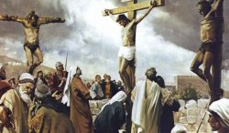
Only the Real Jesus Can Save
Only Jesus was good enough.
Only Jesus can give us His righteousness and take upon Himself our sins.

Slide 32
Only Jesus was good enough
For we do not have a high priest who cannot sympathize with our weaknesses, but One who has been tempted in all things as we have, yet without sin. – Hebrews 4:15
For it was fitting that we should have such a high priest – holy, innocent, undefiled, separated from sinners and exalted above the heavens. – Hebrews 7:26

Slide 33
Only Jesus gives us righteousness and takes our sins
He [God] made Him [Jesus] who knew no sin to be sin on our behalf, that we might become the righteousness of God in Him. – 2 Corinthians 5:21
And He Himself bore our sins in His body on the cross, that we might die to sin and live to righteousness; for by His wounds you were healed. – 1 Peter 2:24

Slide 34
Only Jesus gives us righteousness and takes our sins
But God, being rich in mercy, because of His great love with which He loved us, even when we were dead in our transgressions, made us alive together with Christ … in order that in the ages to come He might show the surpassing riches of His grace in kindness toward us in Christ Jesus. For by grace you have been saved through faith; and that not of yourselves, it is the gift of God; not as a result of works, that no one should boast. – Ephesians 2:4-9

Slide 35
Only Jesus gives us righteousness and takes our sins
But God demonstrates His own love toward us, in that while we were yet sinners, Christ died for us. – Romans 5:8
… who died for us, that whether we are awake or asleep, we may live together with Him. – 1 Thessalonians 5:10

Slide 36
We need to be able to share the reason for our hope
But sanctify Christ as Lord in your hearts, always being ready with a defense to everyone who asks you to give an account for the hope that is in you, yet with gentleness and reverence. – 1 Peter 3:15

Slide 37
We need to be able to share the reason for our hope
Ask yourself:
What kind of evidence do these people have for their beliefs?
What kind of evidence do I have, and how can I share with them?
  Evidence of fulfilled prophecy about Jesus
  Evidence of the historicity of Jesus’ ministry
  Evidence of changed lives

Slide 38
We need to warn ourselves & others of the consequences
For if the word spoken through angels proved unalterable, and every transgression & disobedience received a just recompense, how shall we escape if we neglect so great a salvation? After it was at the first spoken through the Lord, it was confirmed to us by those who heard, God also bearing witness with them by signs & wonders & by various miracles & by gifts of the Holy Spirit according to His own will. – Hebrews 2:2-4

Slide 39
The End
… of this talk.
The problem will continue
till the second coming!

