Slide 1
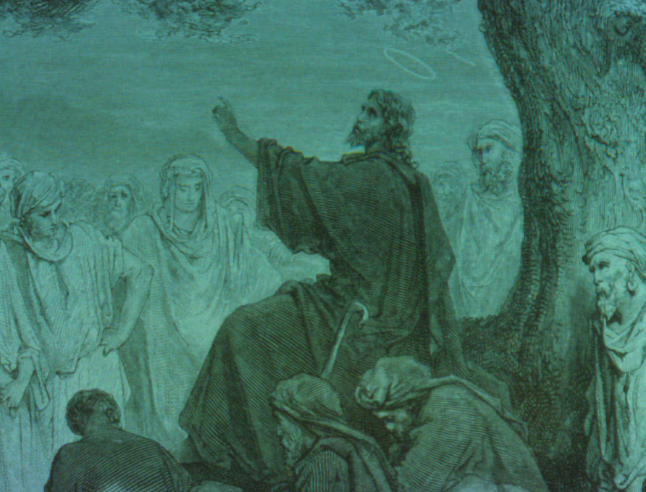

Overview of
Jesus' Ministry
Robert C. Newman
Biblical Theological Seminary

Slide 2
Introduction
Some disagreement on length of Jesus' Ministry
  About 1 year
  2-3 years
  3-4 years
Some disagreement on date of crucifixion
  ~ AD 29
  ~ AD 30
  ~ AD 33

Slide 3

Outline of Jesus' Life & Ministry
We will follow Guthrie, A Shorter Life of Christ
Thirty Years in Nazareth
Period of Preparation
Early Judean Ministry
Galilean Ministry
Closing Period
Passion & Resurrection

Slide 4
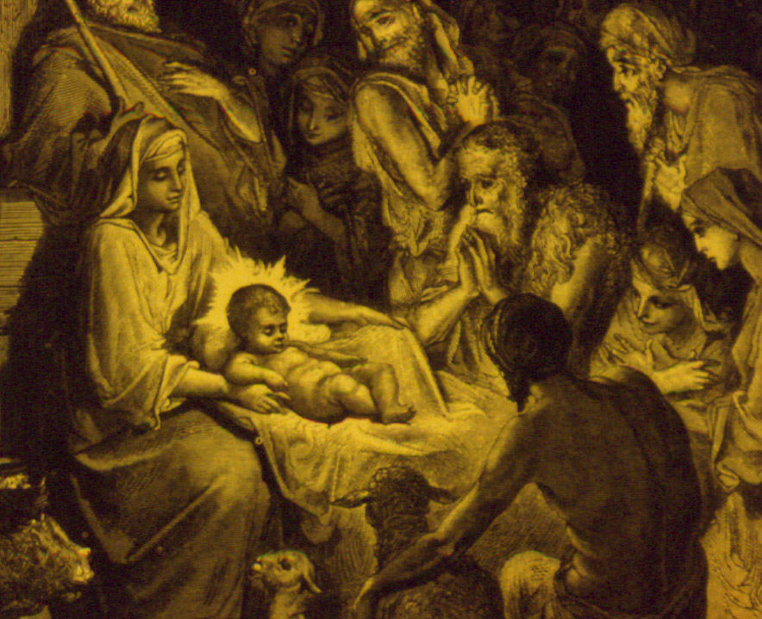
Thirty Years in Nazareth
John's Prologue
  Jesus' deity, His incarnation
The Birth Narratives
  Virginal conception, birth at Bethlehem
  Matthew: Joseph's perspective, Wise men
  Luke: Mary's perspective, shepherds
Jesus at age 12
  A hint of things to come

Slide 5
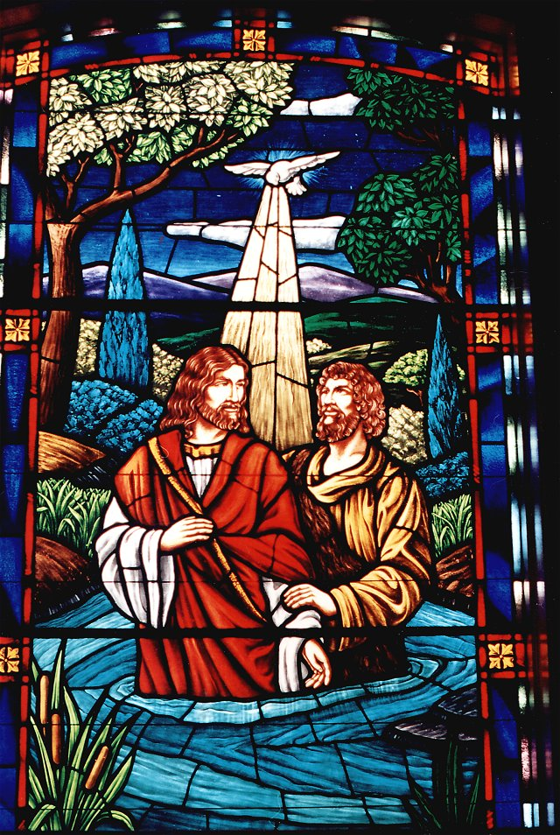
Period of Preparation
John the Baptist
  His person & message
Jesus baptized
  John's reluctance & heaven opened
Jesus tempted
  Compare the temptations of Adam & Eve; of Israel in the wilderness

Slide 6
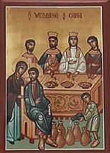
Early Judean Ministry
Only in John:
First contact with future disciples
Wedding at Cana
First cleansing of temple
Conversation with Nicodemus
Conversation with Samaritan Woman

Slide 7
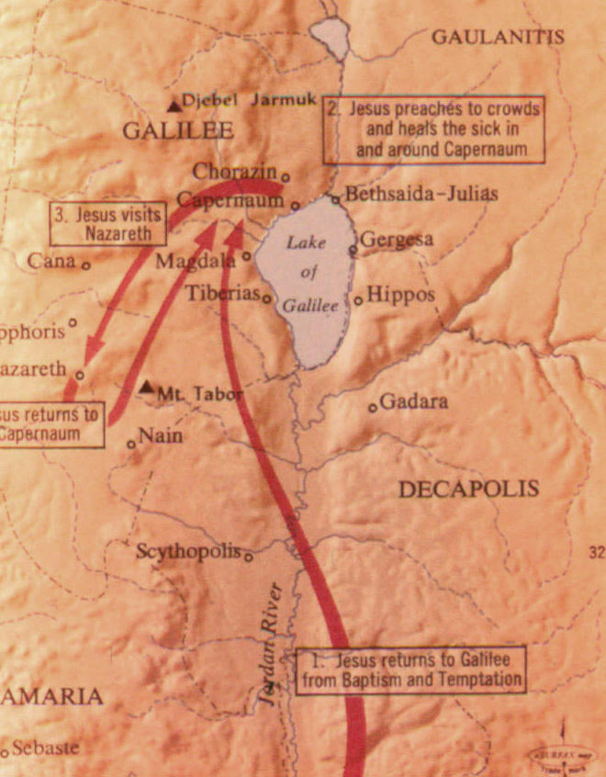
Jesus' Galilean Ministry
Subdivided into periods:
To the choosing of the Twelve
To the withdrawal northward
To Jesus' last journey to Jerusalem

Slide 8
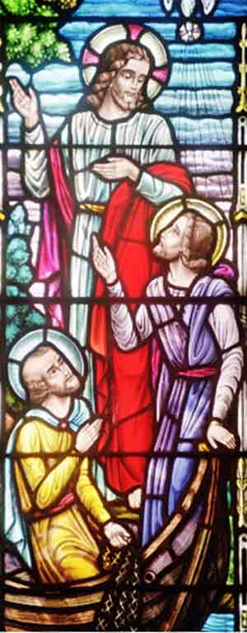
To the choosing of the Twelve
Initial call of the disciples
  Peter, Andrew, James & John by seaside
The sermon on the mount
Healings & other miracles
Popularity & criticism of Jesus
The twelve chosen

Slide 9
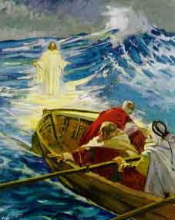
To the withdrawal northward
Sabbath controversies & healings
Division & attack
Samples of Jesus' teaching
Unbelief at Nazareth
Feeding of the five thousand
Walking on the water
Tradition of the elders

Slide 10
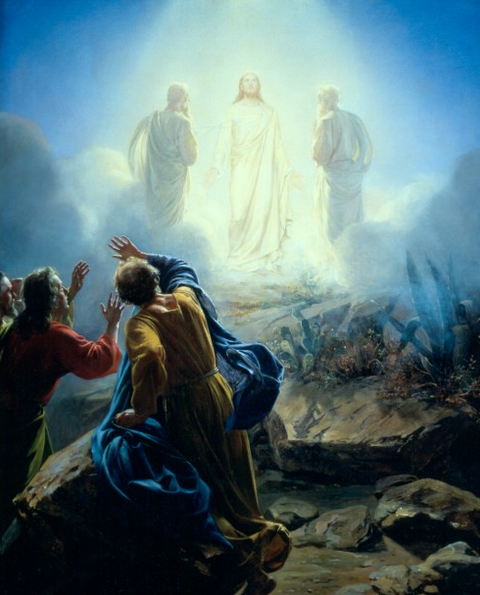
To Jesus' last journey to Jerusalem
In Gentile territory
The feeding of the four thousand
Peter's confession
Jesus' transfiguration
More miracles
More sayings

Slide 11
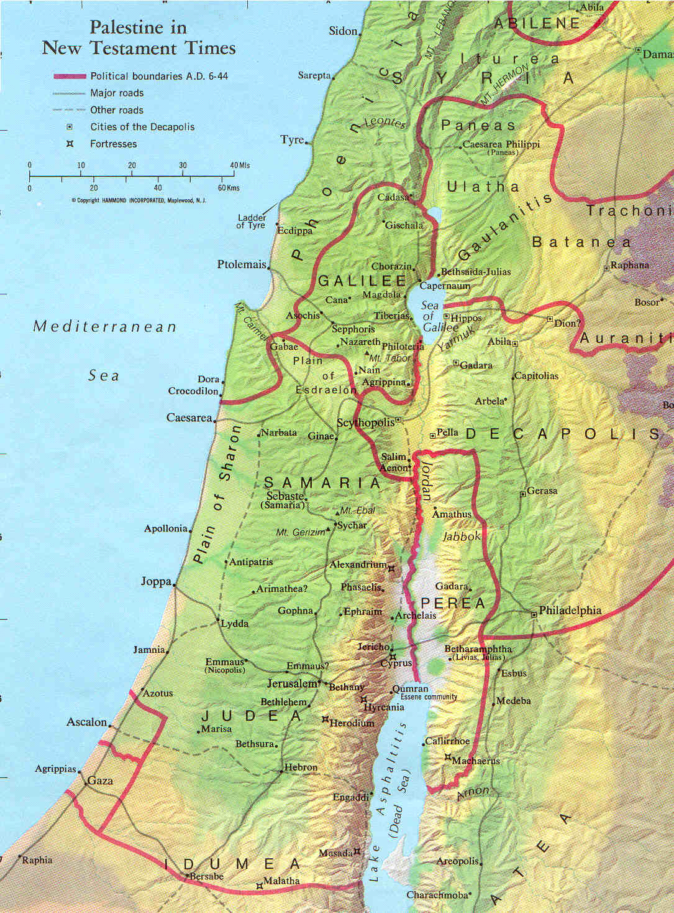
The Closing Period
Much from Luke's Perean Ministry section:
Moving toward Jerusalem
The journey into Jerusalem
The ministry in Jerusalem

Slide 12
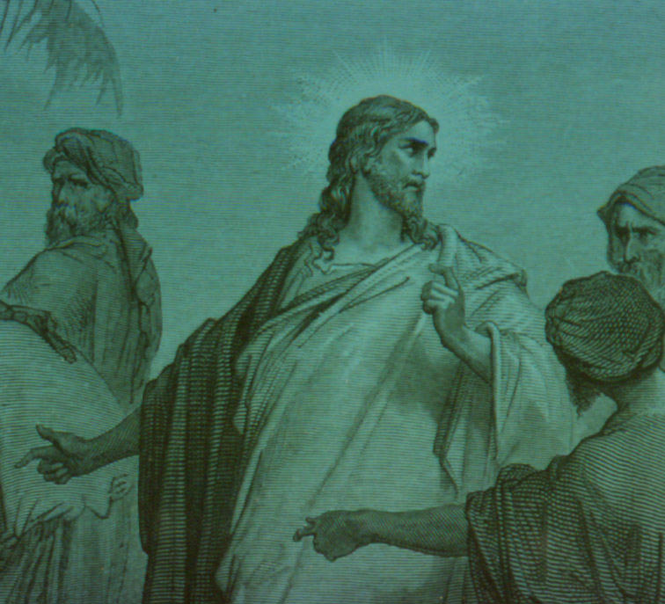
Moving toward Jerusalem
Galilee to Bethany
Some teaching on prayer
More teaching by parables
Encounters with Pharisees
Jesus at two Jewish feasts
Jesus dines with Pharisees
Address to the crowds

Slide 13
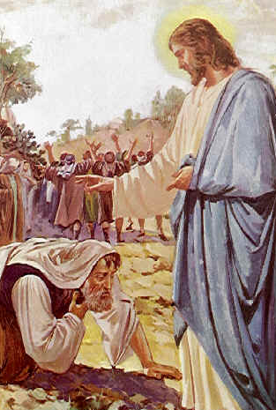
Moving toward Jerusalem
More parables for the Pharisees
Teaching for the disciples
Another clash with the Pharisees
Teaching about service
Healing the ten lepers
Sayings about the Kingdom & the future
Two parables on prayer
Raising of Lazarus

Slide 14
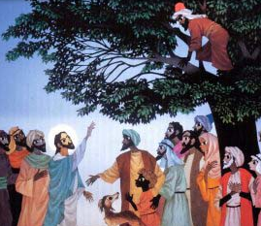
The journey into Jerusalem
Conclusion of Perean ministry
  Divorce, children, rich young ruler, vineyard workers
Jericho
  Blind man, Zacchaeus
Jesus at Bethany
  Anointing by Mary

Slide 15
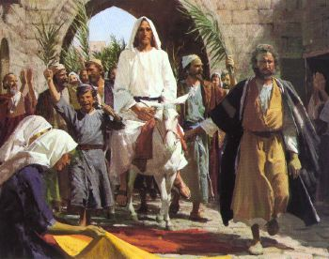
The ministry in Jerusalem
Triumphal entry
Fig tree cursed
Trying to trap Jesus
His Olivet discourse

Slide 16
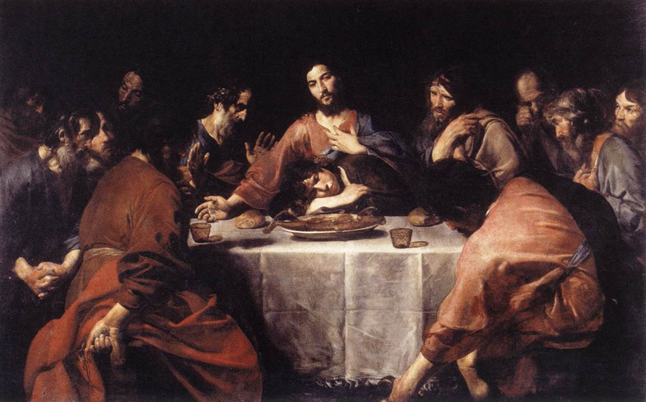
Jesus' Passion & Resurrection
Plot to kill Jesus
Last supper
Arrest in garden
Jesus’ trials
  Annas’ house
  Jewish trial
  Roman trial

Slide 17
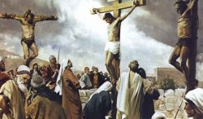
Jesus' Passion & Resurrection
On the way to the cross
  Simon of Cyrene, the women of Jerusalem
On the cross
  The inscription, thieves, soldiers, mocking, darkness, the temple veil, Jesus’ words
Jesus' burial
Jesus' resurrection

Slide 18
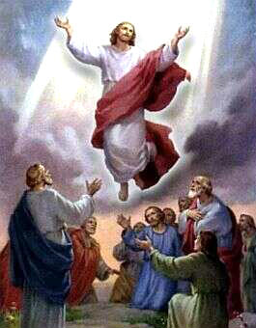
Not the end …
... because He lives!

