Slide 1
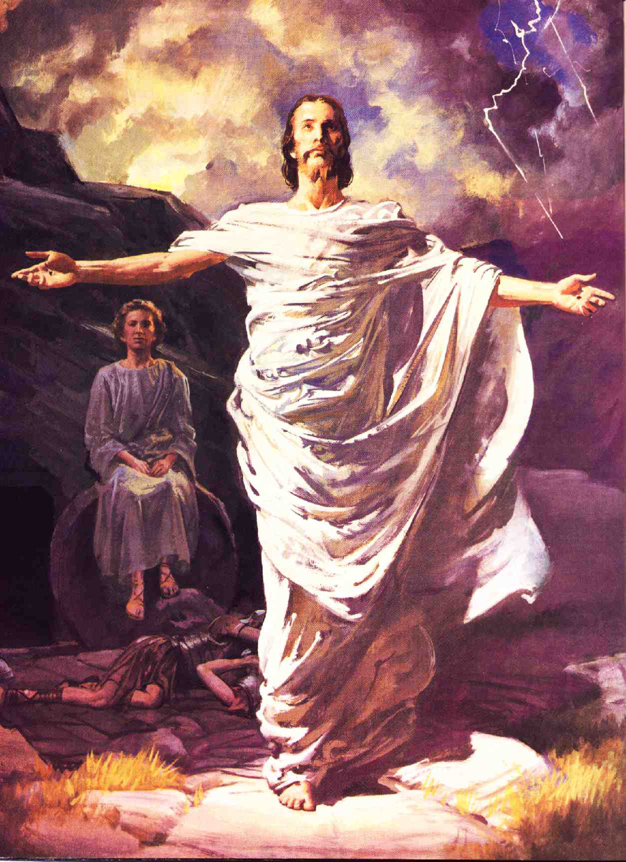

Jesus Lives!
Convincing
Evidence
Robert C. Newman

Slide 2
The Disciples Transformed
According to the Bible, on the third day after Jesus' death, his disciples were fearful & discouraged.
  John 20:19 (NIV) On the evening of that first day of the week… the disciples were together, with the doors locked for fear of the Jews…
But by the 50th day, they were risking their lives to speak out for him!
  Acts 2:14 (NIV) Then Peter stood up with the Eleven, raised his voice and addressed the crowd: "Fellow Jews and all of you who live in Jerusalem, let me explain this to you; listen carefully to what I say."

Slide 3
What Happened to Them?
According to the Bible, they were now convinced Jesus was alive:
  Acts 1:3 (NIV) After his suffering, he showed himself to these men and gave many convincing proofs that he was alive. He appeared to them over a period of forty days and spoke about the kingdom of God.
They were now empowered by the Holy Spirit:
  Acts 1:8 (NIV) But you will receive power when the Holy Spirit comes on you; and you will be my witnesses in Jerusalem, and in all Judea and Samaria, and to the ends of the earth.

Slide 4
Alternative Suggestions
Those who deny the miraculous have proposed other scenarios:
  Jesus' disciples stole his body.
  Jesus didn’t die on the cross, but only went into a coma.
  Jesus' disciples had hallucinations in which they saw him alive.
All these proposals have serious historical problems. See our other PowerPoint talk, "Evidence for the Resurrection."
Few recent historians doubt that the disciples thought Jesus had risen from the dead.

Slide 5
Many Convincing Evidences
The Bible presents a number of features regarding Jesus' resurrection that are convincing:
Many post-resurrection appearances
Appearances to many people at once
Multiple-sense appearances
Lengthy appearances
Appearances which convey teaching

Slide 6
Many Appearances
At least 11 appearances, perhaps 13, are recorded in the New Testament.
(1) To the women returning from the tomb (Matthew 28:9):
  Matt 28:8-10 (NIV) So the women hurried away from the tomb, afraid yet filled with joy, and ran to tell his disciples. 9 Suddenly Jesus met them. "Greetings," he said. They came to him, clasped his feet and worshiped him. 10 Then Jesus said to them, "Do not be afraid. Go and tell my brothers to go to Galilee; there they will see me."

Slide 7
Many Appearances
(2) to Mary Magdalene (John 20:11-17):
  John 20:11 (NIV) but Mary stood outside the tomb crying. As she wept, she bent over to look into the tomb 12 and saw two angels in white, seated where Jesus' body had been, one at the head and the other at the foot. 13 They asked her, "Woman, why are you crying?" "They have taken my Lord away," she said, "and I don't know where they have put him." 14 At this, she turned around and saw Jesus standing there, but she did not realize that it was Jesus. 15 "Woman," he said, "why are you crying? Who is it you are looking for?" Thinking he was the gardener, she said, "Sir, if you have carried him away, tell me where you have put him, and I will get him." 16 Jesus said to her, "Mary." She turned toward him and cried out in Aramaic, "Rabboni!" (which means Teacher). 17 Jesus said, "Do not hold on to me, for I have not yet returned to the Father. Go instead to my brothers and tell them, 'I am returning to my Father and your Father, to my God and your God.'"

Slide 8
Many Appearances
(3) to Peter (1 Cor 15:5; Lk 24:34):
  1Cor 15:3-5 (NIV) For what I received I passed on to you as of first importance: that Christ died for our sins according to the Scriptures, 4 that he was buried, that he was raised on the third day according to the Scriptures, 5 and that he appeared to Peter, and then to the Twelve.
  Luke 24:33-34 (NIV) They got up and returned at once to Jerusalem. There they found the Eleven and those with them, assembled together 34 and saying, "It is true! The Lord has risen and has appeared to Simon."

Slide 9
Many Appearances
(4) to two on the way to Emmaus (Luke 24:13-31):
  Luke 24:13 (NIV) Now that same day two of them were going to a village called Emmaus, about seven miles from Jerusalem. 14 They were talking with each other about everything that had happened. 15 As they talked and discussed these things with each other, Jesus himself came up and walked along with them; 16 but they were kept from recognizing him. 17 He asked them, "What are you discussing together as you walk along?" They stood still, their faces downcast. 18 One of them, named Cleopas, asked him, "Are you only a visitor to Jerusalem and do not know the things that have happened there in these days?" 19 "What things?" he asked. "About Jesus of Nazareth," they replied. "He was a prophet, powerful in word and deed before God and all the people. 20 The chief priests and our rulers handed him over to be sentenced to death, and they crucified him; 21 but we had hoped that he was the one who was going to redeem Israel. And what is more, it is the third day since all this took place. 22 In addition, some of our women amazed us. They went to the tomb early this morning 23 but didn't find his body. They came and told us that they had seen a vision of angels, who said he was alive. 24 Then some of our companions went to the tomb and found it just as the women had said, but him they did not see." 25 He said to them, "How foolish you are, and how slow of heart to believe all that the prophets have spoken! 26 Did not the Christ have to suffer these things and then enter his glory?" 27 And beginning with Moses and all the Prophets, he explained to them what was said in all the Scriptures concerning himself. 28 As they approached the village to which they were going, Jesus acted as if he were going farther. 29 But they urged him strongly, "Stay with us, for it is nearly evening; the day is almost over." So he went in to stay with them. 30 When he was at the table with them, he took bread, gave thanks, broke it and began to give it to them. 31 Then their eyes were opened and they recognized him, and he disappeared from their sight.

Slide 10
Many Appearances
(5) to ten apostles (1 Cor 15:5; Luke 24:36-48; John 20:19-23):
  John 20:19 (NIV) On the evening of that first day of the week, when the disciples were together, with the doors locked for fear of the Jews, Jesus came and stood among them and said, "Peace be with you!" 20 After he said this, he showed them his hands and side. The disciples were overjoyed when they saw the Lord. 21 Again Jesus said, "Peace be with you! As the Father has sent me, I am sending you." 22 And with that he breathed on them and said, "Receive the Holy Spirit. 23 If you forgive anyone his sins, they are forgiven; if you do not forgive them, they are not forgiven."

Slide 11
Many Appearances
(6) to 11 apostles the next week (John 20:26-29):
  John 20:26 (NIV) A week later his disciples were in the house again, and Thomas was with them. Though the doors were locked, Jesus came and stood among them and said, "Peace be with you!" 27 Then he said to Thomas, "Put your finger here; see my hands. Reach out your hand and put it into my side. Stop doubting and believe." 28 Thomas said to him, "My Lord and my God!" 29 Then Jesus told him, "Because you have seen me, you have believed; blessed are those who have not seen and yet have believed."

Slide 12
Many Appearances
(7) to 7 disciples on the shore of Galilee (John 21:1-22):
  John 21:1 (NIV) Afterward Jesus appeared again to his disciples, by the Sea of Tiberias. It happened this way: 2 Simon Peter, Thomas (called Didymus), Nathanael from Cana in Galilee, the sons of Zebedee, and two other disciples were together. 3 "I'm going out to fish," Simon Peter told them, and they said, "We'll go with you." So they went out and got into the boat, but that night they caught nothing. 4 Early in the morning, Jesus stood on the shore, but the disciples did not realize that it was Jesus. 5 He called out to them, "Friends, haven't you any fish?" "No," they answered. 6 He said, "Throw your net on the right side of the boat and you will find some." When they did, they were unable to haul the net in because of the large number of fish. 7 Then the disciple whom Jesus loved said to Peter, "It is the Lord!" As soon as Simon Peter heard him say, "It is the Lord," he wrapped his outer garment around him (for he had taken it off) and jumped into the water. 8 The other disciples followed in the boat, towing the net full of fish, for they were not far from shore, about a hundred yards.9 When they landed, they saw a fire of burning coals there with fish on it, and some bread. 10 Jesus said to them, "Bring some of the fish you have just caught." 11 Simon Peter climbed aboard and dragged the net ashore. It was full of large fish, 153, but even with so many the net was not torn. 12 Jesus said to them, "Come and have breakfast." None of the disciples dared ask him, "Who are you?" They knew it was the Lord. 13 Jesus came, took the bread and gave it to them, and did the same with the fish. 14 This was now the third time Jesus appeared to his disciples after he was raised from the dead. 15 When they had finished eating, Jesus said to Simon Peter, "Simon son of John, do you truly love me more than these?"

Slide 13
Many Appearances
(8) to 11 on a mountain in Galilee (Matthew 28:16; = 1 Cor 15:6?):
  Matt 28:16 (NIV) Then the eleven disciples went to Galilee, to the mountain where Jesus had told them to go. 17 When they saw him, they worshiped him; but some doubted. 18 Then Jesus came to them and said, "All authority in heaven and on earth has been given to me…"
  1Cor 15:6 (NIV) After that, he appeared to more than five hundred of the brothers at the same time, most of whom are still living, though some have fallen asleep.

Slide 14
Many Appearances
(9) to James (1 Cor 15:7):
  1Cor 15:7 (NIV) Then he appeared to James, then to all the apostles…
(10) to the apostles in Jerusalem at a meal (Acts 1:4-5):
  Acts 1:4 (NIV) On one occasion, while he was eating with them, he gave them this command: "Do not leave Jerusalem, but wait for the gift my Father promised, which you have heard me speak about. 5 For John baptized with water, but in a few days you will be baptized with the Holy Spirit."

Slide 15
Many Appearances
(11) to the apostles at his ascension (1 Cor 15:7; Luke 24:49-51; Acts 1:6-9):
  Acts 1:6 (NIV) So when they met together, they asked him, "Lord, are you at this time going to restore the kingdom to Israel?" 7 He said to them: "It is not for you to know the times or dates the Father has set by his own authority. 8 But you will receive power when the Holy Spirit comes on you; and you will be my witnesses in Jerusalem, and in all Judea and Samaria, and to the ends of the earth." 9 After he said this, he was taken up before their very eyes, and a cloud hid him from their sight.

Slide 16
Many Appearances
(12) to Paul, on the road to Damascus (1 Cor 15:8; three times in Acts 9, 22, 26):
  1Cor 15:8 (NIV) and last of all he appeared to me also, as to one abnormally born. 9 For I am the least of the apostles and do not even deserve to be called an apostle, because I persecuted the church of God.
  Paul in Acts three times narrates how this appearance of the risen Jesus turned his whole life around.

Slide 17
Appearances to Many at Once
(1) to several women returning from the tomb
(5), (6), (7) to groups of apostles
(8) to more than 500 on a single occasion
(10), (11) to groups of apostles

Slide 18
Multiple-Sense Appearances
All the appearances listed involve seeing Jesus.
All of them involve hearing him speak.
In (1) and (5), possibly (2), and perhaps on other occasions, the disciples touched Jesus.
In (5), and probably (7) and (10), Jesus eats food in their presence.

Slide 19
Lengthy Appearances
In (4) Jesus walks with two disciples for several miles, and waits while food is being prepared. This appearance probably lasted an hour or so.
In (5), Jesus eats some food and explains a number of Bible passages to the apostles.
In (7), the disciples drag the boat ashore, count the fish, cook some of them and eat them.
At least on these three occasions, Jesus’ appearances probably lasted an hour or more.

Slide 20
Appearances which convey teaching
Twice Jesus explains Scripture to his disciples (on the way to Emmaus, afterwards in Jerusalem).
These sessions are probably the sources of the Old Testament interpretations that see Jesus as the fulfillment of messianic prophecy which the various NT writers give us in their writings.

Slide 21
Conclusions
Jesus’ disciples were crushed by his death.
It was necessary for him to convince his followers that he had risen from the dead.
He did! They were later willing to risk death for his sake.
The New Testament gives us sufficient evidence that the apostles must be true witnesses, liars, or fools; there is no real fourth alternative.
Do you need to be convinced he is living?
  John 7:17 (NIV) If anyone chooses to do God's will, he will find out whether my teaching comes from God or whether I speak on my own.

Slide 22
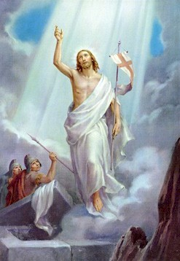
The End
May you encounter the living Jesus!

