Slide 1

Israel: Evidence of God in History
Robert C. Newman

Slide 2
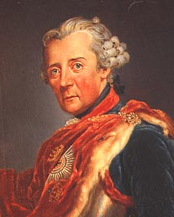
Evidence for God?
Frederick the Great (1712-86), a skeptic, once asked his chaplain, "Can you give me any good evidence that God exists?"
The chaplain answered, "Yes, the Jews!"
Here we unpack the chaplain's answer.

Slide 3
The Prophecies
Moses' Blessings & Curses
(about 1400 BC)

Slide 4
The Blessings – Leviticus 26
If you follow my decrees and are careful to obey my commands, I will send you rain in its season, and the ground will yield its crops and the trees of the field their fruit. Your threshing will continue until grape harvest and the grape harvest will continue until planting, and you will eat all the food you want and live in safety in your land.
I will grant peace in the land, and you will lie down and no one will make you afraid… (verses 3-13)

Slide 5
The Curses – Leviticus 26
But if you will not listen to me and carry out all these commands… then I will do this to you: I will bring upon you sudden terror, wasting diseases and fever that will destroy your sight and drain away your life. You will plant seed in vain, because your enemies will eat it. I will set my face against you so that you will be defeated by your enemies; those who hate you will rule over you, and you will flee even when no one is pursuing you…. If after all this you do not listen to me, I will punish you for your sins seven times over… (verses 14-46)

Slide 6
The Curses – Deuteronomy 28
Just as it pleased the LORD to make you prosper and increase in number, so it will please him to ruin and destroy you. You will be uprooted from the land you are entering to possess.
Then the LORD will scatter you among all the nations, from one end of the earth to the other…. Among the nations you will find no repose, no resting place for the sole of your foot… (verses 63-68)

Slide 7
The Curses – Leviticus 26
But if they confess their sins… I will remember my covenant with Jacob,… and I will remember the land. For the land will be deserted by them and will enjoy its sabbaths while it lies desolate without them…. Yet in spite of this, when they are in the land of their enemies, I will not reject them or abhor them so as to destroy them completely, breaking my covenant with them…. But for their sake I will remember the covenant with their ancestors whom I brought out of Egypt… (verses 40-45)

Slide 8
The Prophecies
The Writing Prophets
(about 700 BC)

Slide 9
Israel to Be Regathered
In that day the LORD will reach out his hand a second time to reclaim the remnant that is left of his people, from Assyria, from Lower Egypt, from Upper Egypt, from Cush, from Elam, from Babylonia, from Hamath, and from the islands of the sea. (Isaiah 11:11-15)

Slide 10
Israel's History Characterized
For the Israelites shall live many days without king or prince, without sacrifice or sacred stones, without ephod or idol. Afterward the Israelites will return and seek the LORD their God and David their king. They will come trembling to the LORD and to his blessings in the last days. (Hosea 3:4-5)

Slide 11
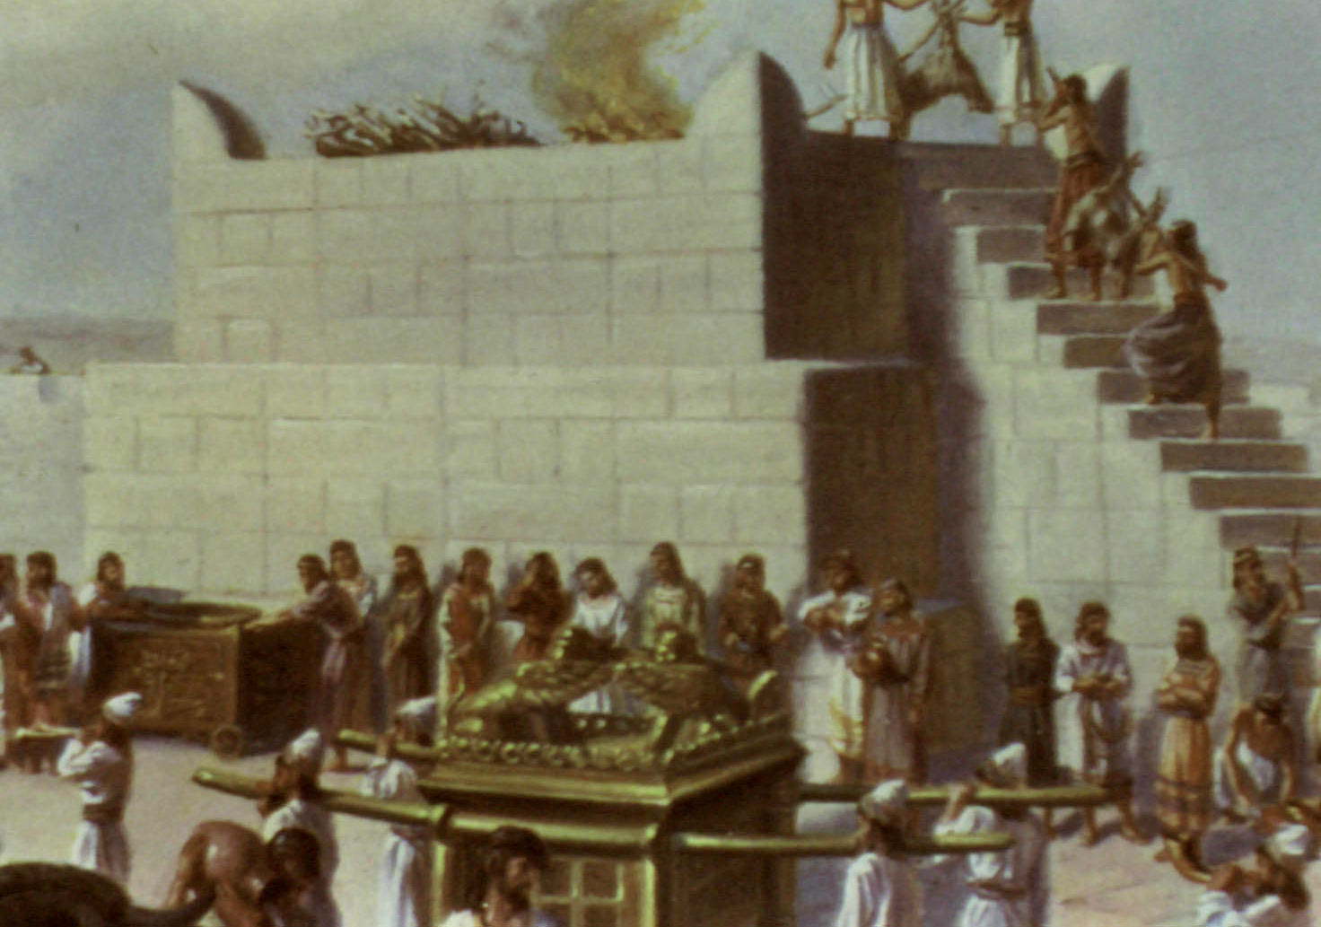
Without Sacrifice
The altar at the Jerusalem temple

Slide 12
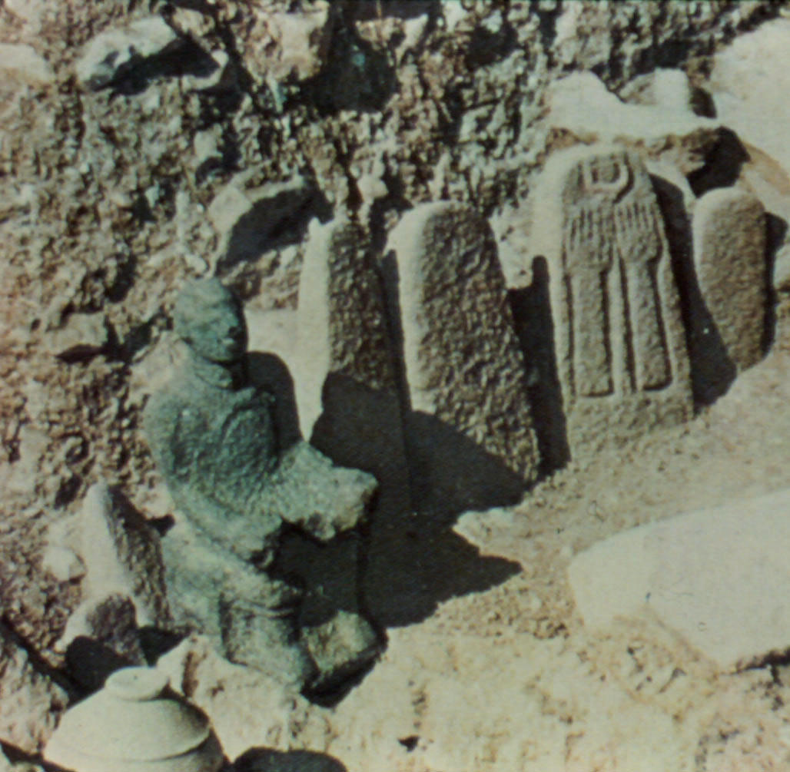
Without Sacred Stones
Canaanite
Sacred
Pillars

Slide 13
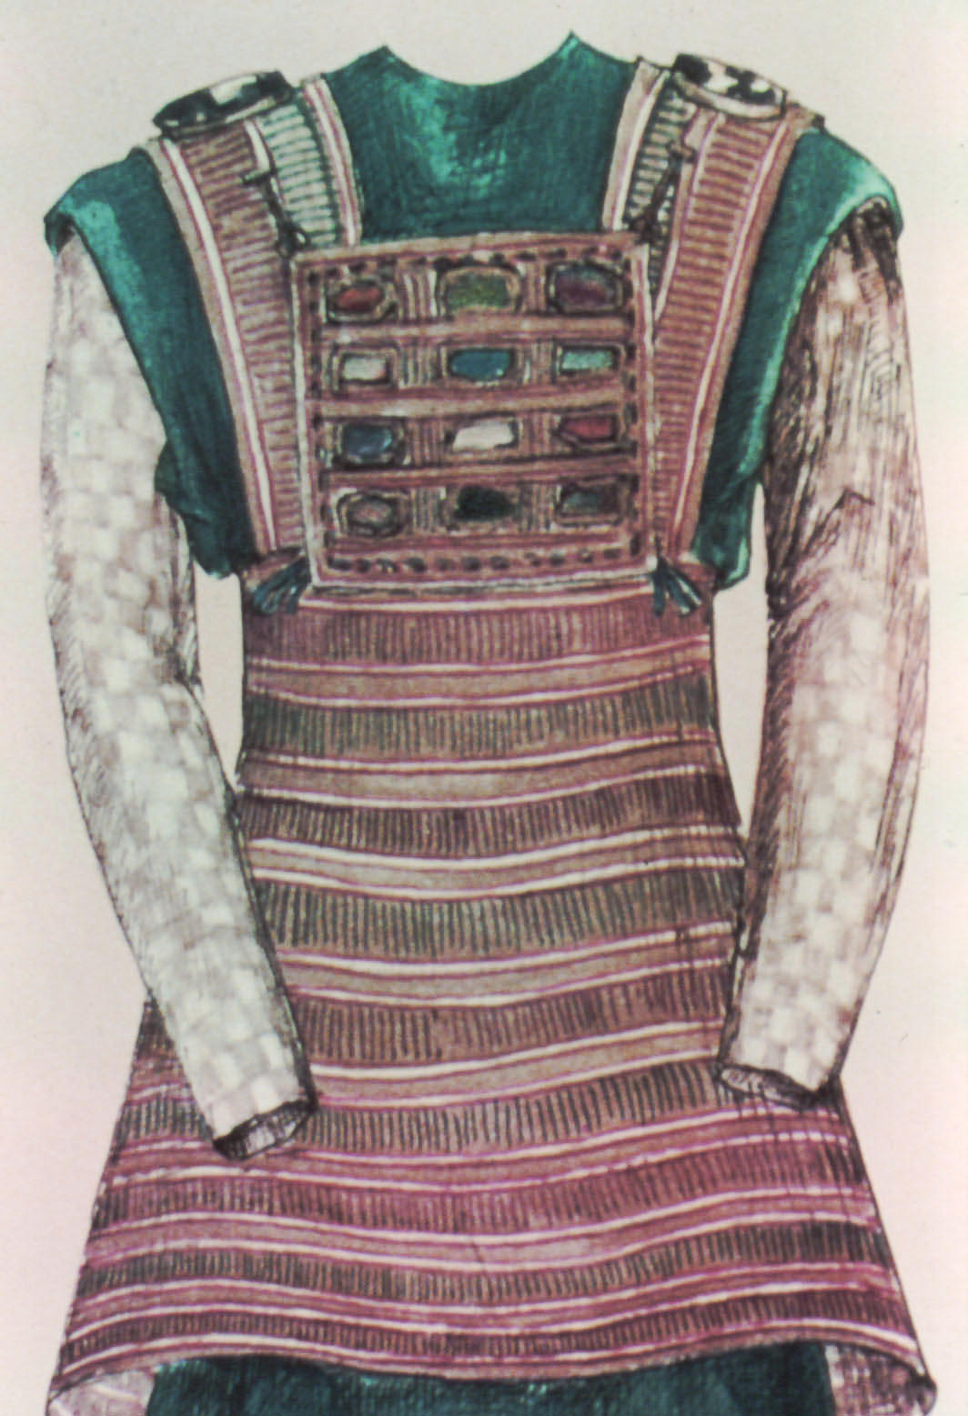
Without Ephod
Artist's conception of the high priest’s garments, including the ephod.

Slide 14
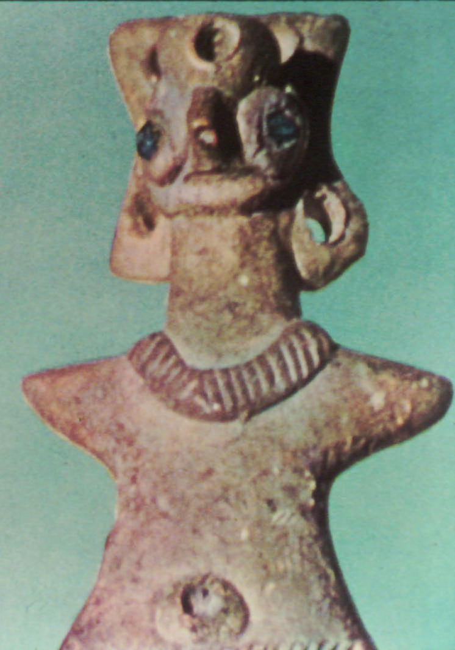
Without Idols
Literally "teraphim," which refers to household idols

Slide 15
The Prophecies
Jesus
(about AD 30)

Slide 16
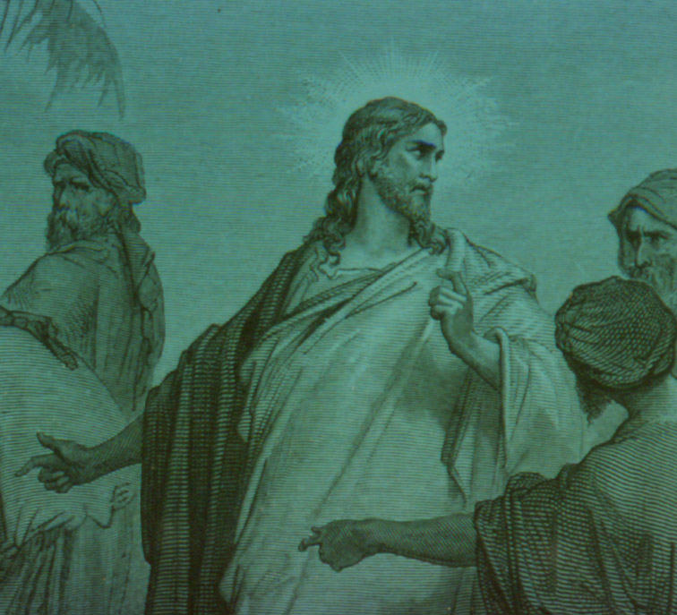
Acceptance & Rejection
I have come in my Father’s name, and you do not accept me; but if someone else comes in his own name, you will accept him. How can you believe if you accept praise from one another, yet make no effort to obtain the praise that comes from the only God? (John 5:43)

Slide 17
The Fulfillments
931 BC to the present

Slide 18
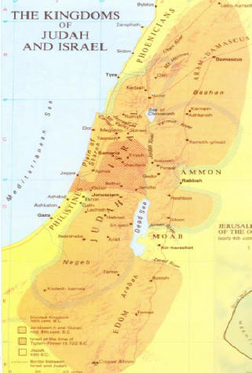
Israel Divided – 931 BC
After three centuries as a league of 12 tribes, followed by a century as a united kingdom, the nation splits in two.
Israel (Ephraim) the northern kingdom, rejects the rule of David’s family and remodels its religion.
Judah the southern kingdom continues with Davidic kings, Jerusalem temple and Levitical priests.
ISRAEL
JUDAH

Slide 19
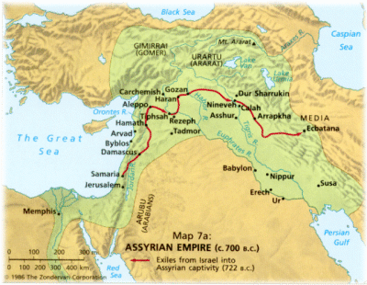
Rise of Assyria
Meanwhile, Assyria, to the East, develops an aggressive empire which reaches the Mediterranean coast.
Using great cruelty to terrorize their opponents, they overrun the nations in spite of coalitions against them.
Assyrian Empire

Slide 20
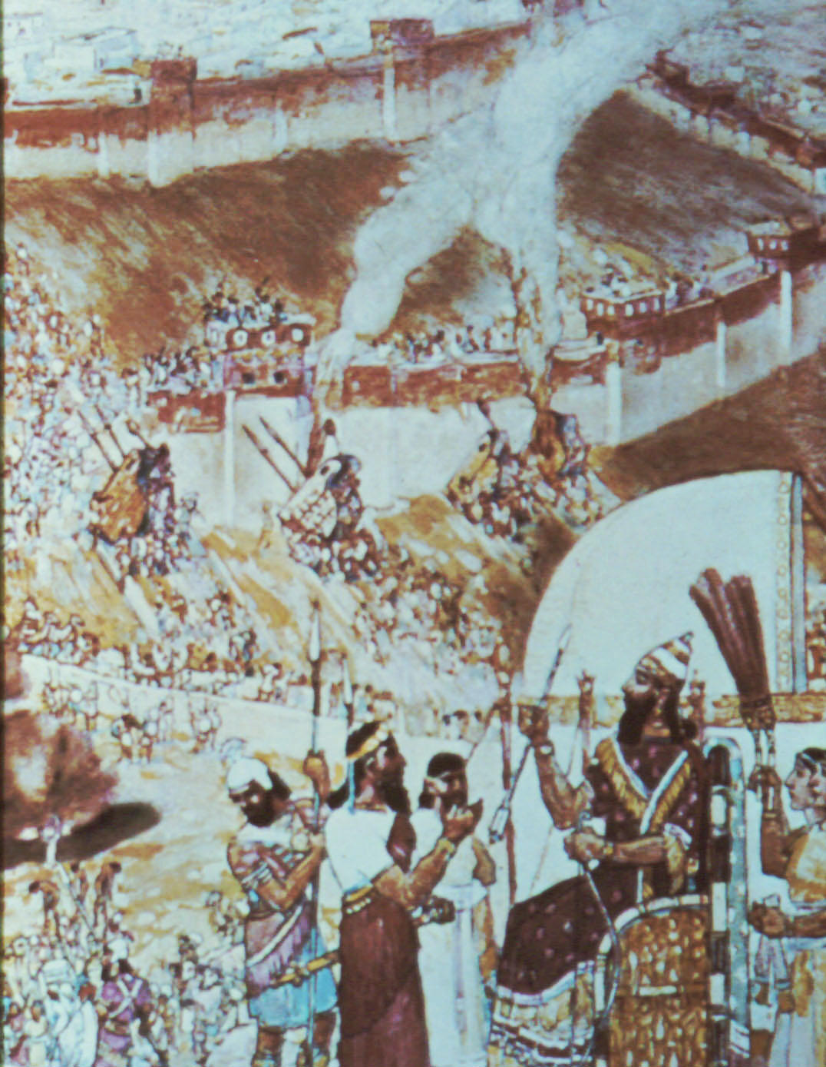
Fall of Israel – 722 BC
Samaria, the capital of the Northern Kingdom, is taken, and its survivors exiled.
Since then, only a minority of Israelites have lived in the land.
Surprisingly, the Southern Kingdom survives, though much reduced, when the Assyrians are unable to take Jerusalem.

Slide 21
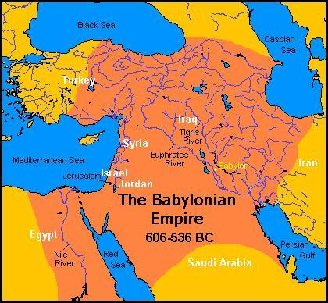
Rise of Babylon
In 612 BC, the Babylonians take Nineveh, destroying the Assyrian Empire.
Shortly thereafter, the Babylonians under Nebuchadnezzar reach the Mediterranean coast.
They make Judah a subject kingdom in 606.

Slide 22
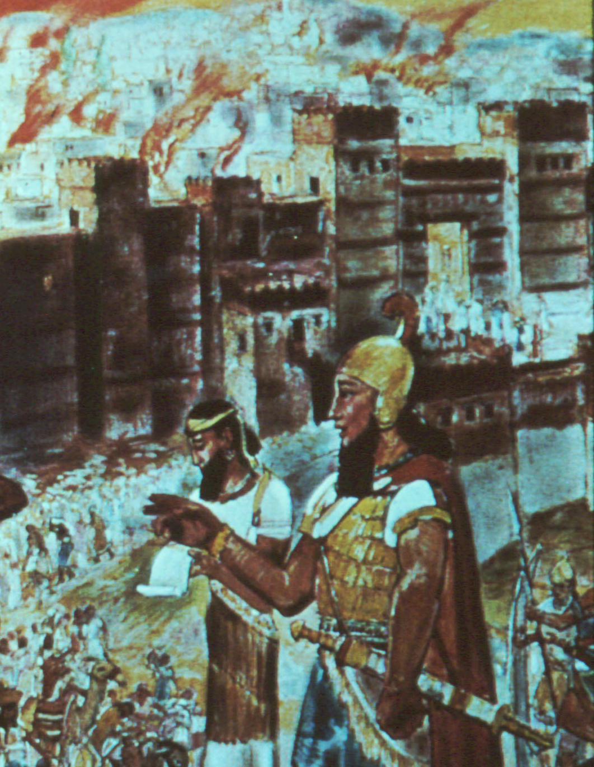
Fall of Judah – 587 BC
Judah rebels against Nebuchadnezzar twice.
The second time Jerusalem is destroyed.
The captives are taken to Babylon and the kingship ends.
The temple, built by Solomon nearly 400 years earlier, is leveled.

Slide 23
Return from Babylon – 537 BC
When the Babylonian Empire is taken by the Persians, the Jews are allowed to return home.
Only a few return.
This Babylonian captivity is traditionally counted as lasting 70 years, from 1st exile to 1st return, or from the destruction of the temple to its rebuilding.

Slide 24
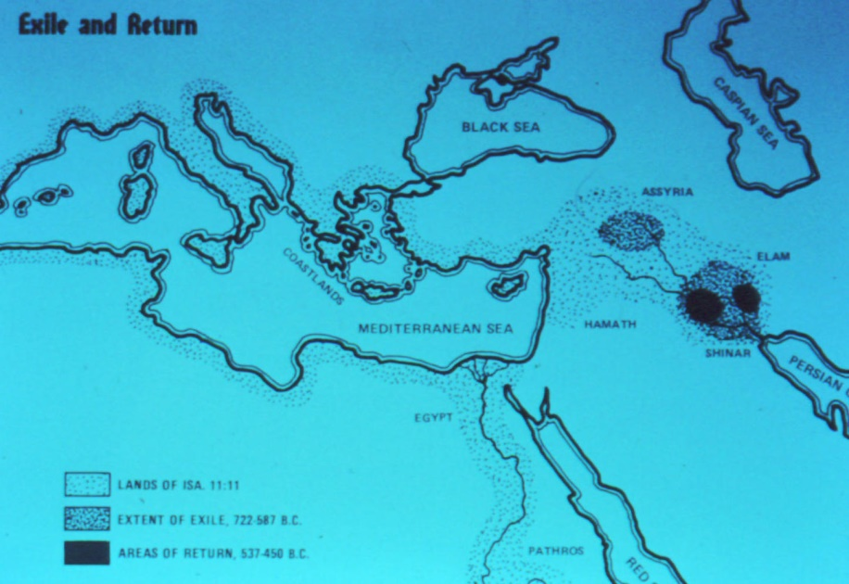
Isaiah 11:11 Fulfilled Yet?
Doesn’t look like it. The 537 return is only from a small region, not the large area predicted by Isaiah.
Nor does it appear that Hosea 3 is fulfilled yet, as Jeconiah is called “king” during his captivity and the priesthood is preserved, though its functions are interrupted.
537 Return

Slide 25
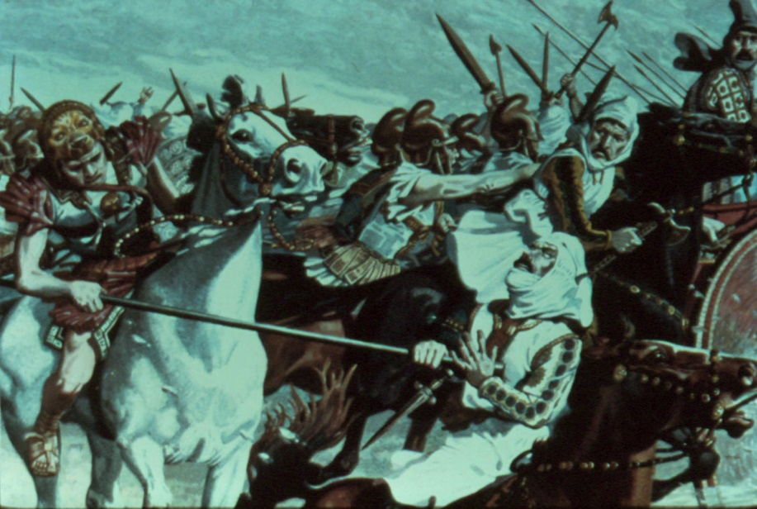
Alexander the Great – 332 BC
The Persian Empire (which replaced the Babylonian) is conquered by Alexander.
He swept across Asia Minor (now Turkey) in just a year, destroyed 3 large armies, and eventually took territory all the way to India before dying at age 33.

Slide 26
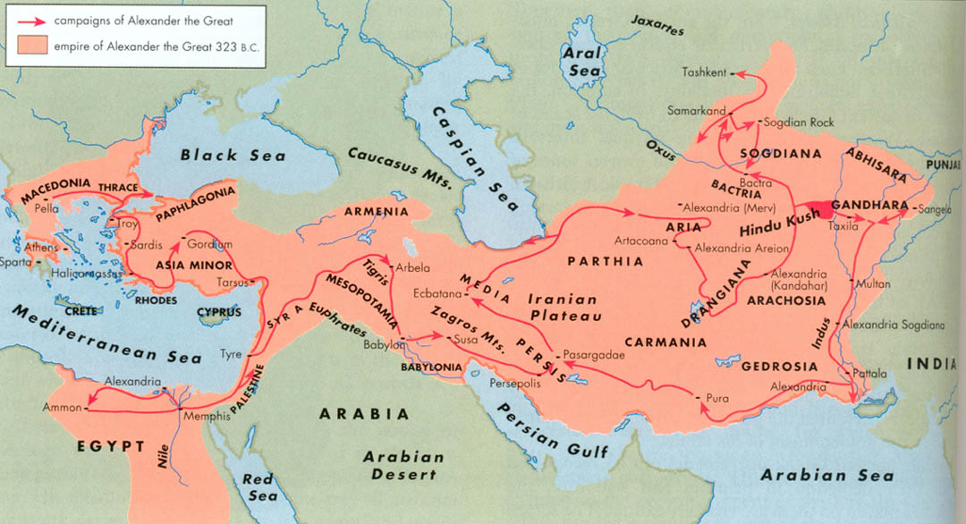
Alexander's Empire
Alexander treated the Jews well. According to Josephus, this was because they showed him a prophecy about himself from Daniel.
After his early death, his empire was split into pieces by his feuding generals.

Slide 27
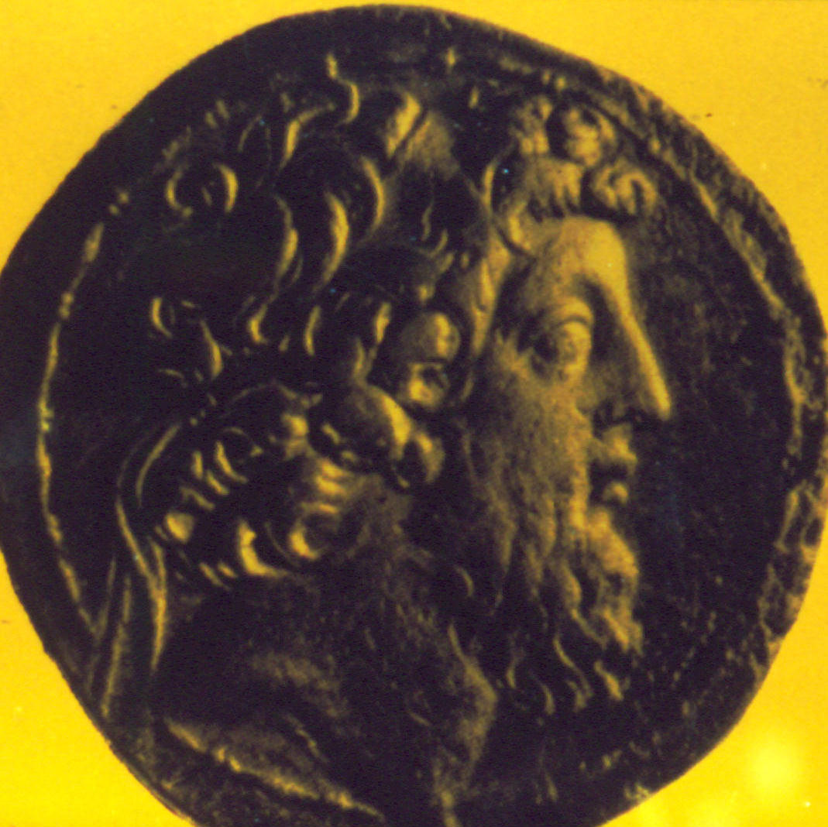
Antiochus Epiphanes
One of these generals, Seleucus, founds a dynasty that eventually controls Judea.
One of his descendants, Antiochus 4, considers himself a manifestation of Zeus, and tries to destroy Judaism.
Miraculously, the Jews are able to stop Antiochus and win their freedom under the Maccabees.

Slide 28
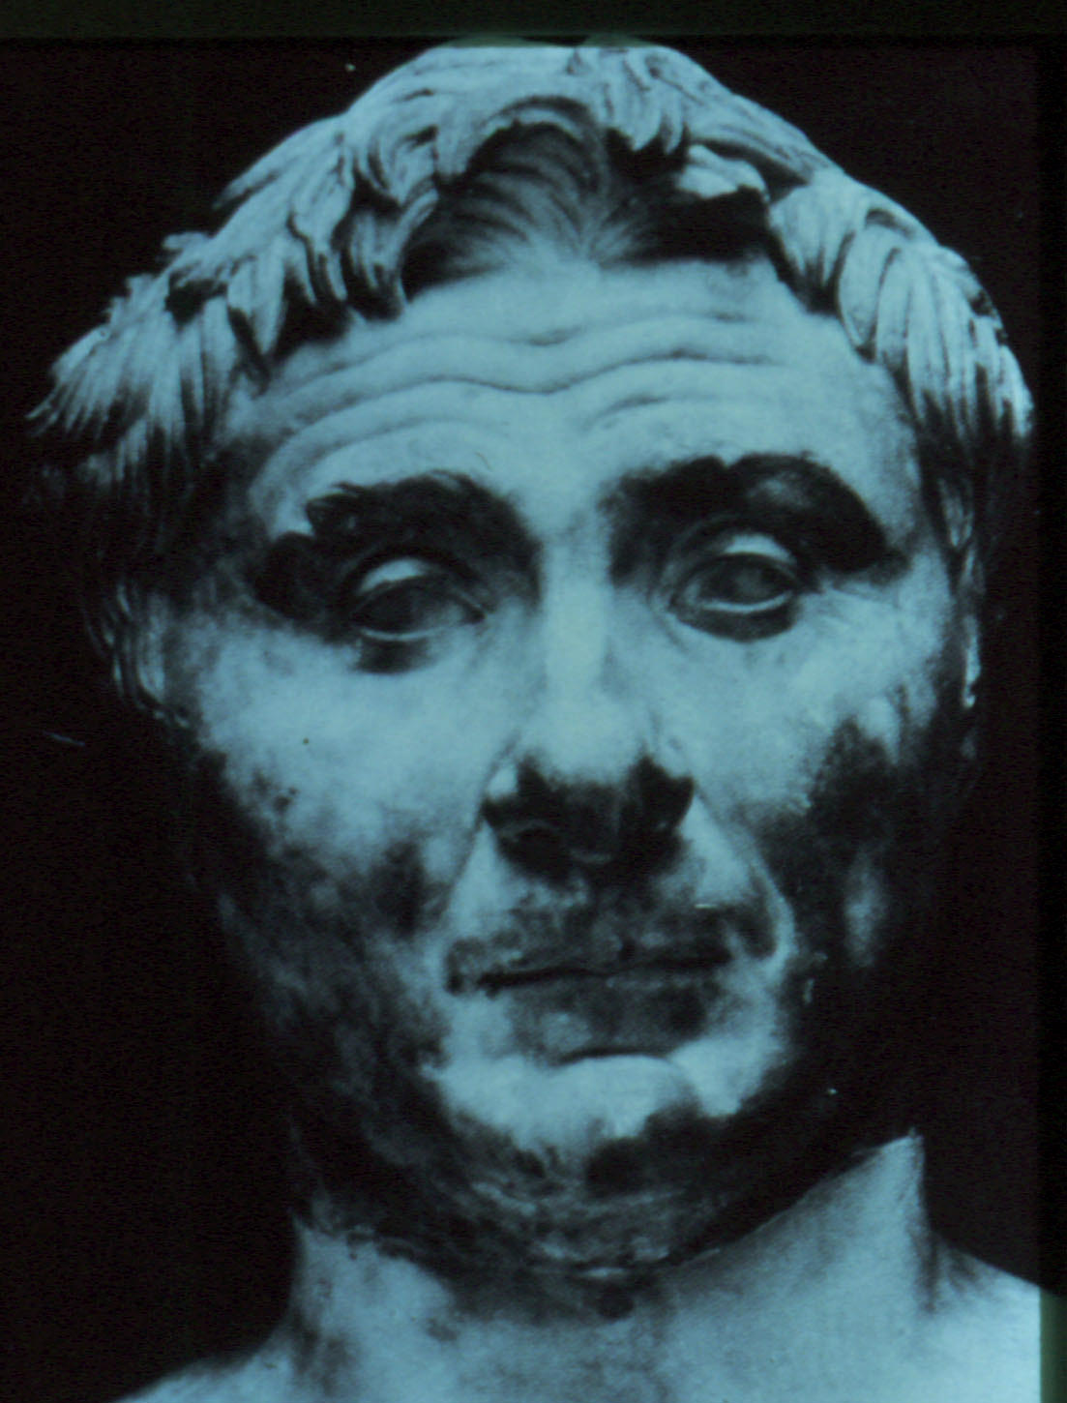
The Coming of Rome
The Jews are able to keep their freedom for less than a century.
Two of the Maccabean descendants fall to fighting over who will rule, and Rome intervenes.
The Triumvir Pompey sides with one of them, takes Jerusalem, and the Jews become vassals of Rome.

Slide 29
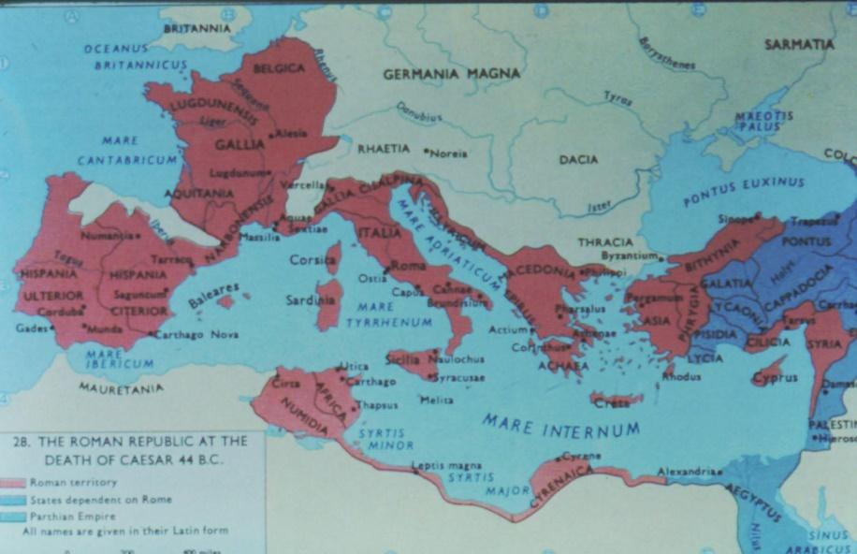
Roman Empire
The Romans eventually conquer all the Mediterranean coast, and Judea is one of their provinces.
The Romans, as pagans worshiping many gods, cannot understand or appreciate the Jewish worship of one God without images.
This leads to a growing tension between them.
Roman
Empire

Slide 30
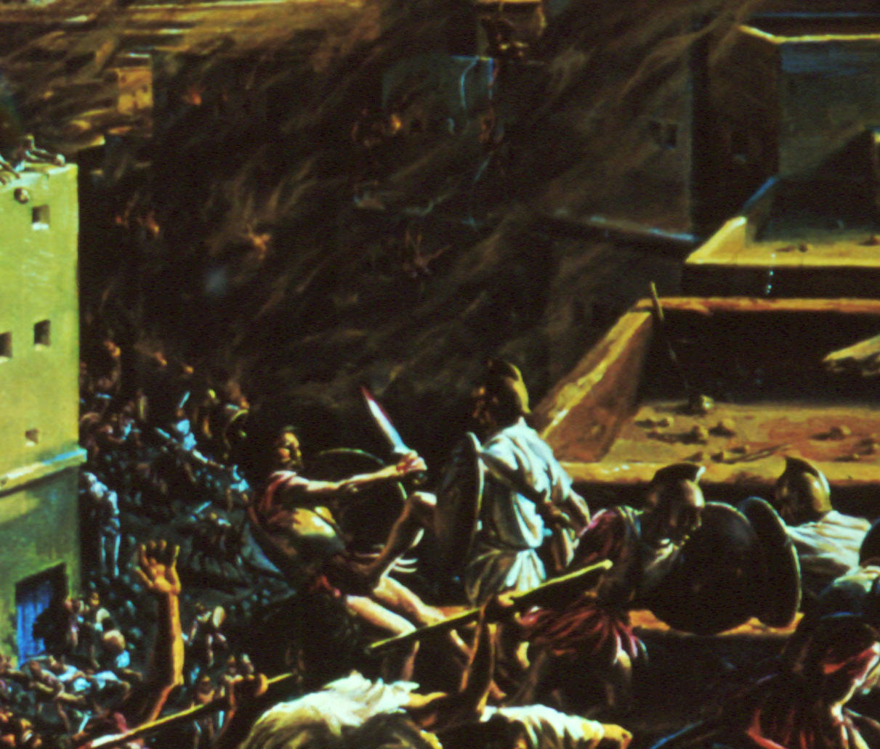
The Roman-Jewish War
In 66 AD, the Jews revolt against Roman oppression; initially they are successful.
But the Romans bring in more legions, take the outlying areas, and besiege Jerusalem.
In August of 70 AD, the city is taken.

Slide 31
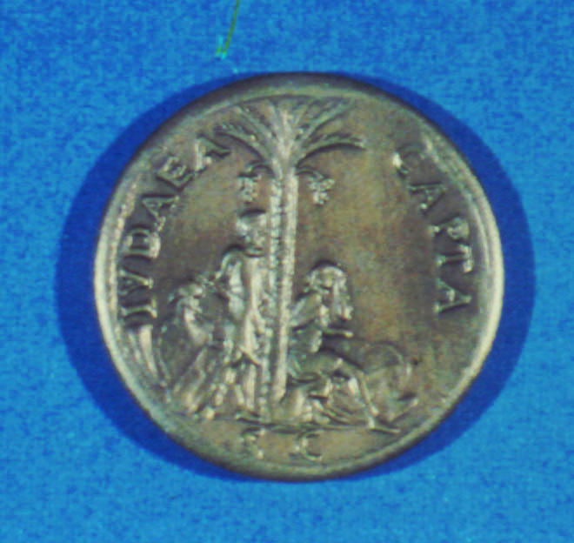
Destruction of the Jewish State
Over one million Jews die in the war & siege.
The rest are sold into slavery, glutting the slave market, as Moses predicted in Deut 28:68.
The final resistance is put down at Masada in 73 AD.
The Romans mint coins to commemorate their victory.

Slide 32
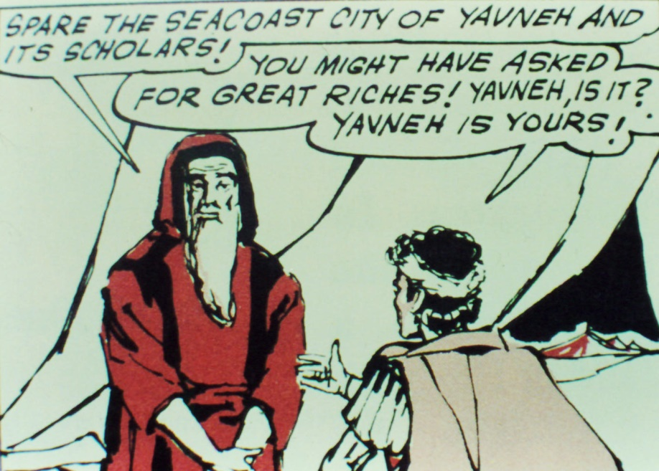
Rabbinic Judaism Survives
Rabbi Johannan ben Zakkai escapes Jerusalem & surrenders to the Romans.
He is given permission to continue his rabbinic school in Jamnia on the coast.
Thus rabbinic Judaism (the Pharisees) survives the destruction, but the Sadducees don’t.

Slide 33
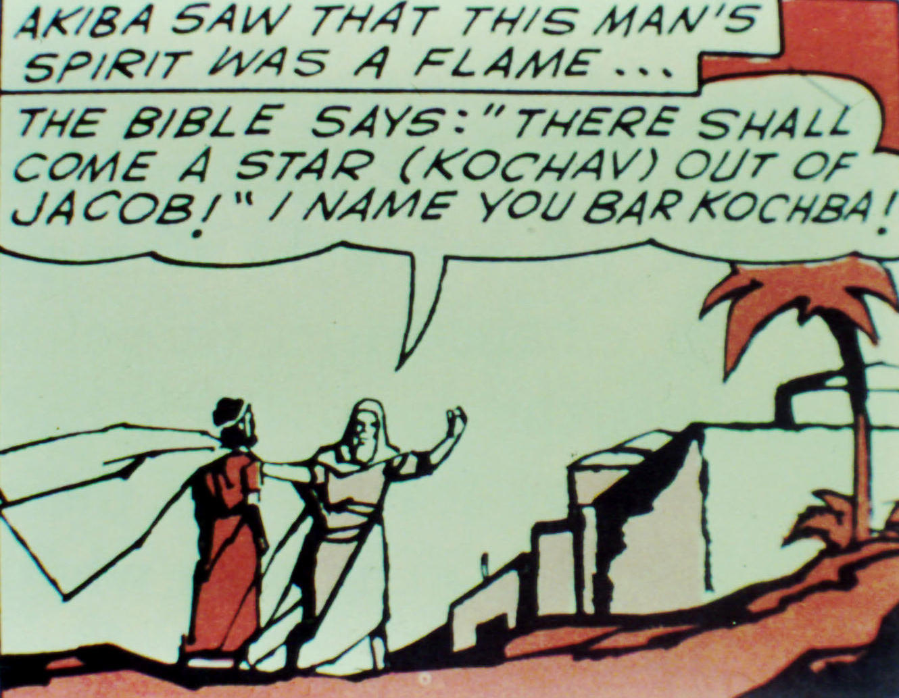
Bar-Kochba Rebellion
In 132 AD, the Romans decide to found a pagan city on the site of Jerusalem.
Simeon ben Kosiba organizes a revolt to oppose this.
Rabbi Akiba recognizes Simeon as the Messiah, with the title “Bar Kochba.”

Slide 34
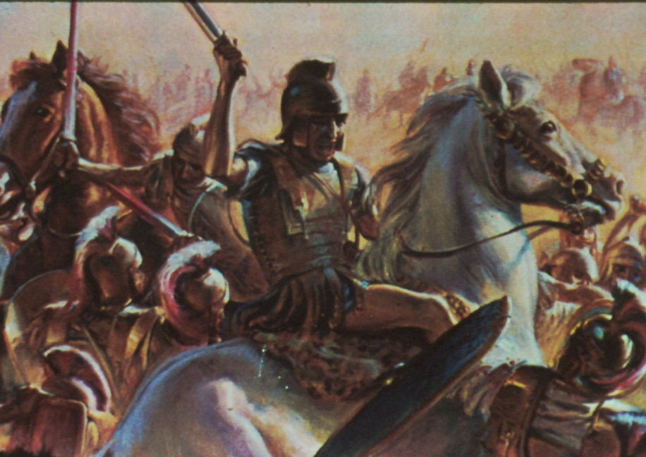
Jewish Defeat
Again, after some initial success, the Jews are defeated by Rome.
Bar-Kochba & Akiba are both put to death.
Jews are forbidden to come within 10 miles of Jerusalem on pain of death, except on Yom Kippur.
The Holy Land is increasingly populated by non-Jews.

Slide 35
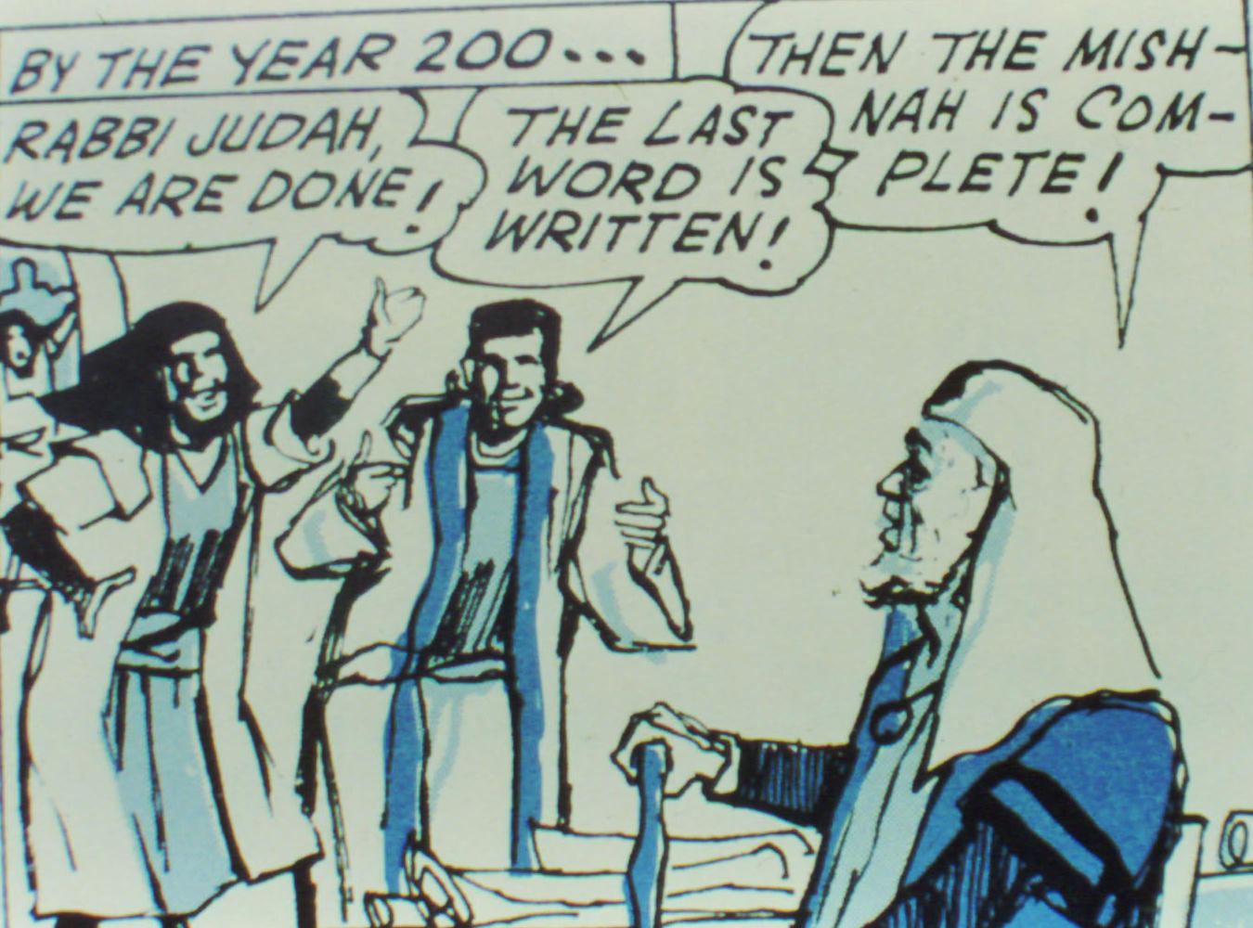
Completion of the Mishnah
About 200 AD, a written digest of the rabbinic oral tradition is completed.
This is important in preserving rabbinic Judaism, the basis for modern orthodox Judaism.
It also marks an early justification for how Judaism will function without temple and sacrifice.

Slide 36
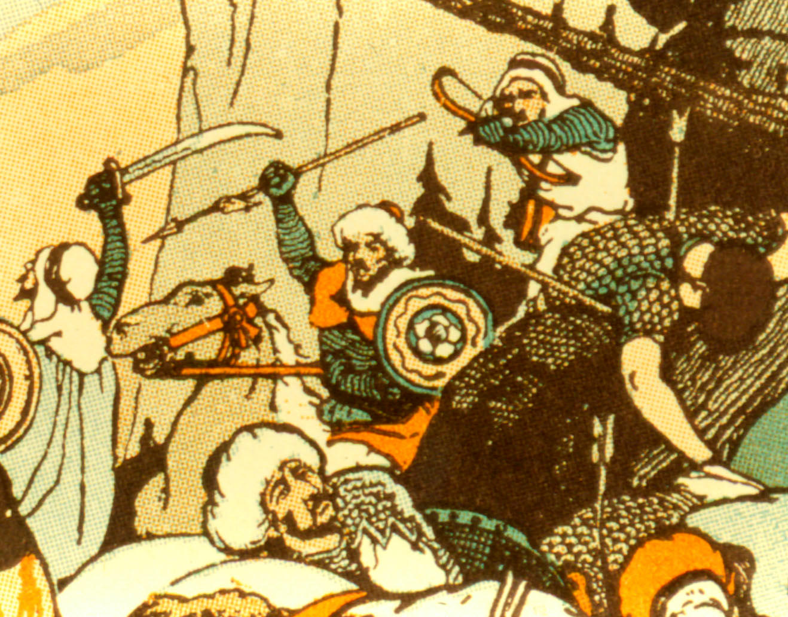
Rise of Islam
In Arabia, Muhammad claimed to be a prophet, and gathered followers who spread his message by military evangelism.
Jerusalem was taken in 638, and was held by them (except during the Crusades) into the 20th century.

Slide 37
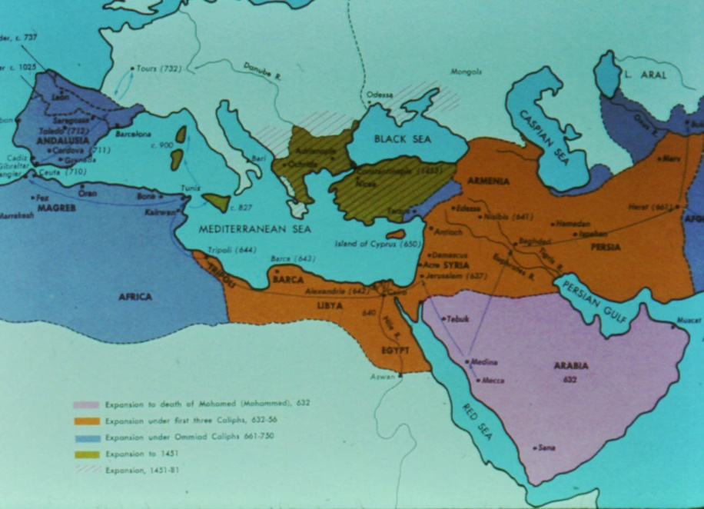
Muslim Empire
Islam spread rapidly thru the Middle East and N Africa, eventually into Europe & the Far East.
Sometimes Jews & Christians were killed outright, but usually they were allowed to live as 2nd class citizens.
Muslim Empire

Slide 38
Review at 1000 AD
By this time, the Jews had been without a homeland for nearly a thousand years.
Yet they continued to exist as a people, scattered though they were, not being assimilated into the surrounding nations.
They had followed false Messiahs on at least two occasions, during the revolts against Rome.
They are without king or prince, sacrifice or sacred stone, ephod or idols, since about 70 AD, and with no sign they would return to their land.

Slide 39
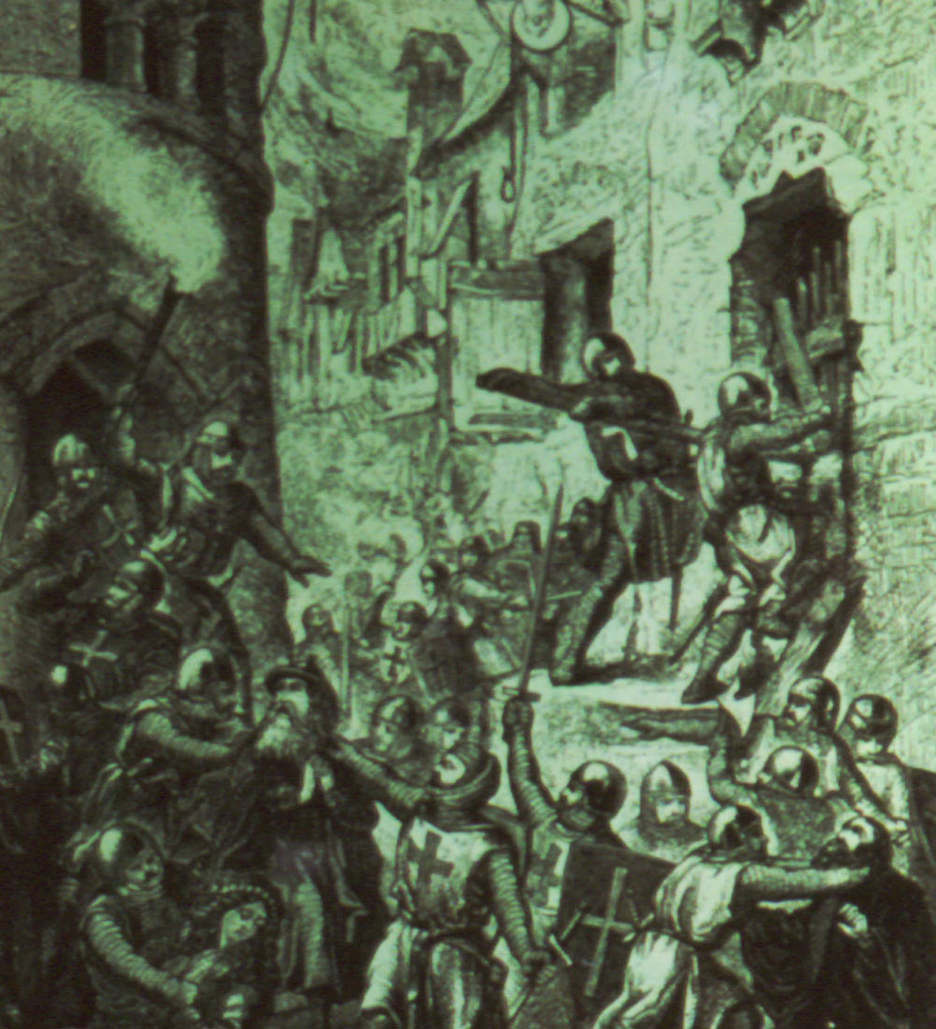
The Crusades
These wars by Christians to rescue the Holy Land from the Muslims were a terror for the Jews.
The Jews tended to be treated as enemies just like the Muslims.
Many Jews were killed in Europe & the Middle East during the 10th-12th centuries.

Slide 40
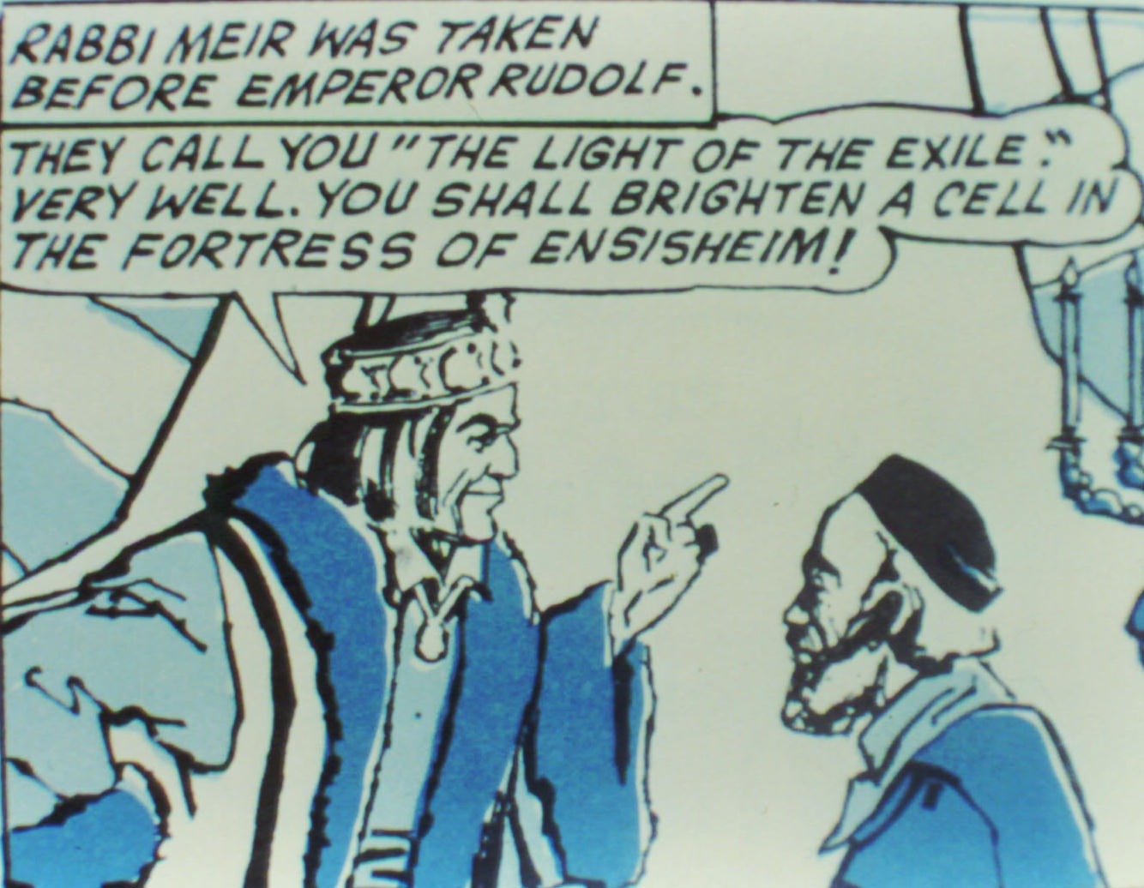
Jews in Europe
Jews often faced extortion in Europe.
The Holy Roman Emperor held Rabbi Meir for ransom.
Meir died in prison rather than let his Jewish friends pay his ransom.

Slide 41
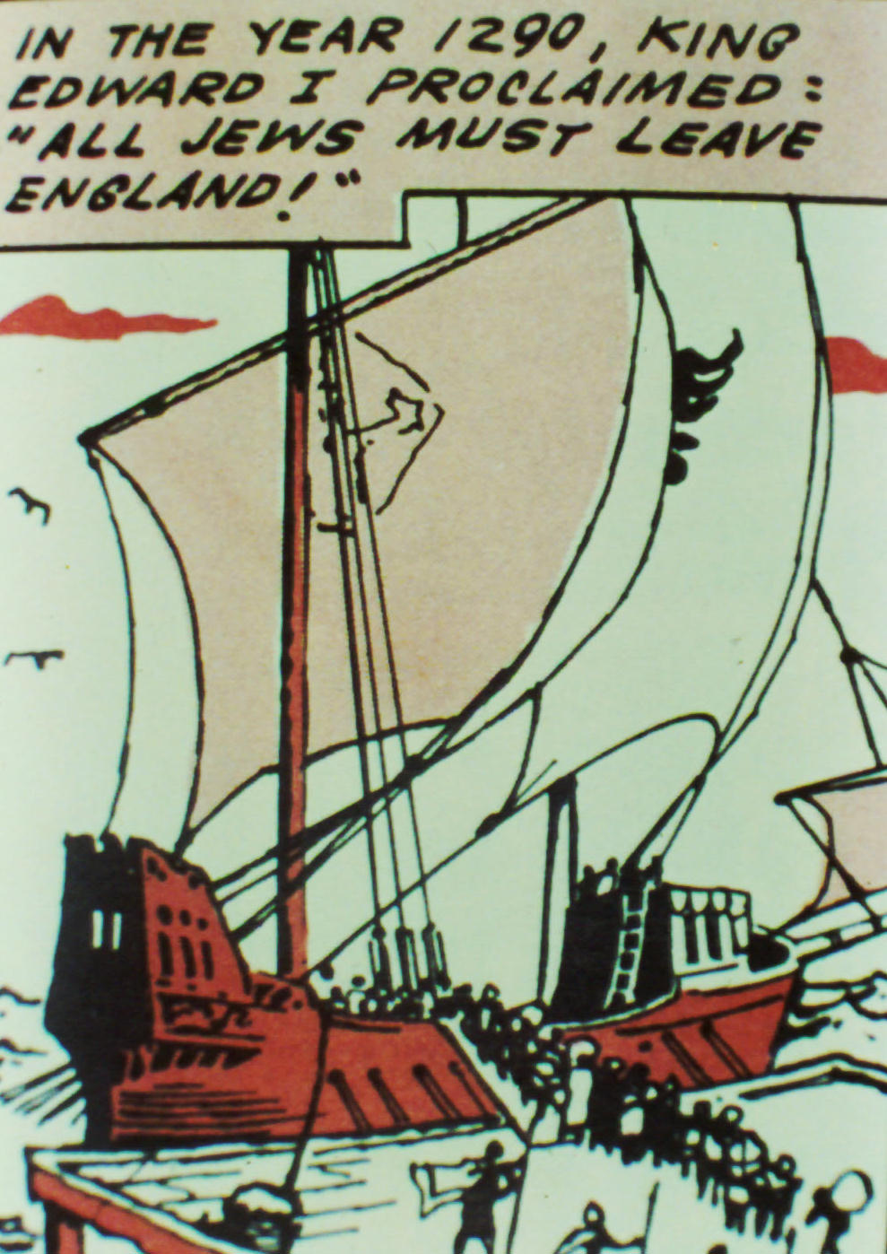
Jews in England
Various European nations began to expel the Jews.
England forced all Jews to leave in 1290 AD.
They were not allowed to return until the time of Oliver Cromwell in the 1600s.

Slide 42
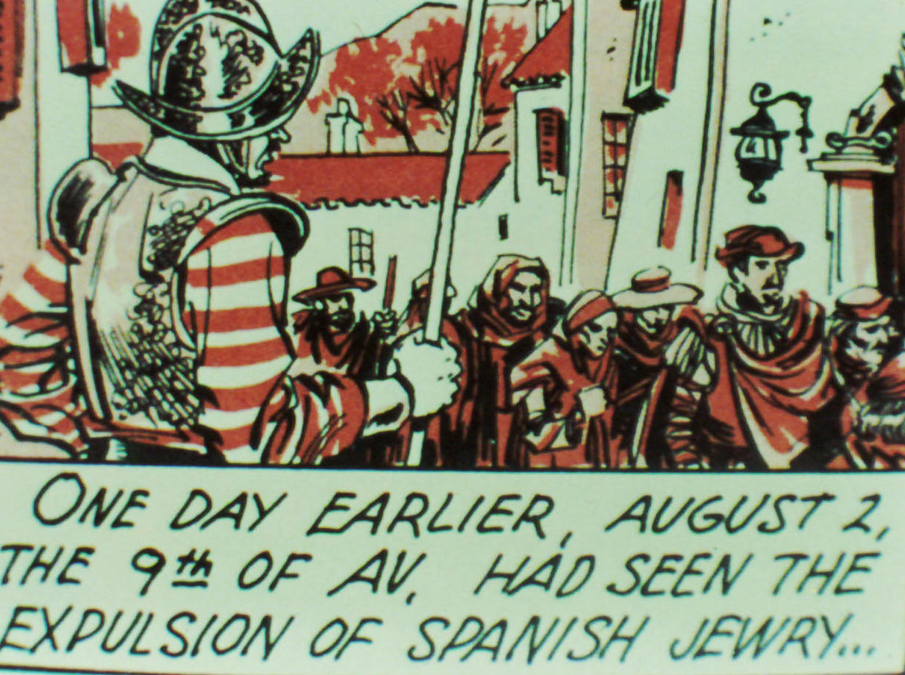
Jews in Spain
The same thing happened in Spain after it was retaken from the Muslims.
In the year Colombus discovered America, Ferdinand & Isabella forced the Jews out.
By this time, there were few places in Europe for Jews to go.

Slide 43
Expulsion Predicted
Then the LORD will scatter you among all nations…. Among these nations you will find no repose, no resting place for the sole of your foot. There the LORD will give you an anxious mind, eyes weary with longing, and a despairing heart. You will be in constant suspense, filled with dread both night and day, never sure of your life. (Deuteronomy 28:64-66)

Slide 44
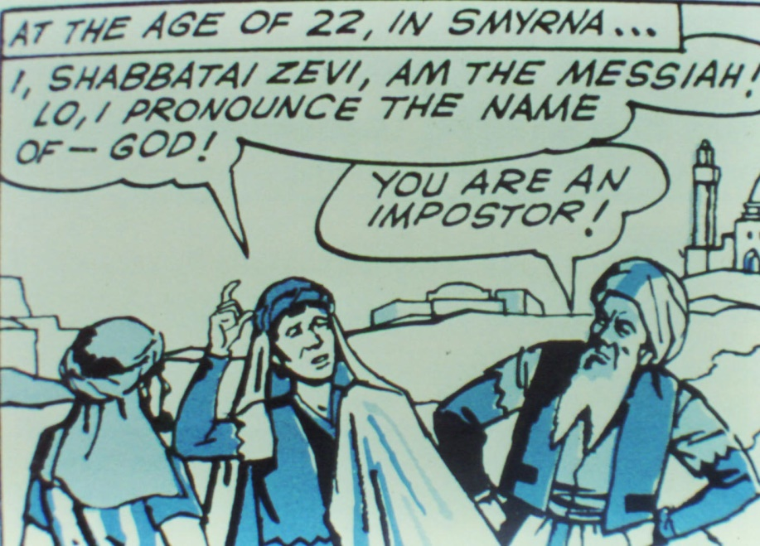
False Messiah
In 1672, a Jewish fellow, Shabbati Zevi, in Turkey, claimed to be the Messiah.
He attracted a large following.
When the authorities jailed him & threatened his life, he became a Muslim.
He still has followers today.
He is another example of Jesus’ prediction in John 5:43.

Slide 45
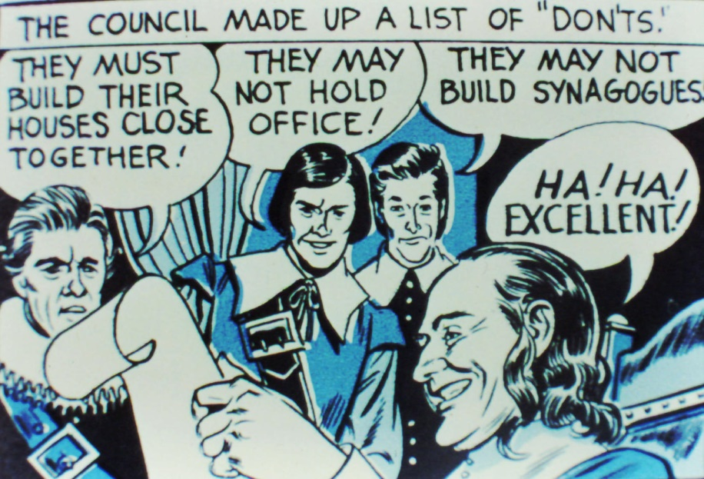
Jews in America
Jews have generally been treated much better here than elsewhere, but they have faced discrimination.
One example is the treatment they received in colonial New Amsterdam.
Until late in the 20th century, they frequently faced bias in club memberships, jobs & housing.

Slide 46
Review to 1850
Up to this point, we have seen the disaster prophecies of Moses fulfilled in a striking way.
We have also seen a number of people claiming to be the Messiah & attracting a significant following.
Israel has also been without king or prince, sacrifice or sacred stones, ephod or idols.
But what about Hosea 3:5 and Isaiah 11 re/ a return? To 1850, little evidence of this fulfillment.

Slide 47
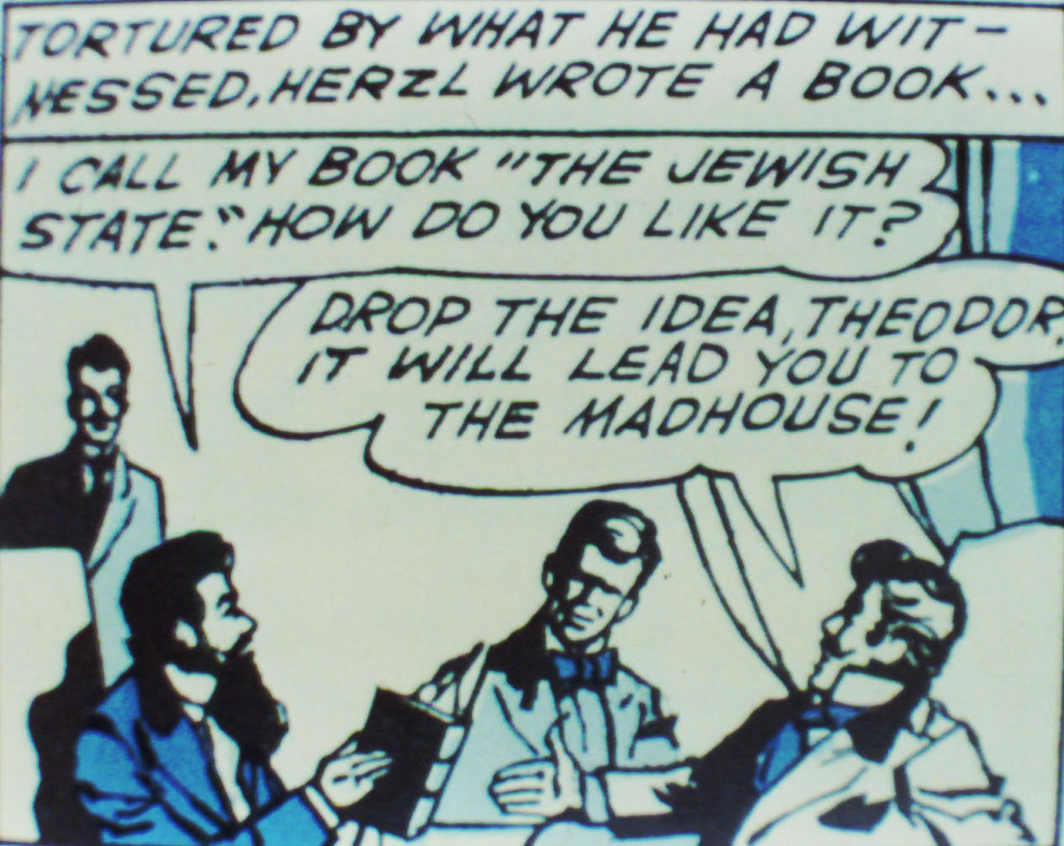
Herzl's Dream
About1895, a Jewish officer in the French army was court-martialed due to bias. Reporter Theodore Herzl felt the Jews would never be safe unless they had their own state.
Herzl founded the movement called Zionism.
At one point Uganda was considered, but later Herzl became convinced Palestine was the right place.

Slide 48
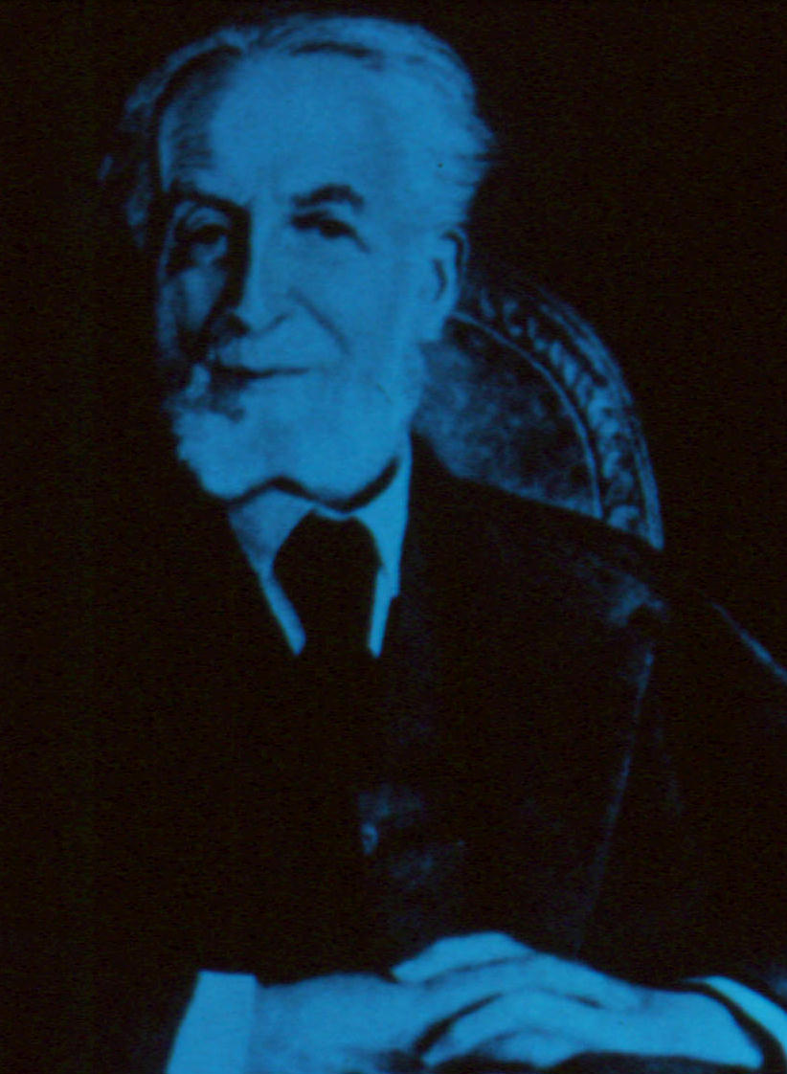
Settlement in Palestine
Several wealthy Jews gave funds for Jewish settlement in Palestine.
But for a long time, only a few Jews were willing to leave Europe or America for a hard life in the Middle East.

Slide 49
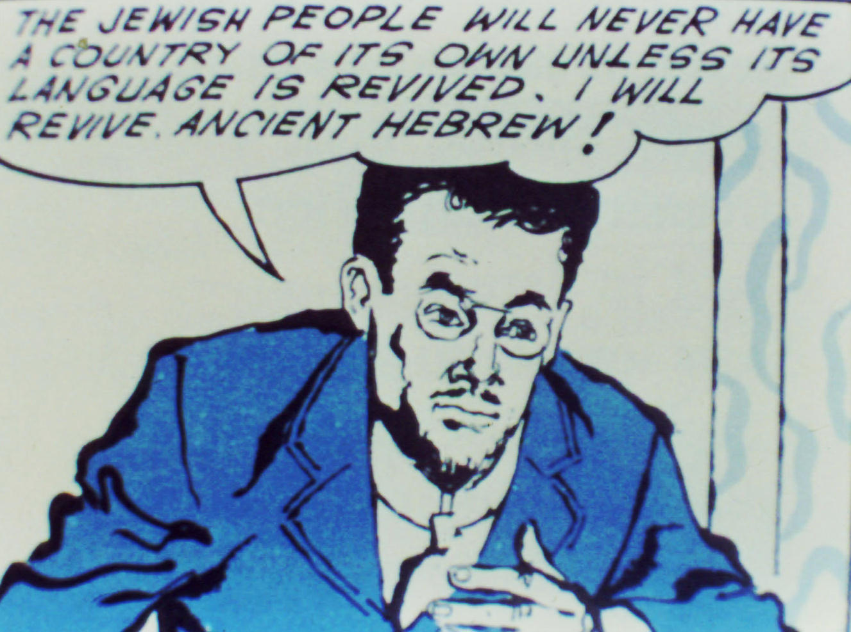
Resurrection of Hebrew
As settlers returned to Palestine, the question of language arose. What should they speak? Arabic? Yiddish?
Eliezer ben Yehudah felt they would best be united by reviving ancient Hebrew.
His dictionary was published in 1909, and he became the Noah Webster of Hebrew.

Slide 50
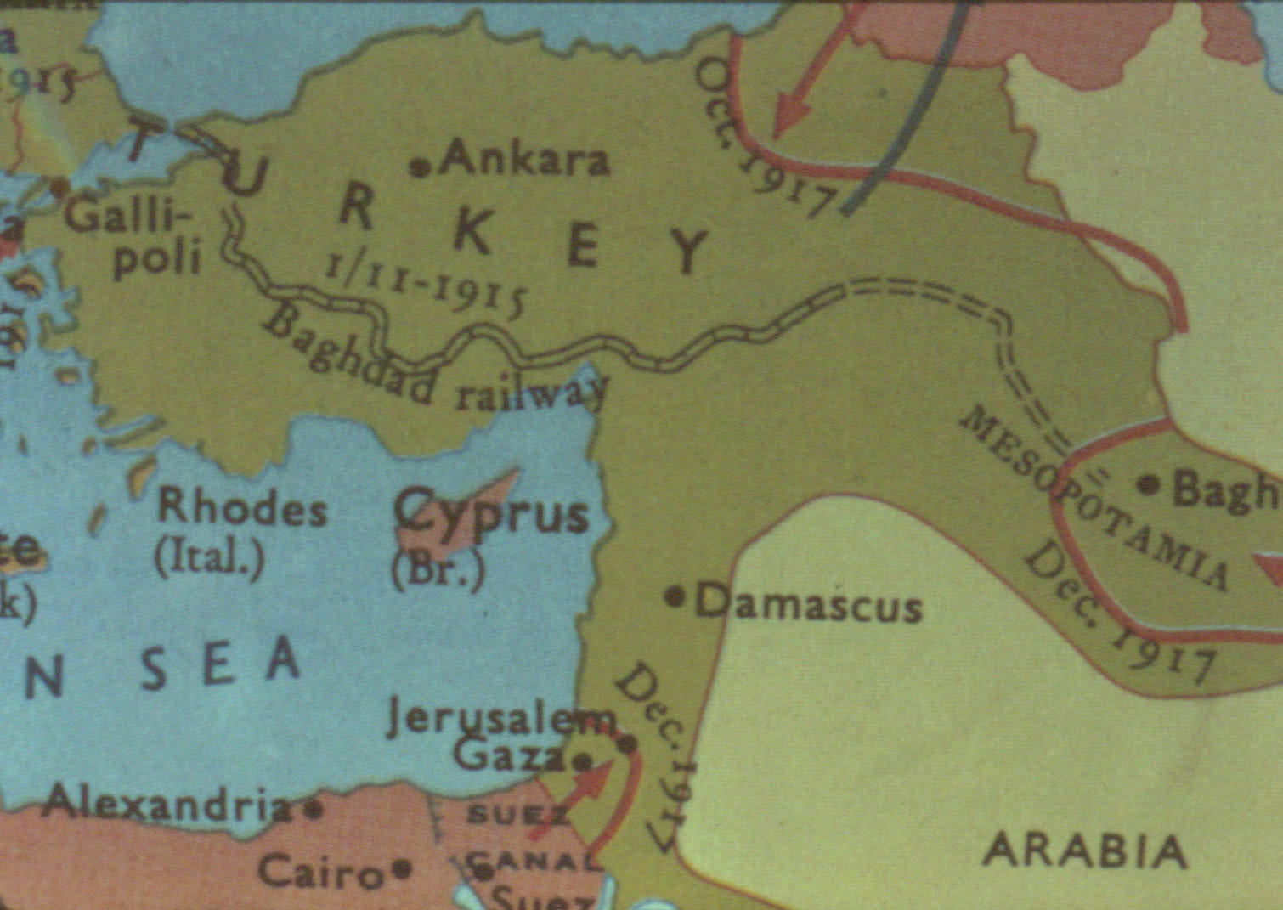
Ottoman Empire
By the early 20th century, the Ottoman Empire was in bad shape, "the sick man of Europe."
It fell apart at the end of World War 1, where it had allied with Germany.
Ottoman Empire

Slide 51
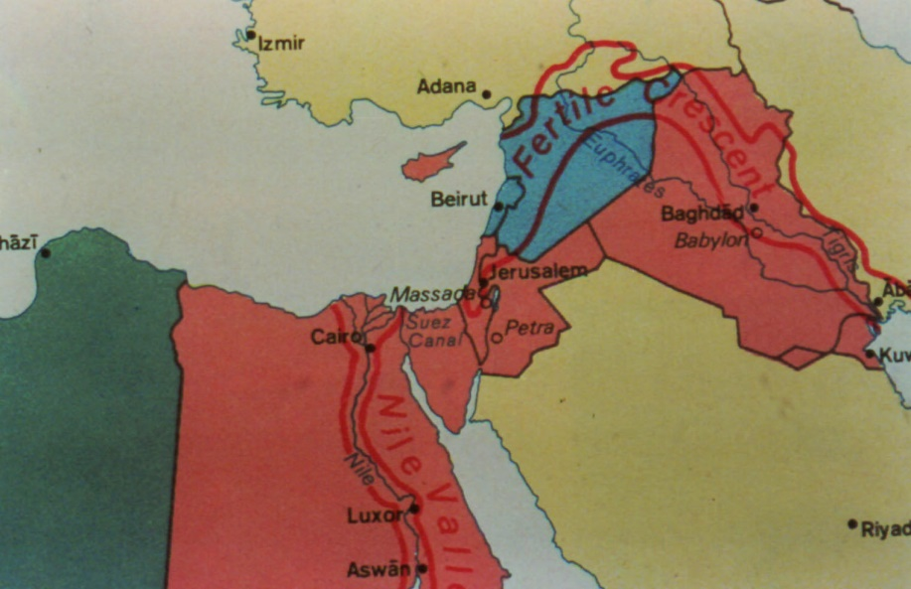
Spheres of Influence
After World War 1, the victors received parts of the Middle East for oversight.
Britain got the red areas, France the blue, and Italy the green.
Providentially, Britain got Palestine.

Slide 52
Chaim Weitzmann
It so happened that Britain owed a big favor to Chaim Weitzmann, a Jewish chemist and a Zionist.
Weitzmann had invented Cordite, a substitute for gunpowder, which allowed Britain to survive the German blockade.
Weitzmann asked that Britain use its mandate in Palestine to provide a Jewish homeland.

Slide 53
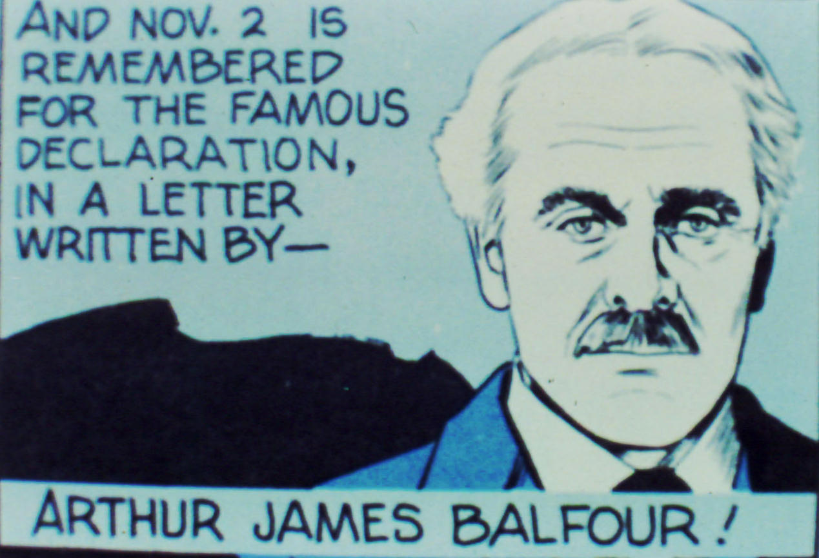
The Balfour Declaration
As a result, in 1917 the British Foreign Secretary Arthur Balfour declared that the government’s policy would be to favor the formation of a Jewish state in Palestine.

Slide 54
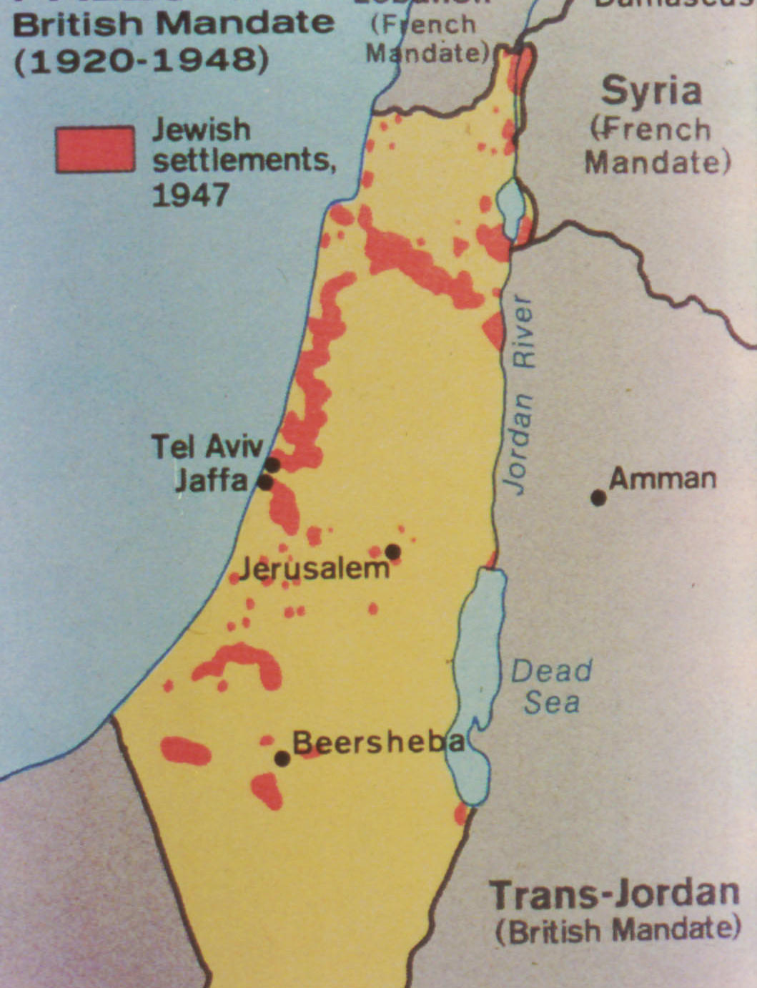
The British Mandate
From 1920 to 1948, Great Britain ruled Palestine under a mandate given it by the League of Nations.
The map shows in red the extent of Jewish settlements in 1947, just before the mandate ended.
Areas in yellow show the Arab settlement.

Slide 55
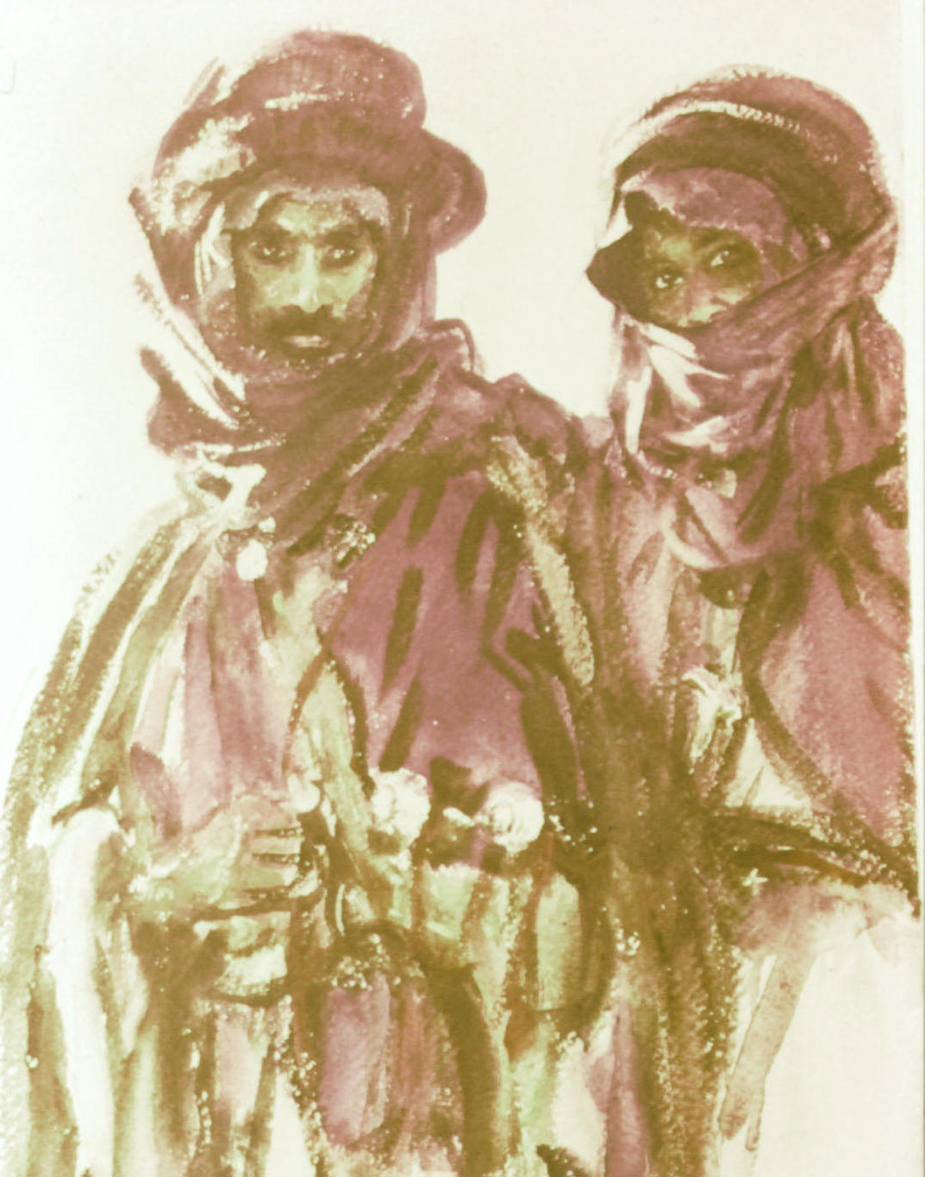
Arab Opposition
Many Arabs were unhappy with Jewish settlements and the British promise.
The British had made promises to the Arabs as well.
This led to Arab guerilla action against Jewish settlers.

Slide 56
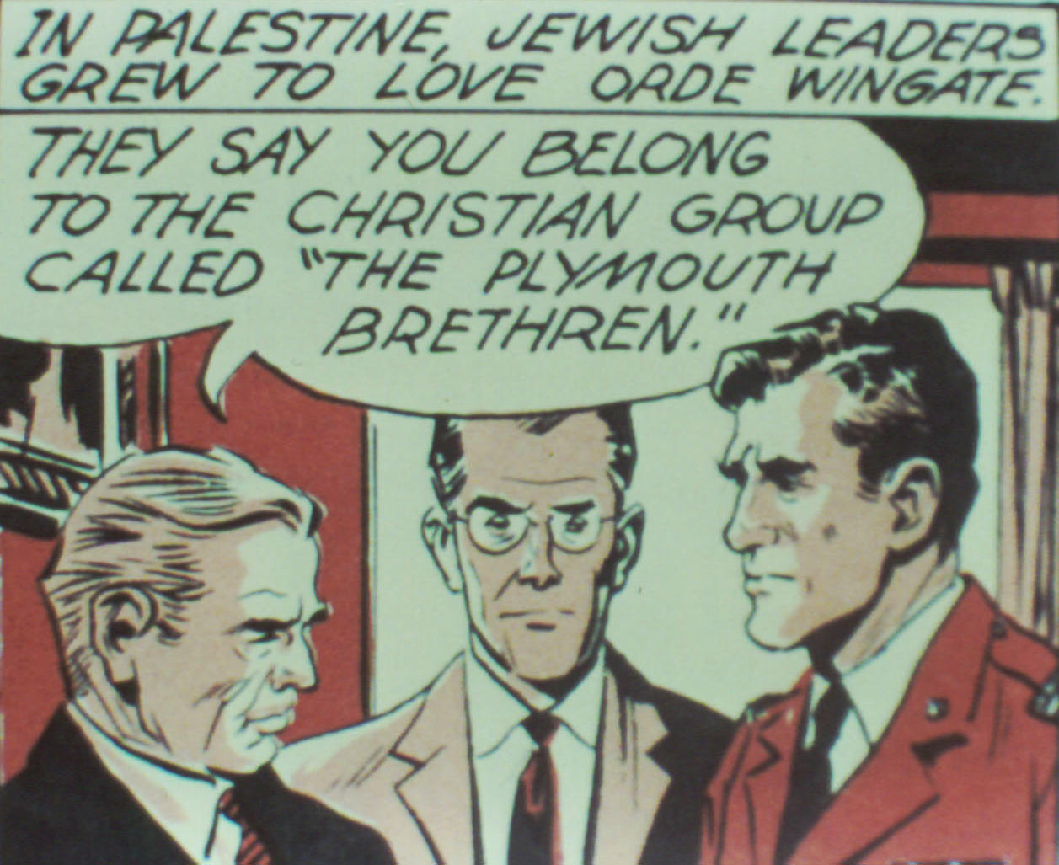
Jewish Response
The Jews at first were unprepared for such attacks.
Providentially, a British officer in Palestine, Orde Wingate, was a specialist in guerilla tactics and a believer in OT prophecy.
With official approval, Wingate trained the Jews to defend themselves.

Slide 57
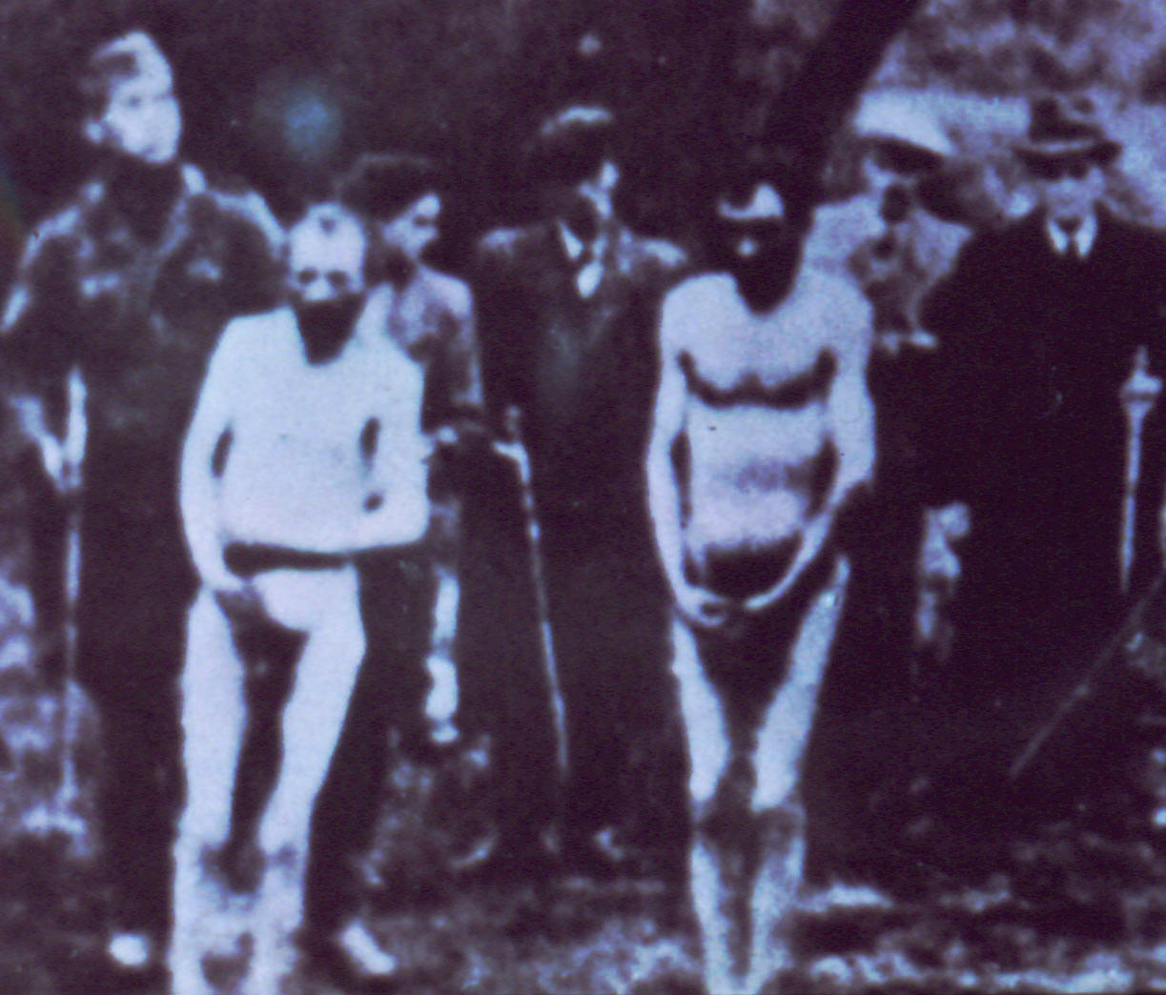
The Nazi Holocaust
Meanwhile in Germany, Adolf Hitler came to power with a strong anti-Semitic agenda.
As the Nazis conquered Europe, they began an ethnic cleansing by killing Jews and some others.
This began with firing squads, but soon progressed to gas chambers.

Slide 58
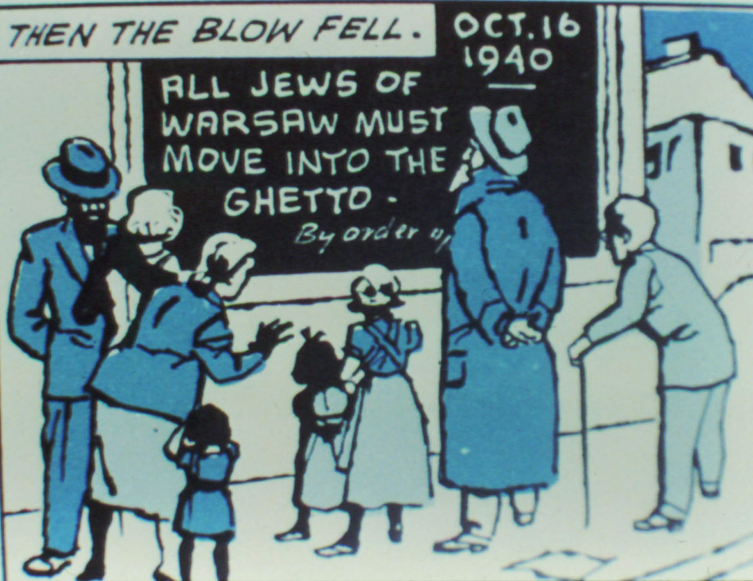
The Warsaw Ghetto
In Poland, the Jews of Warsaw were forced to move into the old Jewish ghetto.
No Jew was allowed to leave.
The Nazis told the Jews that they would be transported to the East for resettlement.

Slide 59
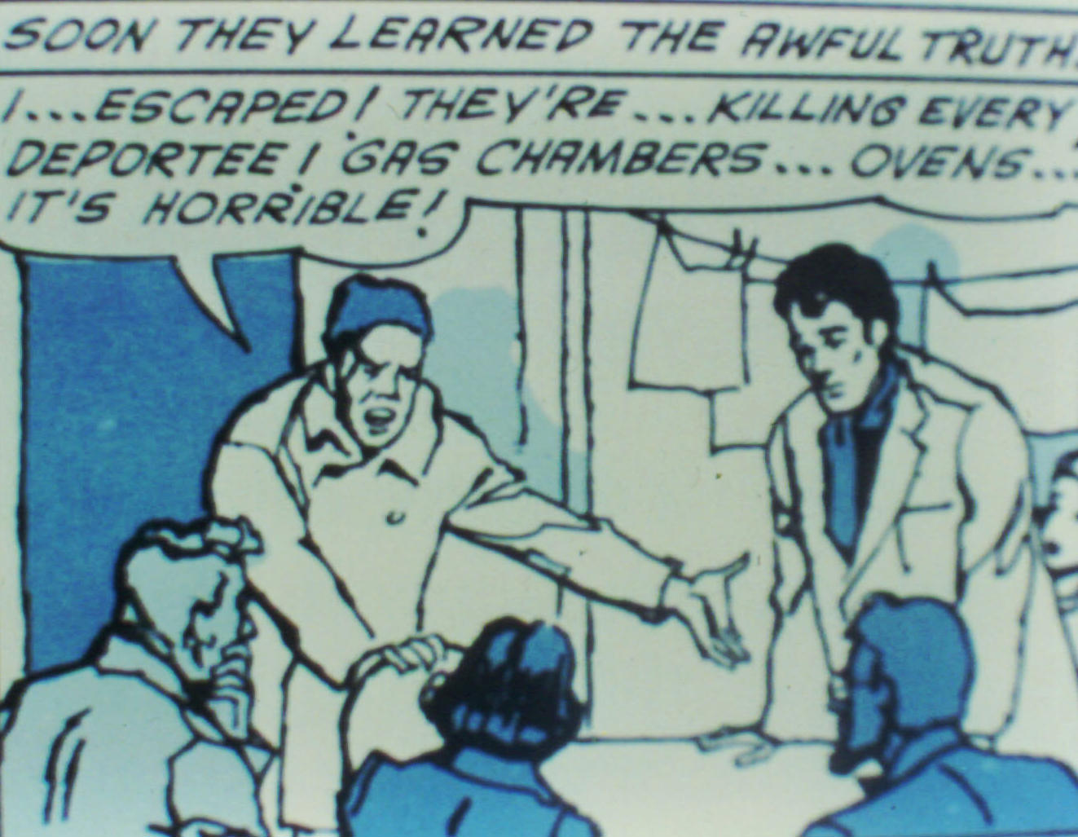
"Resettlement"
Eventually, word got back to the ghetto what was really happening – extermination!
Many in the ghetto could not believe it. Their view of human nature did not have a category for such behavior.

Slide 60
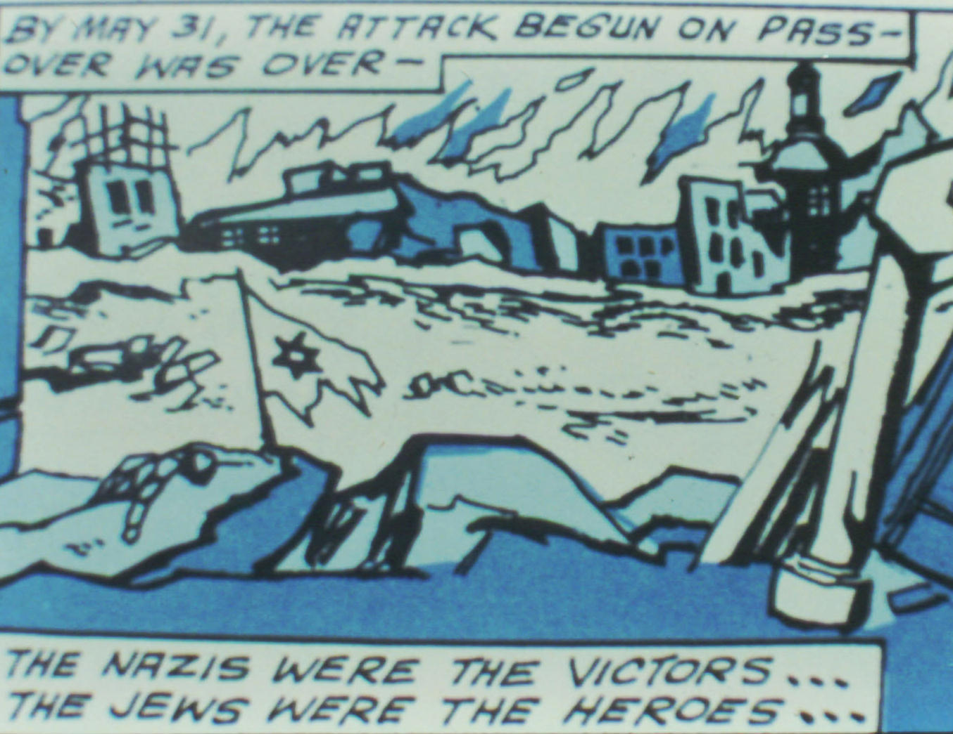
Destruction of the Ghetto
Some of the Jews in the ghetto began an armed resistance.
The German military moved in, and after a fierce struggle, destroyed the ghetto.
A few young people escaped thru the sewers.

Slide 61
No Rest
Among those nations you will find no repose, no resting place for the sole of your foot. There the LORD will give you an anxious mind, eyes weary with longing, and a despairing heart. You will live in constant suspense, filled with dread both night and day, never sure of your life. In the morning you will say, "If only it were evening!" and in the evening, "If only it were morning!" – because of the terror that will fill your hearts and the sights that your eyes will see. (Deuteronomy 28:65-67)

Slide 62
Flight to Palestine
This holocaust led to a great migration to Palestine.
It begins in earnest with the rise of Nazi anti-Semitism.
It is held back significantly by British limitation on immigration.
But it becomes very strong just after World War 2.

Slide 63
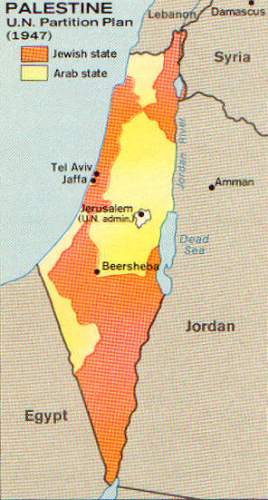
Palestine Partitioned
With outright war developing between Arab and Jew, the British resign their mandate and call on the UN to draw up a partition.
This is done, as at right.
The Jews accept the partition, the Arabs don’t.

Slide 64
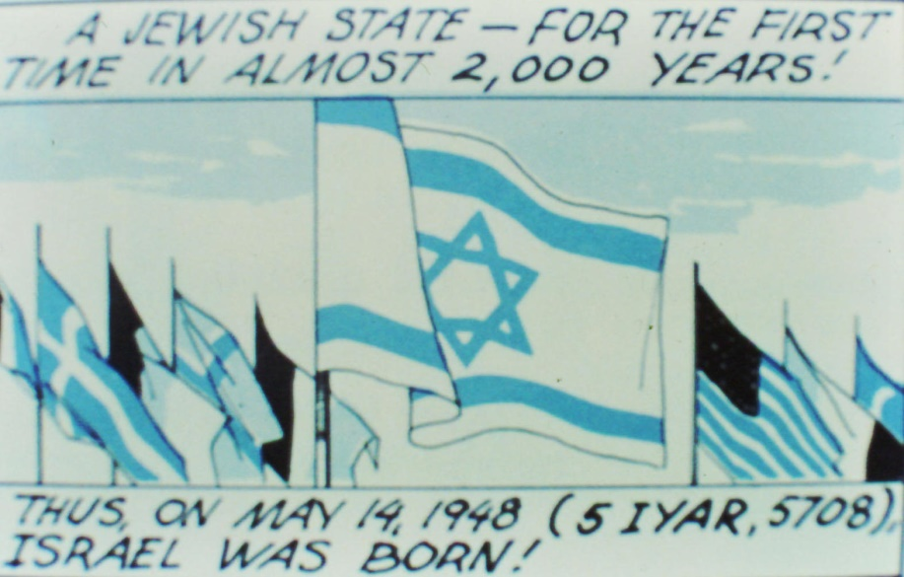
Israel Reborn
As soon as the British withdraw, the Jews declare the formation of the State of Israel.
For the first time since 70 AD, the Jews have a state of their own.
For the first time in centuries, the Jews have a "prince."

Slide 65
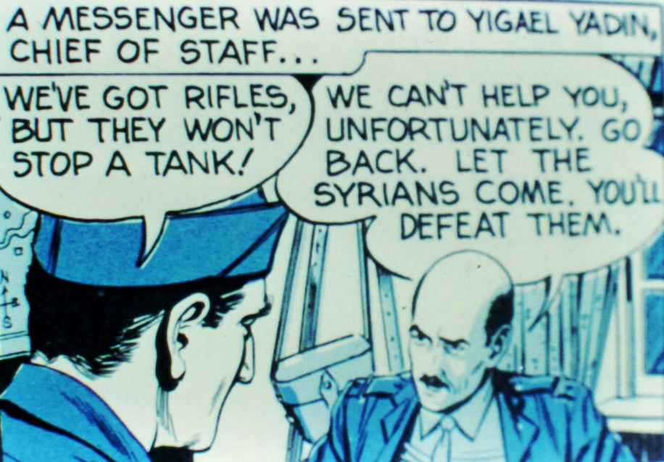
The 1948 War
Five Arab armies invade Israel on the day the British withdraw.
Though none of the armies are world-class, they all have many weapons the Israelis do not.

Slide 66
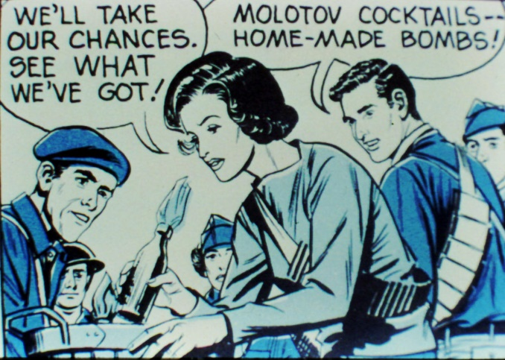
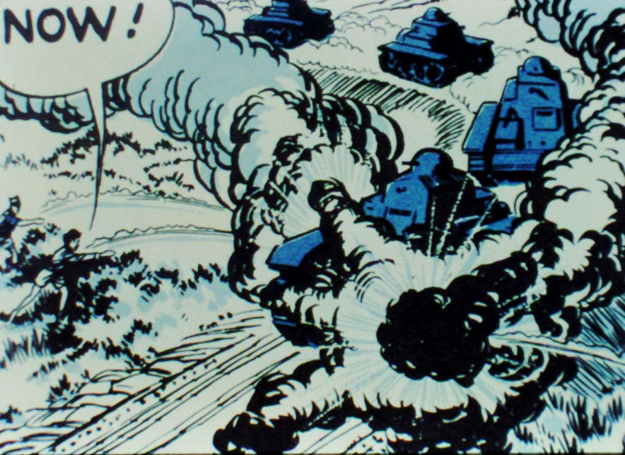
Israel Wins!
The Israelis fight back, often with primitive weapons such as Molotov cocktails.
They are able to smuggle in some better weapons also.
Yet their victory is viewed as almost miraculous even by many who do not believe in God.

Slide 67
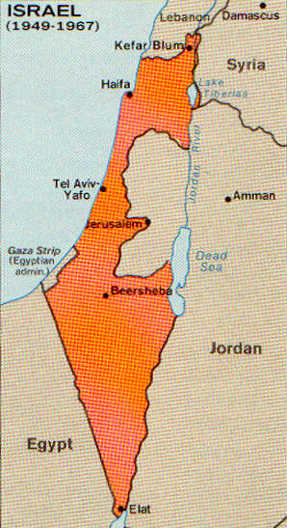

Since 1948
Israel has fought several more wars, always on the occasion of Arab provocation.
Things have not settled down, but this too is predicted. Zechariah 12:2-3 pictures Israel as an insoluble international problem.
The Jews have survived a multitude of disasters and have returned to their land.

Slide 68
Summary to Date
Hosea 3:5 speaks of a return, and of Israel seeking the LORD their God and David their king. This seems to be in process.
Isaiah 11 speaks of a second regathering, and this seems to be in progress.
The Bible predicts continual problems for the Jews and their land until the Messiah returns.

Slide 69
Exile and Return
The places named in Isaiah 11 correspond to:
  Egypt
  Iraq
  Iran
  Syria
The “coastlands of the sea” correspond to:
  North Africa
  Europe

Slide 70
Return of the Jews
The holocaust removed many European Jews, many of whom went to Israel.
Anti-Jewish feeling in Arab countries has caused most Jews to leave, many to Israel.

Slide 71

Solutions to Our Problems
Many today are worried whether the human race will make it.
Some seek guidance from the occult, others look for ETs who have solved our problems.
We really need to seek God.

Slide 72

Seek God!
We have looked at how what God said about Israel has come true in detail.
This is just part of the evidence.
"He has the whole world in His hands."

Slide 73

For Further Reading

