Slide 1

Introduction to Ireland
Robert C. Newman

Slide 2
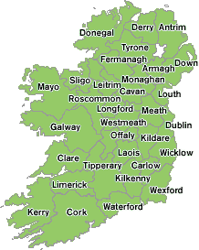
Ireland's History
Prehistoric
  To AD 400
Early Christian
  AD 400-800
Viking Invasions
  800-1170
English Rule
  1170-1922
Irish Freedom
  Since 1922

Slide 3
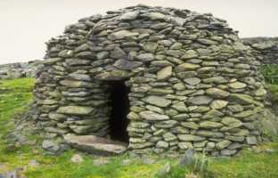
Prehistoric Ireland
To AD 400

Slide 4
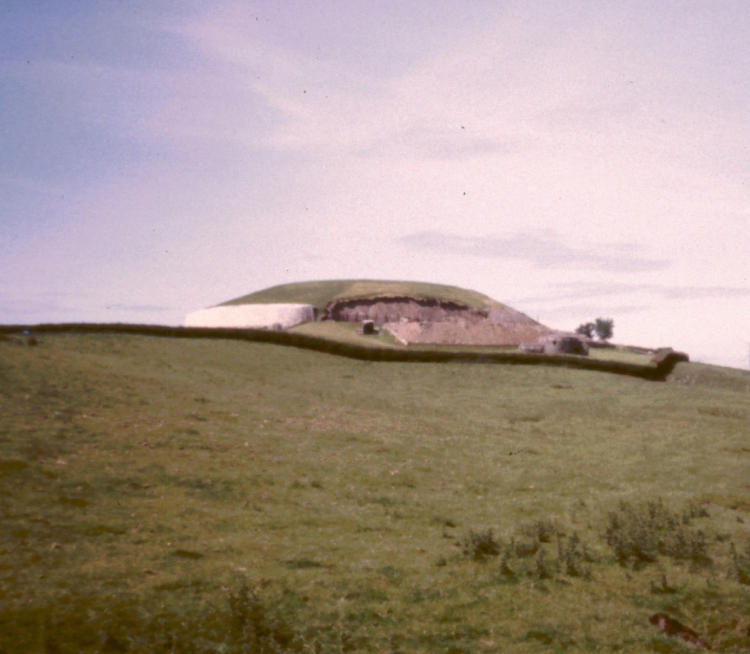
Newgrange
A burial mound from ~3000 BC.
A passage grave inside a mound some 35 feet high and nearly 300 feet across.
The tunnel & inner chamber total about 75 feet long.

Slide 5
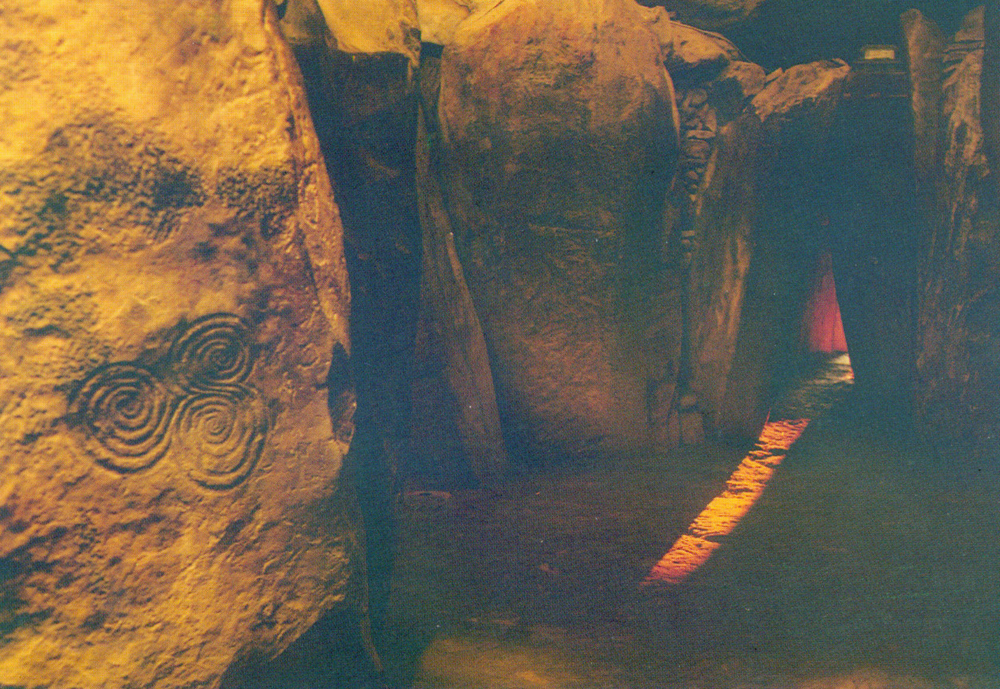
Newgrange
The inner chamber is illumined by the sun only around winter solstice, December 21.

Slide 6
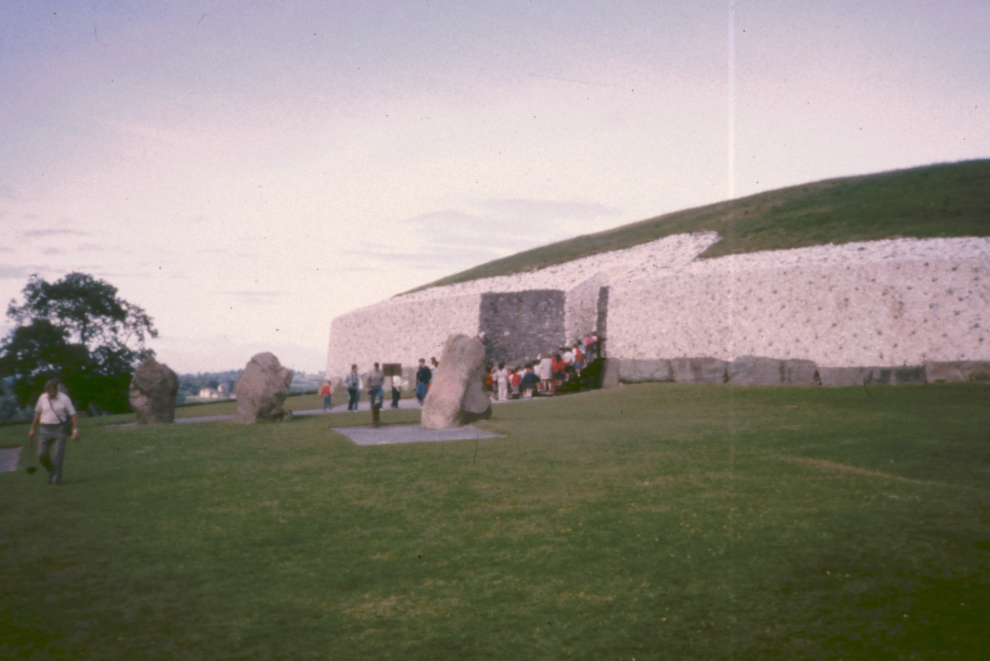
Newgrange

Slide 7
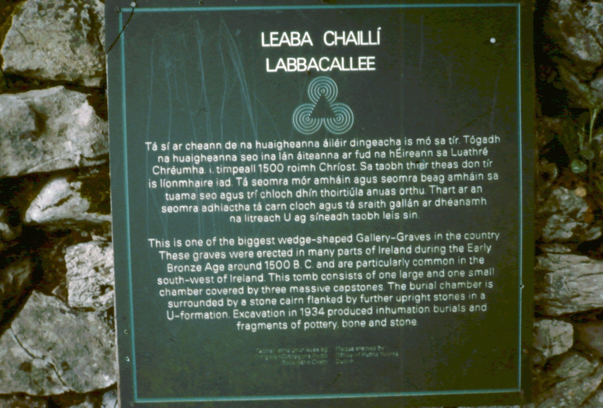
Labbacallee

Slide 8
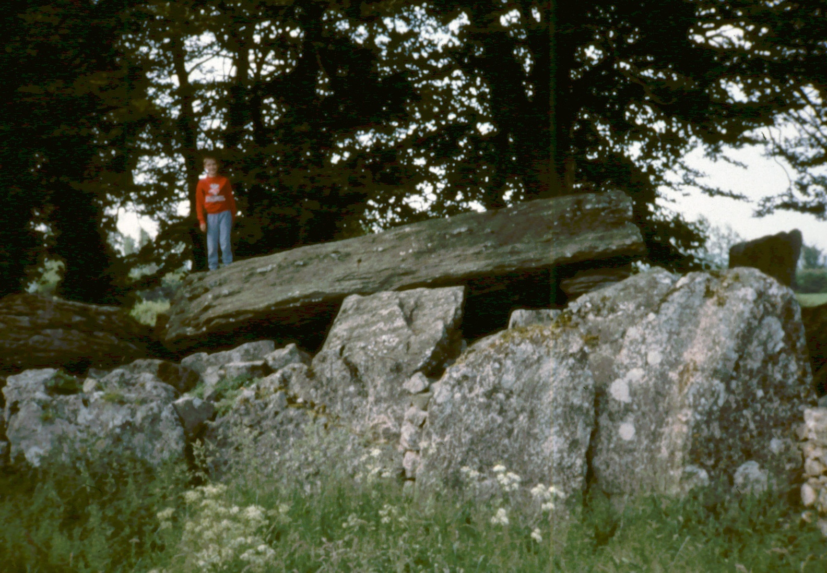
Labbacallee
A megalithic wedge tomb from about 1500 BC

Slide 9
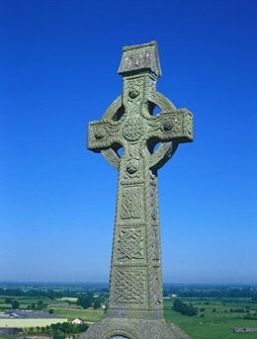
Early Christian Ireland
AD 400-800

Slide 10
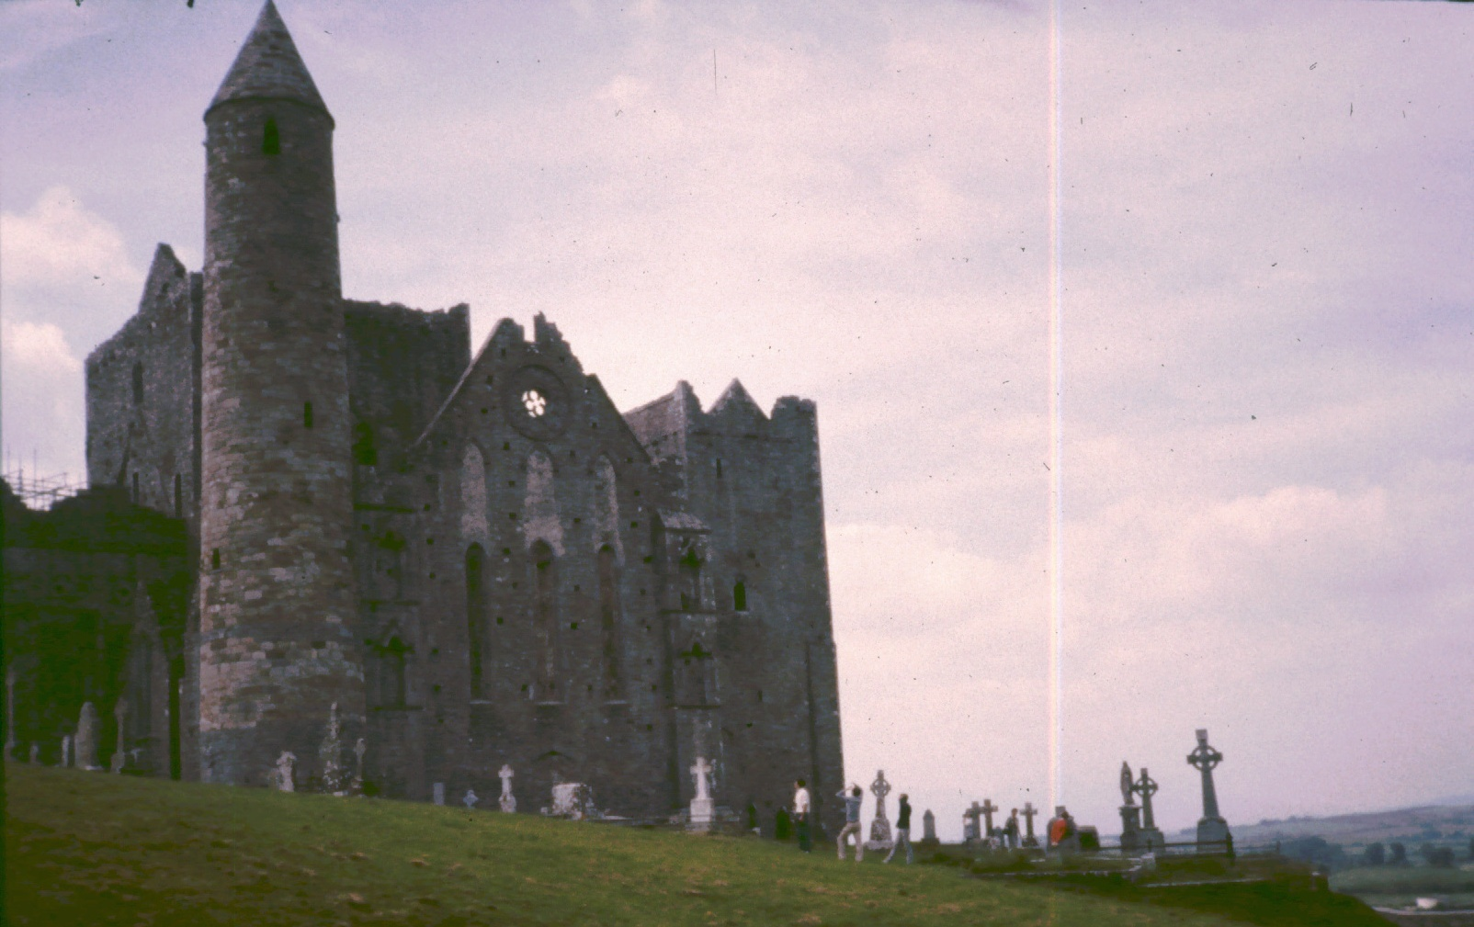
Rock of Cashel
Seat of the Kings of Munster

Slide 11
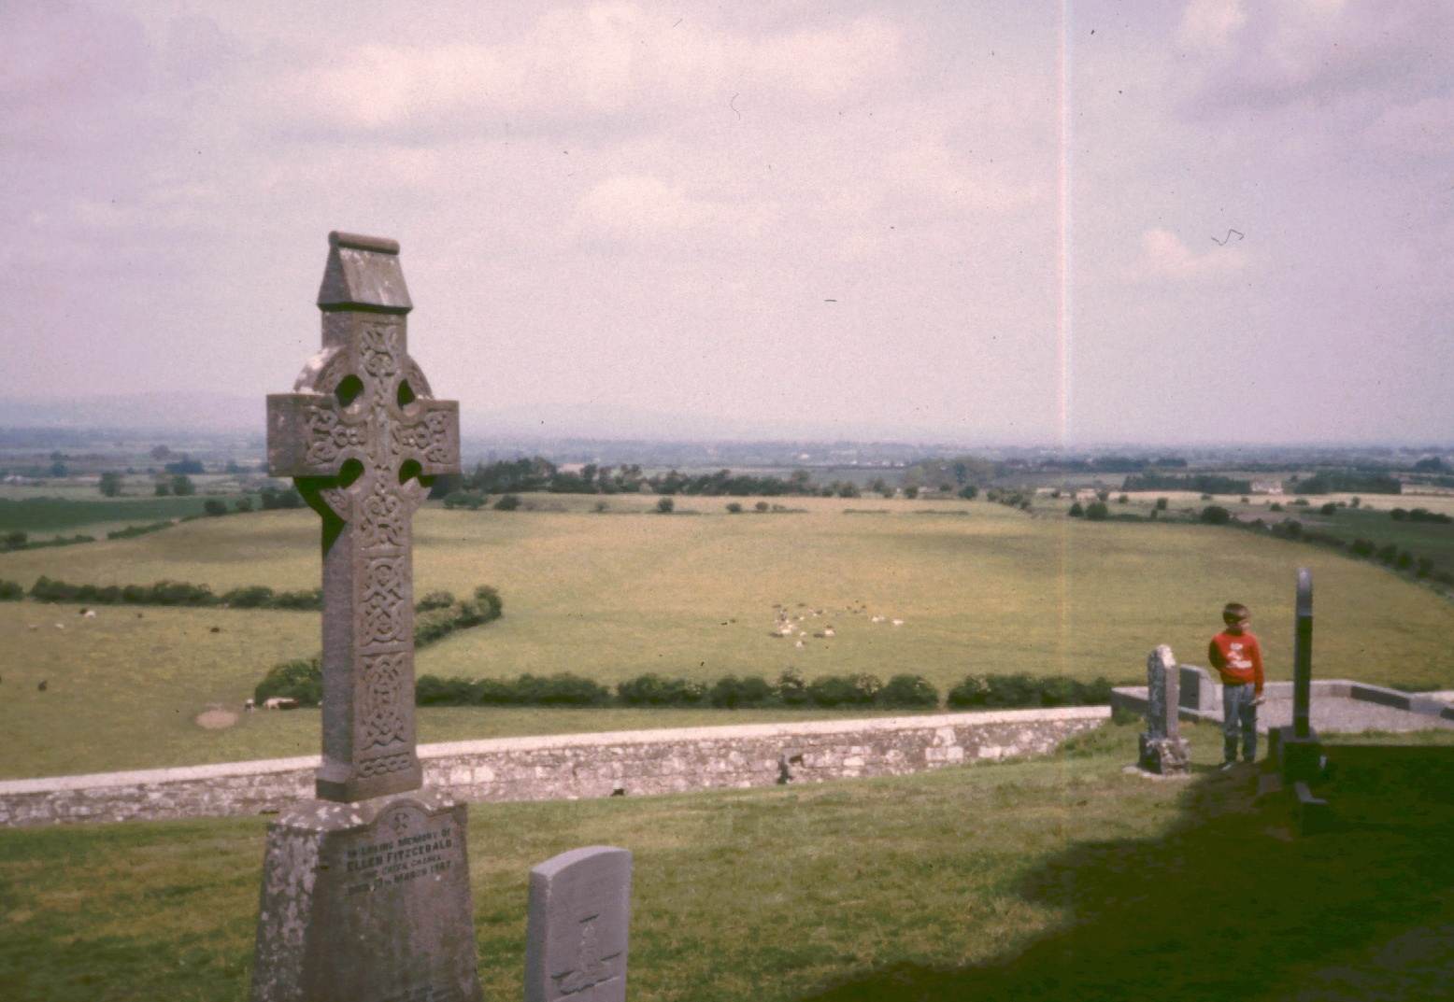
Rock of Cashel
St Patrick was here
One of the stone crosses goes back to his time

Slide 12
Viking Invasions
Beginning AD 800

Slide 13
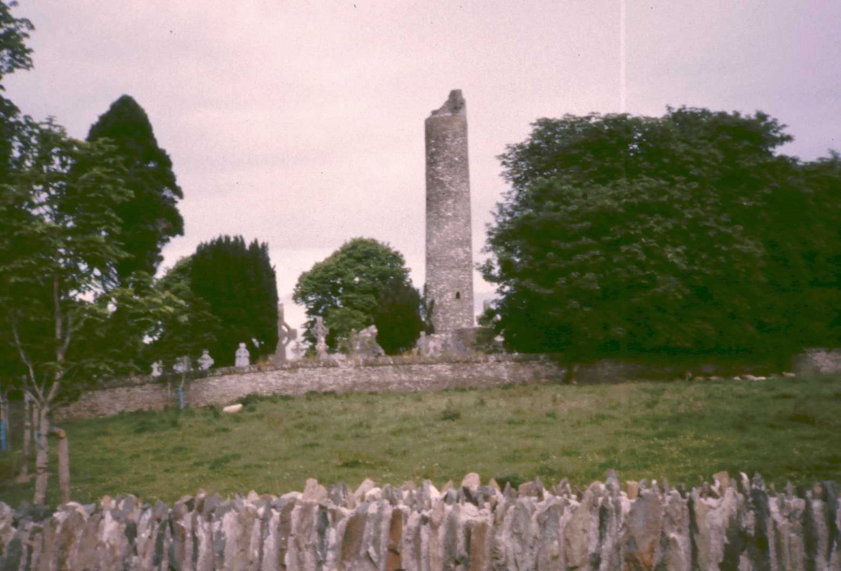
Monasterboice

Slide 14
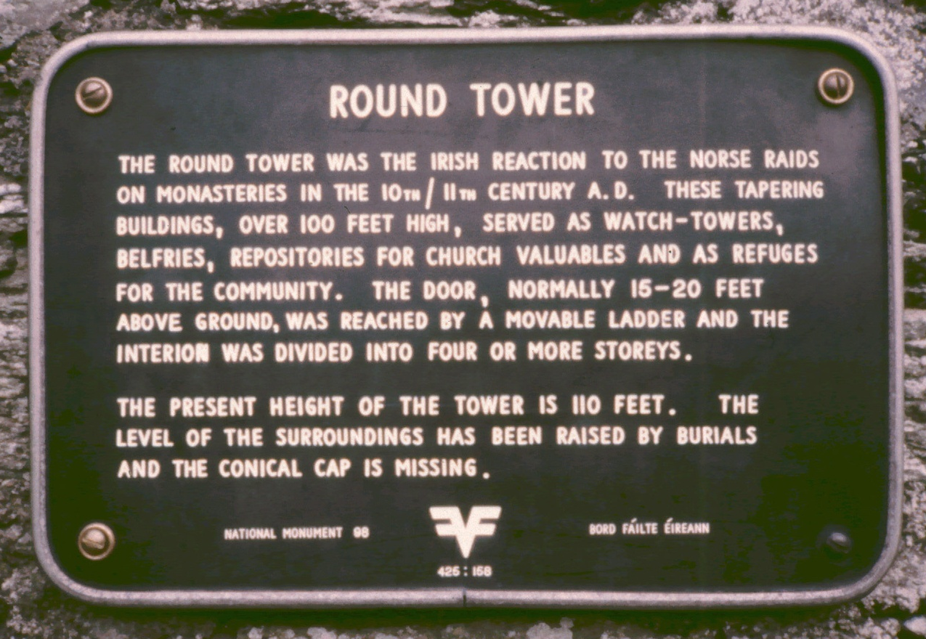
Monasterboice

Slide 15
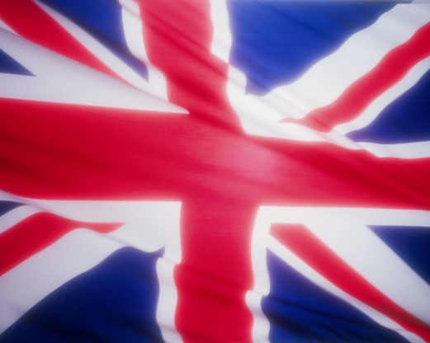
Under English Rule
1170-1922

Slide 16
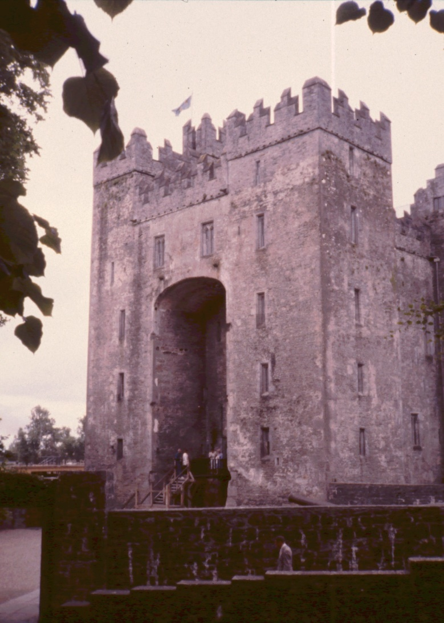
Bunratty Castle
Built ~1450
In the 16th-17th centuries, it was the stronghold of the O'Briens, the Kings (and later Earls) of Thomond.

Slide 17
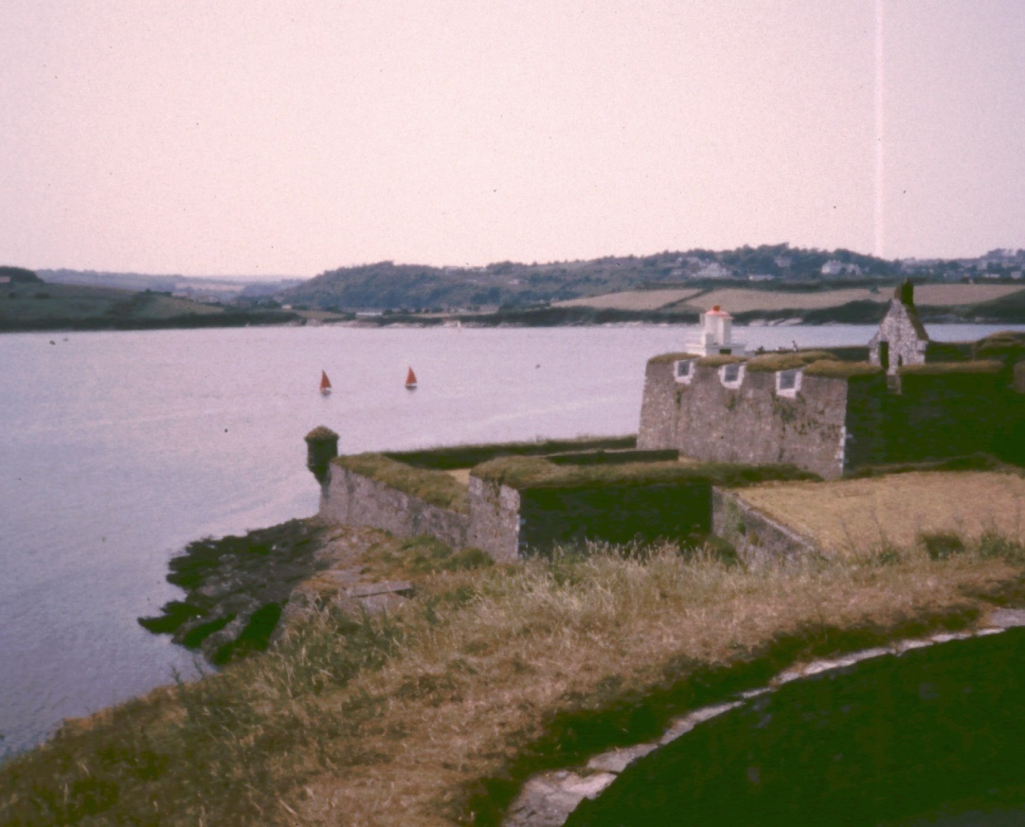
Charles Fort
A British fort guarding Kinsale harbor, near Cork.
In 1601, Spanish troops landed here to help the Irish in their revolt against England.

Slide 18
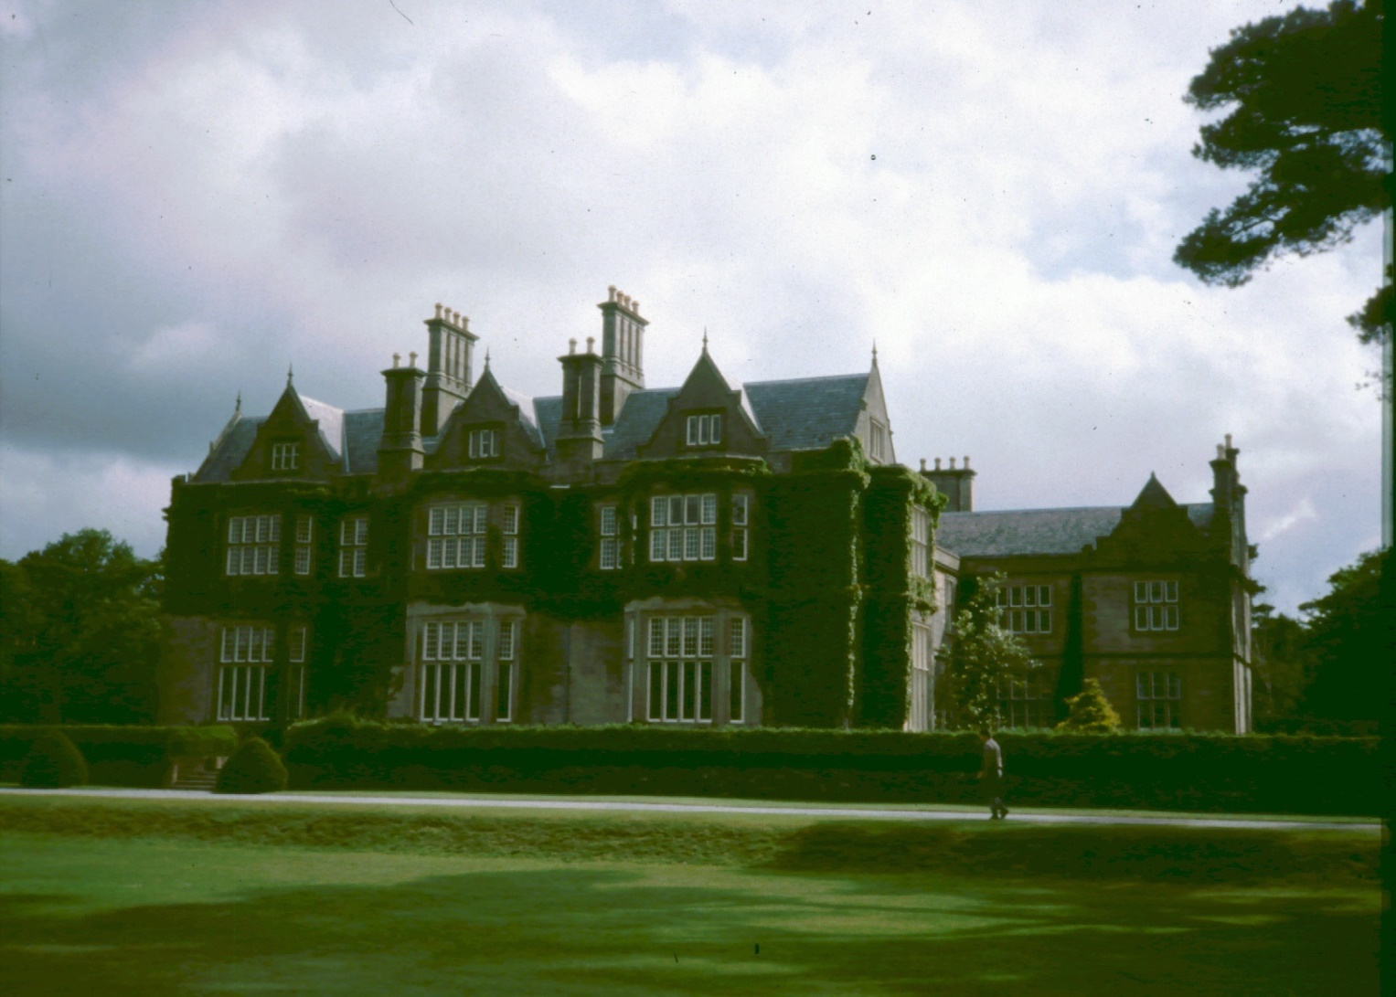
Muckross House
A 19th century manor house, now a museum

Slide 19
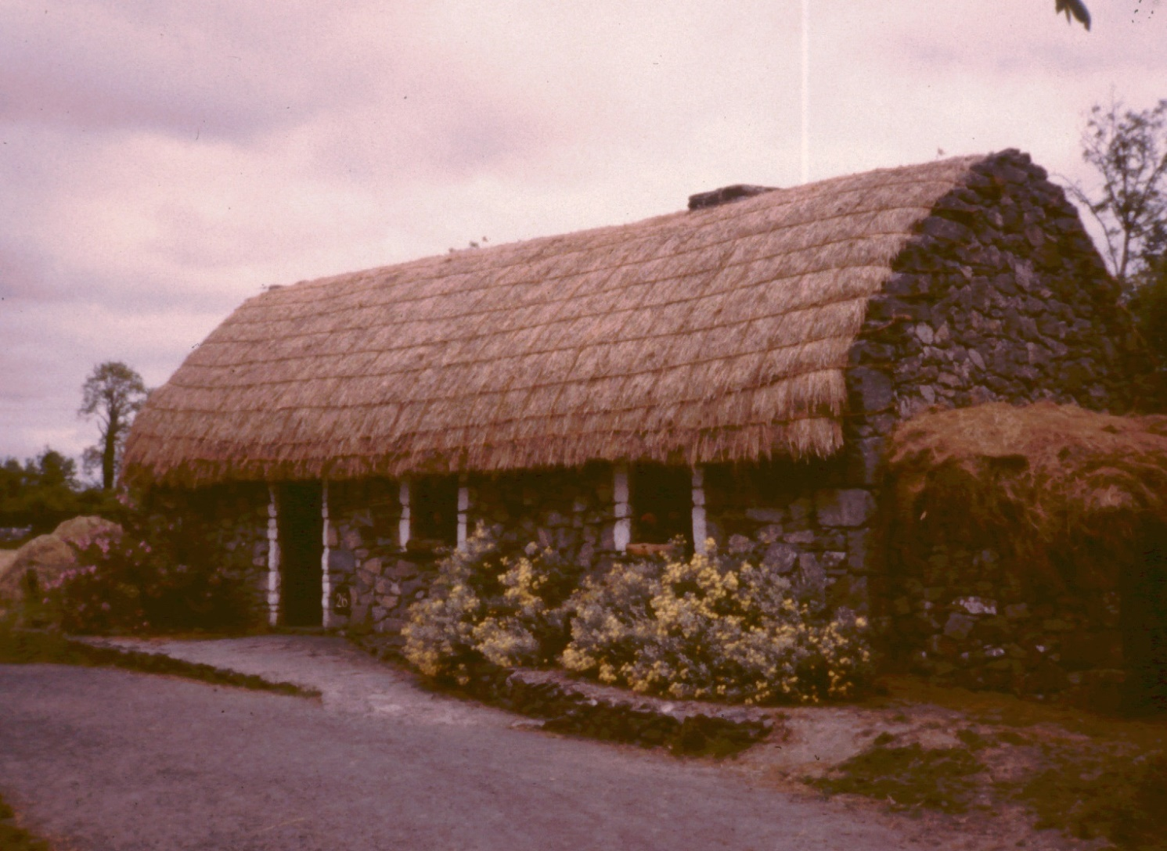
An Irish Cottage
A byre dwelling, both cows & people together

Slide 20
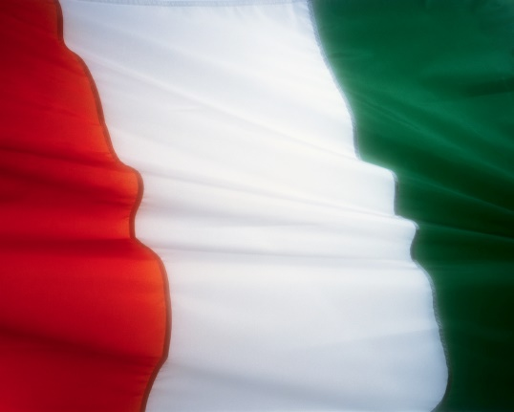
Irish Independence
Since 1922

Slide 21
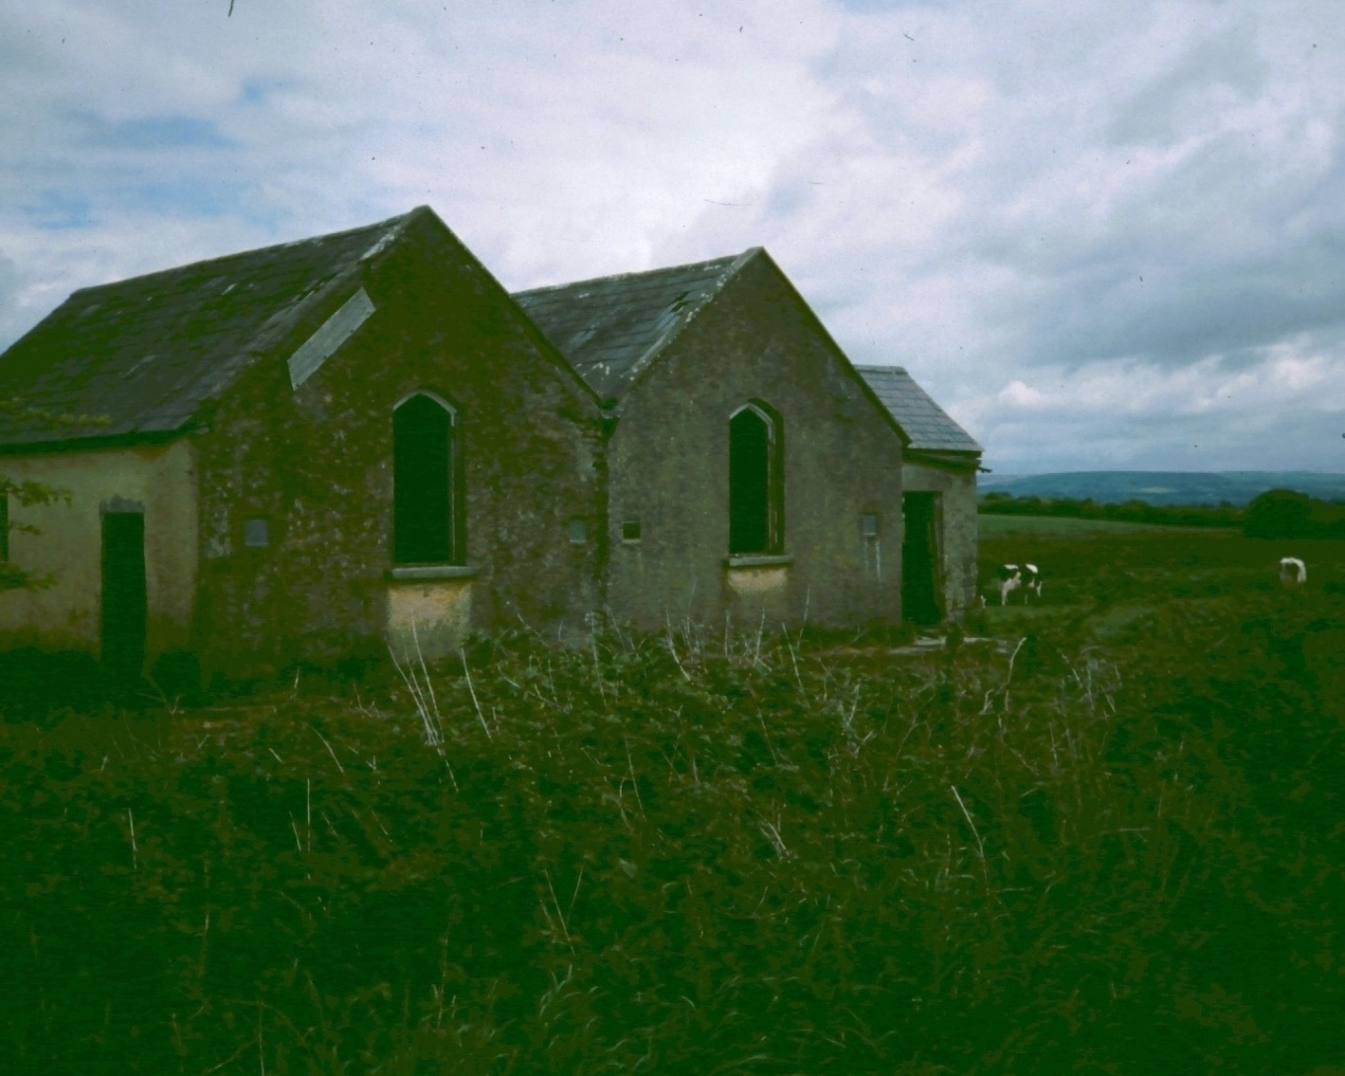
Abandoned house
Many English killed in rebellion, houses abandoned

Slide 22
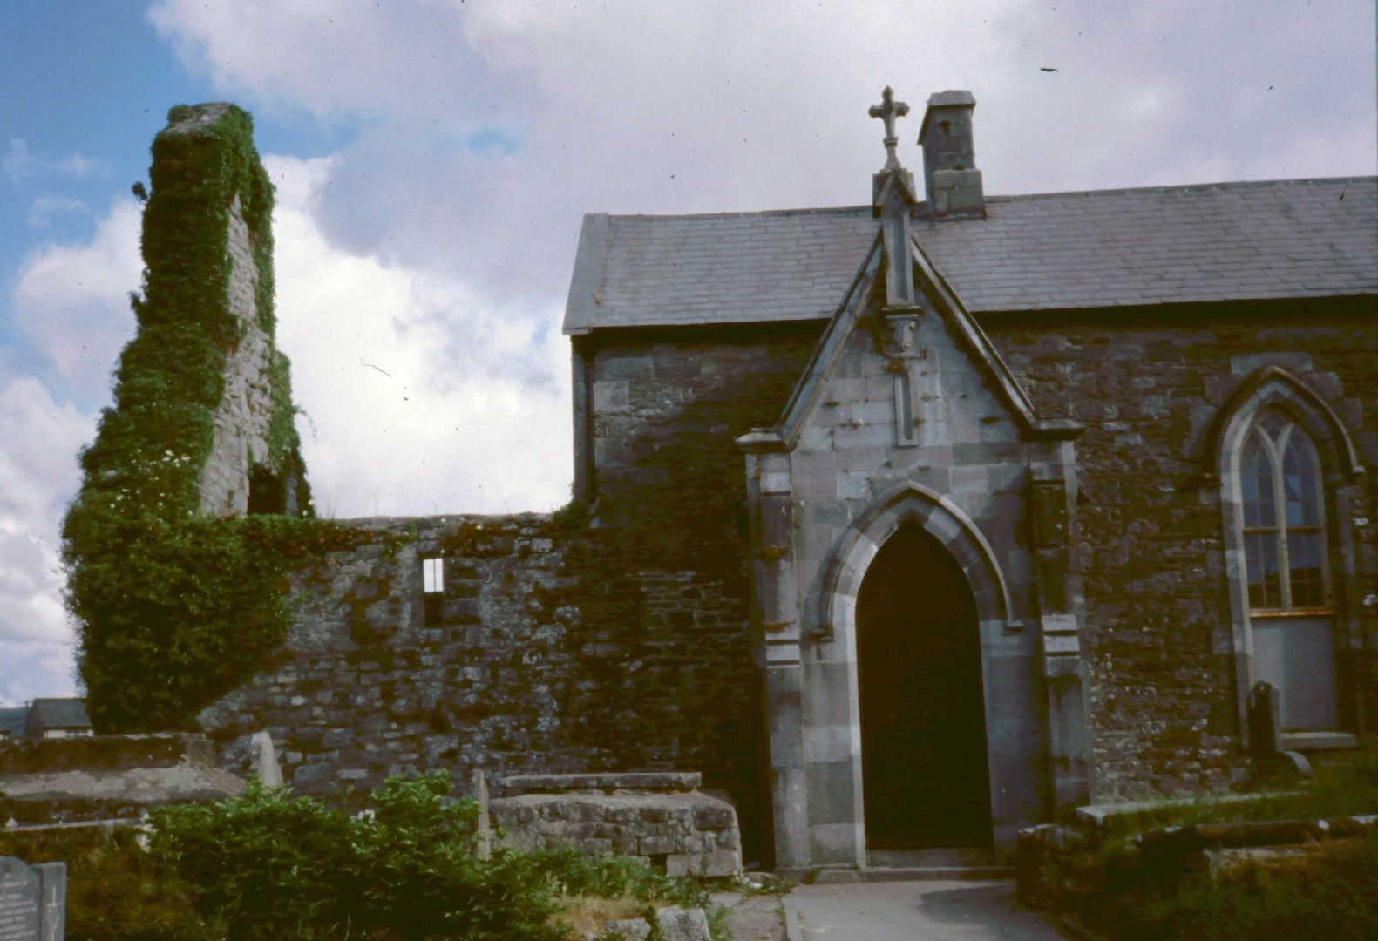
Church of Ireland
Discredited w/ freedom now a cultural center

Slide 23
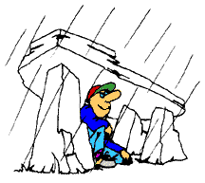
Irish Climate & Culture

Slide 24
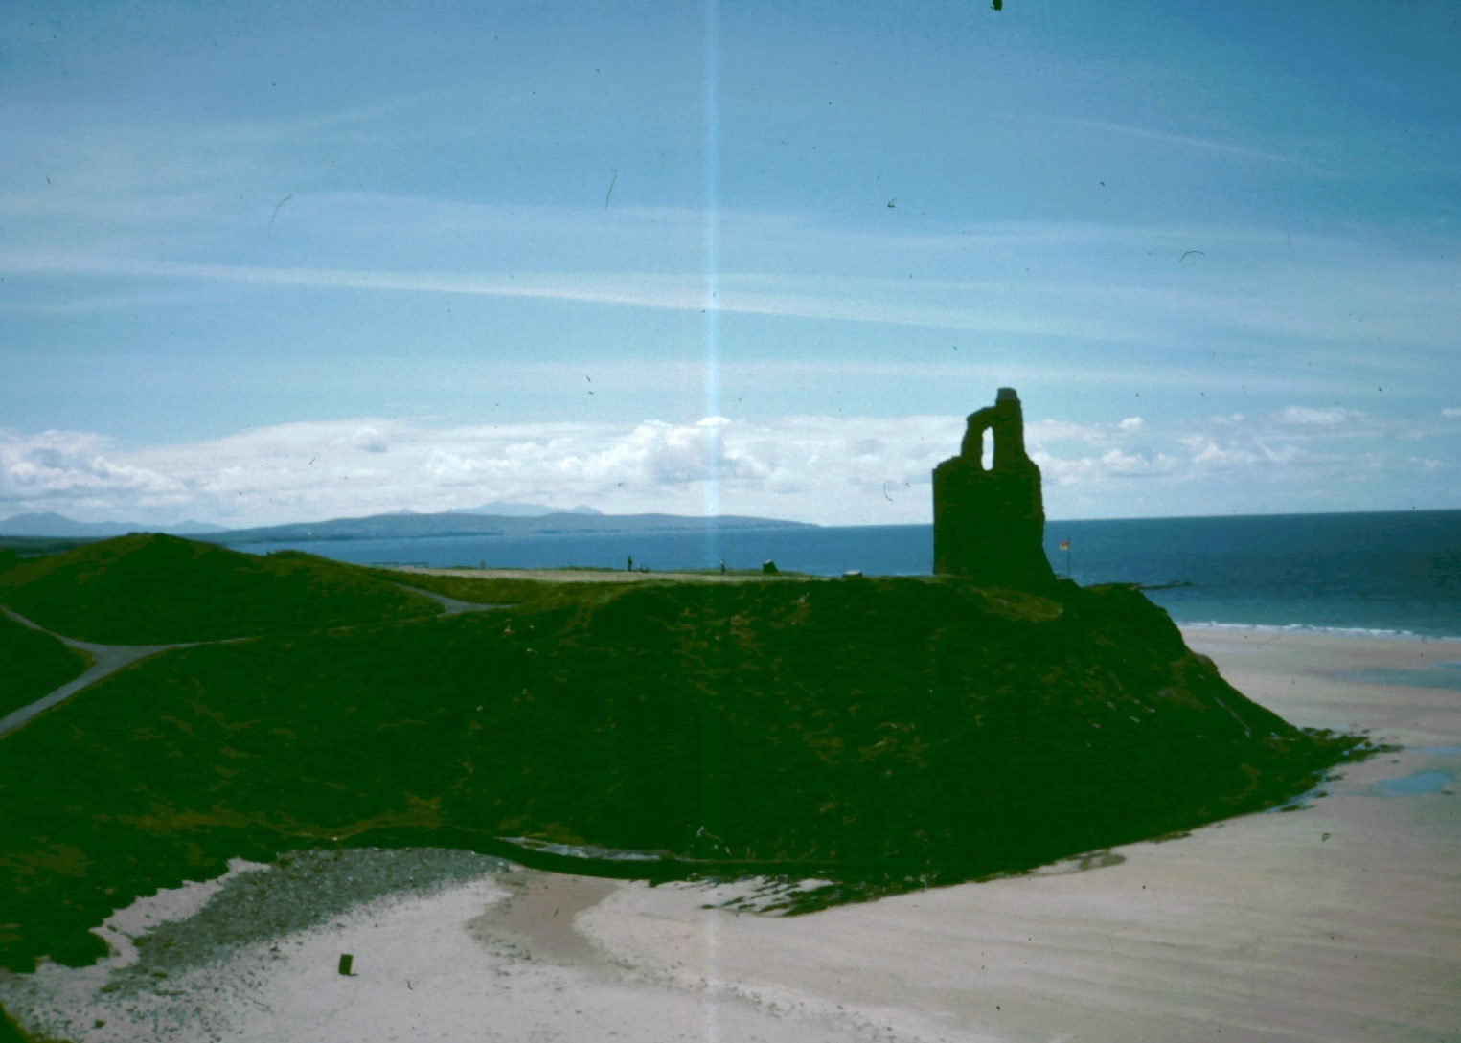
Near the Sea

Slide 25
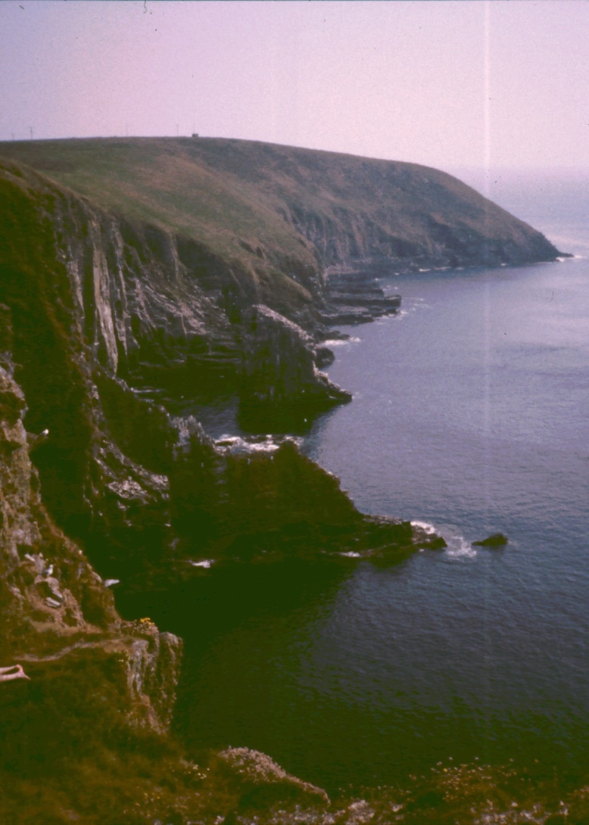
Near the Sea
Anywhere in Ireland you are no more than 40 miles from the sea.
This has a significant moderating effect on the climate.
So does the warm Gulf Stream.

Slide 26
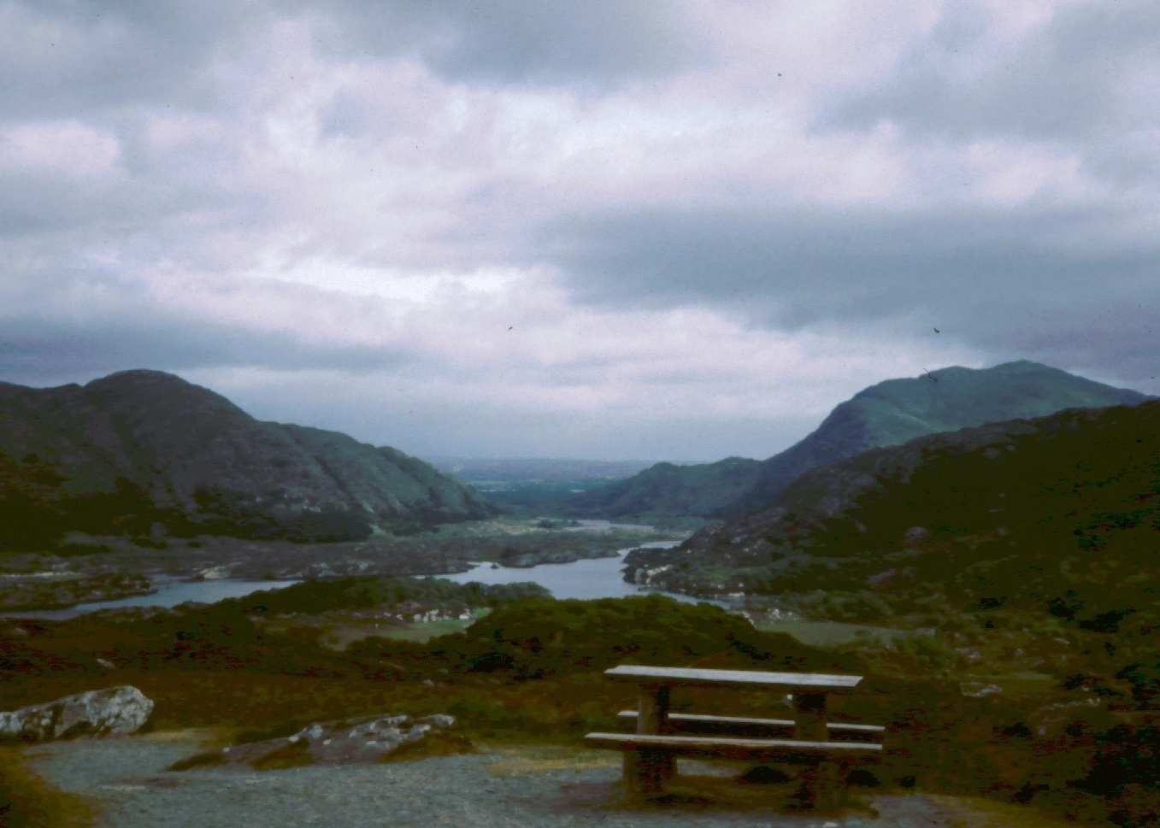
Mountains

Slide 27
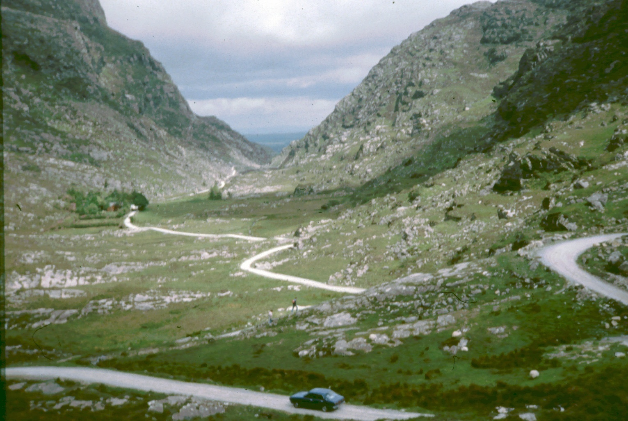
Mountains

Slide 28
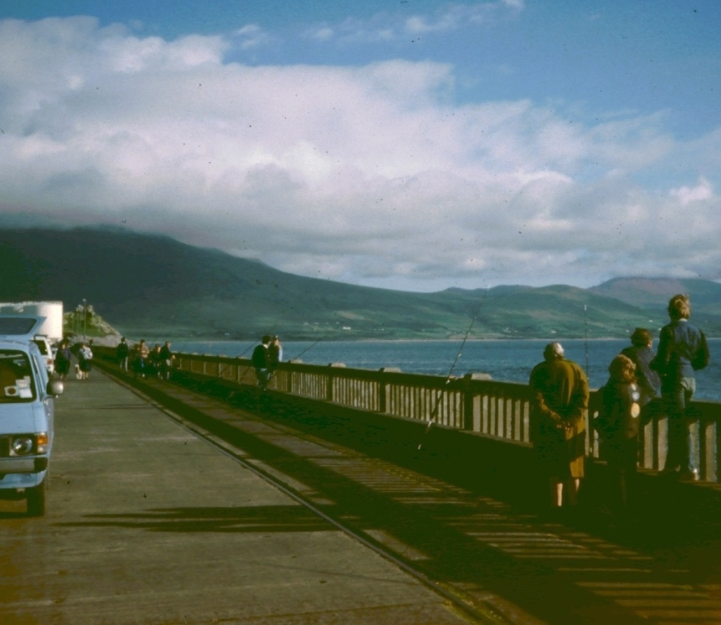
Mountains
Ireland has beautiful mountains.
Typically, the mountains are around the edges of Ireland, and the plains are mostly in the center of the country.

Slide 29
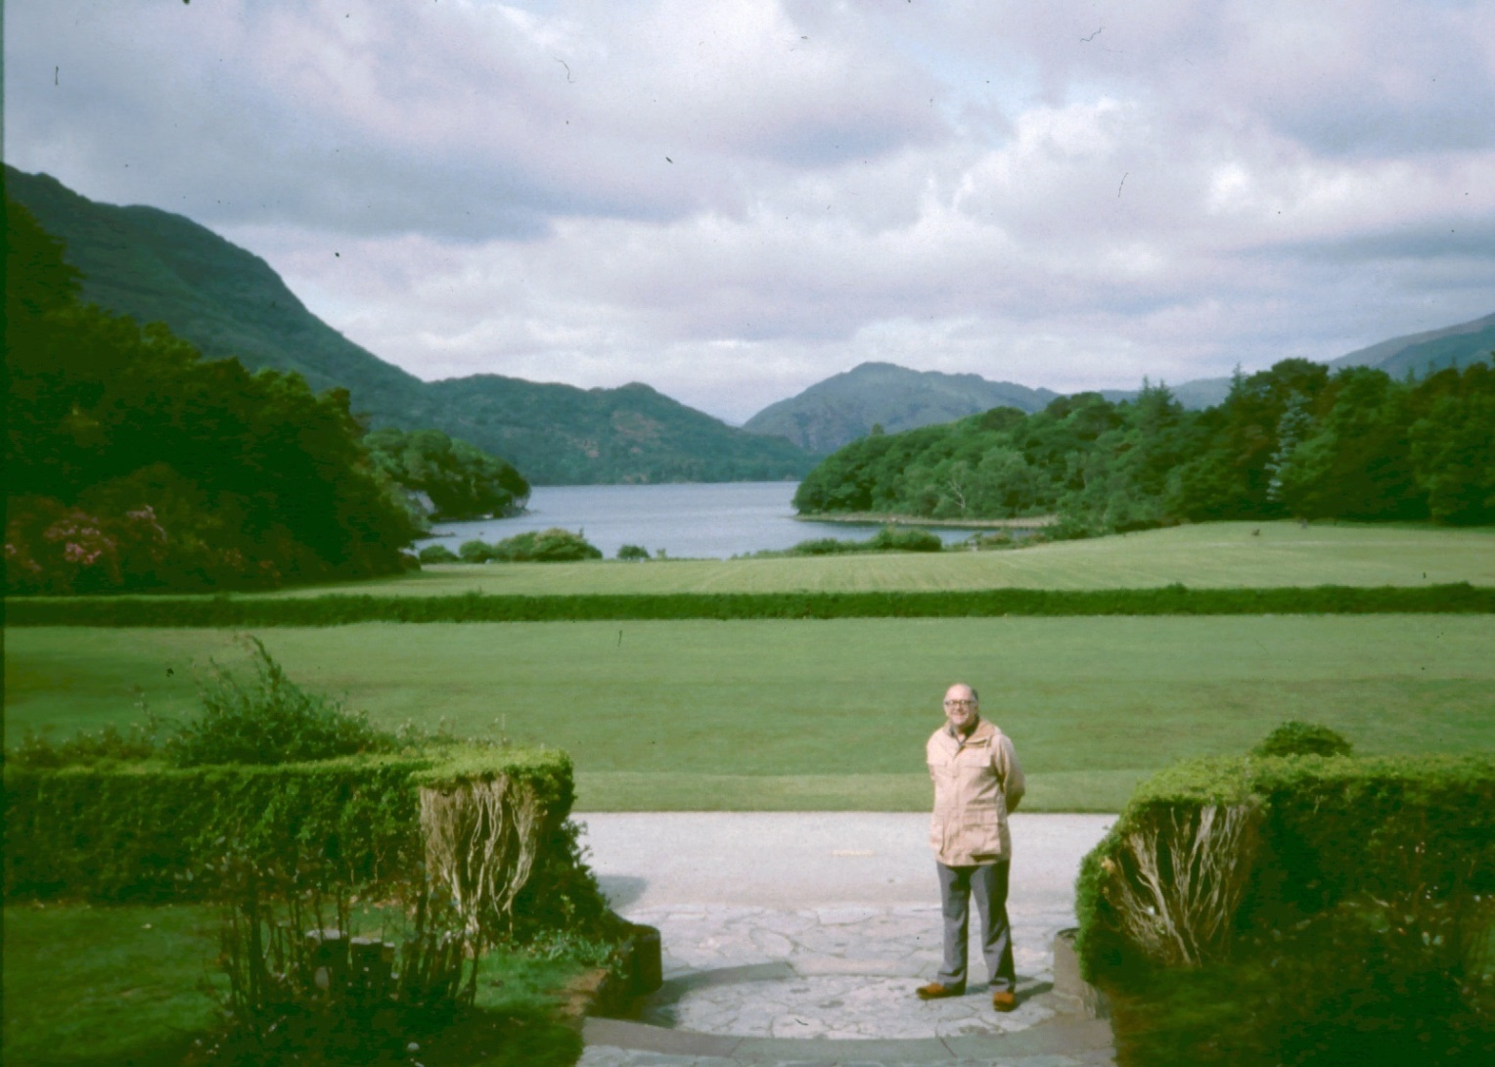
Lakes

Slide 30
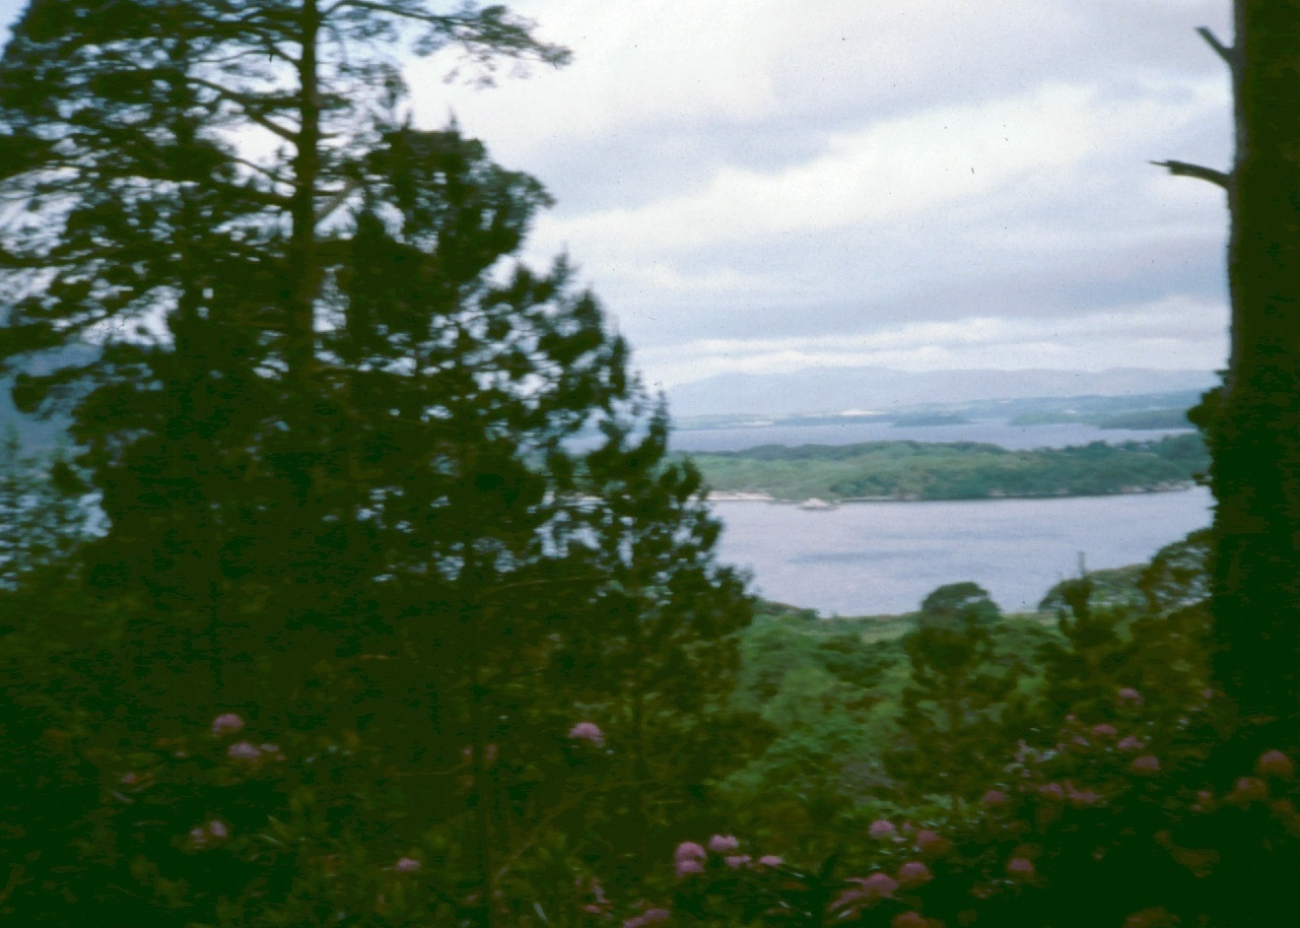
Lakes

Slide 31
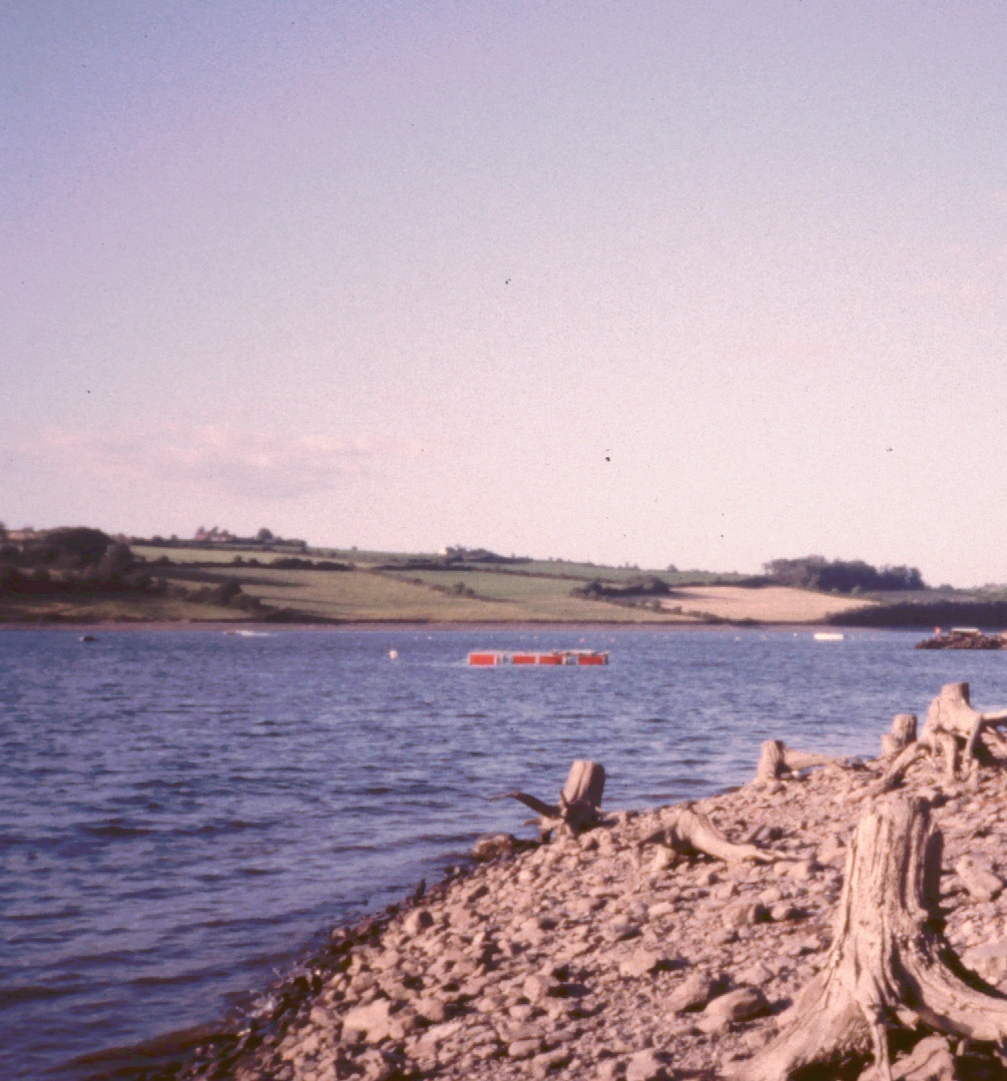
Lakes
Ireland has an abundance of lakes also.
The first two of these are near Killarney.
This one is near Cork.

Slide 32
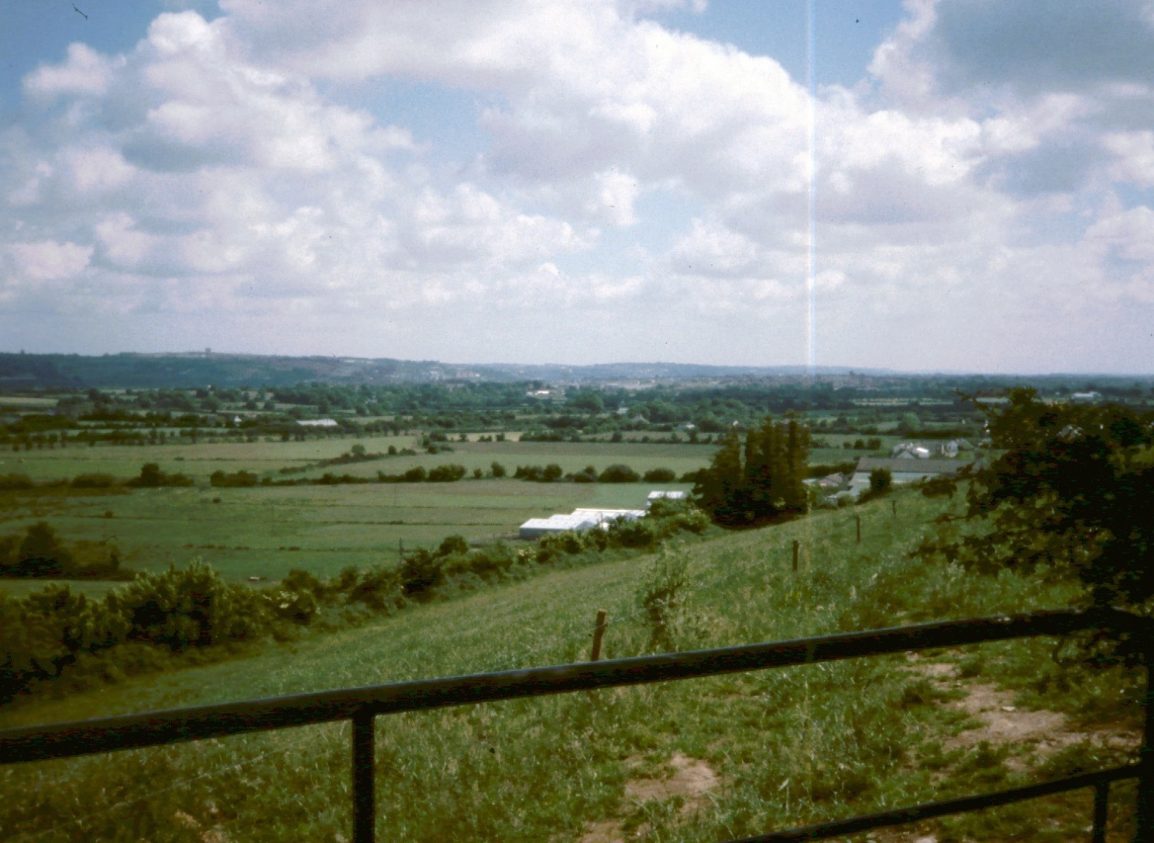
Farms

Slide 33
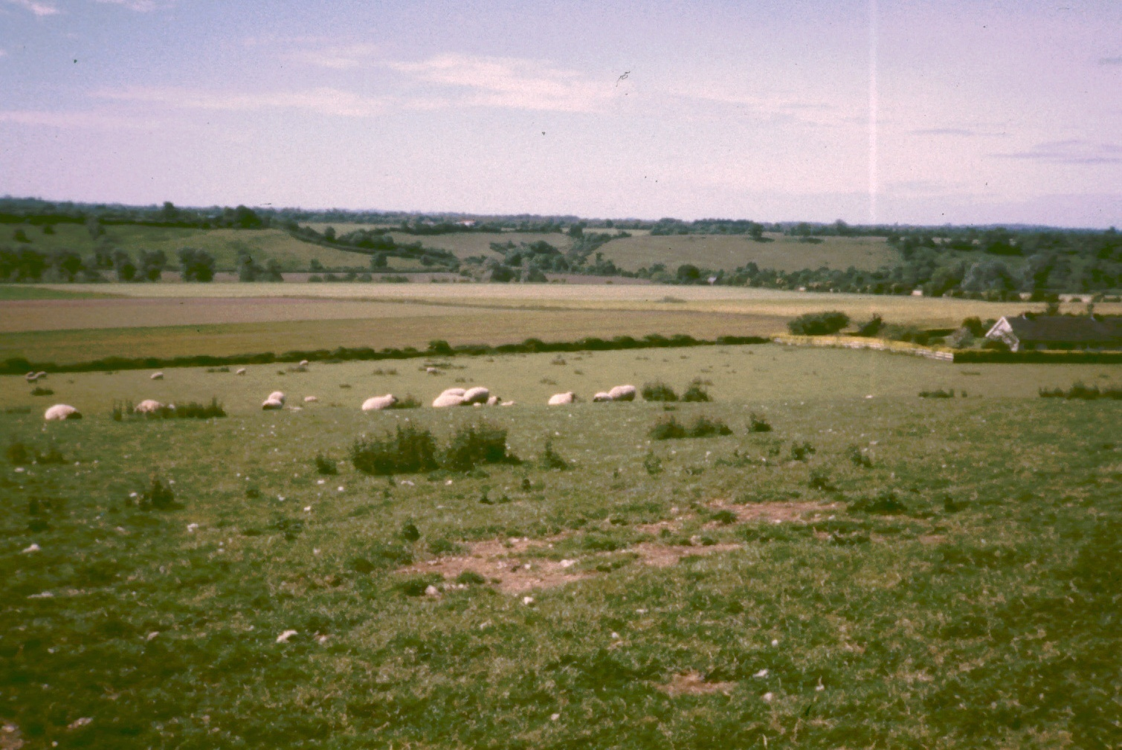
Farms

Slide 34
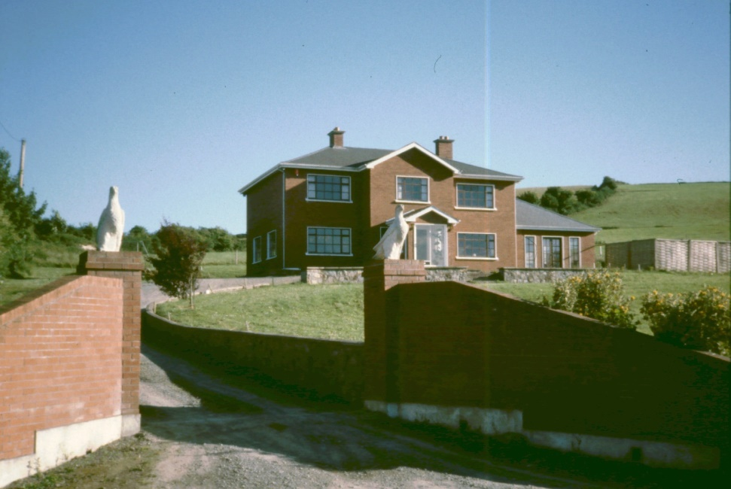
Farms
Farms in Ireland are mostly small, with distinctive stone or hedge field dividers.
Due to agricultural policies of the European Union, Irish farmers have done very well.

Slide 35
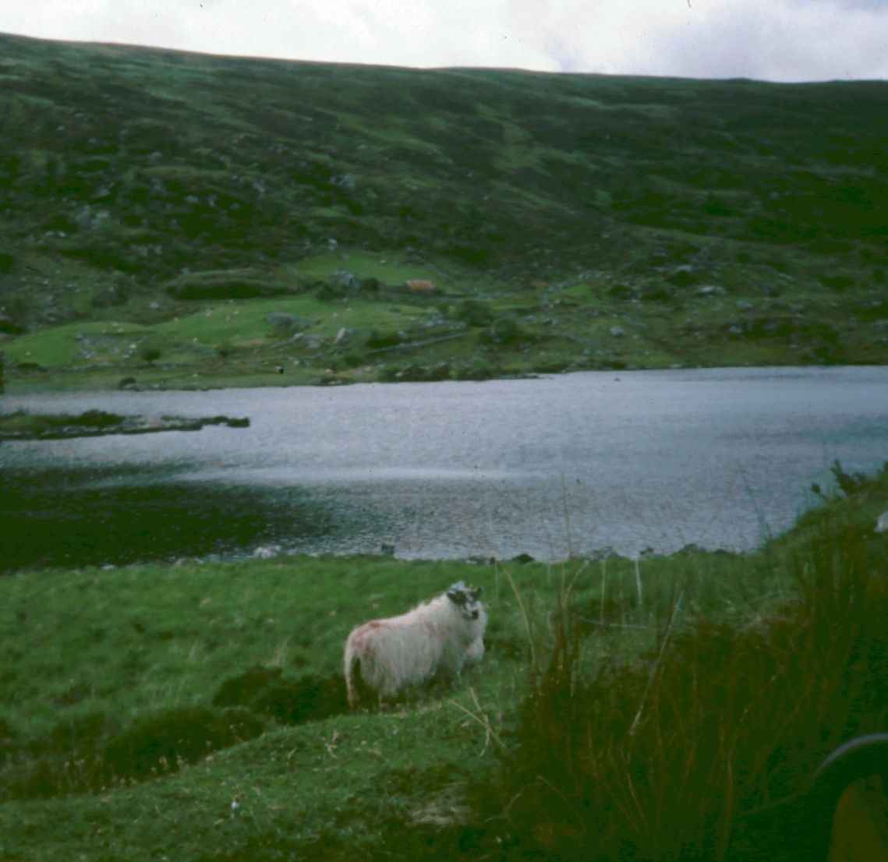
Livestock
Ireland is especially good for grazing, with lush grass everywhere.
The main livestock are sheep, goats and cattle.

Slide 36
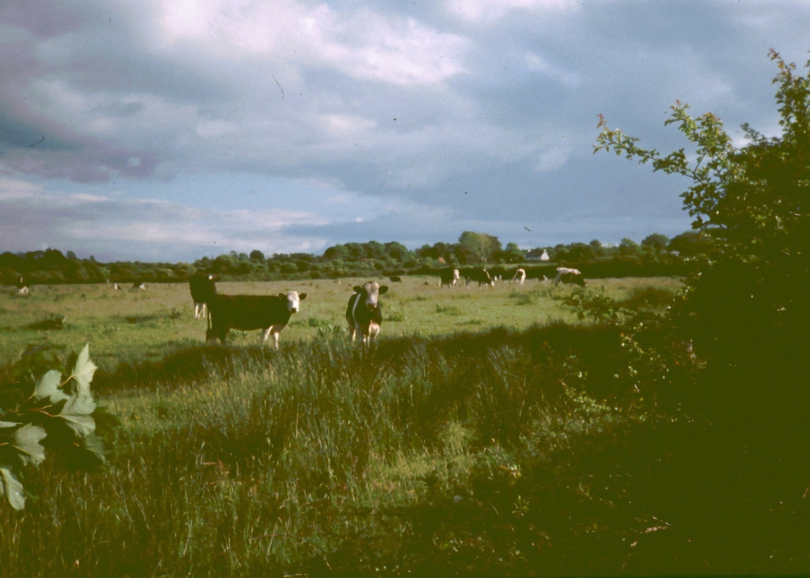
Livestock

Slide 37
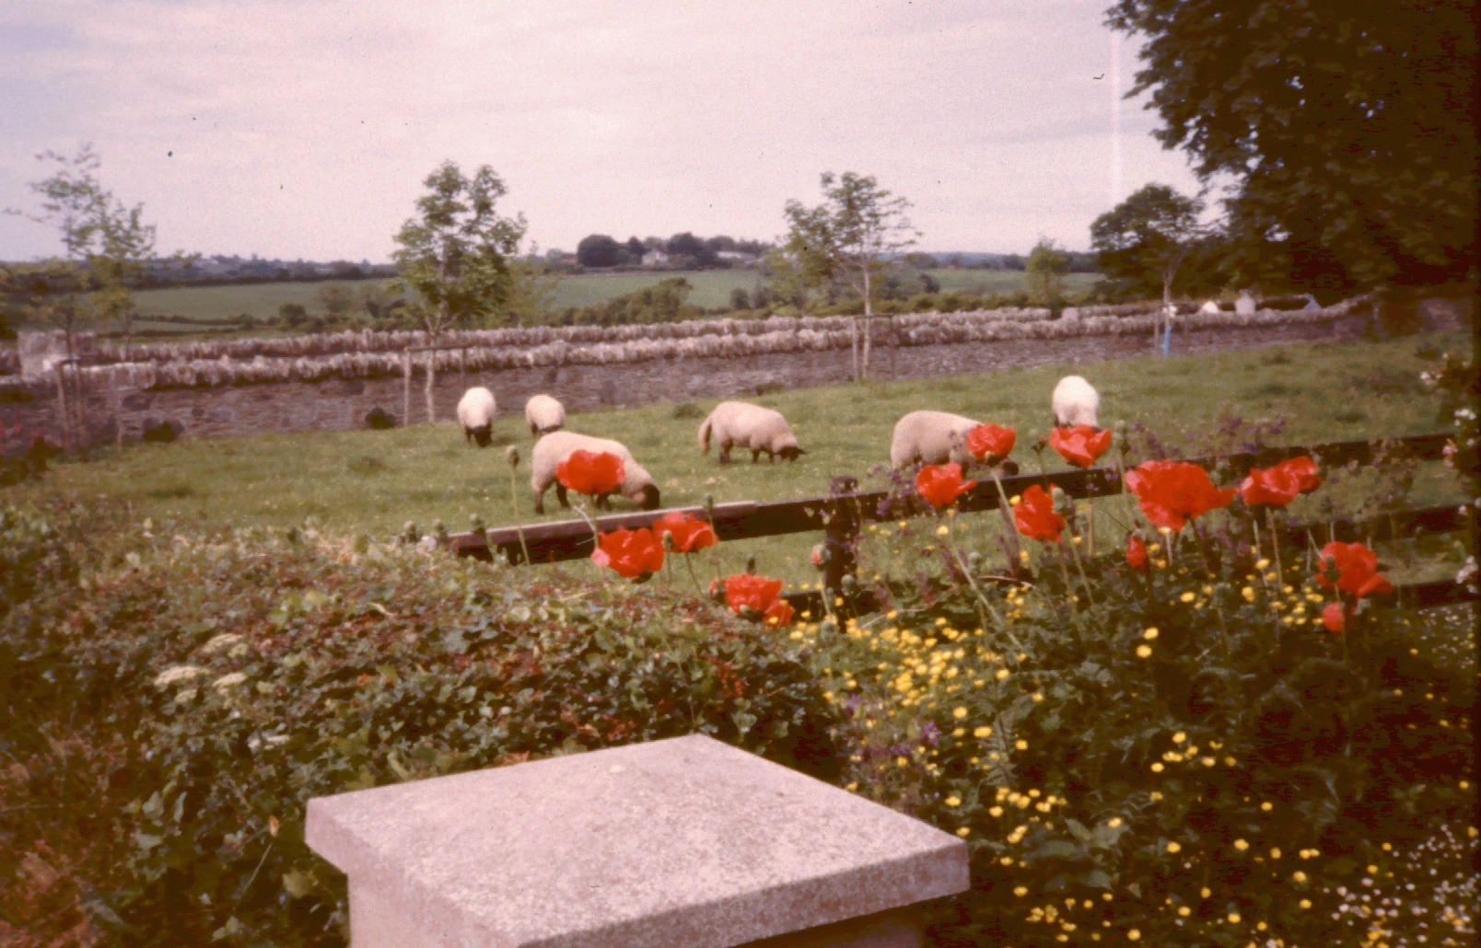
Livestock

Slide 38
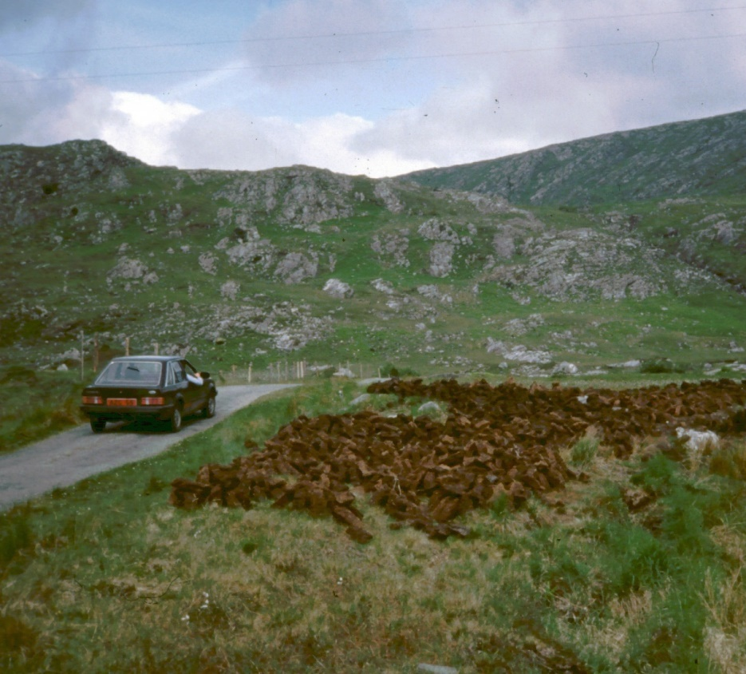
Peat Farming
Peat is a matted turf that is on its way to forming coal.
It is mined & dried in rural areas and used for home & industrial fuel.
It makes a fine, sweet-smelling fire.

Slide 39
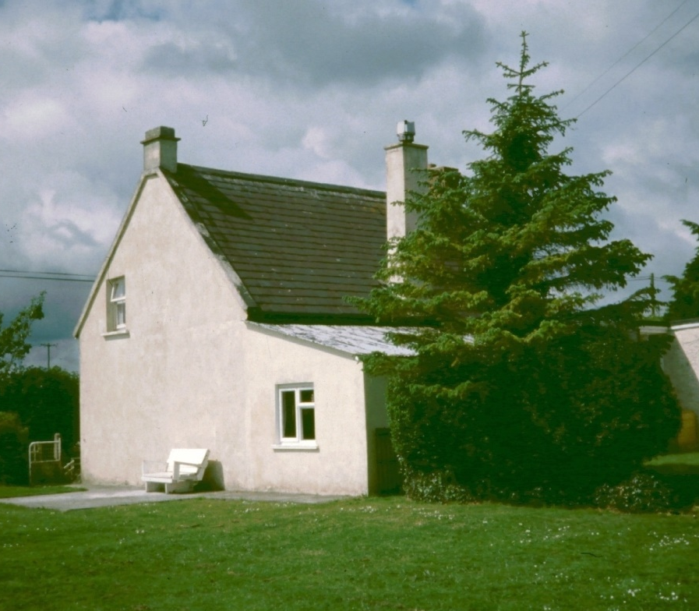
Rural Cottages
This is an example of a typical cottage in the country.
This one, near Tralee, was renovated by the Murphys, a missionary couple.

Slide 40
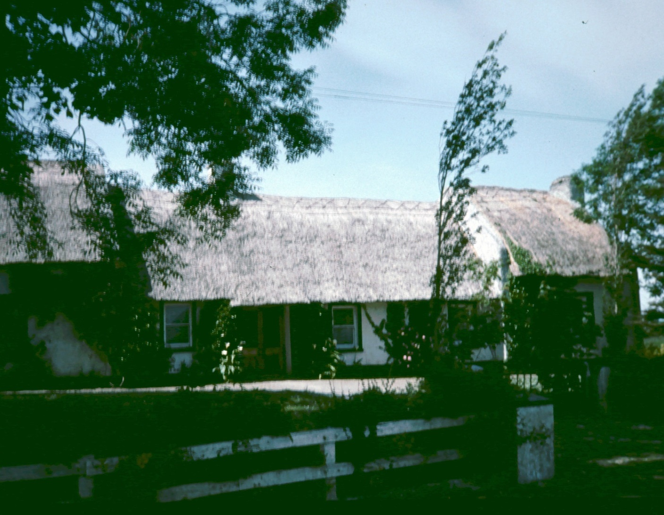
Rural Cottages
Thatched house, N of Tralee

Slide 41
Rural Cottages
19th cen cottage, at Bunratty Castle

Slide 42
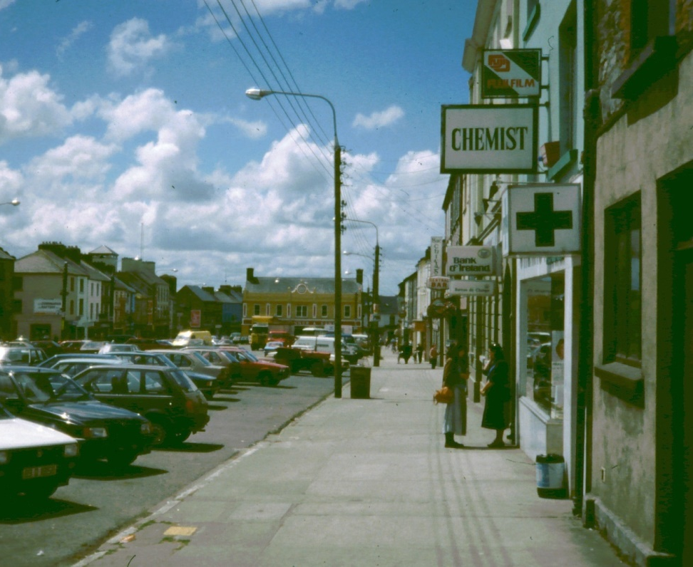
Towns
Ireland has the lowest population density in Europe.
It has many small towns.
This is Castleisland in SW Ireland, County Kerry.

Slide 43
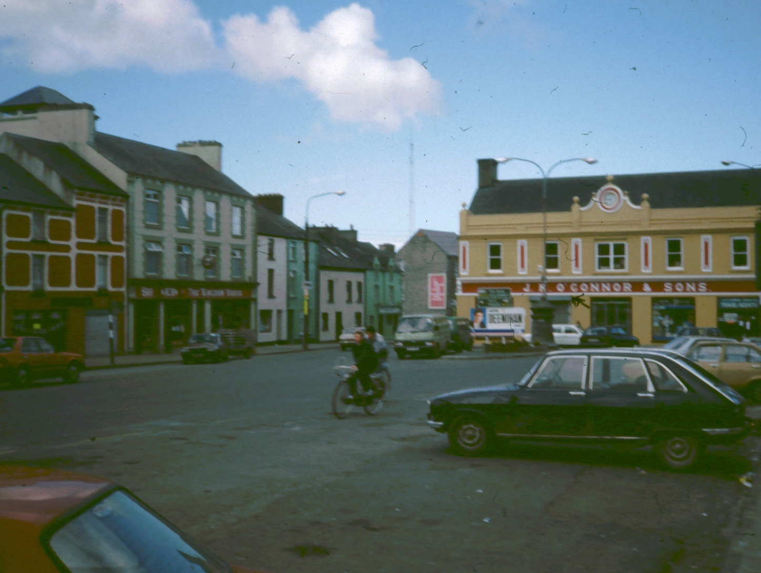
Castleisland

Slide 44
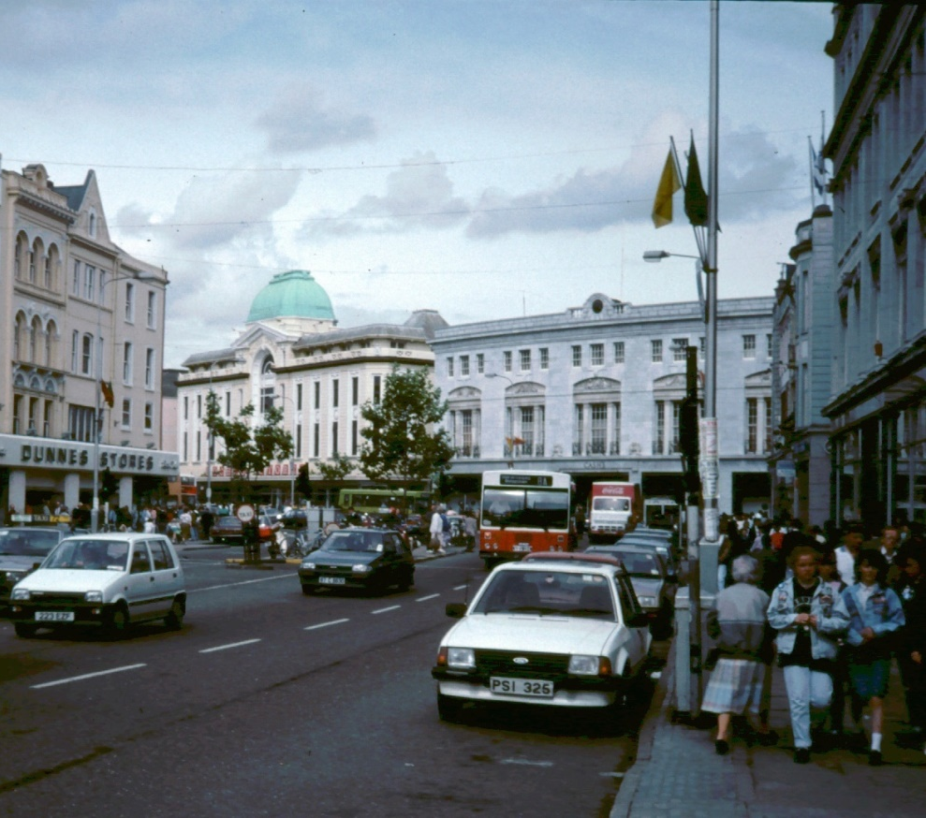
City of Cork
This is the city of Cork, the 2nd largest in Ireland (Republic of Ireland).
At the time of these pictures (1989), its population was about 150,000.

Slide 45
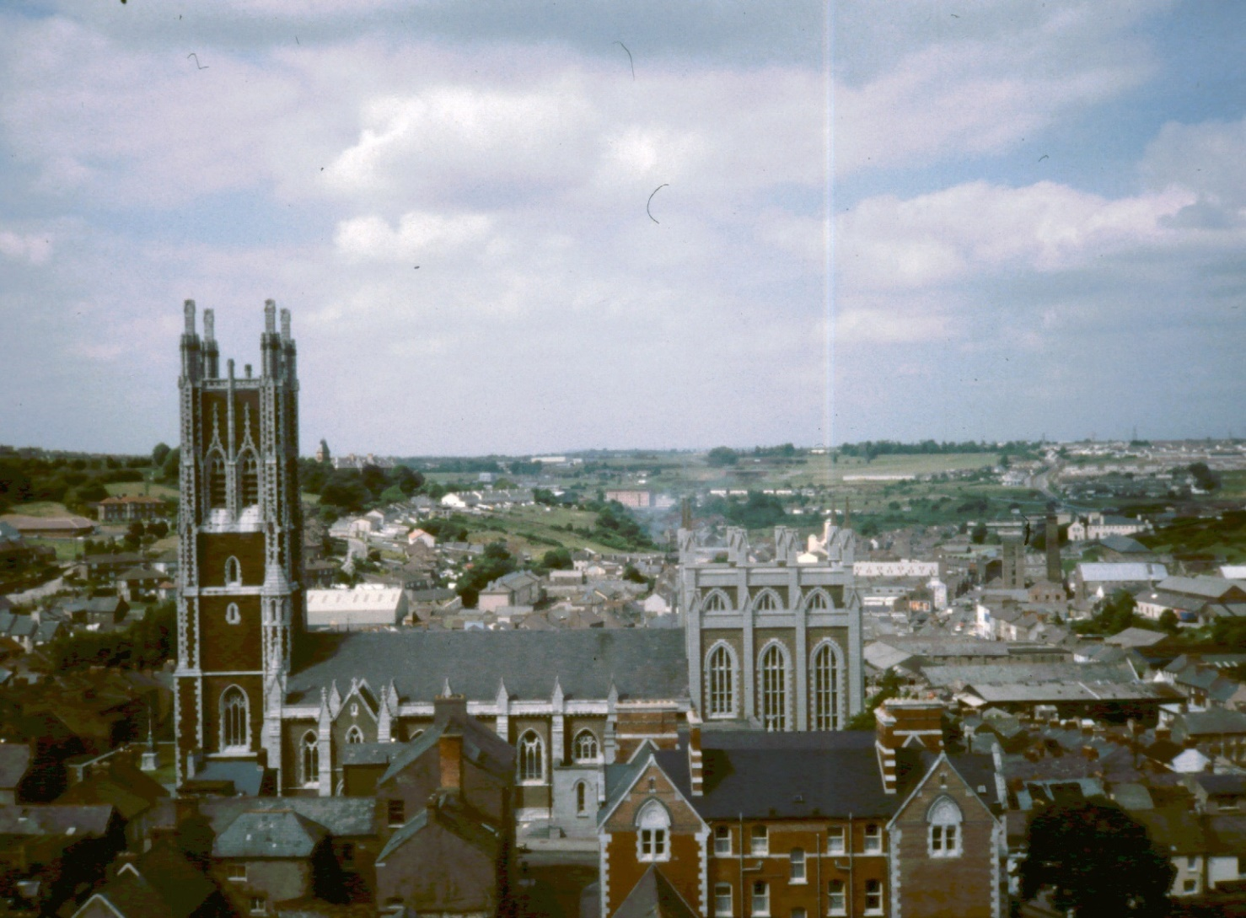
City of Cork

Slide 46
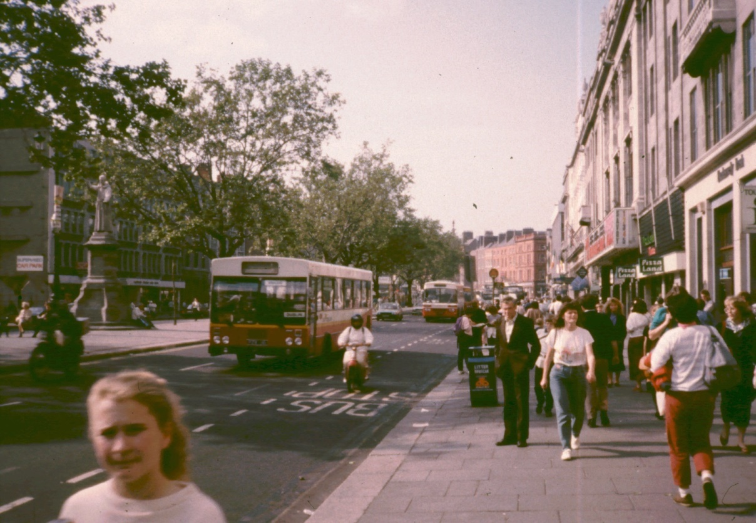
City of Dublin
Dublin is Ireland's largest city, with over 1 million people.
It is the capital of the Republic of Ireland.

Slide 47
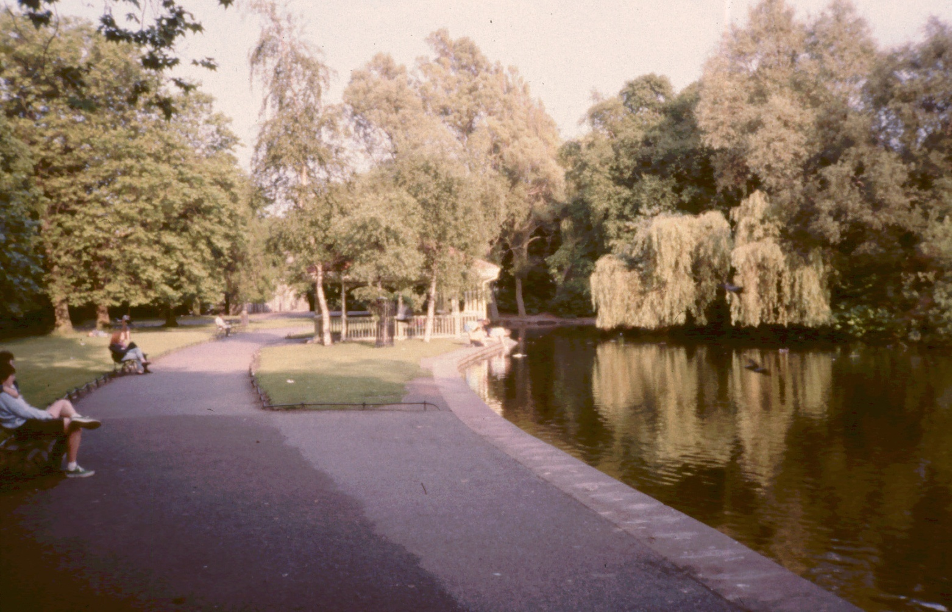
City of Dublin
St. Stephen's Green

Slide 48
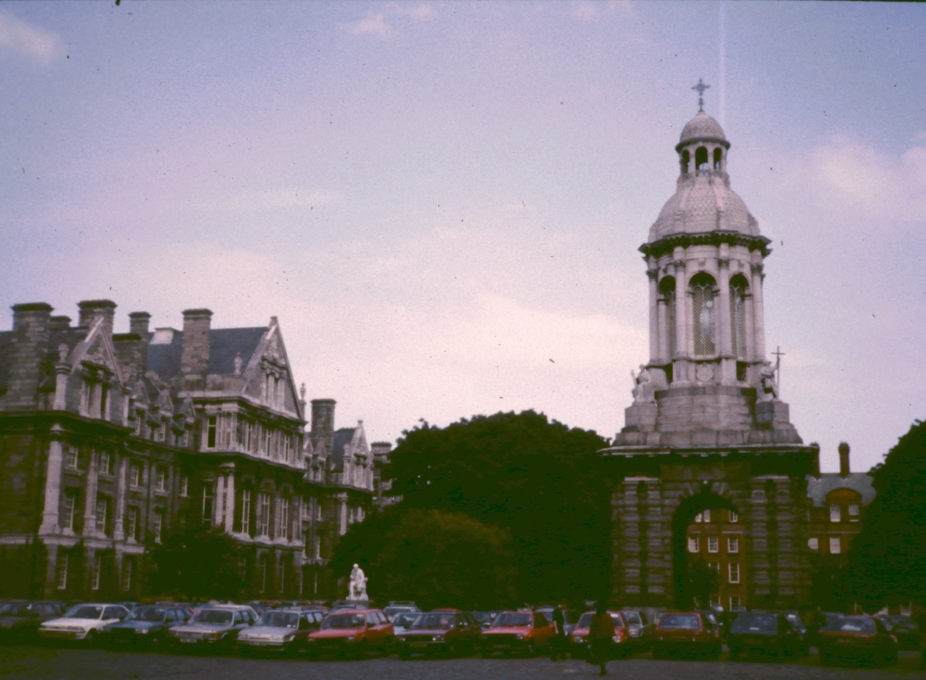
City of Dublin
Trinity College

Slide 49
Churches & Shrines

Slide 50
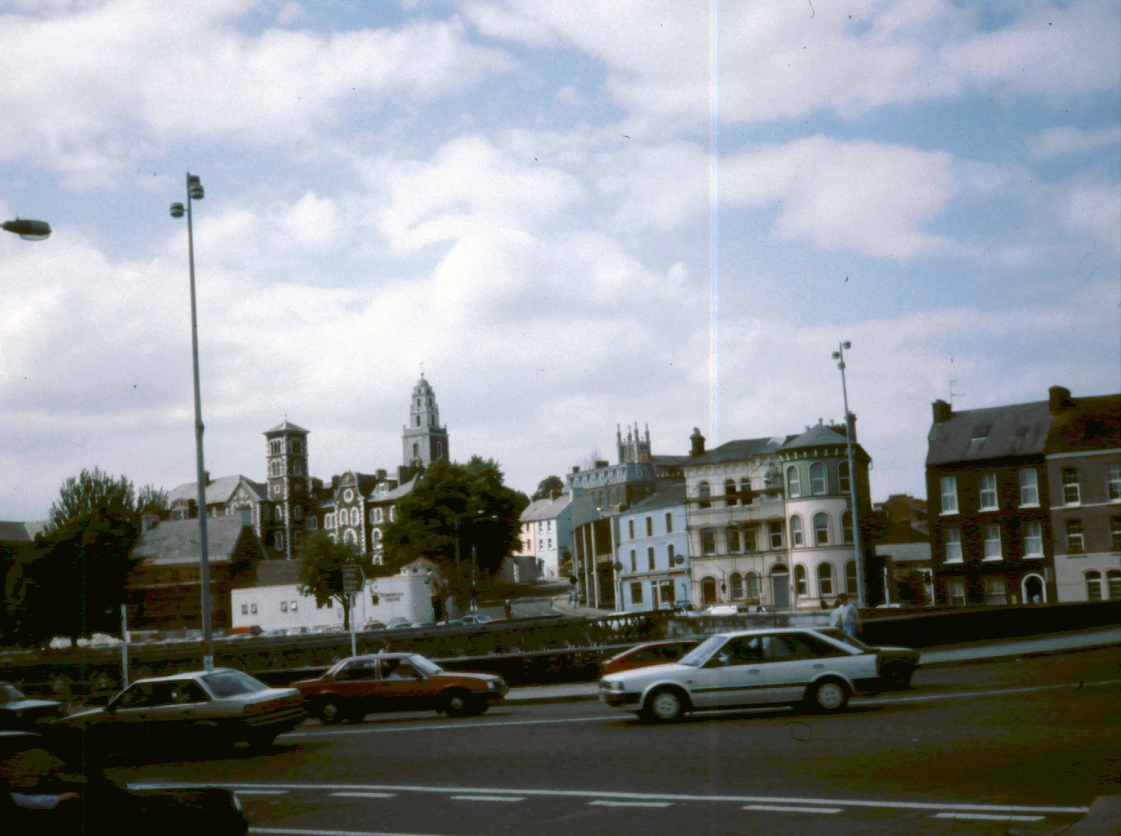
Shandon Cathedral
Church of Ireland (Anglican), Cork

Slide 51
St Margaret's
Roman Catholic, Cork

Slide 52
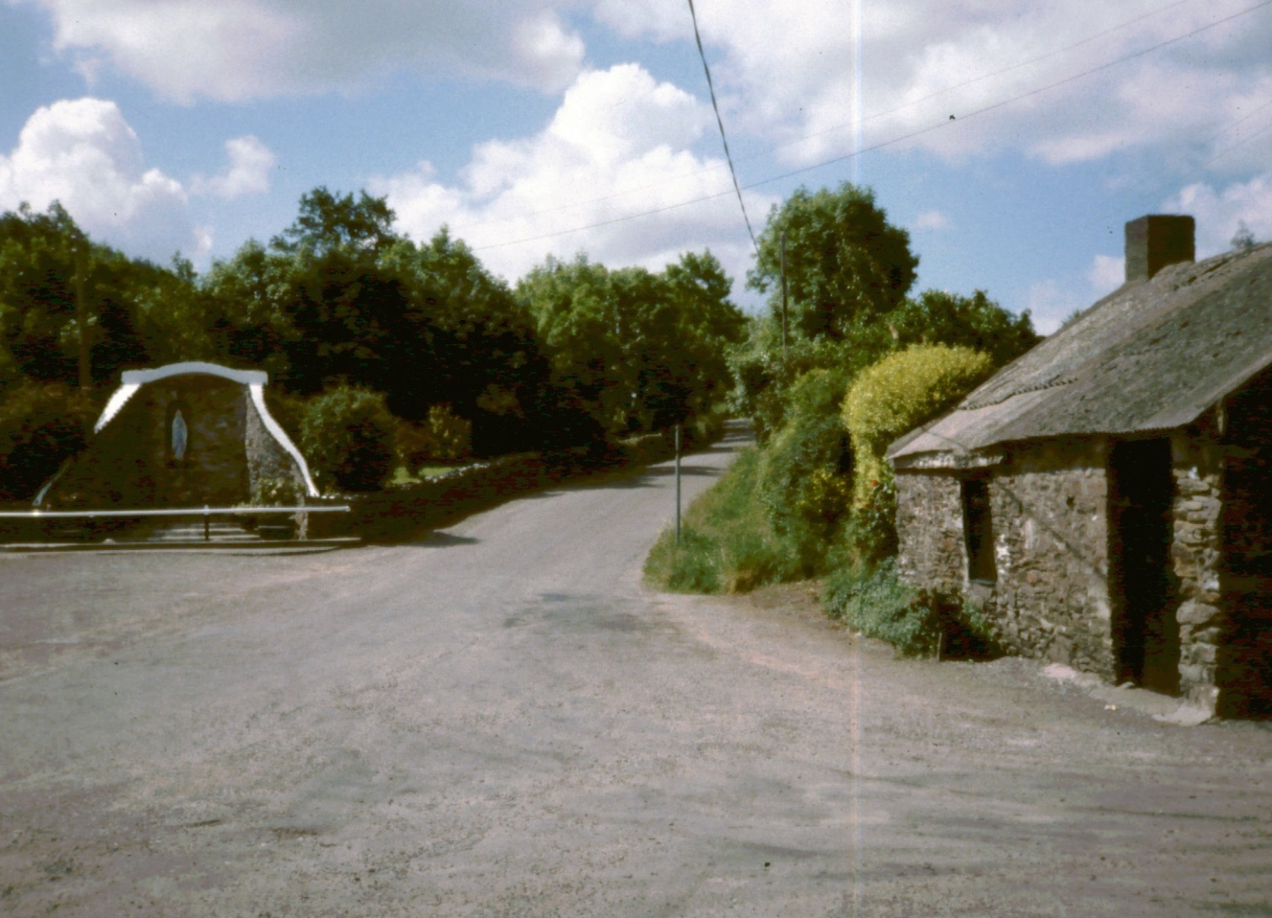
Marian Shrine, Ballinora

Slide 53
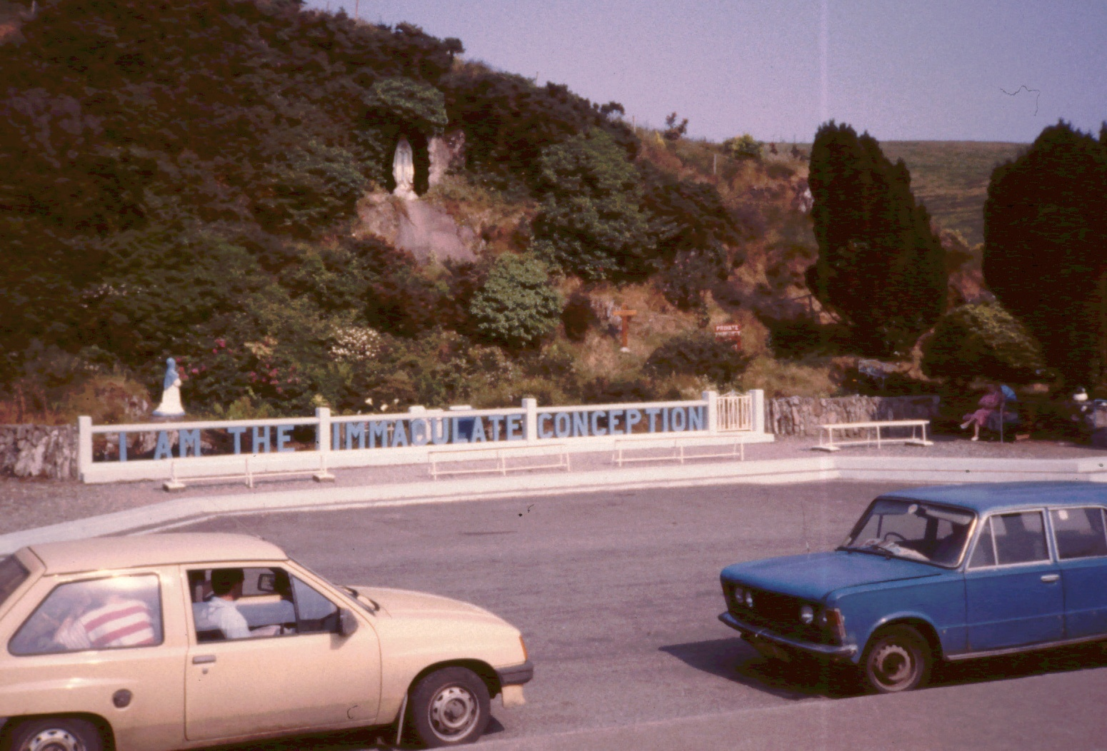
Marian Shrine, Ballinspittle

Slide 54
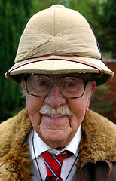
Missionaries

Slide 55
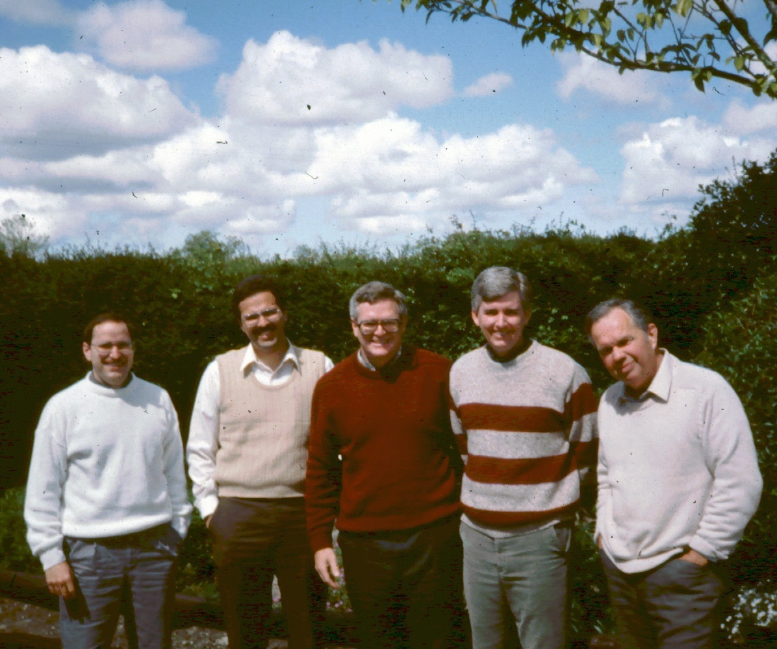
BMW Team, Killarney, Tralee
From Left:
John Herrick
Brian Wagner
Bill Doran
Kerry Butram
Tom Murphy

Slide 56

The Wagners, Killarney
From Left:
Unidentified
Brian Wagner
Lori Wagner
Jessie Wagner
John Toome
John's wife
Jeanette Wagner

Slide 57

The McGanns, UFM, Cork
Bob McGann
Karen
Bobbie
Timmy
Stephen
Ashling

Slide 58

UFM Summer Team
Dan Zagone
Jonathan Thar
With
Bob McGann
& son Bobbie

Slide 59
Irish Believers

Slide 60

Richard Tobin
With Bob McGann in front of The Word Bookshop

Slide 61

Brendan Walsh
Lives in Tralee
Disabled
Writer

Slide 62

The Moores
Live in Ballincollig, near Cork
He owns a computer business
Tony
Heather
Ruth
Lynn

Slide 63
Speaking Sites
For my June 1989 visit

Slide 64

Ivy Cultural Center
Castleisland
A former Ch of Ireland church building

Slide 65

St Colm's High School
Private school emphasizing Irish culture

Slide 66

Connolly Hall
Labor Union hall
In downtown Cork

Slide 67
Which Way, Ireland?

Slide 68

Heavy Metal in Cork

Slide 69

Scripture Sign
Jesus said: What shall it profit a man if he shall gain the whole world and lose his own soul?

Slide 70

Which way?

Slide 71
The End
Pray for Ireland!

