Slide 1
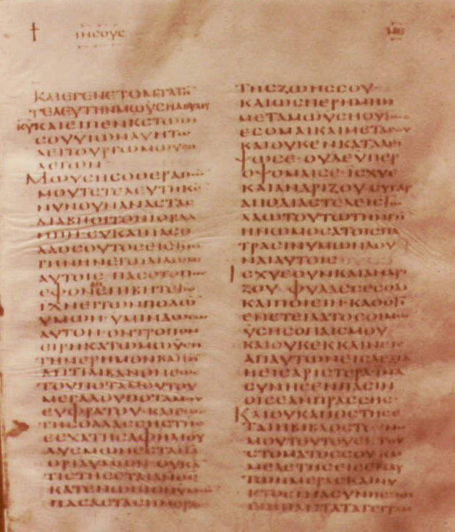
The Incarnation & the Text of the Septuagint
Robert C. Newman

Slide 2
A Puzzle
Have you ever noticed the peculiar quotation in Hebrews 10:5-7?
5 (NIV) Therefore, when Christ came into the world, he said: "Sacrifice and offering you did not desire, but a body you prepared for me; 6 with burnt offerings and sin offerings you were not pleased. 7 Then I said, 'Here I am–it is written about me in the scroll–I have come to do your will, O God.'"

Slide 3
A Puzzle
This is a quotation from Psalm 40, but it reads differently there in the English, which is a translation from the Hebrew.
6 (NIV) Sacrifice and offering you did not desire, but my ears you have pierced; burnt offerings and sin offerings you did not require. 7 Then I said, "Here I am, I have come–it is written about me in the scroll."

Slide 4
A Puzzle
Hebrews 10 has "a body you prepared for me," but Psalm 40 has "my ears you have pierced."
It turns out that Hebrews 10 is following the ancient Greek translation which we call the Septuagint, often abbreviated "LXX."
Some have claimed that this was a mistranslation, a copying error, or even that the writer of Hebrews intentionally changed the text.

Slide 5
A Solution?
Here we are going to suggest that this is not a copying error or a mistranslation, but a paraphrase.
We suspect that the translator of this portion of the Psalms was seeking to preserve an ambiguity in the Hebrew by choosing a phrase in the Greek with a similar ambiguity.
Let’s see.

Slide 6
Psalm 40
Let's look at the context of this passage in Psalm 40.
In verses 1-5, someone is delivered from destruction by God.
In verses 6-8, this person is seen to have been predicted to come, and that he somehow replaces sacrifice.
The rest of the psalm indicates this has some peculiar connection with sin and righteousness.

Slide 7
Ps 40:1-5: Delivered
40:1 (NIV) I waited patiently for the LORD; he turned to me and heard my cry. 2 He lifted me out of the slimy pit, out of the mud and mire; he set my feet on a rock and gave me a firm place to stand. 3 He put a new song in my mouth, a hymn of praise to our God. Many will see and fear and put their trust in the LORD.
4 Blessed is the man who makes the LORD his trust,
who does not look to the proud, to those who turn aside to false gods.
5 Many, O LORD my God, are the wonders you have done. The things you planned for us no one can recount to you; were I to speak and tell of them, they would be too many to declare.

Slide 8
Ps 40:6-8: Predicted
6 (NIV) Sacrifice and offering you did not desire,
but my ears you have pierced;
burnt offerings and sin offerings
you did not require.
7 Then I said, "Here I am, I have come–
it is written about me in the scroll.
8 I desire to do your will, O my God;
your law is within my heart."

Slide 9
Ps 40:9-13: Sin & Righteousness
9 (NIV) I proclaim righteousness in the great assembly;
I do not seal my lips, as you know, O LORD.
10 I do not hide your righteousness in my heart;
I speak of your faithfulness and salvation.
I do not conceal your love and your truth
from the great assembly.
11 Do not withhold your mercy from me, O LORD;
may your love and your truth always protect me.
12 For troubles without number surround me;
my sins have overtaken me, and I cannot see.
They are more than the hairs of my head,
and my heart fails within me.
13 Be pleased, O LORD, to save me;
O LORD, come quickly to help me.

Slide 10
Ps 40:14-17: Sin & Righteousness
14 May all who seek to take my life be put to shame and confusion; may all who desire my ruin be turned back in disgrace.
15 May those who say to me, "Aha! Aha!"
be appalled at their own shame.
16 But may all who seek you rejoice and be glad in you;
may those who love your salvation always say,
"The LORD be exalted!"
17 Yet I am poor and needy; may the Lord think of me.
You are my help and my deliverer;
O my God, do not delay.

Slide 11
Psalm 40
To recap:
In verses 1-5, someone is delivered from destruction by God.
In verses 6-8, this person is seen to have been predicted to come, and that he somehow replaces sacrifice.
The rest of the psalm indicates this has some peculiar connection with sin and righteousness.

Slide 12
Hebrews 10
Now let’s look at Hebrews 10:1-14.
In verses 1-4, we see that animal sacrifice is insufficient, though (v 8b) commanded.
In verses 5-7, Psalm 40:6-8 is applied to Jesus' coming.
His doing God's will replaces animal sacrifice (8-10).
This doing God's will involves Jesus' own sacrifice (10, 12, 14)

Slide 13
Heb 10:1-4: Sacrifice
1 (NIV) The law is only a shadow of the good things that are coming–not the realities themselves. For this reason it can never, by the same sacrifices repeated endlessly year after year, make perfect those who draw near to worship.
2 If it could, would they not have stopped being offered? For the worshipers would have been cleansed once for all, and would no longer have felt guilty for their sins.
3 But those sacrifices are an annual reminder of sins,
4 because it is impossible for the blood of bulls and goats to take away sins.

Slide 14
Heb 10:5-7: Applied to Jesus
5 (NIV) Therefore, when Christ came into the world, he said:
"Sacrifice and offering you did not desire,
but a body you prepared for me;
6 with burnt offerings and sin offerings
you were not pleased.
7 Then I said, 'Here I am–it is written about me in the scroll–
I have come to do your will, O God.'"

Slide 15
Heb 10:8-10: Doing God’s Will
8 (NIV) First he said, "Sacrifices and offerings, burnt offerings and sin offerings you did not desire, nor were you pleased with them" (although the law required them to be made).
9 Then he said, "Here I am, I have come to do your will." He sets aside the first to establish the second.
10 And by that will, we have been made holy through the sacrifice of the body of Jesus Christ once for all.

Slide 16
Heb 10:10-14: Jesus’ Sacrifice
10 (NIV) And by that will, we have been made holy through the sacrifice of the body of Jesus Christ once for all.
11 Day after day every priest stands and performs his religious duties; again and again he offers the same sacrifices, which can never take away sins.
12 But when this priest had offered for all time one sacrifice for sins, he sat down at the right hand of God.
13 Since that time he waits for his enemies to be made his footstool,
14 because by one sacrifice he has made perfect forever those who are being made holy.

Slide 17
Hebrews 10
To recap:
In verses 1-4, we see that animal sacrifice is insufficient, though (v 8b) commanded.
In verses 5-7, Psalm 40:6-8 is applied to Jesus’ coming.
His doing God’s will replaces animal sacrifice (8-10).
This doing God’s will involves Jesus’ own sacrifice (10, 12, 14).

Slide 18
The Problem
How do we get from "my ears you have pierced" to "a body you have prepared me"?
Let's look first at the Hebrew and then at the Greek.

Slide 19
The Hebrew
In English, to pierce one's ears sounds like punching a hole in one’s earlobe.
The Hebrew, more literally, says "my ears you have dug."
This suggests another possibility as well, the picture of a potter molding a human head, and opening its ear holes by digging his thumbs into the clay.

Slide 20
The Hebrew
The idea of piercing a person’s ears is connected with voluntary slavery in Exodus 21:2-6 and Deuteronomy 15:12-18.
Let's look at the Exodus passage.

Slide 21
Exodus 21:2-6
2 (NIV) "If you buy a Hebrew servant, he is to serve you for six years. But in the seventh year, he shall go free, without paying anything. 3 If he comes alone, he is to go free alone; but if he has a wife when he comes, she is to go with him. 4 If his master gives him a wife and she bears him sons or daughters, the woman and her children shall belong to her master, and only the man shall go free. 5 But if the servant declares, 'I love my master and my wife and children and do not want to go free,' 6 then his master must take him before the judges. He shall take him to the door or the doorpost and pierce his ear with an awl. Then he will be his servant for life."

Slide 22
The Hebrew
So, there are (at least) two possibilities in the Hebrew expression "my ears you have dug."
(1) The author is using a synecdoche (a part for the whole) to picture God making someone's body.
(2) The author is referring to God having made the person a voluntary slave.

Slide 23
The Greek
What are we to make of the Greek expression "a body you have prepared for me"? Does it have a similar ambiguity?
Obviously, the expression as it is usually translated fits very well with the picture of God making his body, without even using a figure of speech.
In fact, a common feature of the LXX is to explain Hebrew speech figures in literal language.

Slide 24
The Greek
The Greek word translated "body" here is σωμα (soma), and this is its usual translation.
This word is sometimes translated "slave," though this is not its commonest meaning.
If we do this, the phrase becomes "You have made me a slave," which exactly fits the other Hebrew connotation!

Slide 25
The Solution?
The translator of Psalm 40 into Greek has apparently chosen a paraphrase by which to preserve the creation/enslavement ambiguity of the Hebrew in his Greek translation.
Both sides of this ambiguity perfectly fit the incarnation of God in Jesus which occurred centuries after the original of Psalm 40 was written!

Slide 26
Jesus!
The New Testament tells us that Jesus is God incarnated in humanity – that He is uncreated as regards His deity, created as regards his humanity.
So God "dug his ears" or "prepared his body" when He came into the world.
But Jesus came into the world to be the suffering servant of Isaiah 40-53, to become a slave voluntarily because He loved his master, wife and children and did not want to go free!

Slide 27
Conclusions
May the Lord help us to appreciate better what He has done in sending Jesus to be our savior.
May He help us to appreciate His control of history as seen in fulfillment of prophecy.
May we share Jesus' attitude of humble servant in order to be more like Him.

Slide 28
The End
Jesus' Incarnation Fulfills the Prophecy of Psalm 40

