Slide 1
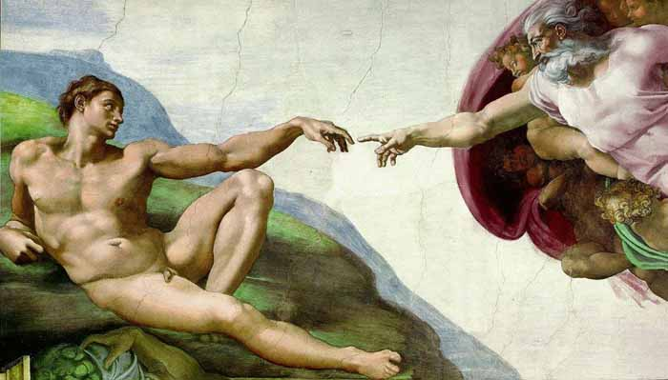

Human Origins
Robert C. Newman

Slide 2
The Biblical Account
In Genesis one, we are told that God made man, both male & female, in His own image, without any further detail.
In Genesis two, we are told in addition that God made the human male first (from the dust of the earth), and made the female later from his side.
This pair, though created morally good, rebelled & brought disaster to themselves & their offspring.

Slide 3
The Evolutionary Account
The typical evolutionary picture of human origins is that mankind developed gradually from a whole population of apes over the course of millions of years.
Thus there never was an original pair, so that the fall of humans (if such ever happened) must have been something quite different.
This account dominates education & the media, liberal Christendom, and is beginning to have influence in evangelical circles.

Slide 4
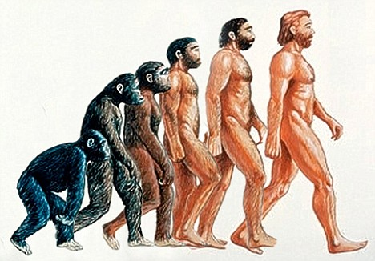
The Typical Presentation

Slide 5
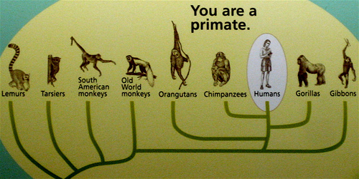
Relation of Humans to Primates

Slide 6
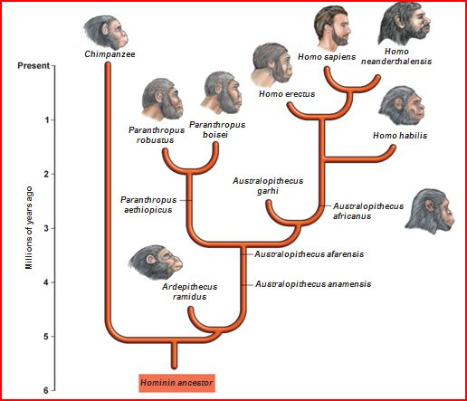
Relation to Other Hominins

Slide 7
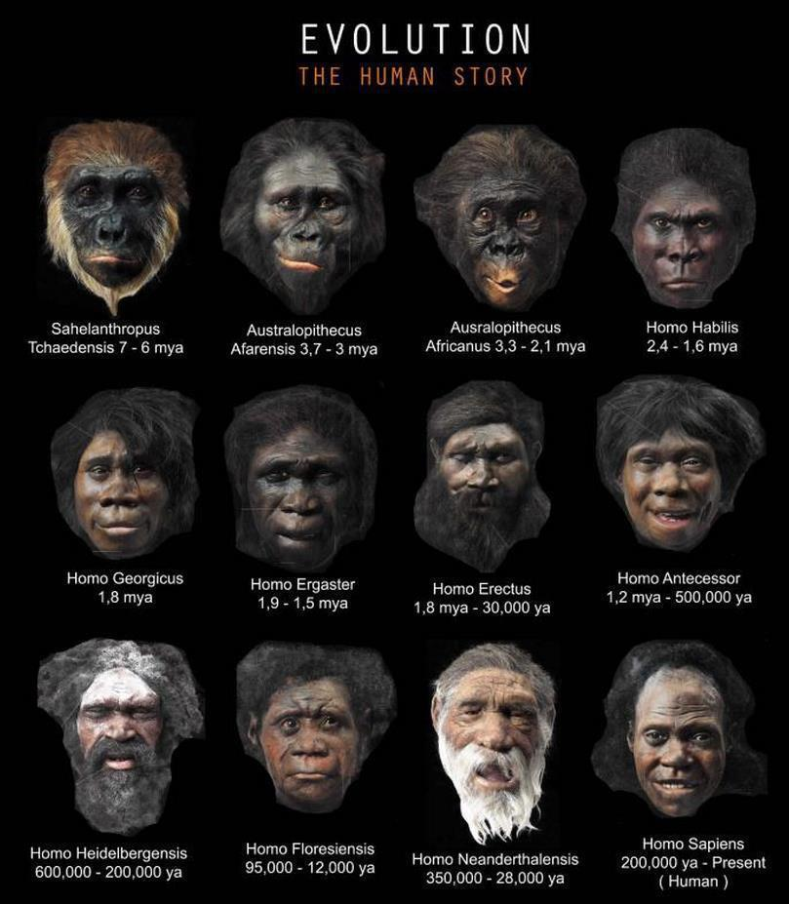
Artist's Reconstructions

Slide 8
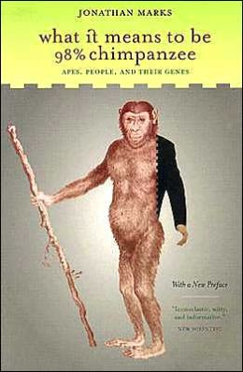
DNA: the Human Genome
The human genome has recently been decoded, though it is not yet fully understood.
It contains about 3 billion base-pairs.
It is claimed to be 98% the same as that of the chimpanzee.

Slide 9
Our Response
So what can we say? Is it evolution after all?
Let's start with the DNA.
Let's also suppose the 98% figure is correct.
Then we must have 2% change in 5 million years to get from chimp to humans.

Slide 10
DNA Calculation
That would be 1% change in each branch, the human and the chimp.
One percent of 3 billion base-pairs is 30 million base-pairs.
Divided by 5 million years, is 6 b-p per year.
That means 6 b-p in the genome leading to humans have to be changed each year, and all these incorporated into the whole population.

Slide 11
DNA Calculation
The effective population size is about 10 thousand, the mutation rate is 10⁻⁸ per nucleotide per generation, the generation time is 5 to 10 years.
So in 5 million years, we get about 3 x 10¹¹ mutations, which sounds like enough!
But that was scattered thru the whole population of 10 thousand individuals in each of one million generations.

Slide 12
DNA Calculation
So how many of these mutations survive & spread to the whole population & thus characterize the final population of humans?
To survive & spread, mutations typically need to be beneficial.
If they are harmful, they tend to be eliminated.
If they are neutral, they only spread by a random walk, a very slow process!

Slide 13
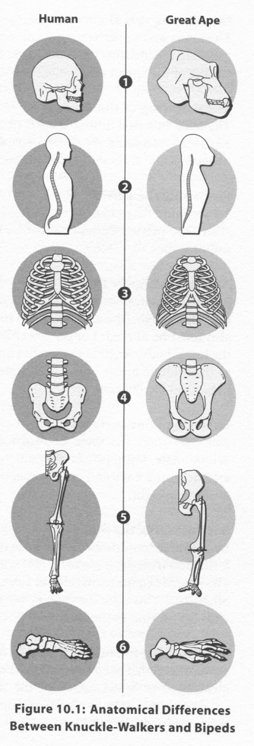
Distinctive Anatomical Features
Distinguishing Ape & Human
Bramble & Lieberman count 16 features that appear first in the Homo lineage.
The picture at right illustrates six of these:
  Relocating foramen magnum
  Introducing spinal curvature
  Restructuring the rib cage
  Reshaping the pelvis
  Altering the lower limbs
  Restructuring the foot
Each of these features surely required multiple mutations.

Slide 14
Getting Coordinated Changes
Gauger & Axe have shown that to get 7 coordinated mutations even in a bacterial population would take 10²⁷ years.
Bacteria have populations of billions.
They reproduce with thousands of generations per year.
So there is no way these changes will occur in a few million years!

Slide 15
Do We Have 98% Similarity?
This number is somewhat like the claim that all of Shakespeare is in the Dictionary. It ignores location & syntax.
When one considers the DNA in chimps but not humans (& vice versa), the number drops to about 70% similarity.
This became apparent when the whole chimp genome was deciphered.

Slide 16
What About Junk DNA?
The presence of large amounts of DNA in the human genome which doesn’t code for proteins was initially seen as junk, evidence that humans (& life itself) were not designed but the result of random changes.
Both Francis Collins & Kenneth Miller make a great deal of this, claiming that God (who exists) did not design humans, but let chance do so.
Richard Dawkins agrees, tho he leaves out God.

Slide 17
Is It Really Junk?
Already by 2002, Richard Sternberg noted there was considerable evidence that 'junk DNA' was functioning in the cell in ways other than coding for proteins.
These functions include numerous control activities of various sorts.
The ENCODE project and more recent work suggest that most DNA is used in one way or another.

Slide 18
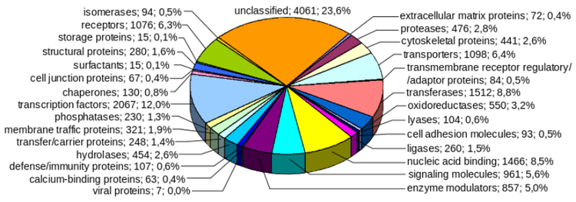
Junk DNA?

Slide 19
A Second Genetic Code
It has been known for a long time that the cell often processes its DNA by cutting it into pieces which are then spliced together in various ways before being used.
It now appears that there is some sort of splicing code which gives the cell great diversity of function.
These codes differ substantially between species. How did they get there?

Slide 20
Some Conclusions
Life in general (& humans in particular) seem to be very cleverly designed, even without taking the intellectual & spiritual differences between humans & apes into account.
It now appears that the development of life over the history of the earth looks more like what we are learning to do in genetic engineering than it does like unguided processes.

Slide 21
What About Adam?
One problem in fitting the evidence from nature with that of Scripture is the question: Where does Adam fit into the chronology of the fossil record?
Is Adam rather recent, as young-earth creationists and some old-earth creationists say?
Is he further back, as other old-earth creationists suggest?

Slide 22
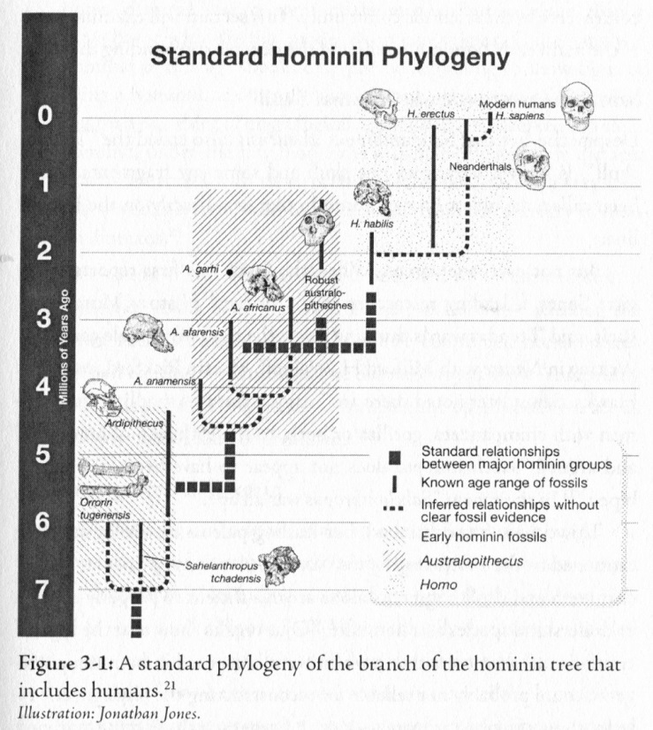
The Standard Scheme for Hominins
One old-earth creationist I know puts Adam back at 5 million years, with the appearance of the Australopithecines.
Another puts Adam up at about 5000 BC, just before the historical period begins.
Homo
Lucy

Slide 23
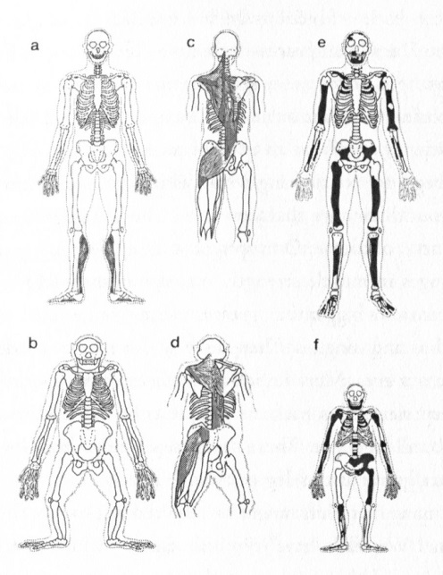
Homo vs pre-Homo
Human-like body plan
a,c: human
b,d: chimp
e: Homo erectus
f: Australopithecus afarensis (Lucy)
Ape-like body plan

Slide 24
What About Adam?
It seems to me Adam would have had a human-like body plan, rather than ape-like.
But if Adam is Homo habilis, he could still go back 2.5 million years.
This seems much too far back to be consistent with the Genesis genealogies.

Slide 25
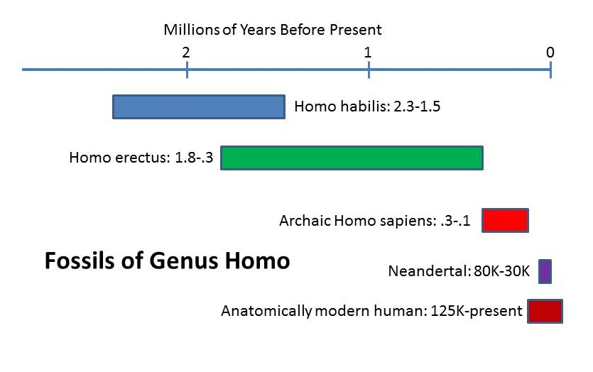
What About Adam?
The same problem faces Homo erectus @ some 2 million years ago.
This leaves Neanderthal and H. sapiens, which range from 10 to 100+ thousand years.
This is where most evangelicals place Adam.

Slide 26
More on Adam
Within these parameters, there are two abrupt changes:
  130,000 yrs BP: the appearance of anatomically modern humans
  40,000 yrs BP: the explosion of culture
Others have suggested even more recent dates, but these face the problem of pre-Adamite humans.

Slide 27
Pre-Adamites
But in any case, we have something that looks rather human, that was able to construct tools and even used fire before these dates.
On a genetic engineering view of the development of life, this would suggest that God (or his angels) made preparatory models before God put his image in humans.

Slide 28
Conclusions
That's where we are at this point.
It looks to me like God inserted an individual that looked rather like beings already living at that time, but that God put His image in this being and he became the progenitor of the human race.

Slide 29
For Further Reading
John Bloom, "On Human Origins: A Survey," Christian Scholar's Review 27 (1997), 181-203.
Ann Gauger, Douglas Axe & Casey Luskin, Science & Human Origins (Discovery Institute, 2012).
Fazale Rana with Hugh Ross, Who Was Adam? (NavPress, 2005).

Slide 30

The End … So Far

