Slide 1
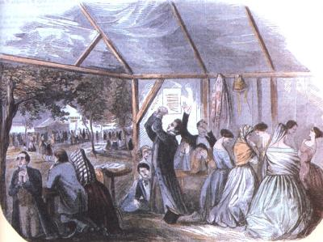
How Do You Know You Are Saved?
Robert C. Newman

Slide 2
Lordship Salvation Debate
In recent years there has been a debate over salvation, especially in Dispensational circles.
John McArthur vs Zane Hodges
McArthur in Gospel According to Jesus warns of cheap grace & presumption among evangelicals.
Hodges in Totally Free claims McArthur is denying salvation by faith alone.
I am concerned that many professing Christians are mistaken & misleading others.

Slide 3
What is Salvation?
What does it mean to be saved by faith alone?
None of our works are good enough to avoid condemnation at the judgment.
All our works are like filthy rags (Isa 64:6).
No one does good (Rom 3:10-18).
See the parable of the Pharisee & Tax Collector.
Therefore, we must depend on the work of Christ alone.

Slide 4
Isaiah 64:5-7
5 (NIV) You come to the help of those who gladly do right, who remember your ways.
But when we continued to sin against them, you were angry. How then can we be saved?
6 All of us have become like one who is unclean,
and all our righteous acts are like filthy rags;
we all shrivel up like a leaf, and like the wind our sins sweep us away.
7 No one calls on your name or strives to lay hold of you; for you have hidden your face from us
and made us waste away because of our sins.

Slide 5
Romans 3:10-18
10 (NIV) As it is written: "There is no one righteous, not even one; 11 there is no one who understands, no one who seeks God. 12 All have turned away, they have together become worthless;
there is no one who does good, not even one."
13 "Their throats are open graves; their tongues practice deceit." "The poison of vipers is on their lips.“ 14 "Their mouths are full of cursing and bitterness.“ 15 "Their feet are swift to shed blood;
16 ruin and misery mark their ways,
17 and the way of peace they do not know."
18 "There is no fear of God before their eyes."

Slide 6
Luke 18:9-14
9 (NIV) To some who were confident of their own righteousness and looked down on everybody else, Jesus told this parable: 10 "Two men went up to the temple to pray, one a Pharisee and the other a tax collector. 11 The Pharisee stood up and prayed about himself: `God, I thank you that I am not like other menn robbers, evildoers, adulterersnor even like this tax collector. 12 I fast twice a week and give a tenth of all I get.' 13 But the tax collector stood at a distance. He would not even look up to heaven, but beat his breast and said, `God, have mercy on me, a sinner.' 14 I tell you that this man, rather than the other, went home justified before God. For everyone who exalts himself will be humbled, and he who humbles himself will be exalted."

Slide 7
Some Questions
Is there such a thing as “cheap grace”?
Is there such a distinction in the Bible as “saving faith”?
Is faith only a matter of believing certain propositions are true?
Is it a sin to question one’s salvation?
We can get answers to much of this in the first letter of the apostle John.

Slide 8
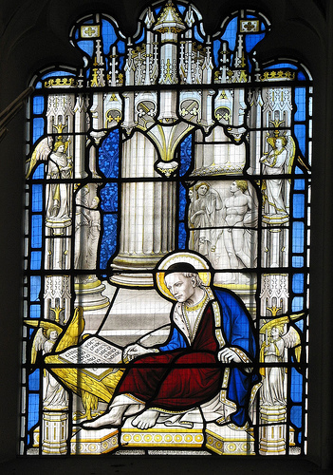
1 John on Assurance

Slide 9
The Theme Verse
1 John 5:13 (NIV) I write these things to you who believe in the name of the Son of God so that you may know that you have eternal life.

Slide 10
How are we to understand John’s statement here?
Hodge and others of his view say:
If you believe, you may know that you have eternal life; no further test.
McArthur and others of his view say:
“These things” refers to the rest of John’s letter, which contains several tests.
In fact, John’s letter does contain several tests. Let’s see.

Slide 11
1 John 1:5-7
5 (NIV) This is the message we have heard from him and declare to you: God is light; in him there is no darkness at all. 6 If we claim to have fellowship with him yet walk in the darkness, we lie and do not live by the truth.
7 But if we walk in the light, as he is in the light, we have fellowship with one another, and the blood of Jesus, his Son, purifies us from all sin.

Slide 12
1 John 2:3-6
3 (NIV) We know that we have come to know him if we obey his commands. 4 The man who says, "I know him," but does not do what he commands is a liar, and the truth is not in him. 5 But if anyone obeys his word, God's love is truly made complete in him. This is how we know we are in him: 6 Whoever claims to live in him must walk as Jesus did.

Slide 13
1 John 2:9-11
9 (NIV) Anyone who claims to be in the light but hates his brother is still in the darkness. 10 Whoever loves his brother lives in the light, and there is nothing in him to make him stumble. 11 But whoever hates his brother is in the darkness and walks around in the darkness; he does not know where he is going, because the darkness has blinded him.

Slide 14
1 John 2:23
23 (NIV) No one who denies the Son has the Father; whoever acknowledges the Son has the Father also.

Slide 15
1 John 2:28-29
28 (NIV) And now, dear children, continue in him, so that when he appears we may be confident and unashamed before him at his coming. 29 If you know that he is righteous, you know that everyone who does what is right has been born of him.

Slide 16
1 John 3:6-10
6 (NIV) No one who lives in him keeps on sinning. No one who continues to sin has either seen him or known him. 7 Dear children, do not let anyone lead you astray. He who does what is right is righteous, just as he is righteous. 8 He who does what is sinful is of the devil, because the devil has been sinning from the beginning. The reason the Son of God appeared was to destroy the devil's work. 9 No one who is born of God will continue to sin, because God's seed remains in him; he cannot go on sinning, because he has been born of God. 10 This is how we know who the children of God are and who the children of the devil are: Anyone who does not do what is right is not a child of God; nor is anyone who does not love his brother.

Slide 17
1 John 3:14-19
14 (NIV) We know that we have passed from death to life, because we love our brothers. Anyone who does not love remains in death. 15 Anyone who hates his brother is a murderer, and you know that no murderer has eternal life in him. 16 This is how we know what love is: Jesus Christ laid down his life for us. And we ought to lay down our lives for our brothers. 17 If anyone has material possessions and sees his brother in need but has no pity on him, how can the love of God be in him? 18 Dear children, let us not love with words or tongue but with actions and in truth. 19 This then is how we know that we belong to the truth, and how we set our hearts at rest in his presence

Slide 18
1 John 3:24
24 (NIV) Those who obey his commands live in him, and he in them. And this is how we know that he lives in us: We know it by the Spirit he gave us.

Slide 19
1 John 4:1-3
1 (NIV) Dear friends, do not believe every spirit, but test the spirits to see whether they are from God, because many false prophets have gone out into the world. 2 This is how you can recognize the Spirit of God: Every spirit that acknowledges that Jesus Christ has come in the flesh is from God, 3 but every spirit that does not acknowledge Jesus is not from God. This is the spirit of the antichrist, which you have heard is coming and even now is already in the world.

Slide 20
1 John 4:6
6 (NIV) We are from God, and whoever knows God listens to us; but whoever is not from God does not listen to us. This is how we recognize the Spirit of truth and the spirit of falsehood.

Slide 21
1 John 4:12-13
12 (NIV) No one has ever seen God; but if we love one another, God lives in us and his love is made complete in us. 13 We know that we live in him and he in us, because he has given us of his Spirit.

Slide 22
1 John 4:15
15 (NIV) If anyone acknowledges that Jesus is the Son of God, God lives in him and he in God.

Slide 23
1 John 4:20-5:3
4:20 (NIV) If anyone says, "I love God," yet hates his brother, he is a liar. For anyone who does not love his brother, whom he has seen, cannot love God, whom he has not seen. 21 And he has given us this command: Whoever loves God must also love his brother.
5:1 Everyone who believes that Jesus is the Christ is born of God, and everyone who loves the father loves his child as well. 2 This is how we know that we love the children of God: by loving God and carrying out his commands. 3 This is love for God: to obey his commands. And his commands are not burdensome…

Slide 24
1 John 5:9-10
9 (NIV) We accept man's testimony, but God's testimony is greater because it is the testimony of God, which he has given about his Son. 10 Anyone who believes in the Son of God has this testimony in his heart. Anyone who does not believe God has made him out to be a liar, because he has not believed the testimony God has given about his Son.

Slide 25
1 John 5:13
13 (NIV) I write these things to you who believe in the name of the Son of God so that you may know that you have eternal life.

Slide 26
1 John 5:18
18 (NIV) We know that anyone born of God does not continue to sin; the one who was born of God keeps him safe, and the evil one cannot harm him.

Slide 27
Back to Those Questions
Is there such a thing as “cheap grace”?
Yes, when we claim salvation but show no evidence of a changed life. Real grace is not cheap; look what it cost Jesus!
Is there such a distinction in the Bible as “saving faith”?
The term not used in 1 John, but that is what he wants us to demonstrate. Luke 8:13 speaks of those who “believe for a while, and then fall away.”

Slide 28
Back to Those Questions
Is faith only a matter of believing certain propositions are true?
No, as James points out (2:19), even the demons believe as much.
Is it a sin to question one’s salvation?
Satan can raise doubts in the mind of true believers, but it is important for anyone to make their “calling and election sure” (2 Peter 1:10).

Slide 29
Summary on 1 John
Here are the tests John provides:
Do I walk in the light rather than in the darkness?
Do I keep God’s commandments, practice righteousness?
Do I really love my brother?
Do I accept, confess, trust in Jesus?
Do I believe the right things about Him?

Slide 30
How about Us?
Are any of us very good in these things?
Probably not.
But John assures us that:
Though we deceive ourselves if we think we are not still sinners…
We also deceive ourselves if we think we are saved when there is no evidence of these things in our lives.

Slide 31
How about Us?
We can never earn our salvation by trying to do good works.
But if God’s Spirit really lives in us, then we will be trying to do (and having some success in doing) good works.
How about us?
The Lord, through Jesus & His apostles, calls on us to make our calling & election sure.

Slide 32
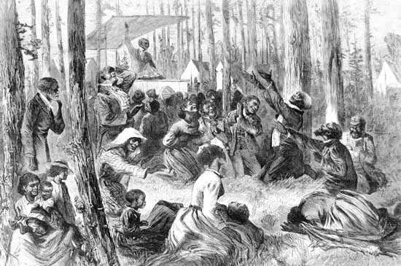
The End
I write these things to you who believe in the name of the Son of God so that you may know that you have eternal life.

