Slide 1
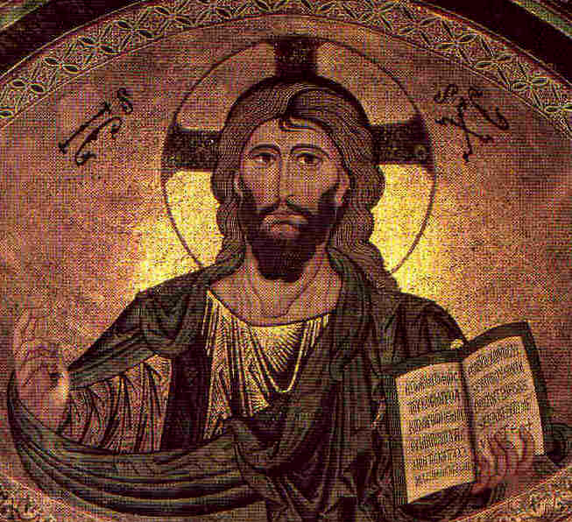
The Historical Jesus
Robert C.
Newman

Slide 2
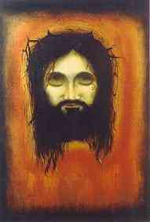
Introduction
People have enormously diverse views about Jesus.
Some motivated by their religion or worldview.
Others claim to be trying to grapple honestly with the historical data.

Slide 3
Basically Religious Views
The biblical data point to a Jesus who is somehow fully God and fully human.
Other religious views divide into two alternative categories:
Jesus is only human, not God in any real sense.
Jesus is divine in some sense, but not in the biblical sense.

Slide 4
Jesus only Human
Atheism
Islam
Old Liberalism
Neo-Orthodoxy
This view has had considerable influence on pop culture.

Slide 5
Jesus divine in some sense
Jehovah's Witnesses
Mormonism
New Age Movement

Slide 6
Allegedly Historical Views
Reimaurus – Deism
Paulus – Rationalism
Strauss – Idealism
Renan – Romanticism
Wrede – Scepticism

Slide 7
The Present Situation
The Post-Bultmannians – Paradox
Schonfield – Passover Plot
Allegro – Sacred Mushroom and the Cross
Smith – The Secret Gospel
The Jesus Seminar

Slide 8
Responses to the Jesus Seminar
Craig Blomberg, Historical Reliability of the Gospels
Greg Boyd, Cynic Sage or Son of God?
William Lane Craig, Reasonable Faith
Josh McDowell & Bill Wilson, He Walked Among Us
Craig Evans, Fabricating Jesus

Slide 9
Summary on Liberal Lives
Guiding principle is rejection of miracle
Resulting attitude progressive skepticism
Jesus becomes an enigma
If Jesus never existed, where data come from?
If fraud, where moral teaching come from?
If gentle teacher, why the opposition?
How reconcile moral teaching with claims?
If Jesus not supernatural, doesn't make sense.

Slide 10
Are the arguments against miracle valid?
Deductive argument
Is miracle really a contradictory idea?
Inductive arguments:
Hume shifts definition from rare to impossible.
Harnack plays on ignorance of ancients.
Bultmann assumes universe cannot be penetrated.

Slide 11
What does miracle do to science & history?
It makes an enormous difference in ultimate explanation.
It may or may not make a big difference on a local scale.
It adds another variable to explanations.
Miracle is not irrational in a biblical worldview, but is the action of a person.
It solves a lot of problems in biblical history and natural pre-history.

Slide 12
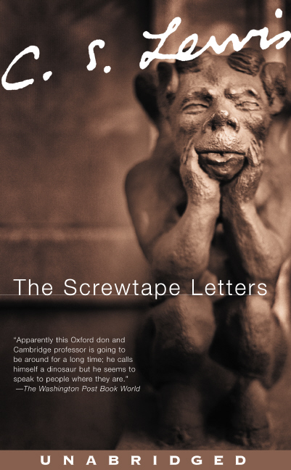
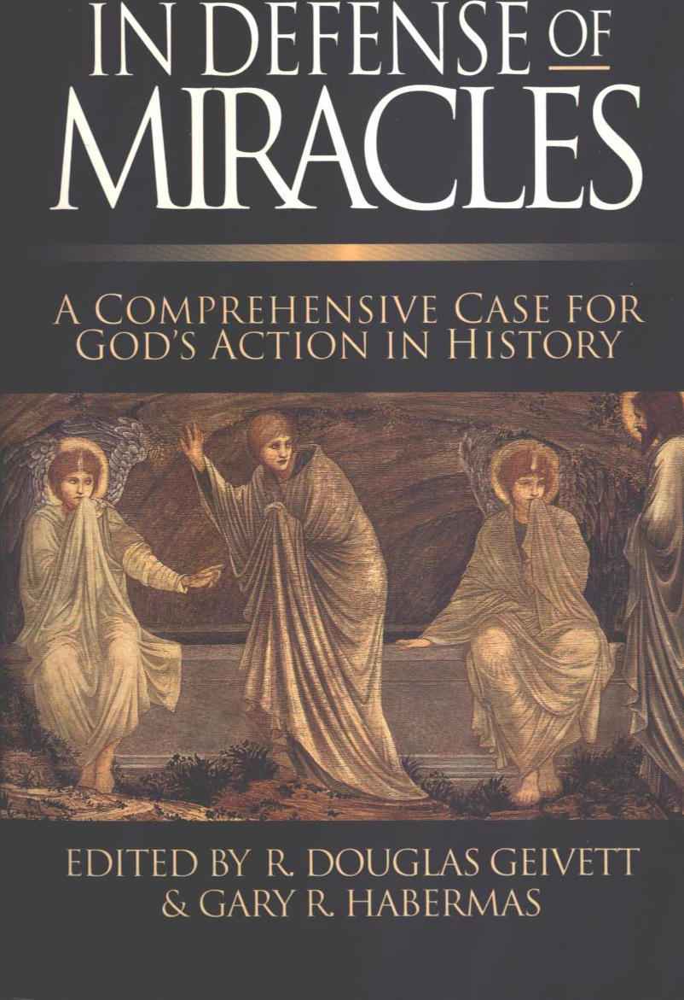
What are we to make of liberal reconstructions?
They are Satan's work!
See CS Lewis, Screwtape Letters, chap 23
Why does God permit this?
See Deut 13:1-5 re/ God allowing false prophets
Re/ reality of miracles, see Geivett and Habermas, In Defense of Miracles

Slide 13
Not the End!
We can expect more of this until Jesus comes again.

